Slide 1
Selenium WebDriver
Adding real browsers to your tests!
holanda.kamilla@gmail.com - github.com/kamillacrozara - Kamilla H. Crozara

Slide 2
About
Kamilla Holanda Crozara
Finishing the Bachelor's degree – Software Engineering at University of Brasília (Brazil)
Working at Nation Institute of Standards and Technology (NIST)
2 years working with Python

Slide 3
Selenium WebDriver
History and Goals

Slide 4
How do I use it?
Demo 000!

Slide 5
Exporting and Cleaning up!
Demo 001!

Slide 6
Better examples.
Demo 002!

Slide 7
Good practices
Real Case - SRD Test Suite

Slide 8
DRY
Real Case - SRD Test Suite

Slide 9
Write small tests
Real Case - SRD Test Suite

Slide 10
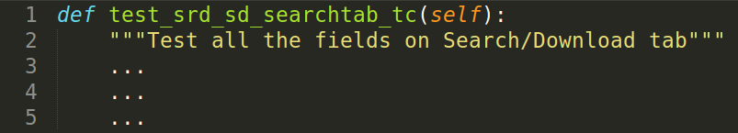
:,(

Slide 11
Avoiding inter-test dependencies
Real Case - SRD Test Suite

Slide 12
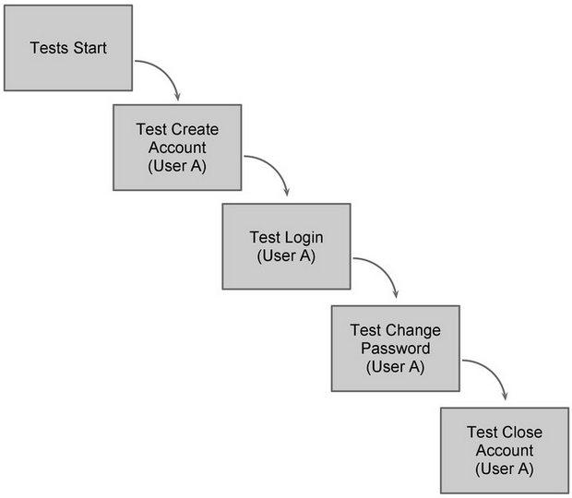
Avoid inter-test dependencies
Real Case - SRD Test Suite

Slide 13
In progress -
Better error messages
Real Case - SRD Test Suite

Slide 14
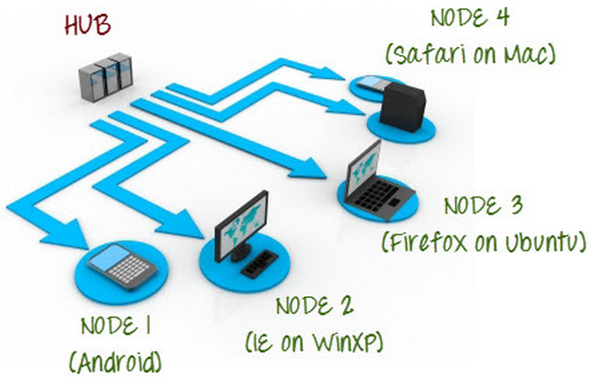
Bonus – Selenium Server

