Slide 1


DSA 210 Project
INSTAGRAM SCREEN TIME &
WEATHER ANALYSIS
İpek Kamiloğlu
32020

Slide 2
Introduction
The project analyzes the relationship between Instagram screen time and weather conditions in Istanbul between 17/02/2025 and 17/04/2025.

Slide 3
Hypothesis
When the weather is bad (rainy, cloudy, foggy, or snowy), my daily Instagram screen time increases compared to days with good weather (sunny).

Slide 4
Motivation
After noticing a significant increase in screen time, I aimed to track and understand behavioral patterns using data-driven methods.

Slide 5
Data Source
Instagram screen time: Apple Screen Time section Weather data: Weather Underground (https://www.wunderground.com/calendar/tr/istanbul/LTBA/date/2025-4)
Features:
• Weather condition
• Average daily temperature
• Average daily humidity
Weather Categories:
• Sunny
• Cloudy
• Rainy
• Foggy
• Snowy

Slide 6
Project Plan
1. Data collection
2. Data preparation
3. Descriptive analysis
4. Hypothesis testing
5. Predictive modeling
6. Result interpretation

Slide 7
Exploratory Data Analysis (EDA)
& Visualization
1. Histogram
2. Boxplot
3. Bar chart
4. Scatterplot with Regression Line
5. ML Scatterplots and Confusion Matrices

Slide 8


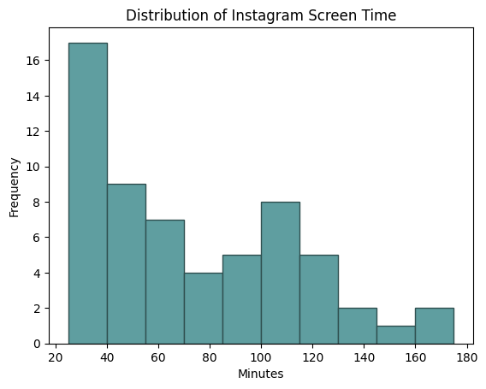
1. Histogram
This histogram shows the distribution of daily Instagram screen time.
Most values are between 30 and 100 minutes.
The distribution is right-skewed, indicating that higher screen times are less common.

Slide 9
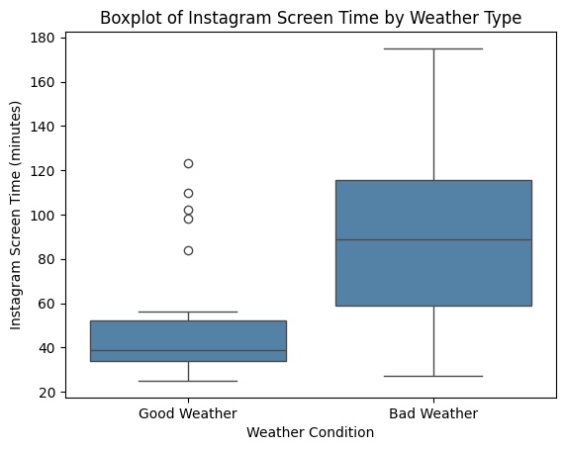
2. Boxplot
This boxplot compares screen time under good and bad weather conditions.
The median usage is noticeably higher on bad weather days.
Bad weather clearly leads to longer Instagram usage.

Slide 10
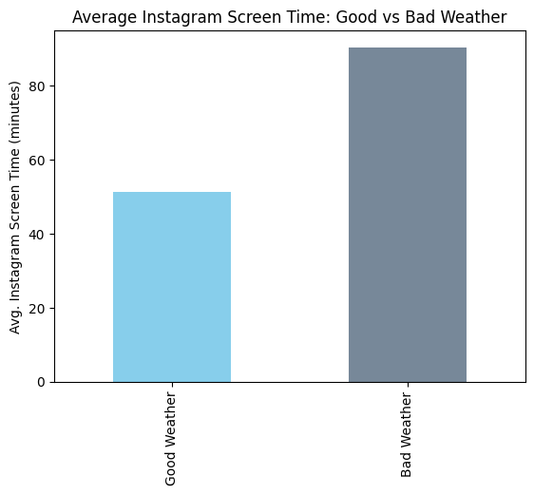
3. Bar Chart
This bar chart shows the average Instagram screen time:
On bad weather days the average time is ~90.46 minutes.
On good weather days the average time is ~51.4 minutes.

Slide 11
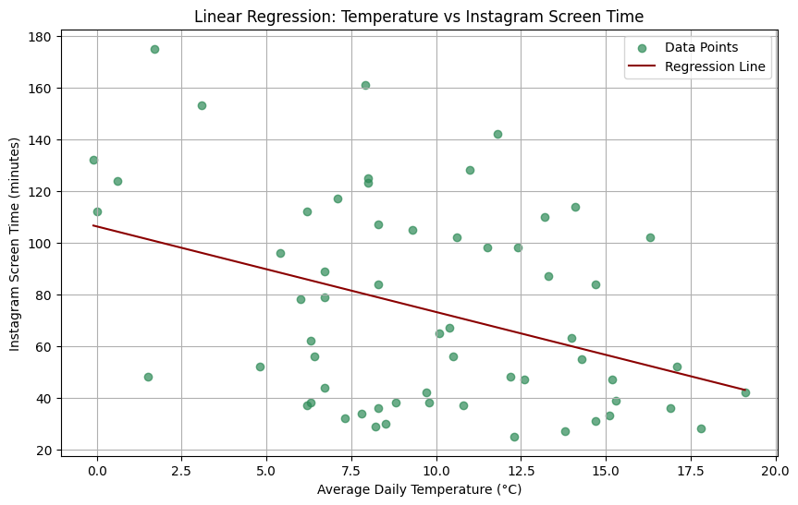
4. Scatterplot
This scatterplot shows the relationship between average daily temperature and Instagram screen time.
Each point represents a day's usage.
The negative slope of the line indicates that as temperature increases, Instagram screen time tends to decrease.
Intercept (β₀): 106.24
Slope (β₁): -3.31

Slide 12
Statistical Analysis
Null hypothesis (H₀): There is no significant difference in Instagram screen time between bad and good weather days.
Alternative hypothesis (H₁): Instagram screen time is significantly higher during bad weather days.
Pearson Correlation: 0.49 T-test: T = 4.52, P = 0.000031
Instagram screen time significantly increases during bad weather.

Slide 13
Machine Learning Models
Used cross-validation to evaluate:
1. Random Forest
2. K-Nearest Neighbors (KNN)
3. Support Vector Regression (SVR)

Slide 14
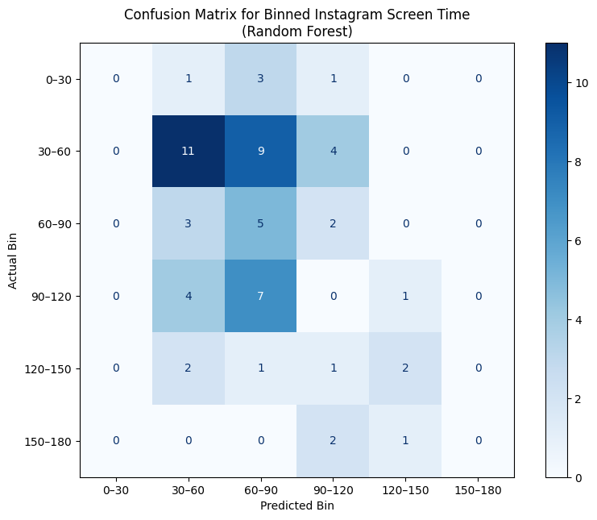
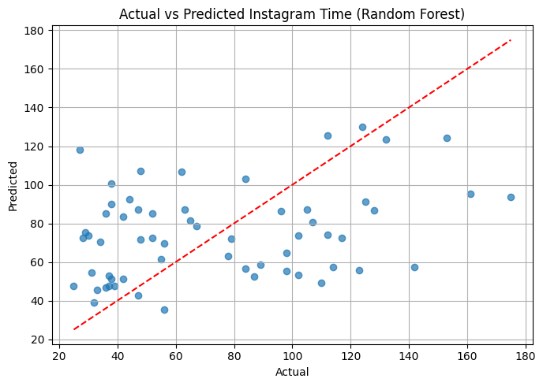
1. Random Forest
MAE: 32.30 | RMSE: 38.57 | R²: 0.034
The confusion matrix shows that most predictions are in the neighboring bins, but the model performs less accurately at higher usage intervals.
The scatter plot reveals that predictions mostly fall below the ideal line, indicating that the model tends to underestimate screen time.

Slide 15
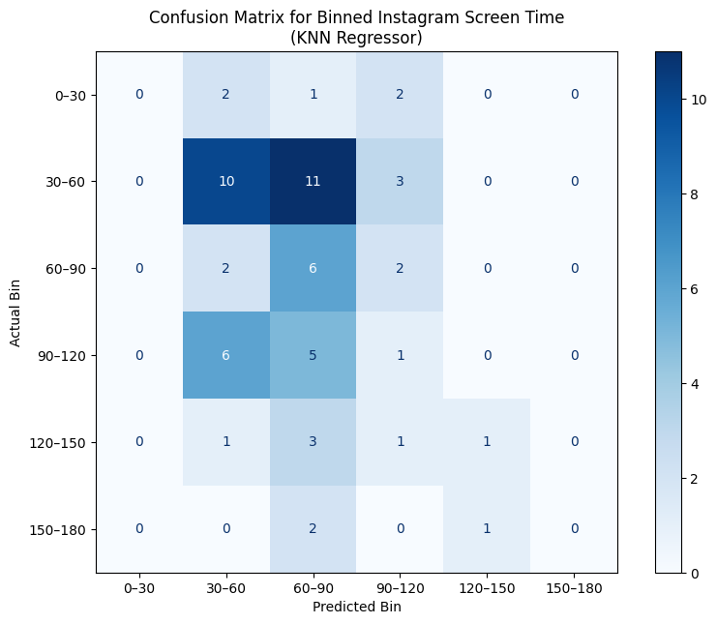
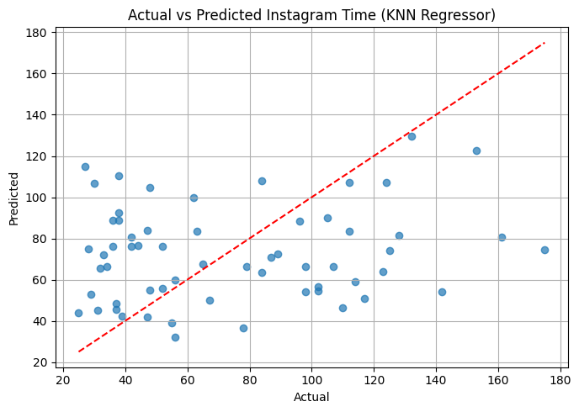
2. KNN Regressor
MAE: 34.74 | RMSE: 42.16 | R²: -0.155
The confusion matrix shows that predictions mostly fall into the adjacent bins, though accuracy drops for middle and higher ranges.
The scatter plot indicates that even though the KNN model captures the general trend, it struggles to make accurate point predictions, especially for higher screen times.

Slide 16
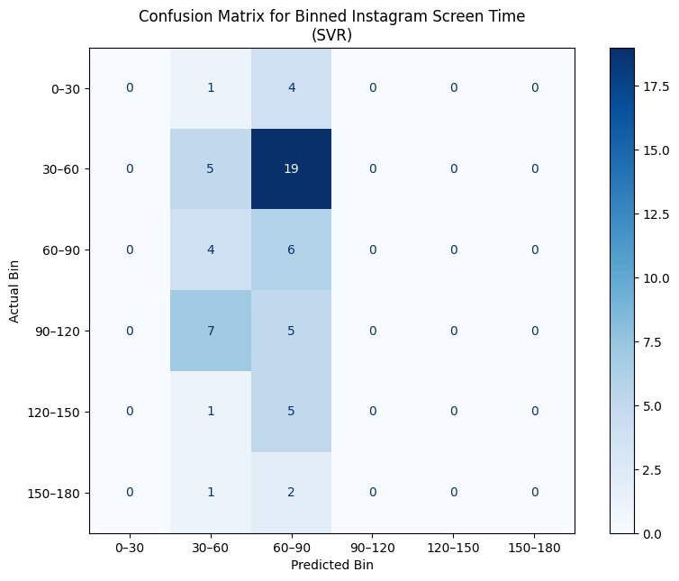
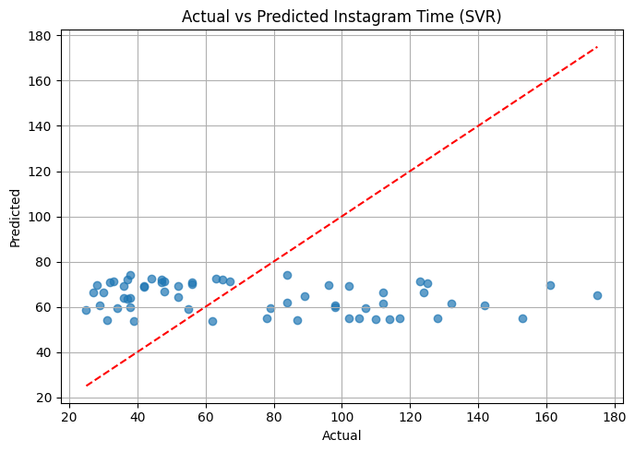
3. SVR
MAE: 36.09 | RMSE: 42.53 | R²: -0.175
The confusion matrix shows that SVR frequently assigns values to middle bins (30–90), even when actual usage differs.
The scatter plot shows that SVR struggles to capture variation, often predicting around a constant value regardless of actual usage.

Slide 17
Limitations
• Binary weather classification
• Personal factors like mood, sleep, or workload are not included
• Manually collected, small dataset

Slide 18
Future Work
Further improvements:
• Collecting data over a longer time
• Including data from multiple individuals
• Including personal behavioral variables such as mood and sleep quality
• Expanding the weather data with metrics like precipitation amount, wind speed, etc.
Dataset already enriched with daily average temperature and humidity.

Slide 19
Findings
• Screen time is significantly higher on bad weather days.
• Regression analysis shows a negative relationship between temperature and Instagram usage.
• Random Forest is the best performing model among the ML models.
• Confusion matrices show good bin classification.
• SVR and KNN underperform compared to RF.

Slide 20
Conclusion
The findings support the initial hypothesis that Instagram screen time tends to increase on bad weather days.
Understanding these patterns can support better screen management.
Project shows value of personal data and predictive modeling.

