Slide 1

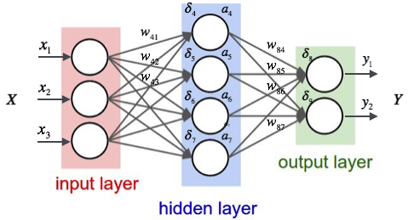
Deep Learning and Neural Networks
Final Project
Camilo Torres Ovalle
Wilfredo Vega Buelvas

Slide 2

Algorithm implemented
Random Forest
Random Forest
Aboard the ship, passenger John Geiger hacks into the ship's computer system, and the following evening, he destroys the ship's communication systems and kills the captain. After remotely shutting down the ship's engines, Geiger calls the bridge to tell the first officer, Juliano, that the captain is dead and he is in charge. Juliano is ordered by Geiger to evacuate the ship. Geiger steals jewelry from the ship's vault.
Convolutional Neural Network
Neural Network
Transfer Learning
VVG16
RNN - Long short-term memory (LSTM)
Concatenate the results of the two neural networks

Slide 3
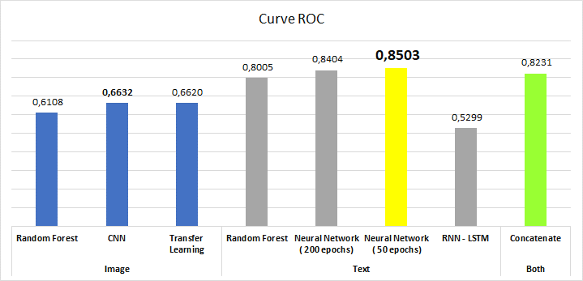
Comparative

Slide 4
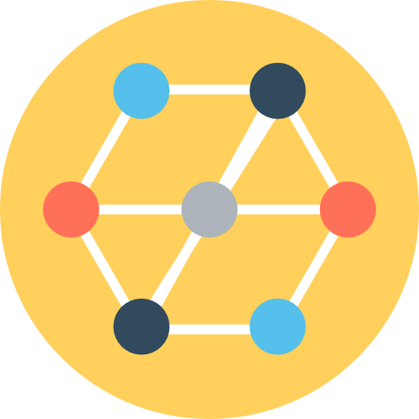
Model architecture
- Relu Activation
- Dropout(0.6)
- Flattern
- Dense(24, sigmoid)
- Optimized using Adam
- Loss categorical_crossentrop

Slide 5
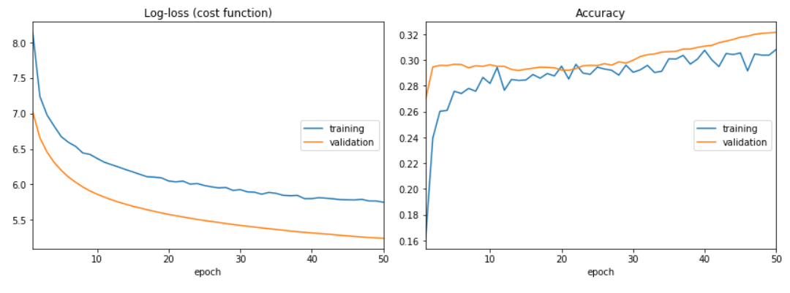
Algorithm results
Curve ROC = 0,8503

