Slide 1
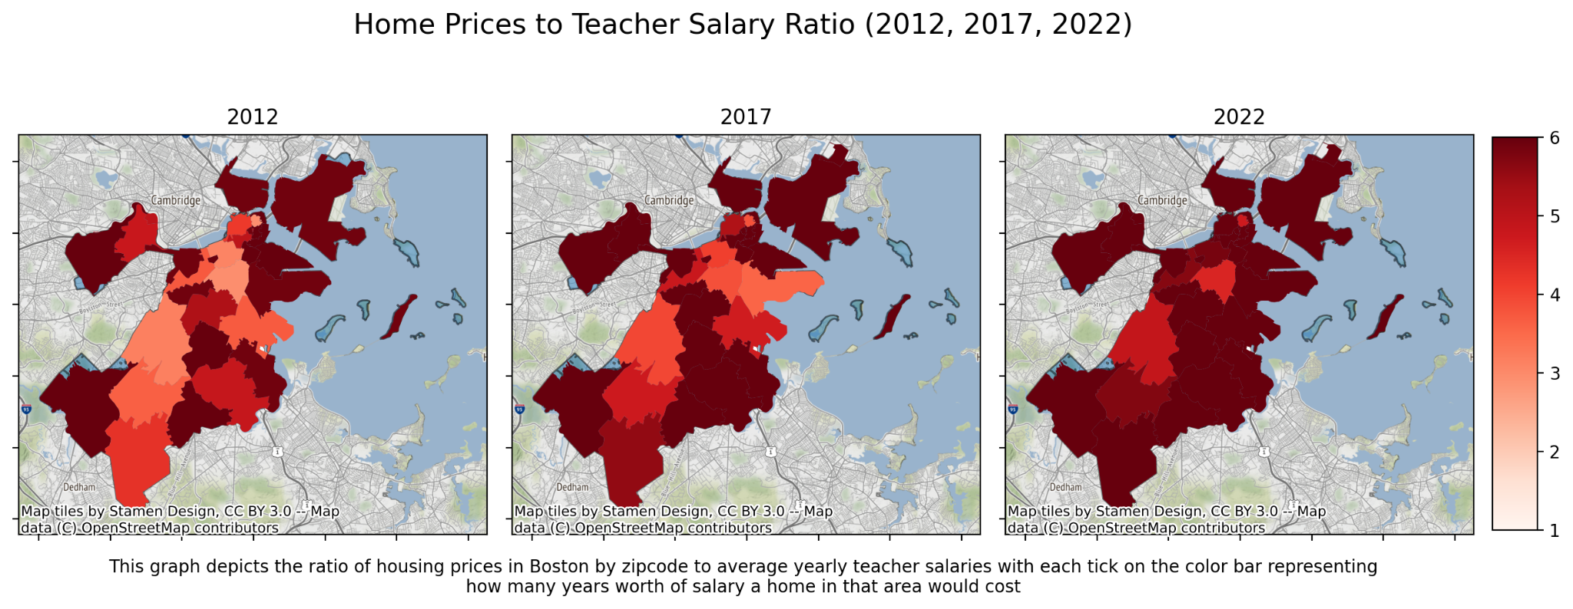
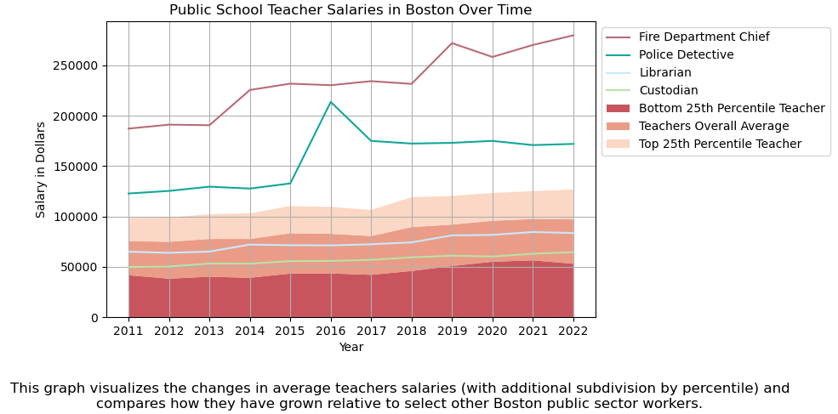
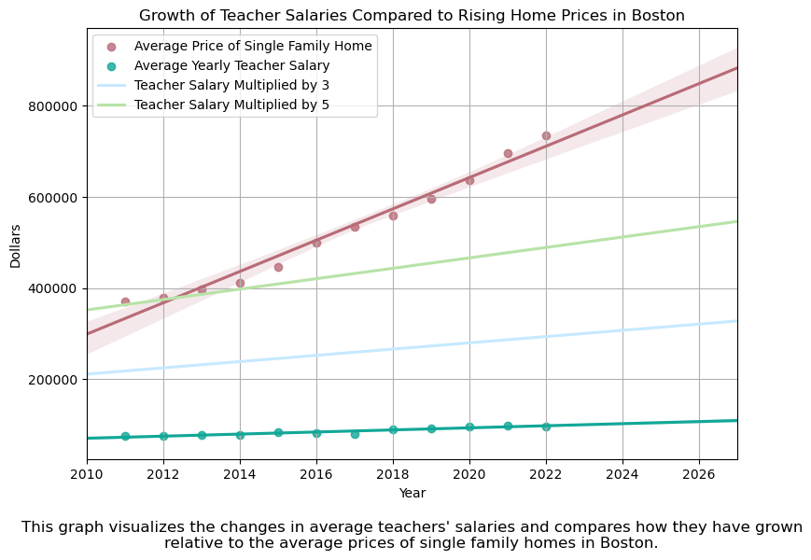
The American Dream for Boston Public School Teachers
Research question: Can Boston public school teachers afford the American Dream in Boston across the past, present and future?
For our purposes, we defined the American Dream as the ability to purchase a single family home, focusing specifically for Boston.
Notes:
Dimitar’s Graph Information:
-Raise worth 6 years worth of salary, massive raise to account for raises that were not given in prior years, retroactive pay
-Didn’t subtract any injury from gross pay
-Data processing: For every year there was a large range of salaries, some equating to a part-time worker. Teachers work 180 days a year on contract, so anyone whose wage data equated to an amount that wouldn’t make sense with that piece of information was written off as a part-time worker
Kamil’s Graph Information:
-Doesn’t include condos, or another other type of housing besides single family homes

