Slide 1

Company XYZ
Adobe Financial Benefit Analysis
Dynamic Content:
Company Name
Date
September 10, 2013
Evaluation only.
Created with Aspose.Slides for Java 7.7.0.0
Copyright 2004-2013 Aspose Pty Ltd.

Slide 2
Statement of Confidentiality and Disclaimers
The information and analysis contained herein are the confidential and proprietary materials of Adobe. No part of this publication may be reproduced, published, disseminated, or otherwise disclosed in any form or for any purpose without the express written permission of Adobe. The information contained herein may be changed without prior notice.
The furnishing of this document shall not be construed as an offer or as constituting a binding agreement on the part of Adobe and/or its affiliated organization (“Adobe”) to enter into any relationship. Adobe provides this document as guidance only to illustrate estimated costs and benefits of the predicted delivery project.
These materials may be based upon both information provided by the subject organization, information provided by other organizations and assumptions that are subject to change. These materials present illustrations of potential performance and cost savings, and do not guaranty future results, performance or cost savings. The materials are provided solely for internal review and use by the subject organization. These materials are provided “AS IS” and Adobe makes no representation or warranties of any kind with respect to these materials, and Adobe shall not be liable for errors or omissions with respect to these materials. The material cannot account for all risks and other factors that may affect results or performance, or for changes in your business practices or operating procedures that may be required to realize results or performance, that are projected or implied in the document.
Further, this document is not a commitment to deliver any future material, code, or functionality. The development, release, and timing of any features or functionality described in this document remains at the sole discretion of Adobe.
Evaluation only.
Created with Aspose.Slides for Java 7.7.0.0
Copyright 2004-2013 Aspose Pty Ltd.

Slide 3
“E-Commerce Spending Continues to Grow, Triggered by the Asia-Pacific Markets” [eMarketer]
Global B2C E-Commerce Sales: 2011-13
(in $ Billions)
Global B2C E-Commerce Sales Break-up by Region: 2013-16E
Dynamic Content:
Content is static, but dynamic based on industry
CAGR (2011-13): 24.6%
Evaluation only.
Created with Aspose.Slides for Java 7.7.0.0
Copyright 2004-2013 Aspose Pty Ltd.
Key Highlights:
Three Asia-Pacific markets (China, India and Indonesia) are predicted to see more B2C ecommerce sales growth than all other markets worldwide in 2013, while Japan is expected to continue to take a large share of global sales
China is the primary driver of growth in the Asia-Pacific region, and it is expected to surpass Japan as the world's second-largest B2C ecommerce market this year, with an estimated 14% share of global sales. Its sales are forecasted to reach $181.62 billion in 2013, up 65% from $110.04 billion in 2012.
The primary reason for the growth is that China boasts of the highest number of people who buy goods online in the world (nearly 220 million in 2012); a result of increasing internet penetration; a burgeoning middle class with growing trust in online shopping; as well as improved infrastructure, product selection and services offered by online sellers and retailers
The US is expected to remain the single country with the largest share of worldwide B2C ecommerce spending, at 29.6% in 2013, down from 31.5% in 2012, despite relatively strong growth in sales
Source: Worldwide B2C ecommerce Report, eMarketer, 2013

Slide 4
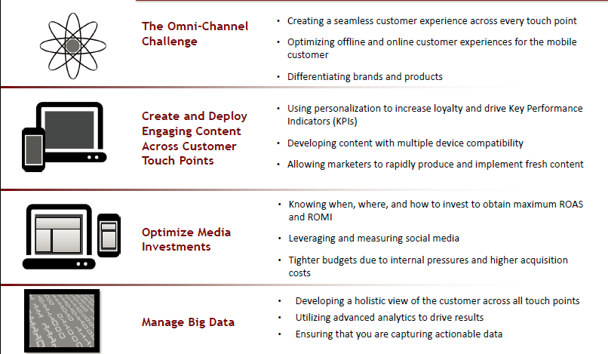
Major Trends that Impact the Retail Industry Today
Dynamic Content:
Content is static, but dynamic based on industry
Evaluation only.
Created with Aspose.Slides for Java 7.7.0.0
Copyright 2004-2013 Aspose Pty Ltd.

Slide 5
Benchmark Comparison for Key Operational Metrics Shows Significant Potential For Improvement
WIP
Marketing Goal | Operational Metric | Benchmark Performance
Acquire Customers | Number of Unique Visitors per Month (Millions)
Convert Customers | Average Current Conversion Rate (%)
Upsell/Cross-sell & Retain Customers | Current Average Order Value ($)
Improve Profitability – Reduce Effort | Total Online Marketing Effort (as a % of Online Marketing Budget)
Improve Profitability – Reduce 3rd Party Spend | Total Online Marketing Spend (as a % of Online Marketing Budget)
Dynamic Content:
Benchmark Metrics
Customer Current State
Bottom 25%
Average
Top 25%
50.0
35.4
55.8
65.4
Bottom 25%
Average
Top 25%
1.1
0.8
2.0
3.1
Bottom 25%
Average
Top 25%
Evaluation only.
Created with Aspose.Slides for Java 7.7.0.0
Copyright 2004-2013 Aspose Pty Ltd.
50
120
140
180
Bottom 25%
Average
Top 25%
3.5
1.9
1.7
0.6
Bottom 25%
Average
Top 25%
2.7
1.9
0.8
2.1
Improve Profitability – Reduce Call Center Costs | Total Call Center Customer Sales Transaction Costs (as a % of Online Marketing Revenue)
Bottom 25%
Average
Top 25%
1.5
1.1
1.0
0.5
Key Highlights:
Significant potential exists for improving performance on key KPIs such as conversion rate and AOV
Implementing best practices can help close the gap to top quartile performers
Source: Independent Analysts; Adobe Analysis

Slide 6
Key Business Requirements (dynamic)
Key Digital Marketing Goals
Key Business Requirements
Key Solution Areas
Dynamic Content:
Key Business Requirements
Key Solution Areas
Predict and Generate Demand to Acquire Customers
Generate high-quality visitors to the conversion pipeline to ensure a constant supply of new prospects to convert
Provide clear, complete views into customer data, web analytics and campaign performance to optimize marketing investments
Allow marketers to continually optimize the customer experience on digital properties by creating a better and more targeted experience, driving up engagement and conversion
Optimally manage explosion of content available to customers to personalize messages and experiences presented to customers at each stage of the buying cycle
Optimize Customer Experience to Convert New and Returning Customers
Evaluation only.
Created with Aspose.Slides for Java 7.7.0.0
Copyright 2004-2013 Aspose Pty Ltd.
Experience Management
Effectively upsell/cross-sell to customers in a targeted manner in order to drive up metrics, such as average order value or items per order
Measure and track the lifetime value of customers across multiple channels to identify high value customers and offer differentiated service to maximize customer loyalty and advocacy
Grow Revenue from Upsell/Cross-sell and Customer Retention
Drive up efficiency of multiple creative and production teams, to enable marketing regions/teams to quickly build/review/execute their individual content production needs
Automate marketing optimization, wherever performance will be equivalent or better
Streamline Operations to Improve Profitability
Source: Company Website; Adobe Analysis
Notes:
Just the key business requirements

Slide 7
Key Solution Area: Experience Management (dynamic)
Key Digital Marketing Goals
Key Solution Areas
Experience Management Capabilities
Dynamic Content:
Key Solution Area
Capabilities
Predict and Generate Demand to Acquire Customer
Marketing Campaign Management
Digital Asset Management
Optimize Customer Experience to Convert New and Returning Customers
Evaluation only.
Created with Aspose.Slides for Java 7.7.0.0
Copyright 2004-2013 Aspose Pty Ltd.
Dynamic Media
Experience Management
Multiple Site Management
Grow Revenue from Upsell/Cross-sell and Customer Retention
Video Publishing
Social Collaboration
Streamline Operations to Improve Profitability
Adaptive Design
Source: Company Website; Adobe Analysis

Slide 8
Marketing Campaign Management: Challenges and Best Practices (dynamic)
Current Challenges
Use of multiple point solutions for managing different aspects of marketing campaigns
Ineffective, complex, and difficult to use experience management tools that lack the capability to develop and manage newsletter content
The lack of robust tools to create and publish campaigns
The lack of an integrated marketing dashboard
The inability to reuse content and assets for newsletters and campaigns through template-driven newsletter editing during content creation
Best Practices For Improvement
Single solution for managing different aspects of web marketing campaigns increases the ability to build meaningful connections between the different functions of these campaigns
Effective, simple and easy to use experience management tools with the capability to develop and manage newsletter content decreases the editorial turnaround time required to create and approve content
Robust tools to create and publish campaigns ensures fresh and engaging content is delivered to the target audience
Integrated marketing dashboard increases the ability to analyze data related to performance of marketing campaigns in near real-time to take actions to optimize current/future initiatives
Ability to reuse content and assets for newsletters and campaigns through template-driven newsletter editing to help quickly create content
Dynamic Content:
Current Challenges
Best Practices
Evaluation only.
Created with Aspose.Slides for Java 7.7.0.0
Copyright 2004-2013 Aspose Pty Ltd.

Slide 9
Digital Asset Management: Challenges and Best Practices (dynamic)
Current Challenges
Digital assets that are spread among siloed systems, network folders, and external agencies, often with varied quality, relevance, and consistency
Difficult to use experience management systems, lacking easy-to-use interface that enables business users to publish, manage and review assets
The inability of digital asset management tools to publish and maintain metadata for every asset
The inability to decentralize asset production and administration in several languages
The inability to leverage a global shared repository equipped with enterprise-class versioning and permissions based access to digital media assets
Best Practices For Improvement
One unified digital assets management system increases the ability to efficiently manage the exponential growth of assets to optimize customer experience
Easy-to-use experience management system with easy-to-use interface that enables business users to publish, manage and review assets to ensure delivery of fresh and engaging content
Ability of digital asset management tools to publish and maintain metadata for every asset makes it easier to find relevant content on websites
Ability to decentralize asset production and administration to have full unicode capabilities for publishing in numerous languages and all character sets to target specific geographic markets and segments
Ability to leverage a global shared repository equipped with enterprise-class versioning and permissions based access to quickly publish content
Dynamic Content:
Current Challenges
Best Practices
Evaluation only.
Created with Aspose.Slides for Java 7.7.0.0
Copyright 2004-2013 Aspose Pty Ltd.

Slide 10
Dynamic Media: Challenges and Best Practices (dynamic)
Current Challenges
The inability of marketers to enable customers to view all angles, details, colors, and variations of a product before purchase
The inability to create and publish multiple variations of an asset on demand from the original asset
The inability to automatically detect the device type that the customer is utilizing to access content
The inability to use digital asset templates
Difficult to use experience management tools increase time consuming reliance on third parties for content creation
Best Practices For Improvement
Ability of marketers to enable customers to view all angles, details, colors, and variations of a product before purchase improves customer experience
Ability to create and publish multiple variations of an asset on demand from the original asset (including any size, format, resolution, crop, or effect) increases the ability to respond to customer demands for rich media viewing
Ability to automatically detect the device type (e.g. company website, mobile etc.) that the customer is utilizing to access content to deliver the best viewing experience across multi-touch points
Ability to use digital asset templates to help manipulate content and properties of images and display banners for streamlined localization of content
Utilizing easy to use experience management tools increases the ability of marketers to create content which decreases time consuming reliance on third parties for content creation to ensure fresh and engaging content is delivered to the target audience
Dynamic Content:
Current Challenges
Best Practices
Evaluation only.
Created with Aspose.Slides for Java 7.7.0.0
Copyright 2004-2013 Aspose Pty Ltd.

Slide 11
Multiple Site Management: Challenges and Best Practices (dynamic)
Current Challenges
The inability to rapidly create, publish and tailor multiple sites across various regions, languages, and production divisions, while maintaining administration of site design, components, and messaging from a central master
The inability to easily create, publish and tailor site content and targeting rules for a unique campaign across multiple regional websites
The inability to manage the entire ecosystem of websites across divisions, product lines, geographies, audience interests, and languages through a common application
The inability to utilize master templates for cascading style sheets with support for custom-generated corporate fonts
Best Practices For Improvement
Ability to rapidly create, publish and tailor multiple sites, while maintaining administration of site design, components, and messaging from a central master system, to ensure that localizations are contextually accurate
Ability to easily create, publish and tailor site content and targeting rules for a unique campaign across multiple regional websites increases the ability to override changes to any blueprinted/master website with new brand designs and messages
Ability to manage the entire ecosystem of websites across divisions, geographies, and languages through a common application to help rapidly create and tailor new site experiences across all sites in sync
Ability to utilize master templates for cascading style sheets with support for custom-generated corporate fonts to help rapidly create and tailor content which is in sync with corporate guidelines
Dynamic Content:
Current Challenges
Best Practices
Evaluation only.
Created with Aspose.Slides for Java 7.7.0.0
Copyright 2004-2013 Aspose Pty Ltd.

Slide 12
Video Publishing: Challenges and Best Practices (dynamic)
Current Challenges
The inability to create and deliver personalized, high-quality videos with relevant, clickable calls-to-action
The inability to add interactive features, clickable annotations, and calls-to-action directly in the video by utilizing a video template
The inability to create out-of-the-box reports to monitor video consumption trends across segments
The lack of efficient video workflow management capabilities
The lack of video management capabilities to allow drag and drop of a single video component onto the web page
Best Practices For Improvement
Ability to create and deliver personalized, high-quality videos with relevant, clickable calls-to-action helps create and tailor interactive video experiences
Ability to add interactive features, clickable annotations, and calls-to-action directly in the video by utilizing a video template helps target content dynamically
Ability to create out-of-the-box reports to monitor video consumption trends across segments increases the ability to derive insights to help optimize initiatives
Efficient video workflow management capabilities decreases the time to create, review and approve videos
Utilizing video management capabilities which allow drag and drop of a single video component onto the web page helps automatically deliver the right video format in the right video player
Dynamic Content:
Current Challenges
Best Practices
Evaluation only.
Created with Aspose.Slides for Java 7.7.0.0
Copyright 2004-2013 Aspose Pty Ltd.

Slide 13
Social Collaboration: Challenges and Best Practices (dynamic)
Current Challenges
The inability to allow decentralized authoring and administration in multiple languages on social communities
The inability to create and review blog publishing content
The inability to incorporate a seamless blend of collaborative actions such as ratings, reviews, and comments into the content
The lack of a robust security and access control model for social collaboration that offers built-in moderation tools
The lack of ability of experience management system to use social logins on websites
Best Practices For Improvement
Ability to allow decentralized authoring and administration in multiple languages on social communities helps collaborate and create social communities across different geographies
Ability to create and review blog publishing content helps build brand fan blog sites to cross-promote content to like audience and amplify marketing investments through viral sharing
Ability to incorporate a seamless blend of collaborative actions such as ratings, reviews, and comments into the content helps gather instant customer feedback
Robust security and access control model for social collaboration helps ensure that only filtered and workflow-moderated content is posted
Ability of experience management system to use social logins on website increases the ability of the marketer to identify customer profiles via their social network account
Dynamic Content:
Current Challenges
Best Practices
Evaluation only.
Created with Aspose.Slides for Java 7.7.0.0
Copyright 2004-2013 Aspose Pty Ltd.

Slide 14
Adaptive Design: Challenges and Best Practices (dynamic)
Current Challenges
The Inability to leverage the same workflows and browser-based authoring as those used for mobile sites to seamlessly update mobile applications
The lack of ability to support open frameworks by using standard web technologies like HTML, CSS, and JavaScript for hybrid mobile application development
The inability to automatically sync between native mobile applications and the web to update content frequently and efficiently
The lack of one single platform for all of mobile applications and mobile sites to reuse existing assets and investments efficiently across devices
Best Practices For Improvement
Ability to leverage the same workflows and browser-based authoring as those used for mobile sites increases the ability of the marketer to seamlessly update mobile applications without the need to provide a new application version
Ability to support open frameworks by using standard web technologies like HTML, CSS, and JavaScript for hybrid mobile application development increases the ability to build applications for different mobile operating systems
Ability to automatically sync between native mobile applications and the web increases the ability of the marketer to update content frequently and efficiently to offer optimized customer experience
One single platform for all of mobile applications and mobile sites increases the ability of the marketer to reuse existing assets and investments efficiently across devices, or specifically optimize a site for a dedicated device experience from one coherent management and authoring system, to improve customer experience
Dynamic Content:
Current Challenges
Best Practices
Evaluation only.
Created with Aspose.Slides for Java 7.7.0.0
Copyright 2004-2013 Aspose Pty Ltd.

Slide 15
Goal Achievement Can be Mapped to Financial Benefit Impact Areas
Increase Annual Online Marketing Operating Profit
Increase Annual Online Marketing Revenue
Reduce Annual Online Marketing Costs
Evaluation only.
Created with Aspose.Slides for Java 7.7.0.0
Copyright 2004-2013 Aspose Pty Ltd.
Increase Number of Unique Visitors per Month
Increase Conversion Rate
Increase Average Order Value
Reduce Annual Online Marketing Effort as % of Online Marketing Budget
Reduce Annual Online Marketing Spend as % of Online Marketing Budget
Reduce Call Center Customer Sales Transaction Costs as % of Online Marketing Revenue
Acquire Customers
Convert Customers
Upsell / Cross-sell
& Retain
Reduce Effort
Reduce Third Party Spend
Reduce Call Center Costs

Slide 16
Methodology to Estimate Potential Financial Benefits (dynamic)
Apply Improvement % to Current State Baseline
Independent Analysts
Adobe Customer References
Suggested Potential Financial Benefits
Incremental Online Marketing Revenue
More Visitors
Higher Conversion Rate
Larger AOV
Reduction in Online Marketing Costs
Reduced Effort
Reduced 3rd Party Spend
Reduced Call Center Sales Transaction Costs
Dynamic Content:
Financial Benefit
Percentage Lifts
Assess Current Best Practice Adoption to Estimate Improvement %
Customer Interviews
Independent Analysts
Adobe Customer References
Compute Baseline Revenue and Costs Using Current State Data
Customer Interviews
Public Financials
Executive Presentations
Evaluation only.
Created with Aspose.Slides for Java 7.7.0.0
Copyright 2004-2013 Aspose Pty Ltd.
A potential increase in conversion rate from 2% to 8% is applied to the baseline online marketing revenue
Based on current best practice adoption, we estimate a potential increase in conversion rate from 2% to 8%
Current online marketing revenue = $50M
Current conversion rate = 3%
Resulting increase in online marketing revenue from
$1M - $4M

Slide 17
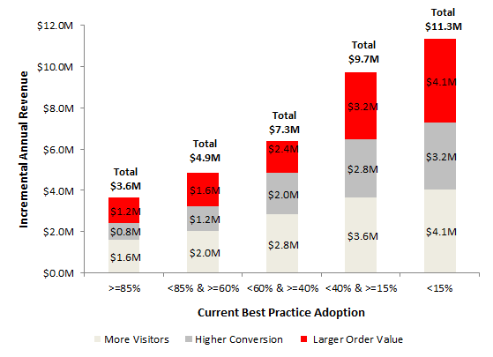
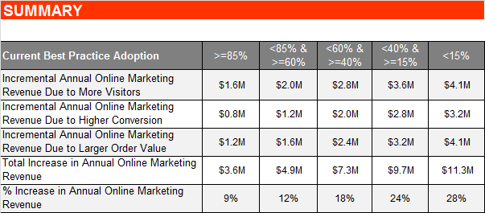
Best Practice Adoption Can Help Increase Annual Online Marketing Revenue by $4M-$11M… (dynamic)
Dynamic Content:
Graph
Chart
Evaluation only.
Created with Aspose.Slides for Java 7.7.0.0
Copyright 2004-2013 Aspose Pty Ltd.
NOTE: Analysis is directional in nature. Access to specific data points will help ascertain more accurate results. Information contained herein is not a guaranty of future results or cost savings.
Source: Customer Interviews, Adobe Customer References, Adobe Analysis

Slide 18
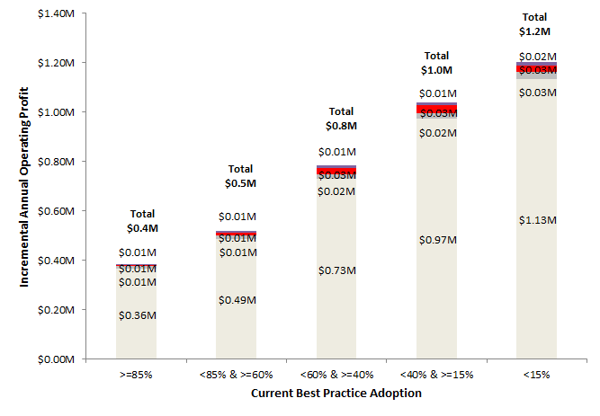


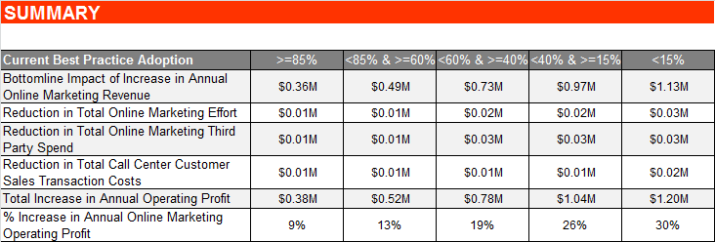
…And Help Increase Annual Online Marketing Operating Profit by 9% - 30%, with a Quarterly Cost of Delay Between $0.1M - $0.4M (dynamic)
Hello World
Dynamic Content:
Graph
Chart
Estimated Cost of Delay
Evaluation only.
Created with Aspose.Slides for Java 7.7.0.0
Copyright 2004-2013 Aspose Pty Ltd.
Estimated Cost of Delay Between $0.1M – 0.4M
Every Three Months
NOTE: Analysis is directional in nature. Access to specific data points will help ascertain more accurate results. Information contained herein is not a guaranty of future results or cost savings.
Source: Customer Interviews, Adobe Customer References, Adobe Analysis

Slide 19
Additional Strategic Impacts
Strategic Impact Area
Key Strategic Objective
Relevant Best Practices
Improved Customer Satisfaction
Increased quality of customer interactions at each touch point leads to increased satisfaction with overall experience
15
Increased Brand Equity
Increased awareness, recognition, and loyalty for the brand,
which translates into higher equity commanded by brand
9
Customer Experiential Impact
Improved Social Sentiment
Improved feelings or emotions associated with the brand reflecting in comments / tweets /mentions on the social web
3
Increased Competitive Advantage
The ability to improve the overall customer experience leads
to an Increased and unique advantage over competitors
7
Evaluation only.
Created with Aspose.Slides for Java 7.7.0.0
Copyright 2004-2013 Aspose Pty Ltd.
Greater Visibility
Reliable and near real time information availability from
various sources leads to faster and quicker decision making
2
Insight Based Decision Making
Readily available and reliable insights help guide critical
decisions resulting in higher quality of decision making
3
Organizational Impact
Increased Business Agility
Improved information availability leads to faster responses to insights, with the focus shifting on ‘prevention’ from ‘cure’
18
6
Reduced Financial, Legal or Compliance Related Risk
Lower financial, legal or compliance related risk to the
organization
Increased Job Enrichment
Let employees focus on true value added activities instead of manual activities to help increase their engagement
2
There could be other benefits such as a reduction in call center support costs due to an increase in the ability to service customers online etc. which are outside the scope of this study

Slide 20



Adobe AEM Customers in Retail Have Achieved Significant Value
Dynamic Content:
Content is static, but references dynamic based on industry and solution
CUSTOMER NAME:
Customizo
CUSTOMER CHALLENGE:
Increasing web traffic
Improving on-screen image rendering and production workflows
Improving conversion rates
ADOBE SOLUTION:
Dynamic image authoring and delivery
Content creation
Customizo is using Scene7 to provide customers with faster and more accurate on-screen portrayals of the custom products they create
BEST PRACTICE ADOPTION:
Adopted 75% of suggested best practices
CUSTOMER RESULTS:
Dramatically increased conversion rates by 400% in just four weeks
Radically reduced bounce rates by 95%
Optimized design process for mobile visitors representing 36% of overall traffic
New website with Online Design Studio increased engagement in the form of page views 340% compared with previous site
Reduced average production workflows from one hour to under ten minutes
CUSTOMER NAME:
Freemans Grattan Holdings
CUSTOMER CHALLENGE:
Showing visuals of product details and quality to enhance the shopping experience
Streamlining image production across four e-commerce websites
Leverage beautiful catalogue layouts on the web to efficiently market to new customers
ADOBE SOLUTION:
Use dynamic imaging capabilities of Scene7 to generate resized images from a master image
Convert the existing print catalogues into digital version with Scene7
BEST PRACTICE ADOPTION:
• Adopted 80% of suggested best practices
CUSTOMER RESULTS:
Implemented dynamic imaging for more than 25,000 products in only a month
Reduced time and labour costs for imaging by 50%
Doubled the conversion rate for newly acquired online catalogue shoppers
Increased Christmas sales more than 25% versus previous year
CUSTOMER NAME:
Matelsom
CUSTOMER CHALLENGE:
Hosting and serving images and videos without hindering site performance
Implementing a video-based virtual mattress tool to increase site traction
ADOBE SOLUTION:
Leverage dynamic imaging capabilities of Scene7 to reduce resources and time spent on images
Create intuitive, interactive videos using Scene7 to captivate and inform customers and increase sales
BEST PRACTICE ADOPTION:
Adopted 70% of suggested best practices
CUSTOMER RESULTS:
Increased online revenue by 15%
Increased the conversion rate 30% on products offering integrated viewing with zoom and alternate views
Increased the conversion rate 15% on products with video
Reduced time spent on image production and management by 60% to 70%
Evaluation only.
Created with Aspose.Slides for Java 7.7.0.0
Copyright 2004-2013 Aspose Pty Ltd.

Slide 21



Adobe AEM Customers in Retail Have Achieved Significant Value
Dynamic Content:
Content is static, but references dynamic based on industry and solution
CUSTOMER NAME:
Lenox
CUSTOMER CHALLENGE:
Increasing response rates and revenue for email campaigns
Reducing production times and costs while increasing conversion rates through use of dynamic images
ADOBE SOLUTION:
Leverage Scene7 to provide dynamic, resizable images and personalization across emails, websites, and catalogs
Create interactive digital catalogs using Adobe Scene7 that can be customized through further use of dynamic imaging
BEST PRACTICE ADOPTION:
Adopted 75% of suggested best practices
CUSTOMER RESULTS:
Increased response rate and sales by 30% to 40% with personalized email campaign
Doubled conversion rates for personalized products
Increased conversion rate by 46% for products using dynamic zoom
Decreased the time and costs of web image production by 30%
CUSTOMER NAME:
Forzieri
CUSTOMER CHALLENGE:
Reducing time and costs associated with web production through dynamic content resizing
Maintaining consistent quality across the site
ADOBE SOLUTION:
Leverage capabilities of Scene7 to implement dynamic images including zoom
Create dynamic backgrounds that reflect the look and feel of each brand in every online shop using Scene7
BEST PRACTICE ADOPTION:
• Adopted 85% of suggested best practices
CUSTOMER RESULTS:
Saved 30% annually through significant reductions in the resources previously required to manage the image database
Increased conversion by 20% as a result of the product zoom function that enables detailed views of products
Reduced product returns from customers by 33% due to imaging and visualization functions that allow users to obtain a better understanding of products
CUSTOMER NAME:
Nautilus
CUSTOMER CHALLENGE:
Updating and creating new product images
Optimizing web content for enhanced navigation and increased conversion rates
Gaining real-time insight into online asset performance
ADOBE SOLUTION:
Content and conversion optimization
Online analytics
Rich media management and delivery
BEST PRACTICE ADOPTION:
Adopted 70% of suggested best practices
CUSTOMER RESULTS:
Increased conversion by 13% with recommendations and product reviews
Enabled more frequent testing and optimization of web content
Streamlined management of product images across sites
Enabled real-time analysis of customer interactions and site abandonment
Enhanced productivity and operational efficiency
Evaluation only.
Created with Aspose.Slides for Java 7.7.0.0
Copyright 2004-2013 Aspose Pty Ltd.

Slide 22


Independent Analysts Recognize Adobe as The Industry Leader in Web Content Management
"Adobe leads in WCM due to breadth of functionality, market momentum,
and resources. Adobe provides a solid set of tools to enable business users to manage experiences. Adobe has the richest, most intuitive UI as well as the best complementary DX products.”
Dynamic Content:
Content is static, but references dynamic based on solution
“Adobe is the leader in WCM as per magic quadrant. The ease with which CQ can be used by non-IT users, and the speed with which it can be deployed (relative to typical deployments of some other vendors' solutions), make it one of the best Java-based products in the WCM market. Adobe's creative culture and capabilities give its user interface a competitive edge in terms of intuitiveness, while its analytical capabilities enable persona-based assessments of the potential of different types of experience. “
“Adobe has the most complete and cohesive strategy of all the WCM providers for supporting mobility. CQ's architecture ensures the integrity of a single authoritative content source to serve a broad range of established and new mobile delivery mechanisms and technologies, including device detection, mobile sites, mobile Web applications and hybrid mobile applications..”
Evaluation only.
Created with Aspose.Slides for Java 7.7.0.0
Copyright 2004-2013 Aspose Pty Ltd.
Source: Forrester Wave Web Content Management For Digital Customer Experience, Q2 2013, Gartner Magic Quadrant report for September 2012 , report ID:G00233574, Magic Quadrant report for Web Content Management , published on 31 July 2013 , Report ID:G00250615
Notes:
1 slide

Slide 23
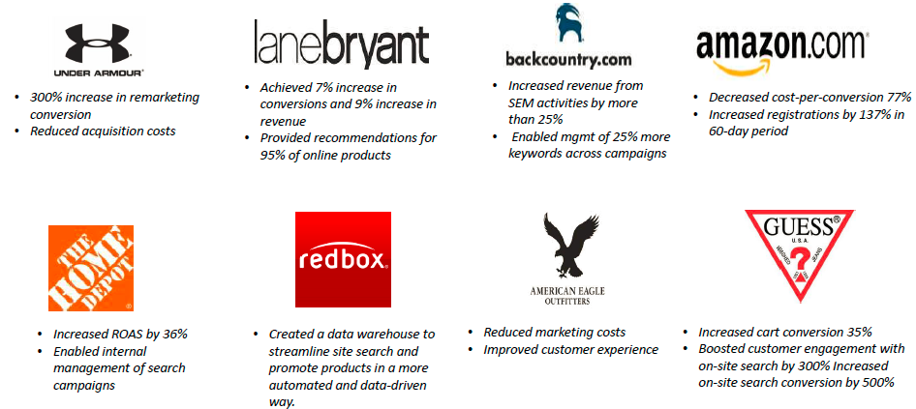
The World’s Largest Retail Organizations Have Adopted our Digital Marketing Solutions
Evaluation only.
Created with Aspose.Slides for Java 7.7.0.0
Copyright 2004-2013 Aspose Pty Ltd.

Slide 24








Adobe AEM Customers Across Industries Have Achieved Tremendous Benefits
Dynamic Content:
Content is static, but references dynamic based on industry and solution
“Reduced the administrative load to optimize user experiences”
“Improved conversion on major brand campaigns by 33%”
“Increased web team productivity by 300%”
“Accelerated delivery of new, localized content from days to minutes”
Evaluation only.
Created with Aspose.Slides for Java 7.7.0.0
Copyright 2004-2013 Aspose Pty Ltd.
“Increased average sales by 140% across all products deploying video”
“Doubled site traffic and provided a foundation for an enhanced mobile channel”
“Optimized website interface for 70% higher conversion
rate”
“Decreased typical time to publish content by as much as 50%”

Slide 25




Proposed Next Steps
We Look Forward To
Working With You…
Evaluation only.
Created with Aspose.Slides for Java 7.7.0.0
Copyright 2004-2013 Aspose Pty Ltd.
1
EXECUTIVE FOLLOW-UP
Meet with key executives to discuss the value of adopting best practices
2
DETAILED ASSESSMENT
Understand detailed requirements and define specific value impacts; demonstrate capabilities
3
RECOMMENDATIONS/ ROADMAP/BUSINESS CASE
Quantify suggested ROI, and develop custom roadmap and investment plan

