Slide 1



Report
View in Power BI
Last data refresh:
12/1/2024 10:28:55 AM UTC
Downloaded at:
12/1/2024 11:15:23 AM UTC

Slide 2
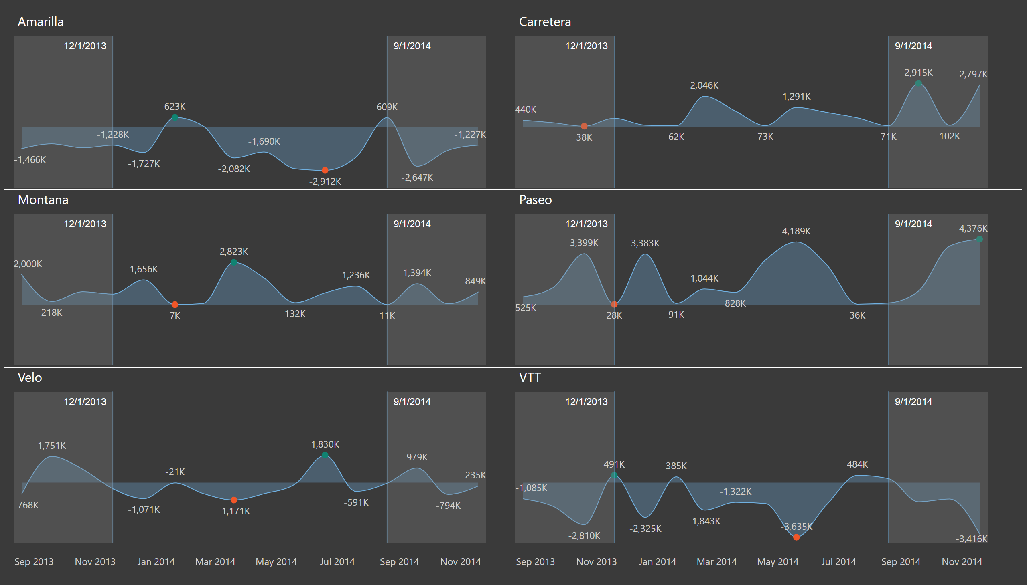
Small multiples
Notes:
No alt text provided

Slide 3
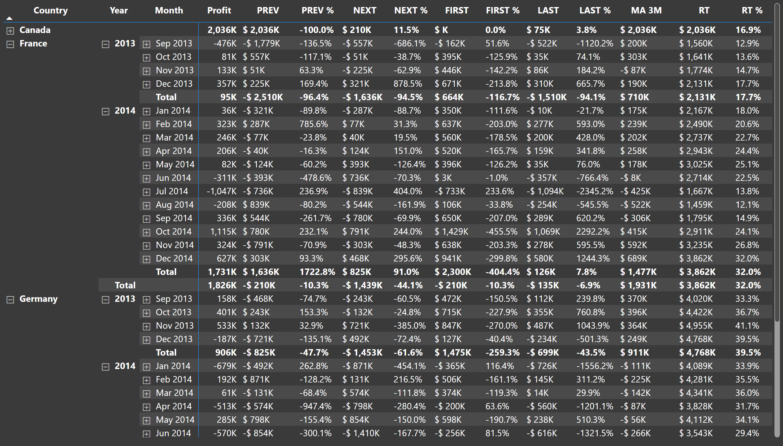
Visual calculations
Notes:
pivotTable
No alt text provided

Slide 4
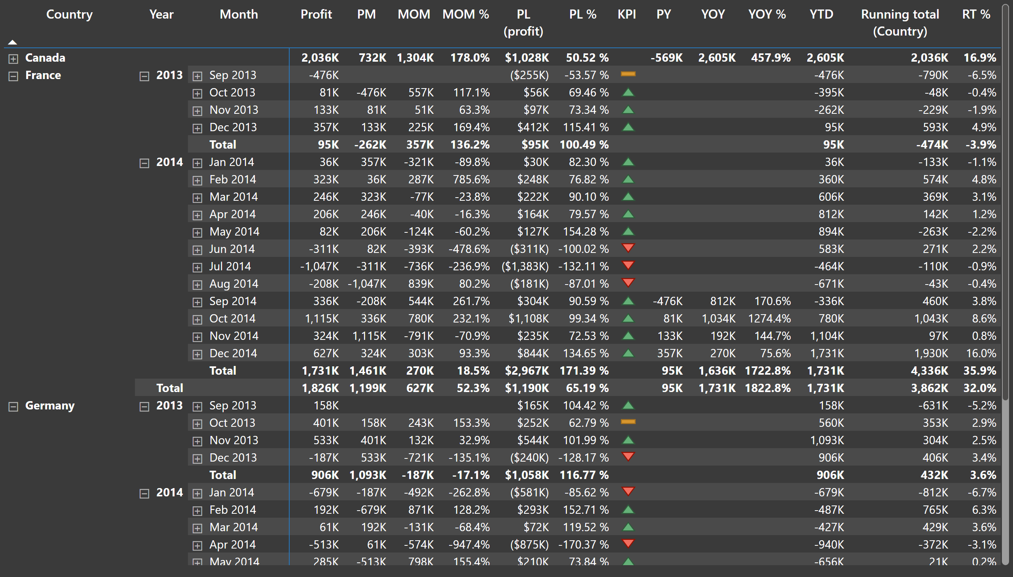
Time intelligence
Notes:
pivotTable
No alt text provided

Slide 5
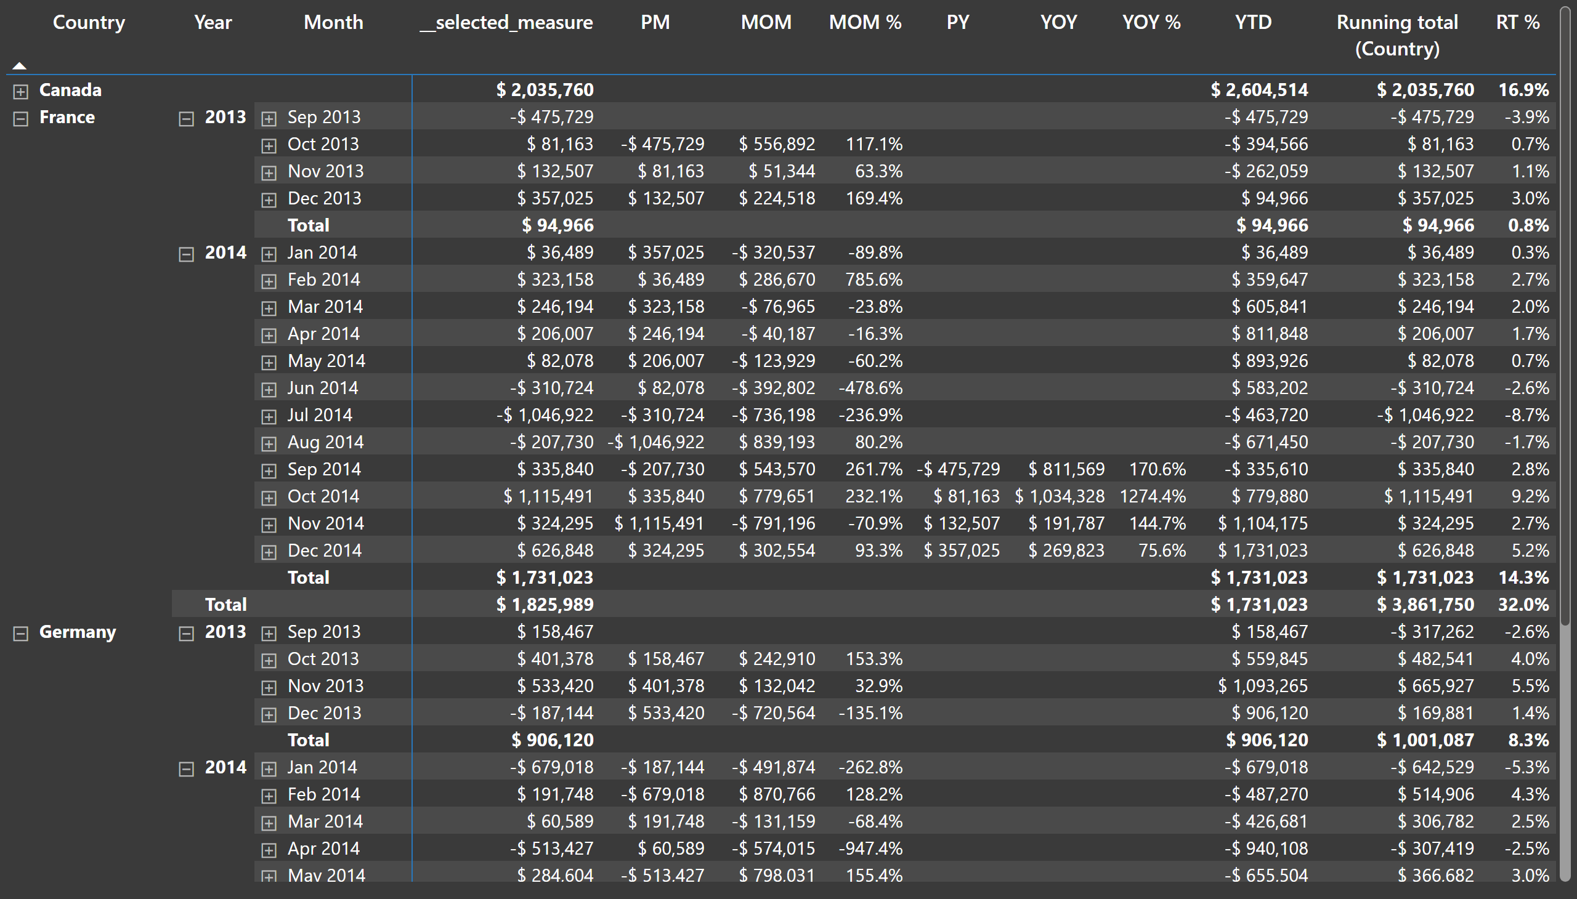
Calculation groups
Notes:
pivotTable
No alt text provided

Slide 6
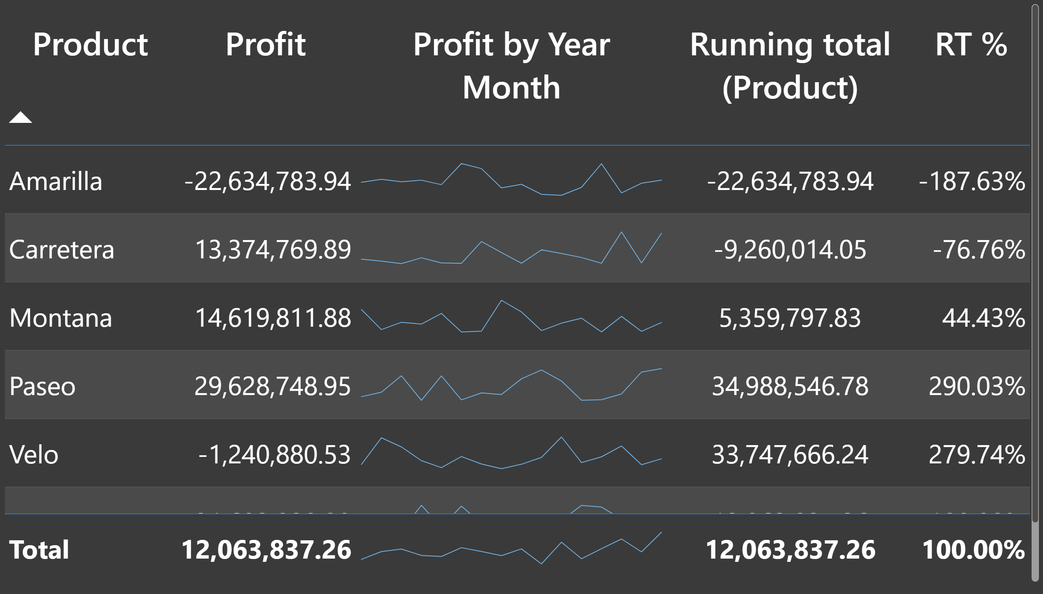
Sparklines
Notes:
tableEx
No alt text provided

Slide 7
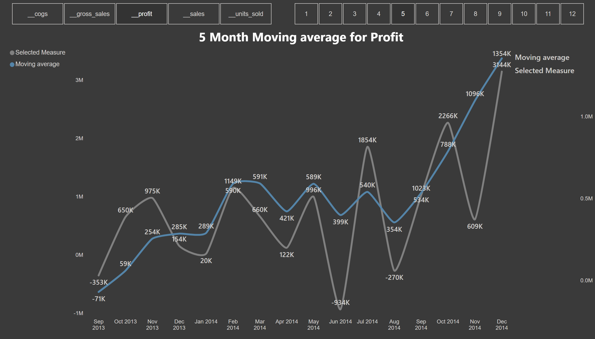
Moving average
Notes:
slicer
No alt text provided
slicer
No alt text provided
5 Month Moving average for Profit
No alt text provided

Slide 8
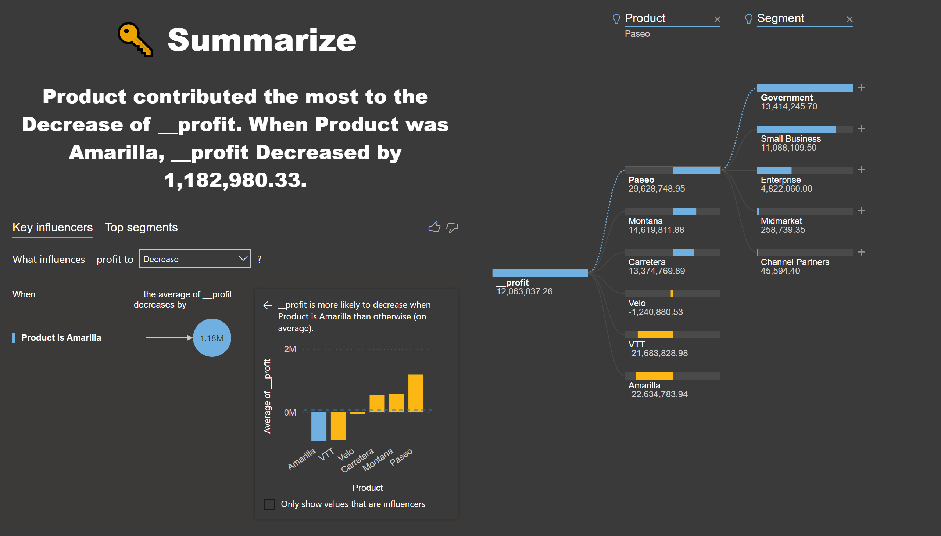
AI
Notes:
keyDriversVisual
No alt text provided
decompositionTreeVisual
No alt text provided
textbox
No alt text provided
textbox
No alt text provided

Slide 9
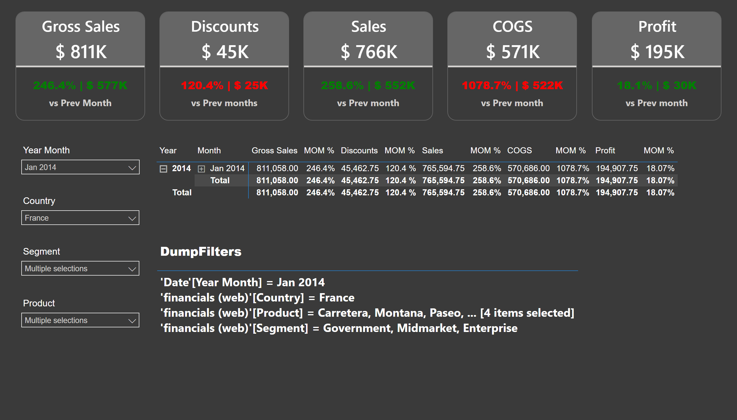
KPI Cards
Notes:
Sales
No alt text provided
COGS
No alt text provided
Profit
No alt text provided
Gross Sales
No alt text provided
Discounts
No alt text provided
pivotTable
No alt text provided
slicer
No alt text provided
slicer
No alt text provided
slicer
No alt text provided
slicer
No alt text provided
tableEx
No alt text provided

Slide 10
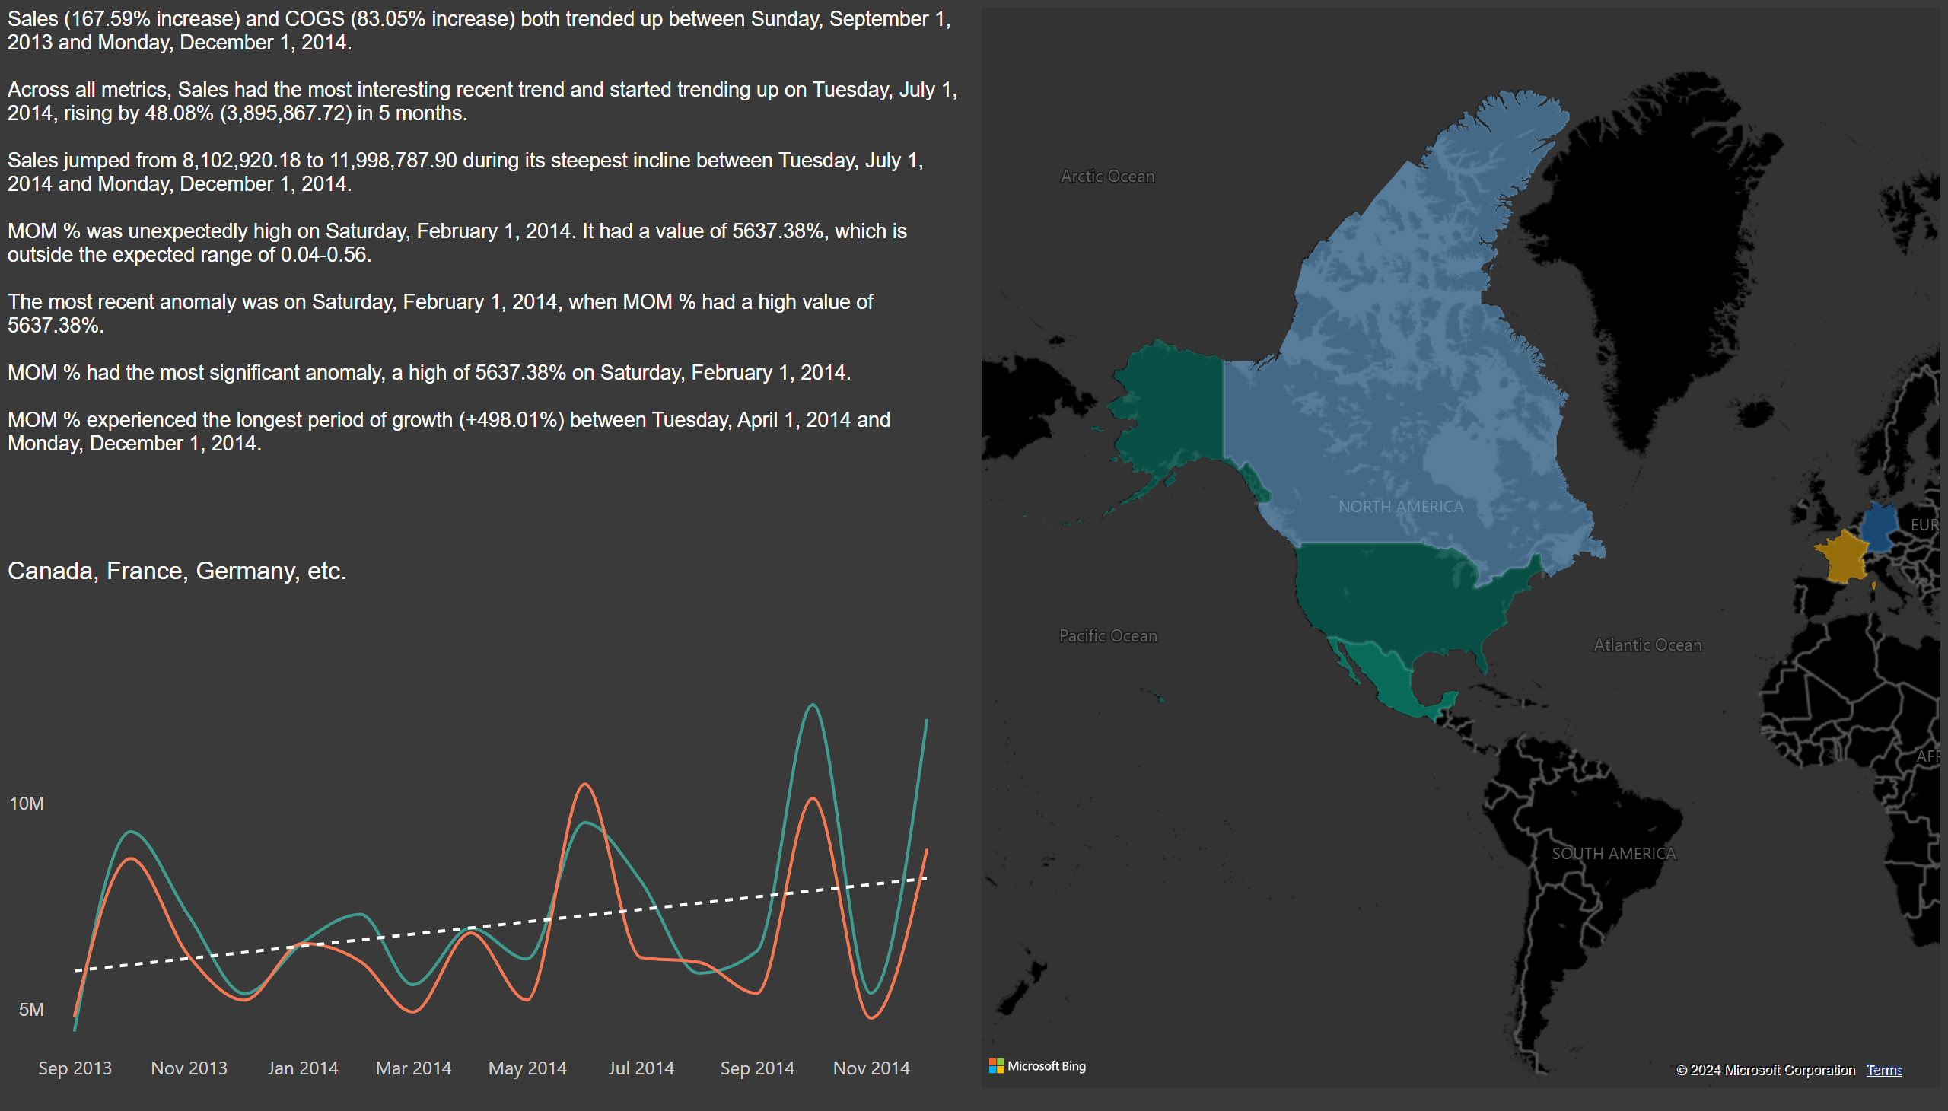
Filled map
Notes:
filledMap
No alt text provided
lineChart
No alt text provided
textbox
No alt text provided
multiRowCard
No alt text provided

Slide 11
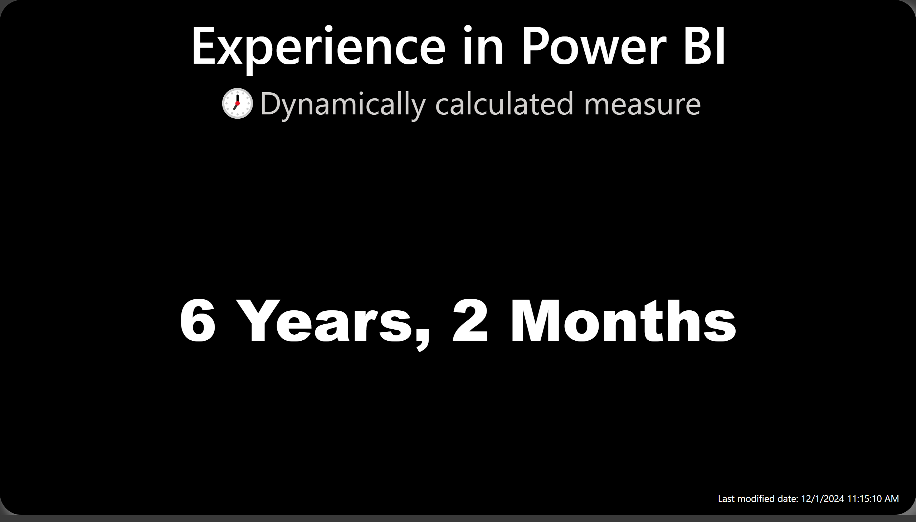
Experience
Notes:
Experience in Power BI
No alt text provided
card
No alt text provided

