Slide 1
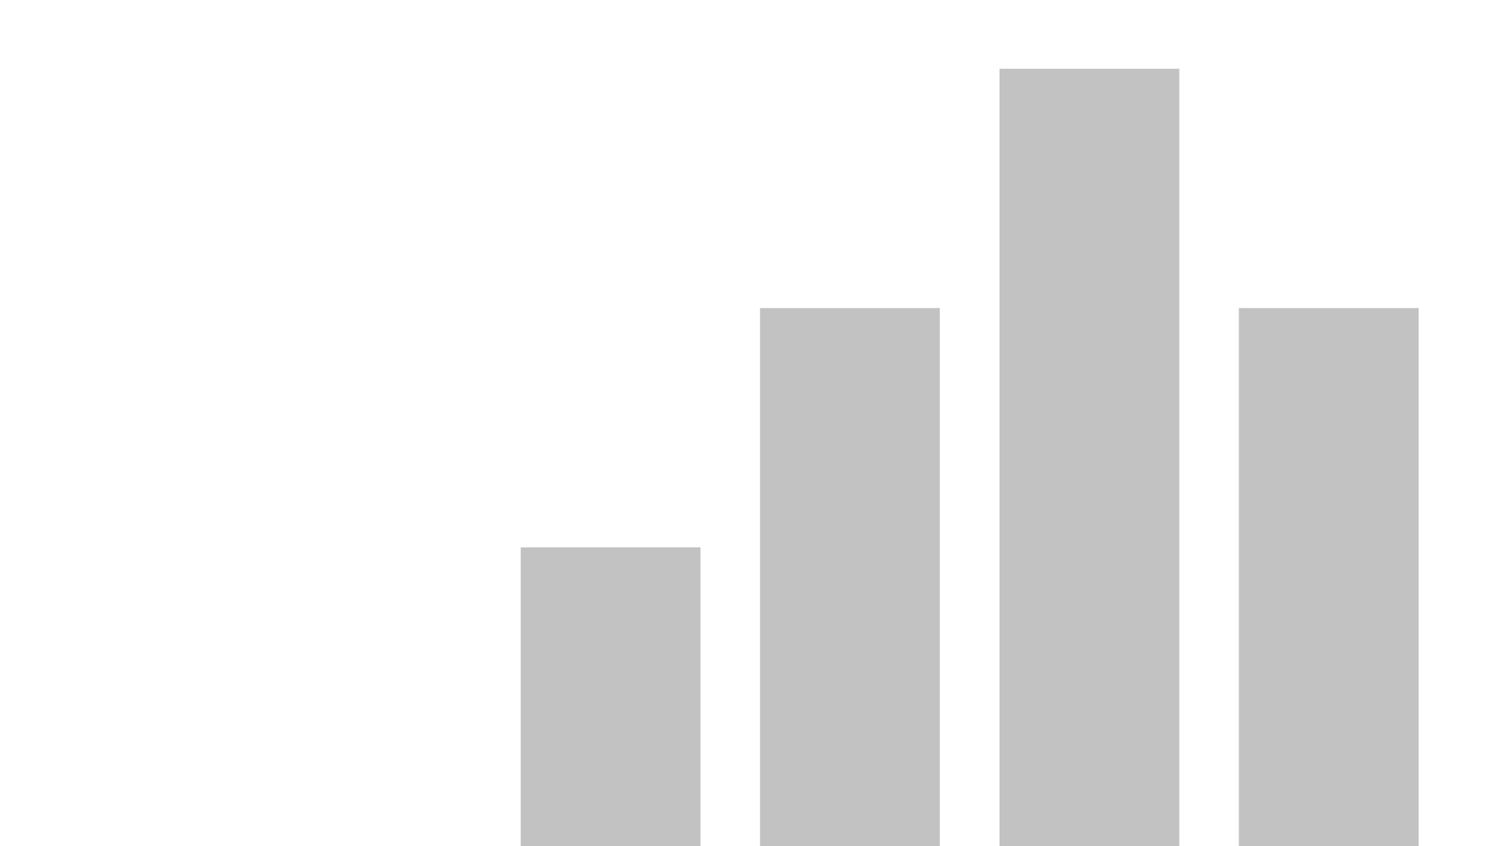


Countries
View in Power BI
Last data refresh:
1/25/2026 10:24:01 AM UTC
Downloaded at:
1/25/2026 10:30:33 AM UTC

Slide 2
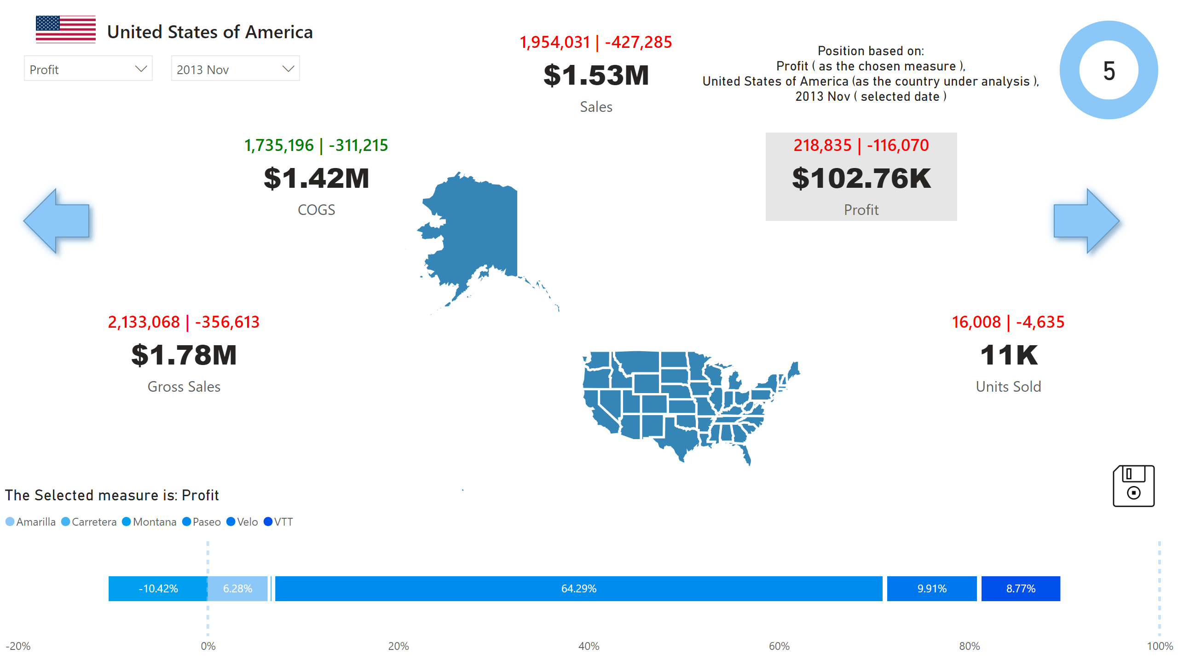
United States of America
Notes:
1,954,031 | -427,285
No alt text provided
slicer
No alt text provided
The Selected measure is: Profit
No alt text provided
1,735,196 | -311,215
No alt text provided
shape
No alt text provided
cardVisual
No alt text provided
16,008 | -4,635
No alt text provided
2,133,068 | -356,613
No alt text provided
shapeMap
No alt text provided
slicer
No alt text provided
card
No alt text provided
218,835 | -116,070
No alt text provided
card
No alt text provided
actionButton
No alt text provided
shape
No alt text provided
donutChart
No alt text provided

Slide 3
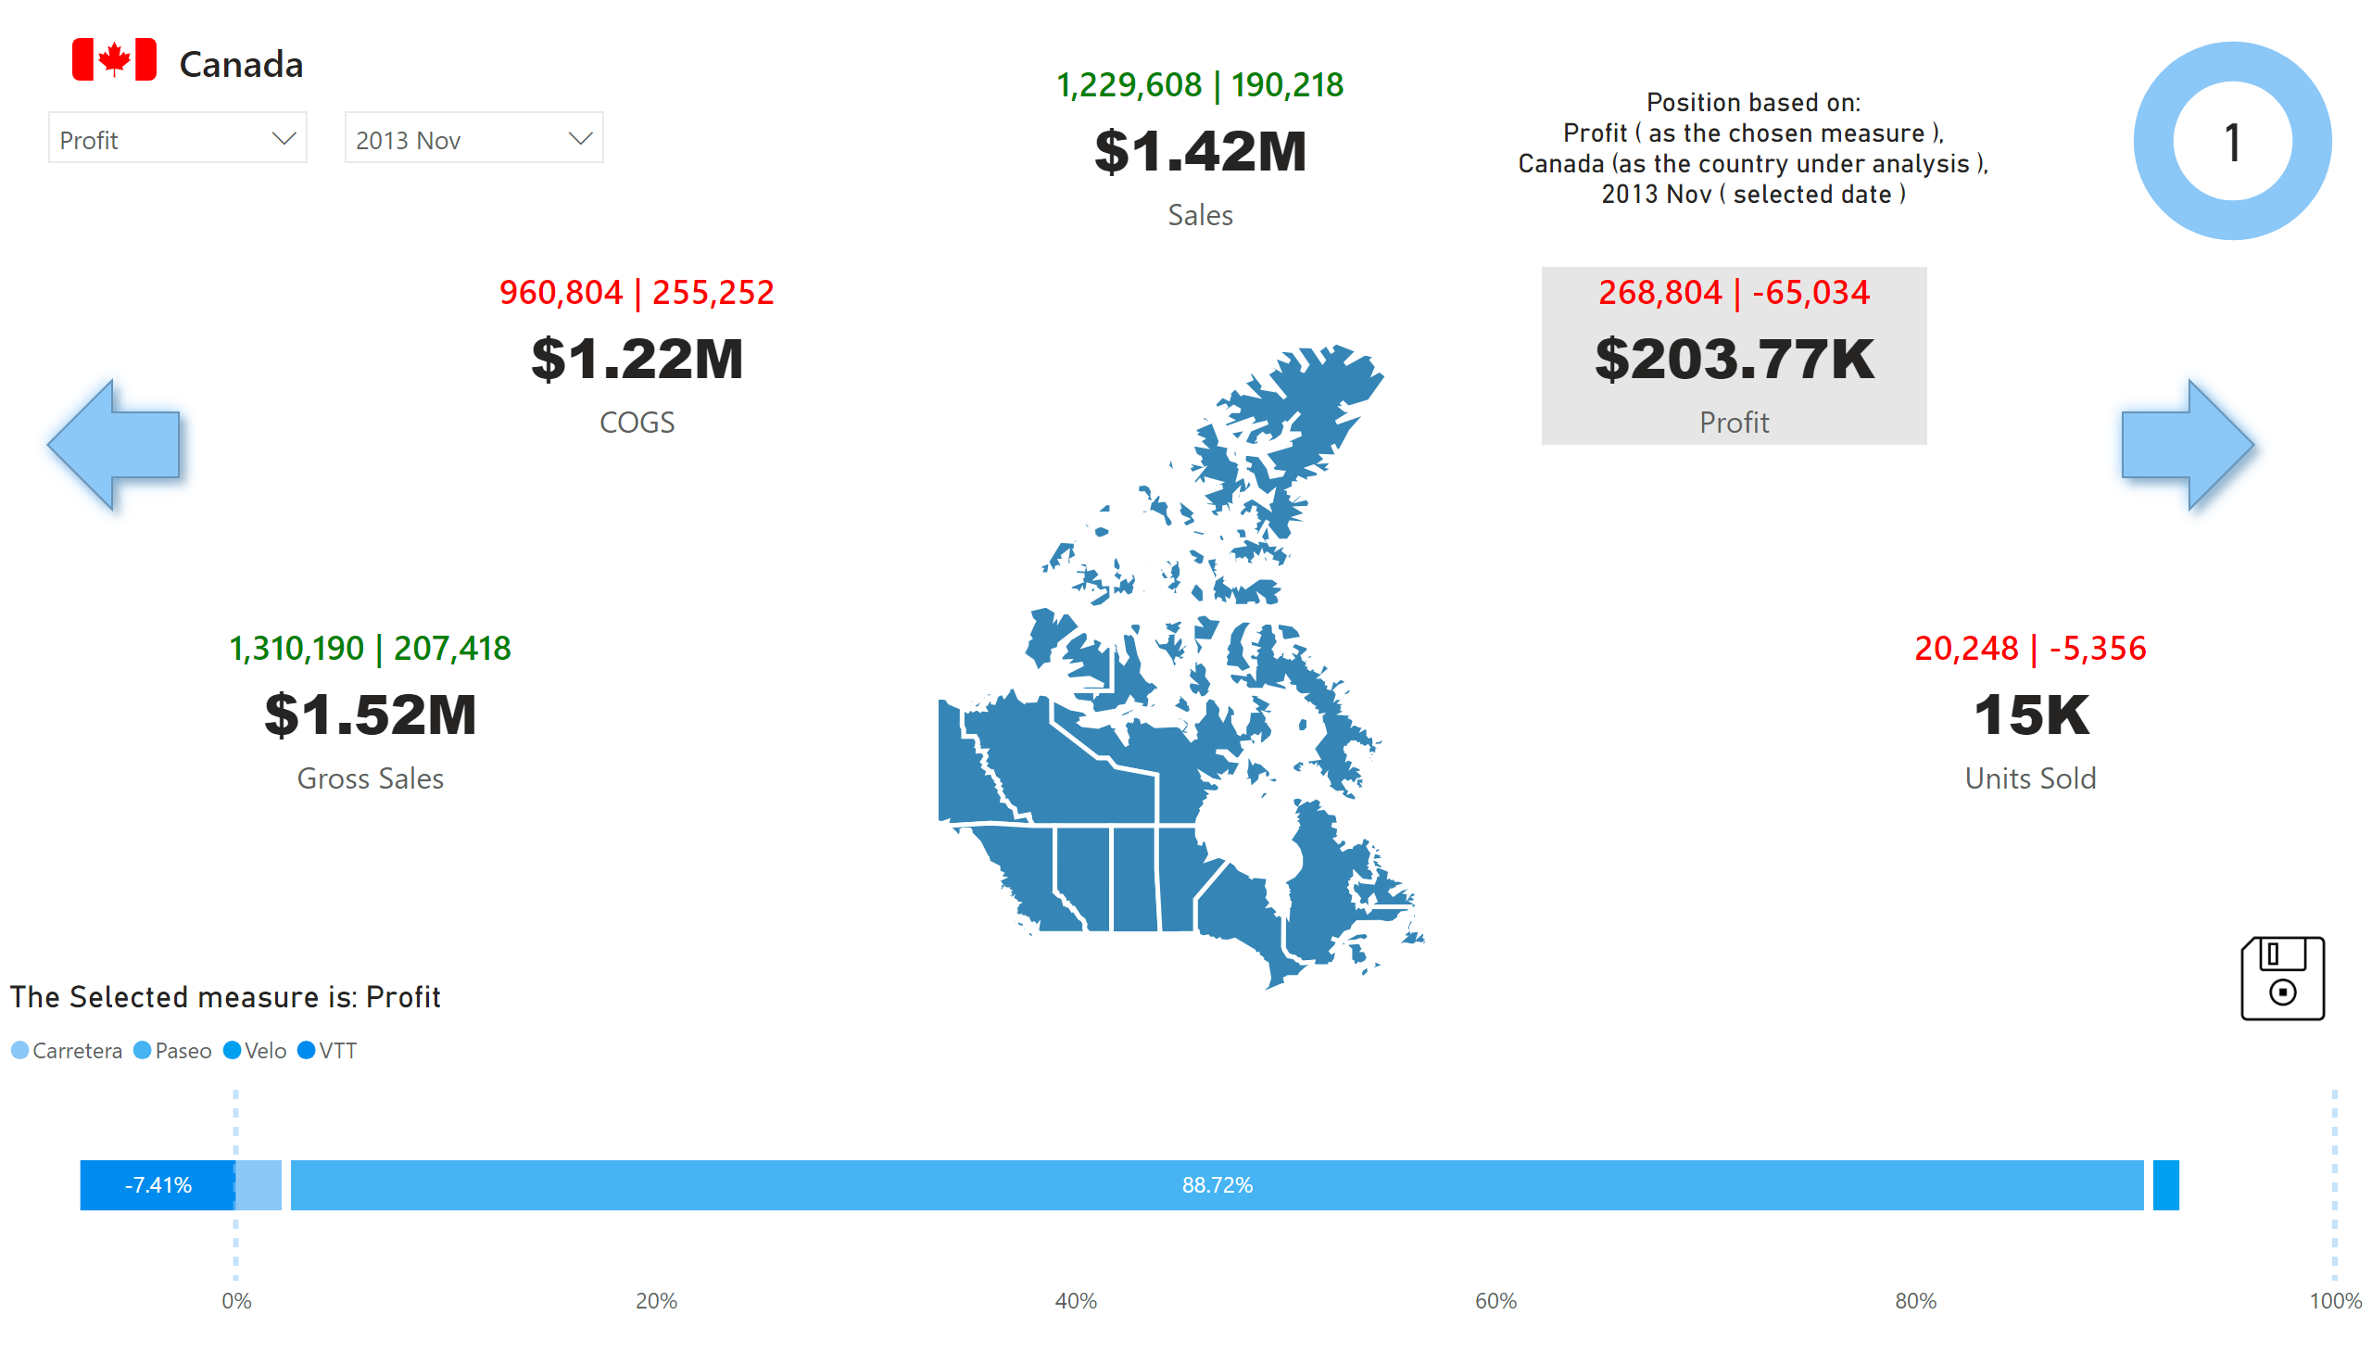
Canada
Notes:
slicer
No alt text provided
card
No alt text provided
960,804 | 255,252
No alt text provided
actionButton
No alt text provided
shape
No alt text provided
268,804 | -65,034
No alt text provided
1,229,608 | 190,218
No alt text provided
shape
No alt text provided
The Selected measure is: Profit
No alt text provided
cardVisual
No alt text provided
donutChart
No alt text provided
slicer
No alt text provided
card
No alt text provided
20,248 | -5,356
No alt text provided
1,310,190 | 207,418
No alt text provided
shapeMap
No alt text provided

Slide 4
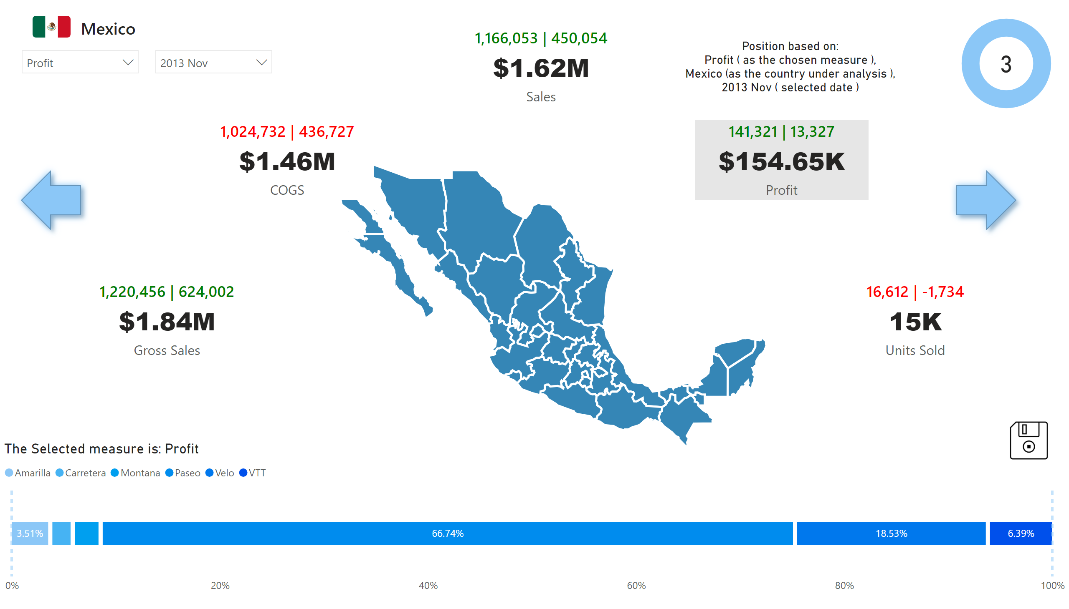
Mexico
Notes:
slicer
No alt text provided
card
No alt text provided
1,024,732 | 436,727
No alt text provided
donutChart
No alt text provided
141,321 | 13,327
No alt text provided
card
No alt text provided
actionButton
No alt text provided
1,166,053 | 450,054
No alt text provided
slicer
No alt text provided
cardVisual
No alt text provided
1,220,456 | 624,002
No alt text provided
shape
No alt text provided
The Selected measure is: Profit
No alt text provided
shapeMap
No alt text provided
shape
No alt text provided
16,612 | -1,734
No alt text provided

Slide 5
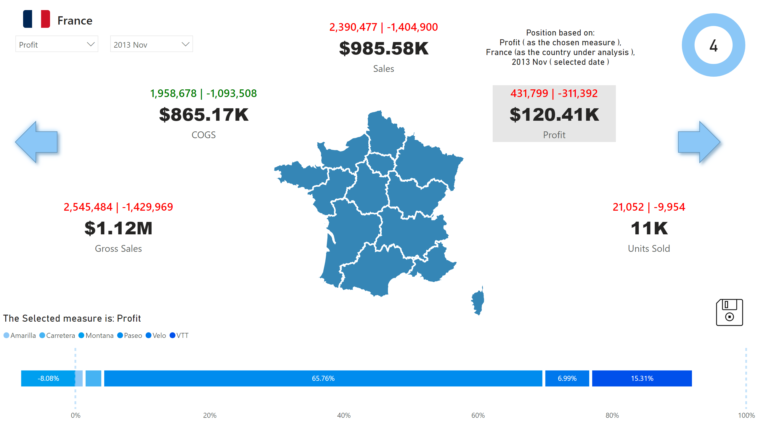
France
Notes:
slicer
No alt text provided
shapeMap
No alt text provided
cardVisual
No alt text provided
slicer
No alt text provided
card
No alt text provided
shape
No alt text provided
21,052 | -9,954
No alt text provided
donutChart
No alt text provided
actionButton
No alt text provided
1,958,678 | -1,093,508
No alt text provided
431,799 | -311,392
No alt text provided
shape
No alt text provided
The Selected measure is: Profit
No alt text provided
card
No alt text provided
2,390,477 | -1,404,900
No alt text provided
2,545,484 | -1,429,969
No alt text provided

Slide 6
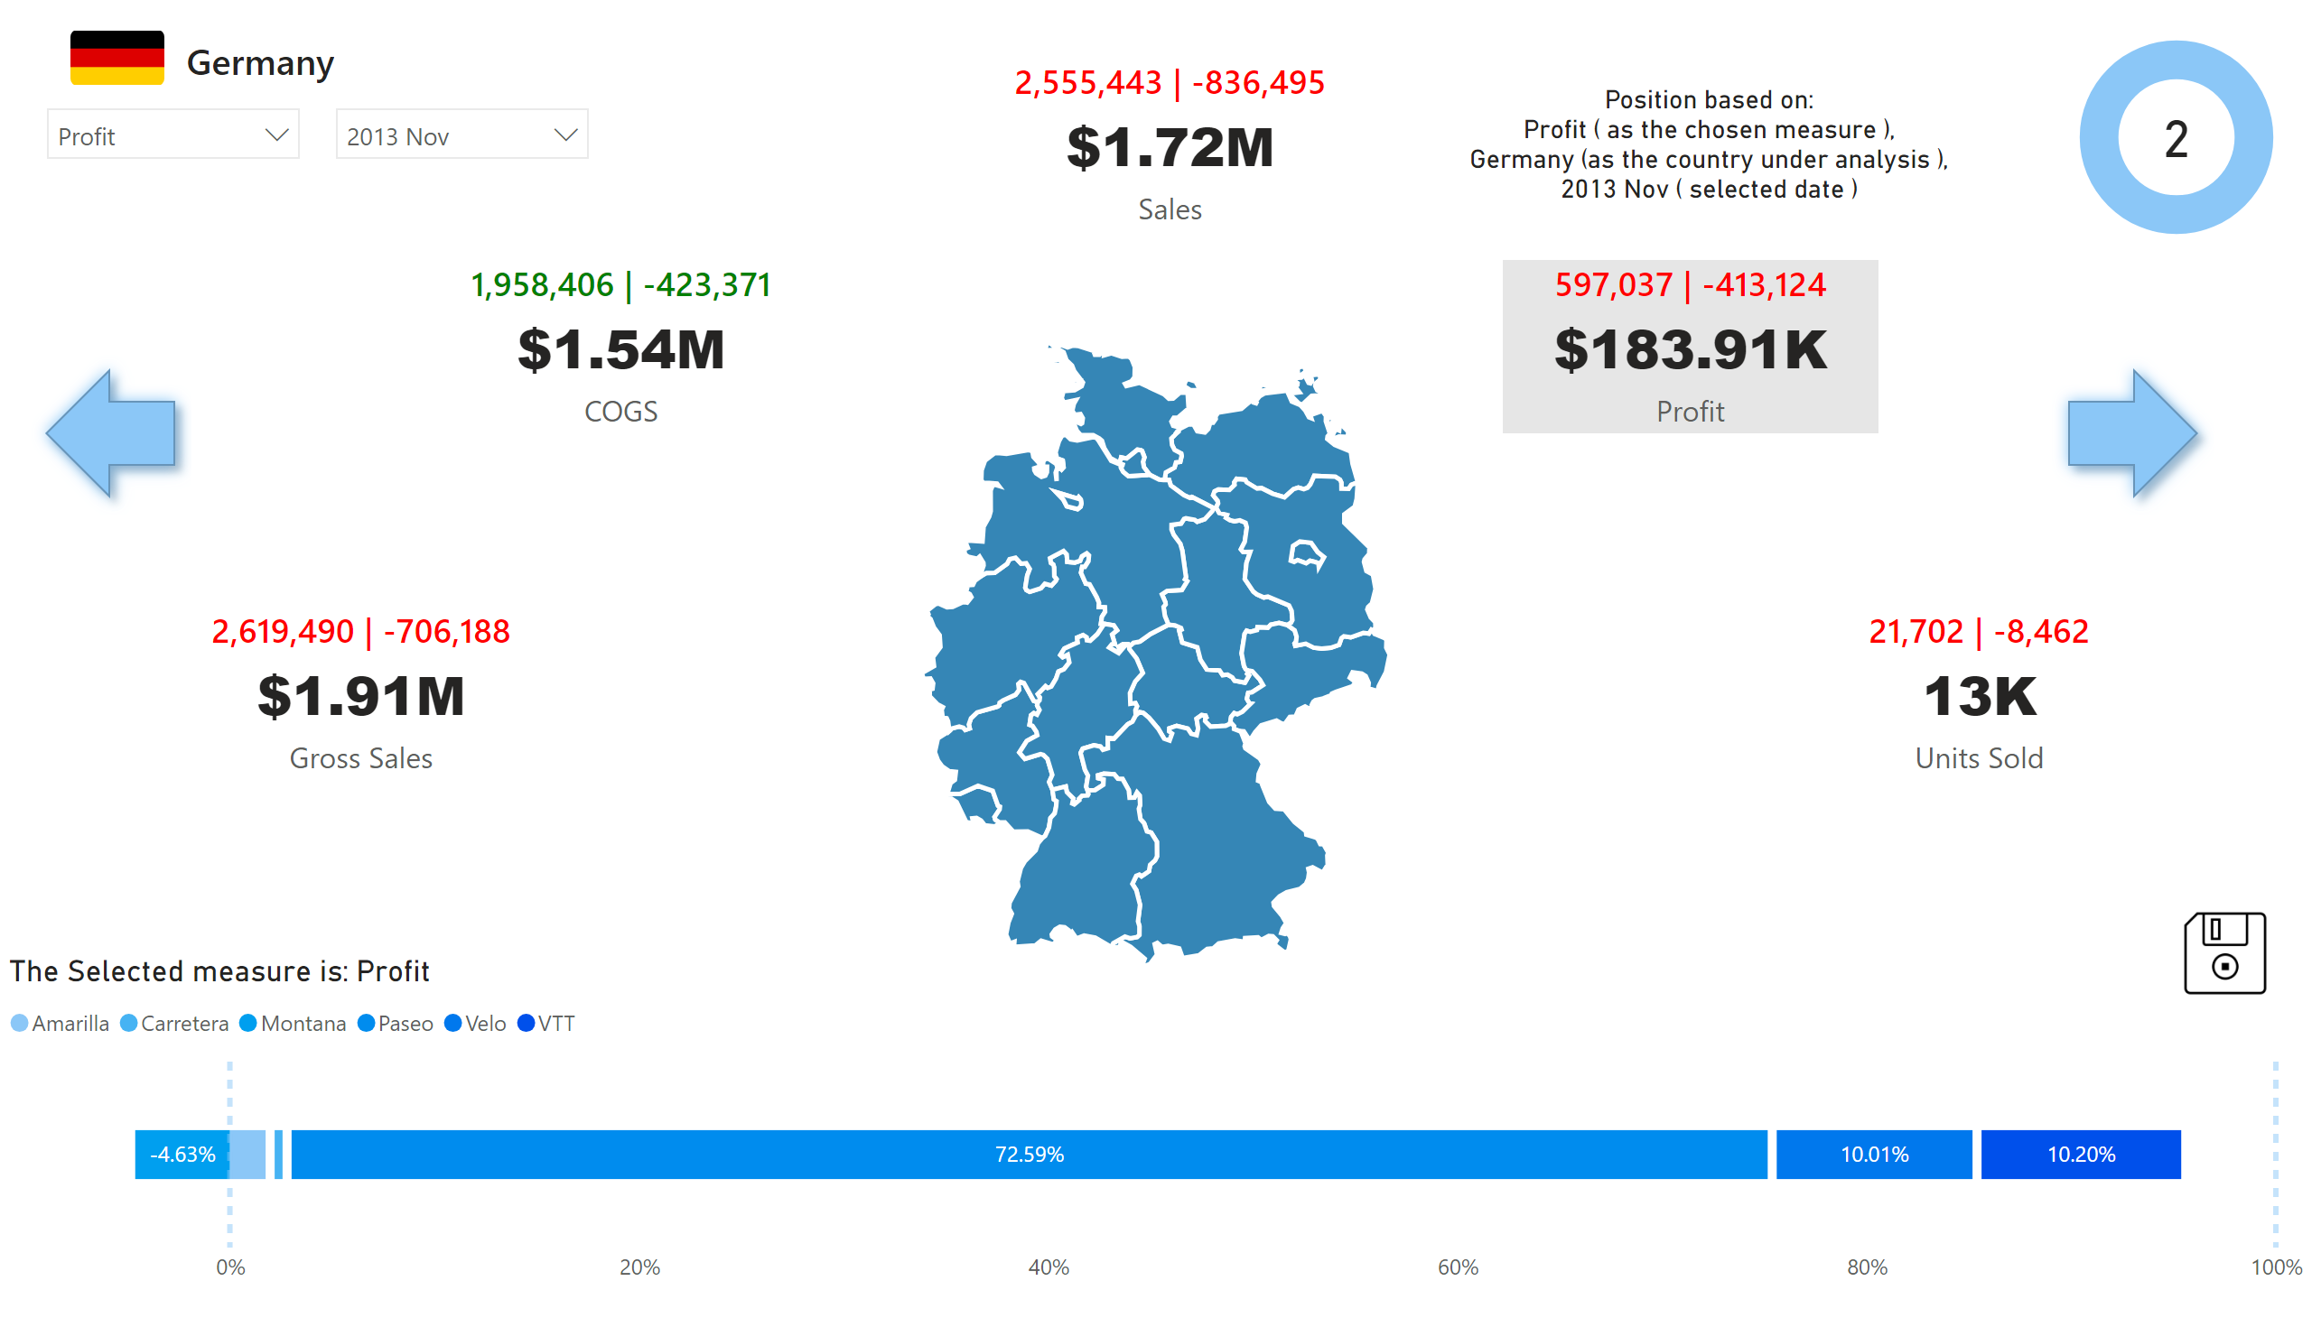
Germany
Notes:
cardVisual
No alt text provided
shape
No alt text provided
slicer
No alt text provided
donutChart
No alt text provided
The Selected measure is: Profit
No alt text provided
card
No alt text provided
21,702 | -8,462
No alt text provided
597,037 | -413,124
No alt text provided
shape
No alt text provided
actionButton
No alt text provided
card
No alt text provided
1,958,406 | -423,371
No alt text provided
slicer
No alt text provided
2,555,443 | -836,495
No alt text provided
shapeMap
No alt text provided
2,619,490 | -706,188
No alt text provided

Slide 7
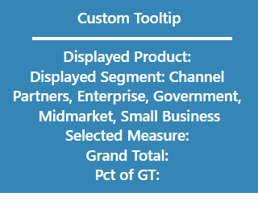
Custom Tooltip
Notes:
card
No alt text provided
card
No alt text provided
shape
No alt text provided

Slide 8
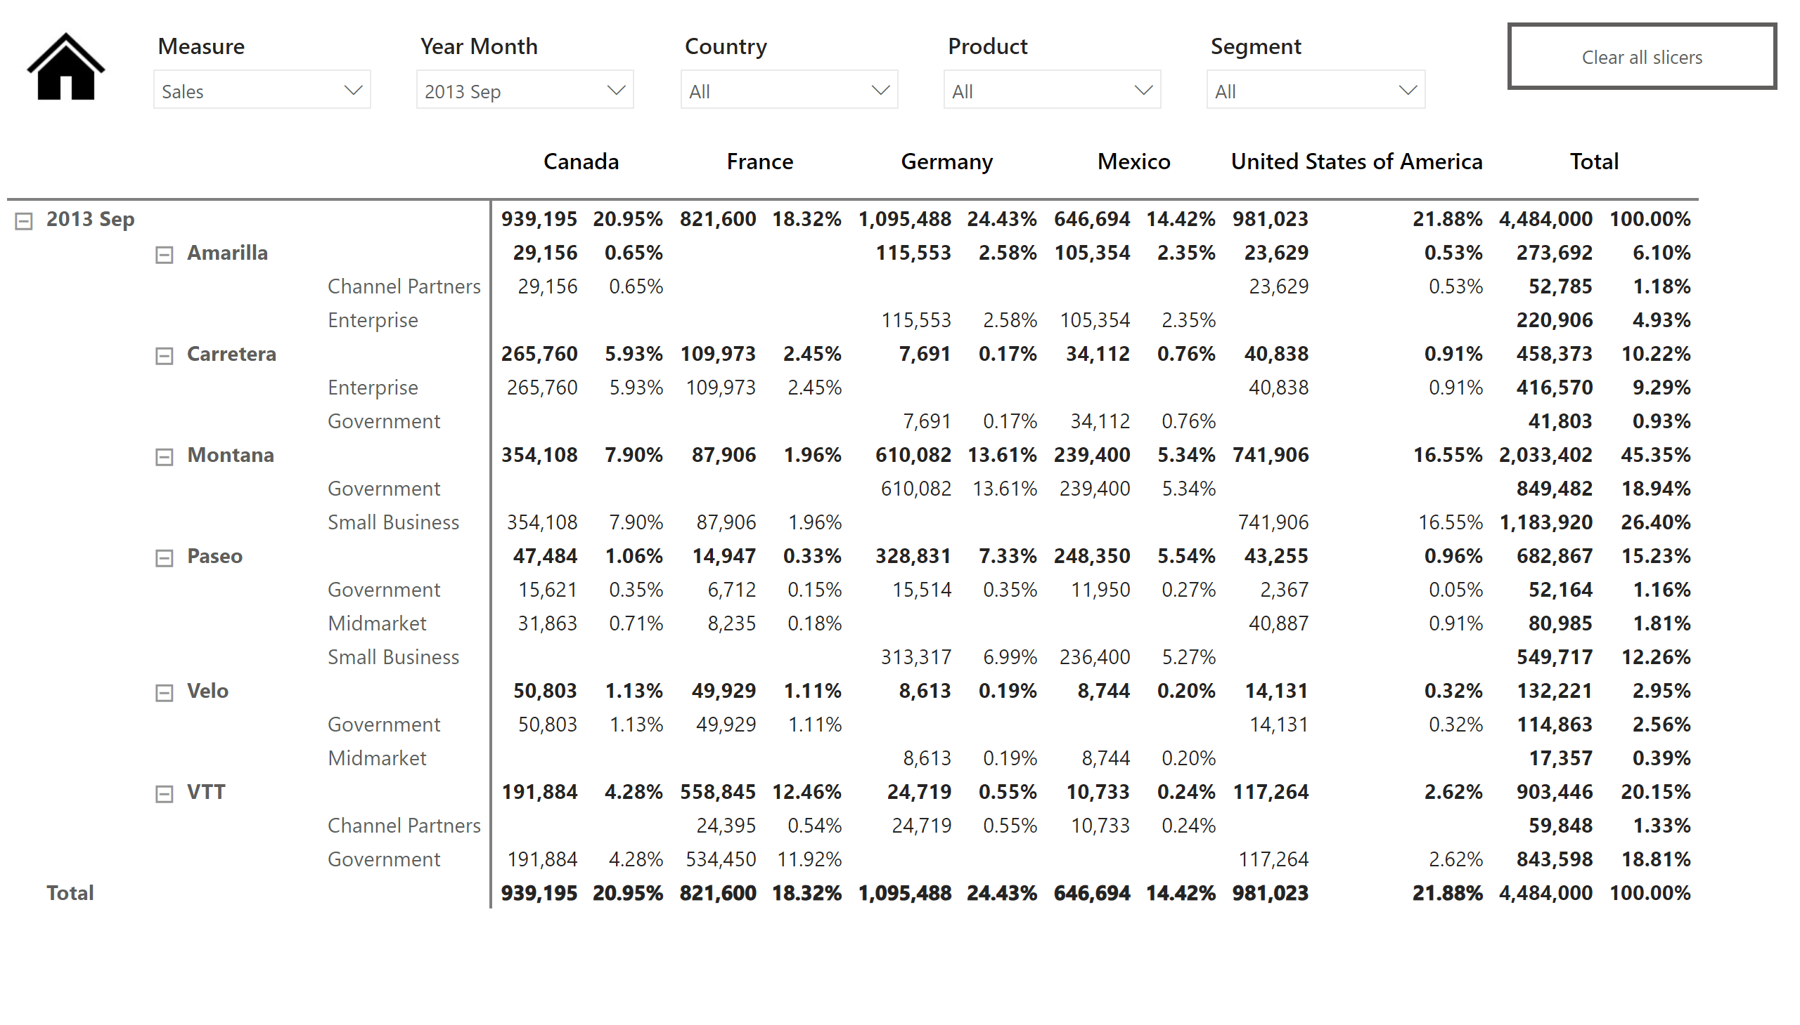
Table
Notes:
slicer
No alt text provided
slicer
No alt text provided
slicer
No alt text provided
slicer
No alt text provided
actionButton
No alt text provided
actionButton
No alt text provided
pivotTable
No alt text provided
slicer
No alt text provided

