Slide 1

Real-Time Meteorological Web Application
Backend and Frontend Implementation with React and FastAPI
Notes:
Introduce yourself, briefly mention the purpose of the assignment, and set the stage for what will be covered.

Slide 2


Understanding the Problem
Real-time data from IoT sensors
Daily forecast and historical data management
User-driven inputs for forecasting

Slide 3

Technology Choice
TypeScript
React
PostgreSQL
WebSockets
Python
FastAPI
Docker
Tailwind
Notes:
Why FastAPI? (Real-time capabilities, async native, automatic docs)
TypeScript/React for frontend
PostgreSQL for storing weather data
Docker for ease of deployment

Slide 4

IMPLEMENTATION

Slide 5
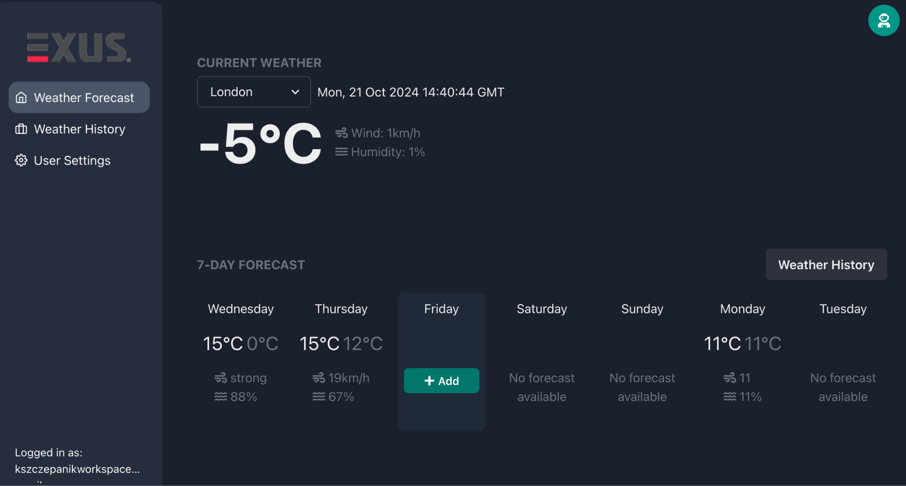

Slide 6
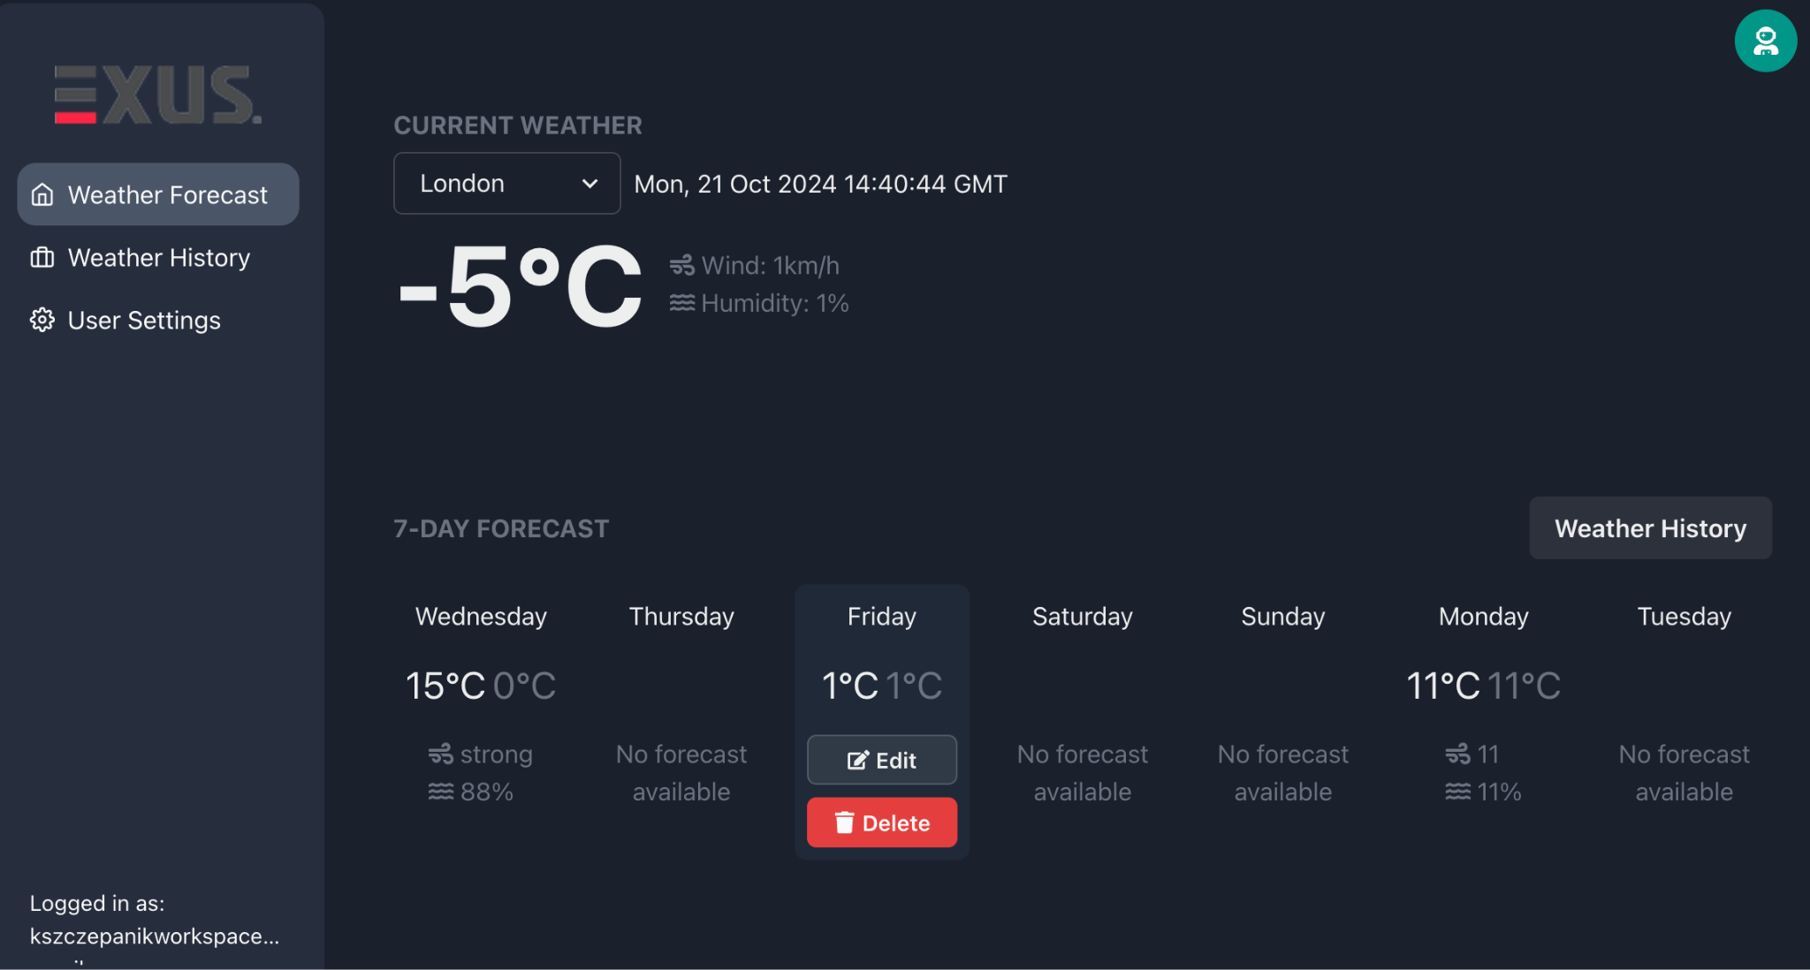

Slide 7
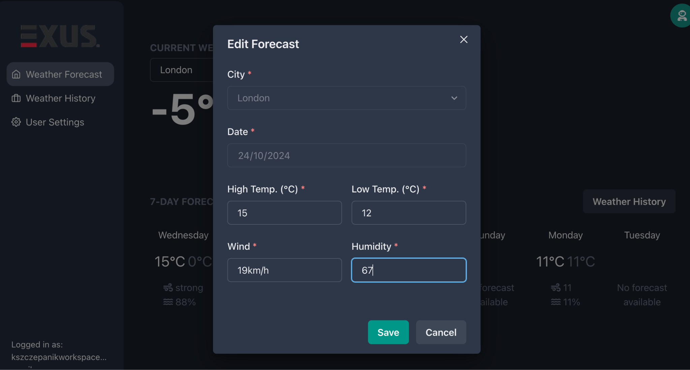

Slide 8
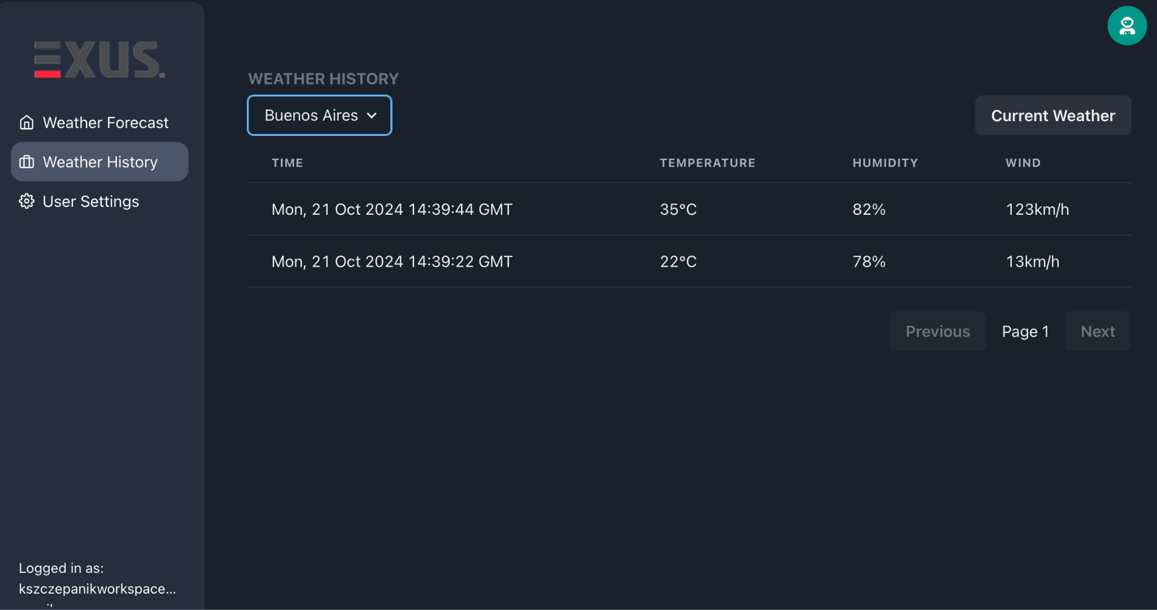

Slide 9
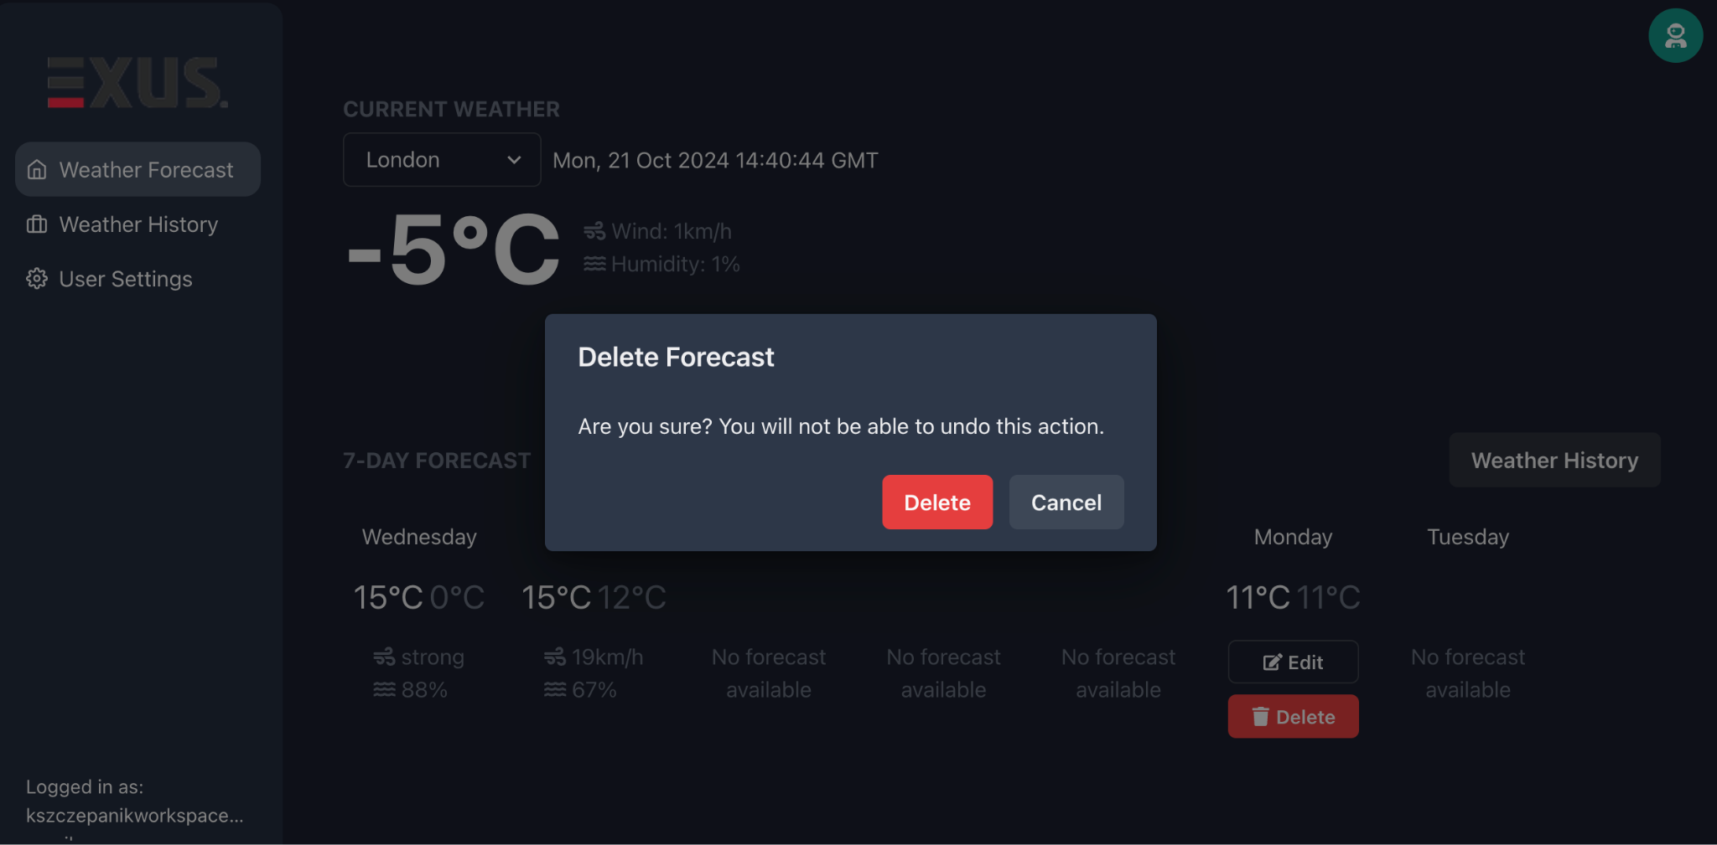

Slide 10
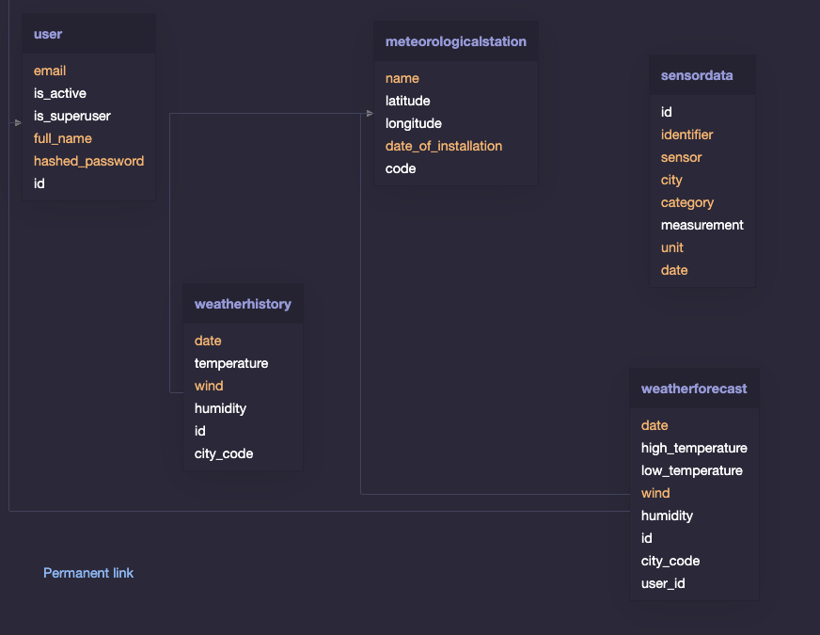
Database
Design

Slide 11

Next Steps and Improvements
WebSockets
Testing & Quality
Complete the WebSocket integration to enable real-time data updates from the backend to the frontend, ensuring immediate weather updates for users.
Add comprehensive e2e, integration and unit tests, while also creating reusable components and improving overall code quality.
IoT
UX/UI Design
Implement a script that generates mocked sensor data, which can be seamlessly swapped with real IoT device data for future scalability.
Implement a full responsive design, ensuring an optimal user experience across all devices and screen sizes.

Slide 12
THANKS!
DO YOU HAVE ANY QUESTIONS?
+46 668 287 111
kszczepanikcontact@gmail.com
https://www.linkedin.com/in/kamilszczepanik/

