Slide 1

Zomato Sales Analysis
By Kamini Sharma

Slide 2

Agenda
Problem Statement
Dataset Overview
Objective Key Metrics and Visualizations
Insights
Recommendations
Conclusion
Dashboard

Slide 3
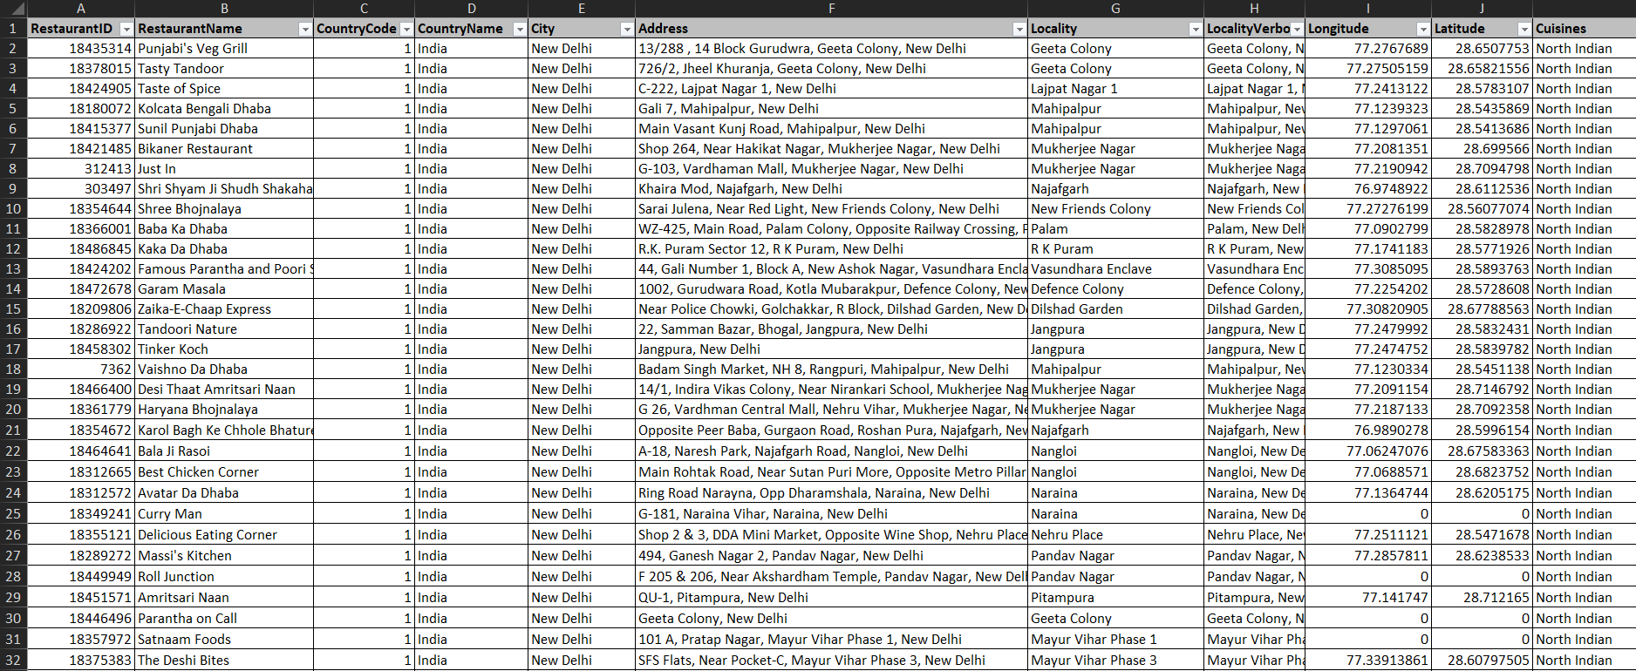
Problem Statement
The goal is to optimize restaurant openings while ensuring a balance between market growth and maintaining high-quality customer experiences.

Slide 4
Dataset Overview
Restaurant Details
Online Delivery / Table Booking: Availability of these services.
Price Range: Numeric indicator of pricing.
Votes and Rating: Number of votes received and overall user rating.
Geolocation: Latitude and Longitude coordinates for precise location mapping
Key Features of the Data
Cuisines Offered: Different types of cuisines served by the restaurants.
Online Delivery & Table Booking: Indicates service availability.
Price Range & Ratings: Restaurant price category and user ratings.
Average Cost for Two: User feedback and cost for two people.

Slide 5
Year-Wise Restaurant Count Analysis
2011 Peak: The restaurant count increased from 1080 (2010) to 1097 (2011), the highest point on the graph before a drop.
2012 Decline: A noticeable decline to 1022 restaurants in 2012, marking the lowest point.
Fluctuations: The count fluctuates between 1060 (2013), 1051 (2014) and drops again to 1022 (2015).
Growth Post-2016: After a stable period in 2015-2016, there's a sharp rise from 1027 (2017) to 1102 (2018), marking a strong recovery and growth phase.
Current Trend: 2018 shows the highest restaurant count in the observed years, suggesting a positive growth trajectory.

Slide 6
Top 10 Cuisines Analysis
North Indian cuisine is the clear favourite, followed by combinations that include Chinese and Mughlai.
Fast Food continues to have a strong market, reflecting the demand for quick and convenient dining.
Cafes and Bakeries indicate growing trends in casual dining and dessert-focused eateries.

Slide 7
Countries With Least Number of Restaurants
Limited Restaurant Presence : Canada has the fewest restaurants with just 4, indicating a minimal footprint or underreporting.
Close Counts Among Others: Sri Lanka, Qatar, Singapore, and Indonesia all have a similar range of 19-21 restaurants, suggesting small but comparable markets.
Potential Market Opportunity: These countries' low restaurant counts may present opportunities for new restaurant ventures or food businesses.
Niche Market Trends: Insights from these countries might highlight niche dining preferences, given the limited but distinct restaurant presence.

Slide 8
Average Cost Analysis
Southeast Asian countries, especially Singapore and Philippines, exhibit the highest dining costs, which could be attributed to higher living standards or more premium dining experiences.
Sri Lanka offers the most budget-friendly options, indicating a possible target market for economical dining.
Countries like UAE and USA have a moderate to high range, representing a mixture of budget and premium dining experiences.

Slide 9
Country Wise ratings
Philippines holds the highest average restaurant rating at 4.47, indicating India has the lowest average rating at 2.77, suggesting that restaurants in India receive comparatively lower feedback.
Indicating strong customer satisfaction with the dining experience.
Most countries, such as Turkey, Indonesia, New Zealand, and the UAE, have average ratings ranging between 4.20 and 4.30, reflecting a generally positive reception in these regions.
Canada and Singapore both share a rating of 3.58, placing them in the middle tier for customer satisfaction.

Slide 10
Insights
Cuisines | Country Name
Australian, Asian, Italian, Mediterranean, Cafe Shop | Australia
Canadian, Chinese, Asian, Italian, Mediterranean, Japanese | Canada
Indonesian, Asian, French, Japanese, Korean, Italian, Western, Cafe Shop | Indonesia
Sri Lankan, Indian, American, Continental, Italian, Seafood, Chinese, Cafe Shop | Sri Lanka
Turkish, Kebab, Steak, Cafe, World Cuisine, Italian, Mexican | Turkey
Cuisine Distribution: From the data, it is clear that Italian and Cafe Shop cuisines are the most frequently appearing across different countries (Australia, Canada, Indonesia, Sri Lanka, and Turkey). This suggests that Italian and Cafe Shop cuisines are universally popular.
Justification for Cafe Shop: Cafe Shops appear across Australia, Indonesia, Sri Lanka, and Turkey, indicating strong demand. Moreover, they typically require lower investment than full-service restaurants, making them an attractive option in terms of profitability.
So, from the above analysis, in terms of most repeated numbers, we can focus on establishing a Cafe Shop as our cuisine as it also needs low investment and in terms of high investment we can go for Native / Italian cuisine.

Slide 11
Insights
Summary:
Online Delivery - No: 74% of users
Online Delivery - Yes: 26% of users
This indicates that a significant majority (74%) do not use online delivery services, while only 26% opt for it. This presents an opportunity to enhance or promote the online delivery system to attract more users and cater to shifting market trends.
Summary:
Online Booking - No: 8393 users (large majority)
Online Booking - Yes: 1158 users (small minority)
This shows that the vast majority of users (approximately 88%) are not opting for online booking, while only a small portion (around 12%) do. This indicates a potential opportunity for promoting or improving the online booking system to encourage more users to adopt it.

Slide 12
Recommendations
Expand Presence in Underrepresented Markets:
Canada, Qatar, and other countries with fewer than 5–20 restaurants represent growth opportunities. Focus marketing efforts to increase restaurant partnerships in these regions. Australia also shows potential, with a decent number of restaurants but room for more.
Leverage Popular Cuisines:
Café shops, Italian, and native cuisines have widespread appeal across multiple countries. Prioritize these cuisines in new restaurants to align with customer preferences and optimize menu diversity
Focus on High-Rated Markets:
Brazil and Sri Lanka have relatively strong average ratings (3.85 and 3.87, respectively). These markets show promise for further growth while maintaining customer satisfaction. Indonesia and Turkey boast high average ratings (4.3), positioning them as key areas for brand strength.
Address Discrepancy Between Restaurant Numbers and Ratings:
The number of restaurants doesn't always correlate with higher ratings. Zomato should focus on quality over quantity, ensuring that Onboarding new restaurants doesn't compromise service or food quality.
Improve Customer Satisfaction in India:
With the lowest average rating of 2.77, India's restaurant quality and customer service need significant improvement. Implement service quality initiatives and work closely with restaurant partners to enhance food standards and customer experience.

Slide 13
Conclusions
Expand Zomato's presence in underrepresented markets like Canada and Qatar.
Improve customer satisfaction in India, which has the lowest average rating
Leverage high-rated markets such as Indonesia and Turkey for growth
Focus on popular cuisines like Café shops and Italian for new restaurants.
Prioritize quality over quantity when expanding restaurant partnerships.
Enhance customer experience to boost satisfaction and ratings across regions.

Slide 14
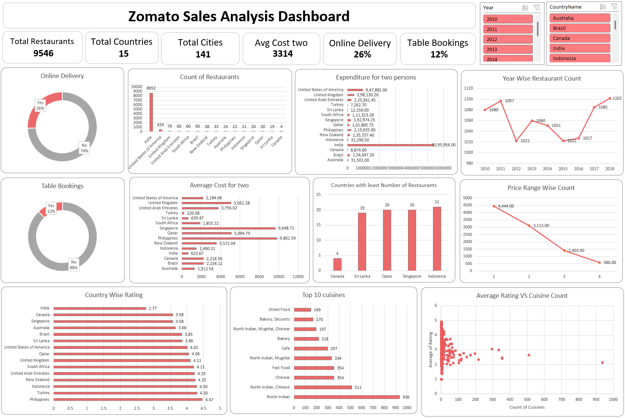
Dashboard

Slide 15
Thank You

