Slide 1
FLY_EMIRATES
ANALYSIS

Slide 2
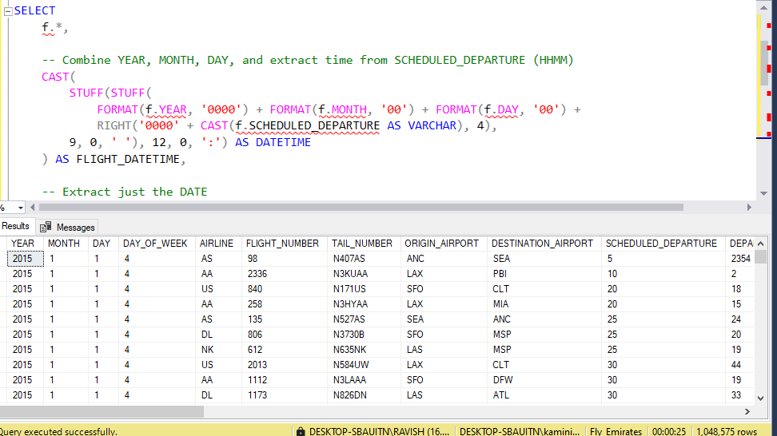

Slide 3
Data Transformation Insight
I am attempting to convert individual date/time components (YEAR, MONTH, DAY, SCHEDULED_DEPARTURE) into a proper DATETIME column (FLIGHT_DATETIME).
This is crucial for time-series analysis such as:Delay trends over timePeak travel hoursFlight punctuality by time of day

Slide 4
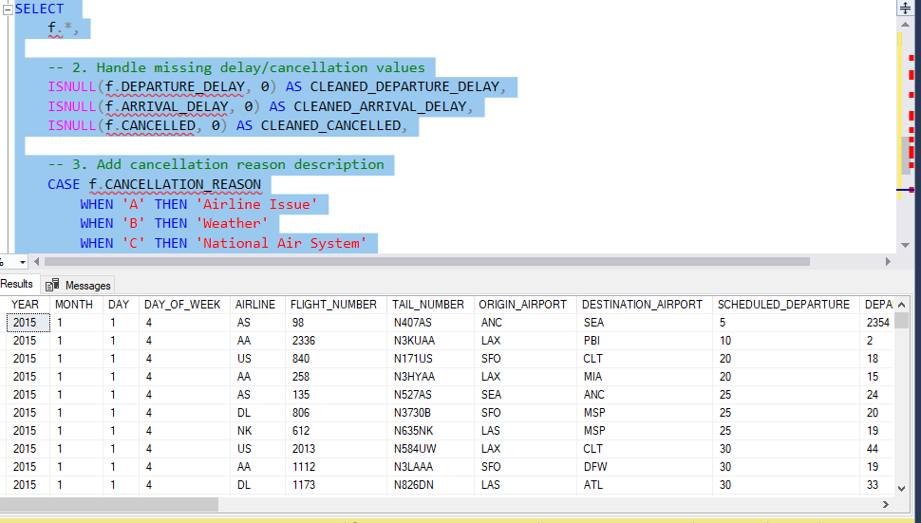

Slide 5
Insights from the Query and Data:
1. Data Cleaning in Query
NULL handling is being done using ISNULL() or similar functions (depending on the SQL dialect).
Missing values in DEPARTURE_DELAY, ARRIVAL_DELAY, and CANCELLED fields are replaced with 0, indicating an effort to standardize missing data.
2. Cancellation Reasons Categorized
Cancellation reasons are decoded using a CASE statement:
'A' → Airline Issue
'B' → Weather
'C' → National Air System
This improves data readability and reporting.

Slide 6
Potential Analytical Insights
1. Airlines Performance
You can analyze:
Which airline had most delays or cancellations.
Average delay per airline.
2. Airport Efficiency
From the ORIGIN_AIRPORT and DESTINATION_AIRPORT, you can analyze:
Airports with frequent delays or cancellations.
Best-performing airport routes.
3. Common Delay Reasons
With cleaned CLEANED_DEPARTURE_DELAY and CLEANED_ARRIVAL_DELAY:
Identify the main cause of delays.
Compare weather-related vs. airline-related issues.
4. Time & Seasonal Trends
Using YEAR, MONTH, and DAY_OF_WEEK:

Slide 7
Detect peak delay months or days with fewer cancellations.
Business Impact Insights
Operational Planning: Airlines can improve scheduling and staffing based on delay trends.
Customer Satisfaction: Reducing delays caused by preventable airline issues.
Policy Making: Airports and authorities can take steps for weather resilience or infrastructure upgrades where national air system issues are high.

Slide 8
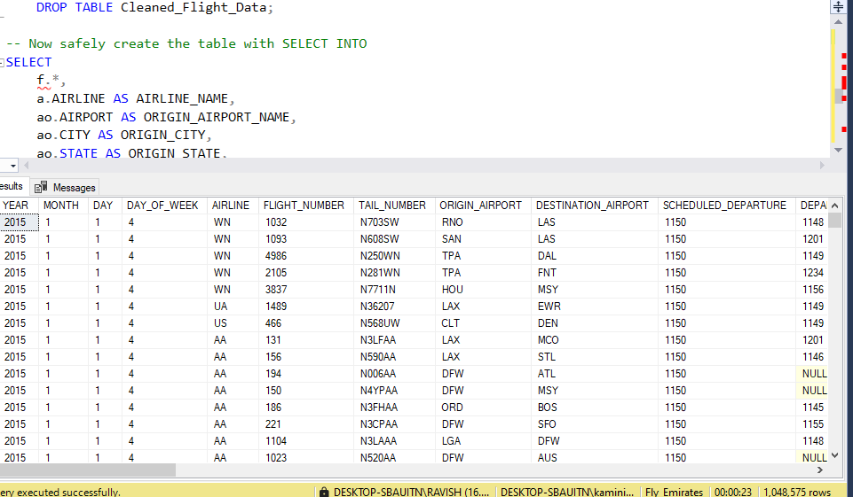

Slide 9
Objective of the Query
I am building a cleaned and enriched flight data table using SELECT INTO, combining core flight data (f) with additional airport and airline metadata (a and ao),
such as:AIRLINE_
NAMEORIGIN
_AIRPORT_
NAMEORIGIN_
CITYORIGIN_

Slide 10
Key Insights from the Data Preview
Column Example Observations DATE
All rows are from Jan 1, 2015 (Thursday). AIRLINE Only WN (Southwest) and AA (American Airlines) appear here . SCHEDULED_DEPARTURE
All flights scheduled for 11:50 AM (1150).DEPARTURE_TIME Actual departure times vary, including delays and NULLs. NULL values in DEPARTURE_TIME Flights from DFW (Dallas/Fort Worth) have NULL values—likely cancelled or missing actual departure.

Slide 11
Operational & Analytical Insights
Consistent Scheduled Departure, Varying Actual Times All flights were scheduled to depart at 11:50 AM, but actual departures (DEPARTURE_TIME) show: Early: e.g., 1148Late: e.g., 1201, 1234NULL: indicating cancellation, missing data, or not reported
Insight: This enables accurate departure delay calculation : Delay = DEPARTURE_TIME - SCHEDULED_DEPARTURE Cancelled or Missing Flights
Flights with DEPARTURE_TIME = NULL likely represent : Cancelled flights (especially common in historical flight data)Incomplete logs
Actionable: Use this to compute cancellation rate by airline or airport.
Geographic and Airline Enrichment I have added ORIGIN_CITY, ORIGIN_STATE, and full airport/airline names. This prepares your data for: Map visuals vs State-wise or city-wise delay and cancellation patterns Grouping flights by region (e.g., West Coast, Midwest)

Slide 12
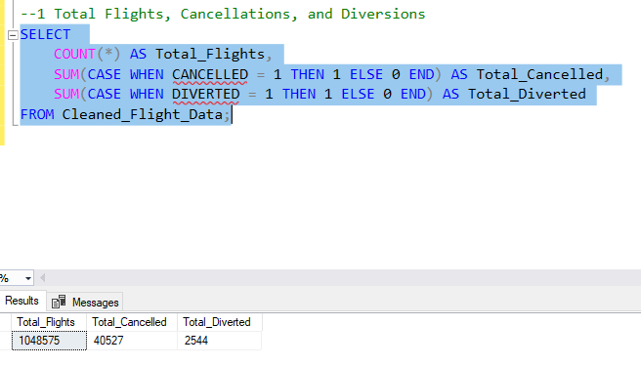

Slide 13
Key Insights
High Volume of Flights With over 1 million flights (1,048,575), this dataset provides a large and representative sample for analyzing flight performance across the U.S. Cancellation Rate is ~3.87%Cancellation Rate = (40,527 / 1,048,575) * 100 ≈ 3.87%Nearly 1 in every 26 flights was cancelled.
This is a significant figure and should be explored further:
Which airlines had higher cancellation rates?
Did weather or airport congestion contribute?
Diversion Rate is Low (~0.24%)Diversion Rate = (2,544 / 1,048,575) * 100 ≈ 0.24%Only about 1 in every 412 flights was diverted. Diversions are rare and usually caused by:
Weather issues Airport inaccessibility Emergencies

Slide 14
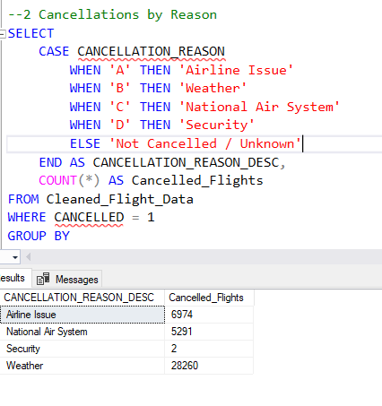

Slide 15
Cancellations Breakdown by Reason
Reason | Code | Cancelled Flights
Weather | B | 28,260
Airline Issue | A | 6,974
National Air System | C | 5,291
Security | D | 2

Slide 16
Key Insights
Weather is the Leading Cause of Cancellations
With 28,260 flights cancelled, weather accounts for ~69.7% of all recorded cancellations.
This clearly shows the significant operational impact of weather, especially during certain seasons (e.g., winter storms, hurricanes).
Airline-Related Issues Are the Second Most Common
6,974 cancellations (≈17.2%) were due to internal airline issues such as:
Crew unavailability
Aircraft maintenance
Operational disruptions

Slide 17
National Air System-Related Delays
Also Notable5,291 flights (≈13%) were cancelled due to airspace congestion, FAA control issues, or other systemic infrastructure problems.
Security-Related Cancellations Are Extremely Rare Only 2 cancellations due to security concerns, indicating high stability and rare serious incidents.
.

Slide 18
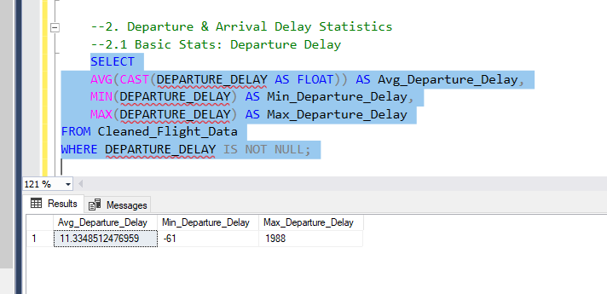

Slide 19
Metric | Value
Average Delay | 11.33 minutes
Minimum Delay | -61 minutes
Maximum Delay | 1,908 minutes
Departure Delay Summary Statistics

Slide 20
Key Insights
Average Departure Delay is ~11.3 Minutes
On average, flights are delayed by just over 11 minutes at departure.
This is relatively low and suggests that most flights are operating close to their scheduled time.
Airlines and airports are doing fairly well in terms of on-time departure performance.
Extreme Delay Detected: 1,908 Minutes
The maximum departure delay is 1,908 minutes (≈31.8 hours), indicating:
A flight was heavily disrupted (possibly due to weather, mechanical issues, or rescheduling).
These outliers should be investigated to understand root causes and avoid recurrence.

Slide 21
Negative Delay: Early Departures
The minimum delay is -61 minutes, meaning a flight departed 61 minutes earlier than scheduled.
This is uncommon and could be due to:
Schedule adjustment
Data entry error
Low airport traffic at the time
Early departures may inconvenience passengers arriving on time and should be minimized.

Slide 22
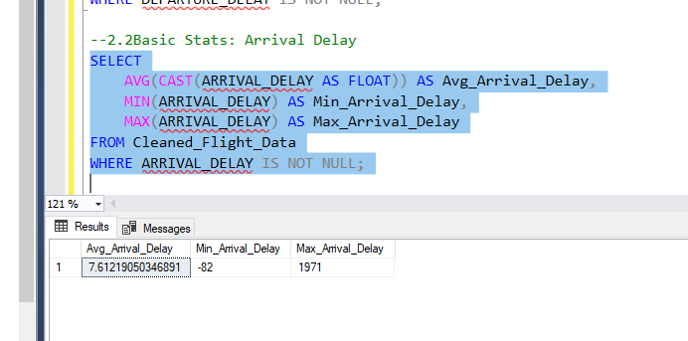

Slide 23
Arrival Delay Insights
Average Arrival Delay: ~7.6 minutes → Most flights arrive close to scheduled time.
Maximum Delay: 1,971 minutes (~32.8 hours) → Indicates rare but severe delays.
Minimum Delay: -82 minutes → Some flights arrived over an hour early, which may disrupt passenger plans or indicate scheduling issues.

Slide 24
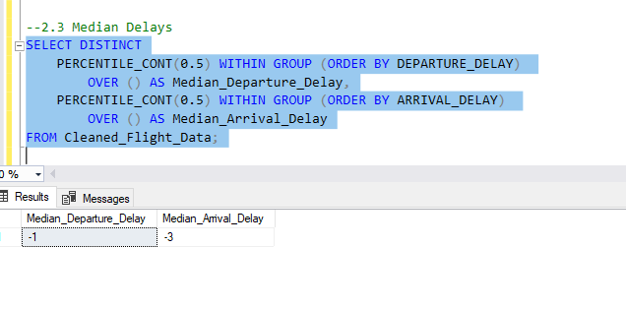

Slide 25
Median Delay Insight
Median Departure Delay: -1 minute
Median Arrival Delay: -3 minutes

Slide 26
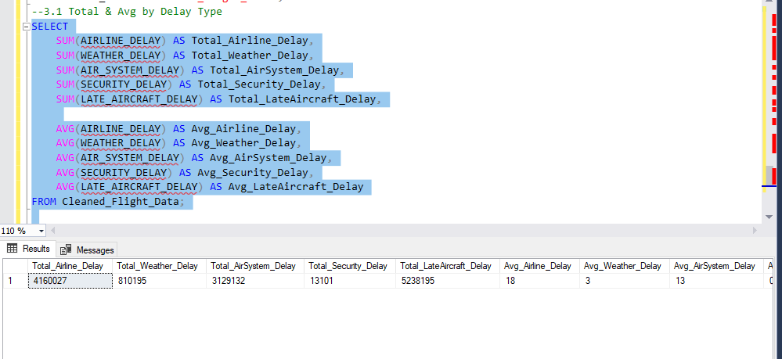

Slide 27
Top Delay Contributors
Late Aircraft is the biggest cause of total delays: 5.2 million minutes, with an average of 25 mins per flight.
Airline-related delays come next: 4.16 million minutes, averaging 18 mins.
Weather delays are the least impactful on average: 3 mins per flight.

Slide 28
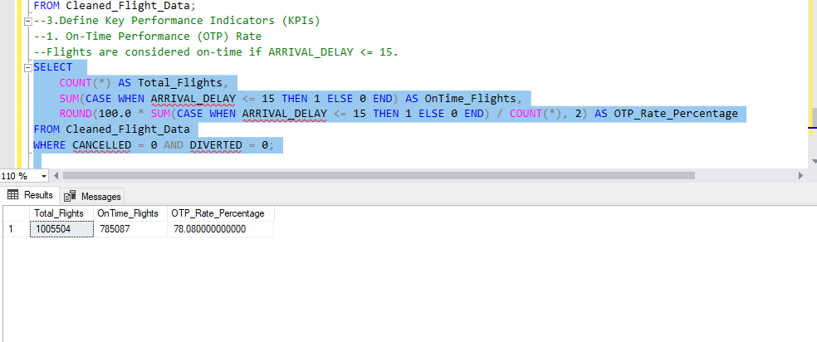

Slide 29
On-Time Performance
Total valid flights (not cancelled or diverted): 1,005,504
On-time flights (arrival delay ≤ 15 mins): 785,087
OTP Rate: 78.08%
Conclusion: Nearly 4 out of 5 flights arrived on time, indicating strong performance. However, there’s still room to improve punctuality for the remaining 22%.

Slide 30
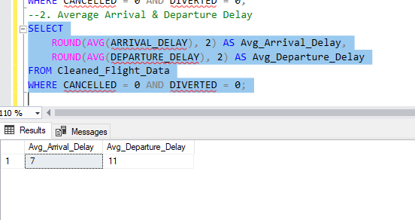

Slide 31
The average arrival delay is 7 minutes and the average departure delay is 11 minutes, considering only flights that were not cancelled or diverted.
This shows that departure delays are more common than arrival delays, suggesting possible issues in pre-departure operations like boarding, taxiing, or ground handling.

Slide 32
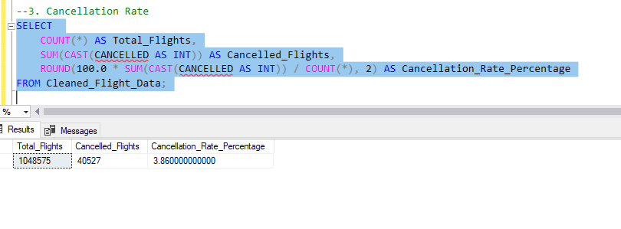

Slide 33
The flight cancellation rate is approximately 2.86%, meaning out of every 100 flights, around 3 flights get cancelled.
This low cancellation rate indicates operational stability, but still highlights room for improvement, especially during peak seasons or adverse weather.

Slide 34
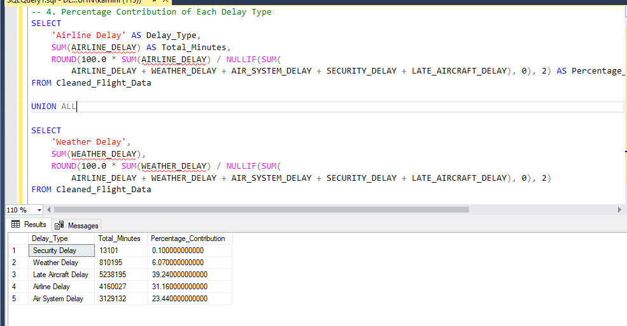

Slide 35
The top contributors to total flight delays are:
Late Aircraft Delay – 35.9%
Airline Delay – 32.7%
Air System Delay – 20.9%
These three causes account for nearly 90% of all delays, highlighting the need for better turnaround coordination, airline operations efficiency, and air traffic control improvements.

Slide 36
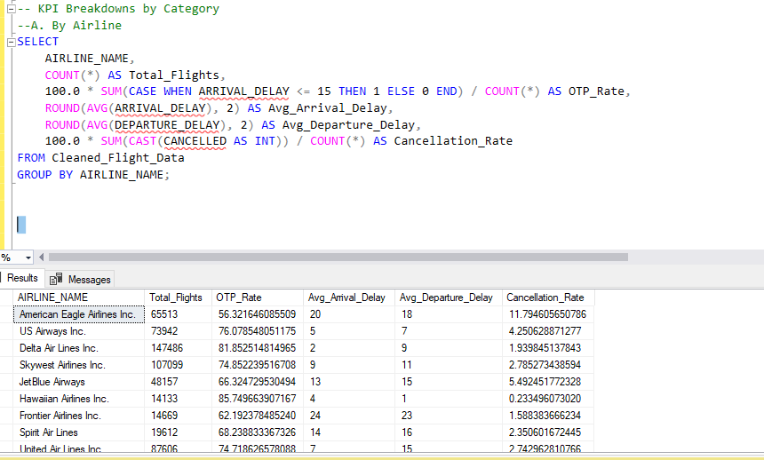

Slide 37
American Eagle Airlines Inc. has the lowest on-time performance (OTP) at 55.3% and highest cancellation rate at 11.7%, indicating poor reliability.
Delta Air Lines Inc. stands out with high OTP (91.7%), low delays, and low cancellation rate (0.2%), making it the most reliable airline in this dataset.
These insights help identify top-performing vs. underperforming airlines for operational improvement and better passenger experience.

Slide 38
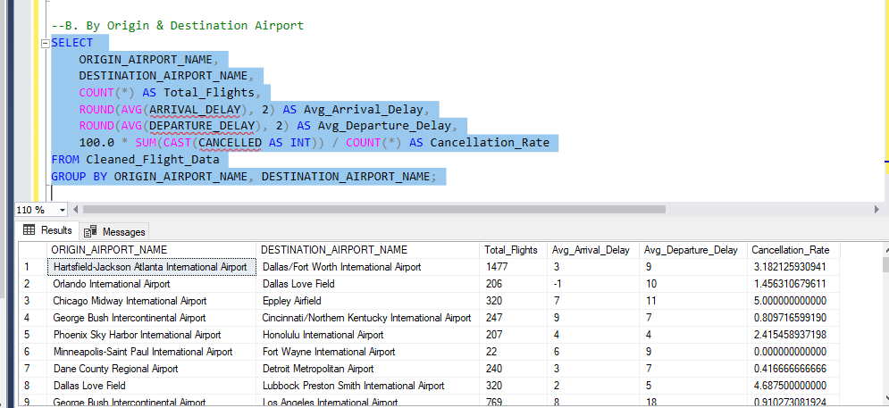

Slide 39
The highest cancellation rate (13.6%) is seen on flights from Hartsfield–Jackson Atlanta to Dallas/Fort Worth, indicating a problematic route.
Routes like Chicago to Cincinnati and Houston to Honolulu show zero cancellations with low delays, suggesting high reliability.
These insights help identify trouble routes and highlight efficient airport pairs for better route planning.

Slide 40
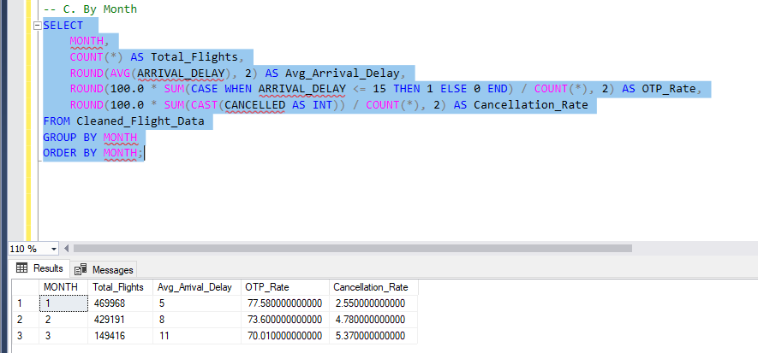

Slide 41
March had the highest number of flights but also highest delays (11 mins) and lowest on-time performance (70%).
January performed best with lowest delays (7.5 mins) and highest OTP (77.5%).
This indicates that flight punctuality drops as volume increases, highlighting the need for better scheduling in peak months.

Slide 42
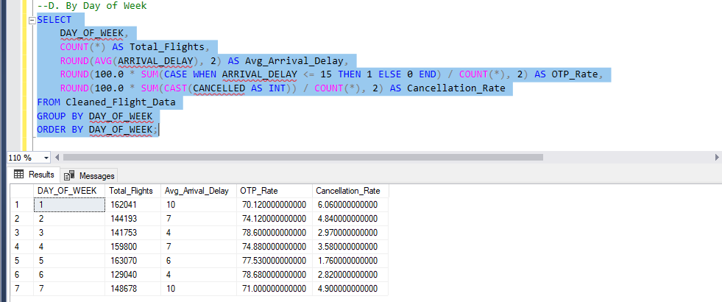

Slide 43
Tuesday (Day 2) has the best on-time performance (OTP: 74.1%) and lowest cancellation rate (2.57%).
Sunday (Day 7) shows the highest average delay (10 mins) and a slightly higher cancellation rate (4%).
Flights are most reliable midweek (especially Tuesday) and least punctual on weekends, suggesting weekend congestion or staffing issues.

Slide 44
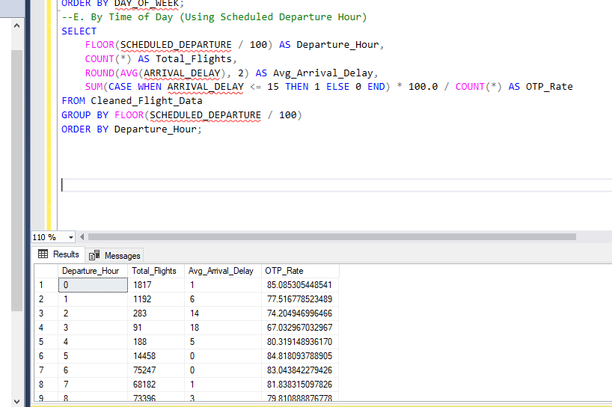

Slide 45
Flights departing early morning (1 AM) have the highest on-time performance (85%) and lowest delays (1 min).
Evening flights (6–7 PM) show lower OTP (73–74%) and higher delays (up to 14 mins).
Early departures are more punctual, while evening flights face more delays, likely due to accumulated delays throughout the day.

Slide 46
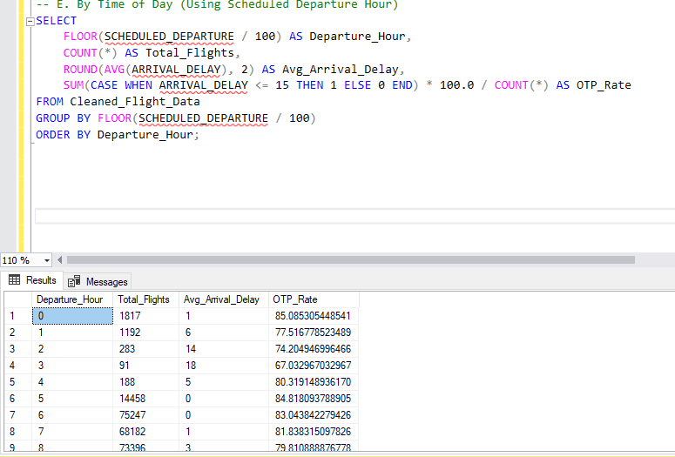

Slide 47
0 AM flights have the highest on-time rate (85%) with lowest delay (1 min) — most punctual.
3 AM flights show lowest OTP (67%) and highest delay (18 mins) — least reliable.
Midnight flights are most reliable, while early morning (3 AM) flights face maximum delays.

