Slide 1
BikeDekho

Slide 2
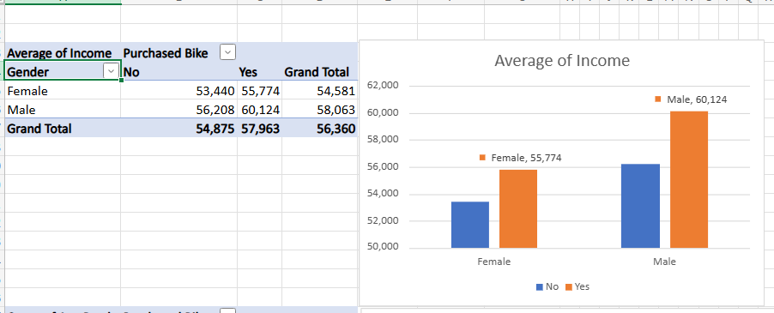

Slide 3
Overall Income by Gender:Males have a significantly higher average income (₹58,063) than females (₹54,581).
Impact of Bike Purchase on Income:For both genders, those who purchased a bike have higher average income than those who did not:
Females:
Purchased: ₹55,774Did not purchase: ₹53,440
Difference: ₹2,334
Males:
Purchased: ₹60,124
Did not purchase: ₹56,208
Difference: ₹3,916
Gender-wise Gap Among Buyers:
Among those who purchased a bike:
Males (₹60,124) earn more than females (₹55,774) — a gap of ₹4,350.
This suggests a gender income gap persists even among bike purchasers.

Slide 4
General Observation: Higher income is positively associated with the likelihood of purchasing a bike.
The pattern is consistent across both genders, indicating income plays a key role in purchasing decisions.
Business Interpretation:
Marketing strategies for high-end bikes could target higher-income segments, especially males.
Income-based segmentation can be effective in tailoring promotions.
Gender-focused outreach may help address disparity and increase conversion among female customers.

Slide 5
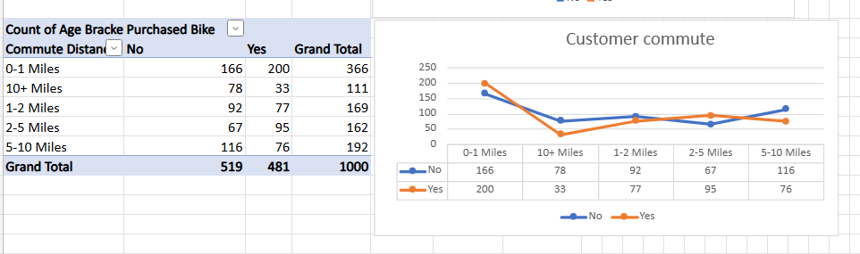

Slide 6
Key Insights:1. Customers with Very Short Commutes (0–1 Miles)
Highest number of total customers: 366More people purchased a bike (200) than didn’t (166)
Insight: People living very close to work may prefer bikes for short, quick rides—convenience seems to drive purchases.
Long Commutes (10+ Miles):
Least likely to purchase a bike: only 33 buyers out of 111
Majority did not purchase a bike (78)
Insight: Customers with long commutes may find bikes impractical for distance or may prefer other transport (e.g., public transport or cars).
Moderate Commute Ranges (1–5 Miles):
Balanced behavior:
1–2 Miles: 92 (No), 77 (Yes) → slightly more non-buyers
2–5 Miles: 67 (No), 95 (Yes) → more buyers than non-buyers
Insight: For these ranges, bike purchase becomes more appealing and practical. Especially for 2–5 miles, more people are buying bikes.

Slide 7
Commute Distance of 5–10 Miles:Reverse trend: More people did not purchase bikes (116) than those who did (76)
Insight: As commute distance increases beyond 5 miles, the likelihood of buying a bike decreases again.
Overall Pattern:
There is a U-shaped relationship:
High bike purchase at very short (0–1 miles) and moderate distances (2–5 miles)
Lower bike purchase at very long (10+ miles) and some mid-range distances (5–10 miles)
Business Interpretation:
Target bike marketing toward:
Customers commuting under 1 mile (for convenience)
And 2–5 miles (for practicality)
Avoid spending heavily on customers with 10+ miles commutes, as they are least likely to buy.
Consider offering electric bikes or other solutions for the 5–10 miles and 10+ miles groups.

Slide 8
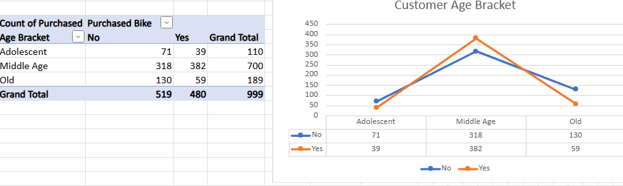

Slide 9
Key Insights:
Middle-Aged Customers (most active segment)
Largest group overall: 700 customers
Majority purchased bikes: 382 (Yes) vs 318 (No)
Insight: Middle-aged customers are the most engaged segment and show the highest conversion rate for bike purchases.
Likely due to financial stability, regular commuting needs, or lifestyle convenience.
Adolescents:
Total: 110 customers
Fewer purchases: Only 39 purchased, 71 did not
Insight: Low conversion rate — possibly due to:
Dependence on parents
Lack of income
Preference for public transport or other interests

Slide 10
Older Adults:
Total: 189 customers
Also lower purchases: 59 (Yes), 130 (No)
Insight: Older adults are less likely to purchase bikes, possibly due to
Reduced mobility Less need for daily commuting Preference for comfort over convenience
Overall Trend:
Middle-aged group dominates both in size and in bike purchases.
Adolescents and older adults show relatively low purchasing behavior.
The chart reflects a peak in purchase activity during middle age, forming a bell-shaped pattern.
Business Interpretation:
Focus marketing and sales efforts on the middle-aged demographic, especially urban professionals and daily commuters.
For adolescents:
Consider marketing low-cost bikes or family bundle offers (targeting parents).
For older customers:
Explore comfort-oriented bikes or e-bikes for leisure rather than commuting.

Slide 11
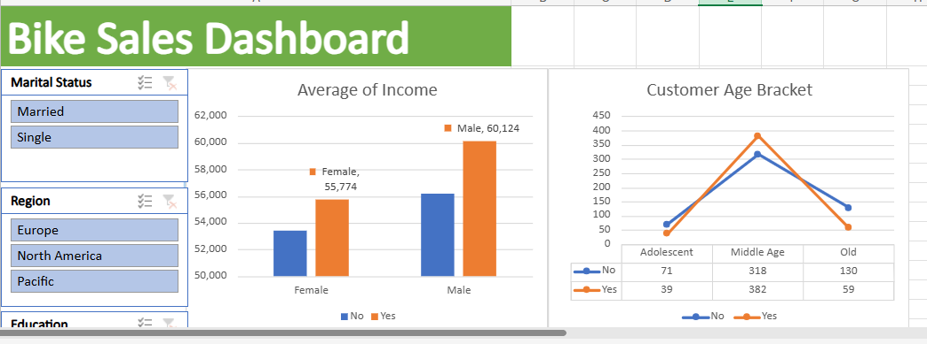

Slide 12
