Slide 1
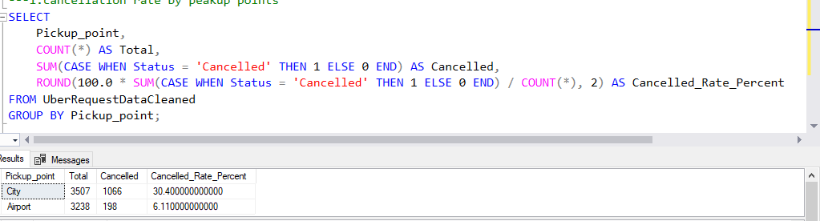
1.cancellation rate by peak up points

Slide 2
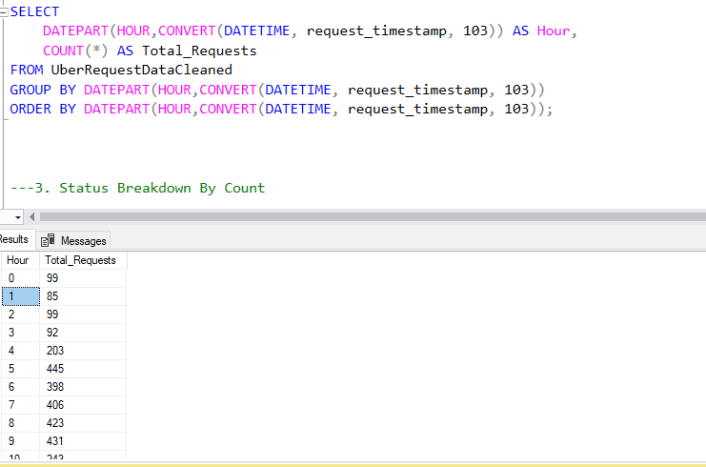
2.Peak Request Hour

Slide 3
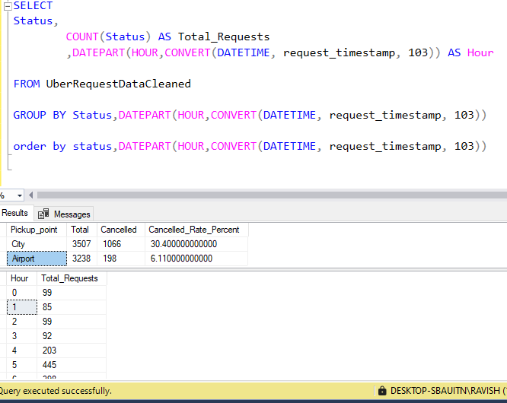
3. Status Breakdown By Count

Slide 4
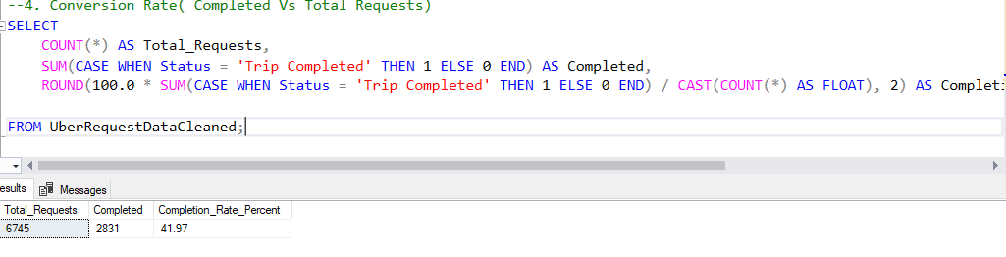
Conversion Rate( Completed Vs Total Requests)

