Slide 1
The Secret in Wine
By Group number: students names

Slide 2

Introduction
Vinho Verde is a unique natural beverage and a highly regarded wine from the northwest region of Portugal
From 1997 to 2007, exports of vinho verde have increased by 36%
Experts graded the quality of red and white vinho verde wine samples based on physicochemical properties
We got the wine quality datasets from UCI Machine Learning Repository

Slide 3
Objective and Methodology
To find out significant physical and chemical properties causing high quality wine
Apply logistic regression analysis

Slide 4
Data Description
There are two datasets: red wine and white wine
1599 samples for red, 4898 samples for white
11 continuous variables (predictors)
Fixed acidity, volatile acidity, citric acid, residual sugar, chlorides, free sulfur dioxide, total sulfur dioxide, density, pH, sulphates, alcohol
1 categorical variable (response)
Quality [ordinal: from 0 (very bad) to 10 (very excellent) ]
At least 3 evaluation from wine experts

Slide 5
Data Adjusting
Transform quality from ordinal to binary by setting the cut-off for quality of red wine and white wine
Histogram and quantile tables
Scale variables to avoid insignificant odds ratio
Boxplot of small ranges of some variables

Slide 6
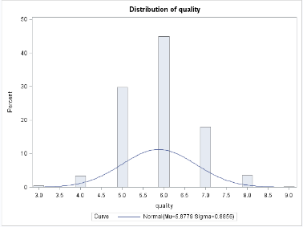
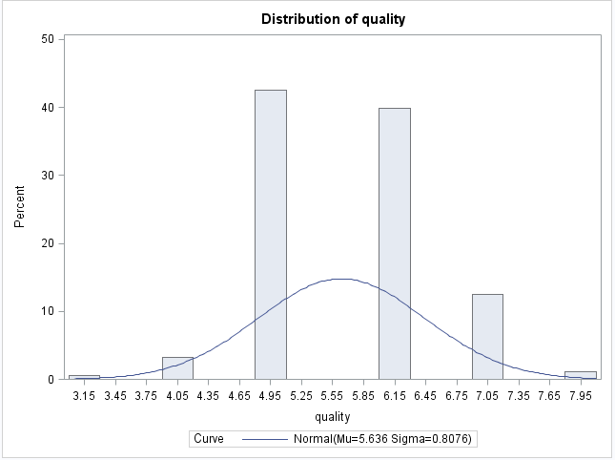


White Wine
Red Wine
We observed from measures of location for white and red wine that top 10% have quality equal or greater than 7
Set 7 as quality cut-off, transforming response variable to binary

Slide 7
Set Cut-off for Quality
If quality is equal or greater than 7, set quality = 1 and classify as high quality wine;
otherwise, set quality = 0 and classify as low quality wine
We modeled 1 cases since our intention on high quality

Slide 8
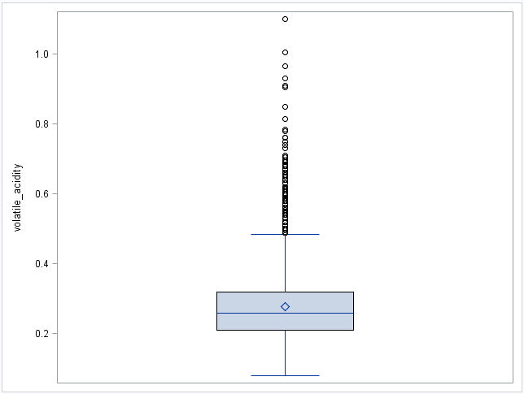
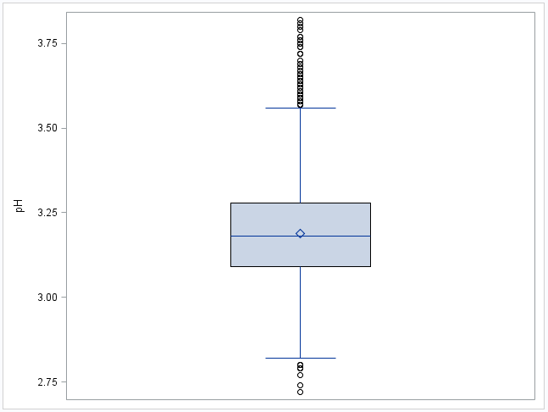
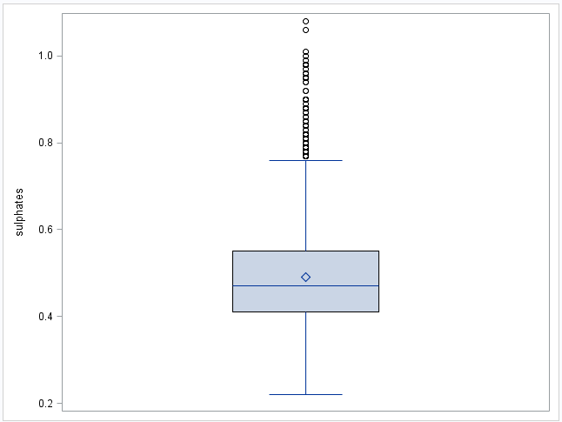
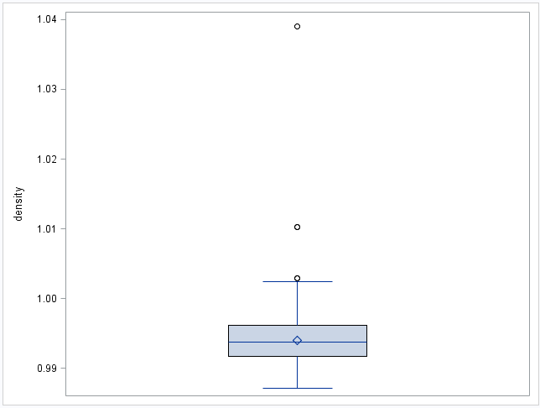
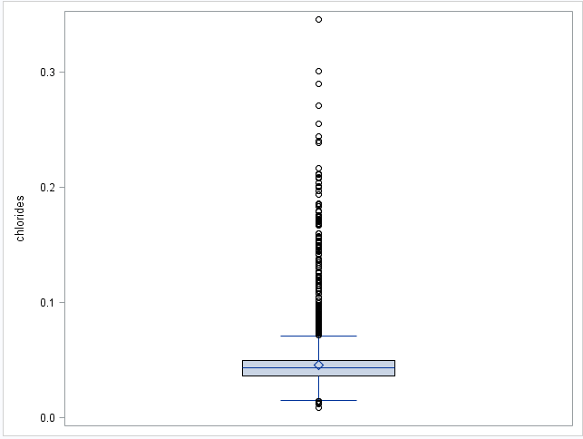
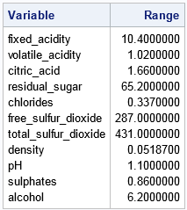
These continuous variables have range around or less than 1 that motivates us to scale

Slide 9
Scaling variables
We interpret the odds ratio estimates as: for a one unit change in the predictor variable, the odds ratio for a positive outcome is expected to change by the respective coefficient while others hold constant
Chl = chlorides * 100
Den = density * 1000
Vol = volatile_acidity * 10
Sul = sulphates *10
Ph_value = pH*100
Chlorides | Density | Volatile_acidity | Sulphates | pH
0.045 | 0.99400 | 0.270 | 0.45 | 3.00
0.049 | 0.99510 | 0.300 | 0.49 | 3.30
0.050 | 0.99560 | 0.280 | 0.44 | 3.26

Slide 10
Correlations
There are some positive and negative correlations between predictor variables, but most of them are under 0.4
We didn’t worry about multicollinearity issue since variance inflation factor (VIF) are all less than 10
Since all VIFs are less than 10 in multiple regression, we concluded that most of information from a specific predictor is not a linear combination of other predictors

Slide 11
Logistic Regression for White Wine
Selection method: Backward selection
Variable removed:
total_sulfur_dioxide
alcohol
citric_acid

Slide 12
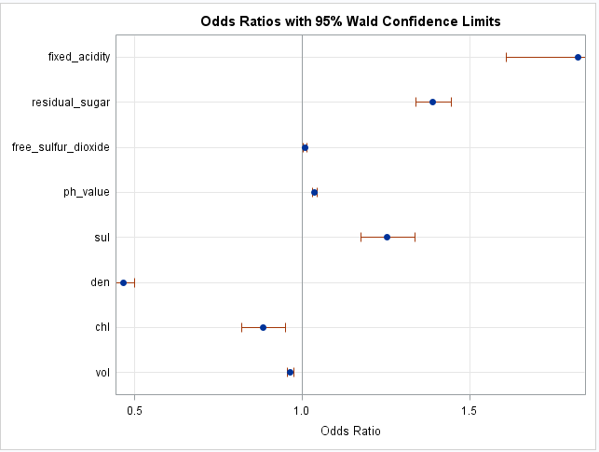
Odds Ratio
Odds Ratio Estimates and Wald Confidence Intervals
Label | Estimate | 95% Confidence Limits
fixed_acidity | 1.823 | 1.610 | 2.065
residual_sugar | 1.391 | 1.339 | 1.444
free_sulfur_dioxide | 1.008 | 1.003 | 1.013
ph_value | 1.037 | 1.031 | 1.044
sul | 1.254 | 1.176 | 1.338
den | 0.466 | 0.434 | 0.499
chl | 0.883 | 0.820 | 0.950
vol | 0.701 | 0.641 | 0.767
None of these intervals include 1, so they are all significant;
Density and Fixed Acidity have the most significant effect
Free sulfur dioxide has the least significant effect

Slide 13
Interpretation for White Wine
1. Higher fixed acidity
2. Additional residual sugar
3. Greater free sulfur dioxide and sulphates
4. Increasing pH value
1. More tartness
2. Sweeter
3. Protect the wine from oxidation and improve aroma
4. Rounder and softer mouth feel
High quality
1. Denser
2. Increasing chlorides
3. Higher volatile acidity
1. Dryer
2. Salty
3. Distinct smell of vinegar
Low quality

Slide 14
Logistic Regression for Red Wine
Selection Method: Backward selection
Variables removed:
ph_value
citric_acid
free_sulfur_dioxide

Slide 15
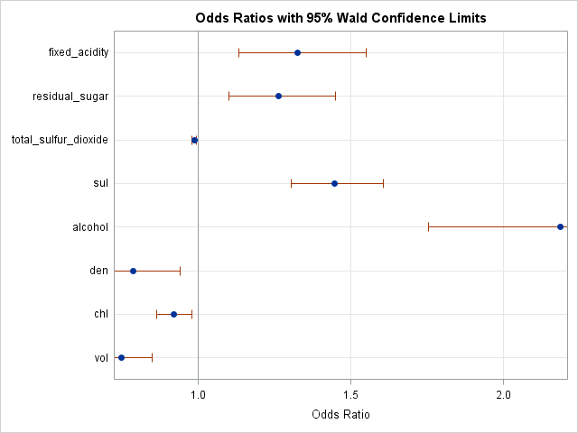
Odds Ratio
None of these intervals include 1, so change in predictors will cause differences for red wine quality
Alcohol has the most significant effect
Total sulfur dioxide has least significant effect

Slide 16
Interpretation for Red Wine
Odds Ratio Estimates and Wald Confidence Intervals
Label | Estimate | 95% Confidence Limits
fixed_acidity | 1.325 | 1.132 | 1.550
residual_sugar | 1.262 | 1.100 | 1.448
total_sulfur_dioxide | 0.986 | 0.980 | 0.993
sul | 1.448 | 1.305 | 1.606
alcohol | 2.186 | 1.755 | 2.723
den | 0.786 | 0.656 | 0.941
chl | 0.919 | 0.862 | 0.980
vol | 0.747 | 0.658 | 0.848
Total sulfur dioxide, density, chlorides and volatile acidity have negative effects
Fixed acidity, residual sugar, sulphates and alcohol have positive effects
Compared to white wine
density has less negative effect
alcohol has significant impact on red wine

Slide 17
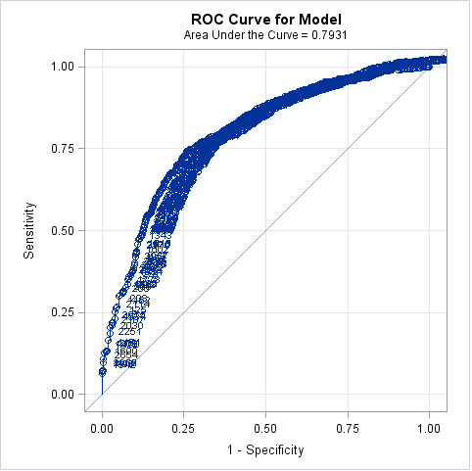
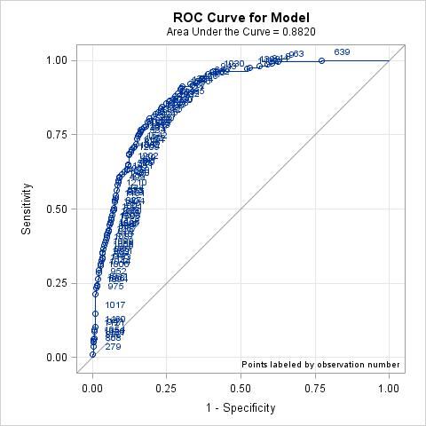
Fitness of Logistic Regression
We found that logistic regression analysis fit both white and red wine data
79% white wine and 88% red wine samples are correctly predicted by models

Slide 18
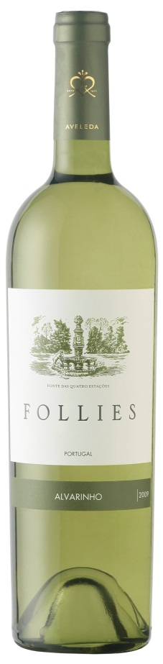
Summary for White Wine
Additional fixed acidity, residual sugar, free SO₂, pH, sulphates contribute to high quality
Increasing density, chlorides and volatile acidity results in lower probability of higher quality
Total SO₂, alcohol and citric acid have no significant effect on quality of white wine

Slide 19
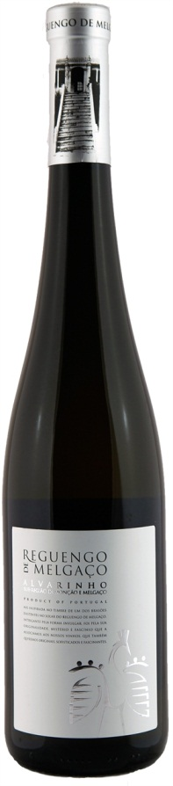
Summary for Red Wine
Additional fixed acidity, residual sugar, sulphates and alcohol cause high quality
Increasing amounts in volatile acidity, chlorides, total SO₂ and density result in lower probability of higher quality
pH, citric acid and free SO₂ have no significant effect on quality of red wine

Slide 20

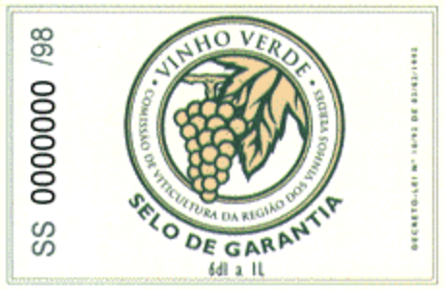

Summary
For both high quality red and white wine, fixed acidity, residual sugar, and sulphates are higher while volatile acidity, chlorides are lower
Since most wine labels only write alcohol and sugar content , we recommend first tasters to try high sugar ones

