Slide 1
Etosha Workspace
Overview version 0.9 (September 2016)

Slide 2
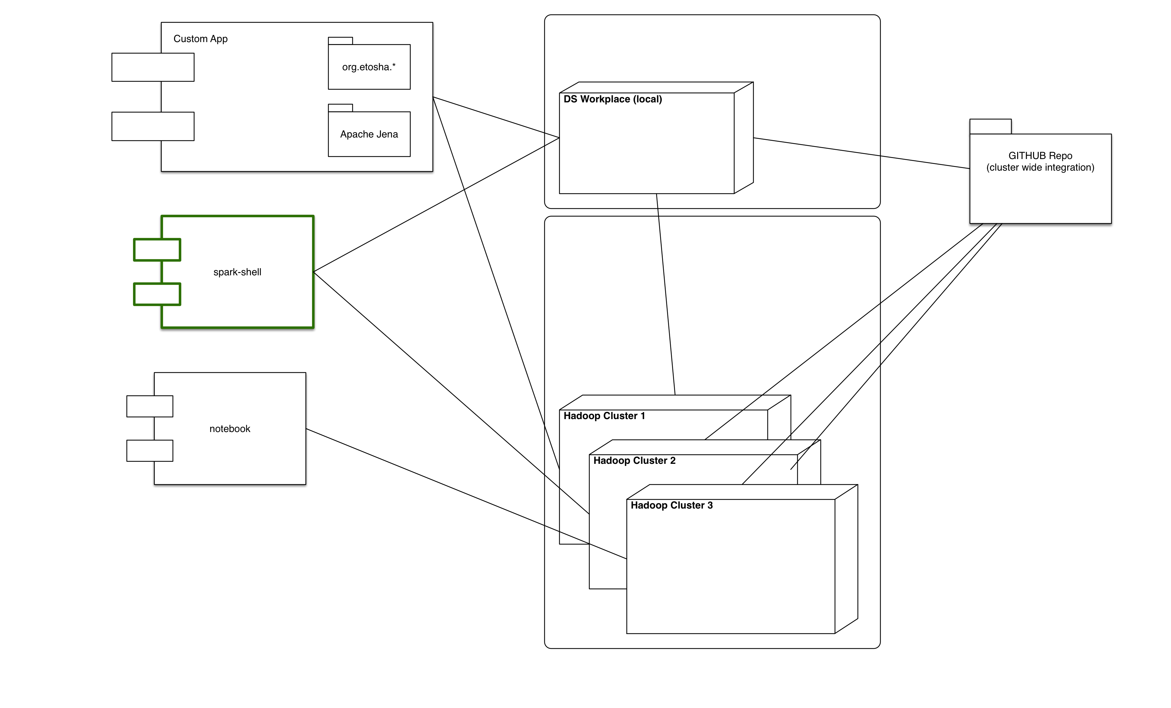
Cluster Spanning Metadata Integration

Slide 3
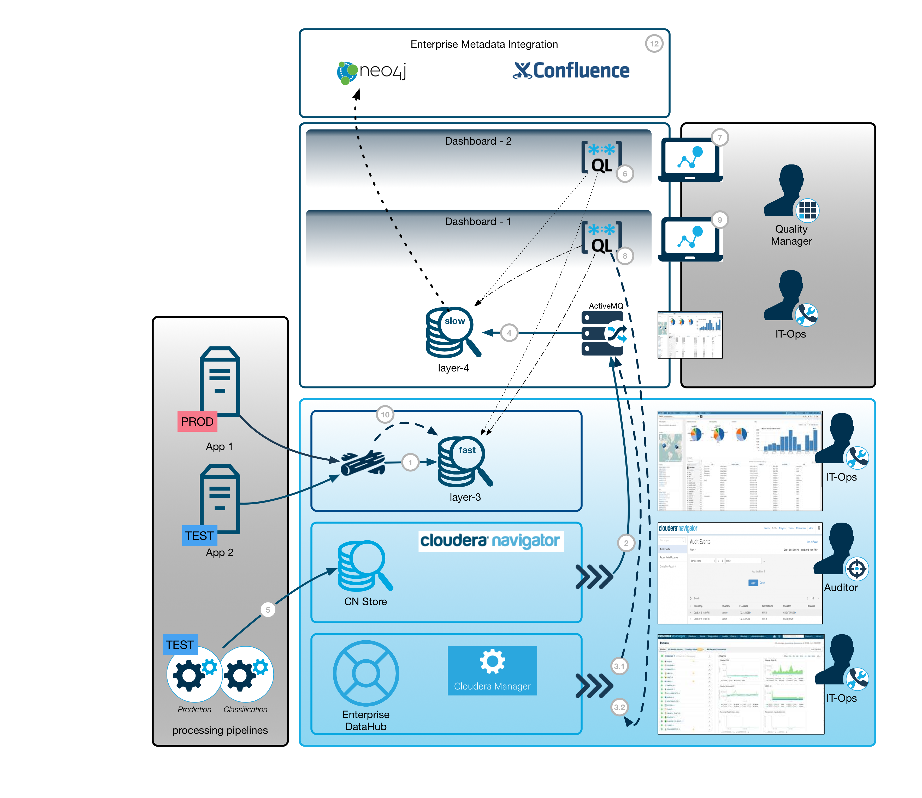
Metadata Exposure

Slide 4
Multi-Cluster Mode : WHAT is this?
EDH typical holds data for continuous analysis of data in real time.
Cheap cloud storage, or integration clusters are used to hold aggregated data sets for temporal but recurring usage:
incremental growth
not permanently needed
Transient clusters generate and process aggregated data.

Slide 5
Multi-Cluster Mode : HOW?
Metadata (about datasets and Hadoop clusters) allow generation of data migration procedures (see: Skool project from BT).
Automatic “function-push-down” on algorithm level:
Indexing of node data.
Analysis of time series data, incl. functional network extraction.
Graph analysis in parallel (in different clusters)
Automatic data migration for intermediate results
=> Map-phase
=> Reduce-phase

Slide 6
Pseudo-Multi-Cluster Mode
Extracts of real data
prototyping and algorithmic tuning/optimizations
Training procedures and model fitting on small subsets
Metadata
Procedure analysis:
Cost estimation
Compliance checks
Consistency checks
No automatic “function-push-down” on algorithm level

Slide 7
About the Workbench concept:
Storage location is HDFS in one cluster
Currently, there is only pseudo-multi-cluster support under construction.
An Etosha-workspace contains (meta)data for a particular project
Typically, an HDFS cluster is used for a workspace.
An S3 bucket can be used as well.
Multiple workspaces can coexist in one HDFS cluster.
Dataset descriptors provide valuable information about the dataset if it can not be copied (if it is too large or if the policies do not allow a copy).
Algorithmic prototyping will help to negotiate access roles and techniques based on preliminary results.

Slide 8
Data Architecture: Workspace structure
Extract Structure
Collect Raw data
Preprocess (ETL)
Model creation
Expose Model
Apply Model
Partitioned RDF Graph (SPARQL)
Lucene Index (full text search, node similarity)
Similarity Network(s) Functional Network(s)
^
Extract of Raw Data (nodes)
^
Time Series Buckets (incl. Metadata)
(corpus was renamed to buckets)

Slide 9
./WORKBENCH/DEMO-WS
DEMO-WS folder is the Workspace and a subfolder in the WORKBENCH folder.
Data for demo use-cases are collected in this place.
Collaboration between software engineers, data scientists, and researchers can start in this place.
The WORKBENCH folder can contain multiple WS (workspace folders)
This maps directly to the Eclipse workspace structure.

Slide 10
DSP Model
Provide a list of Elements in the DSP model
We use Neo4J to represent the DSP in a property graph.
An RDF representation is generated using Apache Jena. This model files can be loaded, using the FusekiCloud service.
Model creation is based on semantic logging. This means, relevant well known facts are directly exposed already during runtime and during data analysis procedures, rather than crawling the logs.
Log based metadata management coexists and allows advanced consistency checks.

Slide 11
DSP-Domain Model
Purpose of this classe is representation of data, flow, owners, systems etc. as entities. It is the static view of the system which describes relations, dependencies, history etc.
Simply describe the system and expose knowledge in a machine readable form.

Slide 12
DSP-Process Model
Purpose of this classes is representation and control of dataset lifecycles, e.g. during distributed analysis workflows. It is the dynamic view of the system which describes the current state, history and possible future.
Track the life cycle and build a bridge between business and technical metadata.

Slide 13
Model Store (1) Local files (single user)
Simply store model data locally on a workstation
Folder: $user.home/etosha

Slide 14
Model Store (2) Cluster Local files (multi user)
Store all model files in HDFS for reliability
HDFS: /etosha/CLUSTER-ID/USER/ … (model files)
CLUSTER-ID: same as HDFS-ID

Slide 15
The Etosha Tripple Collector Service (build on FUSEKI)
{
"name" : "ETCS",
"label" : "ETCS",
"description" : "The Etosha Tripple Collector Service (build on FUSEKI)",
"version" : "1.0",
"icon" : "images/etcs.png",
"rolesWithExternalLinks" : ["ETC_SERVICE"],
"runAs" : {
"user" : "root",
"group" : "root"
},
"roles" : [
{
"name" : "ETC_SERVICE",
"label" : "ETC Service",
"pluralLabel" : "ETC Services",
"parameters" : [
{
"name" : "port_num",
"label" : "Fuseki Web UI port",
"description" : "The Fuseki Web UI port number",
"required" : "true",
"type" : "port",
"default" : 9200
}
],
"externalLink" : {
"name" : "fuseki_web_ui",
"label" : "Fuseki Web UI UI",
"url" : "http://${host}:${port_num}$"
},
"topology" : {
"minInstances" : "1",
"maxInstances" : "1"
},
"startRunner" : {
"program" : "scripts/control.sh",
"args" : [ "start" ],
"environmentVariables" : {
"WEBSERVER_PORT" : "${port_num}"
}
}
}
]
}

Slide 16
Fuseki & FusekiCloud
Import all model files from multiple clusters
HDFS:/etosha/CLOUD-ID/CLUSTER-ID/USER/ … (model files)
Query using SPARQL
Use multiple Fuseki servers
Expose data to other triple stores
Manage collaboration via GITHUB binding on a node’s local disc

Slide 17
The Etosha Model Integrator Service (build on FUSEKI CLOUD and GIT)
{
"name" : "ETCS",
"label" : "ETCS",
"description" : "The Etosha Tripple Collector Service (build on FUSEKI)",
"version" : "1.0",
"icon" : "images/etcs.png",
"rolesWithExternalLinks" : ["ETC_SERVICE"],
"runAs" : {
"user" : "root",
"group" : "root"
},
"roles" : [
{
"name" : "ETC_SERVICE",
"label" : "ETC Service",
"pluralLabel" : "ETC Services",
"parameters" : [
{
"name" : "port_num",
"label" : "Fuseki Web UI port",
"description" : "The Fuseki Web UI port number",
"required" : "true",
"type" : "port",
"default" : 9200
}
],
"externalLink" : {
"name" : "fuseki_web_ui",
"label" : "Fuseki Web UI UI",
"url" : "http://${host}:${port_num}$"
},
"topology" : {
"minInstances" : "1",
"maxInstances" : "1"
},
"startRunner" : {
"program" : "scripts/control.sh",
"args" : [ "start" ],
"environmentVariables" : {
"WEBSERVER_PORT" : "${port_num}"
}
}
}
]
}

