Slide 1




Final Project of TIC Information and Communication Technologies ICT & Technologies related to ICT
Group 8 Members :
BALAMAN Hala Hadjer BOUDIAF Aisha HAMZA Noor Nacera KAMIRI Lilia YAHYAOUI Chahinez

Slide 2

Table of Contents:
Introduction ………………………………………………..
History and evolution of TIC………………………..............
The impact of TIC…………………………………………...
Technologies related to TIC …………………………………
The future of TIC…………………………………………….
Conclusion …………………………………………………..

Slide 3
Introduction
Information and Communication Technologies (ICT) represent a broad category encompassing a range of technologies designed to facilitate the acquisition, storage, processing, and dissemination of information. It includes computing technologies like servers, laptop computers and software applications, as well as the wired and wireless communication technologies that support telephones and the Internet.
ICT is often used as a synonym for information technology (IT), but the two terms can have slightly different meanings when used in different contexts. In some industries, IT only applies to enterprise computing, while the broader label ICT encompasses both IT and communication technologies. Therefore, IT is often considered to be a subset of ICT that deals with the technical aspects of managing information, while ICT is a broader term that encompasses both IT and communication technologies.
Over the past few decades, ICT has become an integral part of modern society, influencing how we communicate, work, learn, and conduct business.

Slide 4
History and evolution of TIC
Information and Communication Technology (ICT) has undergone tremendous changes since its beginning. The evolution of ICT applications has been driven by technological advancements, changing user needs, and the desire for greater efficiency and effectiveness in communication and information management. This evolution had undergone major stages:
Stage 1: The Emergence of Telecommunications :
The first stage of ICT applications was marked by the emergence of telecommunications. This began in the early 19th century with the invention of the telegraph, which revolutionized communication by allowing messages to be transmitted across long distances in a matter of minutes. Later, the invention of the telephone in the late 19th century enabled people to communicate in real-time, allowing for faster and more efficient communication.

Slide 5
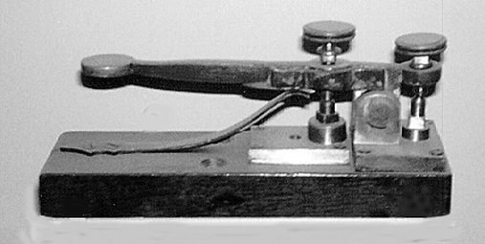
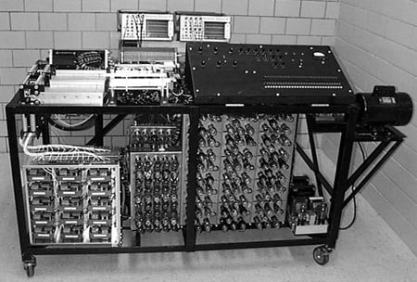
Stage 2: The Rise of Computing :
The second stage of ICT applications was marked by the rise of computing. This began in the mid-20th century with the invention of the first electronic computers. These early computers were large and expensive, and were used primarily by government agencies and large corporations. However, as technology advanced, computers became smaller, faster, and more affordable, making them accessible to a wider range of users.
Figure 1: a Telegraph
Figure 2 : First electronic computer

Slide 6
Stage 3: The Emergence of the Internet
The third stage of ICT applications was marked by the emergence of the internet. This began in the late 20th century with the creation of the World Wide Web, which allowed for the sharing of information across networks. The internet revolutionized communication by enabling people to communicate and share information across vast distances in real-time. The emergence of the internet also led to the creation of new industries and business models, such as e-commerce, social media, and online advertising.
Stage 4: The Rise of Mobile Computing
The fourth stage of ICT applications was marked by the rise of mobile computing. This began in the early 21st century with the invention of smartphones and tablets. Mobile computing allowed for greater mobility and flexibility, enabling people to access information and communicate from anywhere at any time. The emergence of mobile computing also led to the creation of new industries and business models, such as mobile apps and mobile advertising

Slide 7

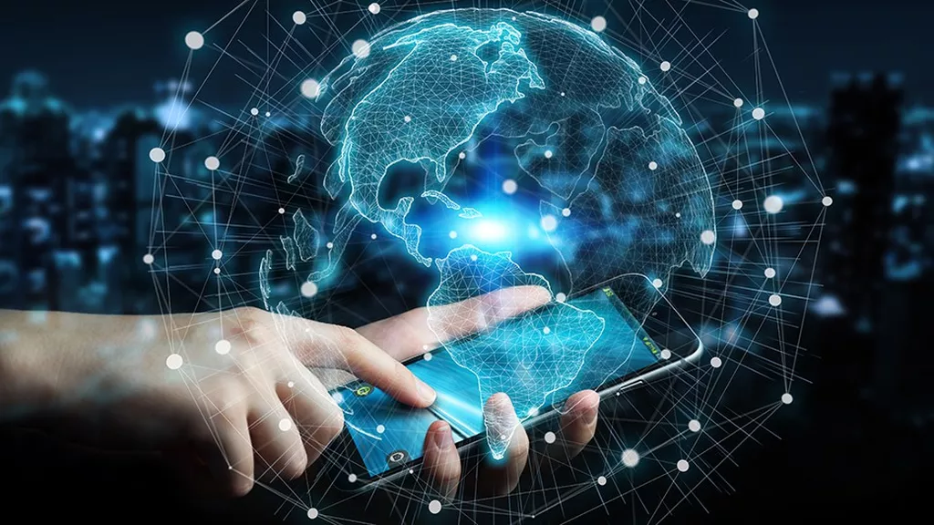
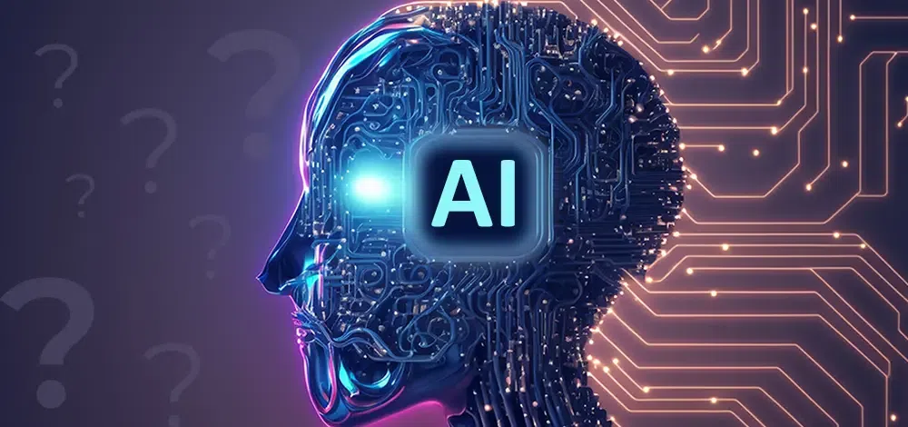
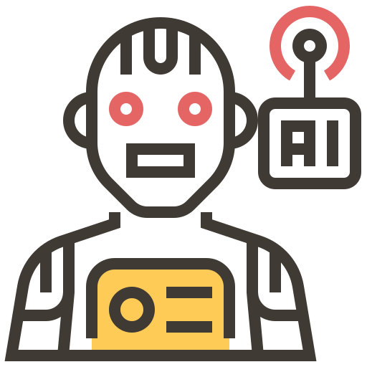
Stage 5: The Emergence of Artificial Intelligence
The fifth stage of ICT applications is currently underway and is marked by the emergence of Artificial Intelligence (AI). AI is a field of computer science that involves the development of algorithms and computer programs that can perform tasks that typically require human intelligence, such as visual perception, speech recognition, and decision-making. AI has the potential to revolutionize the way we work and live by enabling greater automation, efficiency, and accuracy in various industries and fields.
Figure 3 : Internet
Figure 4 : Artificial Intelligence

Slide 8

The Impact of ICT:
The impact of Information and Communication Technology (ICT) is profound and pervasive across various aspects of society and individual lives. Notably:
On Education:
E-Learning: ICT has facilitated the growth of e-learning, making education accessible to a global audience. Online courses, educational apps, and digital resources have expanded learning opportunities.
Remote Learning: Especially evident during global events like the COVID-19 pandemic, ICT has allowed for remote learning, enabling students to access educational materials from home.
On Business and Economy:
Automation and Efficiency: ICT has increased efficiency in business operations through automation, data analytics, and enterprise resource planning (ERP) system.

Slide 9

On Healthcare:
Telemedicine: ICT has played a crucial role in the development of telemedicine, allowing patients to consult with healthcare professionals remotely. This is particularly important for those in remote areas or unable to travel.
Health Information Systems: Electronic health records and health information systems have improved the management and accessibility of patient data, leading to better healthcare outcomes.
Technologies related to ICT:
Now, let's explore specific technologies related to ICT, including Google services, Microsoft tools, Git, and GitHub…
Google services
Google offers a range of services as part of its suite of cloud computing, productivity, and collaboration tools. Here are more details on some key Google services.

Slide 10



GOOGLE WORKSPACE
 | Gmail is an email service provided by Google. As of 2019, it had 1.5 billion active users worldwide, making it the largest email service in the world. It also provides a webmail interface, accessible through a web browser, and is also accessible through the official mobile application.
 | Google Drive is a file storage and synchronization service developed by Google. Launched on April 24, 2012, it allows users to store files in the cloud, synchronize files across devices, and share files.
 | Google Docs is an online word processor included as part of the free, web-based Google Docs Editors suite offered by Google. It is accessible via an internet browser as a web-based application and is also available as a mobile app.

Slide 11



 | Google Sheet is a spreadsheet application included as part of the free, web-based Google Docs Editors suite offered by Google. The app allows users to create and edit files online while collaborating with other users in real-time. Edits are tracked by which user made them, along with a revision history.
 | Google Slides is a presentation program included as part of the free, web-based Google Docs suite offered by Google. The app allows users to create and edit files online while collaborating with other users in real-time. Those edits are tracked by a user with a revision history presenting changes.
 | Google Classroom is a free blended learning platform developed by Google for educational institutions that aims to simplify creating, distributing, and grading assignments. The primary purpose of Google Classroom is to streamline the process of sharing files between teachers and students. As of 2021, approximately 150 million users use Google Classroom.

Slide 12


Microsoft tools
Microsoft offers a wide range of tools and services that cater to various needs, including productivity, collaboration, development, and cloud computing. Here are some key Microsoft tools:
MICROSOFT 365
 | Microsoft Word: A word processing application for creating and editing documents that was developed by Microsoft . It was first released on October 25, 1983, under the name Multi-Tool Word for Xenix systems.
 | Microsoft Excel: A spreadsheet application for data analysis and visualization. It features calculation or computation capabilities, graphing tools, pivot tables, and a macro programming language called Visual Basic for Applications (VBA).

Slide 13




 | Microsoft PowerPoint: is a presentation program developed by Microsoft. PowerPoint presentations are widely used for creating slideshows for business, education, and other purposes.
 | Microsoft Outlook: is a personal information manager software system from Microsoft, available as a part of the Microsoft 365 software suites. Though primarily being popular as an email client for businesses.
 | Microsoft OneNote: is a note-taking software developed by Microsoft. It is available as part of the Microsoft 365 suite and since 2014 has been free on all platforms outside the suite.
VISUAL STUDIO
 | Visual Studio IDE: An integrated development environment for building applications for Windows, Android, iOS, and web applications.
 | Visual Studio Code: A lightweight, open-source code editor with support for various programming languages.

Slide 14
These Microsoft tools are designed to support a broad range of tasks, from personal productivity to enterprise-level development and cloud services. They often integrate seamlessly with each other, providing a comprehensive ecosystem for individuals and organizations.
Git and GitHub:
Git and GitHub play significant roles in the field of Information and Communication Technology (ICT), particularly in the realm of software development, version control, and collaborative coding. Here's an overview of their relation to ICT:
Version Control (Git): Git is a distributed version control system that allows developers to track changes in their codebase. It is crucial in ICT as it enables multiple developers to work on the same project simultaneously without conflicts, roll back to previous versions, and collaborate effectively.
Remote Collaboration (GitHub): GitHub allows developers to work on projects from different locations. This is especially important in the context of distributed teams and remote work, common in the ICT industry.

Slide 15
Code Hosting and Repository Management (GitHub): GitHub serves as a central hub for hosting Git repositories. Developers can push their code to GitHub, making it accessible to others in the team. The repository management features of GitHub are crucial in organizing code, managing access, and ensuring a centralized location for codebase storage.
Issue Tracking and Product Management: GitHub provides tools for issue tracking and project management, allowing teams to organize and prioritize tasks. The issue tracking system helps in identifying and resolving problems, tracking feature requests, and managing the overall project lifecycle.
Open-Source Development: GitHub is a prominent platform for hosting open-source projects, fostering collaboration and community contributions. Many ICT projects, libraries, and frameworks are open source, and GitHub provides a space for developers to contribute, share, and collaborate on such projects.

Slide 16
Other Technologies:
Docker: A platform for developing, shipping, and running applications in containers.
Jenkins: An open-source automation server used for building, testing, and deploying software.
Collaboration Tools:
Slack: A messaging platform for teams that facilitates communication and collaboration.
Confluence: A collaboration tool used to help teams collaborate and share knowledge efficiently.
These technologies play crucial roles in software development, collaboration, and cloud computing, contributing to the efficiency and effectiveness of IT processes. Keep in mind that the technology landscape is dynamic, and new tools and services may emerge over time.

Slide 17

The future of ICT:
Information and Communication Technology (ICT) has been a rapidly evolving field with significant advancements and trends. So we’re going to outline some general trends and potential directions for the future of ICT based on the trajectory up to 2022:
5G Technology:
The deployment and widespread adoption of 5G networks were well underway, promising faster and more reliable connectivity. In the future, 5G is expected to enable new applications and services, especially in areas like augmented reality, virtual reality, and the Internet of Things (IoT).
Artificial Intelligence (AI) and Machine Learning (ML):
The integration of AI and ML into ICT systems was already a prominent trend. In the future, we can expect even more intelligent and adaptive systems, ranging from advanced data analytics to smart automation in various industries.
with technology. This may include advancements in natural language processing, gesture recognition, and the development of more intuitive interfaces.

Slide 18
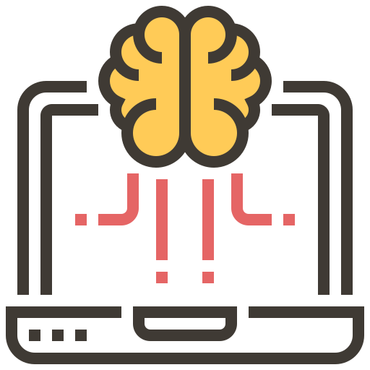
Internet of Things (IoT):
The number of connected devices was increasing, and IoT applications were expanding across sectors such as healthcare, smart cities, agriculture, and manufacturing. The future of ICT involves a more seamless and integrated IoT ecosystem, with enhanced security and interoperability.
Cybersecurity:
With the increasing complexity and connectivity of ICT systems, cybersecurity becomes even more critical. Future developments in ICT will likely focus on improving security measures, incorporating advanced encryption, and developing innovative solutions to counter evolving cyber threats.
Human-Computer Interaction (HCI):
The evolution of ICT involves improving the ways in which humans interact with technology. This may include advancements in natural language processing, gesture recognition, and the development of more intuitive interfaces.

Slide 19
Conclusion:
In conclusion, the dynamic landscape of Information and Communication Technology (ICT) continues to shape and redefine our world. The period leading up to 2022 witnessed remarkable advancements in areas such as 5G technology, artificial intelligence, the Internet of Things, and cybersecurity. These innovations have not only transformed the way we communicate and process information but have also paved the way for unprecedented opportunities.
However, with these advancements many challenges surfaced. One of the most prominent challenges is the rapid pace of technological growth which often outpaced the ability of organizations and individuals to adapt. In addition, the use of ICT raises ethical questions, such as the responsible use of artificial intelligence (AI), automation's impact on employment, and the ethical implications of data collection and analysis. Moreover, not everyone has equal access to ICT, disparities in access to technology, internet connectivity, and digital literacy can widen social and economic gaps.

Slide 20
THANK
YOU

