Slide 1


Final Project of TIC Information and Communication Technologies ICT & Technologies related to ICT
Group 8 Members :
BALAMAN Hala Hadjer BOUDIAF Aisha HAMZA Noor Nacera KAMIRI Lilia YAHYAOUI Chahinez

Slide 2

Table of Contents:
Introduction
History and evolution of ICT
The impact of ICT
Technologies related to ICT
The future of ICT
Conclusion

Slide 3
Introduction:
Information and Communication Technologies (ICT) represent a broad category encompassing a range of technologies designed to facilitate the acquisition, storage, processing, and dissemination of information. It includes computing technologies like servers, laptop computers and software applications, as well as the wired and wireless communication technologies that support telephones and the Internet.

Slide 4
History and evolution of TIC
Information and Communication Technology (ICT) has undergone tremendous changes since its beginning. The evolution of ICT applications has been driven by technological advancements, changing user needs, and the desire for greater efficiency and effectiveness in communication and information management. This evolution had undergone major stages:

Slide 5
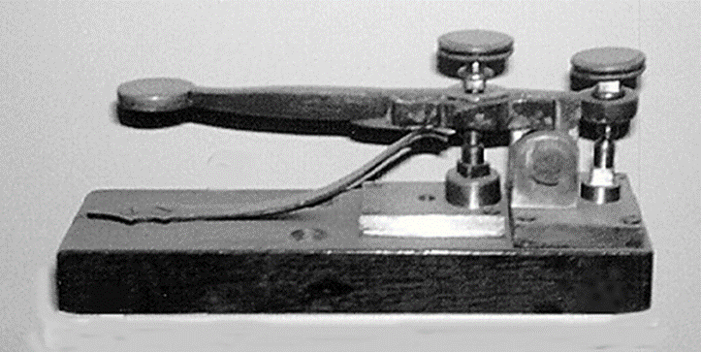
History and evolution of TIC
Stage 1: The Emergence of Telecommunications
The first stage of ICT applications was marked by the emergence of telecommunications. This began in the early 19th century with the invention of the telegraph, and then later with the invention of the telephone.
Figure 1: A Telegraph

Slide 6
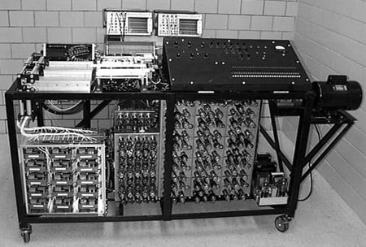
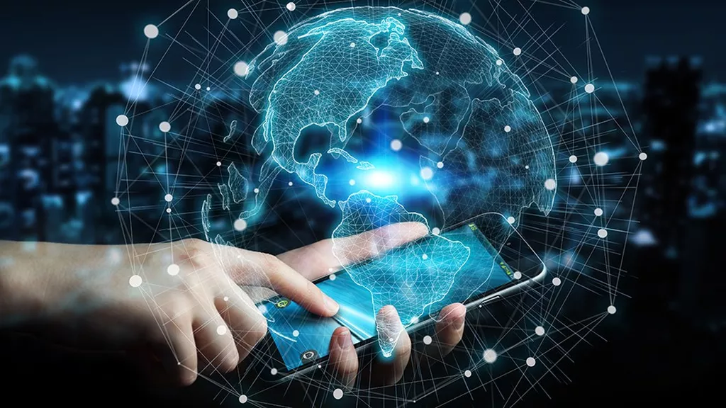
History and evolution of TIC
Stage 2: The Rise of Computing :
The second stage of ICT applications was marked by the rise of computing. This began in the mid-20th century with the invention of the first electronic computers
Figure 2 : First electronic computer
Stage 3: The Emergence of the Internet:
The third stage of ICT applications was marked by the emergence of the internet. This began in the late 20th century with the creation of the World Wide Web.
Figure 3: The World Wide Web

Slide 7
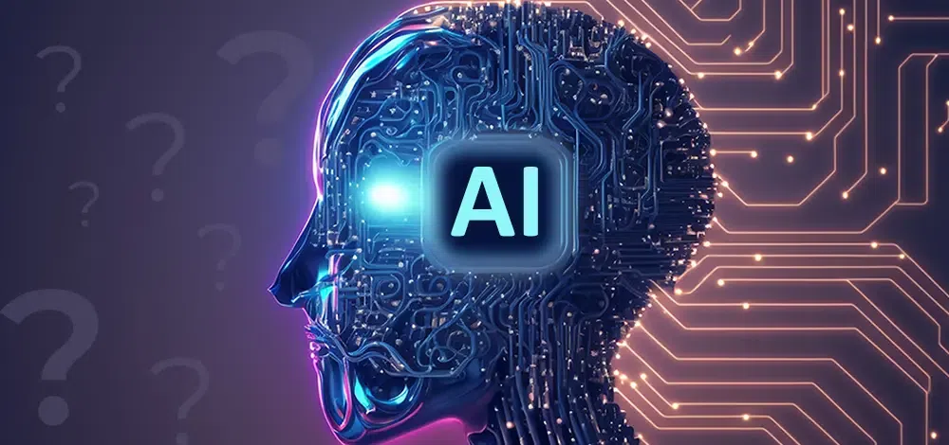
History and evolution of TIC
Stage 4: The Rise of Mobile Computing
The fourth stage of ICT applications was marked by the rise of mobile computing. This began in the early 21st century with the invention of smartphones and tablets.
Stage 5: The Emergence of Artificial Intelligence
The fifth stage of ICT applications is currently underway and is marked by the emergence of Artificial Intelligence (AI).
Figure 4: Artificial Intelligence

Slide 8

The Impact of ICT:
The impact of Information and Communication Technology (ICT) is profound and pervasive across various aspects of society and individual lives. Notably:
On Education:
ICT has facilitated the growth of e-learning, making education accessible to a global audience.
Also It has allowed for remote learning, enabling students to access educational materials from home.

Slide 9

The Impact of ICT:
On Healthcare:
ICT has played a crucial role in the development of telemedicine, allowing patients to consult with healthcare professionals remotely.
Also electronic health records and health information systems have improved the management and accessibility of patient data, leading to better healthcare outcomes.
Figure 5: ICT in Healthcare

Slide 10


Technologies related to ICT:
Google service:
Google offers a range of services as part of its suite of cloud computing, productivity, and collaboration tools. Here are more details on some key Google services.
GOOGLE WORKSPACE
 | Gmail is an email service provided by Google. As of 2019, it had 1.5 billion active users worldwide, making it the largest email service in the world.
 | Google Drive is a file storage and synchronization service developed by Google. It allows users to store files in the cloud, synchronize files across devices, and share files.

Slide 11




Technologies related to ICT:
 | Google Docs is an online word processor included as part of the free, web-based Google Docs Editors suite offered by Google.
 | Google Sheet is a spreadsheet application included as part of the free, web-based Google Docs Editors suite offered by Google.
 | Google Slides is a presentation program included as part of the free, web based Google Docs suite offered by Google
 | Google Classroom is a free blended learning platform developed by Google for educational institutions that aims to simplify creating, distributing, and grading assignments.

Slide 12



Technologies related to ICT:
Microsoft tools
Microsoft offers a wide range of tools and services that cater to various needs, including productivity, collaboration, development, and cloud computing. Here are some key Microsoft tools:
MICROSOFT 365
 | Microsoft Word: A word processing application for creating and editing documents that was developed by Microsoft .
 | Microsoft Excel: A spreadsheet application for data analysis and visualization.
 | Microsoft PowerPoint is a presentation program developed by Microsoft. PowerPoint presentations are widely used for creating slideshows for business, education, and other purposes

Slide 13



Technologies related to ICT:
 | Microsoft Outlook is a personal information manager software system from Microsoft, available as a part of the Microsoft 365 software suites. Though primarily being popular as an email client for businesses.
 | Microsoft OneNote is a note-taking software developed by Microsoft. It is available as part of the Microsoft 365 suite and since 2014 has been free on all platforms outside the suite.
VISUAL STUDIO
 | Visual Studio IDE An integrated development environment for building applications for Windows, Android, iOS, and web applications.
 | Visual Studio Code A lightweight, open-source code editor with support for various programming languages.

Slide 14
Technologies related to ICT:
Git and GitHub:
Git and GitHub play significant roles in the field of Information and Communication Technology (ICT), particularly in the realm of software development, version control, and collaborative coding. Notably:
Version Control
Remote Collaboration (GitHub)
Code Hosting and Repository Management (GitHub)
Issue Tracking and Product Management
Open-Source Development

Slide 15
Technologies related to ICT:
Other Technologies:
Docker: A platform for developing, shipping, and running applications in containers.
Jenkins: An open-source automation server used for building, testing, and deploying software.
Collaboration Tools:
Slack: A messaging platform for teams that facilitates communication and collaboration.
Confluence: A collaboration tool used to help teams collaborate and share knowledge efficiently.

Slide 16


The future of ICT:
Information and Communication Technology (ICT) has been a rapidly evolving field with significant advancements and trends. So we’re going to outline some general trends and potential directions for the future of ICT based on the trajectory up to 2022:
5G Technology
Artificial Intelligence & Machine Learning
Internet of Things
Cybersecurity
Human-computer interactions

Slide 17
Conclusion:
In conclusion, the dynamic landscape of Information and Communication Technology (ICT) continues to shape and redefine our world. The period leading up to 2022 witnessed remarkable advancements in areas such as 5G technology, artificial intelligence, the Internet of Things, and cybersecurity. These innovations have not only transformed the way we communicate and process information but have also paved the way for unprecedented opportunities.

Slide 18

THE END

