Slide 1
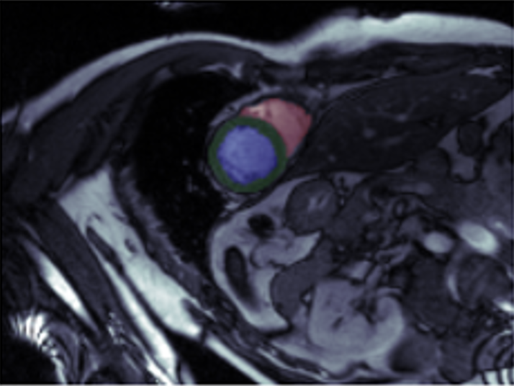

AI4Imaging-Hackathon-2024
Classification of Heart disease based on cine MRI scan
?
- Marvin Leonard Simak -
NOR | MINF | DCM | HCM | RV
Course project
Intermediate Machine Learning
Opencampus.sh

Slide 2

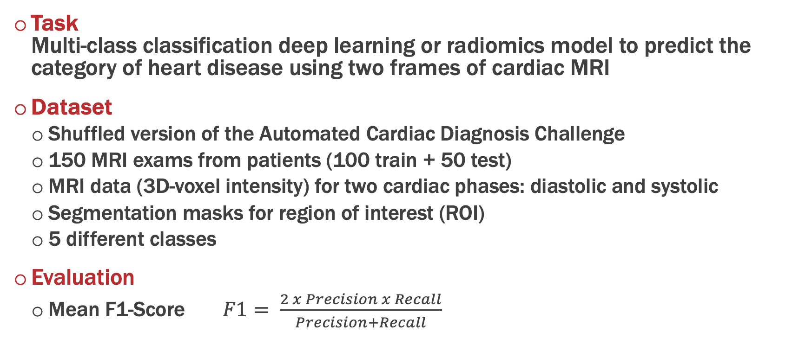
Introduction
Task Multi-class classification deep learning or radiomics model to predict the category of heart disease using two frames of cardiac MRI
Dataset
Shuffled version of the Automated Cardiac Diagnosis Challenge
150 MRI exams from patients (100 train + 50 test)
MRI data (3D-voxel intensity) for two cardiac phases: diastolic and systolic
Segmentation masks for region of interest (ROI)
5 different classes
Evaluation
Mean F1-Score $F1= \frac{2 x Precision x Recall}{Precision+Recall}$

Slide 3
Heart structure & physiology
The heart functions as a pump, delivering oxygenated blood to the body and deoxygenated blood to the lungs
Myocardium: Cardiac / heart muscle
Thick middle layer between the the pericardium and the endocardium
2 hearts / 4 chambers: Right heart: Body right atrium, right ventricle, left atrium & left ventricle
Cardiac cycle: Alternates between
Systole (contraction) and
Diastole (relaxation)
Cardiac cycle: Body → Right Atrium → Right Ventricle (blue) → Lung → Left Atrium → Left Ventricle (red) → Body

Slide 4
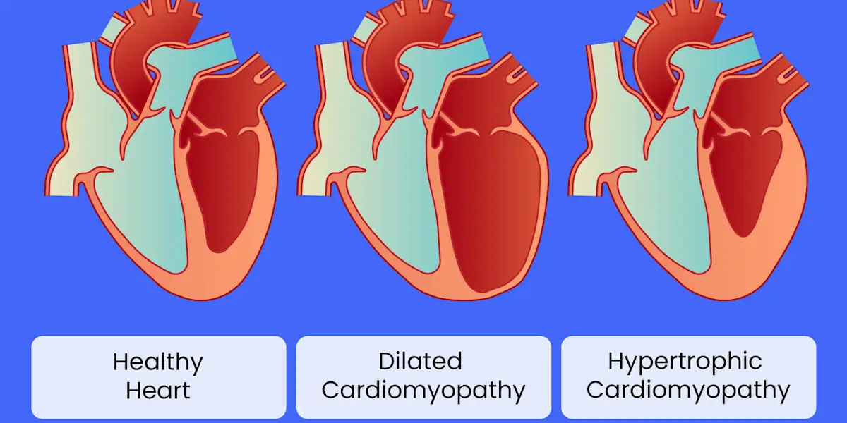
Structural heart diseases
Myocardial infarction (MINF):
Blood flow decreases or stops in one of the coronary arteries of the heart, causing infarction (tissue death) to the heart muscle
Dilated cardiomyopathy (DCM):
Heart muscle disease that causes the heart chambers (ventricles) to thin and stretch, growing larger. It typically starts in the heart's main pumping chamber (left ventricle)
Hypertrophic cardiomyopathy (HCM):
A condition affecting the left ventricle, the main pumping chamber of the heart. The walls of the left ventricle become thick and stiff
Abnormal right ventricle (RV):
Abnormal enlargement of the cardiac muscle surrounding the right ventricle

Slide 5
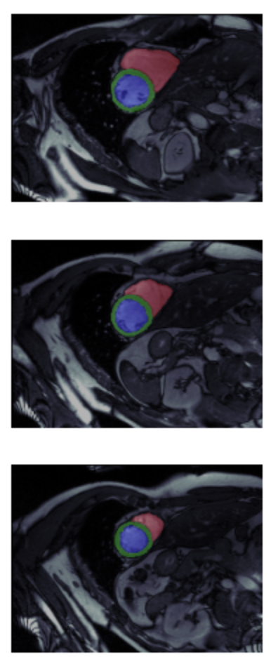
Dataset
3D cardiac MRI images and corresponding segmentation masks for diastolic and systolic phase each
100 patients for training (and 50 patients for testing)
Multi-label segmentation mask:
1 = right ventricle 2 = left ventricle 3 = myocardium
5 classes (with 20 samples each)
NOR: Normal subjects
MINF: Myocardial infarction
DCM: Dilated cardiomyopathy
HCM: Hypertrophic cardiomyopathy
RV: Abnormal right ventricle
Right ventricle
Left ventricle
Mycardium
Right ventricle
Mycardium
Left ventricle
1 = right ventricle 3 = left ventricle 2 = myocardium

Slide 6

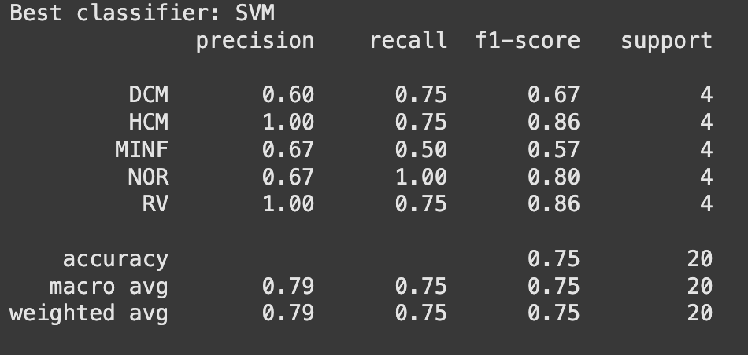

Baseline: Calculate volumes & use a simple model
 | ESV_{R} | EDV_{R} | ESV_{L} | EDV_{L} | MV_{Sys} | MV_{Dia}
NOR | 147.7 | 69.2 | 94.1 | 109.0 | 130.8 | 51.0
MINF | 126.2 | 58.3 | 129.2 | 143.4 | 189.3 | 131.8
DCM | 186.1 | 128.6 | 158.1 | 168.6 | 275.6 | 224.9
HCM | 121.2 | 47.7 | 168.0 | 192.4 | 128.0 | 42.0
RV | 220.6 | 139.6 | 81.63 | 91.02 | 125.5 | 54.0
Voxel segmentation masks → Volume!
Easily done with nibabel
Calculate volumes of both ventricles and the myocardium for both phases
Build a simple ML model:
Sklearn pipeline
StratifiedKFold & GridSearchCV
SVM, RandomForest, GradientBoosting & MLPClassifier
→ SVM (C= 10, kernel = rbf, scaling='passthrough’)

Slide 7
From the ACDC website:
Classification rules
Each group was clearly defined according to physiological parameter, such as the left or right diastolic volume or ejection fraction, the local contraction of the LV, the LV mass and the maximum thickness of the myocardium.
Different possibilities of ambiguous cases are detailed here:
Patients with hypertrophic cardiomyopathy have a left ventricular ejection fraction higher than 55 %. Otherwise, patient with a left ventricular ejection fraction less than 40 % and a local increase of the myocardial thickness (as an adaptation of the myocardium to the disease) must be classified as patients with previous myocardial infarction.
Patients with abnormal high left ventricular diastolic volume, low left ventricular ejection fraction and only several myocardial segments with abnormal contraction must be classified as patients with previous myocardial infarction. Indeed, the increase of the volume of the left ventricle is an adaptation of the left ventricle due to a myocardial infarction.
A patient with dilated left and right ventricles (with or without abnormal function of the right ventricle) must be classified as patients with dilated cardiomyopathy. Indeed, dilated cardiomyopathy of left ventricle could have impact on the right ventricle.
Patients with borderline values should not be included in one particular class. For example, an ejection fraction of the right ventricle greater than 45 % is considered as normal (Mac Kenna criteria) but an ejection fraction of the right ventricle between 40% and 45 % do not allow to classify a case as patient with abnormal right ventricle.

Slide 8
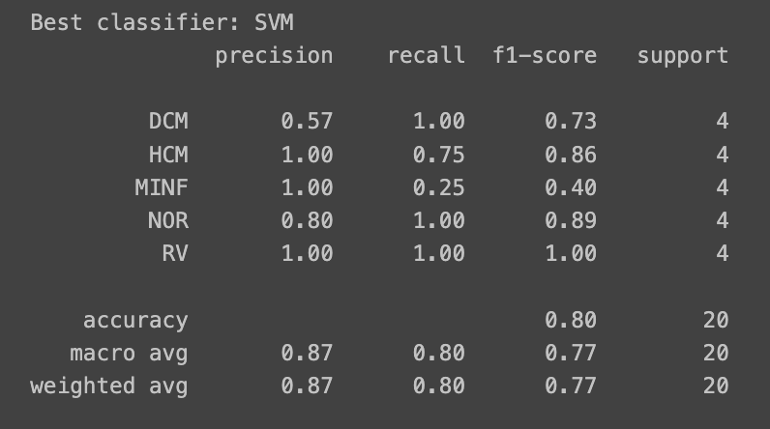
Baseline: A few more features
 | ESV_{R} | EDV_{R} | ESV_{L} | EDV_{L} | MV_{Sys} | MV_{Dia} | MT_{Sys, mean} | MT_{Dia, mean} | MT_{Sys, max} | MT_{Dia, max} | SV | EF [%]
DCM | 186.1 | 128.6 | 275.6 | 224.9 | 158.0 | 168.5 | 5.7 | 7.1 | 11.0 | 13.2 | 50.7 | 0.2
HCM | 121.2 | 47.7 | 127.9 | 42.0 | 167.9 | 192.4 | 9.3 | 15.9 | 19.8 | 24.3 | 86.0 | 0.7
MINF | 126.2 | 58.3 | 189.3 | 131.8 | 129.2 | 143.4 | 6.0 | 8.3 | 12.2 | 16.8 | 57.5 | 0.3
NOR | 147.7 | 69.2 | 130.8 | 51.0 | 94.1 | 109.0 | 5.1 | 9.6 | 10.1 | 15.3 | 79.9 | 0.6
RV | 220.6 | 139.6 | 125.5 | 54.0 | 81.6 | 91.0 | 4.5 | 8.0 | 9.7 | 14 | 71.5 | 0.6
Calculate more features:
Volumes of RV & LV
Myocard thickness (mean / max)
Stroke Volume SV = LV_{sys}- LV_{DIA}
Ejection fraction EF = SV / Lv_{sys}
Slight improvement 0.77

Slide 9
Published results for automatic cardiac diagnosis
Khened et al. [46] used 11 features, 9 derived from their segmentation map in addition to the patient weight and height → Acc: 90%
Isensee et al. [44] extracted a series of instants and dynamic features from the segmentation maps →Acc: 92%
Similar approach but more features based on dynamics and anthropometrics (e.g. age, body mass, sex) – which are not available in the Kaggle dataset
Calculating physiological features is close to medical practice and diagnostics
Explainable / No black-box

Slide 10
Baseline summary
Several diagnostic features calculated from the provided segmentation masks (i.e. ventricle volumes, myocardial thickness, stroke volume and ejection fraction)
Scikit-learn pipeline optimized by GridSearchCV → linear SVM
F1-Score: 0.77 on validation split (best cross-validation score: 0.92)

Slide 11
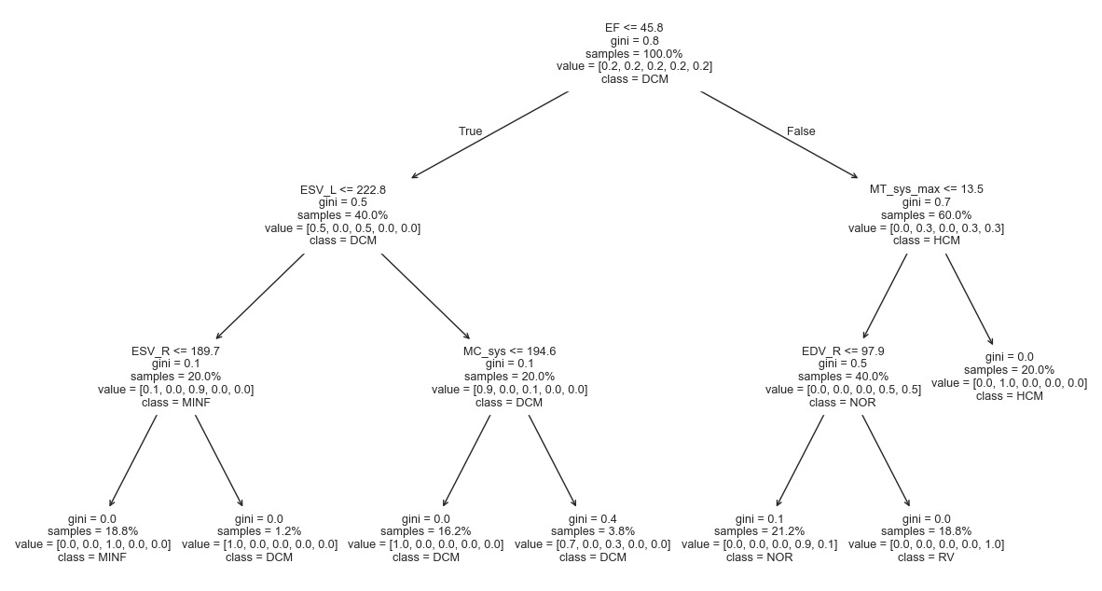
Bonus: Explainability

Slide 12
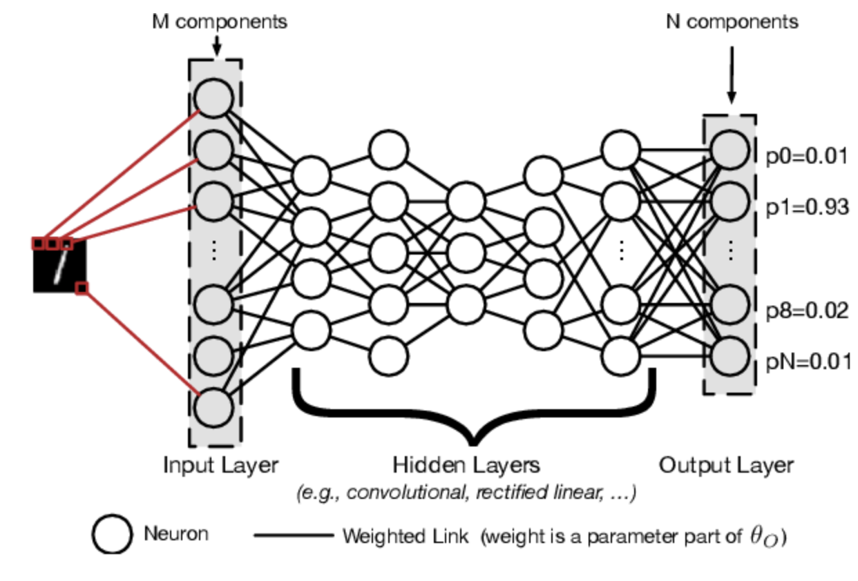
Deep Learning is all your need... Or is it?

Slide 13
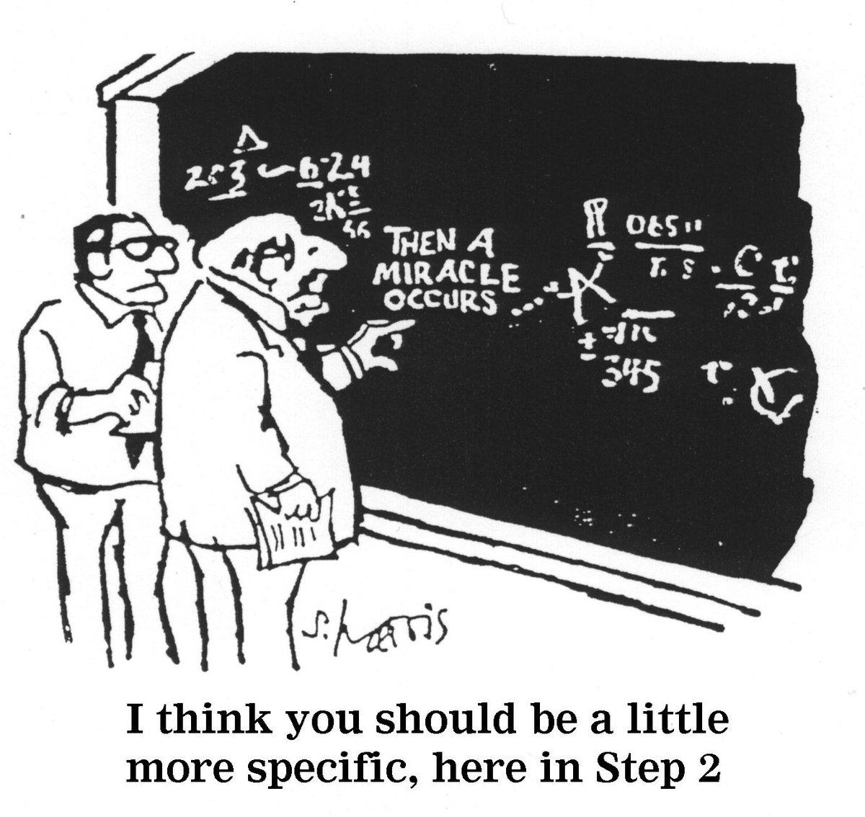

End-to-End Training possible?
Input Tensor
[B x C x D x W x H]
Magical black box
(aka DL model)
Success! eh..
NOR | MINF | DCM | HCM | RV
Class prediction

Slide 14
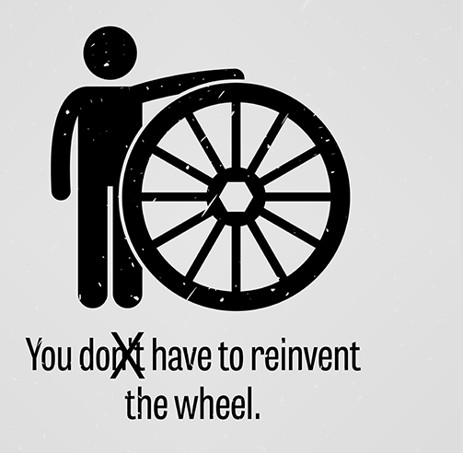





Frameworks & Helpers
Open-source framework built for accelerating research and clinical collaboration in Medical Imaging
Standardized
User Friendly
Reproducible
Easy Integration
High Quality
Open Source Design

Slide 15
Easily done! Or is it...
Just load the data, scale it and dump it into the model...
Training:
PyTorch Lightning
Stratified 80/20 train-val-split
CNN (3D-ResNet18)
CrossEntropy-Loss
AdamW Optimizer
Batch Size 8
Results:
F1-Score: 0.4 😭
NOR | MINF | DCM | HCM | RV

Slide 16
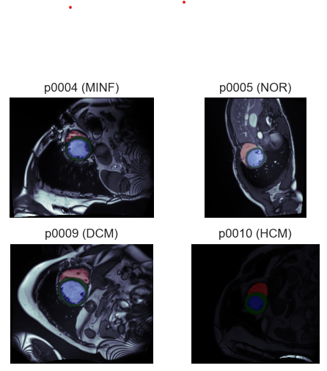
Let’s have another look at the data
Problems:
Different intensities
Different orientation (wrong meta)
Heart is small part of the picture
➔ Preprocessing is mandatory!

Slide 17
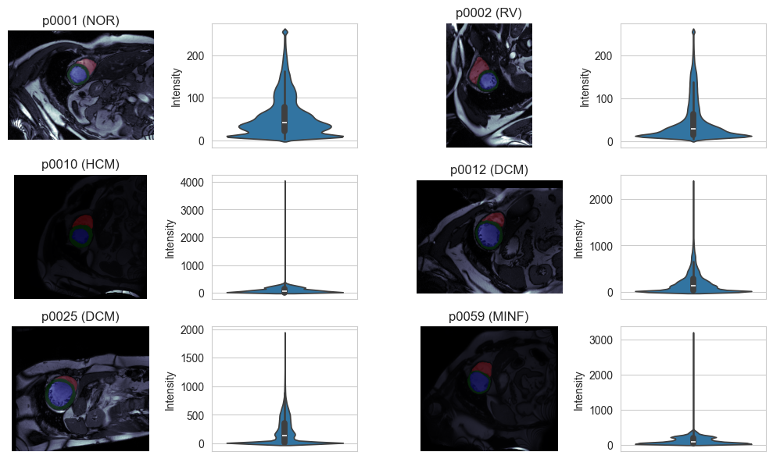
Intensity normalization
Problems:
Completely different scales between patients
Artefacts / Reflections
→ Clip outliers and scale intensity linearly

Slide 18
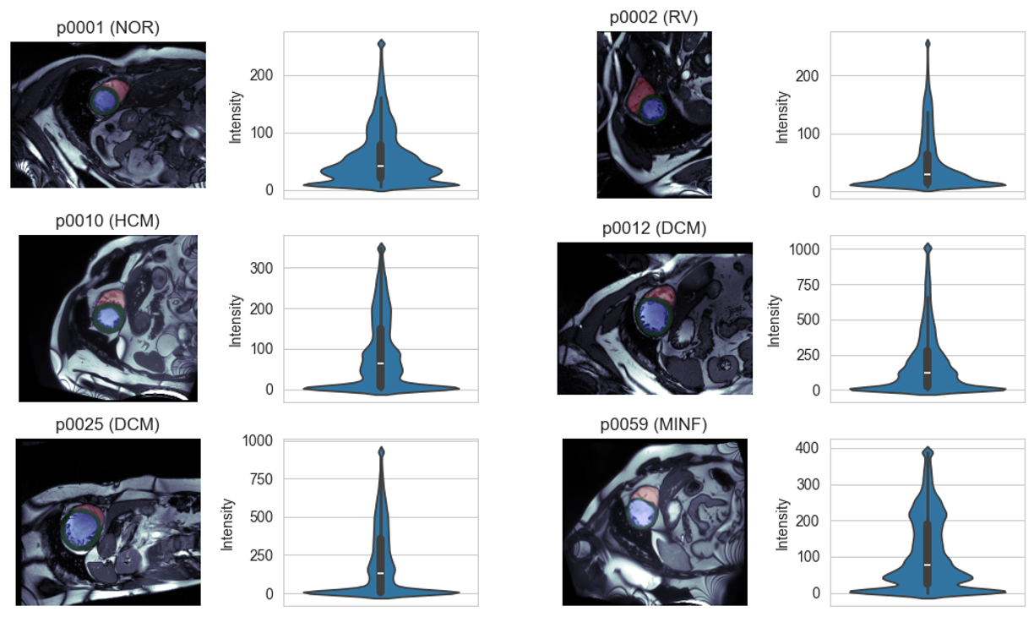
Intensity normalization
Result:
Much better!
Further problems?
Different contrast
→ Histogram normalization

Slide 19
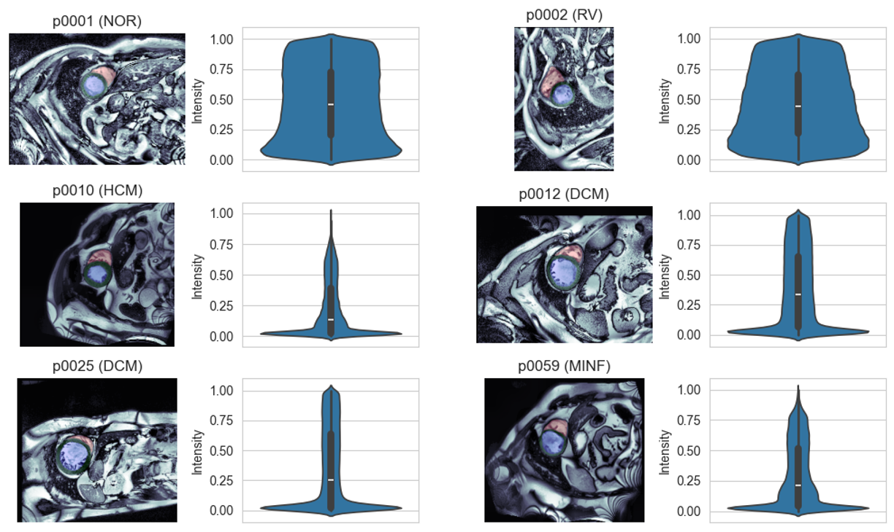
Intensity normalization
Adaptive histogram normalization (CLAHE algorithm)
Better contrast
Less difference between subjects

Slide 20
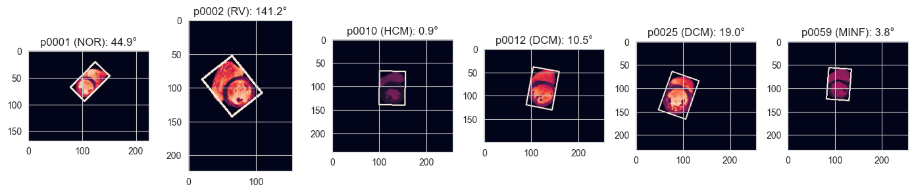
Different Orientation
Normally orientation is given in meta data
Wrong meta data in some samples
Ratio is unambiguous
→ Solution use OpenCV to detect rotation of the heart (using the segmentation mask)

Slide 21
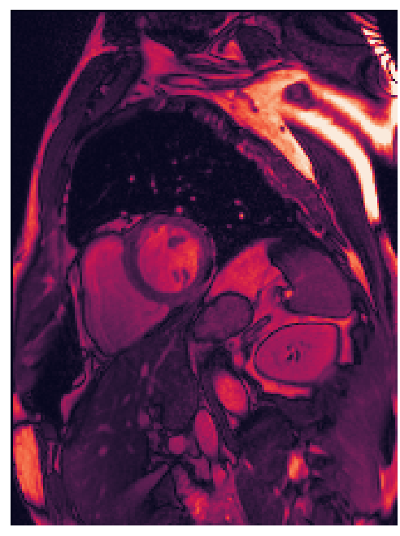
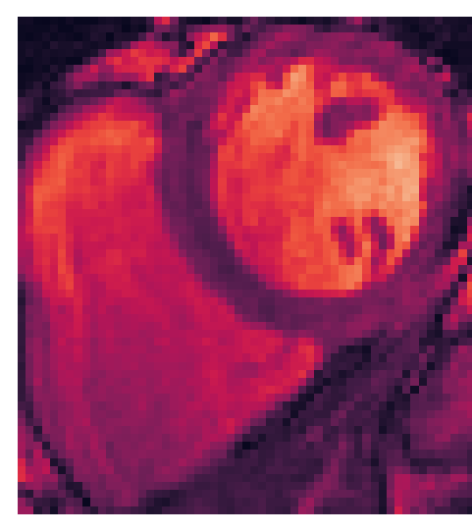
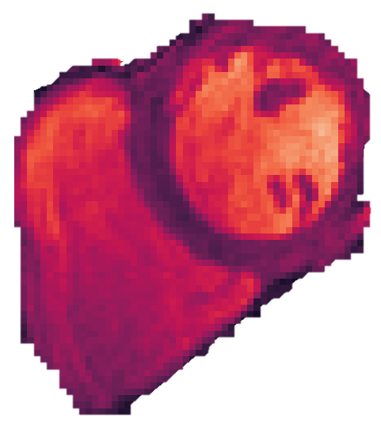
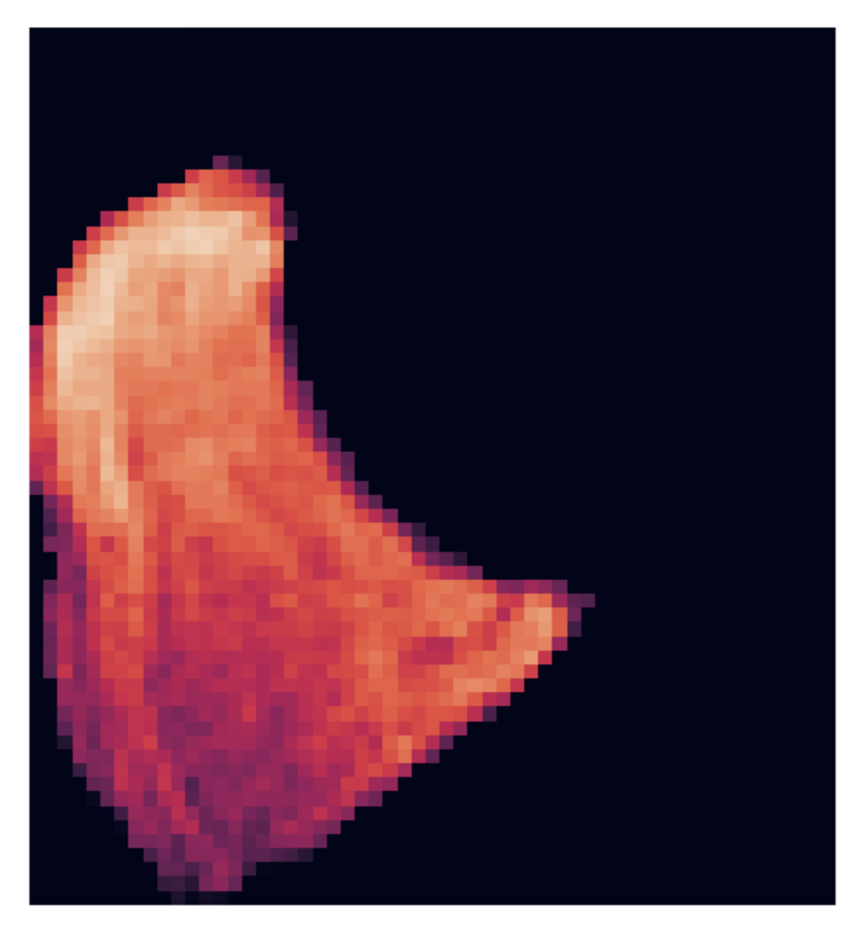
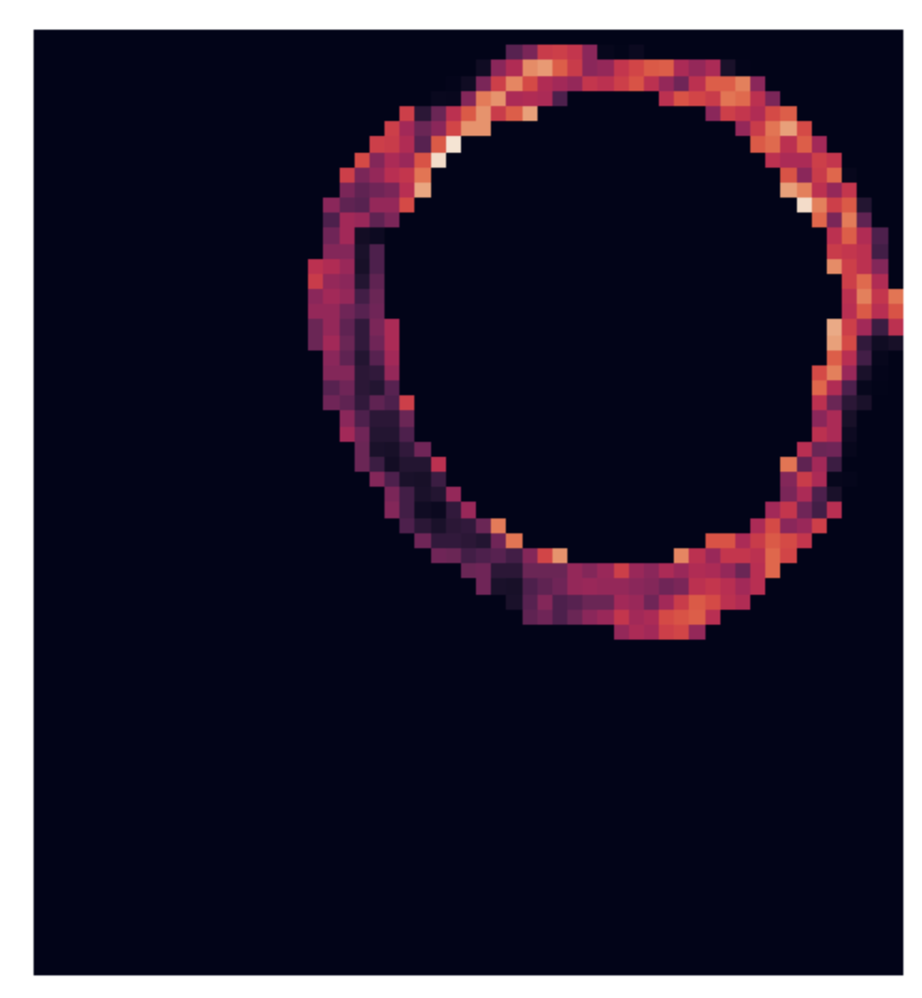
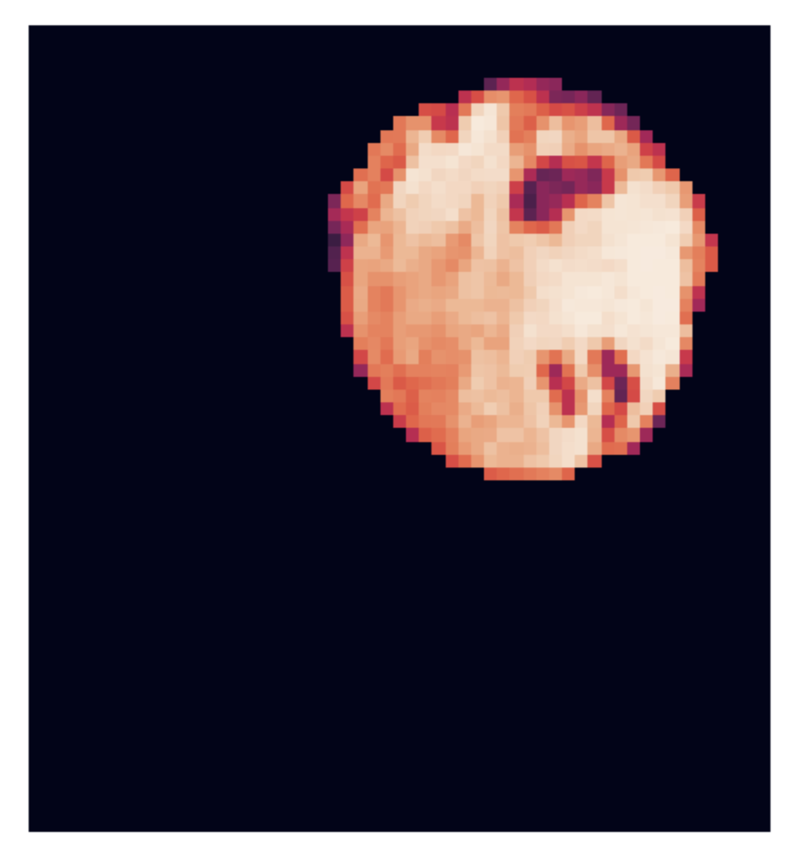
Cropping and masking
Options:
Crop images to ROI area (bounding box around mask)
Use the segmentations to mask the intensity
Use the separate labels to mask different parts of the input

Slide 22
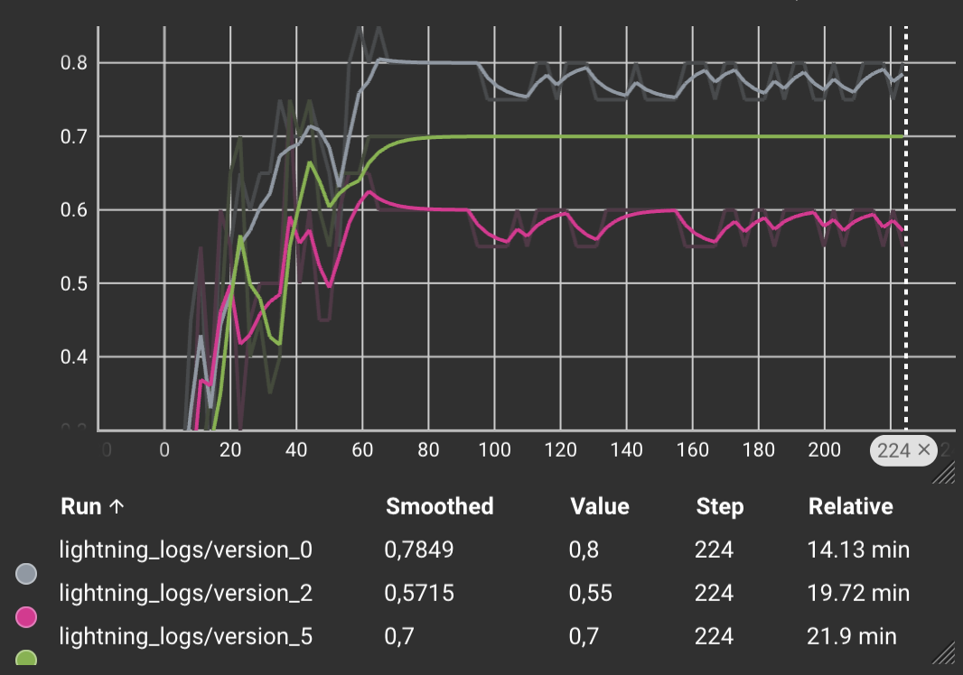
First results
CNN trained with CrossEntropy using PyTorch Lightning
3D-ResNet18
F1-Score: 0.7 - 0.8 (on valid)
What seemed to help:
Intensity normalization
Cropping
Masking intensity
Bigger batches / Gradient accumulation

Slide 23
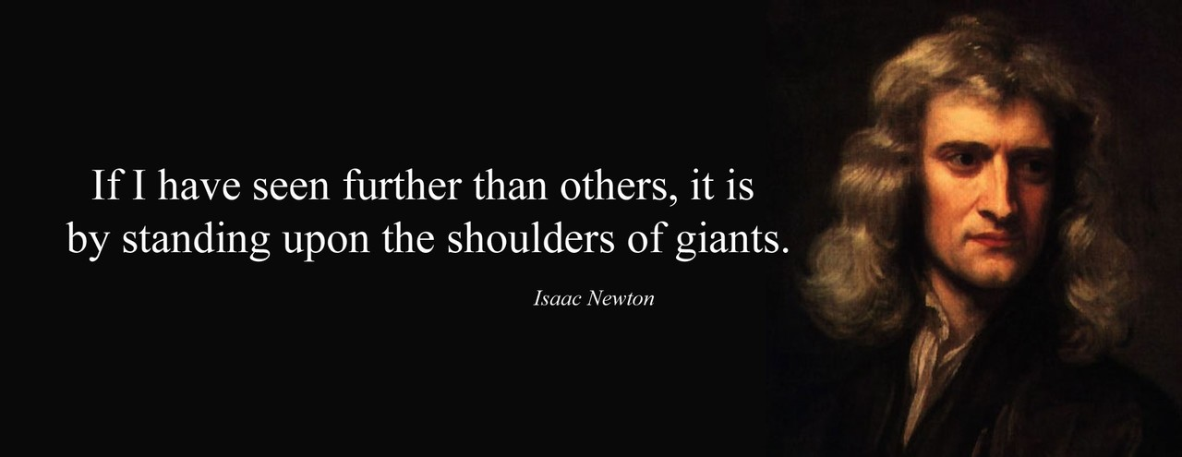
Frameworks and other resources

Slide 24

Pretrained models?
Med3D: Transfer Learning for 3D Medical Image Analysis
Chen et al. (2009)
Dataset with diverse modalities, target organs, and pathologies (MRI & CT)
A series of 3D-ResNet pre-trained models
First results were not that great... F1: ~0.5-0.6
Potential problems:
Different normalization
Domain shift
Finetuning settings (frozen layers, LR, etc.)

Slide 25
Potential outlook
Systematic hyperparameter Testing with optuna
Re-check normalization used in MedicalNet
Train the model to approximate the features as well as the class
(Pre-) Train the model on segmentation task first
Test different input augmentations
Check sensitivity map / gradCAM for plausibility

Slide 26
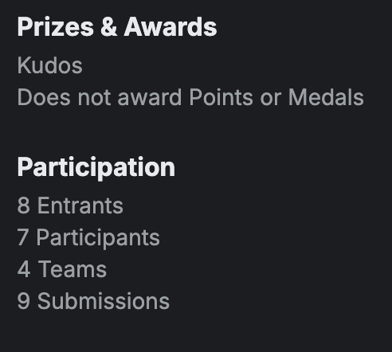
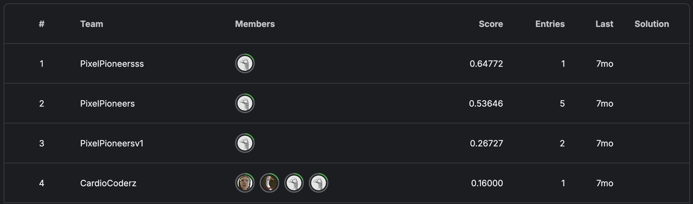

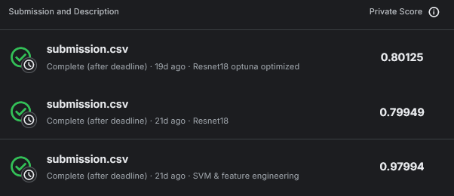
Leaderboard comparison
Not the most popular challenge (just Kudos)
Lets see how the presented approaches compare:
Gold medal!
The baseline approach rocked it with a score of 0.98!

Slide 27
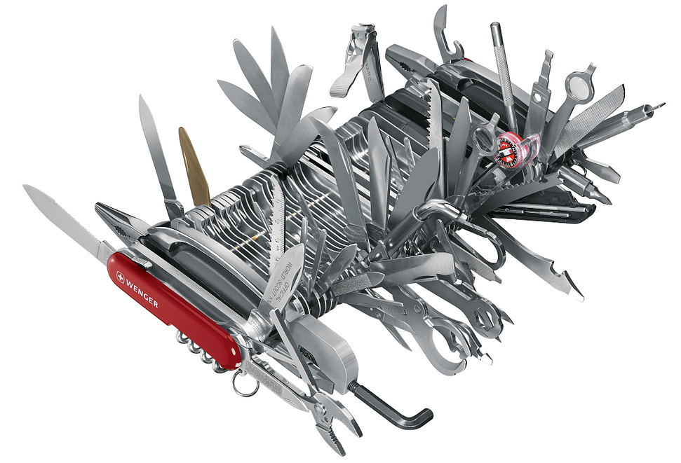
Summary
KISS – Keep it stupid simple!
Really hard to beat the feature-based baseline
Performance & Interpretability
Why actually?
Except for learning ;-)
If you have domain knowledge, use it - especially with small datasets!

Slide 28
Literature
Bernard, O., Lalande, A., Zotti, C., et al. (2018). Deep learning techniques for automatic MRI cardiac multi-structures segmentation and diagnosis: Is the problem solved? IEEE Transactions on Medical Imaging, 37(11), 2514–2525. https://doi.org/10.1109/tmi.2018.2837502
M. Khened, M., Alex, V., and Krishnamurthi, G. (2017). Densely connected fully convolutional network for short-axis cardiac cine mr image segmentation and heart diagnosis using random forest. Proc. STACOM-MICCAI, LNCS, 10663, 140–151. https://doi.org/10.1007/978-3-319-75541-0_15
Isensee, F. , Jaeger, P., Full, P., et al. (2017), Automatic cardiac disease assessment on cine-mri via time-series segmentation and domain specific features. Proc. STACOM-MICCAI, LNCS, 10663, 120–129. https://arxiv.org/pdf/1707.00587
Chen, S., Ma, K. & Zheng, Y. (2019). Med3D: Transfer Learning for 3D Medical Image Analysis. arXiv preprint arXiv:1904.00625 https://arxiv.org/abs/1904.00625

