Slide 1

CHAPTER 1:
THE DATABASE ENVIRONMENT AND DEVELOPMENT PROCESS
Modern Database Management
11th Edition
Jeffrey A. Hoffer, V. Ramesh,
Heikki Topi
© 2013 Pearson Education, Inc. Publishing as Prentice Hall

Slide 2
OBJECTIVES
Define terms
Name limitations of conventional file processing
Explain advantages of databases
Identify costs and risks of databases
List components of database environment
Identify categories of database applications
Describe database system development life cycle
Explain prototyping and agile development approaches
Explain roles of individuals
Explain the three-schema architecture for databases

Slide 3
DEFINITIONS
Database: organized collection of logically related data
Data: stored representations of meaningful objects and events
  Structured: numbers, text, dates
  Unstructured: images, video, documents
Information: data processed to increase knowledge in the person using the data
Metadata: data that describes the properties and context of user data

Slide 4
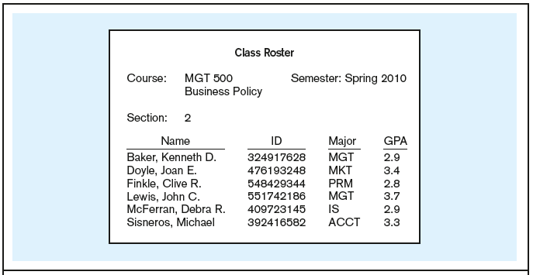
Figure 1-1a Data in context
Context helps users understand data
Chapter 1
© 2013 Pearson Education, Inc. Publishing as Prentice Hall

Slide 5
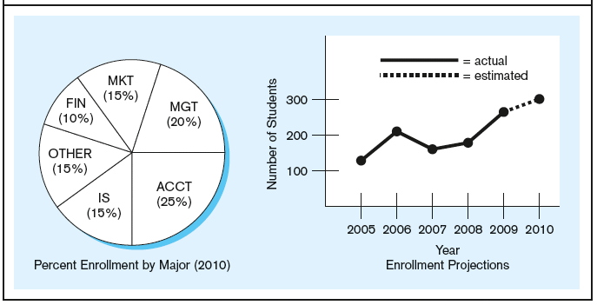
Figure 1-1b Summarized data
Graphical displays turn data into useful information that managers can use for decision making and interpretation
Chapter 1
© 2013 Pearson Education, Inc. Publishing as Prentice Hall

Slide 6
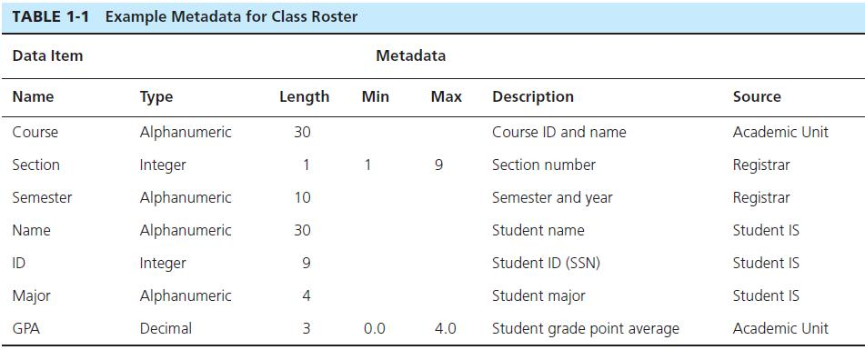
Descriptions of the properties or characteristics of the data, including data types, field sizes, allowable values, and data context
Chapter 1
© 2013 Pearson Education, Inc. Publishing as Prentice Hall

Slide 7
DISADVANTAGES OF FILE PROCESSING
Program-Data Dependence
  All programs maintain metadata for each file they use
Duplication of Data
  Different systems/programs have separate copies of the same data
Limited Data Sharing
  No centralized control of data
Lengthy Development Times
  Programmers must design their own file formats
Excessive Program Maintenance
  80% of information systems budget

Slide 8
PROBLEMS WITH DATA DEPENDENCY
Each application programmer must maintain his/her own data
Each application program needs to include code for the metadata of each file
Each application program must have its own processing routines for reading, inserting, updating, and deleting data
Lack of coordination and central control
Non-standard file formats

Slide 9
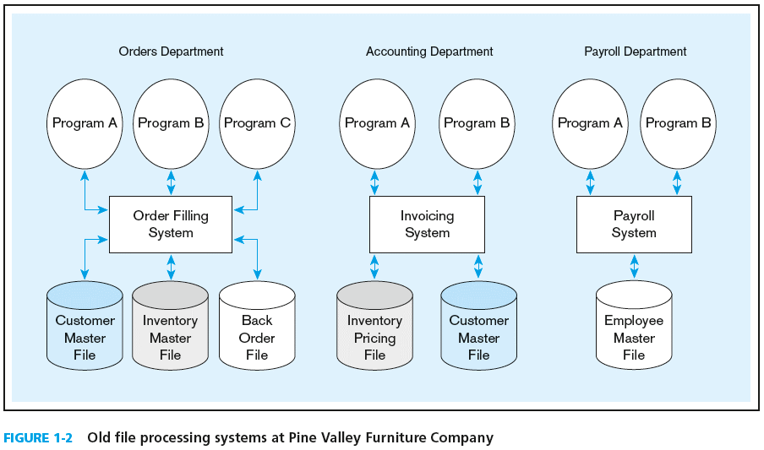
Duplicate Data
Chapter 1
© 2013 Pearson Education, Inc. Publishing as Prentice Hall

Slide 10
PROBLEMS WITH DATA REDUNDANCY
Waste of space to have duplicate data
Causes more maintenance headaches
The biggest problem:
  Data changes in one file could cause inconsistencies
  Compromises in data integrity

Slide 11
SOLUTION: THE DATABASE APPROACH
Central repository of shared data
Data is managed by a controlling agent
Stored in a standardized, convenient form
Requires a Database Management System (DBMS)

Slide 12
DATABASE MANAGEMENT SYSTEM
A software system that is used to create, maintain, and provide controlled access to user databases
Order Filing
System
Central database
Contains employee,
order, inventory,
pricing, and
customer data
Invoicing
System
DBMS
Payroll
System
DBMS manages data resources like an operating system manages hardware resources

Slide 13
ADVANTAGES OF THE DATABASE APPROACH
Program-data independence
Planned data redundancy
Improved data consistency
Improved data sharing
Increased application development productivity
Enforcement of standards
Improved data quality
Improved data accessibility and responsiveness
Reduced program maintenance
Improved decision support

Slide 14
COSTS AND RISKS OF THE DATABASE APPROACH
New, specialized personnel
Installation and management cost and complexity
Conversion costs
Need for explicit backup and recovery
Organizational conflict

Slide 15
ELEMENTS OF THE DATABASE APPROACH
Data models
  Graphical system capturing nature and relationship of data
  Enterprise Data Model–high-level entities and relationships for the organization
  Project Data Model–more detailed view, matching data structure in database or data warehouse
Entities
  Noun form describing a person, place, object, event, or concept
  Composed of attributes
Relationships
  Between entities
  Usually one-to-many (1:M) or many-to-many (M:N)
Relational Databases
  Database technology involving tables (relations) representing entities and primary/foreign keys representing relationships

Slide 16
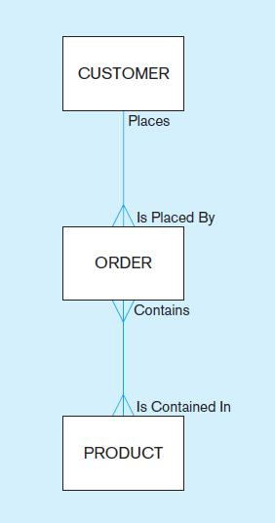
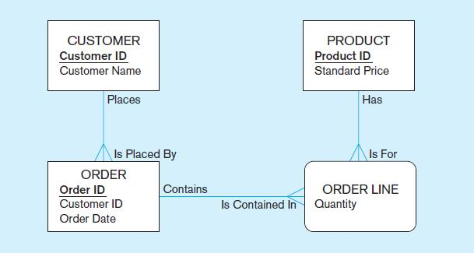
Figure 1-3 Comparison of enterprise and project level data models
Segment of an enterprise data model
Segment of a project-level data model
Chapter 1
© 2013 Pearson Education, Inc. Publishing as Prentice Hall

Slide 17
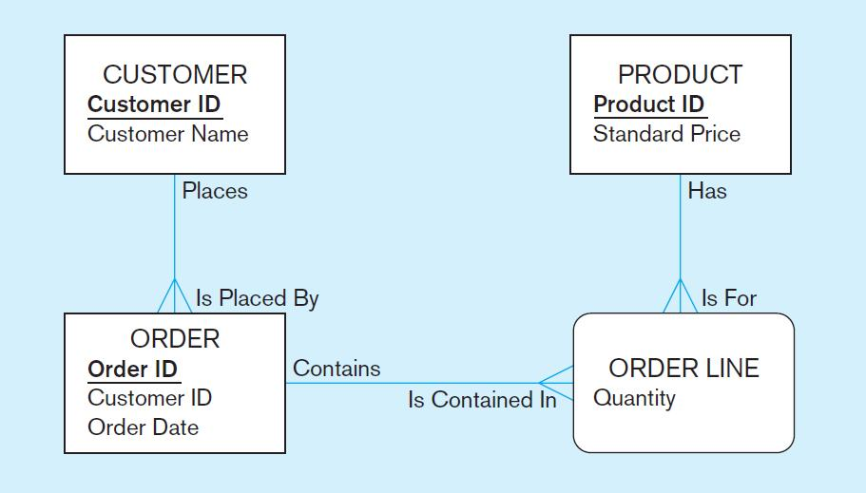
One customer may place many orders, but each order is placed by a single customer
→ One-to-many relationship
Chapter 1
© 2013 Pearson Education, Inc. Publishing as Prentice Hall

Slide 18
One order has many order lines; each order line is associated with a single order
→ One-to-many relationship
Chapter 1
© 2013 Pearson Education, Inc. Publishing as Prentice Hall

Slide 19
One product can be in many order lines, each order line refers to a single product
→ One-to-many relationship
Chapter 1
© 2013 Pearson Education, Inc. Publishing as Prentice Hall

Slide 20
Therefore, one order involves many products and one product is involved in many orders
→ Many-to-many relationship
Chapter 1
© 2013 Pearson Education, Inc. Publishing as Prentice Hall

Slide 21
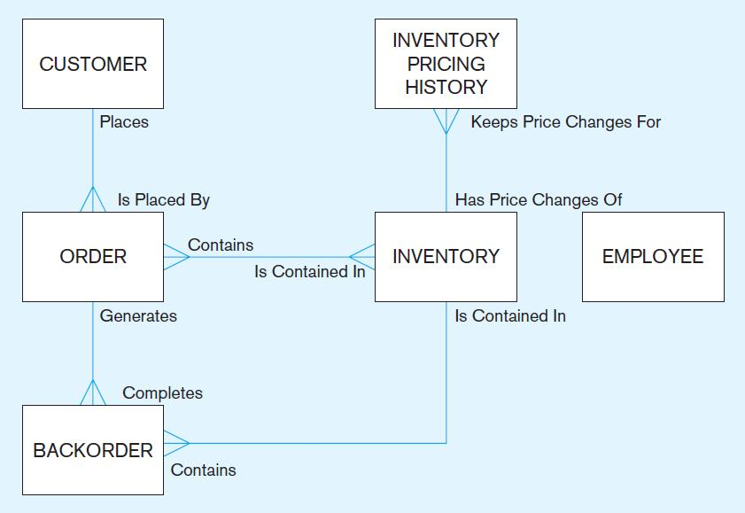

Chapter 1
© 2013 Pearson Education, Inc. Publishing as Prentice Hall

Slide 22
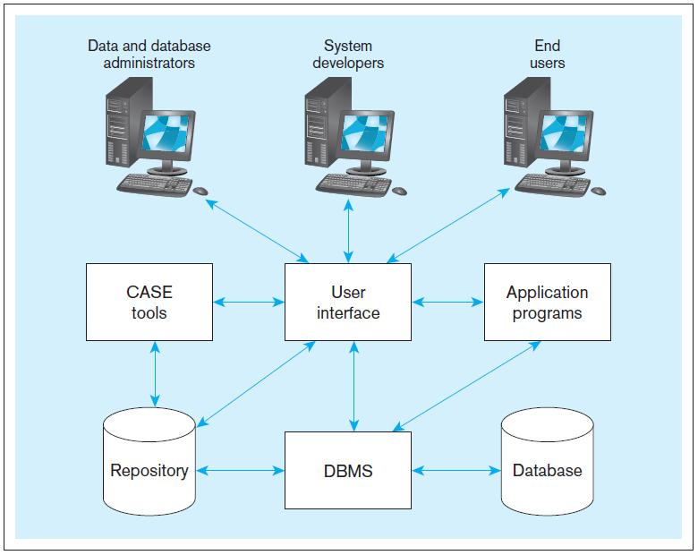
Figure 1-5 Components of the Database Environment

Slide 23
COMPONENTS OF THE
DATABASE ENVIRONMENT
CASE Tools–computer-aided software engineering
Repository–centralized storehouse of metadata
Database Management System (DBMS) –software for managing the database
Database–storehouse of the data
Application Programs–software using the data
User Interface–text and graphical displays to users
Data/Database Administrators–personnel responsible for maintaining the database
System Developers–personnel responsible for designing databases and software
End Users–people who use the applications and databases

Slide 24
ENTERPRISE DATA MODEL
First step in the database development process
Specifies scope and general content
Overall picture of organizational data at high level of abstraction
Entity-relationship diagram
Descriptions of entity types
Relationships between entities
Business rules

Slide 25
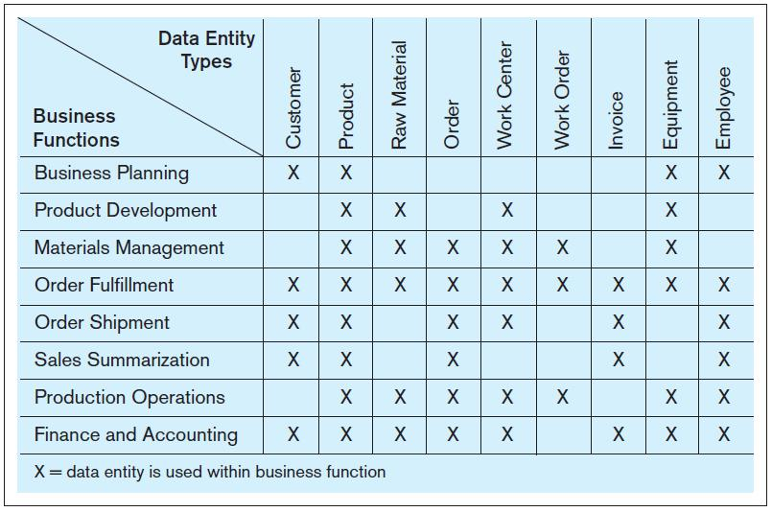
FIGURE 1-6 Example business function-to-data entity matrix
Chapter 1
© 2013 Pearson Education, Inc. Publishing as Prentice Hall

Slide 26
TWO APPROACHES TO DATABASE AND IS DEVELOPMENT
SDLC
  System Development Life Cycle
  Detailed, well-planned development process
  Time-consuming, but comprehensive
  Long development cycle
Prototyping
  Rapid application development (RAD)
  Cursory attempt at conceptual data modeling
  Define database during development of initial prototype
  Repeat implementation and maintenance activities with new prototype versions

Slide 27
SYSTEMS DEVELOPMENT LIFE CYCLE
(SEE ALSO FIGURE 1-7)
Planning
Analysis
Logical Design
Physical Design
Implementation
Maintenance

Slide 28
SYSTEMS DEVELOPMENT LIFE CYCLE
(SEE ALSO FIGURE 1-7) (CONT.)
Planning
Purpose–preliminary understanding
Deliverable–request for study
Planning
Analysis
Logical Design
Physical Design
Database activity–
enterprise modeling and early conceptual data modeling
Implementation
Maintenance

Slide 29
SYSTEMS DEVELOPMENT LIFE CYCLE
(SEE ALSO FIGURE 1-7) (CONT.)
Purpose–thorough requirements analysis and structuring
Deliverable–functional system specifications
Planning
Analysis
Analysis
Logical Design
Physical Design
Database activity–thorough and integrated conceptual data modeling
Implementation
Maintenance

Slide 30
SYSTEMS DEVELOPMENT LIFE CYCLE
(SEE ALSO FIGURE 1-7) (CONT.)
Purpose–information requirements elicitation and structure
Deliverable–detailed design specifications
Planning
Analysis
Logical Design
Logical Design
Physical Design
Database activity–
logical database design (transactions, forms, displays, views, data integrity and security)
Implementation
Maintenance

Slide 31
SYSTEMS DEVELOPMENT LIFE CYCLE
(SEE ALSO FIGURE 1-7) (CONT.)
Purpose–develop technology and organizational specifications
Deliverable–program/data structures, technology purchases, organization redesigns
Planning
Analysis
Logical Design
Physical Design
Physical Design
Database activity–
physical database design (define database to DBMS, physical data organization, database processing programs)
Implementation
Maintenance

Slide 32
SYSTEMS DEVELOPMENT LIFE CYCLE
(SEE ALSO FIGURE 1-7) (CONT.)
Purpose–programming, testing, training, installation, documenting
Deliverable–operational programs, documentation, training materials
Planning
Analysis
Logical Design
Physical Design
Database activity–
database implementation, including coded programs, documentation, installation and conversion
Implementation
Implementation
Maintenance

Slide 33
SYSTEMS DEVELOPMENT LIFE CYCLE
(SEE ALSO FIGURE 1-7) (CONT.)
Planning
Purpose–monitor, repair, enhance
Deliverable–periodic audits
Analysis
Logical Design
Physical Design
Database activity–
database maintenance, performance analysis and tuning, error corrections
Implementation
Maintenance
Maintenance

Slide 34
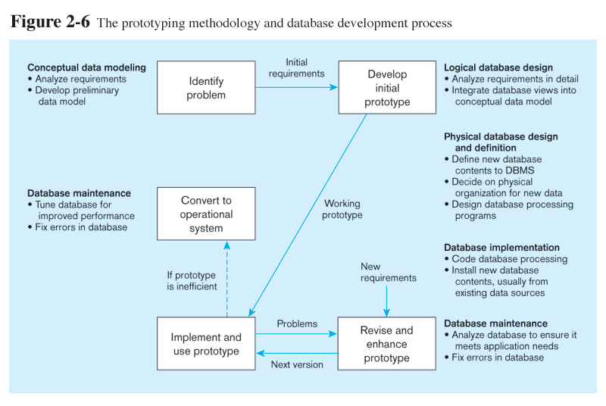
Prototyping Database Methodology
(Figure 1-8)
Chapter 1
© 2013 Pearson Education, Inc. Publishing as Prentice Hall

Slide 35
Prototyping Database Methodology
(Figure 1-8) (cont.)
Chapter 1
© 2013 Pearson Education, Inc. Publishing as Prentice Hall

Slide 36
Prototyping Database Methodology
(Figure 1-8) (cont.)
Chapter 1
© 2013 Pearson Education, Inc. Publishing as Prentice Hall

Slide 37
Prototyping Database Methodology
(Figure 1-8) (cont.)

Slide 38
Prototyping Database Methodology
(Figure 1-8) (cont.)
Chapter 1
© 2013 Pearson Education, Inc. Publishing as Prentice Hall

Slide 39
DATABASE SCHEMA
External Schema
  User Views
  Subsets of Conceptual Schema
  Can be determined from business-function/data entity matrices
  DBA determines schema for different users
Conceptual Schema
  E-R models–covered in Chapters 2 and 3
Internal Schema
  Logical structures–covered in Chapter 4
  Physical structures–covered in Chapter 5

Slide 40
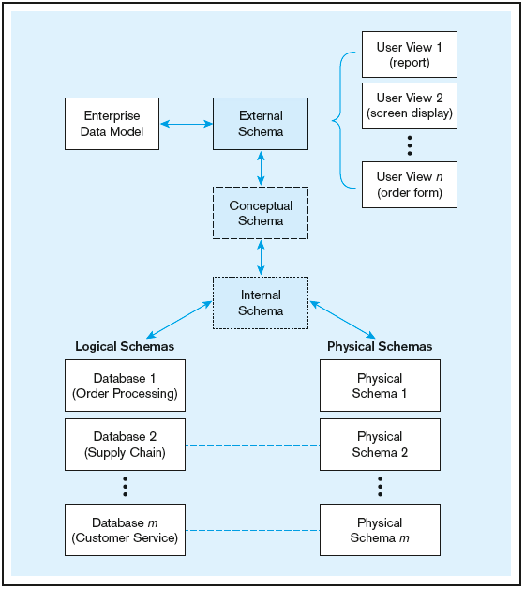
Figure 1-9 Three-schema architecture
Different people have different views of the database…these are the external schema
The internal schema is the underlying design and implementation
Chapter 1
© 2013 Pearson Education, Inc. Publishing as Prentice Hall

Slide 41
MANAGING PROJECTS
Project–a planned undertaking of related activities to reach an objective that has a beginning and an end
Initiated and planned in planning stage of SDLC
Executed during analysis, design, and implementation
Closed at the end of implementation

Slide 42
MANAGING PROJECTS:
PEOPLE INVOLVED
Business analysts
Systems analysts
Database analysts and data modelers
Users
Programmers
Database architects
Data administrators
Project managers
Other technical experts

Slide 43
EVOLUTION OF DATABASE SYSTEMS
Driven by four main objectives:
    Need for program-data independence ➔ reduced maintenance
    Desire to manage more complex data types and structures
    Ease of data access for less technical personnel
    Need for more powerful decision support platforms

Slide 44
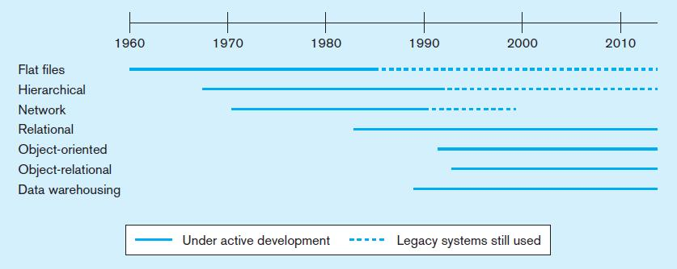
Figure 1-10a Evolution of database technologies

Slide 45
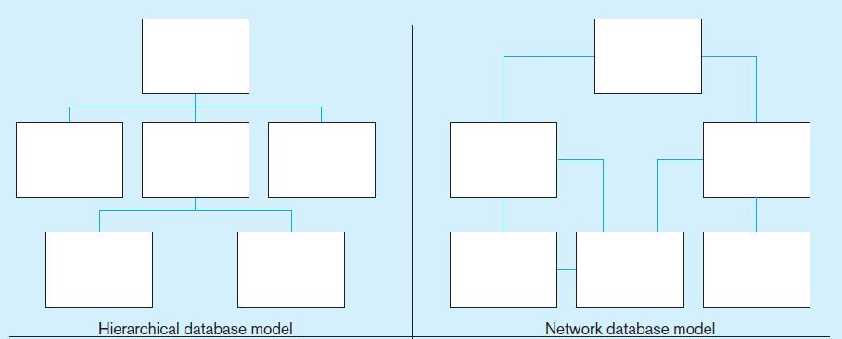
Figure 1-10b Database architectures

Slide 46
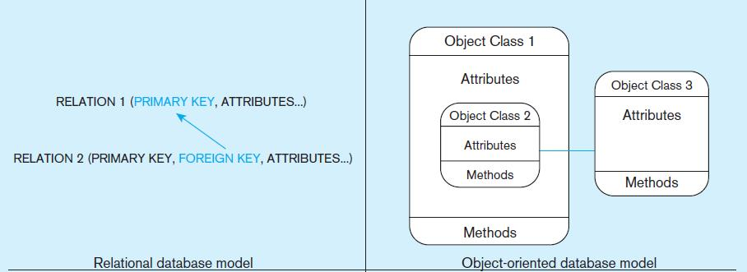
Figure 1-10b Database architectures (cont.)

Slide 47
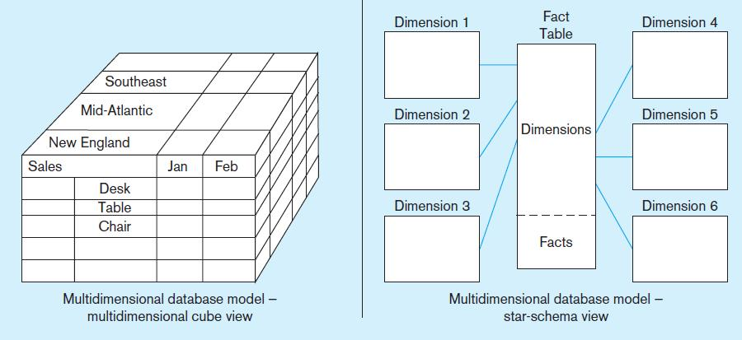
Figure 1-10b Database architectures (cont.)

Slide 48
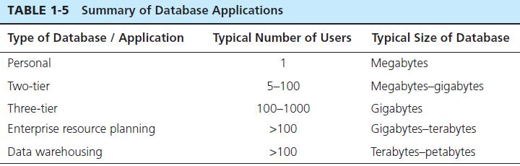
THE RANGE OF DATABASE APPLICATIONS
Personal databases
Two-tier and N-tier Client/Server databases
Enterprise applications
  Enterprise resource planning (ERP) systems
  Data warehousing implementations

Slide 49
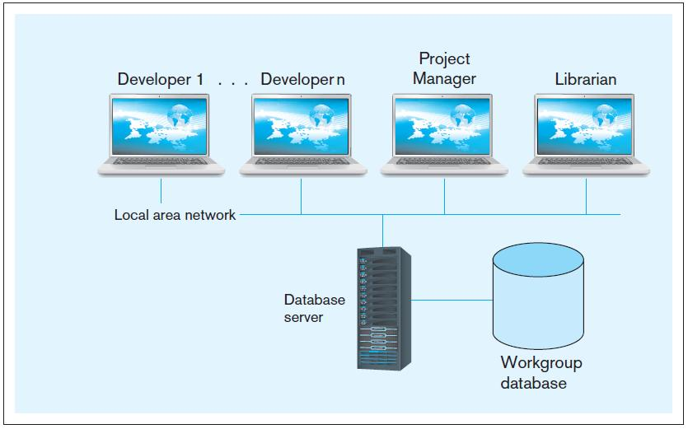
Figure 1-11 Two-tier database with local
area network
Chapter 1
© 2013 Pearson Education, Inc. Publishing as Prentice Hall

Slide 50
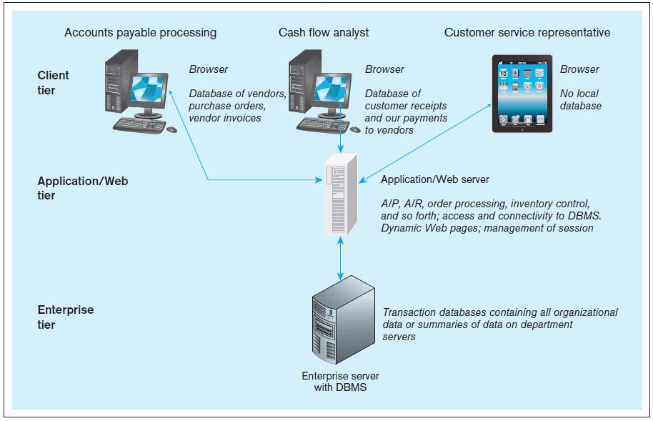
Figure 1-12 Three-tiered client/server database architecture
Chapter 1
© 2013 Pearson Education, Inc. Publishing as Prentice Hall

Slide 51
ENTERPRISE DATABASE APPLICATIONS
Enterprise Resource Planning (ERP)
  Integrate all enterprise functions (manufacturing, finance, sales, marketing, inventory, accounting, human resources)
Data Warehouse
  Integrated decision support system derived from various operational databases

Slide 52
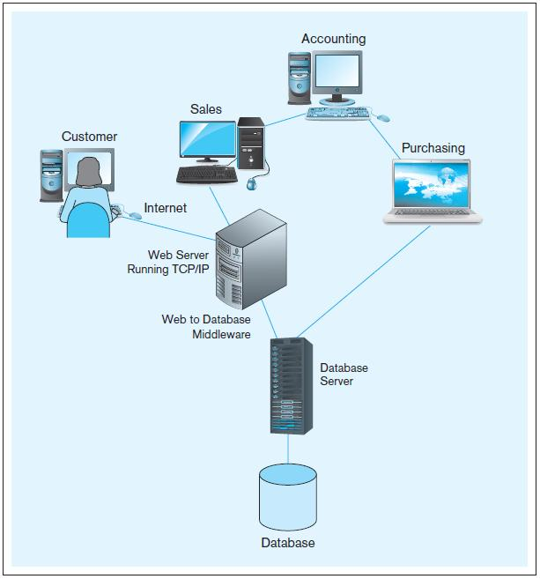
FIGURE 1-13 Computer
System for Pine Valley
Furniture Company
Chapter 1
© 2013 Pearson Education, Inc. Publishing as Prentice Hall

Slide 53

Copyright © 2013 Pearson Education, Inc. Publishing as Prentice Hall

