Slide 1
CHAPTER 6:
INTRODUCTION TO SQL
Modern Database Management
12th Edition
Jeffrey A. Hoffer, V. Ramesh,
Heikki Topi
© 2013 Pearson Education, Inc. Publishing as Prentice Hall

Slide 2
OBJECTIVES
Define terms
Interpret history and role of SQL
Define a database using SQL data definition language
Write single table queries using SQL
Establish referential integrity using SQL
Discuss SQL:1999 and SQL:2008 standards

Slide 3
SQL OVERVIEW
Structured Query Language
The standard for relational database management systems (RDBMS)
RDBMS: A database management system that manages data as a collection of tables in which all relationships are represented by common values in related tables

Slide 4
HISTORY OF SQL
1970–E. F. Codd develops relational database concept
1974-1979–System R with Sequel (later SQL) created at IBM Research Lab
1979–Oracle markets first relational DB with SQL
1981 – SQL/DS first available RDBMS system on DOS/VSE
Others followed: INGRES (1981), IDM (1982), DG/SGL (1984), Sybase (1986)
1986–ANSI SQL standard released
1989, 1992, 1999, 2003, 2006, 2008–Major ANSI standard updates
Current–SQL is supported by most major database vendors

Slide 5
PURPOSE OF SQL STANDARD
Specify syntax/semantics for data definition and manipulation
Define data structures and basic operations
Enable portability of database definition and application modules
Specify minimal (level 1) and complete (level 2) standards
Allow for later growth/enhancement to standard (referential integrity, transaction management, user-defined functions, extended join operations, national character sets)

Slide 6
BENEFITS OF A STANDARDIZED RELATIONAL LANGUAGE
Reduced training costs
Productivity
Application portability
Application longevity
Reduced dependence on a single vendor
Cross-system communication

Slide 7
SQL ENVIRONMENT
Catalog
  A set of schemas that constitute the description of a database
Schema
  The structure that contains descriptions of objects created by a user (base tables, views, constraints)
Data Definition Language (DDL)
  Commands that define a database, including creating, altering, and dropping tables and establishing constraints
Data Manipulation Language (DML)
  Commands that maintain and query a database
Data Control Language (DCL)
  Commands that control a database, including administering privileges and committing data

Slide 8
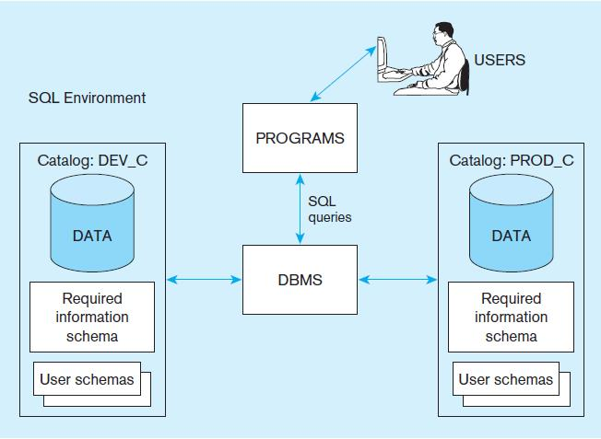
Figure 6-1
A simplified schematic of a typical SQL environment, as described by the SQL: 2008 standard
Chapter 6
© 2013 Pearson Education, Inc. Publishing as Prentice Hall

Slide 9
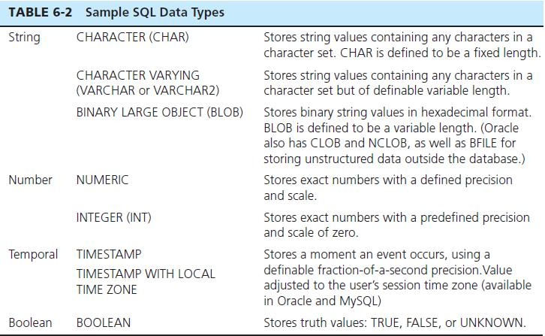
SQL DATA TYPES

Slide 10
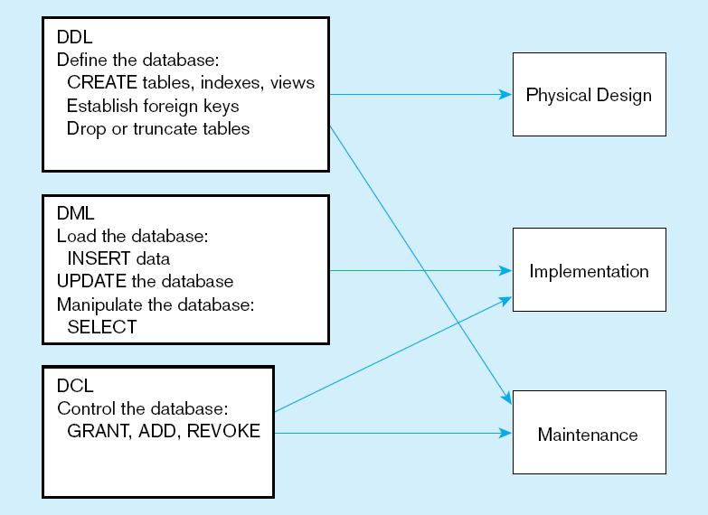
Figure 6-4
DDL, DML, DCL, and the database development process
Chapter 6
© 2013 Pearson Education, Inc. Publishing as Prentice Hall

Slide 11
SQL DATABASE DEFINITION
Data Definition Language (DDL)
Major CREATE statements:
  CREATE SCHEMA–defines a portion of the database owned by a particular user
  CREATE TABLE–defines a new table and its columns
  CREATE VIEW–defines a logical table from one or more tables or views
Other CREATE statements: CHARACTER SET, COLLATION, TRANSLATION, ASSERTION, DOMAIN

Slide 12
CREATE DATABASE IN MYSQL
CREATE {DATABASE | SCHEMA} [IF NOT EXISTS] db_name
  In MySQL, CREATE SCHEMA is a synonym for CREATE DATABASE
SHOW DATABASES or SHOW SCHEMAS
  This command lists existing databases on the MySQL server host.
USE db_name
  This statement tells MySQL to use the db_name database as the default (current) database for subsequent statements.
  This statement is similar to a file command fopen() in C++ and has to be used before using CREATE TABLE in a particular database.
    CREATE DATABASE PVFC;
    USE PVFC;
    CREATE TABLE Customer_T (… …);

Slide 13
STEPS IN TABLE CREATION
Identify data types for attributes
Identify columns that can and cannot be null
Identify columns that must be unique (candidate keys)
Identify primary key–foreign key mates
Determine default values
Identify constraints on columns (domain specifications)
Create the table and associated indexes

Slide 14
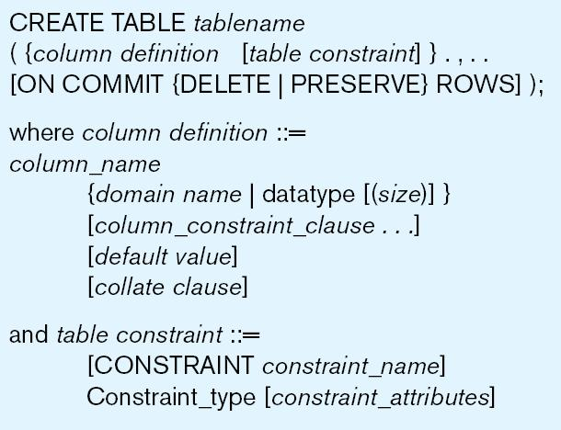
Figure 6-5 General syntax for CREATE TABLE statement used in data definition language

Slide 15
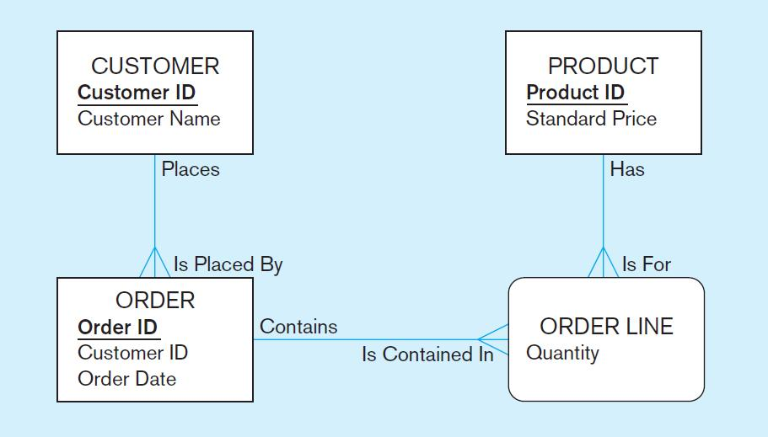
THE FOLLOWING SLIDES CREATE TABLES FOR THIS ENTERPRISE DATA MODEL
(from Chapter 1, Figure 1-3)

Slide 16
Figure 6-6 SQL database definition commands for Pine Valley Furniture Company
CREATE TABLE Customer_T
(CustomerID INT(11) NOT NULL,
CustomerName VARCHAR(25) NOT NULL,
CustomerAddress VARCHAR(30),
CustomerCity VARCHAR(20),
CustomerState CHAR(2),
CustomerPostalCode VARCHAR(10),
CONSTRAINT Customer_PK PRIMARY KEY (CustomerID));
(SQL in MySQL 5.6)
Overall table definitions
CREATE TABLE Order_T
(OrderID INT(11) NOT NULL,
CustomerID INT(11),
OrderDate DATE,
CONSTRAINT Order_PK PRIMARY KEY (OrderID),
CONSTRAINT Order_FK1 FOREIGN KEY (CustomerID) REFERENCES Customer_T(CustomerID));
CREATE TABLE Product_T
(ProductID INT(11) NOT NULL,
ProductDescription VARCHAR(50),
ProductFinish VARCHAR(20)
CHECK (ProductFinish IN ('Cherry‘, 'Natural Ash', 'Natural Maple', 'White Ash', 'Walnut‘)),
ProductStandardPrice DECIMAL(6,2),
ProductLineID INT(11),
CONSTRAINT Product_PK PRIMARY KEY (ProductID),
CONSTRAINT Product_FK1 FOREIGN KEY (ProductLineID) REFERENCES ProductLine_T(ProductLineID));
CREATE TABLE OrderLine_T
(OrderID INT(11) NOT NULL,
ProductID INT(11) NOT NULL,
OrderedQuantity INT(11) ,
CONSTRAINT OrderLine_PK PRIMARY KEY (OrderID, ProductID),
CONSTRAINT OrderLine_FK1 FOREIGN KEY (OrderID) REFERENCES Order_T(OrderID),
CONSTRAINT OrderLine_FK2 FOREIGN KEY (ProductID) REFERENCES Product_T(ProductID));

Slide 17
Defining attributes and their data types
CREATE TABLE Product_T
(ProductID INT(11) NOT NULL,
ProductDescription VARCHAR(50),
ProductFinish VARCHAR(20)
CHECK (ProductFinish IN ('Cherry‘, 'Natural Ash', 'Natural Maple', 'White Ash', 'Walnut‘)),
ProductStandardPrice DECIMAL(6,2),
ProductLineID INT(11),
CONSTRAINT Product_PK PRIMARY KEY (ProductID),
CONSTRAINT Product_FK1 FOREIGN KEY (ProductLineID) REFERENCES ProductLine_T(ProductLineID));
SQL in MySQL
Chapter 6

Slide 18
Non-nullable specification
CREATE TABLE Product_T
(ProductID INT(11) NOT NULL,
ProductDescription VARCHAR(50),
ProductFinish VARCHAR(20)
CHECK (ProductFinish IN ('Cherry‘, 'Natural Ash', 'Natural Maple', 'White Ash', 'Walnut‘)),
ProductStandardPrice DECIMAL(6,2),
ProductLineID INT(11),
CONSTRAINT Product_PK PRIMARY KEY (ProductID),
CONSTRAINT Product_FK1 FOREIGN KEY (ProductLineID) REFERENCES ProductLine_T(ProductLineID));
SQL in MySQL
Primary keys can never have NULL values
Identifying primary key
Chapter 6

Slide 19
Non-nullable specifications
CREATE TABLE OrderLine_T
(OrderID INT(11) NOT NULL,
ProductID INT(11) NOT NULL,
OrderedQuantity INT(11) ,
CONSTRAINT OrderLine_PK PRIMARY KEY (OrderID, ProductID),
CONSTRAINT OrderLine_FK1 FOREIGN KEY (OrderID) REFERENCES Order_T(OrderID),
CONSTRAINT OrderLine_FK2 FOREIGN KEY (ProductID) REFERENCES Product_T(ProductID));
SQL in MySQL
Primary key
Some primary keys are composite– composed of multiple attributes
Chapter 6

Slide 20
Controlling the values in attributes
SQL in MySQL
CREATE TABLE Order_T
(OrderID INT(11) NOT NULL,
CustomerID INT(11),
OrderDate DATETIME Default NOW(),
CONSTRAINT Order_PK PRIMARY KEY (OrderID),
CONSTRAINT Order_FK1 FOREIGN KEY (CustomerID) REFERENCES Customer_T(CustomerID));
Default value
CREATE TABLE Product_T
(ProductID INT(11) NOT NULL,
ProductDescription VARCHAR(50),
ProductFinish VARCHAR(20)
CHECK (ProductFinish IN ('Cherry‘, 'Natural Ash', 'Natural Maple', 'White Ash', 'Walnut‘)),
ProductStandardPrice DECIMAL(6,2),
ProductLineID INT(11),
CONSTRAINT Product_PK PRIMARY KEY (ProductID),
CONSTRAINT Product_FK1 FOREIGN KEY (ProductLineID) REFERENCES ProductLine_T(ProductLineID));
Domain constraint
Chapter 6

Slide 21
Identifying foreign keys and establishing relationships
CREATE TABLE Customer_T
(CustomerID INT(11) NOT NULL,
CustomerName VARCHAR(25) NOT NULL,
CustomerAddress VARCHAR(30),
CustomerCity VARCHAR(20),
CustomerState CHAR(2),
CustomerPostalCode VARCHAR(10),
CONSTRAINT Customer_PK PRIMARY KEY (CustomerID));
Primary key of parent table
CREATE TABLE Order_T
(OrderID INT(11) NOT NULL,
CustomerID INT(11),
OrderDate DATE,
CONSTRAINT Order_PK PRIMARY KEY (OrderID),
CONSTRAINT Order_FK1 FOREIGN KEY (CustomerID) REFERENCES Customer_T(CustomerID));
Foreign key of dependent table
(Pay Attention to the Syntax of this CONSTRAINT.)
Chapter 6

Slide 22
DATA INTEGRITY CONTROLS
Referential integrity–constraint that ensures that foreign key values of a table must match primary key values of a related table in 1:M relationships
Restricting:
  Deletes of primary records
  Updates of primary records
  Inserts of dependent records

Slide 23
SYNTAX OF A REFERENTIAL INTEGRITY CONSTRAINT
In MySQL, the syntax to define a foreign key or a referential integrity constraint is:
  [CONSTRAINT [symbol]] FOREIGN KEY [index_name] (index_col_name, ...)
  REFERENCES tbl_name (index_col_name,...)
  [ON DELETE reference_option]
  [ON UPDATE reference_option]
  The reference_option could be one of the followings: RESTRICT | CASCADE | SET NULL | NO ACTION

Slide 24
REFERENTIAL ACTIONS
Each referential option defines a corresponding referential action to be taken:
  RESTRICT: Rejects the delete or update operation for the parent table. Specifying RESTRICT (or NO ACTION) is the same as omitting the ON DELETE or ON UPDATE clause.
  CASCADE: Delete or update the row from the parent table, and automatically delete or update the matching rows in the child table.
  SET NULL: Delete or update the row from the parent table, and set the foreign key column or columns in the child table to NULL.

Slide 25
REFERENTIAL ACTIONS
Each referential option defines a corresponding referential action to be taken:
  NO ACTION: In MySQL, equivalent to RESTRICT. The MySQL Server rejects the delete or update operation for the parent table if there is a related foreign key value in the referenced table.
  SET DEFAULT: This action is recognized by the MySQL parser, but is not supported by a couple of MySQL storage engines: InnoDB and NDB.
  For an ON DELETE or ON UPDATE that is not specified, the default action is always RESTRICT.

Slide 26

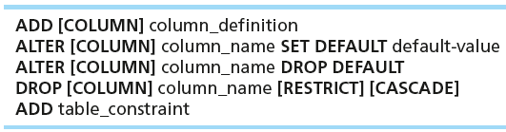
CHANGING TABLES
ALTER TABLE statement allows you to change column specifications:
Table Actions:
Example (adding a new column with a default value):
ALTER TABLE CUSTOMER_T
ADD COLUMN CustomerType VARCHAR(2) DEFAULT “Commercial”;

Slide 27
REMOVING TABLES
DROP TABLE statement allows you to remove tables from your schema:
  DROP TABLE CUSTOMER_T

Slide 28



INSERT STATEMENT
Adds one or more rows to a table
Inserting a row into a table
Inserting a record that has some null attributes requires identifying the fields that actually get data
Inserting from another table

Slide 29
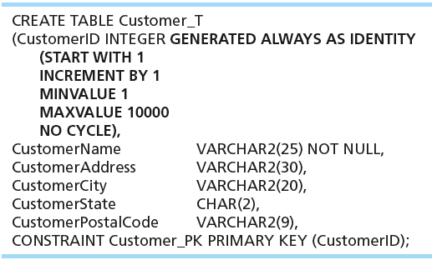
CREATING TABLES WITH IDENTITY COLUMNS
Introduced with SQL:2008
Inserting into a table does not require explicit customer ID entry or field list
  INSERT INTO CUSTOMER_T VALUES ( ‘Contemporary Casuals’, ‘1355 S. Himes Blvd.’, ‘Gainesville’, ‘FL’, 32601);
ATTENTION: This example in the textbook only work for ORACLE. In MySQL, it is defined in a different way, see examples in next slide.

Slide 30
CREATING TABLES WITH IDENTITY COLUMNS
In MySQL, there is no such an IDENTITY Column. In order to increment value of a column, a keyword AUTO_INCREMENT can be used with PRIMARY KEY together. For example:
CREATE TABLE Customers
(CustomerID INTEGER PRIMARY KEY AUTO_INCREMENT,
CustomerName VARCHAR(25) NOT NULL,
CustomerPhone INTEGER);
When inserting a row into the table Customers, user can skip the column for CustomerID
INSERT INTO Customers(CustomerName, CustomerPhone)
VALUES ("Mitchell", 668332211);
In the table, a CustomerID will be automatically added in the new row.

Slide 31
DELETE STATEMENT
Removes rows from a table
To delete rows satisfying certain conditions, WHERE-clause must be used to restrict selection.
  DELETE FROM CUSTOMER_T WHERE CUSTOMERSTATE = ‘HI’;
  Note: values of string-type attributes need to enclosed with single quotation sign in where-clause,
Without using WHERE-clause, all rows will be deleted.
  DELETE FROM CUSTOMER_T;
  This statement will empty the table CUSTOMER_T

Slide 32

UPDATE STATEMENT
Modifies data in existing rows (WHERE-clause is used, too)

Slide 33
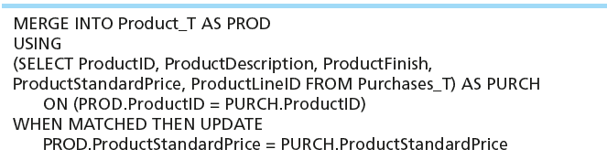
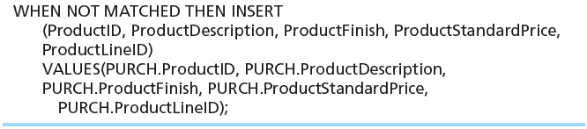
MERGE STATEMENT
In the SQL:2008, a new keyword MERGE is defined. An example is shown below. However, it is not supported by MySQL yet.
Makes it easier to update a table…allows combination of Insert and Update in one statement
Useful for updating master tables with new data

Slide 34
SCHEMA DEFINITION
Techniques to control processing/storage efficiency:
  Choose to index primary / secondary keys
  Select file organizations for base tables
  Select file organizations for indexes
  Data clustering
  Statistics maintenance for tables and their indexes
Not ALL of these techniques are available in all SQL systems.

Slide 35
CREATING INDEXES
Creating indexes
  Speed up random/sequential access to base table data
Below is the syntax for Creating Index in MySQL
  CREATE [UNIQUE|FULLTEXT|SPATIAL] INDEX index_name [index_type] ON tbl_name (index_col_name,...)
  Example
    CREATE INDEX NAME_IDX ON CUSTOMER_T(CUSTOMERNAME)
    This makes an index for the CUSTOMERNAME field of the CUSTOMER_T table
  NOTE: In MySQL, CREATE INDEX cannot be used for a PRIMARY KEY; use ALTER TABLE ADD INDEX command instead.

Slide 36
INDEXES IN MYSQL
Without an index, MySQL must begin with the first row and then read through the entire table to find the relevant rows.
If the table has an index for the columns in question, MySQL can quickly determine the position to seek to in the middle of the data file without having to look at all the data. If a table has 1,000 rows, this is at least 100 times faster than reading sequentially.
Most MySQL indexes (PRIMARY KEY, UNIQUE, INDEX, and FULLTEXT) are stored in B-trees. Exceptions are that indexes on spatial data types use R-trees, and that MEMORY tables also support hash indexes.

Slide 37
SELECT STATEMENT
Used for queries on single or multiple tables
Most Common clauses of the SELECT statement:
  SELECT
    List the columns (and expressions) to be returned from the query
  FROM
    Indicate the table(s) or view(s) from which data will be obtained
    Only names of tables and/or views can be used here.
  WHERE
    Indicate the conditions under which a row will be included in the result
    Where-clause is optional.

Slide 38
SELECT STATEMENT
The written order of the three clauses is:
  SELECT … FROM... WHERE …
But the actual execution order in the DBMS systems is:
  FROM…WHERE…SELECT… (DON’T write your SQL in this order)

Slide 39
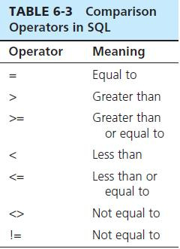

SELECT EXAMPLE
Find products with standard price less than $275
Actual search procedure is:
  From: Locate table Product_T;
  Where: Search all the rows in the table, and find those rows who satisfy ProductStandardPrice < 275;
  Select: Only display two columns from the selected rows in the results.
Table 6-3: Comparison Operators in SQL

Slide 40
SELECT EXAMPLE USING ALIAS
If an attributes is too long, an alias can be used as an alternative column or table name
For example,
    SELECT CUST.CUSTOMERNAME AS NAME, CUST.CUSTOMERADDRESS
    FROM CUSTOMER_V CUST
    WHERE NAME = ‘Home Furnishings’;
Pay attention to where the aliases CUST and where NAME are defined.

Slide 41
SELECT EXAMPLE USING A FUNCTION
Using the COUNT aggregate function to find totals
  SELECT COUNT(*) FROM ORDERLINE_T
  WHERE ORDERID = 1004;
  Note: With aggregate functions you can’t have single-valued columns included in the SELECT clause, unless these columns are included in the GROUP BY clause.

Slide 42
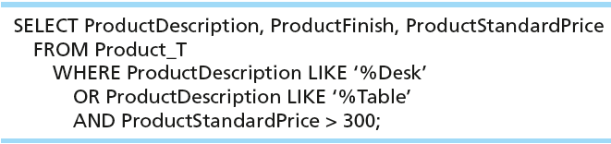
SELECT EXAMPLE–BOOLEAN OPERATORS
AND, OR, and NOT Operators for customizing conditions in WHERE clause
Note: The LIKE operator allows you to compare strings using wildcards. For example, the % wildcard in ‘%Desk’ indicates that all strings that have any number of characters preceding the word “Desk” will be allowed.

Slide 43
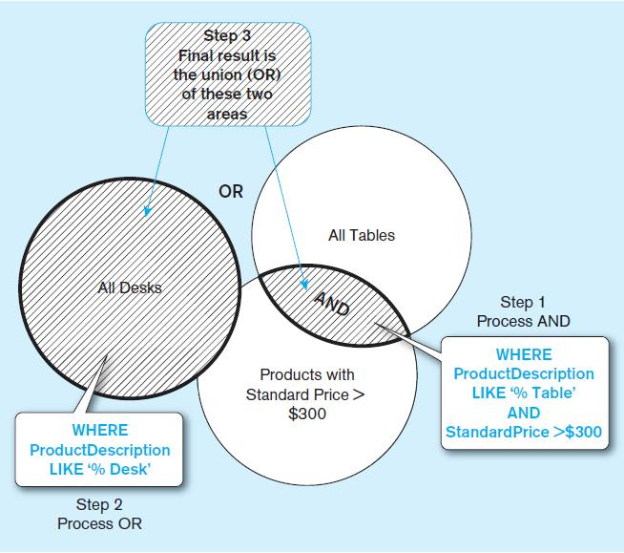
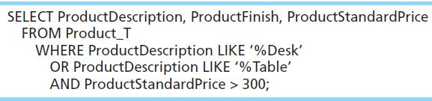
Figure 6-8 Boolean query A without use of parentheses
By default, processing order of Boolean operators is NOT, then AND, then OR

Slide 44
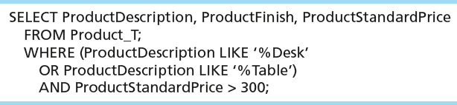
SELECT EXAMPLE–BOOLEAN OPERATORS
With parentheses…these override the normal precedence of Boolean operators
With parentheses, you can override normal precedence rules. In this case parentheses make the OR take place before the AND.

Slide 45
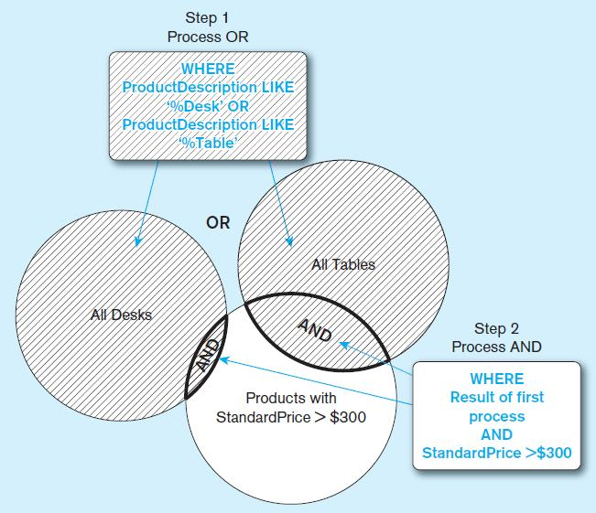
Figure 6-9 Boolean query B with use of parentheses

Slide 46
SELECT STATEMENT
All Clauses of the SELECT statement:
  SELECT
    List the columns (and expressions) to be returned from the query
  FROM
    Indicate the table(s) or view(s) from which data will be obtained
  WHERE
    Indicate the conditions under which a row will be included in the result
  GROUP BY
    Indicate categorization of results
  HAVING
    Indicate the conditions under which a category (group) will be included
  ORDER BY
    Sorts the result according to specified criteria

Slide 47
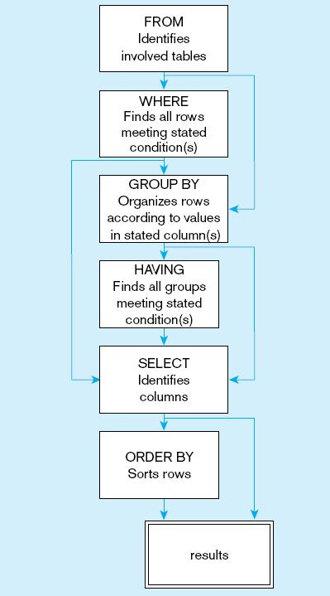
Figure 6-10
  SQL statement processing order (based on van der Lans, 2006 p.100)
Chapter 6
© 2013 Pearson Education, Inc. Publishing as Prentice Hall

Slide 48
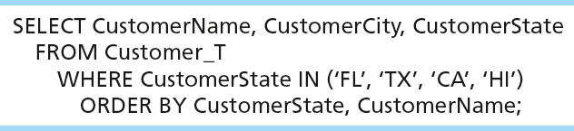
SORTING RESULTS WITH ORDER BY CLAUSE
Sort the results first by STATE, and within a state by the CUSTOMER NAME
Note: The IN operator in this example allows you to include rows whose CustomerState value is either FL, TX, CA, or HI. It is more efficient than separate OR conditions.

Slide 49

CATEGORIZING RESULTS USING GROUP BY CLAUSE
For use with aggregate functions
  Scalar aggregate: single value returned from SQL query with aggregate function
  Vector aggregate: multiple values returned from SQL query with aggregate function (via GROUP BY)
  You can use single-value fields with aggregate functions if they are included in the GROUP BY clause

Slide 50
ANOTHER EXAMPLE OF GROUP BY:
For example:
  SELECT ProductLineID, COUNT(*)
  FROM product_t
  GROUP BY ProductLineID
In this example, ProductLineID is used both in the SELECT-clause and GROUP BY clause.
GROUP BY clause is executed first to group rows based on distinct value of ProducteLineID.
Then, the count(*) is executed once for each group of ProductLineID.
ProductLineID | Count(*)
1 | 2
2 | 4
3 | 2

Slide 51
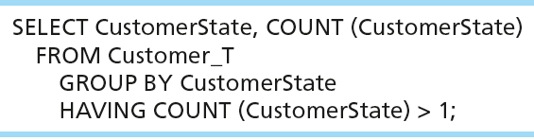
QUALIFYING RESULTS BY CATEGORIES
USING THE HAVING CLAUSE
For use with GROUP BY
Like a WHERE clause, but it operates on groups (categories), not on individual rows. Here, only those groups with total numbers greater than 1 will be included in final result.

Slide 52
DEFINING AND USING VIEWS
Views provide users controlled access to tables
Base Table: table containing the raw data
Dynamic View
  A “virtual table” created dynamically upon request by a user
  No data actually stored; instead data from base table made available to user
  Based on SQL SELECT statement on base tables or other views
Materialized View
  Copy or replication of data
  Data actually stored
  Must be refreshed periodically to match corresponding base tables

Slide 53
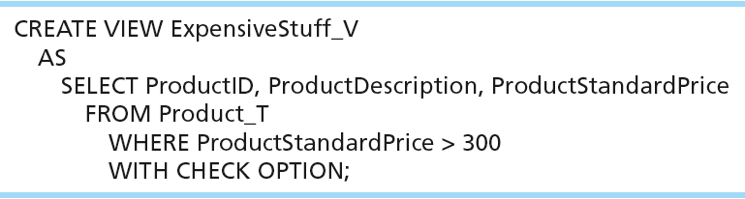
SAMPLE CREATE VIEW
View has a name.
View is based on a SELECT statement.
CHECK_OPTION works only for updateable views and prevents updates that would create rows not included in the view.

Slide 54
ADVANTAGES OF VIEWS
Simplify query commands
Assist with data security (but don't rely on views for security, there are more important security measures)
Enhance programming productivity
Contain most current base table data
Use little storage space
Provide customized view for user
Establish physical data independence

Slide 55
DISADVANTAGES OF VIEWS
Use processing time each time view is referenced
May or may not be directly updateable

Slide 56
REFERENCES FOR MYSQL
Please check for detailed explanation about MySQL Syntax in the following link:
https://dev.mysql.com/doc/refman/5.6/en/sql-syntax.html

