Slide 1
Analyzing Cereal Ratings
How does your favorite cereal rate?
Group 4
Sejla Palic, Amit Nag, Anchit Pandya, and Aditya Narvekar

Slide 2
AGENDA
Research Question
Cereal data
Exploratory data analysis
Methodology & Model
Fitting the model
The best fitted model
Results
Equation
Fitted values
Residuals (normalcy, summary)
Constant variance
Conclusion

Slide 3
INTRODUCTION
MYTH: breakfast is the most important meal of the day [1]
Nowadays, people are paying more attention to nutrition labels and their diets I general
Research Question:
Can we predict a consumer rating of cereal based on its nutritional content.
[1] Kramer, C. (July 5, 2017). Nutrition Myths and Facts Series – Part 1: Breakfast is the most important meal of the day. Day Two. Retrieved from https://www.daytwo.com/blog/nutrition-myths-facts-series-part-1-breakfast-important-meal-day/ on September 1, 2020.

Slide 4
Cereal Data
80 Cereals: Nutrition data on 80 cereal products- https://www.kaggle.com/crawford/80-cereals
77 observations on 80 different cereal
Independent Variables: Name, mfr (Manufacturer), type, calories, protein, fat, sodium, fiber, carbs, sugars, potassium, vitamins, shelf, weight, serving size (cups)
Dependent Variable: Rating

Slide 5
Data Structure
Numerical Variables | Categorical Variables
Fiber | mfr (Manufacturer )
Protein | Type
Calories | Name
Sugars
Fat
Sodium
Carbs
Potassium
Weight
Serving Size
Rating

Slide 6
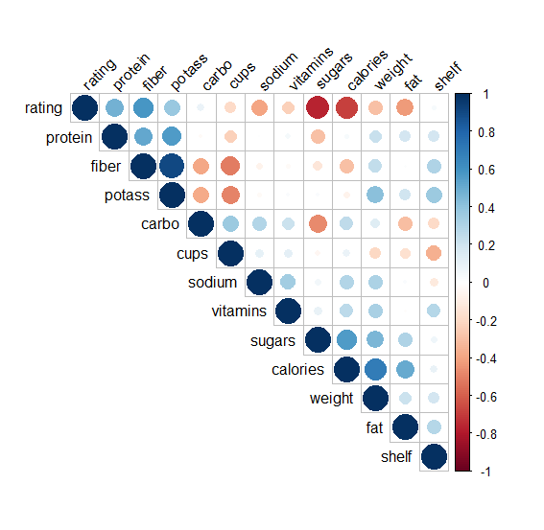
Exploring the Data: Checking for linearity and collinearity
Independent variable | Correlation with the dependent variable
Calories Protein Fat Sodium Fiber Carbohydrates Sugars Pottasium Vitamins Shelf Weight Cups | -0.69 0.47 -0.42 0.40 -0.58 0.09 -0.76 0.38 -0.23 0.04 -0.30 -0.20

Slide 7

The starting model
Initial MLR model:
Rating = $β0+$ $β$₁ (fiber) + $β2$ (protein) + $β$₃ (vitamins) + $β$₄ (sugars) + $β$₅ (calories) + $β$₆ (fat) + $β7$ (weight) + $β8$ (sodium) + $β9$ (carbohydrates)+ $β10$ (shelf)+ $β11$ (cups)+ $β12$ (potassium)+ ε
This model was overfitted and had a R^2-adj of 100%.
Three variables were insignificant and then omitted from the next iteration of the model
Shelf, weight, and cups

Slide 8
Multiple model fitting iterations
After the initial three insignificant variables, all the rest were significant
Based on correlation with rating, one by one variables were omitted
Impact on model performance was checked each time
In total, five different models were fitted until the best fit was found

Slide 9
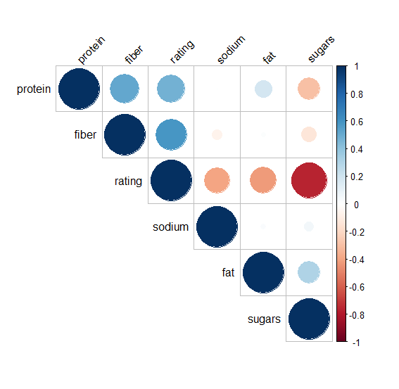
Best Fitted Model
Theoretical model: Rating = 𝛽₀ + 𝛽₁(protein) + 𝛽₂(fat) + 𝛽₃(sodium) + 𝛽₄(fibers) + 𝛽₅(sugars) + 𝛽₆(potassium) + ε
Predicted model: Rating_hat = 58.51 + 1.97 (protein) - 3.9(fat) - 0.057(sodium) + 2.42(fiber) -1.8 (sugars)
The number of variables went from the initial 12 to the final 5, making this the closest to the parsimonious model as possible
This model outperformed all other models with R^2-Adjusted of 98.88%
As seen in the graph on the left, individual predictors have low correlations to each other, minimizing collinearity

Slide 10
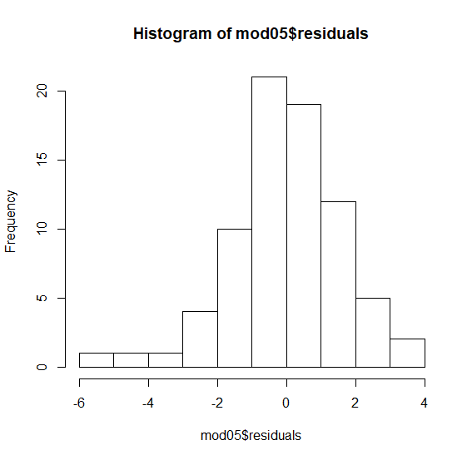

Verifying Model Assumptions - Residuals
Residuals of the model are mostly normal with a slight skew to the left indicating a good model fit
Mean residual was also 0, further indicating normalcy

Slide 11
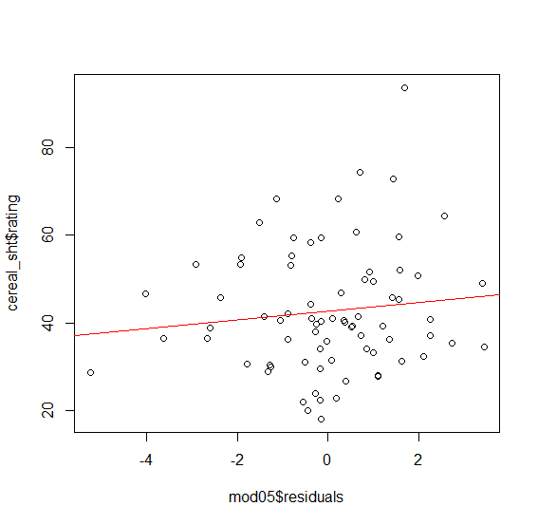
Verifying Model Assumptions – Constant Variation
The scatterplot between residuals and rating does not show a clear pattern which indicates a constant variability

Slide 12
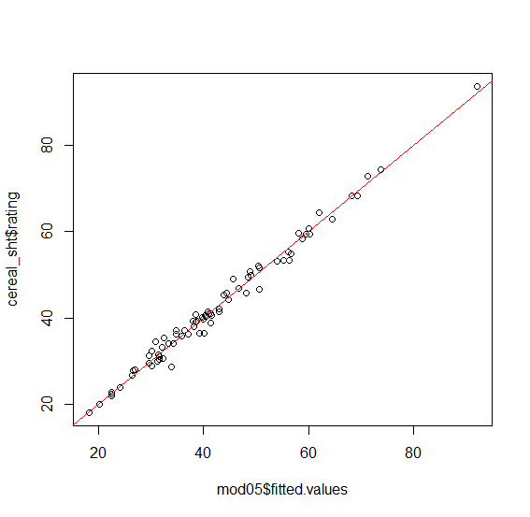
Fitted vs Actual Values
“Squeezed” around the fitted trendline

Slide 13
Conclusion
You can skip breakfast!
Highest rated cereals will be those with highest amount of protein and fiber, and the minimal amounts of sugar, fats, and sodium
Based on this analysis, when skimming through food labels, it is advised to focus on these nutritional values.

Slide 14
THANK YOU AND ENJOY YOUR CEREAL!

