Slide 1
Core Components React Native

Slide 2
What is React Native
an open source framework for building Android and iOS applications using React and the app platform’s native capabilities.

Slide 3
Components [1]
React Native is like React, but it uses native components instead of web components as building blocks.
Basic React concepts
JSX
Components
State
props

Slide 4
Basic React concepts [1]
JSX
<View><Text>Hello world!</Text></View>
This is JSX - a syntax for embedding XML within JavaScript.
JSX lets you write your markup language inside code.
It looks like HTML on the web, except instead of web things like <div> or <span>
In this case, <Text>

Slide 5
Basic React concepts[1]
Components
Basic building block
Anything on the screen is some sort of component.
Props
short for properties
Customize components
Should not be modified
State
allows React components to change their output over time
State changes in response to user Input, network response or anything else.

Slide 6
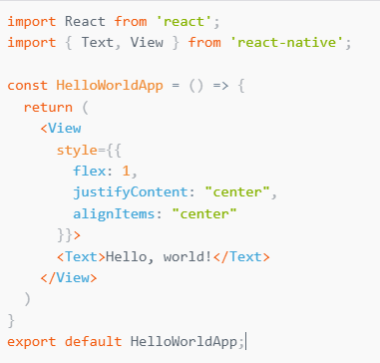
Component(just a function)
Basic component

Slide 7
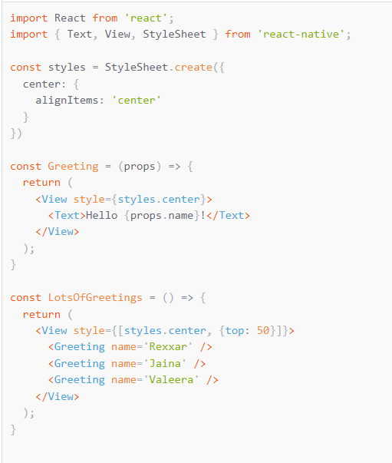
props
Calling custom components

Slide 8
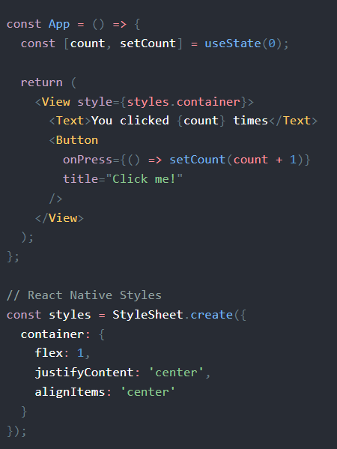
state

Slide 9
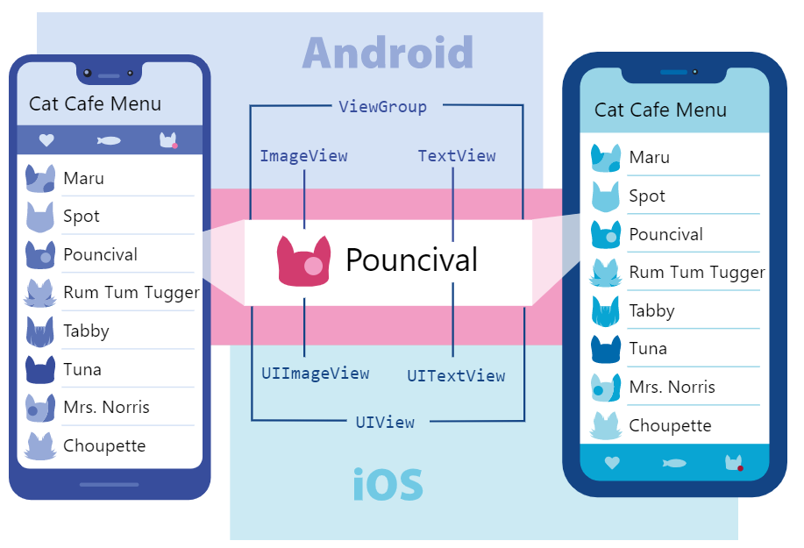
how components work in React Native?

Slide 10
Core/Basic Components
React Native comes with a set of essential, ready-to-use Native Components
View
Text
Image
Button
Touchables
Alert

Slide 11
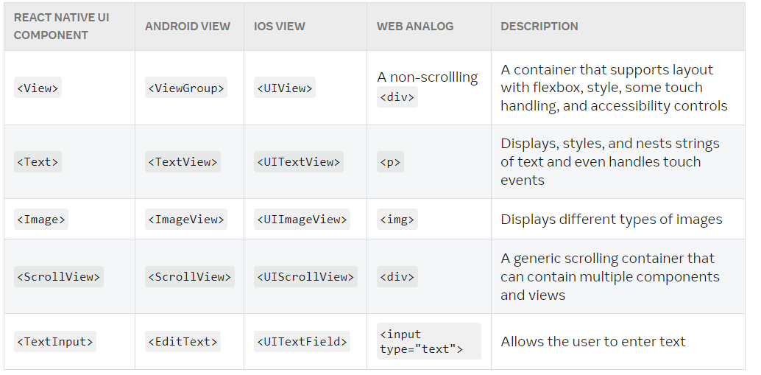
Cross platform working[2]

Slide 12
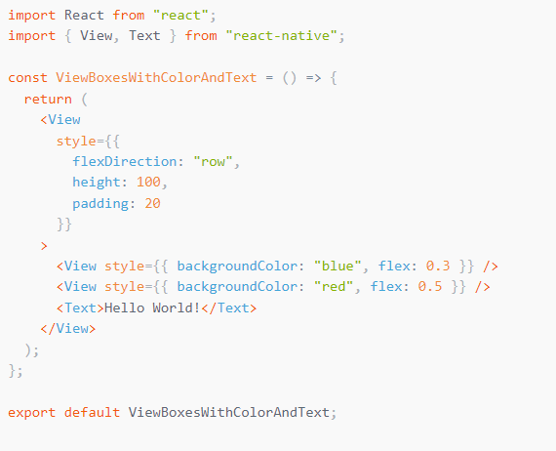
View
basic building block of UI
used to display text, images, or respond to user input
views can contain other views.
Maps to UIView, <div>, android.view

Slide 13

Text
Displays text
supports nesting, styling, and touch handling.
must wrap all the text nodes inside of a <Text> component.
Props
numberOfLines
onPress

Slide 14
Nested Text
<Text style={styles.baseText}>
I am bold and red
<Text style={styles.innerText}> and red</Text>
</Text>

Slide 15
TextInput [3]
foundational component for inputting text into the app via a keyboard.
Props:
autoComplete
autoCorrect
Editable
keyboardType
onChangeText

Slide 16
Image [5]
Display images both local and network
Local Image:
<Image source = {require(‘’)}/>
Network Images:
<Image source = {{uri:‘’}}
Props
blurRadius
defaultSource

Slide 17
Buttons [4]
render nicely on any platform.
Required props
onPress
Title
color

Slide 18
Touchables
Wrapper to make views respond to touches
TouchableHighlight
TouchableOpacity
TouchableWithoutFeedback

Slide 19
References
[1] https://reactnative.dev/docs/tutorial
[2] https://reactnative.dev/docs/intro-react-native-components
[3] https://reactnative.dev/docs/textinput
[4] https://reactnative.dev/docs/button
[5] https://reactnative.dev/docs/image

