Slide 1
Core Components React Native

Slide 2
What is React Native
an open source framework for building Android and iOS applications using React and the app platform’s native capabilities.

Slide 3
Concepts[1]
Components
Basic building block
Anything on the screen is some sort of component.
Props
short for properties
Customize components
Should not be modified
State
allows React components to change their output over time

Slide 4
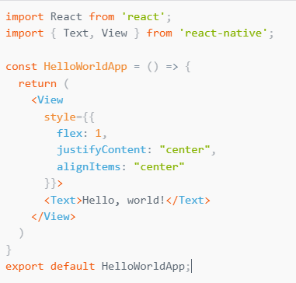
Component(just a function)
Basic component

Slide 5
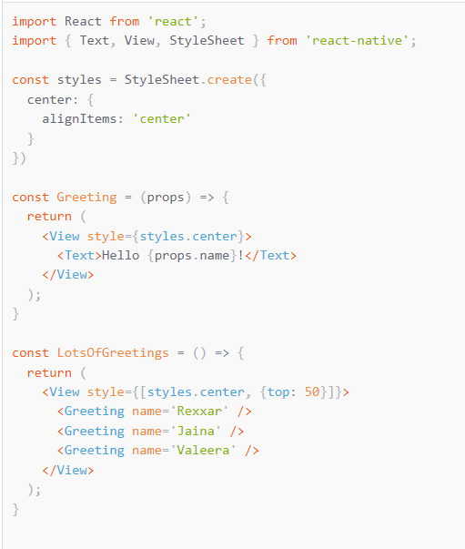
props
Calling custom components

Slide 6
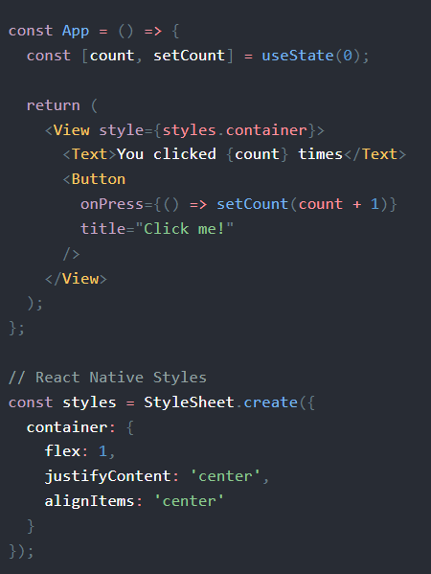
state

Slide 7
Basic Components
View
Text
Image
Button
Touchables
Alert

Slide 8
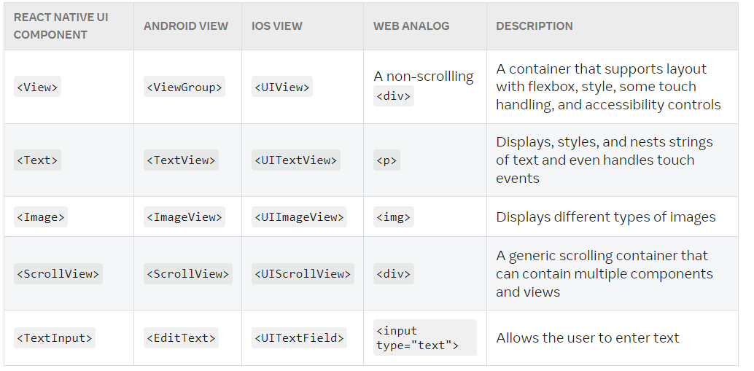
Cross platform working[2]

Slide 9
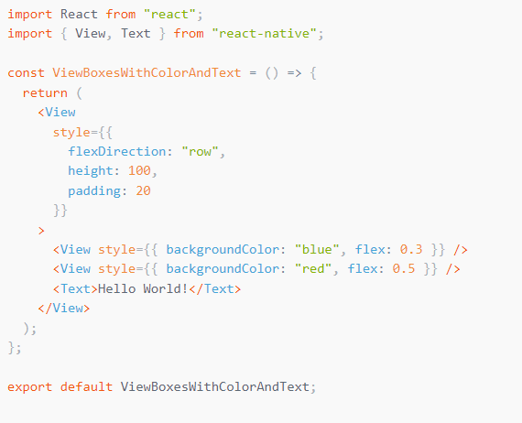
View
basic building block of UI
used to display text, images, or respond to user input
views can contain other views.

Slide 10

Text
Displays text
supports nesting, styling, and touch handling.
must wrap all the text nodes inside of a <Text> component.
Props
numberOfLines
onPress

Slide 11
Image
Display images both local and network
Props
blurRadius

Slide 12
Buttons
render nicely on any platform.
Required props
onPress
title

Slide 13
Touchables
Wrapper to make views respond to touches
TouchableHighlight
TouchableOpacity
TouchableWithoutFeedback

Slide 14
References
[1] https://reactnative.dev/docs/tutorial
[2] https://reactnative.dev/docs/intro-react-native-components

