Slide 1
Layout React Native

Slide 2
Screen Dimensions
Dots per Inch (DPI) to measure UI size.
Dimension API to get width and height
const {height, width} = Dimensions.get('window'); //screen
Calculated = actual x device res/160
Width=200
Actual= 320/160* width

Slide 3
Flexbox[1,2]
provide a consistent layout on different screen sizes.
Flex
how your items are going to “fill” over the available space along your main axis.
Example

Slide 4
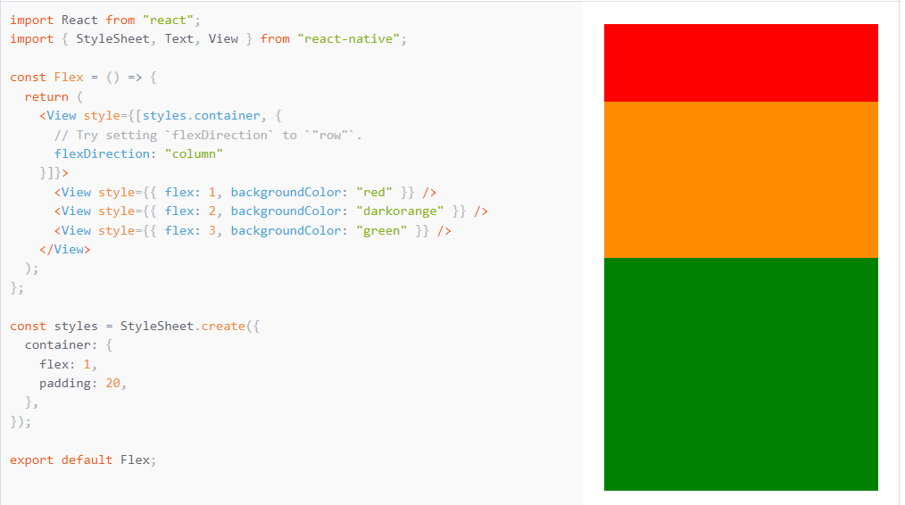

Slide 5
Flexbox
Flex Direction
controls the direction in which the children of a node are laid out
Main axis and cross axis
Values: column, row, row-reverse, column-reverse
Layout Direction
direction in which children and text in a hierarchy should be laid out.
Values: LTR, RTL
Justify Content
align children within the main axis of their container.
Values: flex-start, flex-end, center, space-between, space-around, space-evenly

Slide 6
Flexbox
Align Items
align children along the cross axis of their container.
Values: stretch, flex-start, flex-end, center, baseline
Align Self
align a single item within its parent
Values: same as align items
Flex wrap
controls what happens when children overflow the size of the container along the main axis
Values: wrap, no-wrap
Align Content
distribution of lines along the cross-axis
Values: flex-start, flex-end, center, space-between, space-around, space-evenly

Slide 7
Flexbox
Flex Basis
provides the default size of an item along the main axis
Flex Grow
distributes space among its children along the main axis.
Flex Shrink
shrink children along the main axis in the case in which the total size of the children overflows the size of the container on the main axis.

Slide 8
Flexbox
Absolute & Relative Layout
position defines how it is positioned within its parent.
Values: relative, absolute

Slide 9
References
[1] https://reactnative.dev/docs/layout-props
[2] https://reactnative.dev/docs/flexbox

