Slide 1
Connected healthcare: IoT, Cloud, and Security in digital age
An Activity-Based Learning Experience

Slide 2
WELCOME TO
Connected healthcare!
IoT in healthcare isn’t just innovation—it’s a revolution where every heartbeat writes a new chapter in the story of living, healing, and thriving.

Slide 3
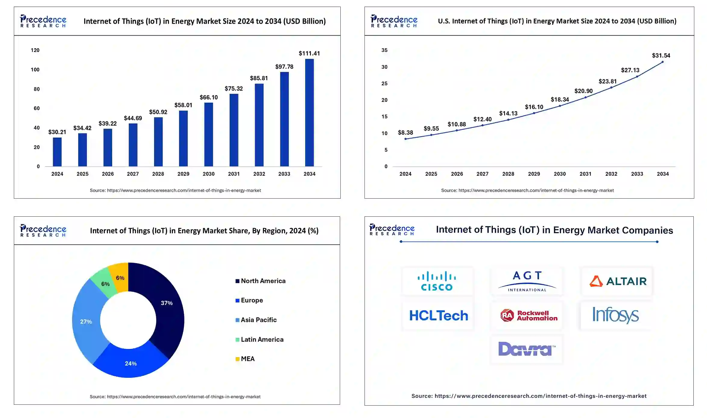
Market size

Slide 4

Week 3
Recap
Notes:
Doug Dietz

Slide 5
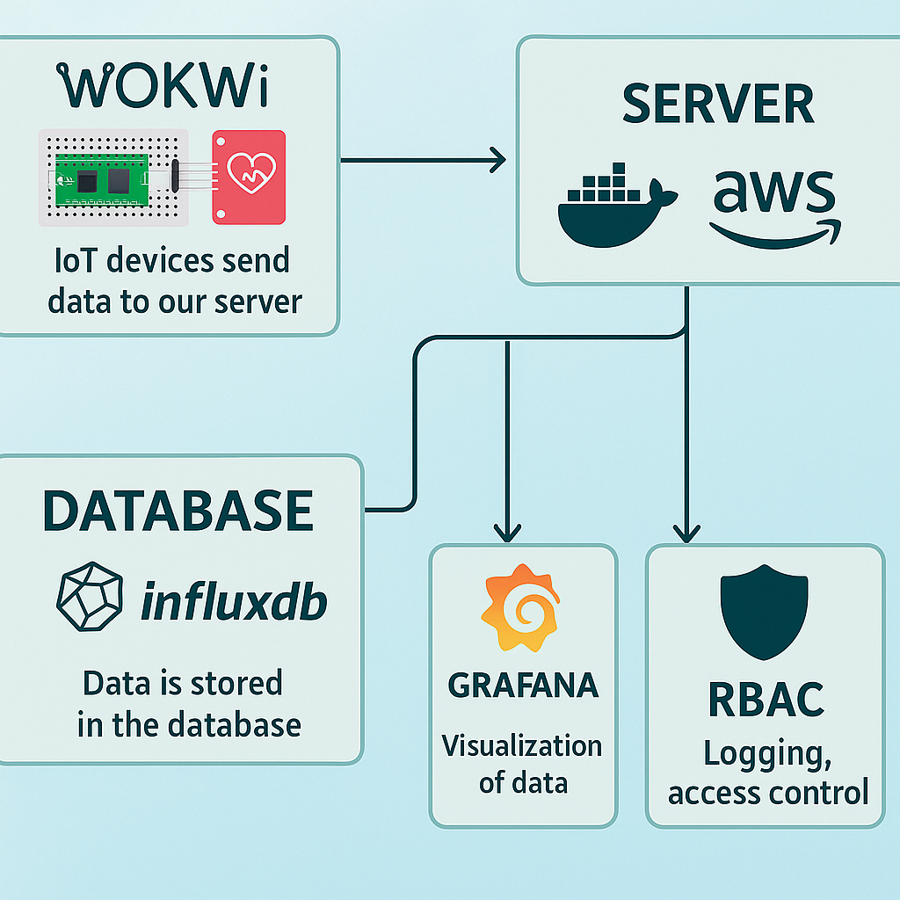
Week 3
Recap
Notes:
Doug Dietz

