Slide 1
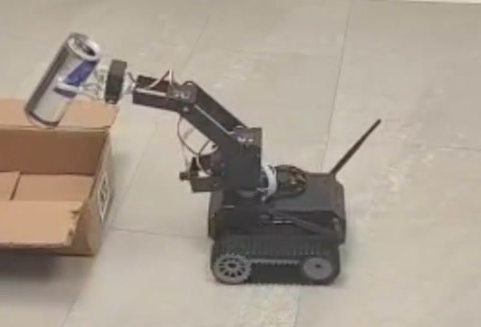
Self-Propelled Arm System
Project presentation
Filip Chekalkin, Huaijing Hou, Spaska Janeva, Kamen Kanev,
Giorgi Khundadze, Xiaosheng Tan, Stoyan Vlaev, Weiye Yuan
Embedded Systems, Cyber-Physical Systems and Robotics
Technical University of Munich, Campus Heilbronn
S.P.A.S. | Embedded Systems, Cyber-Physical Systems and Robotics | TUM Campus Heilbronn
Notes:
[about 0:40]
Good morning, and thank you for coming. We are the S.P.A.S. team, and our
project is the Self-Propelled Arm System.
It is a small tracked robot with a robotic arm on top. Its job is to find drink
cans on the floor of an indoor room, pick them up, and drop them into a
collection bin.
The interesting part of the project is the constraint we worked under. The robot
has one camera and no other sensor. Everything you will see today is decided
from that single image.
I will start with a short overview, and then my colleagues will take you through
the system and the results.

Slide 2

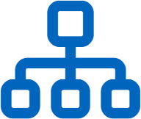

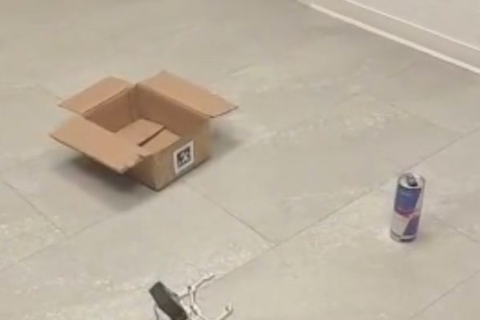


Introduction and Outline
Overview
System summary
Outline
Autonomous can collection robot
Problem and platform
Tracked indoor platform with a four link arm and a parallel gripper
Task definition and hardware constraints
A single RGB camera as the only sensor
Architecture and control
No depth sensor, no range finder, no wheel encoders, no force sensing
System components, state machine, grasping
Vision in the loop at every stage
Search, approach, grasp and delivery are decided from the image
Perception and demonstration
Detection results and a complete run on hardware
Experimental results
Detector accuracy and mission timing
Limitations and conclusion
Open issues, summary and future work
S.P.A.S. | Embedded Systems, Cyber-Physical Systems and Robotics | TUM Campus Heilbronn
2
Notes:
[about 1:10]
Here is the system in three lines.
First, it is an autonomous can collection robot: a tracked indoor platform with a
four link arm and a parallel gripper.
Second, and this is the important one, a single RGB camera is the only sensor.
There is no depth sensor, no range finder, no wheel encoders, and no force
sensing in the gripper.
Third, because of that, vision is in the loop at every stage. Search, approach,
grasp and delivery are all decided from the image.
The photograph on the left shows the environment we work in: drink cans standing
on the floor, and a bin marked with an AprilTag.
The outline on the right is how we will proceed. We start with the problem and
the platform, then the architecture and the control logic, then perception and a
complete run on hardware, then the measured results, and we close with the
limitations and the conclusion.

Slide 3




Problem Statement
Objective and constraints
Drink cans accumulate in indoor public spaces
Collection is repetitive, low risk manual work
The task combines perception, navigation, decision making and manipulation
Sensor configuration
Single RGB camera
Detection
No depth sensing
Rotate in place until the detector accepts a target
Approach
No wheel encoders
Steer on the image error, stop on apparent size
Grasp
No force sensing
Lower the arm, push, close, lift
Delivery
Dock on the AprilTag and release above the bin
S.P.A.S. | Embedded Systems, Cyber-Physical Systems and Robotics | TUM Campus Heilbronn
3
Notes:
[about 1:20]
First, why this task.
Drink cans accumulate in indoor public spaces, and collecting them is
repetitive, low risk manual work. For us it was a good project task because it
combines everything at once: perception, navigation, decision making and
manipulation.
The mission breaks into four stages, shown on the left.
In detection, the robot rotates in place until the detector accepts a target.
In approach, it steers on the image error and stops when the target looks large
enough. In grasp, it lowers the arm, pushes, closes and lifts. In delivery, it
docks on the AprilTag and releases the can above the bin.
On the right is the hardware we had to do this with. One RGB camera, 320 by 240
pixels, with a 60 degree field of view. No depth sensing, no stereo pair, no
range finder. No wheel encoders, so the base returns no motion feedback at all.
And no force sensing, so the gripper cannot detect contact.
The consequence is at the bottom right, and it is the sentence that shapes the
whole system: the base is an open loop actuator. We command it to move, and the
only way to confirm that it moved is to look at the next camera image.

Slide 4
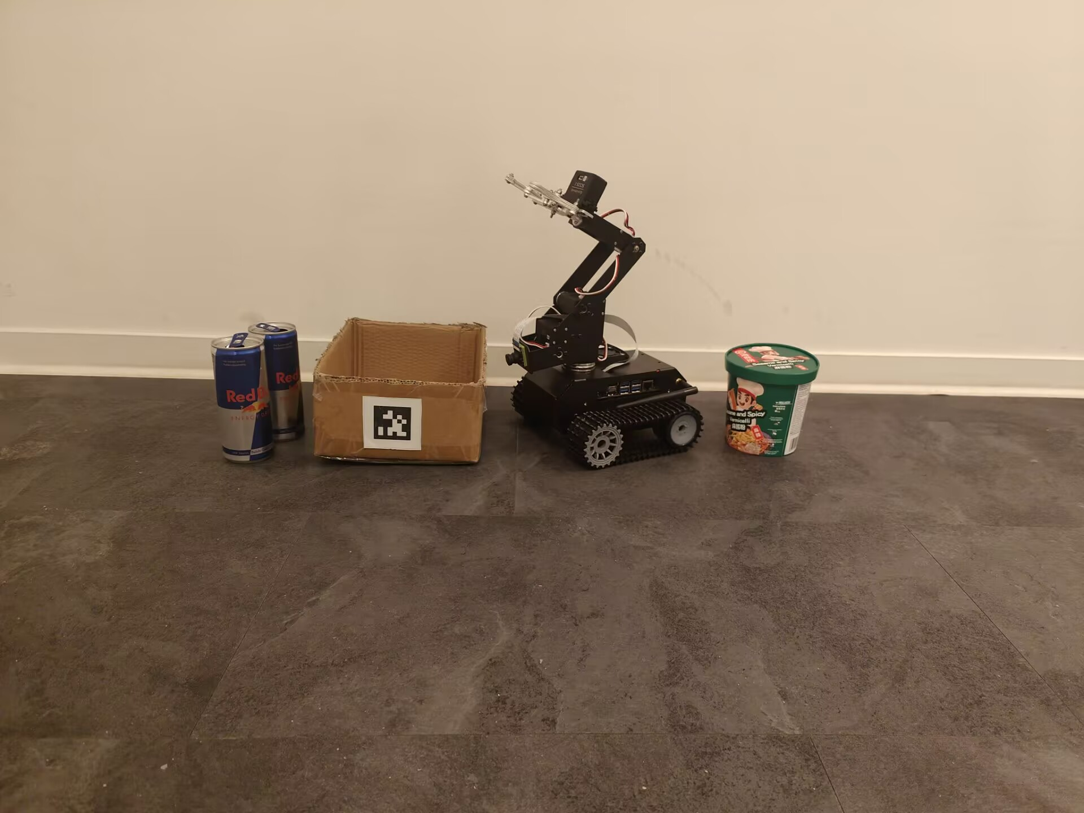
The “actors” of the show

Slide 5


System Architecture
Components and software framework
Three subsystems are connected to the Jetson Nano. Only the servo chain reports its state back.
Two track motors
PWM via motor driver
no position feedback
CSI camera
3200 x 2400 (at max)
CSI-2
Jetson Nano
4 GB shared
frames in
Five bus servos
one TTL serial chain
position readable
Battery and power rail
power
S1
S2
S3
S4
S5
S4 closes the gripper
Software stack
Controller layer
Perception layer
Hardware layer
Configuration
demo_core state machine, 16 states
detectNet, pupil_apriltags, OpenCV
jetbot Robot and Camera, TTLServo
config.json, empirical_parameters.json
camera_calibration.yml etc.
S.P.A.S. | Embedded Systems, Cyber-Physical Systems and Robotics | TUM Campus Heilbronn
4
Notes:
[about 1:15]
This is the hardware architecture.
In the middle is the Jetson Nano with four gigabytes of shared memory. It runs
everything on board. There is no external computer and no remote control.
Three subsystems are connected to it. On the left, the CSI camera delivers 320 by
240 frames over CSI-2. On the right, two track motors are driven with PWM through
a motor driver, and they report nothing back. Below them, five bus servos are
connected in one TTL serial chain, and these are the only devices in the system
whose position we can read. Servo four closes the gripper.
The dashed lines are the power rail, from the battery to the drive and to the
computer.
At the bottom is the software stack, in four layers. The mission layer is our
demo_core state machine with sixteen states. The perception layer uses detectNet,
the pupil_apriltags library and OpenCV. The hardware layer wraps the jetbot Robot
and Camera classes and the TTLServo driver. And all tuning constants live in two
JSON configuration files, so no threshold is hard coded in the logic.

Slide 6
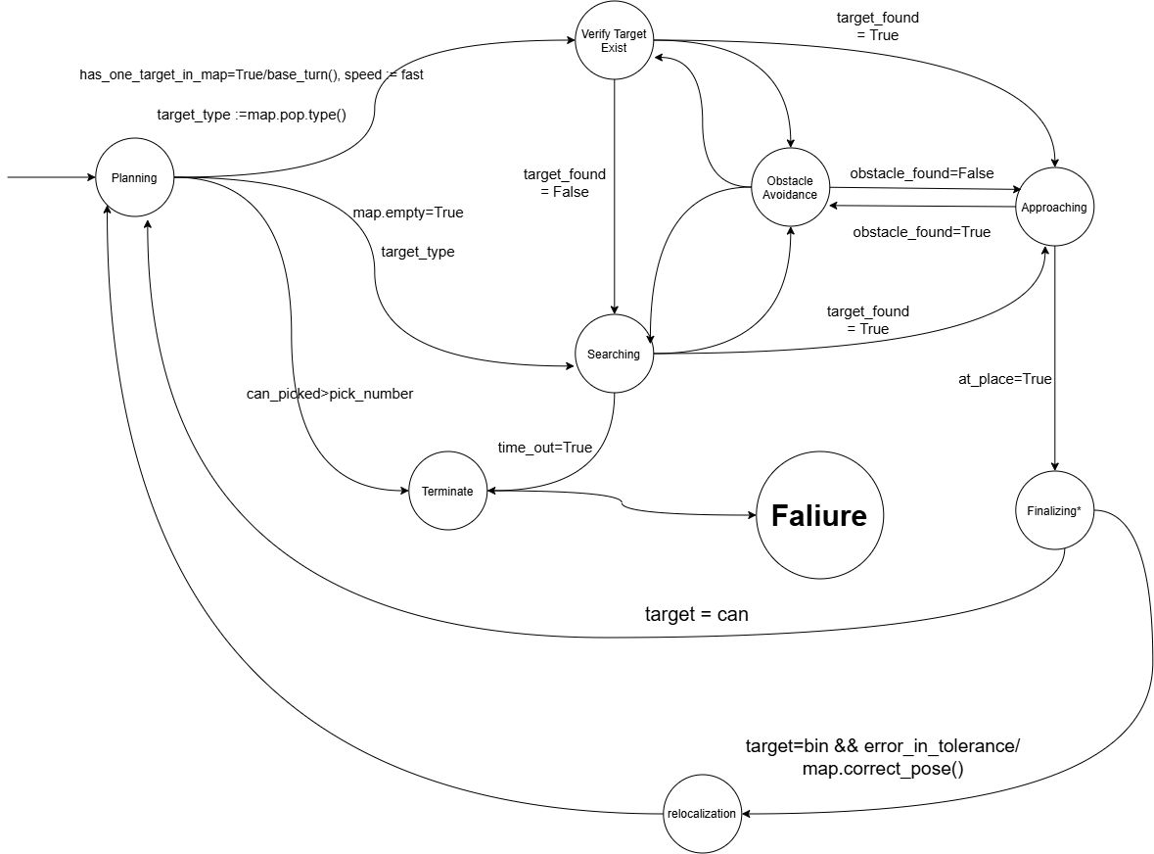
System design using from a (informal)FSM view
Controller with many detail omitted
Vision driven states
Searching
Rotate until a target is accepted or the timeout expires
Aligning
Turn to tolerance, abort if the target is lost
Approaching
Steer or drive forward, stop on apparent size
Final verification
Tighter tolerance over consecutive frames
ex = ( xc - W/2 ) / W
Design level state graph. Transition guards are fields of a single shared context object.
Range -0.5 to 0.5, negative to the left of centre
Stop thresholds: 0.36 box height, 0.15 tag height
Transitions are held in an explicit table, so an undeclared state and event pair raises an error
Finalising requires a stable target, a condition map based navigation never reaches, so dead reckoning triggers no action
S.P.A.S. | Embedded Systems, Cyber-Physical Systems and Robotics | TUM Campus Heilbronn
5
Notes:
[about 1:45]
The mission logic is an explicit finite state machine, sixteen states in total.
The graph on the left is the design level view. The guards on the transitions are
fields of a single shared context object, so every state reads the same picture
of the world.
On the right are the four states that are driven by vision.
In searching, the robot rotates until a target is accepted or the timeout
expires. In aligning, it turns until the target is within tolerance, and it
aborts if the target is lost. In approaching, it steers or drives forward and
stops on apparent size. Final verification repeats the check with a tighter
tolerance over several consecutive frames, so a single lucky frame cannot trigger
a grasp.
The formula below is the whole control input. e_x is the horizontal position of
the target centre, minus half the image width, divided by the image width. It
ranges from minus zero point five to plus zero point five, negative to the left of
centre. We steer to drive that error to zero.
Distance is handled the same way. We do not estimate range. We stop when the
detection box reaches 0.36 of the image height for a can, or 0.15 for the tag.
Apparent size replaces a distance measurement.
Two design decisions at the bottom. Transitions are held in an explicit table, so
an undeclared state and event pair raises an error instead of failing silently.
And finalising requires a stable target, which map based navigation never
provides, so dead reckoning alone can never trigger a grasp.

Slide 8
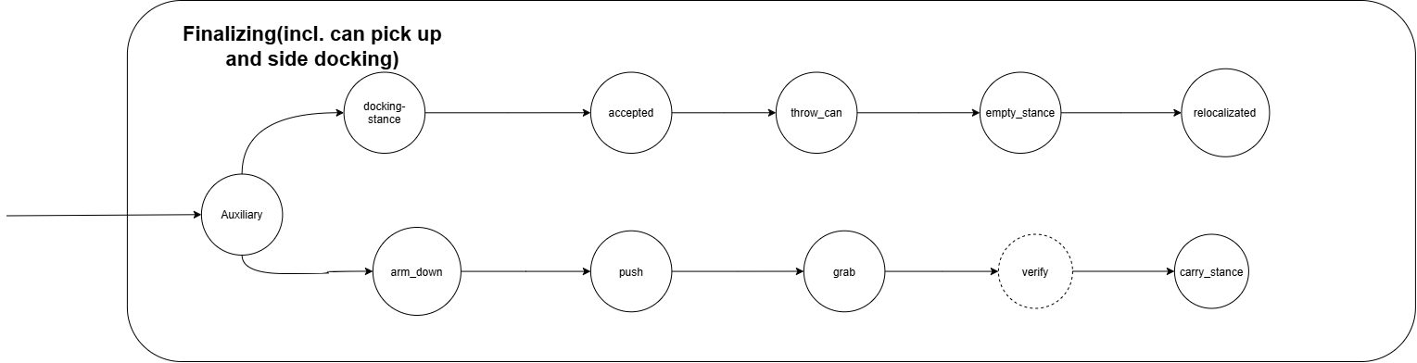
Finalizing: abstraction of docking at bin and picking up cans

Slide 9
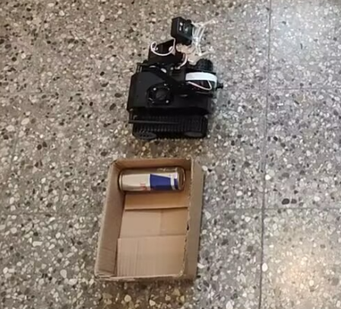
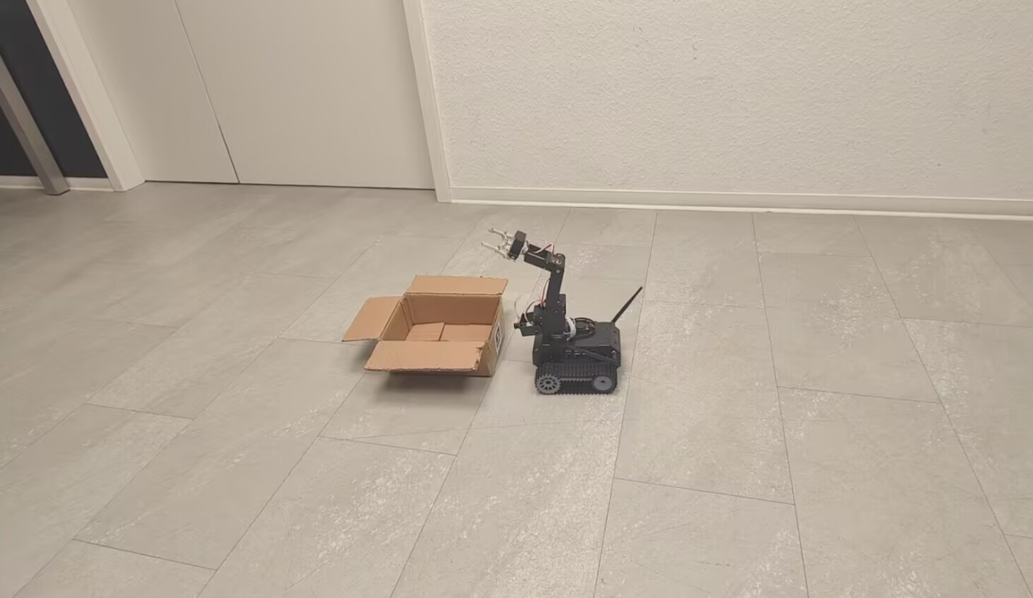
Side-docking? Why need?
Side-docking? Why need?
What we called “front docking”
Side-docking or say left-turn docking
Using “traditional relocalization” in the lecture slides.
Impl. supported by OpenCV SolvePnP

Slide 10
The ground is a 2-dimensional space, to get back to the start point(has many benifits)
as precisely as possible, we need to correct both the “z” and “x” coordinates!
Still didn’t solve the whole problem..but better than „no stance“ docking.
An ideal approach require stronger kinematic analysis and modeling instead of just naive discrete state workaround.

Slide 11
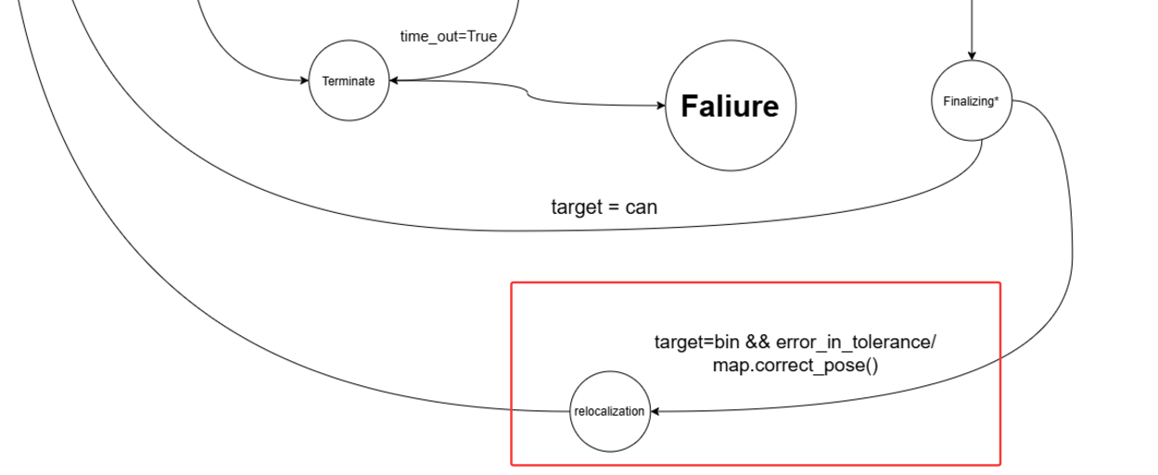
⬆The “benifit”, an invariant that looked like a thing..

Slide 12
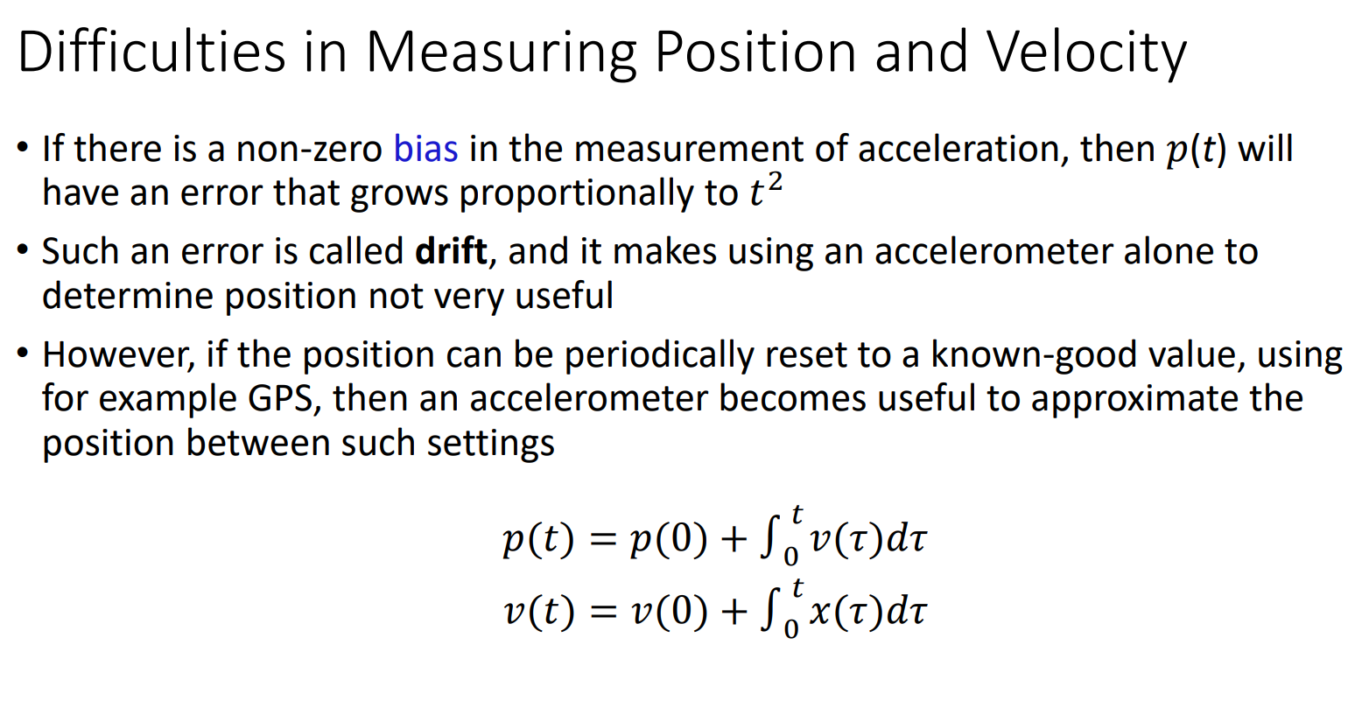
The re-localization design origin(CPS slides):
Here: GPS=AprilTag, Dead reckoning done by calibrated “speed” look-up table.
It’s so hard to implement with our plant...

Slide 13
robot.forward(„speed“): argument in the TTLServo function calls → implemented by
Fixed Voltage.
Linear dynamic model exist?

Slide 14
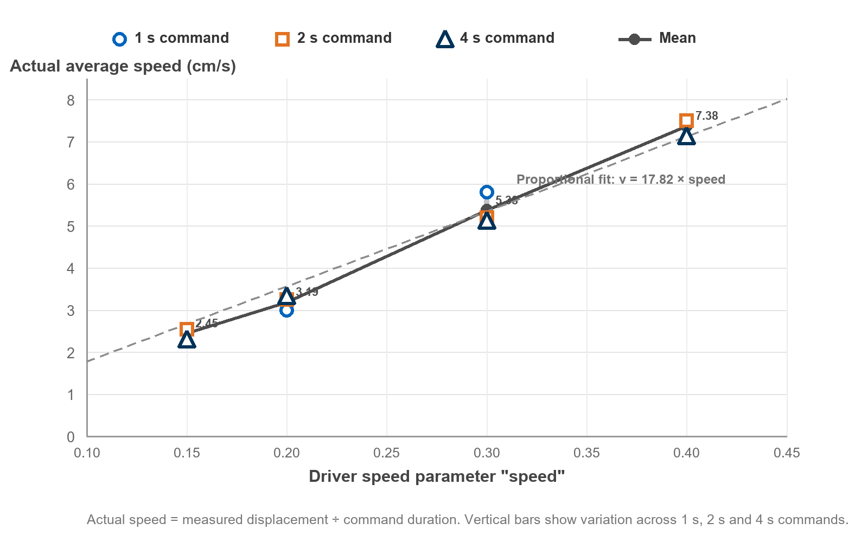
robot.forward(„speed“): argument in the TTLServo function calls → implemented by
Fixed Voltage.
Linear dynamic model exist? Kind of, but for our very fragile (limited sensing) system,
the precision still leads to a excess of the tolerance.

Slide 15
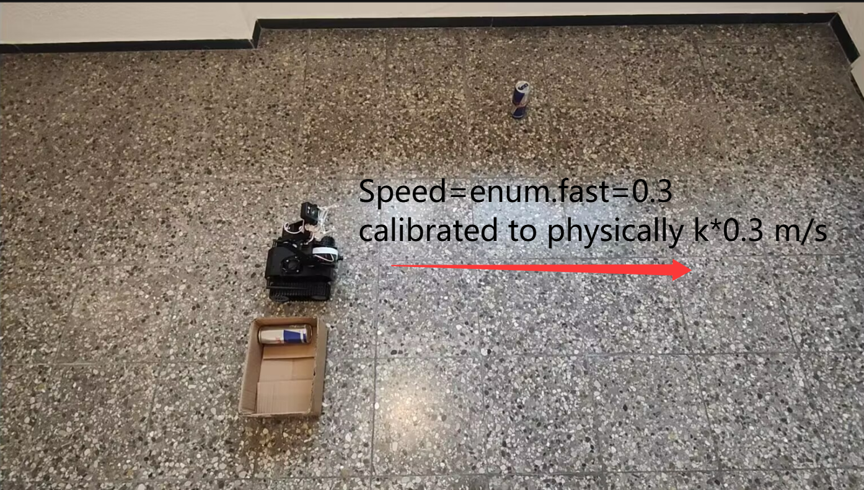
Smart Solution: Taking chip tempreture, friction coefficient,
slipping/drifting factor etc. into account. Solve a linear/quadratic system etc.
Our (Stupid) Solution: Look-up table with fixed “internal speed” parameters and tie it to
the enviroment e.g. the ground in the lecture hall in Weiperstrasse.
Then calibrate/test it again in somewhere else...troublesome but works.

Slide 16
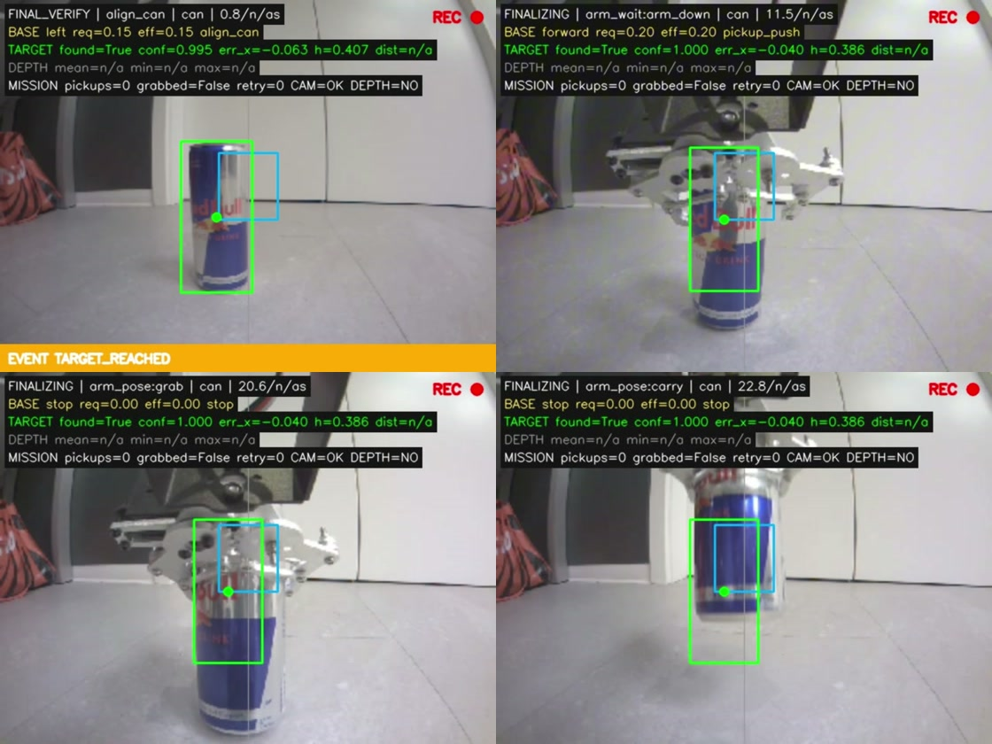
Can Grasping Strategy
Manipulation sequence
Fixed poses — no inverse kinematics(since no sensor on the gripper)
1
2
3
4
5
6
Wait
Lower
Push
Hold
Close
Lift
2.0 s settle
arm_down pose
Slow forward drive
5.0 s lock
Grab pose
Carry pose
Why push, not reach
Short arm, imprecise gripper
Base drives reliably
Can driven into open gripper
Coarse motion beats fine manipulation
Servo feedback
Polled until readings stabilise
Push blocked until settled
4.94 s settle · 7.0 s push · 5.0 s hold
Verify · push · close · carry
S.P.A.S. | Embedded Systems, Cyber-Physical Systems and Robotics | TUM Campus Heilbronn
6
Notes:
[about 1:35]
Now the grasp itself.
There is no inverse kinematics here. The arm moves between fixed, pre-defined
poses, and the base drives the can into the open gripper.
The sequence at the top has six steps. Two seconds of settling. Lower the arm to
the down pose, polling the servos. Push forward slowly, which is the step
highlighted in blue. Hold the arm locked for five seconds. Close to the grab
pose. Lift to the carry pose.
The four frames below are recorded on board during a real pickup: verification,
push, closing, and carry.
Why push instead of simply closing the gripper on the can? The arm is short and
the gripper closes imprecisely, but the base moves reliably over short distances.
So we lower the open gripper to the floor and drive the can into it. We trade
fine manipulation, which our hardware is bad at, for coarse base motion, which it
does well.
The block below is the one place in the whole system with real feedback. Servo
positions are polled until the readings stop changing, instead of waiting a fixed
delay. If the arm has not settled, the push is blocked outright. In the archived
run this took 4.94 seconds of settling, 7 seconds of pushing and 5 seconds of
holding.
The limitation is honest and it is on the slide: this only works for light
objects on a low friction floor.

Slide 17
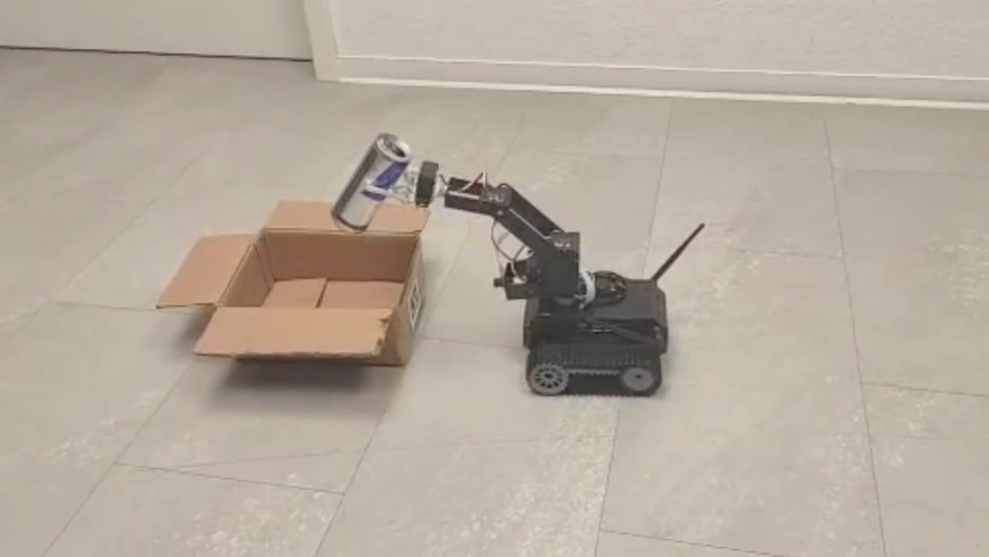
Experimental Setup
Platform with grasped can
Arena: can, AprilTag bin
Release above bin
73.8 s
1
98
41 / 59
Full run
Camera only
Can detections
Tag reads
According to „some piece“ of our testing logs
S.P.A.S. | Embedded Systems, Cyber-Physical Systems and Robotics | TUM Campus Heilbronn
7
Notes:
[about 1:05]
This is the experimental setup and one complete reference run.
On the left, the platform holding a grasped can. In the middle, the arena: a 250
millilitre can and the bin with the AprilTag. On the right, the end of the run,
with the can held above the bin.
The numbers below describe that run. It took 73.8 seconds from the start of the
search to the release over the bin. One camera, with no depth sensor, no range
finder and no encoders. 98 can detections during the run, and 41 successful tag
reads out of 59 attempts.
So search, grasp, transport and release were all completed on real hardware using
the camera alone. And this is not an assumption on our side: the on-board overlay
records DEPTH equals NO on every single frame of that run.

Slide 18

Video

Slide 19
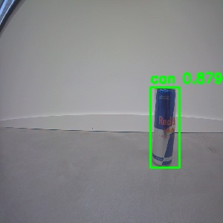
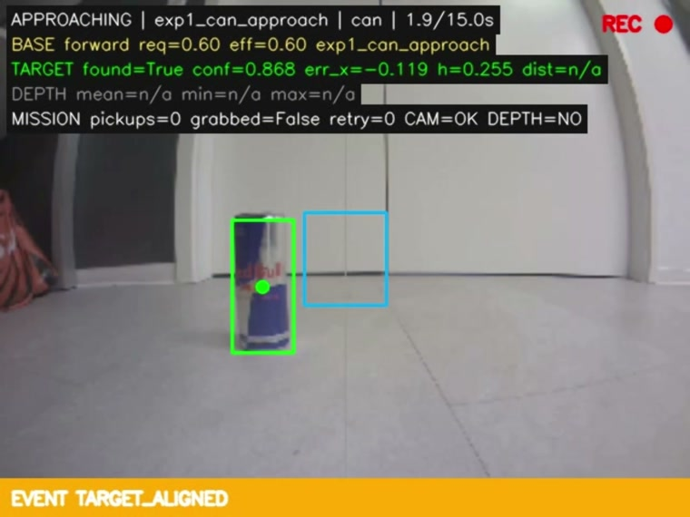
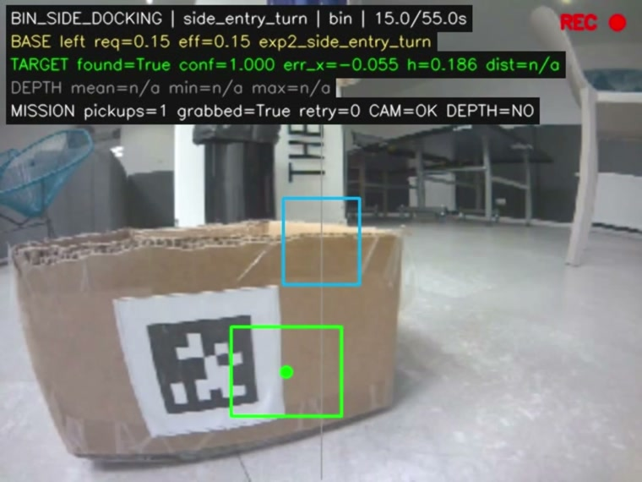
Object and Marker Detection
Two detectors, every controller input
Detector output
Can detection
Tag detection
SSD-MobileNet-V1 · 300 × 300
error −0.119 · height 0.255
tag36h11 id 0 · height 0.186
S.P.A.S. | Embedded Systems, Cyber-Physical Systems and Robotics | TUM Campus Heilbronn
8
Notes:
[about 1:20]
Perception is two detectors, and between them they produce every measurement the
controller uses.
On the left is the object detector, SSD-MobileNet-V1 at 300 by 300 input
resolution, with the confidence score.
In the middle is the same detector running inside the mission, with our overlay
on top. You can read the two values the controller actually consumes: a
horizontal error of minus 0.119, so the can is slightly left of centre, and a box
height of 0.255, which is still below the 0.36 stopping threshold. So at this
moment the robot keeps approaching.
On the right is the AprilTag detector during docking at the bin. Family tag36h11,
identifier zero. The tag height is 0.186 against a threshold of 0.15, and the
error is minus 0.055.
One point worth making explicitly: we never calibrated the camera, and we do not
need to. Tag height, edge ratio and corner angle are all ratios measured in the
image, so the focal length cancels out. The AprilTag library can also give a
metric pose through perspective-n-point, but we deliberately do not use it.

Slide 20
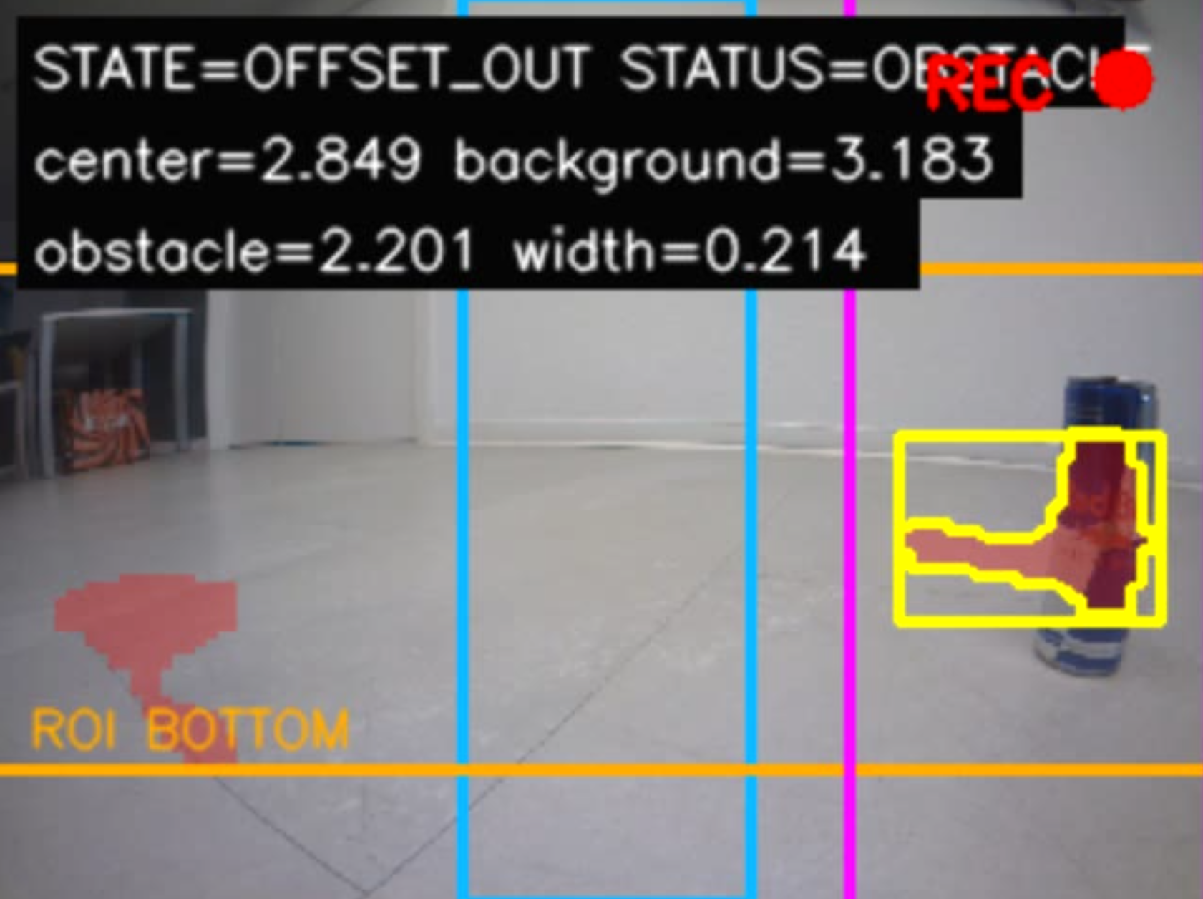
Obstacle avoidance
An experimental feature we didn’t integrate. Purple is the computed tangent of the obstacle.

Slide 21
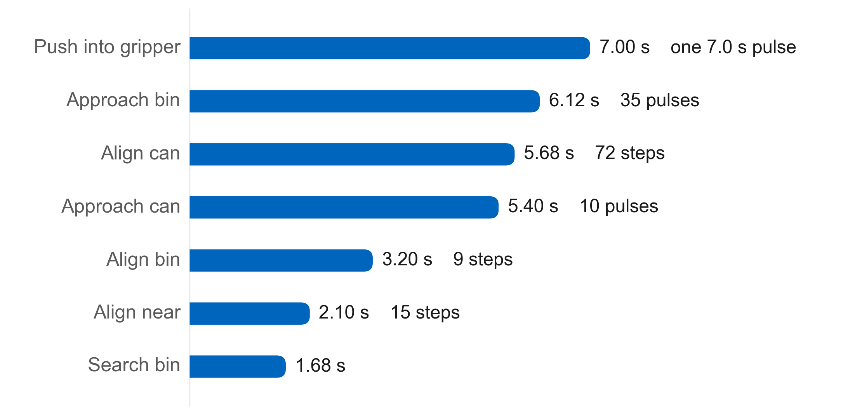
Detector Training Results
Detector F1 by evaluation set
Base motion per phase
Insert Jetson Nano test result
671
194
0.6637
Epoch 22
Training images
Validation images
Best validation mAP
Selected refinement epoch
Training setup
Validation status
MobileNet V1 SSD at 300 × 300
30 initial epochs and 40 refinement epochs
Confidence 0.20, NMS 0.30, IoU 0.50
ONNX checker passed at opset 11
PyTorch vs. ONNX max error 4.4 × 10⁻⁷
Epoch 22 performed better across robot photo and video domains
S.P.A.S. | Embedded Systems, Cyber-Physical Systems and Robotics | TUM Campus Heilbronn
9
Notes:
[about 1:35]
Now the measurements.
The left chart is detector accuracy as F1 score. The two bars per group compare
the model we deployed against the stronger custom model. On photographs we lose
about six F1 points, and on video about two.
We accepted that, and the reason is below the chart. The deployed model removes a
custom post-processing layer and a custom inference backend, and it uses the
inference path that NVIDIA supports natively on the Nano. We traded a small
amount of accuracy for a deployment that works reliably on the device we have.
The conversion itself is lossless in practice: the difference between the PyTorch
model and the exported ONNX model is 4.4 times ten to the minus seven.
The right chart is where the time goes in the 73.8 second run. Only 31.2 seconds,
about 42 percent, is commanded base motion. Another 11.9 seconds are deliberate
holds, the settling and locking we saw in the grasp sequence. The rest is
perception and decision time.
One caveat, and we state it on the slide rather than hiding it. That run was
recorded by the earlier prototype, with the legacy parameter set and the custom
TensorRT detector. Its stop thresholds were 0.400 and 0.500, not the 0.36 and
0.15 we use today. The counts and the timings are exact, but the thresholds do
not match the current configuration.

Slide 22
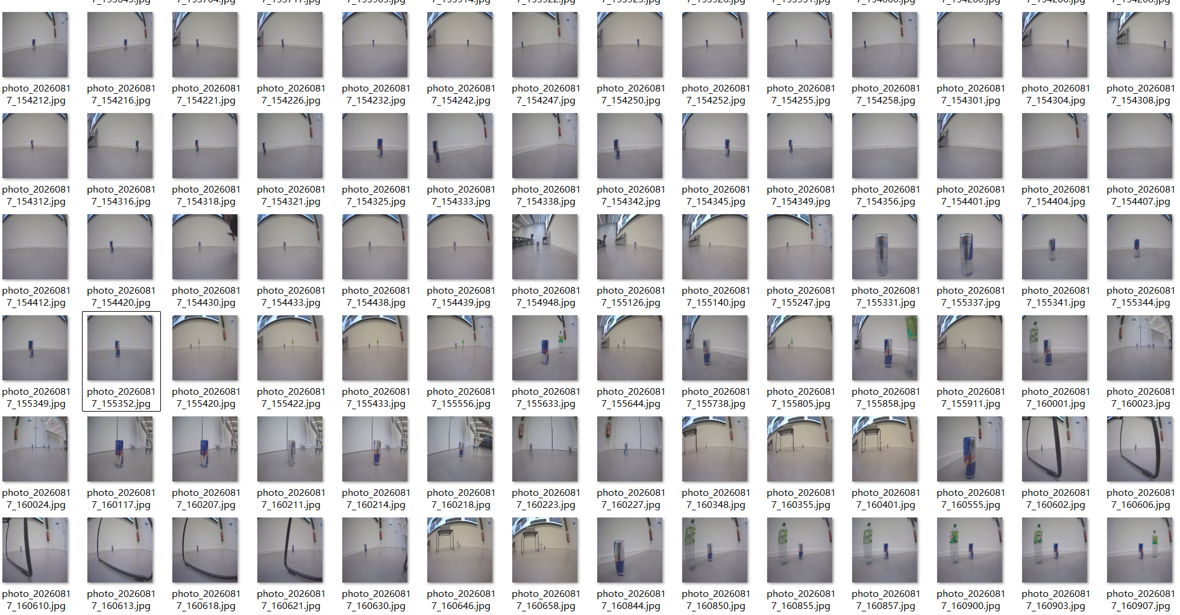
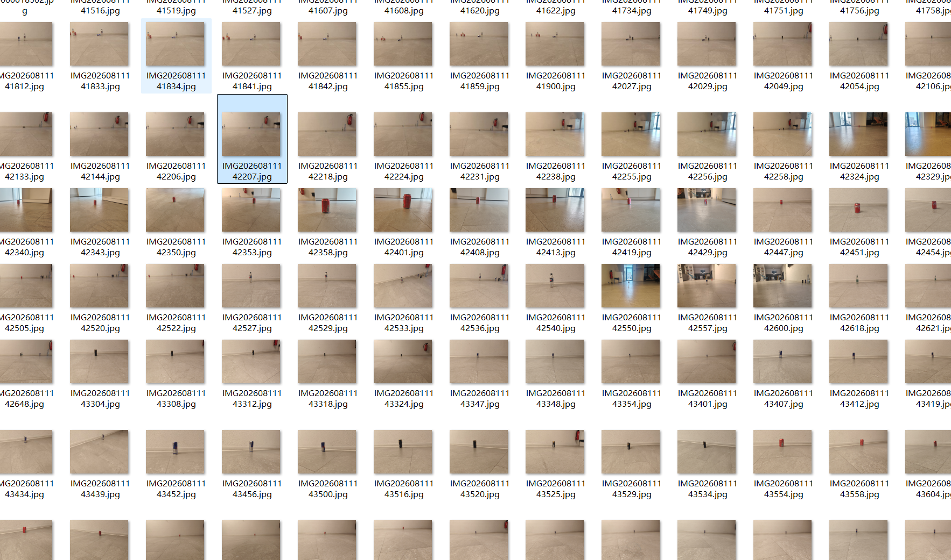
Dataset(raw files)

Slide 23



Limitations and Challenges
Evaluation
Depth excluded
Pose drifts
Silent failure
0.3 m general scenes
1 m white surfaces
Detector reaches 3 m
Left / right: 1–3 rad/s
Modelled 0.471 / 0.942
Error exceeds model
Verification disabled
Pickup always recorded
Empty gripper reports success
Removed from control path
AprilTag: only anchor
First fix: verification flag
Missing capability: relocalisation
Principal challenges
Open-loop turning unreliable
Model deployment
Pulses + visual correction
Accuracy traded for reliability
No gripper feedback
Depth underperformed
Full and empty identical
Unreliable at useful ranges
10–15 fps
Grasp timing
Pulsed motion, low speeds
Polling beat fixed delay
S.P.A.S. | Embedded Systems, Cyber-Physical Systems and Robotics | TUM Campus Heilbronn
10
Notes:
[about 1:35]
We want to be clear about what does not work.
First, depth estimation. We tested a depth network, and it was reliable to about
0.3 metres in a general scene, and to about one metre only on clean white
surfaces. Our can detector already works out to three metres, so the depth
estimate was worse than the detector it was supposed to help. We removed it from
the control path completely.
Second, the pose estimate drifts. The two tracks turn at different rates,
somewhere between one and three radians per second, while our model assumes fixed
values of 0.471 and 0.942. The error is larger than the quantity we are
modelling, so dead reckoning is not trustworthy. The AprilTag on the bin is the
only absolute anchor the robot has.
Third, and this is the failure that worries us most, one failure mode is silent.
Grasp verification is currently disabled, so a pickup is recorded whether or not
the can is actually in the gripper. The robot can report success with an empty
gripper. Enabling that verification flag is the first fix on our list.
Taken together, the missing capability is relocalisation. The map can direct the
robot's attention, but it can never trigger an action on its own.
The challenges at the bottom are the practical ones. Open loop turning was
unreliable, so we replaced it with short pulses and visual correction. The
gripper gives no feedback, so full and empty look identical. We only get 10 to 15
frames per second, so motion is pulsed and speeds are kept low. Deployment cost
us accuracy but bought reliability. Depth underperformed. And timing the grasp
needed real feedback, because a fixed delay simply did not work.

Slide 24

Conclusion and Future Work
Summary
Summary
Sensors worth adding
Mobile manipulator, single camera
Closed on appearance, not geometry
Errors degrade, never break
Drifting map lengthens search
Asymmetric turning needs corrections
Forward distance sensor
First metric measurement
Gripper force sensing
Fixes empty gripper
Wheel odometry
Next steps
Map becomes measurement
Enable grasp verification
More room tags
Calibrate turn constants
Cheap relocalisation anchors
S.P.A.S. | Embedded Systems, Cyber-Physical Systems and Robotics | TUM Campus Heilbronn
11
Notes:
[about 1:10]
To summarise.
We built an indoor mobile manipulator that operates on a single camera. Its
control loops are closed on how the target appears in the image, rather than on
estimated geometry. The practical effect is that errors degrade performance
instead of causing failure: when the map drifts, the robot searches longer, and
when turning is asymmetric, it makes a few more corrections, but it still
completes the mission.
The one exception is the undetected empty gripper, and we have said why. In
general, on hardware without proprioception, we would rather be conservative and
slow than confidently wrong.
Our immediate next steps are small. Enable grasp verification, which costs one
additional observation per pickup. And calibrate the two turn constants, because
the per direction scale factors already exist in the configuration and are simply
set to one.
If we had a budget for sensors, the order would be: a forward distance sensor,
which would be the first true metric measurement in the system; force or current
sensing in the gripper, which addresses the empty gripper failure directly; track
odometry, which would turn the map from a hint into a measurement; and more tags
in the room as cheap relocalisation anchors.
Thank you for your attention. We are happy to take your questions.

