Slide 1

Bachelor of Engineering
Semester -VII
PROJECT PRESENTATION
Computer Engineering Department
VIVA Institute of Technology,
Virar (East)
University of Mumbai
Academic Year 2022-23
Notes:
1

Slide 2
A PRESENTATION ON
“ Virtual whiteboard a gesture control pen free tool ”
By
Kamlakant Bag (58)
Siddharth Urankar (59)
Ankita Yadav (60)
Under the guidance of
Prof. Monali Sankhe

Slide 3
ABSTRACT
The system proposes a virtual whiteboard which will be controlled by hand gestures.
The technique used are based on Computer vision.
The user will be able to assign tools using hand gestures.
PPT can be controlled using hand gestures.
An environment where user can draw whatever he wants by choosing colors from the displayed ones.

Slide 4
LITERATURE SURVEY
Paper Title | Summary | Advantages | Technology used
Virtual Paint Application By Hand Gesture Recognition System[1] | In this paper the author has proposed a system which works like paint application but it takes command by hand gesture. The system has been called virtual because the sketches are drawn air. Web camera is used to extract the hand gestures. | Capable of working in dark , invariant to skin color etc. | Open CV and C++, Algorithm-Three point ,The find contours and The Graham scan algorithm

Slide 5
Paper Title | Summary | Advantages | Technology used
Virtual Sketch using Open CV[2] | Virtual Sketch is the system where user can draw by capturing the motion of colored marker with camera. The project provides the user an environment where the user can draw whatever he wants by choosing colors from the displayed ones. | Interface is very simple and understandable by user. User will be able to draw what he wish without any interruption. | NumPy, OpenCV
PowerPoint control using hand gesture recognition based on hog feature extraction and K-NN classification[3] | The system makes possible to control power point presentation through distance by using KNN. | System does not make use of traditional method which reduce the cost of hand gloves, markers any other device. | K-NN Algorithm
Sketch recognition based intelligent whiteboard teaching system[4] | This paper gives an idea of an intelligent white board system which is based on sketch recognition, which support the user to communicate with each other by sketching pen based HCI. | It can recognition the gesture to help users modify, copy and move familiar pencil and paper process, transform the free hand sketch's into the symbol of the domain specific knowledge automatically using feature point detection and graphic recognition algorithm. | Sketch recognition algorithm

Slide 6
Paper Title | Summary | Advantages | Technology used
Hand Gesture detection[5] | By using computer vision and image processing techniques the system interprets the hand movements of the user that enter the vision field of camera and the user can manage the computer without any physical contact and as being away from the monitor. | The user can control some of the features of the computer without touching the system. | Otsu method
Controlling PowerPoint using hand gesture in Python [6] | The system allows the presenter to manage slides solely by gesture in front of the camera. | The author manage specific gestures to map gestures on the slides, including the next slides, previous slides, zoom in zoom out, opening highlighter/Pen, and play/ pause videos. | PyTorch library
Basic paint window Application via webcam using Open CV and NumPy in Python[7] | The system uses motion to text converter that can serve as software for writing. The system has use computer vision to trace fingers. | No highlighter, paints or stylers required. The system works with the users fingers. | R-CNN

Slide 7
Paper Title | Summary | Advantages | Technology used
Hand Gesture Recognition Software Based on Indian Sign Language.[8] | A simple sign language recognition system was developed by using the skin color segmentation and neural network model. The proposed system shows maximum classification accuracy of 88.25%. | It shows accuracy of 88.25%. | CNN and DNN, OpenCV, Tenserflow
Virtual Painting with OpenCV Using Python.[9] | The proposed system is used to draw virtual painting using different tools. | The proposed system can be classified into mainly two steps after acquiring the input image from camera. These steps are: Extraction Method, image pre-processing and Features estimation and Extraction | Open CV

Slide 8
Research Gap
The system is mixture of Virtual whiteboard and PowerPoint controlling system using hand gesture.
The previous system does not contain assigning tools using hand gesture.
In the existing system we can write only cursive but in the proposed system freehand writing is possible.

Slide 9
PROBLEM STATEMENT & OBJECTIVE
Existing system does not provide PowerPoint control and writing in air together in one system with precise accuracy.
Virtual Whiteboard makes things easy for the users while explaining a PowerPoint presentation in a conference, anyone can use it and it helps them to explain the topic easily and as there are ample of physical tools, that the user can get more engage with the audience.

Slide 10
DETAILS OF HARDWARE & SOFTWARE
Software Requirements :
Language : Python
Platform : Visual studio, Pycharm, Jupyter Notebook.
Library :
Hand gesture recognition and tracking are handled by the Media Pip framework, while computer vision is handled by the OpenCV library. To track and recognize hand movements and hand tips.
OpenCV (for image processing and Color HSV)
NumPy (for Use Array)
Media Pip (for Hand Tracking)
TensorFlow (for Image recognition and Perform the AI functions)
PyTorch (Use for applications such as Computer vision and natural language processing)

Slide 11
DETAILS OF HARDWARE AND SOFTWARE
Hardware requirement :
Processor : Intel i5 10th Generation
RAM : 8GB
Graphics Card : 2GB
Webcam : 720p 30/FPS

Slide 12
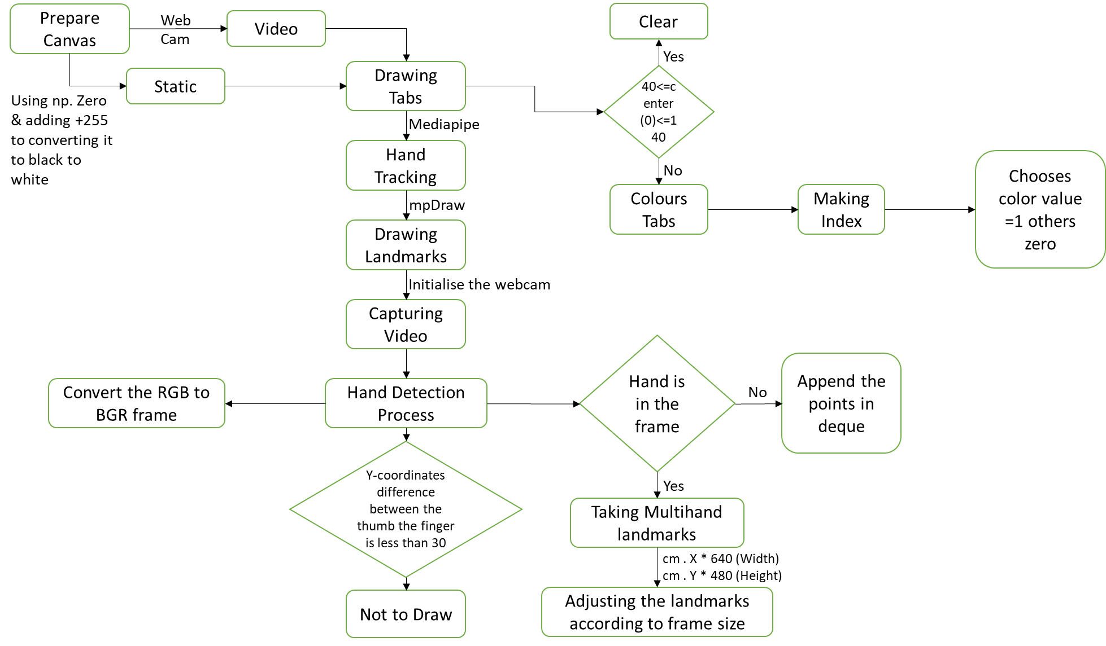
BLOCK DIGRAM

Slide 13
IMPLEMENTATION PLAN FOR NEXT SEMESTER
Sr. No. | Task Name | Start | Finish | Days
1 | PPT control | 28-11-2022 | 20-12-2022 | 23
2 | Adding more colors to write | 26-12-2022 | 28-12-2022 | 3
3 | Adding more tools | 15-12-2022 | 28-12-2022 | 4
4 | Assigning tools using gestures. | 29-12-2022 | 31-01-2023 | 15

Slide 14
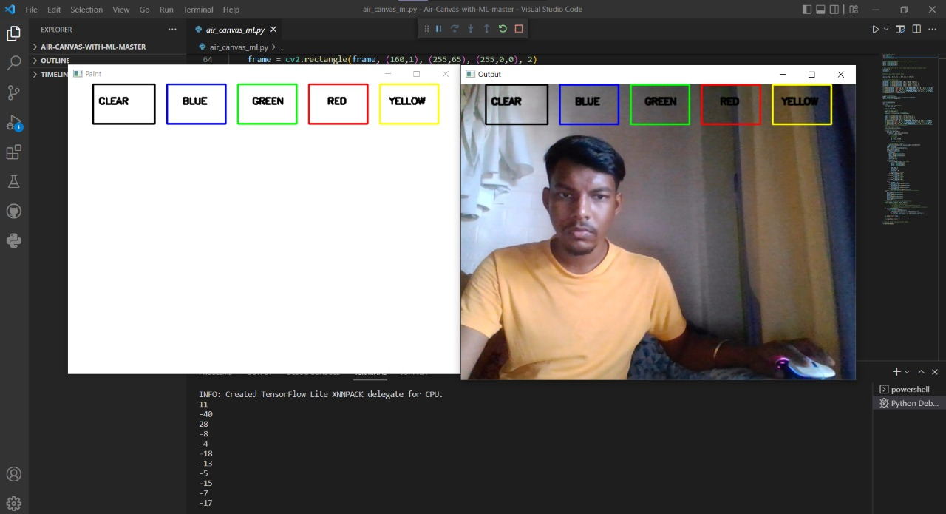
PARTIAL IMPLEMENTATION & RESULT

Slide 15
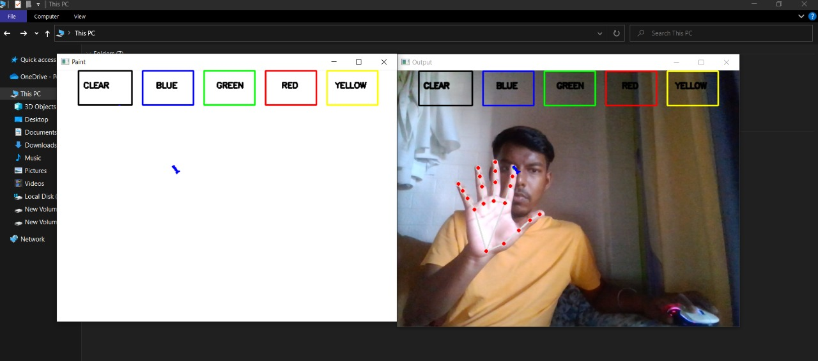
PARTIAL IMPLEMENTATION & RESULT

Slide 16
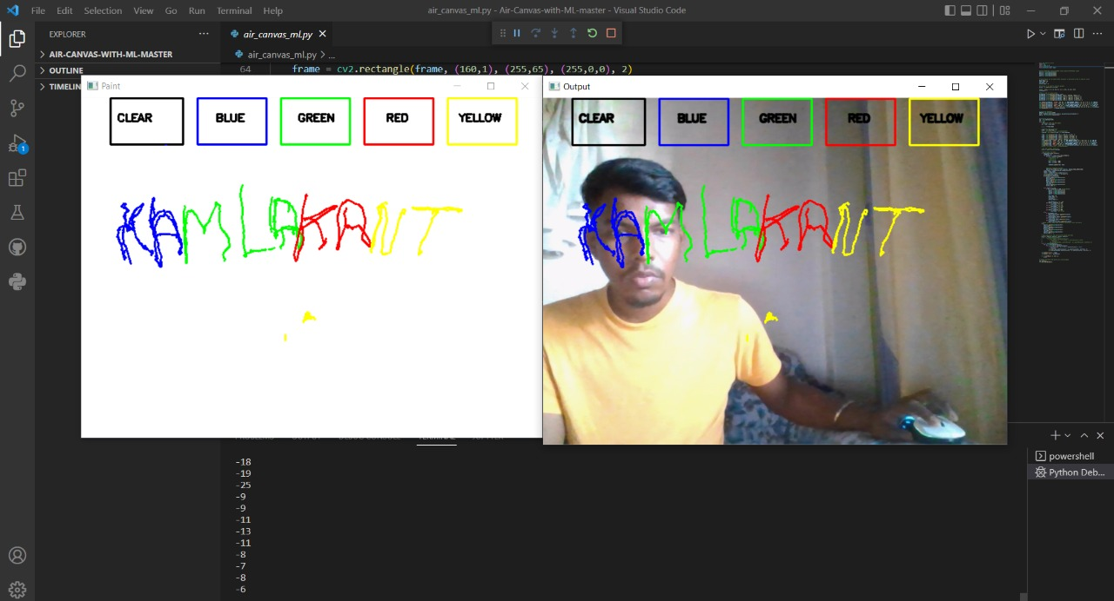
PARTIAL IMPLEMENTATION & RESULT

Slide 17
CONCLUSION
The proposed system is developed as a hands-free drawing program that uses OpenCV to detect the user’s pointer finger. Colorful lines can be drawn wherever the user desires and the brush can even be modified. It is truly like drawing in the air.

Slide 18
REFERENCES
[1] P.Vidhate, “Virtual Paint Application By Hand Gesture Recognition System” IEEE 2019
[2] P.Srungavarapu, P.maganti, S.Sakhamura, “Virtual Sketch using Open CV” IJITEE 2020
[3] T.saluke, “PowerPoint control using hand gesture recognition based on hog feature extraction and K-NN classification” IEEE 2019
[4] Z.Yuan, G.Jil, “Sketch recognition based intelligent whiteboard teaching system” ICCSSE 2008
[5] P.Kirchi, “Hand Gesture detection” IEEE 2019
[6] M.Idrees, “Controlling PowerPoint using hand gesture in Python” ResearchGate 2021
[7] S.Saoji, “Basic paint window Application via webcam using Open CV and NumPy in Python” ResearchGate 2021
[8] S.Kadam, “Hand Gesture Recognition Software Based on Indian Sign Language.” IEEE 2019
[9] Y.Patil, “Virtual Painting with Opencv Using Python.” IJSRST 2020

Slide 19
THANK YOU

