Slide 1

Bachelor of Engineering
Semester -VIII
PROJECT PRESENTATION 4
Computer Engineering Department
VIVA Institute of Technology,
Virar (East)
University of Mumbai
Academic Year 2022-23
Notes:
1

Slide 2
A PRESENTATION ON
“ Virtual whiteboard a gesture control pen free tool ”
By
Kamlakant Bag (58)
Siddharth Urankar (59)
Ankita Yadav (60)
Under the guidance of
Prof. Reshma Chaudhari

Slide 3
ABSTRACT
Air Canvas and PowerPoint controlling using hand gestures are two distinct technologies that use hand movements to interact with digital devices.
Air Canvas is a software application that enables users to draw and write on a virtual canvas using hand gestures. It utilizes computer vision algorithms and machine learning techniques to track the user's hand movements and interpret them as digital strokes. With Air Canvas, users can create digital art, diagrams, or presentations without the need for any physical drawing tools.
On the other hand, PowerPoint controlling using hand gestures allows users to navigate through PowerPoint presentations using hand movements instead of using a physical clicker or keyboard. This technology uses a camera to capture the user's hand gestures, which are then interpreted as commands to move forward and backward.
Both Air Canvas and PowerPoint controlling using hand gestures offer a more intuitive and interactive way of interacting with digital devices, making them ideal for presentations, education, and creative projects.

Slide 4
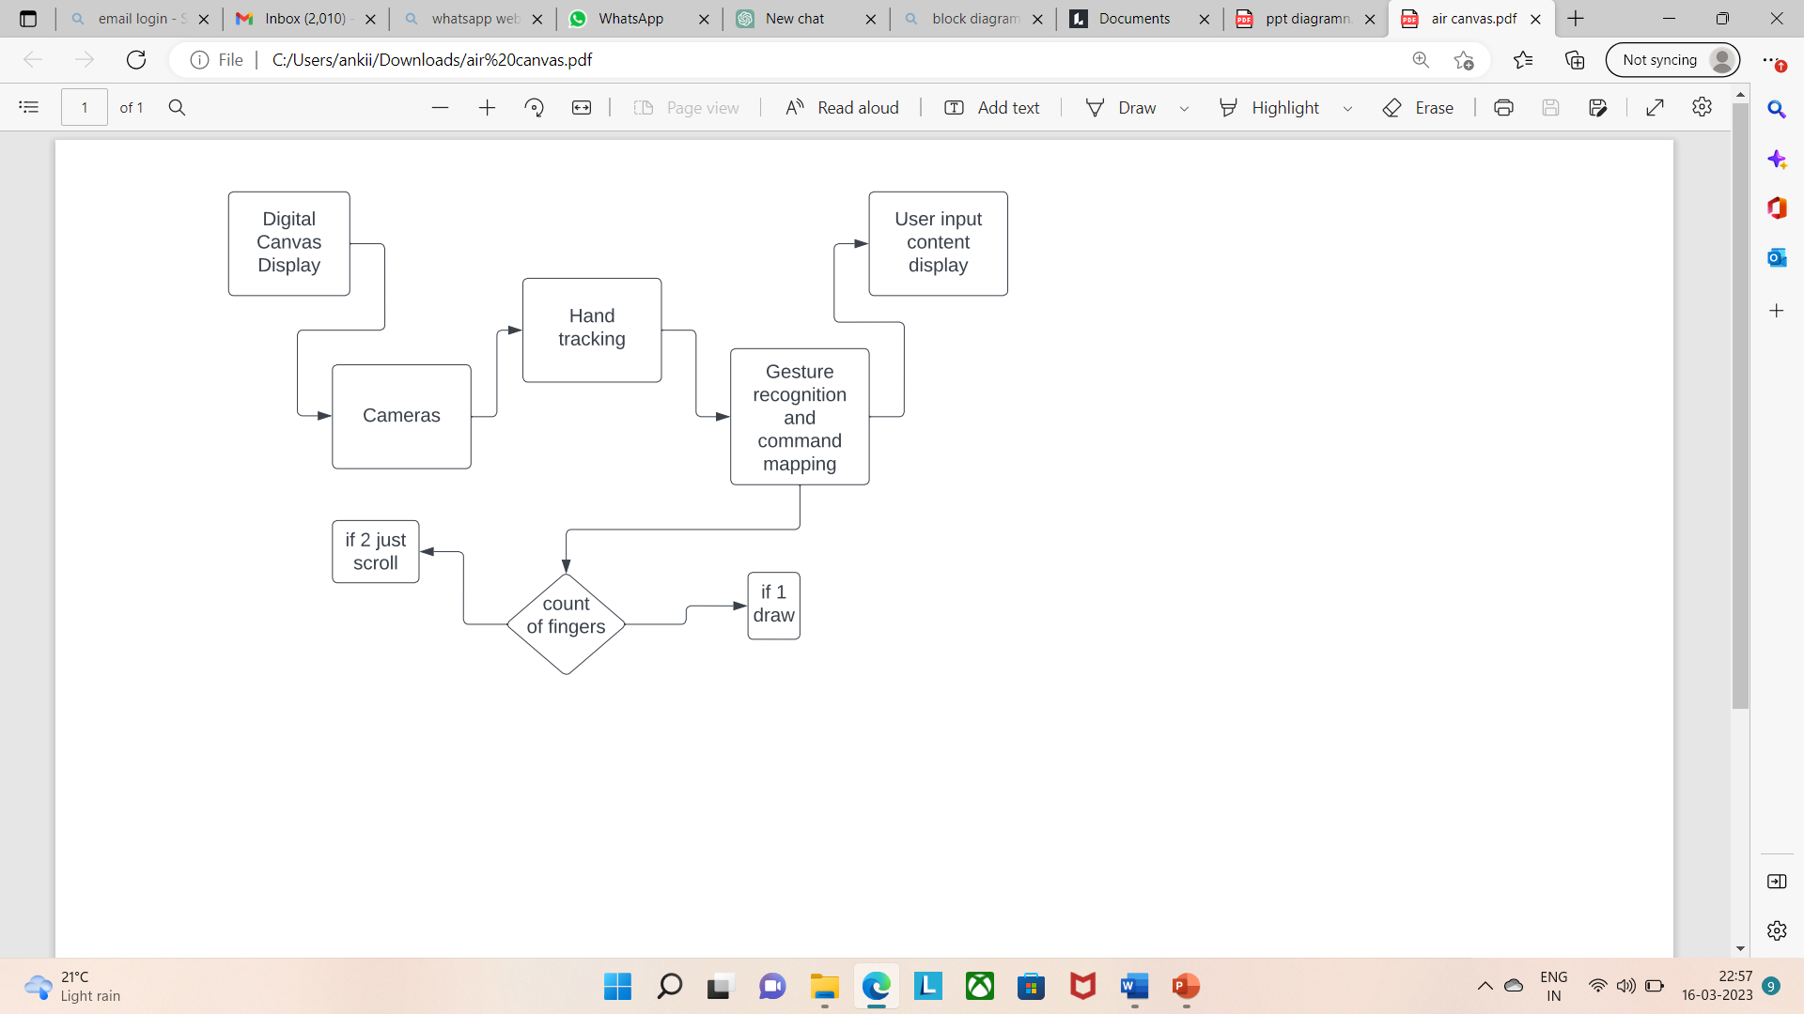
Block Diagram
Whiteboard :

Slide 5
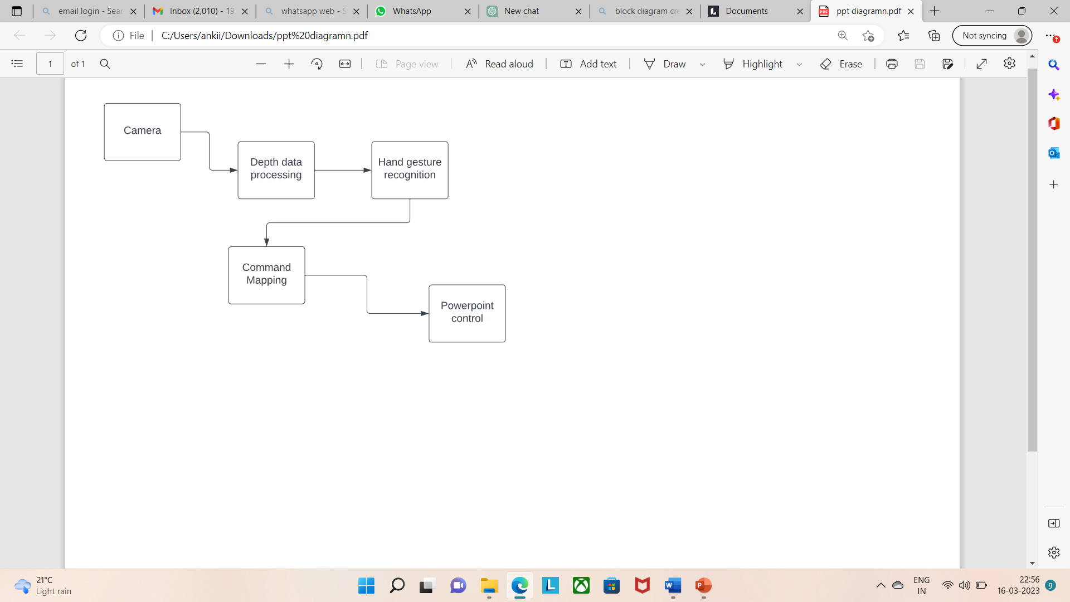
Block Diagram
PPT controlling using Gestures :

Slide 6
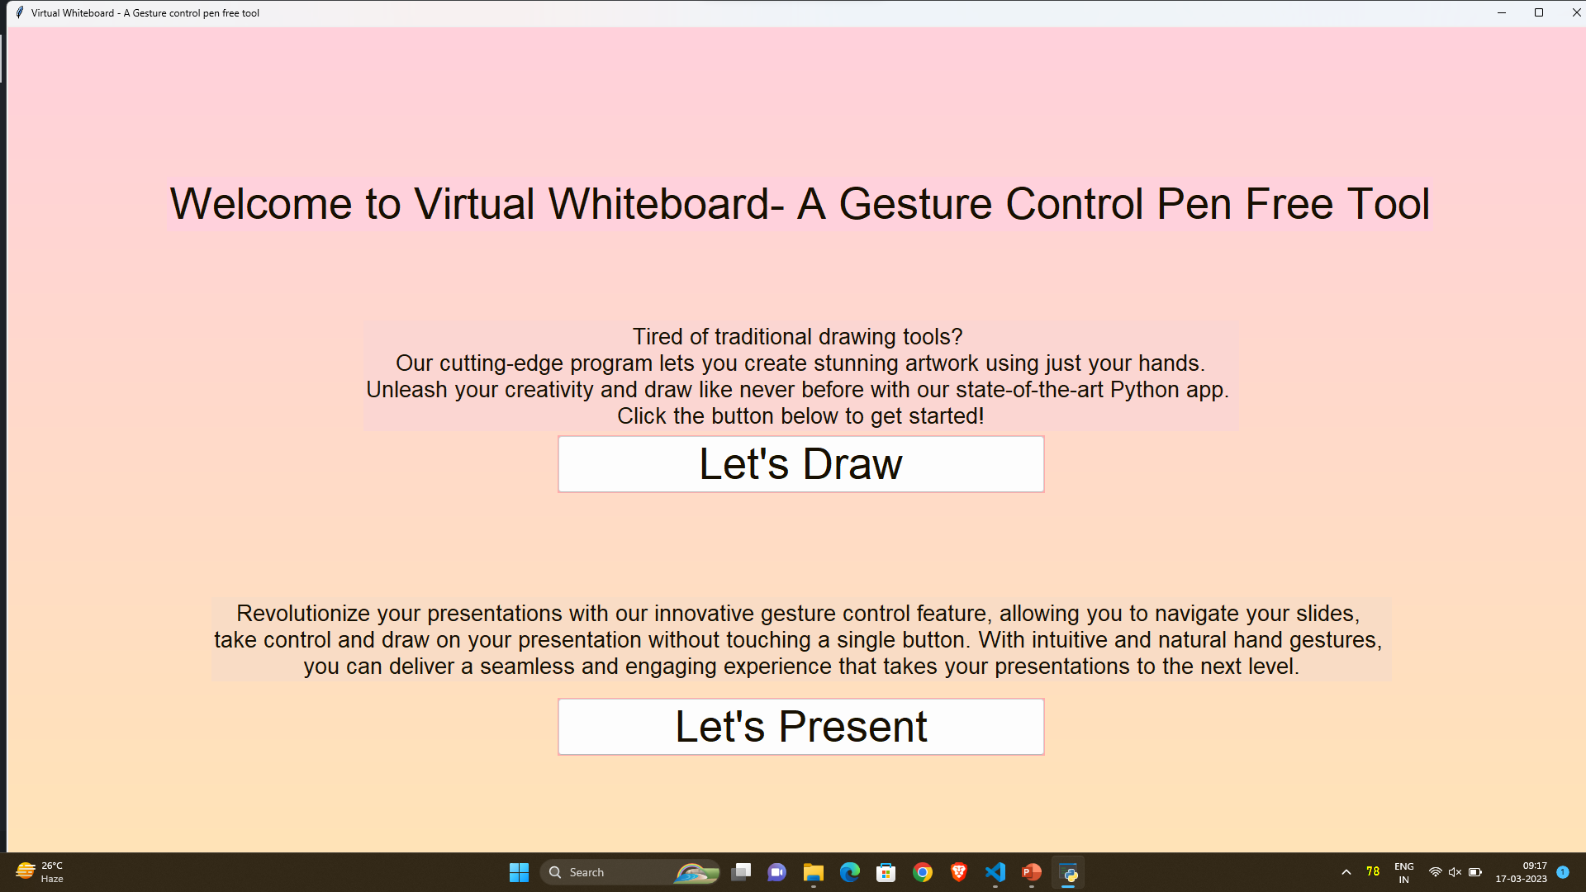
RESULT

Slide 7
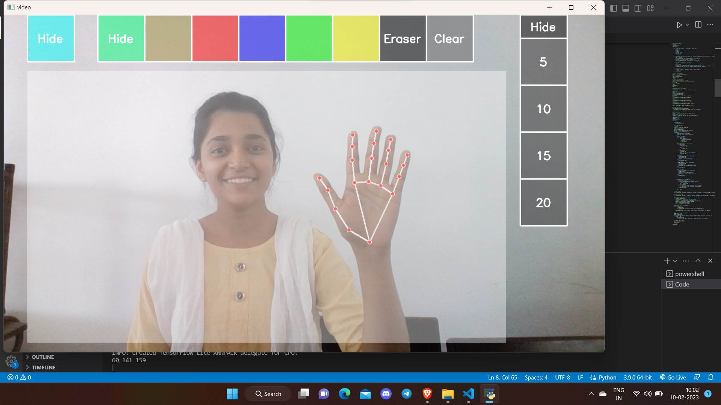
RESULT

Slide 8
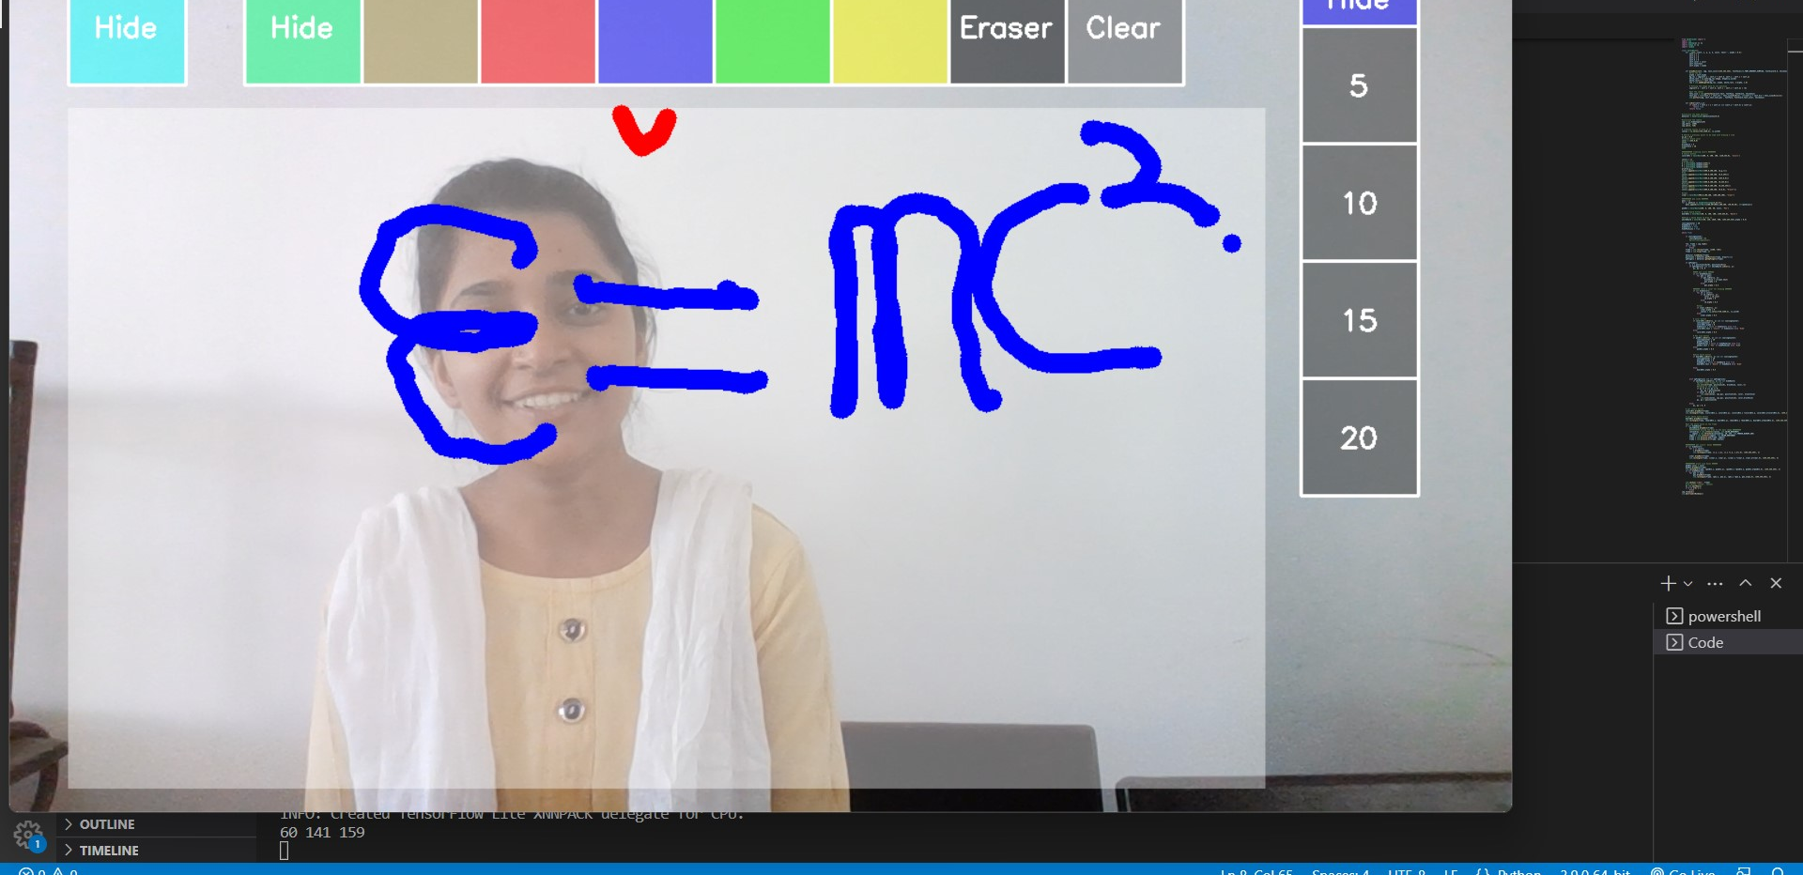
RESULT

Slide 9
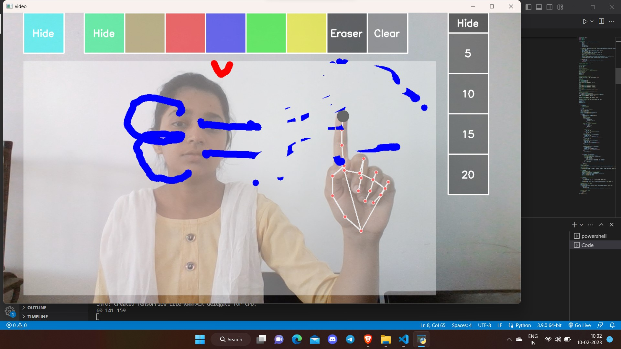
RESULT

Slide 10
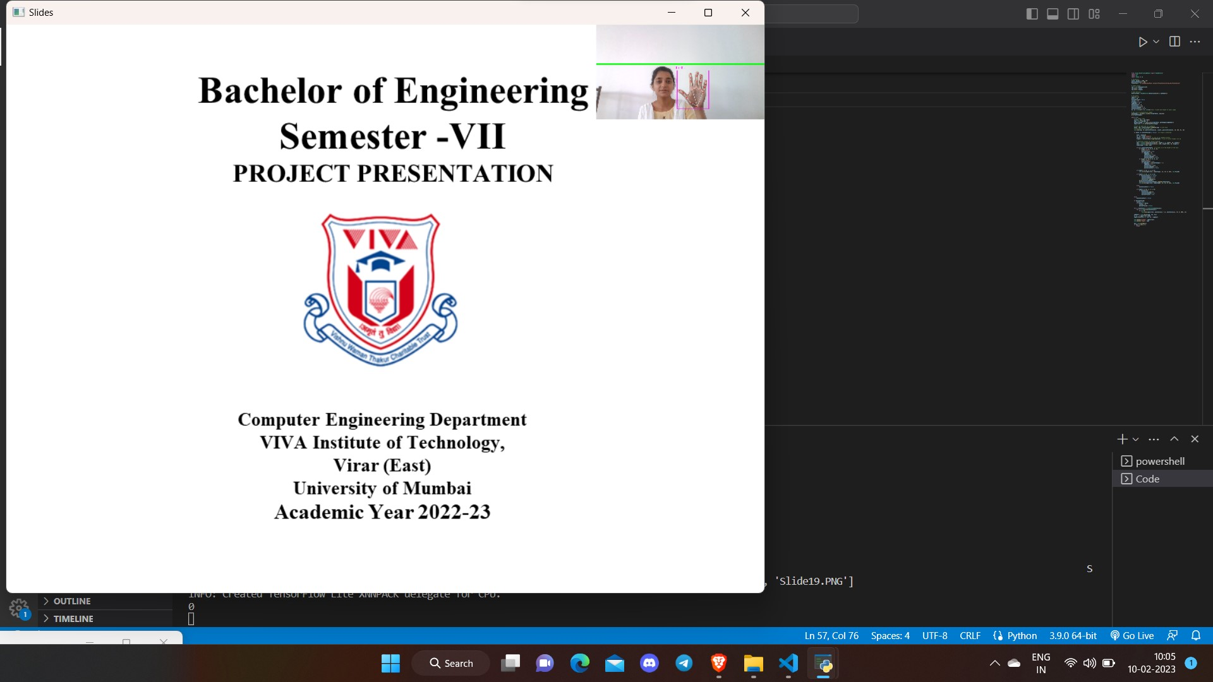
RESULT

Slide 11
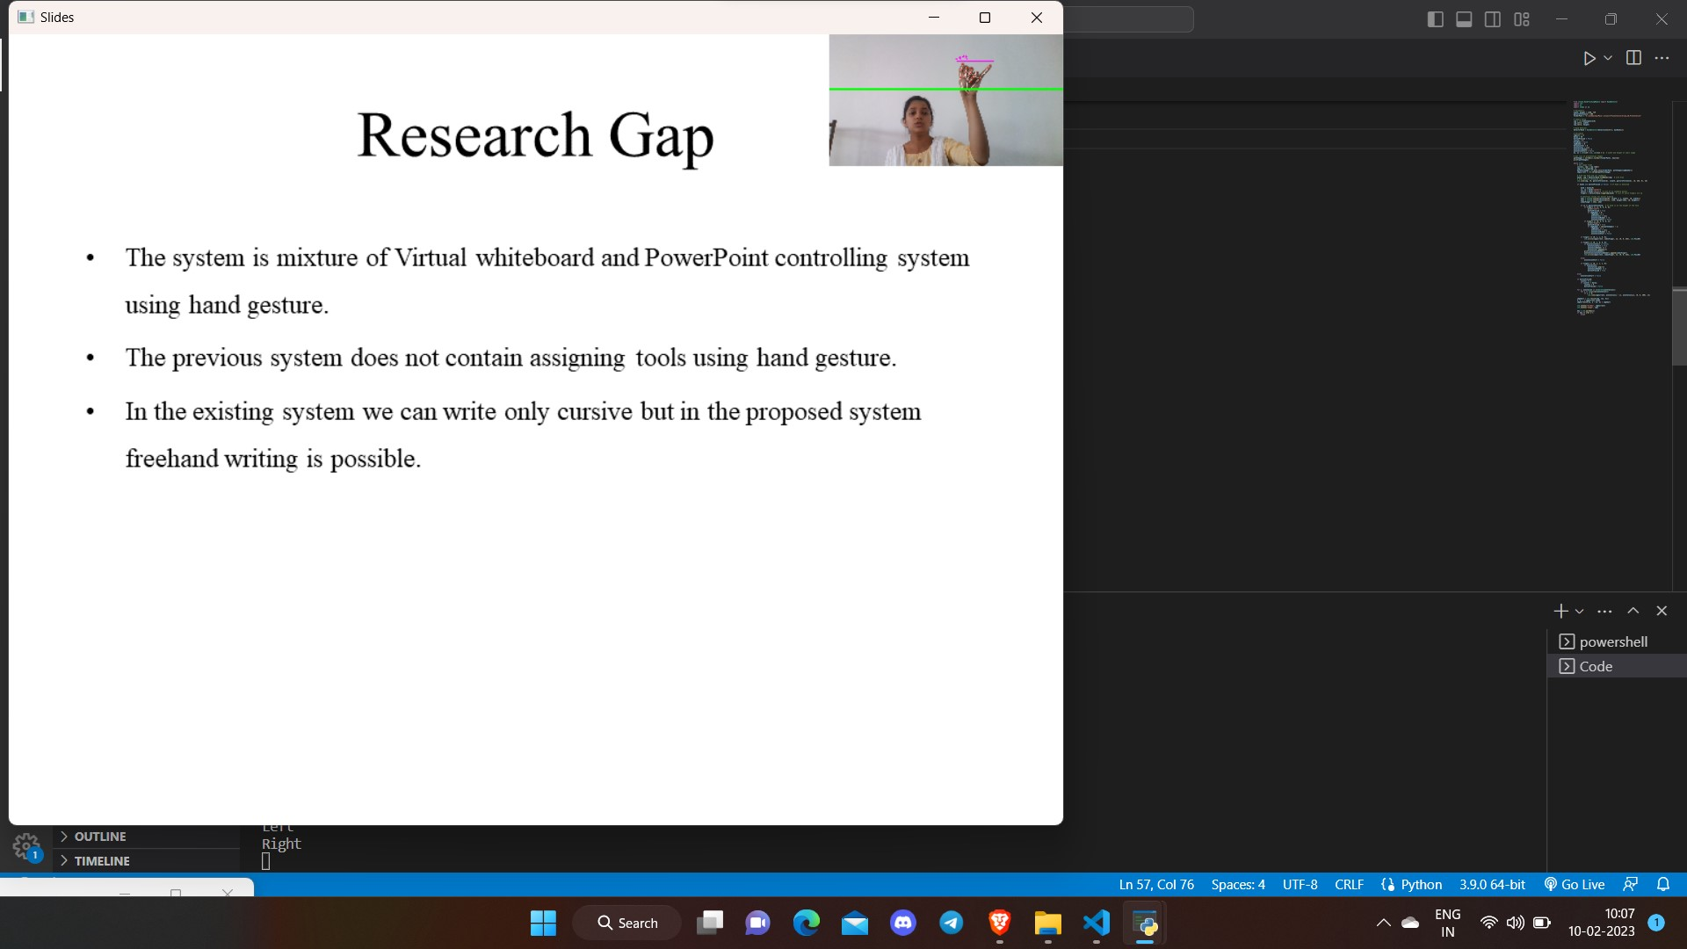
RESULT

Slide 12
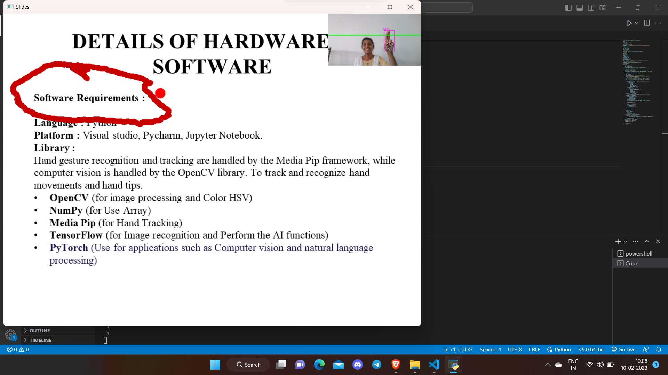
RESULT

Slide 13
PAPER PUBLISH & COMPETITION
List of Paper Published :
IJRPR
NCRENB 2023
3RD INTERNATIONAL CONFERENCE ON ADVANCED COMPUTING TECHNOLOGIES AND APPLICATIONS 2023(ICACTA 2023)
INTERNATIONAL RESEARCH JOURNAL OF ADVANCED ENGINEERING AND SCIENCE (IRJAES)
List of Project Competition :
Imperia 2023
Inter-Collegiate Technical Paper cum Poster Presentation Competition

Slide 14
Bachelor of Engineering
Semester -VIII
PROJECT PRESENTATION
THANK YOU
Notes:
14

