Slide 1
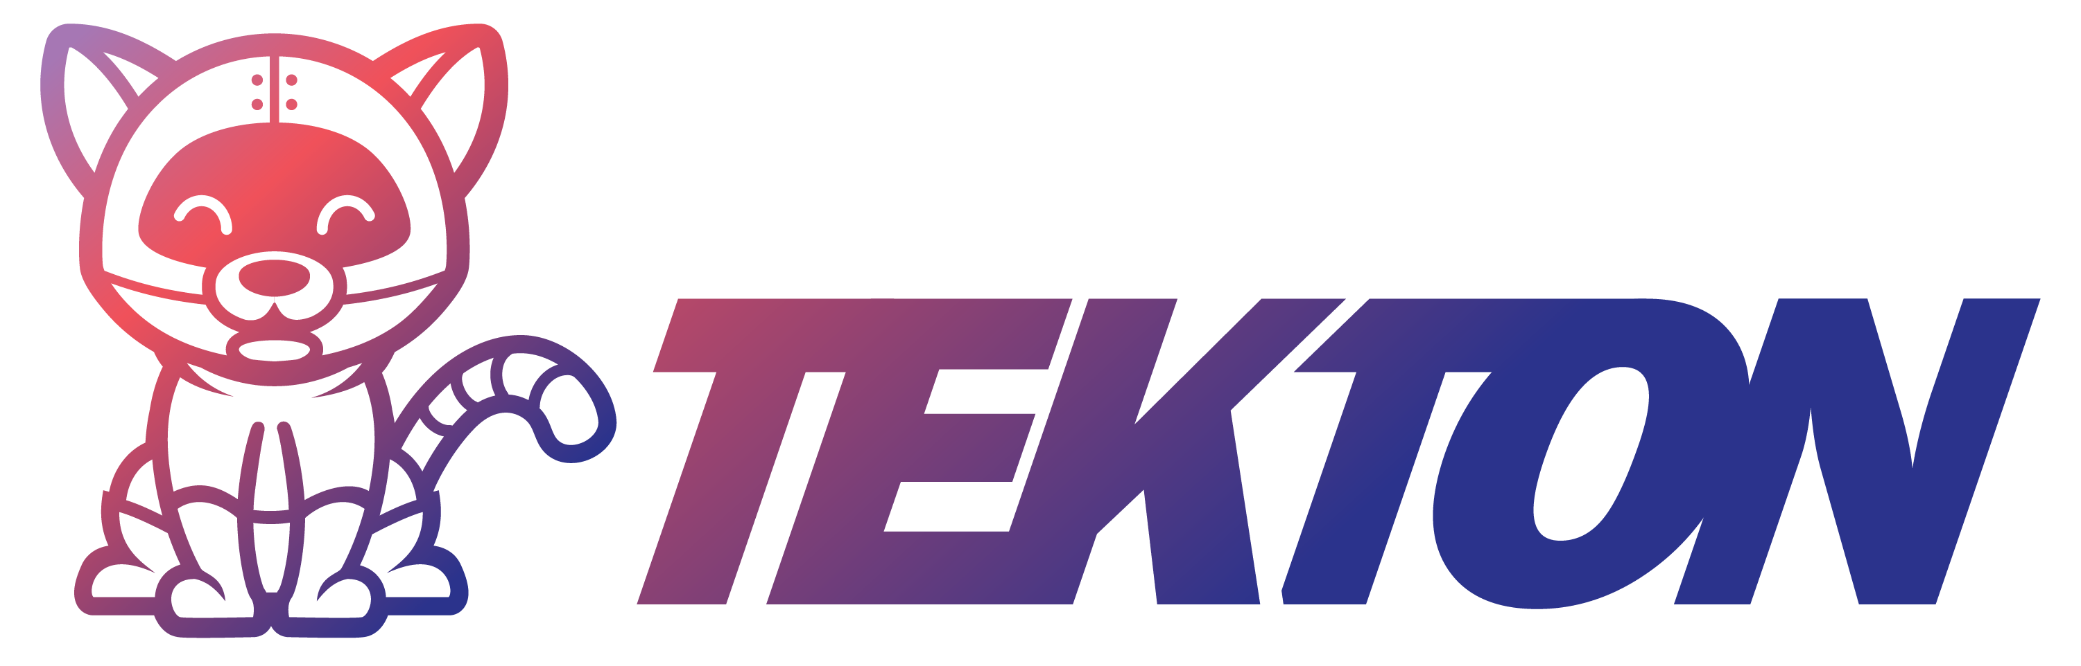
Kubernetes-native CI/CD

Slide 2
Tekton
Open API spec for describing CI/CD pipeline
Open-source CI/CD platform implementation running on kubernestes.
Openly govern under the Continuous Delivery Foundation (CDF).
What is Tekton ?

Slide 3
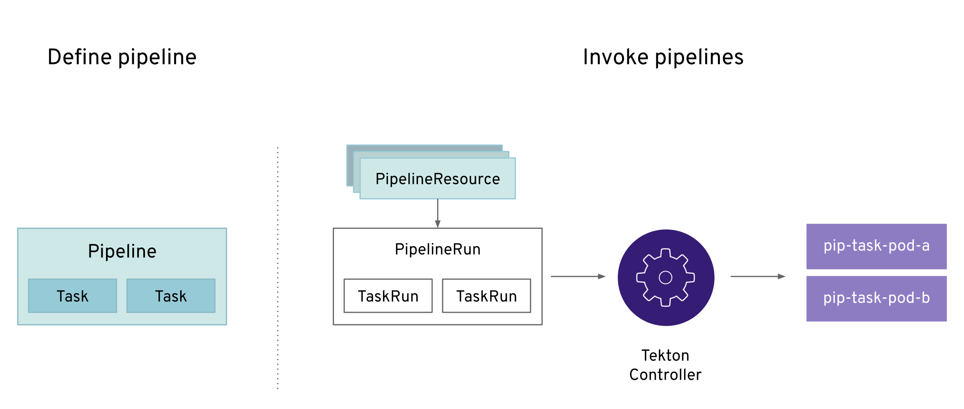
Tekton
Tekton Architecture

Slide 4
Tekton
Pipelines: Basic building blocks (tasks and pipelines) of a CI/CD workflow
Triggers: Event triggers for a CI/CD workflow
CLI: Command-line interface for CI/CD workflow management
Dashboard: General-purpose, web-based UI for Pipelines
Tekton components
Note: Installation of Triggers, CLI, and Dashboard is optional

Slide 5
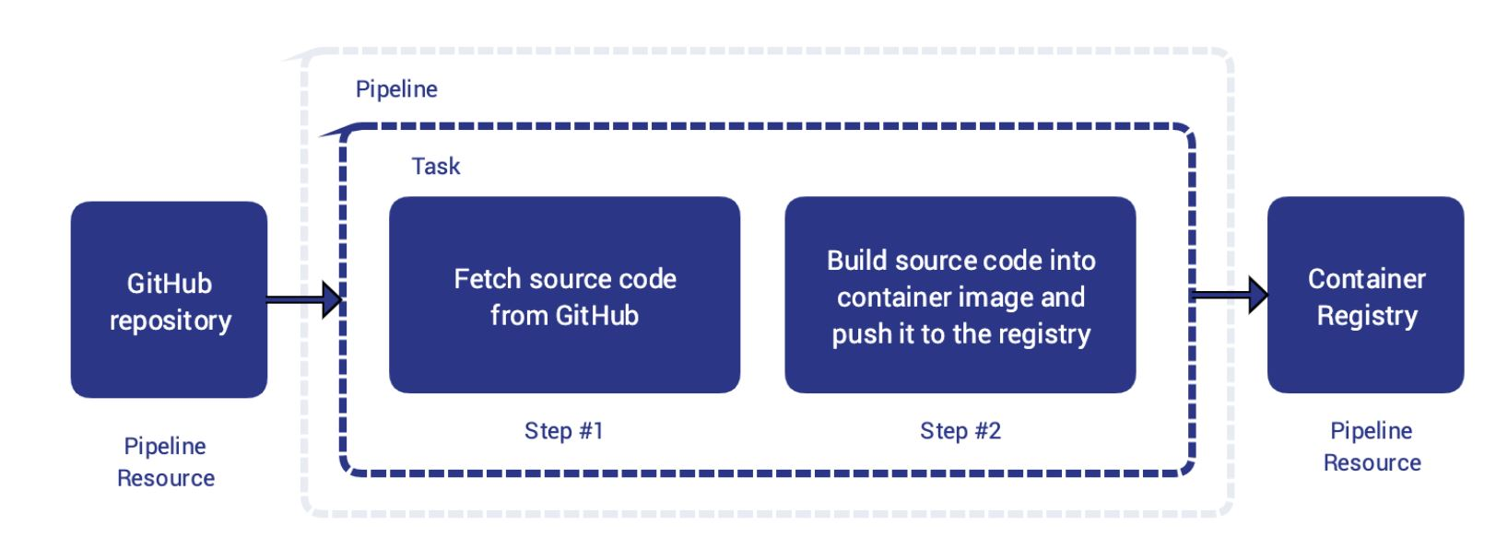
Tekton
A step is an operation in a CI/CD workflow, such as running some unit tests for a Python web app, or the compilation of a Java program. Tekton performs each step with a container image you provide
Concept model
Steps
Tasks
and Pipelines
A task is a collection of steps in order. Tekton runs a task in the form of a Kubernetes pod, where each step becomes a running container in the pod.
A pipeline is a collection of tasks in order
Tekton collects all the tasks, connects them in a directed acyclic graph (DAG), and executes the graph in sequence

Slide 6
Tekton
Each task and pipeline may have its own inputs and outputs, known as input and output resources in Tekton.
Example: git repository as input and a container image as output- the task clones the source code from the repository, runs some tests, and at last builds the source code into an executable container image.
Tekton supports many different types of resources, including:
git: A git repository
Pull Request: A specific pull request in a git repository
Image: A container image
Cluster: A Kubernetes cluster
Storage: An object or directory in a blob store, such as Google Cloud Storage
CloudEvent: A CloudEvent
Input and output resources

Slide 7
Tekton
TaskRun is a specific execution of a task, TaskRuns are also available when you choose to run a task outside a pipeline
A pipelineRun is a specific execution of a pipeline
Example: User may ask Tekton to run your CI/CD workflow twice a day, and each execution will become a pipelineRun resource trackable in your Kubernetes cluster.
Note: TaskRuns and pipelineRuns connect resources with tasks and pipelines. A run must include the actual addresses of resources, such as the URLs of repositories, its task or pipeline needs.
You may create taskRuns or pipelineRuns manually, which triggers Tekton to run a task or a pipeline immediately.
TaskRuns and PipelineRuns

Slide 8
Tekton
Thankyou…

