Slide 1
Parking Management System
The current scenario in major cities and towns is the ever-growing human population as well as vehicle population. This has given rise to the need for multi level parking lots. People tend to get frustrated in finding a parking spot in huge parking lots if not guided properly.
Different Parking System is displayed below

Slide 2
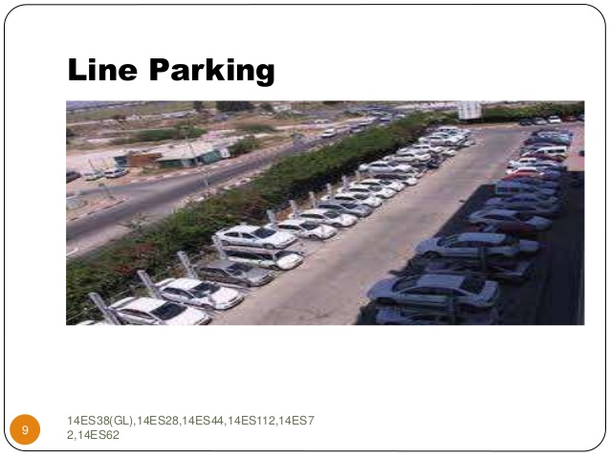
Line Parking

Slide 3
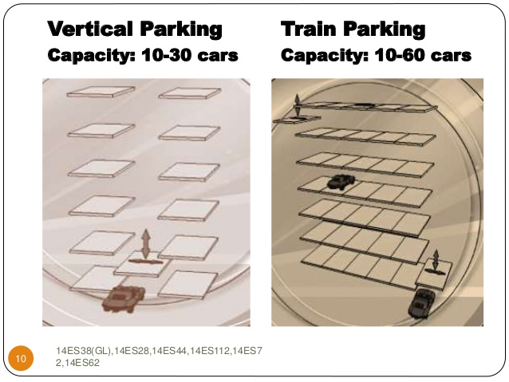
Vertical Parking

Slide 4
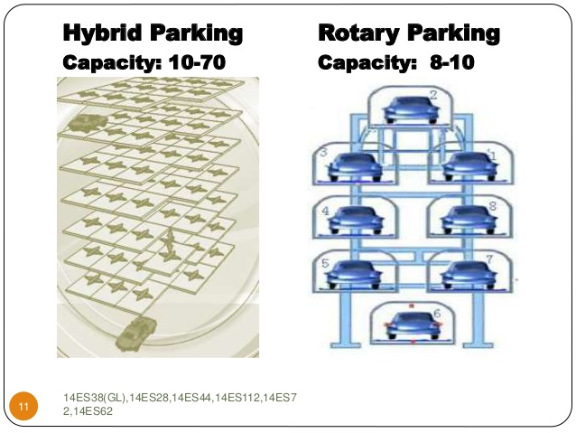
Hybrid Parking

Slide 5
Our System
Our System used the latest technique
1. Wireless parking detection sensor: This sensor works on a wireless radio frequency . It is embed on the asphalt/road . Please find the image for reference.
2. Wireless Data Collector: This acts as a gateway between data server and all the wireless parking
sensors installed in outdoor/indoor parking lots to acquire the occupancy information of each parking spaces.

Slide 6
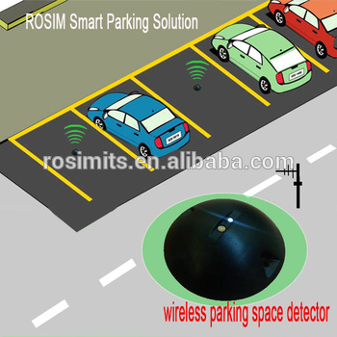
Sensor

Slide 7
Our System Contd
1.The sensors are placed at the different parking locations.
2. The Data collector is placed at the entrance of the parking.
3. The PMSoftware will be integrated with the data collector.
4. The PM will have different parking slots availablity displayed to the agent.
5.When a car comes , the agent will provided either a QR code or a coupon. The code/coupon will have the parking slot details , time, vehice details and a snapshot of the driver.
6. The code/coupon will be shared with the driver mobile no or can be given as a card.
6. The driver of the vehicle will traverse and park the car in the slot. The moment a car is parked, the sensor will get a”red color” and the SW will update the slot as booked.
7. On return , the driver will reach the exit gate and show the code/coupon.Depend upon the tenure the PM will invoke a POS solution.

Slide 8
Contd
The PM will have a db mantained to keep an account of the day-in & day-out code/coupon
The PM will have a CCTV integrated in phase2. This is to provide a secured parking space in a multi parking system.
The sensor based system is not available yet in our country. This might be a good chance for us.

