Slide 1
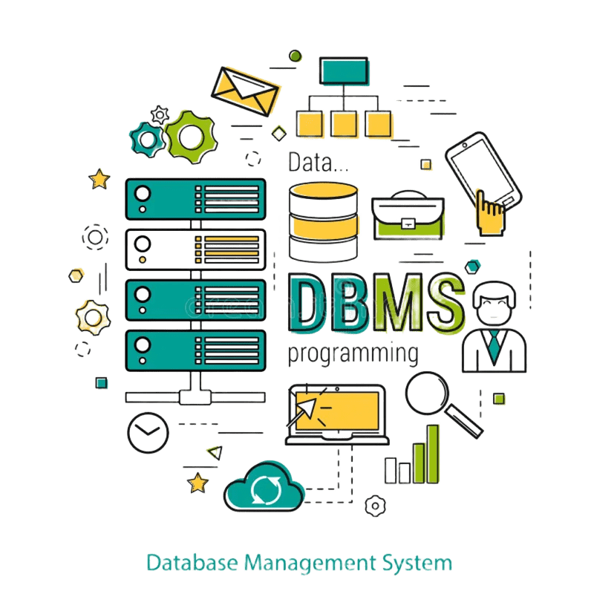
DBMS Project Presentation
Team Name : Team Trio
Team Code : K
Section : CSE-DS-4A
Course Code : 23DS2403
Project Title : Budget Buddy-(Money Management)
Team Members :
Kammala Kalyan | ENG23DS0063
Kovouru Venkata Naga Sai Pranav | ENG23DS0067
Amarnath Gowda KM | ENG23DS0052

Slide 2
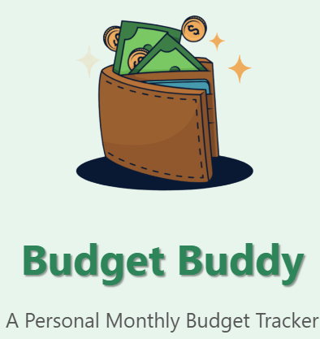
Introduction
What is Budget Buddy? A simple web app that helps you plan and track your personal budget.
Objective of the Project To give anyone—no matter their experience level—a clear way to set a budget, record expenses, and see if they stayed under budget each month.
Scope of the Project
Users can register and log in.
Create a new monthly budget with categories (e.g. groceries, bills).
Add expenses against those categories.
View progress bars and charts showing planned vs. actual spending.
Track a “streak” of months under budget for extra motivation.

Slide 3

Problem Statement
Description of the problem being addressed Many people struggle to keep track of where their money goes. Without a clear way to set limits and record expenses, it’s easy to overspend, miss bills, and lose sight of financial goals.
Importance of the problem for this project
Financial Stress Reduction: Helping users see their spending at a glance minimizes surprises and anxiety.
Better Decision‑Making: With clear budget data, users can adjust habits, cut unnecessary costs, and save more effectively.
Accessibility: Beginners need a simple, guided tool—without it, they may never establish good budgeting habits.

Slide 4

System Architecture
System Architecture of Your Budget Buddy Project
Client (Browser)
Renders HTML/CSS from Jinja2 templates.
Uses JavaScript to fetch category data (/get-categories) and submits forms.
Web/Application Server
Flask’s built‑in WSGI server (via app.run(debug=True)) handles all incoming HTTP(S) requests.
Routes implement:
Authentication & Sessions (/login, /register, login_required)
Budget Management (/budget-setup, streak logic)
Expense Logging (/add-expense, JSON API /get-categories)
Reporting & History (/budget-progress, /reports, /history, /monthly-reset, /reset-all)
Data Access Layer
flask_mysqldb extension connects Flask to MySQL.
Raw SQL queries against four tables:
users
budgets
categories
expenses
Database
MySQL running on localhost:3307, database budgetbuddy.
Persists user accounts, budget periods, category allocations,
and expense records.
User fills data
Browser displays inputs
Flask route writes to MySQL
Flask route queries to MySQL

Slide 5
ER Diagram
Records
Groups
Expenses
Users
Id
Username
Email
Password
streak
Includes
Id
user_id
budget_
category_id
expense_date
amount
note
budgets
Categories
Id
user_id
start_date
end_date
total_budget
used_budget
is_active
adds
Id
budget_id
name (
expected_amount
spent_amount
classifies

Slide 6
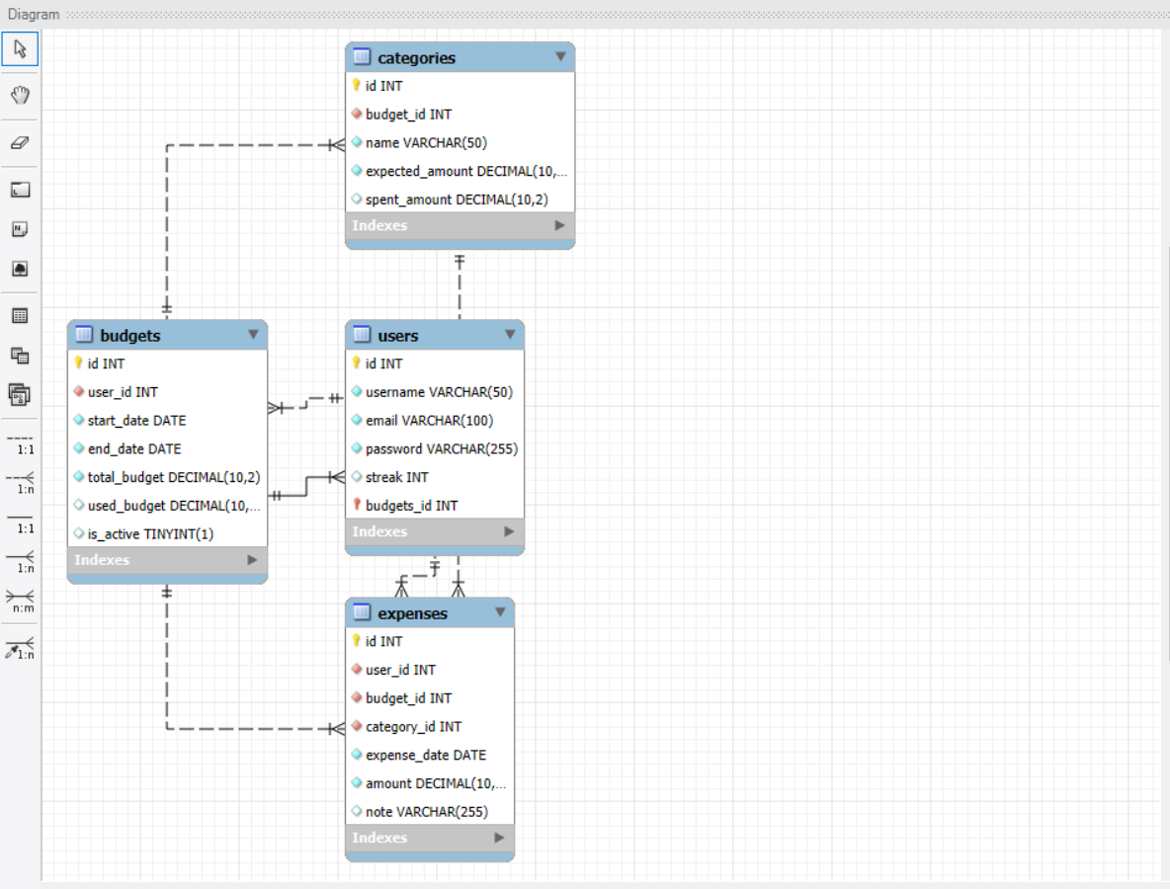
Reverse Engineering Diagram

Slide 7
Database Schema
Users
Columns
id (INT, PK)
username (VARCHAR)
email (VARCHAR)
password (VARCHAR)
streak (INT) — count of consecutive under‑budget months
Notes
Each row is one registered user.
id is referenced by all other tables to tie data back to the user.
2. budgets
Columns
id (INT, PK)
user_id (INT, FK → users.id)
start_date, end_date (DATE) — budget period
total_budget (DECIMAL) — the user’s planned total
used_budget (DECIMAL) — running sum of actual spend
is_active (TINYINT) — flags the current month’s budget
Relationships
1 user → N budgets (a user can have many monthly budgets, but only one active at a time).

Slide 8
Database Schema
3. Categories
Columns
id (INT, PK)
budget_id (INT, FK → budgets.id)
name (VARCHAR) — e.g. “Food”, “Transport”
expected_amount (DECIMAL) — portion of total_budget
spent_amount (DECIMAL) — tally of expenses in this category
Relationships
1 budget → N categories (each budget is broken into multiple categories).
4. Expenses
Columns
id (INT, PK)
user_id (INT, FK → users.id)
budget_id (INT, FK → budgets.id)
category_id (INT, FK → categories.id)
expense_date (DATE)
amount (DECIMAL)
note (VARCHAR)
Relationships
1 user → N expenses
1 budget → N expenses
1 category → N expenses
Every expense row belongs to exactly one user, one budget period, and one category within that budget.

Slide 9
Normalization
Normalization of Budget Buddy Database — Up to Third Normal Form (3NF)
Normalization is a database design technique to eliminate redundancy and improve data integrity. The Budget Buddy schema follows 3NF, as explained below:
First Normal Form (1NF) – Atomic Columns
Each table has:
Atomic (indivisible) values
Unique rows with a primary key
Examples:
username, email are single-valued in users
note in expenses is a single text field
Second Normal Form (2NF) – No Partial Dependencies
All non-key columns depend on the entire primary key
Applies mainly to tables with composite keys (not used here, but still respected)
Examples:
In categories, name and expected_amount depend entirely on budget_id
In expenses, amount, note, etc., depend on the whole row identified by id
3NF
2NF
1NF
Third Normal Form (3NF) – No Transitive Dependencies
Non-key columns do not depend on other non-key columns
Examples:
In users, email doesn’t depend on username; both depend only on id
In budgets, total_budget, used_budget, and is_active depend only on id, not on user_id
In expenses, amount and note are directly related to the expense entry, not indirectly through category or user

Slide 10
Budget Buddy – Basic Flow
User Registration → New users sign up with name, email, and password.
User Login → Registered users log in securely.
Dashboard Access → View all personal budgets and current progress.
Create Budget → Add budgets by category, amount, and time range.
Add Expenses → Log daily expenses under selected budget.
Track Progress → See usage, remaining budget, and alerts.
View History → See list of past budgets and spending.
Monthly Reset → Budgets auto-renew or reset monthly (if opted).
Profile Management → Edit personal info and manage password.
View Reports → Visual charts for expense analysis.

Slide 11

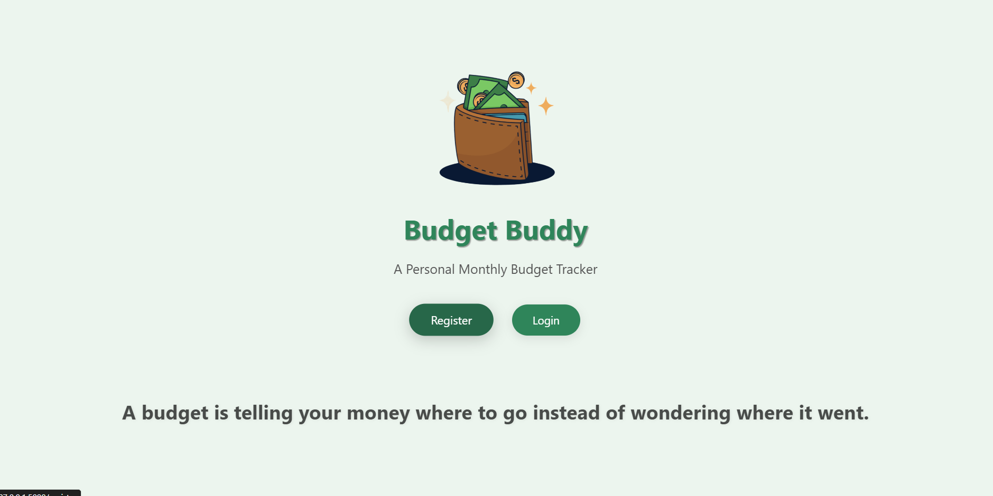
Budget Buddy Flow
1

Slide 12
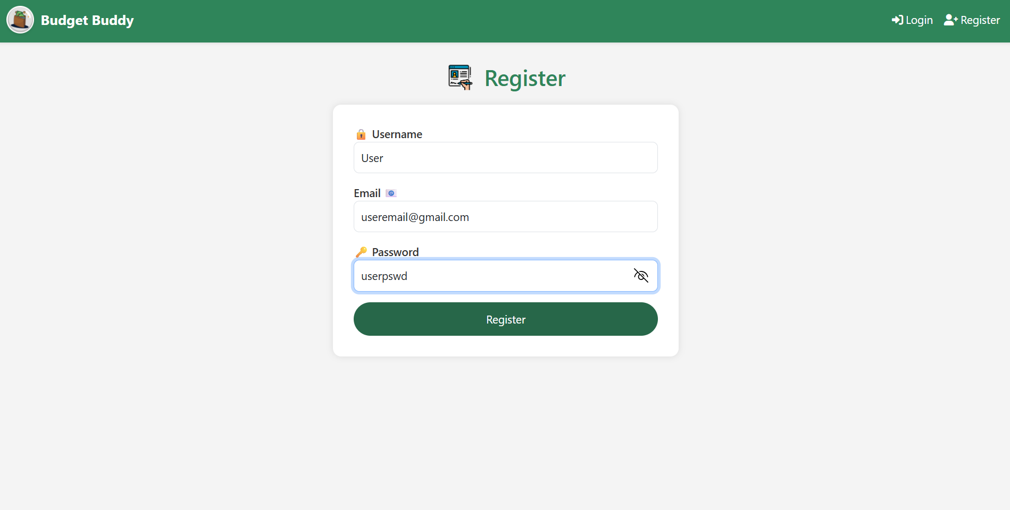
2
1. Register
User visits /register.
Fills in name, email, username, password.
SQL Query 1 (Check duplication):
SELECT * FROM users WHERE username = %s OR email = %s
If exists → show error.
If not: SQL Query 2 (Insert new user):
INSERT INTO users (name, email, username, password) VALUES (%s, %s, %s, %s)
Redirect to login page.

Slide 13
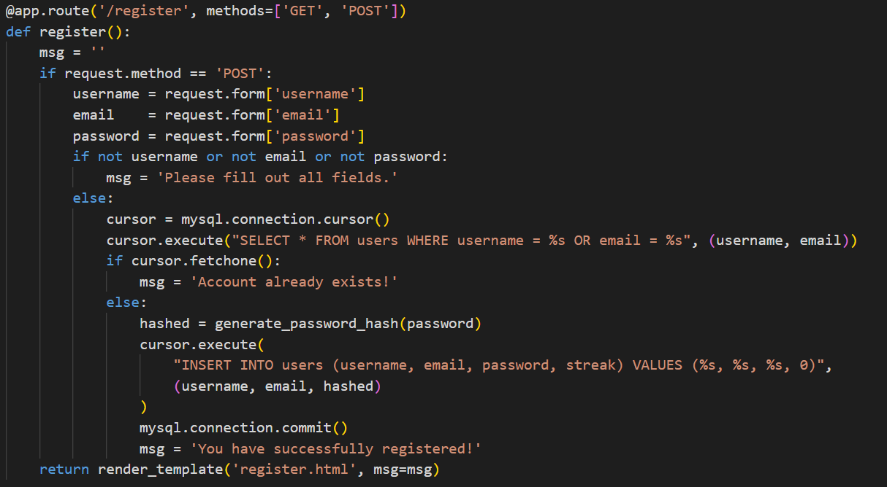
Register

Slide 14
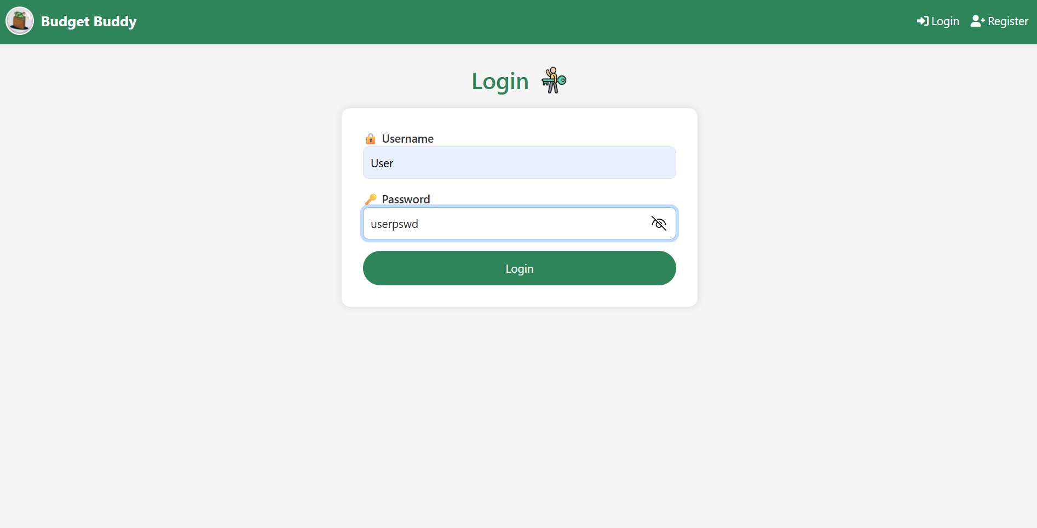
3
2. Login
User visits /login.
Enters username and password.
SQL Query (Fetch user):
SELECT * FROM users WHERE username = %s
If password matches → set session.
Redirect to dashboard.

Slide 15
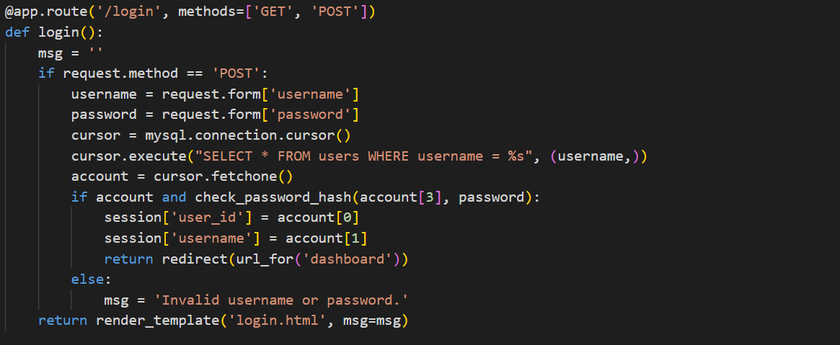
Login

Slide 16
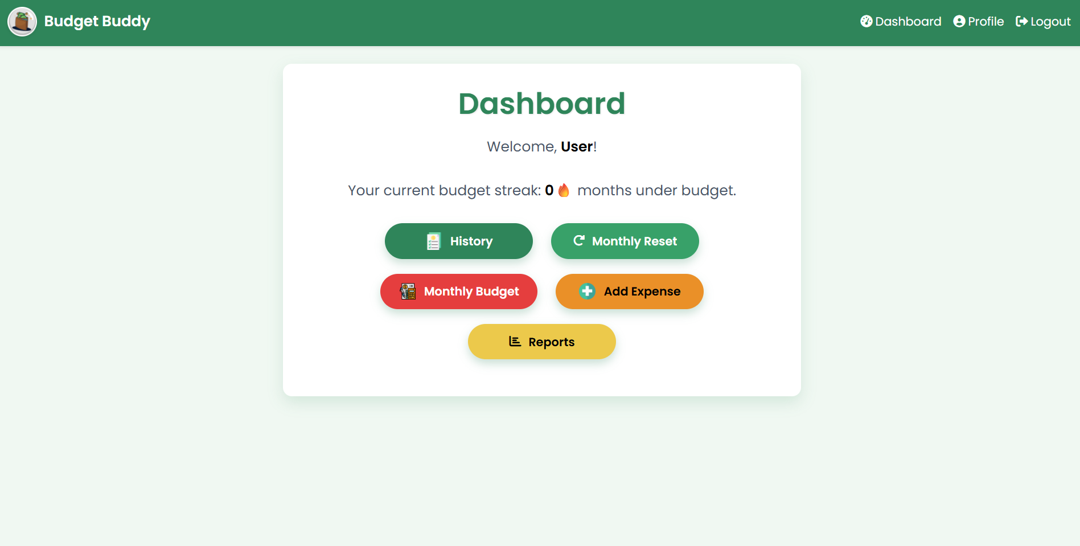
4
Get current streak
SELECT streak FROM users WHERE id = %s;
Why: Show the user how many successful cycles in a row they’ve kept under budget.

Slide 17
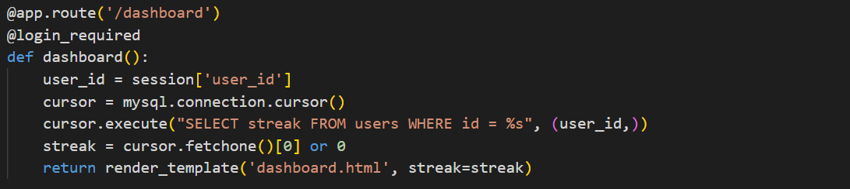
Dashboard
Get current streak
SELECT streak FROM users WHERE id = %s;
Why: Show the user how many successful cycles in a row they’ve kept under budget.

Slide 18
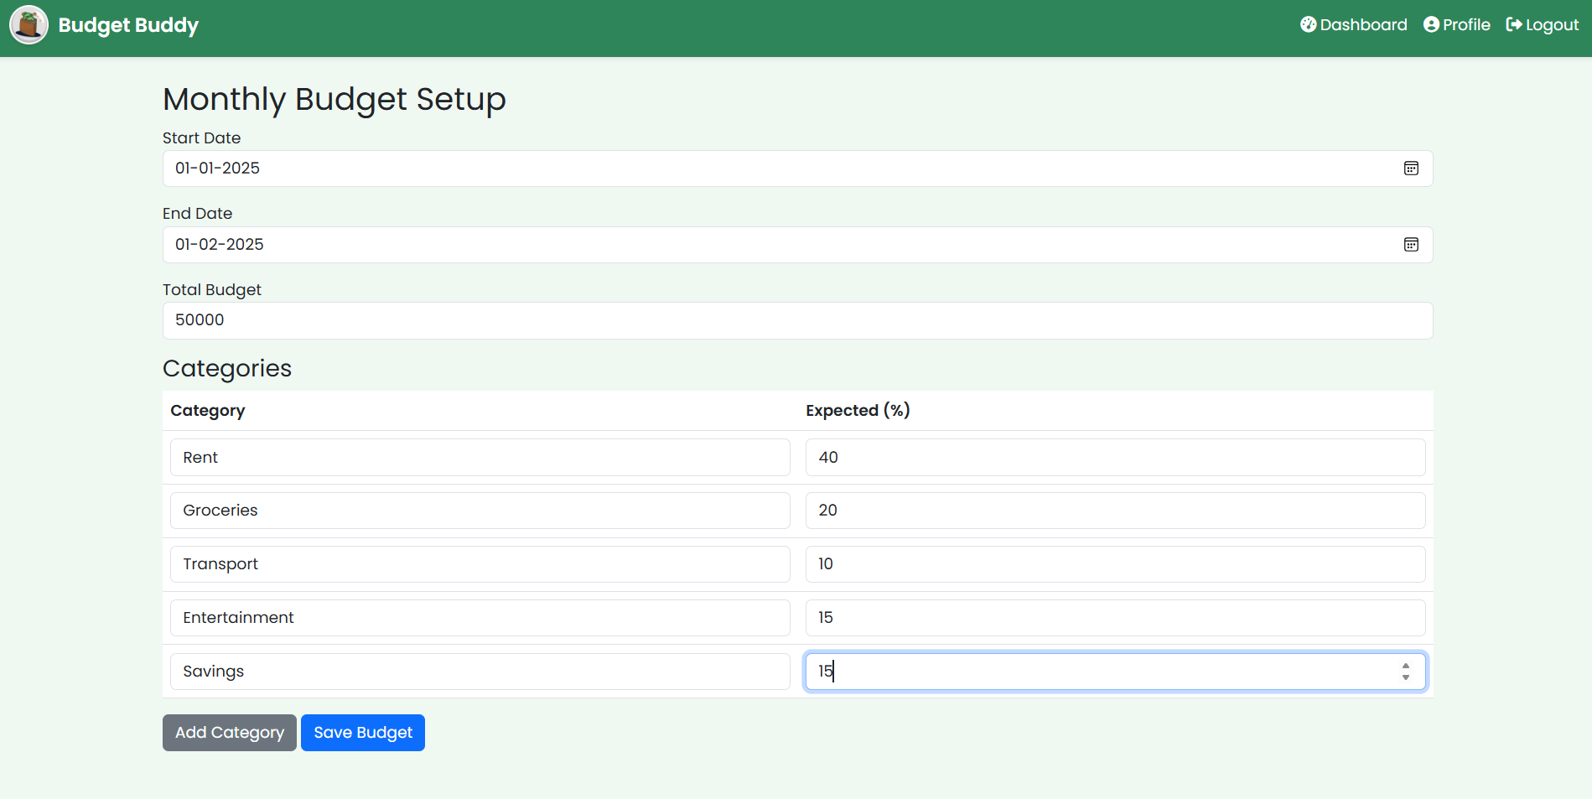
5

Slide 19
Monthly budget Setup
Find any previous active budget
SELECT total_budget, used_budget FROM budgets WHERE user_id = %s AND is_active = TRUE;
Why: Determine if there was an ongoing budget to decide whether the user “succeeded” (used ≤ total) and hence increment or reset their streak
.
Fetch current streak
SELECT streak FROM users WHERE id = %s;
Why: You need their existing streak count so you can bump it up (or zero it) based on last cycle’s performance.
Update streak
UPDATE users SET streak = %s WHERE id = %s;
Why: Store the recalculated streak back into the user record.
Deactivate old budgets
UPDATE budgets SET is_active = FALSE WHERE user_id = %s;
Why: Mark any prior budgets “closed,” so only one cycle is active at a time.
Insert new budget
INSERT INTO budgets (user_id, start_date, end_date, total_budget, is_active, used_budget) VALUES (%s, %s, %s, %s, TRUE, 0);
Why: Create the fresh cycle with zero spent so far.
Insert each category
INSERT INTO categories (budget_id, name, expected_amount, spent_amount) VALUES (%s, %s, %s, 0);
Why: Save every line‑item of the user’s budget plan, with the target amount and zero spent yet.

Slide 20
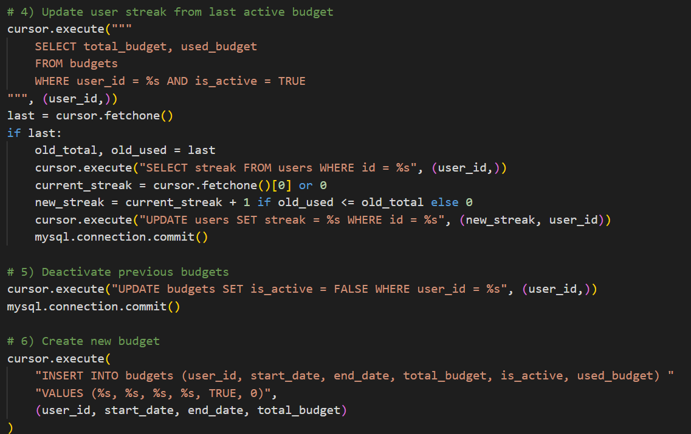
Monthly budget Setup
Check for existing “Others”
SELECT id, expected_amount FROM categories WHERE budget_id = %s AND name = 'Others';
Why: Decide whether to add leftover percentage to an existing “Others” or create a new “Others” row. r.
Update or insert “Others”
-- If exists: UPDATE categories SET expected_amount = %s WHERE id = %s; -- Otherwise: INSERT INTO categories (budget_id, name, expected_amount, spent_amount) VALUES (%s, 'Others', %s, 0);
Why: Ensure any un‑allocated portion of the budget lives in “Others” so 100% of funds are accounted fo

Slide 21
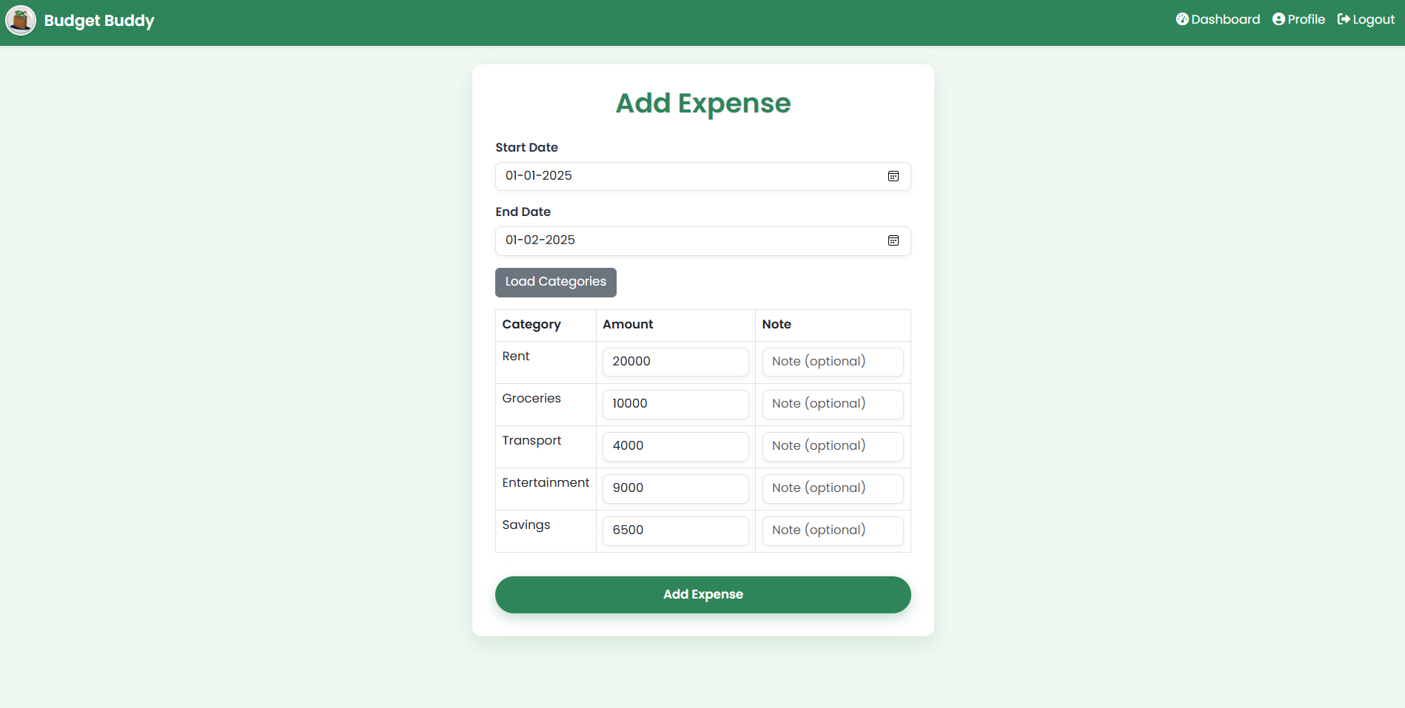
6

Slide 22
Add Expense
1.Locate the relevant active budget
SELECT id FROM budgets WHERE user_id = %s AND is_active = TRUE AND start_date <= %s AND end_date >= %s;
Why: Confirm there’s an open cycle covering the date the user is logging expenses.
Fetch its categories
SELECT id, name FROM categories WHERE budget_id = %s;
Why: Know which category IDs to use when inserting each expense line.
Insert each expense
INSERT INTO expenses (user_id, budget_id, category_id, expense_date, amount, note) VALUES (%s, %s, %s, %s, %s, %s);
Why: Record the actual spend amount, date, and any note for audit and reporting.
Add amount to category’s spent total
UPDATE categories SET spent_amount = spent_amount + %s WHERE id = %s;
Why: Keep a running tally for each category so you can quickly show “spent vs. expected.”
Add amount to budget’s used total
UPDATE budgets SET used_budget = used_budget + %s WHERE id = %s;
Why: Update the overall monthly spend so the dashboard and “streak” logic stay accurate.

Slide 23
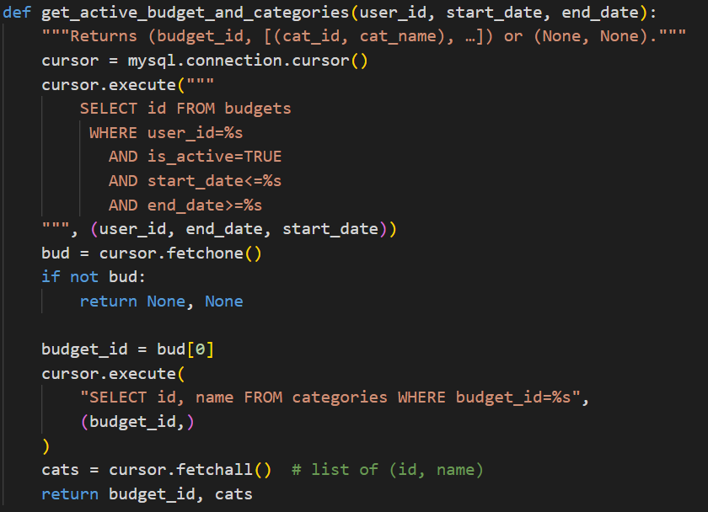
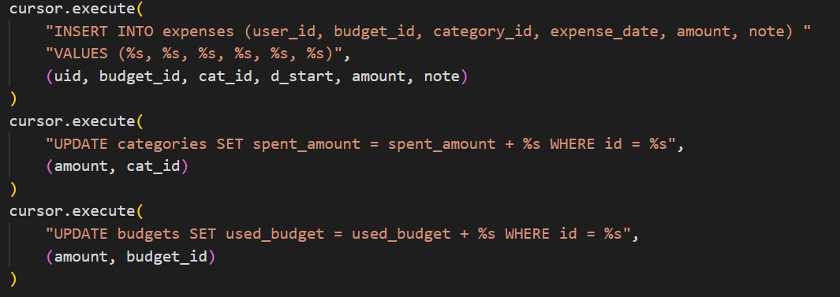
Add Expense

Slide 24
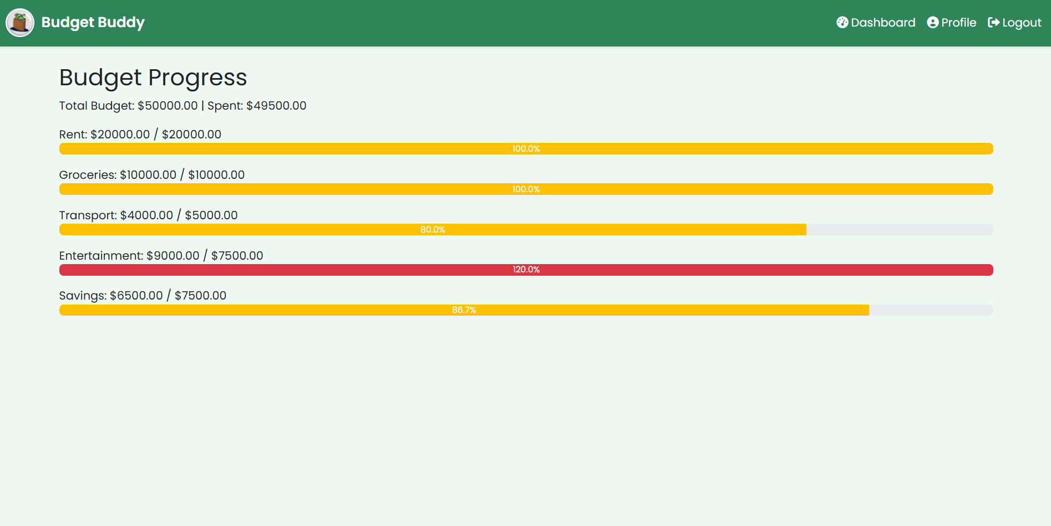
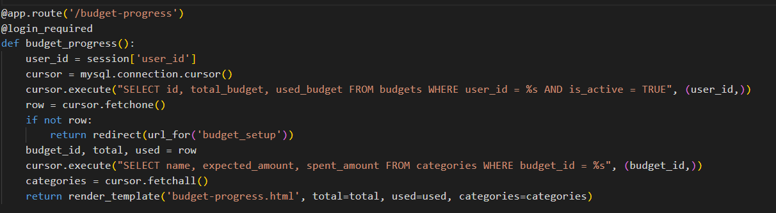
7

Slide 25
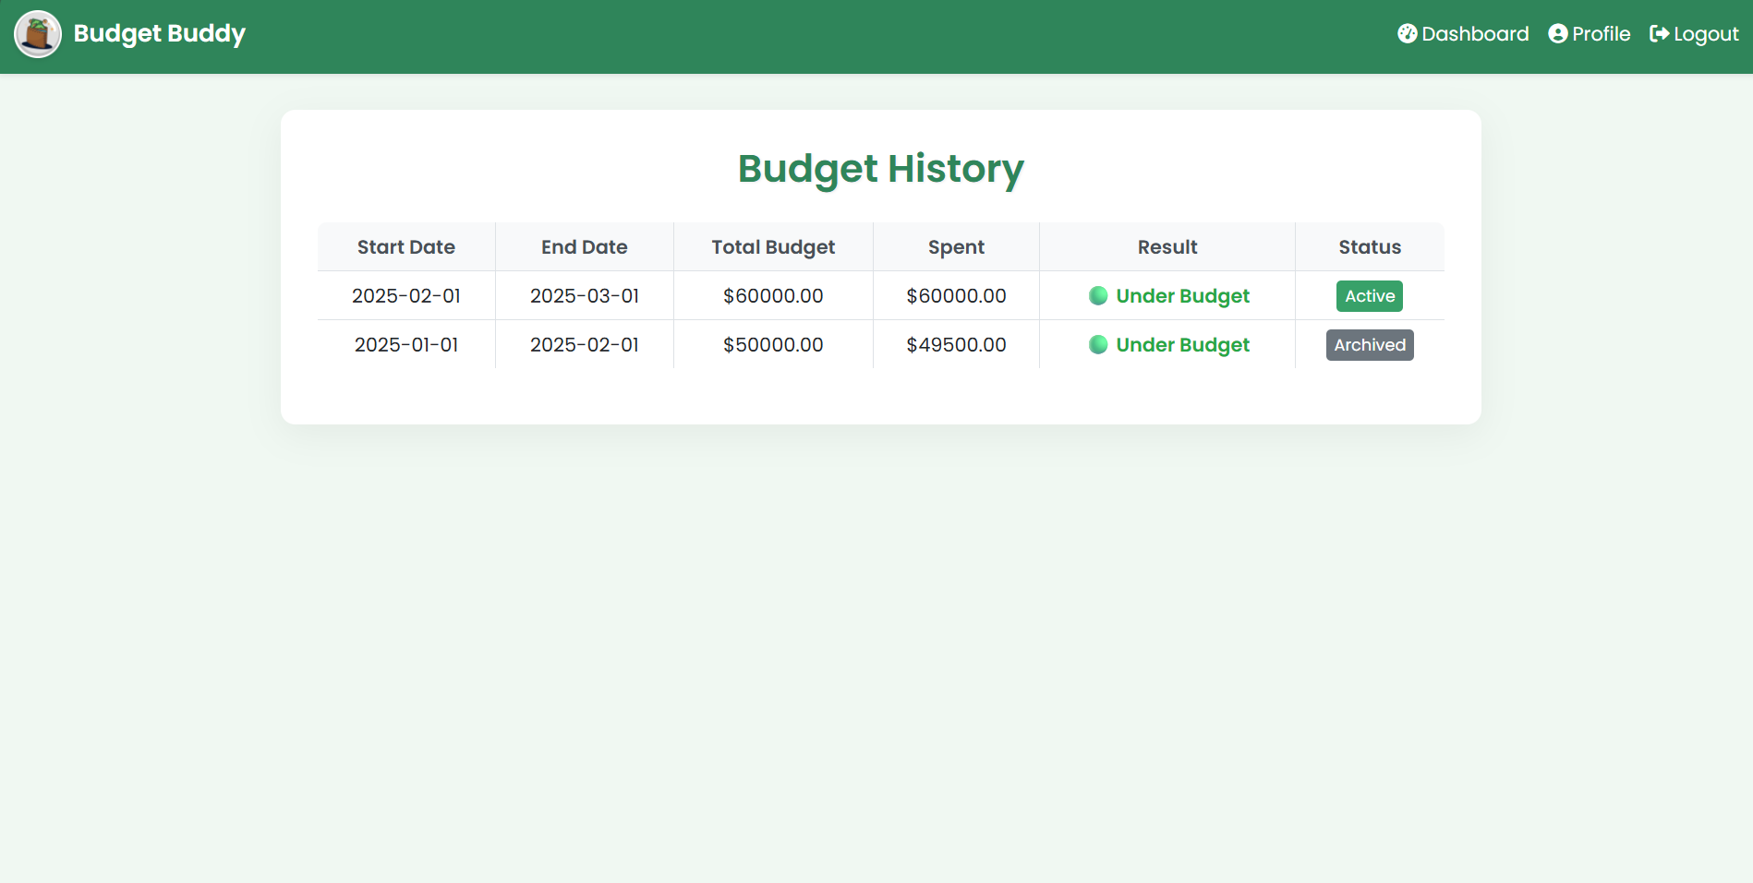
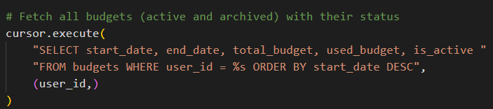
8

Slide 26
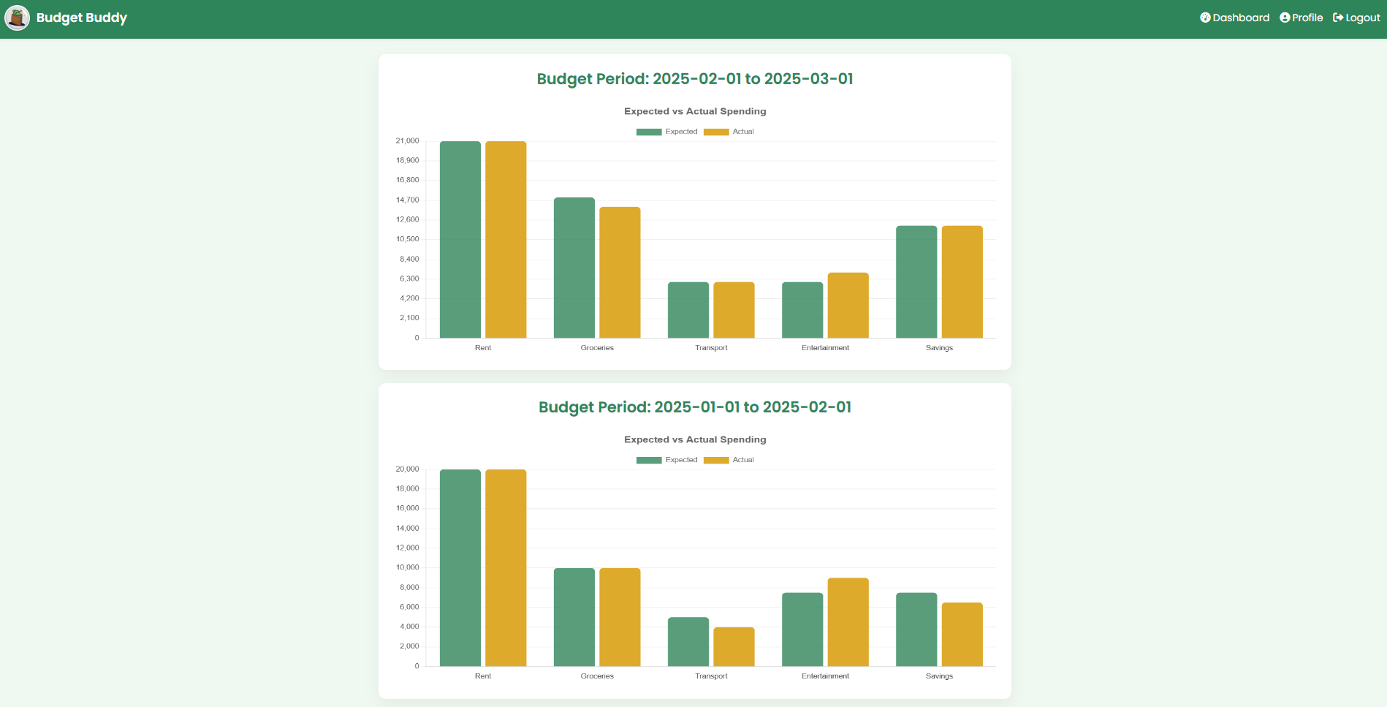
9

Slide 27
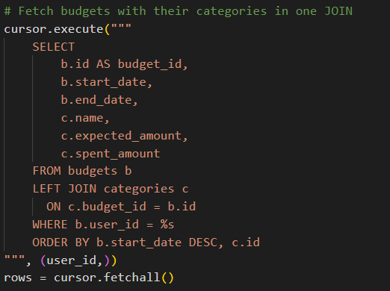
Reports

Slide 28
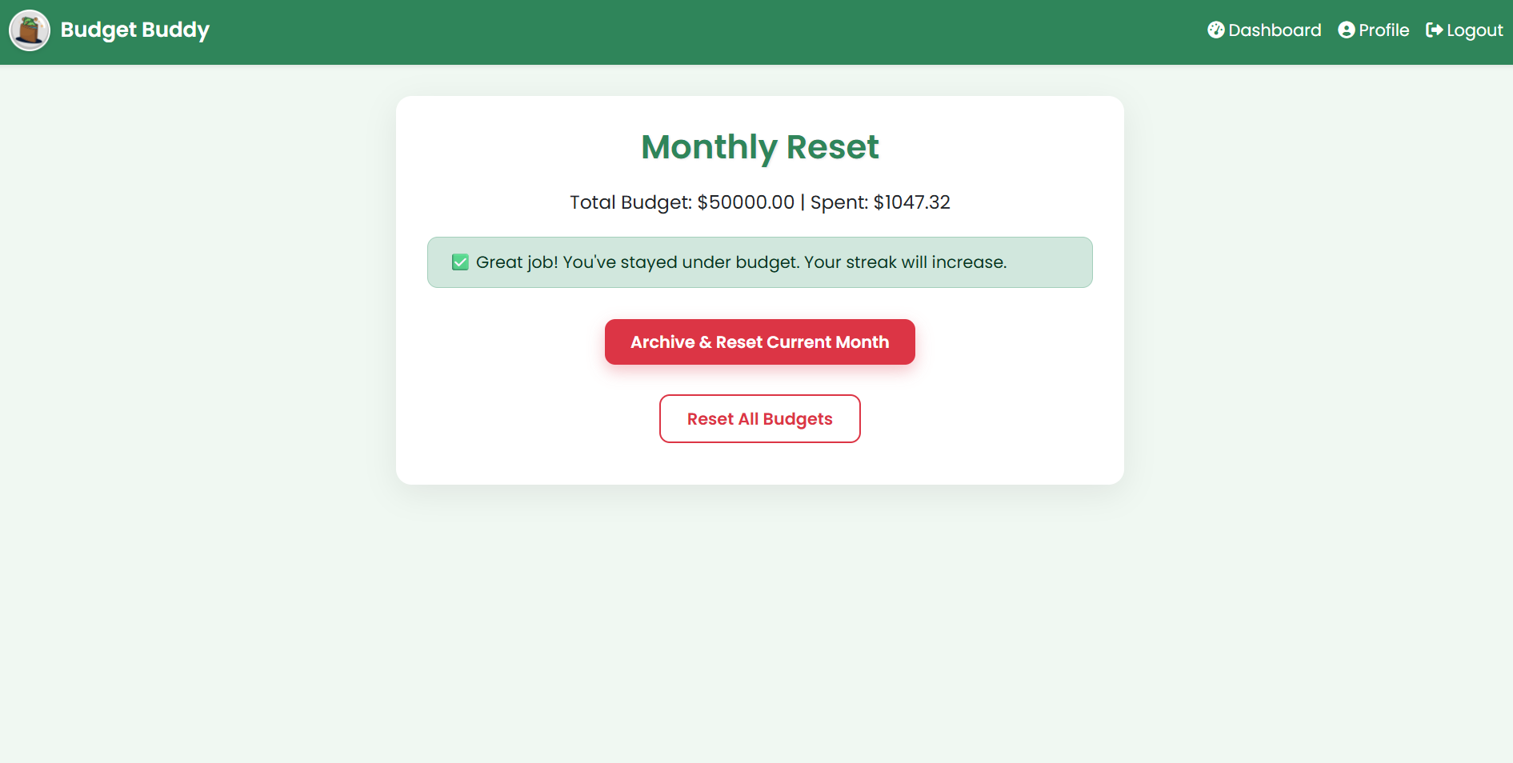
10

Slide 29
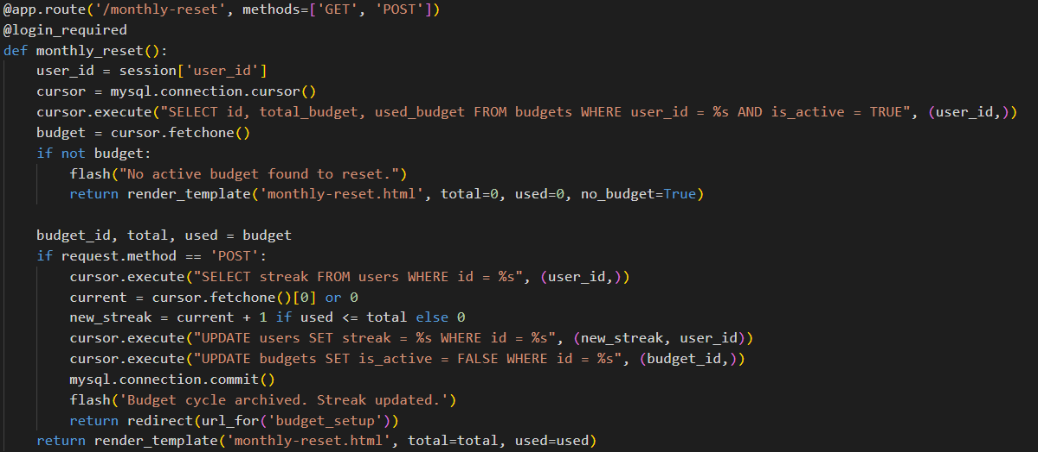
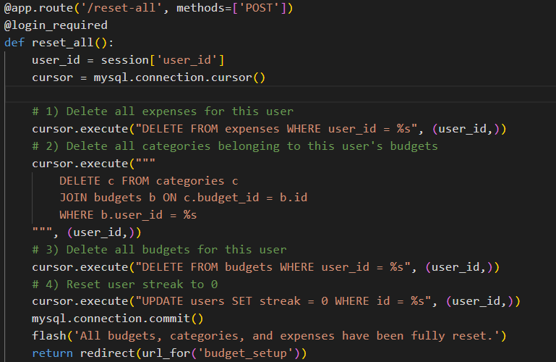
Reset

Slide 30
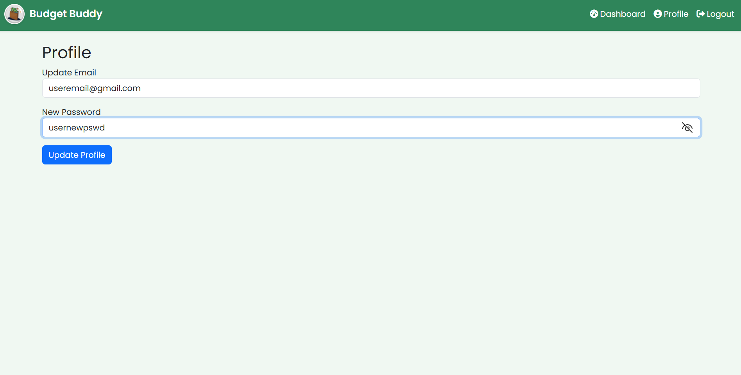
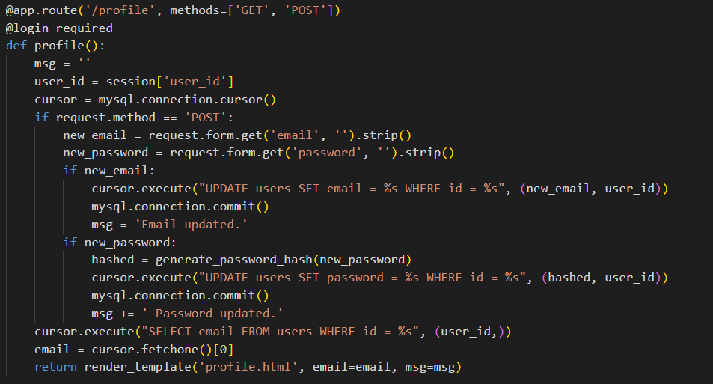

Slide 31

Challenges Faced
Database Design
Hard to avoid data repetition. → Solved using normalization (1NF, 2NF, 3NF).
Login System
Needed secure user accounts. → Used password hashing and unique emails.
Updating Budgets
Updating totals after each expense was tricky. → Handled in Flask backend.

Slide 32

.
THE END

