Slide 1
Introduction to PIG
Notes:
1

Slide 2
PIG
Apache Pig is a platform for data analysis.
It can be alternative to MapReduce Programming.
Pig was developed as a research project at Yahoo.
Framework for analyzing large un-structured and semi-structured data on top of Hadoop.
Pig Engine Parses, compiles Pig Latin scripts into MapReduce jobs run on top of Hadoop.
Pig Latin is declarative, SQL-like language; the high level language interface for Hadoop.

Slide 3

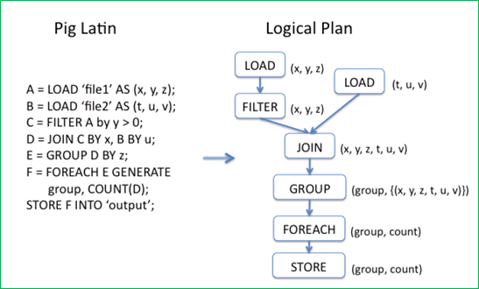
What is Pig
Notes:
Write pig latin job is as simple as writing sql queries, for complex cases, the developers can integrate user defined function into the pig statements.
3

Slide 4
Motivation of Using Pig
Faster development
Fewer lines of code (Writing map reduce like writing SQL queries)
Re-use the code (Pig library, Piggy bank)
One test: Find the top 5 words with most high frequency
10 lines of Pig Latin V.S 200 lines in Java
15 minutes in Pig Latin V.S 4 hours in Java
Notes:
Accelerate development process, many company such as Yahoo, Twitter, using Pig Latin to process large scale data.
4

Slide 5
Who uses Pig for What
70% of production jobs at Yahoo (10ks per day)
Twitter, LinkedIn, Ebay, AOL,…
Used to
Process web logs
Build user behavior models
Process images
Build maps of the web
Do research on large data sets
Notes:
Pig is used for processing large scale data sets
5

Slide 6
Key features of Pig
It provides an engine for executing data flows (how your data should flow).
Pig processes data in parallel on the Hadoop cluster.
It provides a language called “Pig Latin” to express data flows.
Pig Latin contains operators for many of the traditional data operations such as join, filter, sort etc.
It allows users to develop their own functions(User defined Functions) for reading, processing and writing data.

Slide 7
ANATOMY of PIG
The main components of pig are:
1.
1.Data flow language (Pig Latin)
2. Interactive shell where you can type Pig Latin statements (Grunt)
3. Pig interpreter and execution engine.

Slide 8
ANATOMY OF PIG
A=load ‘student’ (rollno,name,gpa)
A=Filter A by gpa>4.0;
A= foreach A generate UPPER (name);
STORE A INTO ‘myreport’
Processes and parses Pig latin
Checks data types
Performs optimization
Creates mapreduce jobs
Submits job(s) to Hadoop
Monitors progress
Hadoop MapReduce jobs
Pig latin script
Pig lnterpreter/ Execution engine
MapReduce Jobs

Slide 9
PIG ON HADOOP
Pig runs on Hadoop.
Pig uses both Hadoop Distributed File System and mapReduce Programming.
Pig reads input files from HDFS.
Pig stores the intermediate data (data produced by MapReduce jobs) and the output in HDFS.
Pig can also read input from and place output to other sources.
Pig supports the following:
HDFS Commands
UNIX SHELL COMMANDS
Relational Operators
Positional Parameters
Common Mathematical functions
Custom functions
Complex data structures

Slide 10
PIG PHILOSOPHY
Pigs Eat Anything: Pig can process different kinds of data such as structured data and unstructured data.
Pigs Live Anywhere: Pig not only processes files in HDFS, it also processes files in other sources such as files in the local file system.
Pigs are Domestic Animals: Pig allows you to develop user-defined functions and the same can be included in the script for complex operations.
Pigs Fly: Pig processes data quickly.
Pigs Fly
Pig Philosophy
Pigs are domestic animals
Pigs eat anything
Pigs live anywhere

Slide 11
USE CASE FOR PIG-ETL PROCESSING
Pig is widely used for ETL (Extract, Transform and Load)
Pigs can extract data from different sources such as ERP, Accounting, Flat files etc.
Pig makes use of various operators to perform transformations on the data and subsequently loads in into data warehouse.
ERP
Data Warehouse
Data Validation
Fixing errors
Removal of duplicates
Encode Value
Accounting
Flat Files

Slide 12
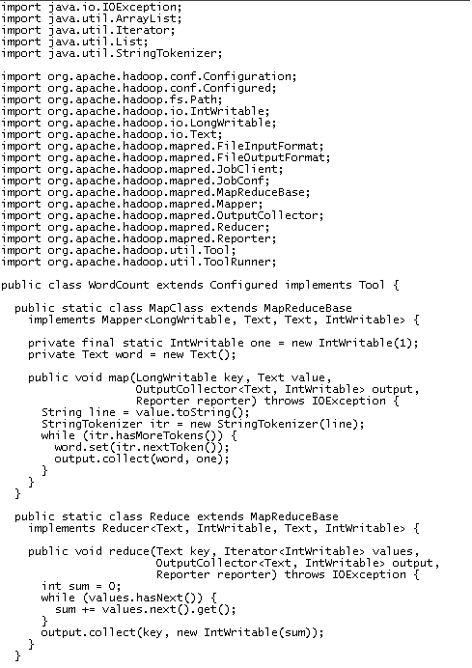
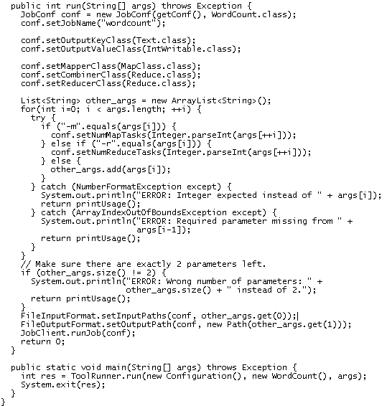
Word Count using MapReduce

Slide 13
Word Count using Pig
Lines=LOAD ‘input/hadoop.log’ AS (line: chararray);
Words = FOREACH Lines GENERATE FLATTEN(TOKENIZE(line)) AS word;
Groups = GROUP Words BY word;
Counts = FOREACH Groups GENERATE group, COUNT(Words);
Results = ORDER Words BY Counts DESC;
Top5 = LIMIT Results 5;
STORE Top5 INTO /output/top5words;

Slide 14
Pig Highlights
UDFs can be written to take advantage of the combiner
Four join implementations are built in
Writing load and store functions is easy once an InputFormat and OutputFormat exist
Multi-query: pig will combine certain types of operations together in a single pipeline to reduce the number of times data is scanned.
Order by provides total ordering across reducers in a balanced way
Piggybank, a collection of user contributed UDFs
Notes:
Inner join, out join, exclusive, inclusive; User defined functions (UDFs) can be written for column transformation (TOUPPER), or aggregation
Merge join; skewed join; replicated join; spare-marge join
14

Slide 15
Pig Latin Overview
Pig Latin Statements:
Pig Latin statements are basic constructs to process data using pig.
Pig latin statement is an operator
An operator in Pig latin takes a relation as input and yields another relation as output.
Pig latin statements include schemas and expressions to process data.
Pig latin statements should end with a semi-colon.

Slide 16
Pig Latin Statements are generally ordered as follows:
LOAD statement that reads data from the file system
Series of statements to perform transformations
DUMP or STORE to display/store result.

Slide 17
Sample Pig Latin script to load, filter and store “student” data
A = load ‘student’ (rollno, name, gpa);
A = filter A by gpa > 4.0;
A = foreach A generate UPPER (name);
STORE A INTO ‘myreport’

Slide 18
Pig Latin: Comments
Two types of comments are supported:
Single line comments that begin with “--”
Multiline comments that begin with “/* and end with */ ”
Pig Latin: Case Sensitivity
Keywords are not case sensitive such as LOAD, STORE, GROUP, FOREACH, DUMP etc.
Relations and paths are case-sensitive.
Function names are case sensitive such as PigStorage, COUNT.

Slide 19
Operators in Pig Latin
Arithmetic | Comparison | Null | Boolean
+ , - , *, / , % | == , !=, < , >, <= , >= | IS NULL, IS NOT NULL | AND, OR, NOT

Slide 20
Pig Data Types
Simple/Scalar Data Types:
Int,
long,
float,
double,
boolean,
chararray,
Bytearry,
Datetime;
Complex Data Types:
Fields
tuples,
bags,
relations;
A Field is a piece of data
A Tuple is an ordered set of fields
A Bag is a collection of tuples
A Relation is a bag
Notes:
Map a set of keyval pair; A Pig relation is a bag of tuples. A Pig relation is similar to a table in a relational database, where the tuples in the bag correspond to the rows in a table. Unlike a relational table, however, Pig relations don't require that every tuple contain the same number of fields or that the fields in the same position (column) have the same type.
20

Slide 21
Accessing Pig
Accessing approaches:
Batch mode: submit a script directly
Interactive mode: Grunt, the pig shell
PigServer Java class, a JDBC like interface
Execution mode:
Local mode: pig –x local filename
Mapreduce mode: pig –x mapreduce / pig filename

Slide 22
Pig Operations
Loading data
LOAD loads input data
Lines=LOAD ‘input/access.log’ AS (line: chararray);
Projection
FOREACH … GENERTE … (similar to SELECT)
takes a set of expressions and applies them to every record.
Grouping
GROUP collects together records with the same key
Dump/Store
DUMP displays results to screen, STORE save results to file system
Aggregation
AVG, COUNT, MAX, MIN, SUM
Notes:
There are more than 20 Pig operations
22

Slide 23
Pig Operations
Pig Data Loader
PigStorage: loads/stores relations using field-delimited text format
TextLoader: loads relations from a plain-text format
BinStorage:loads/stores relations from or to binary files
PigDump: stores relations by writing the toString() representation of tuples, one per line
(John,18,4.0F)
(Mary,19,3.8F)
(Bill,20,3.9F)
students = load 'student.txt' using PigStorage('\t')
as ( name:chararray, age:int, gpa:double);

Slide 24
RELATIONAL OPERATORS
FILTER: It is used to select the tuples from a relation based on specified conditions.
Example:Find the tuples of those student where GPA is > than 4.0
Student (rollno:int, name:chararray, gpa:float)
A= load ‘/pigdemo/student.tsv’ as (rollno:int, name:chararray, gpa:float);
B = filter A by gpa > 4.0;
DUMP B;

Slide 25
FOREACH: It is used to make data transformations based on columns of data
Example: Display the name of all students in uppercase
Student (rollno:int, name:chararray, gpa:float)
A= load ‘/pigdemo/student.tsv’ as (rollno:int, name:chararray, gpa:float);
B = foreach A generate UPPER (name);
DUMP B
Notes:
25

Slide 26
DISTINCT: It is used to remove duplicate tuples. In Pig, DISTINCT operator works on the entire tuple and not on individual fields.
EXAMPLE: To remove duplicate tuples of students
Student (rollno:int, name:chararray, gpa:float)
A= load ‘/pigdemo/student.tsv’ as (rollno:int, name:chararray, gpa:float);
B = DISTINCT A;
DUMP B;

Slide 27
GROUP: It is used to group data.
EXAMPLE: Group tuples of students based on their GPA.
Student (rollno:int, name:chararray, gpa:float)
A= load ‘/pigdemo/student.tsv’ as (rollno:int, name:chararray, gpa:float);
B= GROUP A BY gpa;
DUMP B;

Slide 28
LIMIT: It is used to limit the number of output tuples.
EXAMPLE: Display the first 3 tuples from the ‘student’ relation
Student (rollno:int, name:chararray, gpa:float)
A= load ‘/pigdemo/student.tsv’ as (rollno:int, name:chararray, gpa:float);
B= LIMIT A 3;
DUMP B;

Slide 29
Pig Operations – Dump&Store
DUMP Operator:
display output results, will always trigger execution
STORE Operator:
Pig will parse entire script prior to writing for efficiency purposes
A = LOAD ‘input/pig/multiquery/A’;
B = FILTER A by $1 == “apple”;
C = FILTER A by $1 == “apple”;
SOTRE B INTO “output/b”
STORE C INTO “output/c”
Relations B&C both derived from A
Prior this would create two MapReduce jobs
Pig will now create one MapReduce job with output results
Notes:
Push results to stand output
29

Slide 30
FILTER
It is used to select tuples from a relation based on specified conditions.
To find the tuples of students whose gpa is greater than 4.0
Student(rollno:int,name: chararray,gpa:float)
A=load ‘students.tsv’ as (rollno:int,name:chararray,gpa:float);
B= filter A by gpa>4.0;
DUMP B;

Slide 31
Pig Operations - Count
Compute the number of elements in a bag
Use the COUNT function to compute the number of elements in a bag.
COUNT requires a preceding GROUP ALL statement for global counts and GROUP BY statement for group counts.
X = FOREACH B GENERATE COUNT(A);

Slide 32
Pig Operation - Order
Sorts a relation based on one or more fields
In Pig, relations are unordered. If you order relation A to produce relation X relations A and X still contain the same elements.
student = ORDER students BY gpa DESC;

Slide 33
JOIN
To join two or more relations based on values in the common field.
A= load ‘/pigdemo/student.tsv’ as (rollno:int,name:chararray,gpa:float);
B=load ‘/pigdemo/department.tsv’ as (rollno:int,deptno:int,deptname:chararray);
C=JOIN A BY rollno, B BY rollno;
DUMP C;

Slide 34
UNION
A= load ‘/pigdemo/student.tsv’ as (rollno:int,name:chararray,gpa:float);
B=load ‘/pigdemo/department.tsv’ as (rollno:int,deptno:int,deptname:chararray);
C=UNION A,B;
STORE C INTO ‘/pigdemo/uniondemo’
DUMP C;

Slide 35
SPLIT
To partition a relation into two or more relations.
A= load ‘/pigdemo/student.tsv’ as (rollno:int,name:chararray,gpa:float);
SPLIT A INTO X IF gpa== 4.0 , Y IF gpa<=4.0;
DUMP X;
DUMP Y;

Slide 36
SAMPLE
To select random sample of data based on the specified sample size.
A= load ‘/pigdemo/student.tsv’ as (rollno:int,name:chararray,gpa:float);
B= SAMPLE A 0.01;
DUMP B;

Slide 37
COMPLEX DATA TYPES
TUPLE
An ordered collection of fields.
A = LOAD ‘/root/studentdata.tsv’ AS (t1:tuple(t1a:chararray,t1b:int),t2:tuple(t2a:chararray,t2b:int));
B= foreach A GENERATE t1.t1a,t1.t1b,t2.$0,t2.$1;
DUMP B;

Slide 38
MAP
A= LOAD ‘/root/student.tsv’ Using PigStore as (studname:chararray, m:map[chararray]);
B= foreach A generate m#’city’ as Cityname:chararray;
DUMP B;

Slide 39
PIGGY BANK
Pig use can use Piggy Bank functions in Pig Latin script and they can also share their functions in Piggy Bank.

Slide 40
How to run Pig Latin scripts
Local mode
Local host and local file system is used
Neither Hadoop nor HDFS is required
Useful for prototyping and debugging
MapReduce mode
Run on a Hadoop cluster and HDFS
Batch mode - run a script directly
Pig –x local my_pig_script.pig
Pig –x mapreduce my_pig_script.pig
Interactive mode use the Pig shell to run script
Grunt> Lines = LOAD ‘/input/input.txt’ AS (line:chararray);
Grunt> Unique = DISTINCT Lines;
Grunt> DUMP Unique;
Notes:
40

Slide 41
Hands-on: Word Count using Pig Latin
1. Batch mode
pig –x local wordcount.pig
2. Iterative mode
grunt> Lines=LOAD ‘input.txt’ AS (line: chararray);
grunt>Words = FOREACH Lines GENERATE FLATTEN(TOKENIZE(line)) AS word;
grunt>Groups = GROUP Words BY word;
grunt>counts = FOREACH Groups GENERATE group, COUNT(Words);
grunt>DUMP counts;

Slide 42
TOKENIZE&FLATTEN
TOKENIZE returns a new bag for each input; “FLATTEN” eliminates bag nesting
A:{line1, line2, line3…}
After Tokenize:{{lineword1,line1word2,…}},{line2word1,line2word2…}}
After Flatten{line1word1,line1word2,line2word1…}

Slide 43
User Defined Function
What is UDF
Way to do an operation on a field or fields
Called from within a pig script
Currently all done in Java
Why use UDF
You need to do more than grouping or filtering
Actually filtering is a UDF
Maybe more comfortable in Java land than in SQL/Pig Latin
P = Pig.compile("""register udf.jar
DEFINE find_centroid FindCentroid('$centroids');

Slide 44
Embedding Python scripts with Pig Statements
Pig does not support flow control statement: if/else, while loop, for loop, etc.
Pig embedding API can leverage all language features provided by Python including control flow:
Loop and exit criteria
Similar to the database embedding API
Easier parameter passing
JavaScript is available as well
The framework is extensible. Any JVM implementation of a language could be integrated

Slide 45
PIG VERSUS HIVE
Features | Pig | Hive
Used BY | Programmers and researchers | Analyst
Used for | Programming | Reporting
Language | Procedural data flow language | SQL like
Suitable for | Semi-structure | Structured
Schema types | Explicit | Implicit
UDF support | Yes | Yes
Join/order/sort | Yes | Yes
DFS | Yes Implicit | Yes explicit
Web Interface | Yes | NO
Shell | Yes | yes

Slide 46
When to use Pig
When the data loads are time sensitive.
When you want to process various data sources.
When you want to get analytical insights through sampling.
When not to use Pig
When data is completely in the unstructured form such as Video, text and audio.
When there is a time constraint because Pig is slower than MapReduce jobs.

