Slide 1
15-849E
Wireless Networking
Discussion Lead
Sai Vinayak
George Nychis

Slide 2
Overview of Today’s Discussion
Charles E. Perkins, "Mobile Networking through Mobile IP"
Mark Gritter and David R. Cheriton, "An Architecture for Content Routing Support on the Internet"
Arunesh Mishra, Min-ho Shin, William Arbaugh, "Context Caching using Neighbor Graphs for Fast Handoffs in a Wireless Network”

Slide 3
Mobile IP - Motivation
An IP address not only identifies a host but also a point-of-attachment
A host cannot change its IP address without terminating on-going sessions
Mobility is the ability of a node to change its point-of-attachment while maintaining all existing communications and using the same IP address

Slide 4
Overview
How Mobile IP works
What changes with IPv6
Ongoing work and open questions

Slide 5
Mobile IP – The Gory Details
Mobile node can use 2 IP addresses
  Static Home Address (identifies TCP connections)
  Dynamic Care-of-Address (current point of attachment on the network)

Slide 6
Mobile IP – Details (Contd.)
Mobile IP is a cooperation of 3 mechanisms
  Discovering the care-of-address
  Registering the care-of-address
  Tunneling to the care-of-address

Slide 7
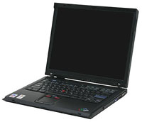
Mobile IP – Details (Contd.)
FA Advertises Service
FA
FA
FA Relays request to HA
MH Requests Service
HA
HA Accepts or denies
FA Relays status to MH
FA
Remote Redirect

Slide 8
Mobile IP – Details (Contd.)
Recap (Remote Redirect)
  MH requests service from FA
  FA relays request to HA
  HA accepts the request (if possible) and its modifies routing table
  FA relays this to ths MH
See anything missing?
  Malicious node could cause HA to alter its routing table with erroneous COA (DOS Attack?)

Slide 9
Mobile IP – Details (Contd.)
Solution?
  Digitally signed Remote Redirect (RR) messages
Would it work now?
  What about replay attacks?
Solution?
  RR messages could be made unique – How?
    Timestamps with each message
    Pseudorandom number with each message

Slide 10
How will Mobile IP change with IPv6?
Stateless Address Autoconfiguration and Neighbor Discovery precludes the need for Foreign Agents
Security
  All IPv6 nodes implement strong authentication and encryption features
Source Routing
  Correspondent nodes no longer tunnel packets to MHs
  Instead they use IPv6 routing headers (variation of IPv4 source routing option)
More …

Slide 11
Ongoing Work and Open Questions
Routing inefficiencies
  Triangle Routing
Security Issues
Ingress Filtering
Slow Growth in the Wireless LAN Market
Competition from other protocols

Slide 12
Questions …. Comments ..?

Slide 13
Context Caching using Neighbor Graphs for Fast Handoffs in a Wireless Network
- Mishra et al.

Slide 14
Motivation
Voice and Multimedia application require fast handoffs between base stations to maintain quality
Previous work on context transfer has focused on Reactive Context Transfer

Slide 15
Handoff Procedure 802.11
Mobile node moves from one AP to another within the same wireless network
Results in transfer of physical layer connectivity and transfer of state information from one AP to another

Slide 16
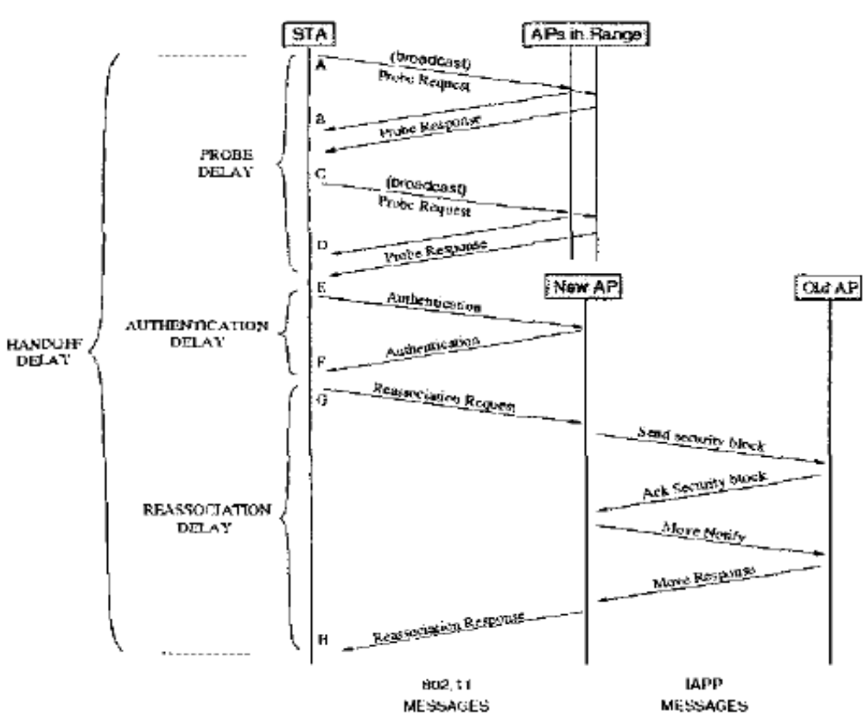

Slide 17
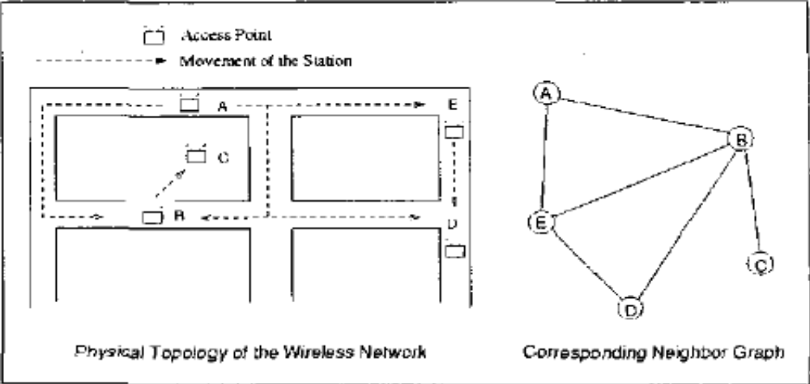
Neighbor Graphs
Reassociation Relationship (RR) – 2 APs ap_{i} & ap_{j} are said to have an RR if it is possible for a station to perform reassociation thru some path between ap_{i} & ap_{j}

Slide 18
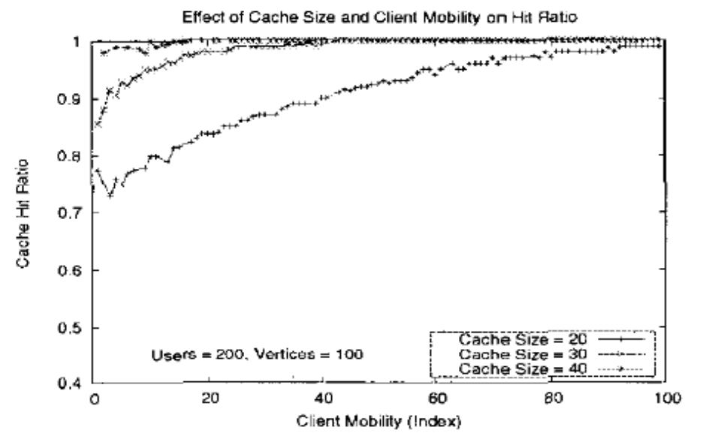
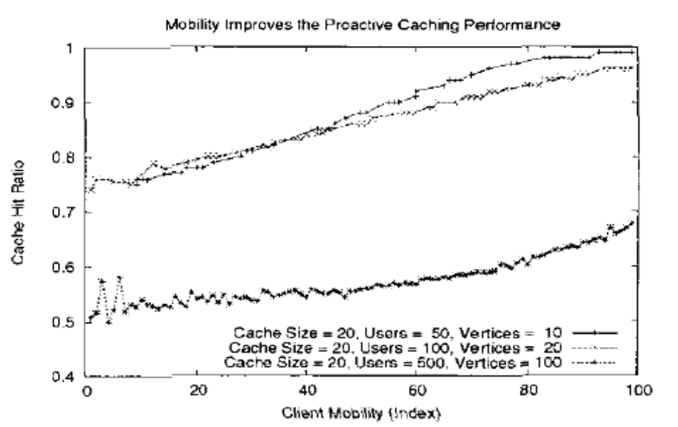
Similation Results

Slide 19
Questions or Comments ?

Slide 20
Context Caching for Content Routing Support in the Internet
- Gritter et al.

Slide 21
Motivation
Millions of (constantly increasing) clients accessing thousands of websites
To scale content delivery content providers replicate at geographically dispersed sites
How to route client requests to a nearby replica?
  aka. The Content routing problem

Slide 22
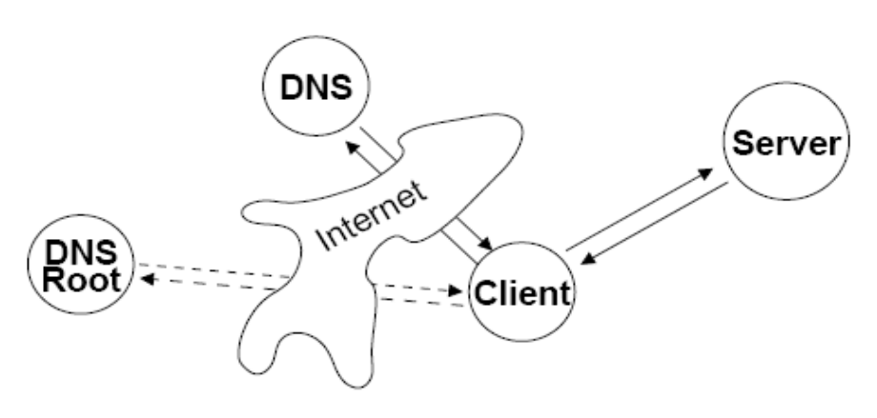
Motivation (Contd.)
On cache miss, the client
  Contacts DNS root (1 RT, say London/Norway)
  Contacts authoritative name server (1RT, say Redmond)
  Contacts Content server (1RT, say Germany)
  Total 3 round trip times

Slide 23
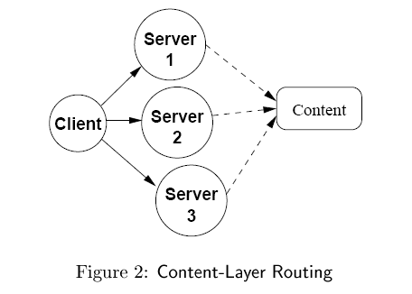
Design Overview
Replicated Servers offer alternate routes to content (Problem reduces to multipath routing)

Slide 24
Design Overview (contd.)
To make use of information about content reachability we need support from the core
Achieved by Content Routers (CR)
  Act as both conventional IP routers
  And name servers
Only firewalls, gateways and BGP level routers need to be CRs

Slide 25
Content Lookup
Name lookup supported by Internet Name Resolution Protocol (INRP)
Each CR maintains a set of name to next hop mappings
When INRP request arrives the desired name is looked up in the name routing table and forwarded to next hop

Slide 26
Name Based Routing (NBRP)
Similar to BGP
NBRP distributes name suffix reachability
Like BGP, NBRP is Distance Vector Algorithm
NBRP routing advertisement contains the path of the content routers toward a content server

Slide 27
Benefits
Client request mapped to content server in one round trip
Hence, no need to contact off-path name servers
This property is maintained even as internet scales

Slide 28
Questions or Comments ?

Slide 29
Internet Mobility 4x4
Summary of different optimizations for Mobile IP
Provides arguments of when to use specific optimizations and functionality
When to use encapsulation?
Can we optimize routing, delay, or size?

Slide 30
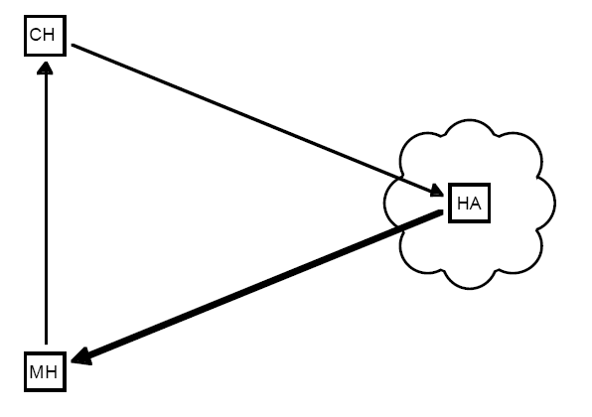
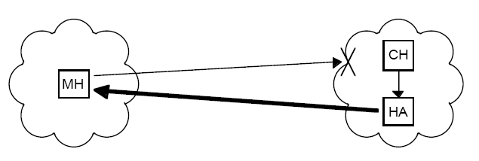
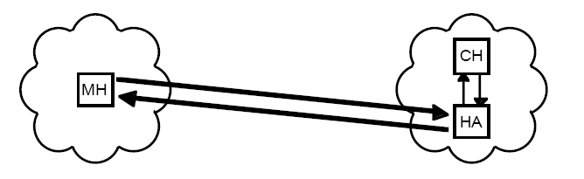
Traditional Mobile IP
security blocking
traditional
Encapsulate all packets

Slide 31
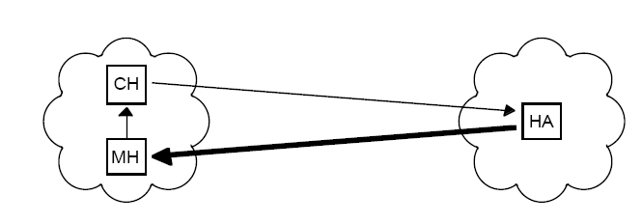
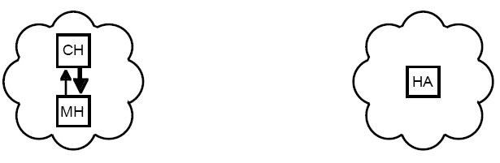
What if both hosts on same Ethernet?
Use ICMP response

Slide 32
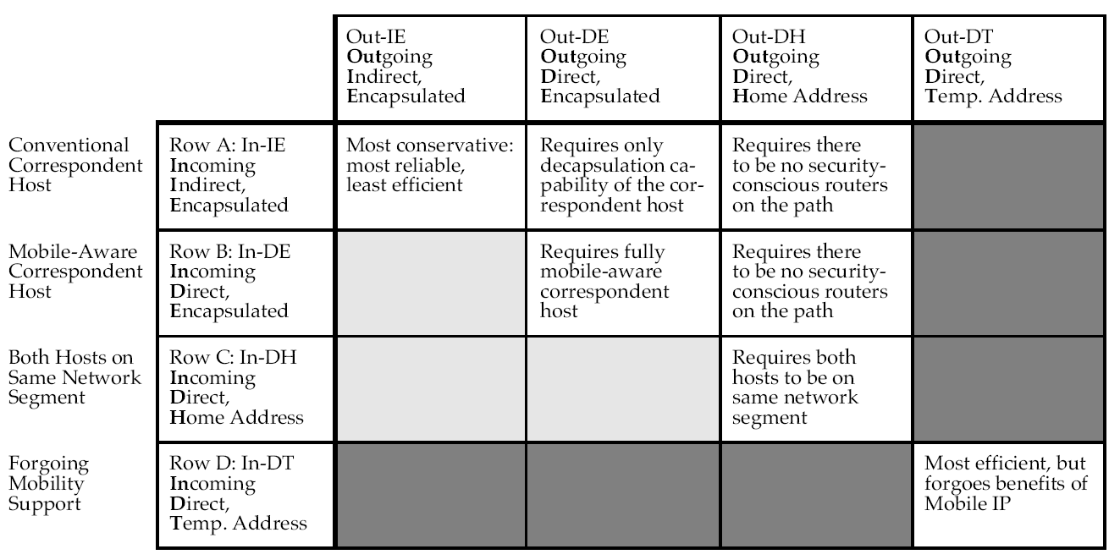
4x4 Chart
Tradeoffs: Encapsulation overhead, mobile awareness, routing indirection delay . . .

Slide 33
MSOCKS
Issues MSOCKS is addressing:
  Overlay networks -> multiple interfaces
  All packets do not have equal priority
  Network layer functionality cannot distinguish data types
  MobileIP not firewall aware

Slide 34
MSOCKS Approach
Transport Layer Mobility... through proxy
Why a proxy?
  provide processing resources
  reformat information
  compress data to reduce bandwidth
  support firewalls
  different priorities to data

Slide 35
MSOCKS Architecture
Three components
  MSOCKS proxy process on a proxy machine
  Kernel modification for TCP Splice service
  shim MSOCKS library under applications
TCP Splice goal: make two seperate TCP connections seem like one connection

Slide 36
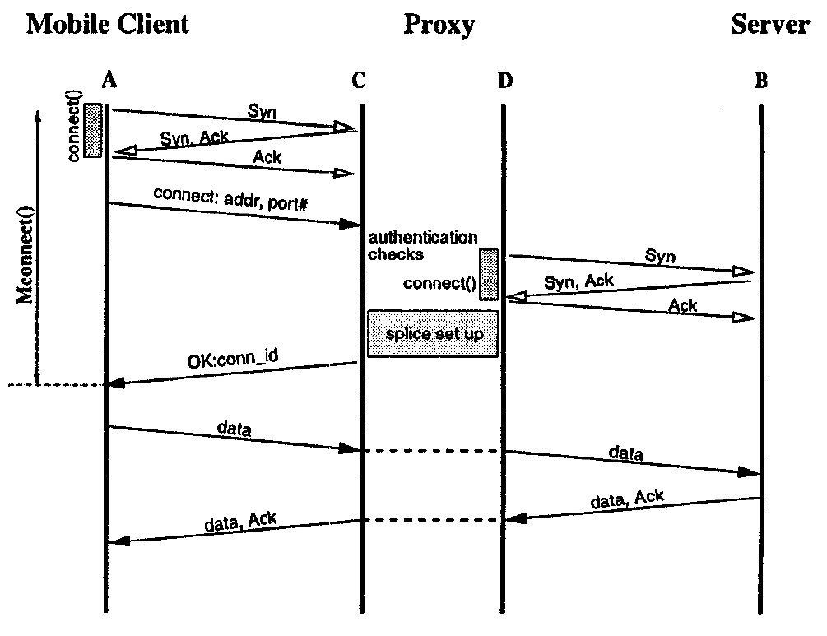
Protocol Overview... MC as Client

Slide 37
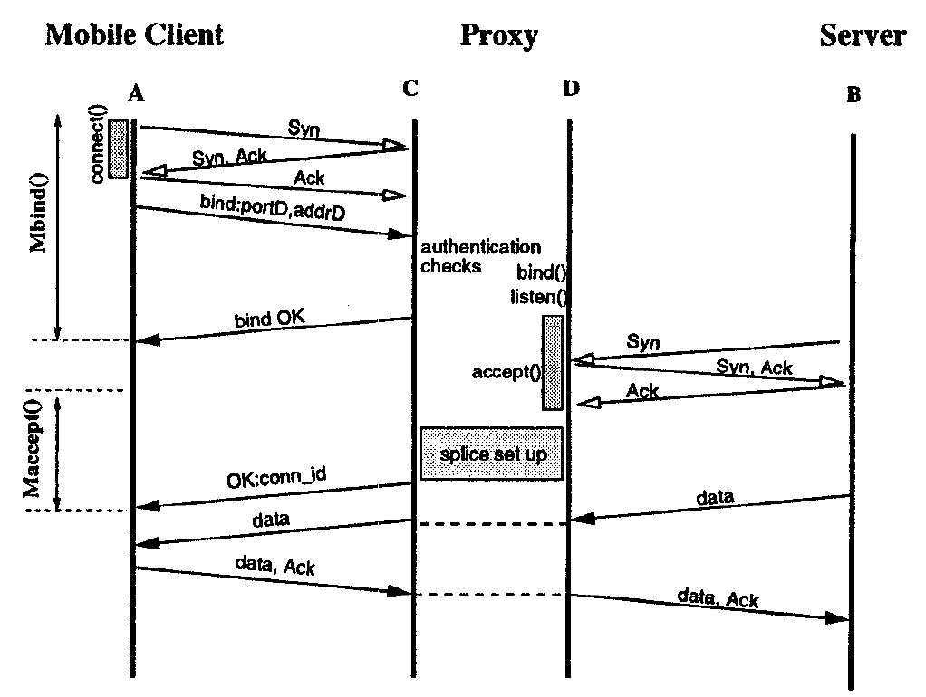
Protocol Overview... MC binding

Slide 38
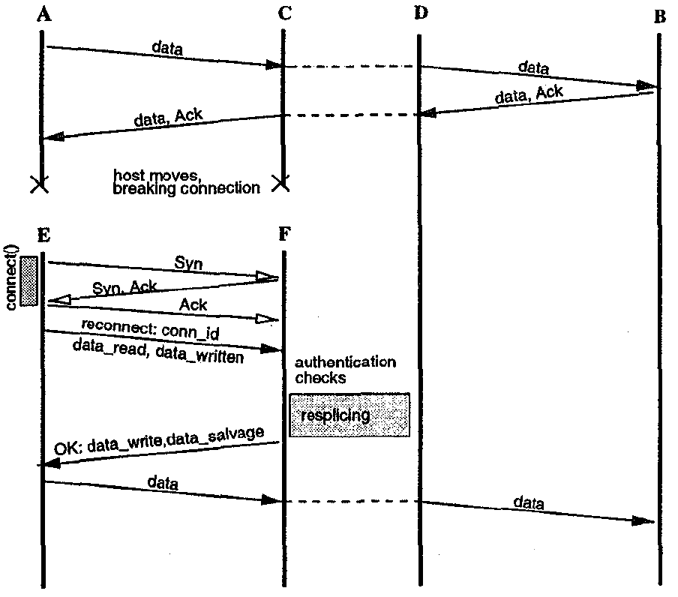
Reconnection... Connection ID

Slide 39
Changes in IP and TCP
IP Changes:
  Change source/destination pair
  Remove IP options
  Update IP header checksum
Alter TCP header:
  Change source/destination port numbers
  Map sequence number
  Map ACK number
  Update TCP header checksum

Slide 40
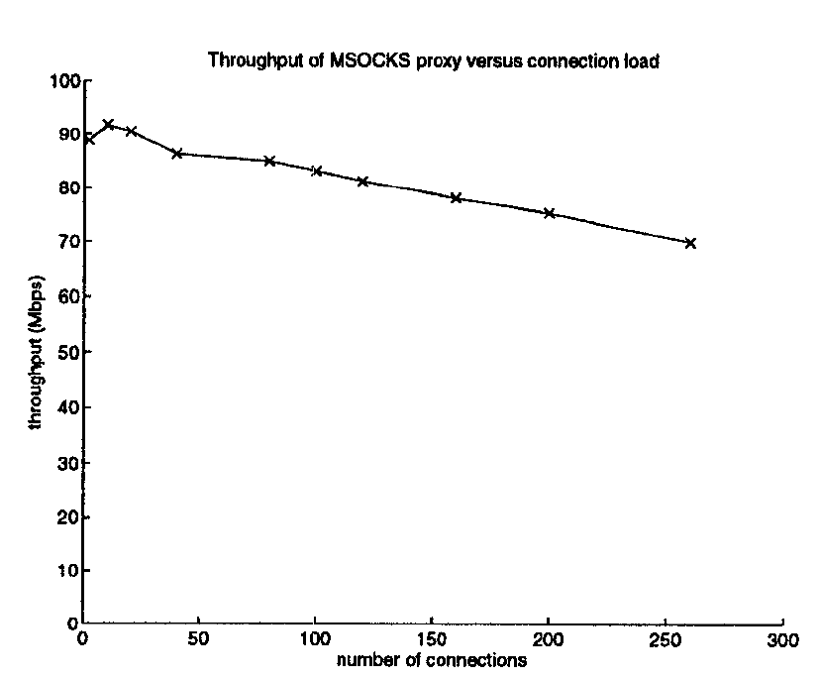
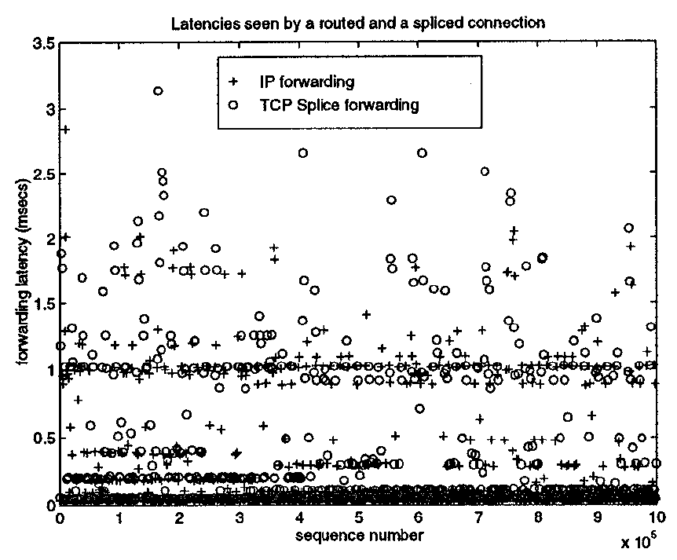
Evaluation

Slide 41
MSOCKS Issues
8-way handshake on average
Slight overhead
Bandwidth bottleneck

Slide 42
Multicast Approach: MSM-IP
Hey! Multicast solves identical challenges
What?
  Location independent addressing
  Packet forwarding
  Location management

Slide 43
MSM-IP versus Mobile IP
Differs in 5 important ways:
  Addressing:
  Mobile IP: explicit address translation
  MSM-IP: unique Class D
  Packet Forwarding:
  Mobile IP: Triangle ... tunneling
  MSM-IP: Multicast tree
  Location Management:
  Mobile IP: home address of mobile host
  MSM-IP: locate host w/ distributed directory
  Service Disruption:
  Mobile IP: delay while home agent is made aware of change
  MSM-IP: joins / prunes terminated at earliest branch
  Advance Reservation / Routing:
  Mobile IP: none
  MSM-IP: notify router to join MC group before handoff

Slide 44
Issues of MSM-IP
TCP support (reliable communication)
Security and authentication
Scalability
deployability ;)

Slide 45
Reliable Network Connections
User level mechanisms... better deployment
Two new systems:
  Reliable Sockets (rocks)
  Reliable packets (racks)
Detect network connection failures and recover broken connections without loss of in-flight data
Handle disconnection, change of IP address, change of physical address, and host crashes

Slide 46
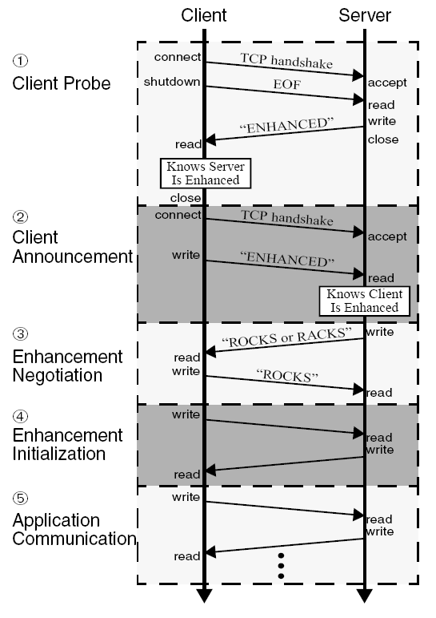
ROCKS: Reliable Sockets
Sits between kernel and application
- Original TCP handshake
- Close for writing
- Wait for response
- Reconnect
- Send Enhanced
- Determine protocol
- Initialize enhancement
- Begin communication

Slide 47
Reconnection w/ ROCKS
Buffers in-flight data
Uses separate socket connection for heartbeat
Suspend when no heartbeat response
Reconnection:
  Establish new connection
  Authenticate with identifier
  Establish a new control socket (heartbeat)
  Recover in-flight data with go-back-N

Slide 48
RACKS: Reliable Packets
Packet filter between kernel and application
Inspect packets, dropping, forwarding, or modifying them
Re-writes sequence space
Uses same EDP protocol to determine if enchancement is on the other end

Slide 49
RACKS: failure detection
Uses a TCP keep alive
Seperate socket if communicating with rocks
When suspending connection, need to be transparent, uses zero receive-window
When receiving a new SYN, checks packet destination, resuming suspended racks
  rewrite source and destination IP if needed like MSOCKS

Slide 50
Recap on Host Mobility
Problem of Internet host mobility solutions classified into two categories:
  Network-layer mobility: hide any changes in network structure from end hosts
    Mobile IP... routing tunnel (forward and reverse)
    route optimization to avoid triangle
    Each mobile host gets a permanent Class D IP
  Higher-layer methods: handle relocation at higher level in the end host
    MSOCKS: transport layer: connection redirection via split-connection proxy
    rocks and racks
    DNS entry + shared connection key!

Slide 51
Approach Taken
3 Crucial components:
  Addressing: How to assign an IP to a mobile host, keeping the scalability of Internet routing with aggregation
  Locating a Mobile Hosts: How do we initially locate a host, and continue to locate a host as it moves, changing addresses
  Migrating Connections: TCP identifies connections via 4-tuple... what happens when the source/destination happens?

Slide 52
Proposed Solution
Addressing: separate issue of obtaining an IP address in a foreign domain ... any suitable mechanism such as DHCP
Locating a Mobile Host
  Can't negotiate new IP before switch (unpredictable)
  use DNS to provide a level of indirection... identifies host without assuming anything about attachment point
  mobile host must detect change in the A-record... use daemon like Mobile IP
  set TTL in A-record of the name to 0... does not cause a scaling problem .....

Slide 53
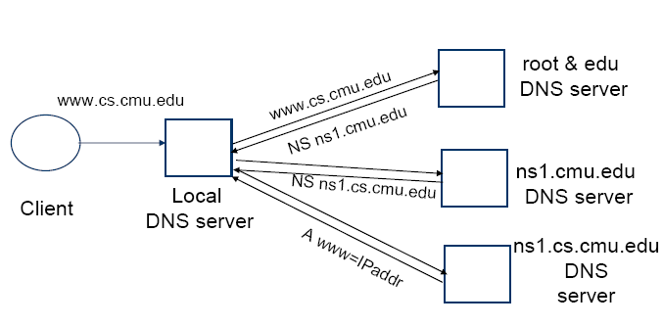
Proposed Solution
Image taken from 15-441 Lecture slides on DNS from S. Seshan

Slide 54
Proposed Solution
Connection Migration
  Introduction of a new Migrate TCP option included in SYN segments
  Need token to identify previously established connection
  Mobile host sends Migrate SYN packet after a relocation
Secure Migration?
  need to guess sequence space and connection token
  easily solvable with IPsec
  can secure token with Elliptic Curve Diffie-Hellman key exchange

Slide 55
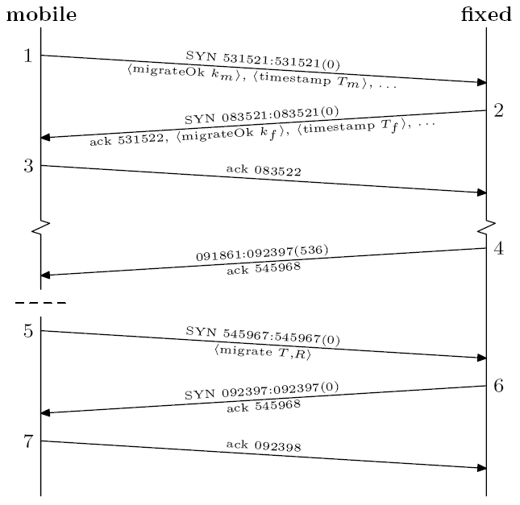
Lets See it Work!
Migrate option set
K = secret key
T = token = SHA1 hash of initial sequence numbers and secret key
<---- relocation
<--- SYN+ACK last transmitted data

Slide 56
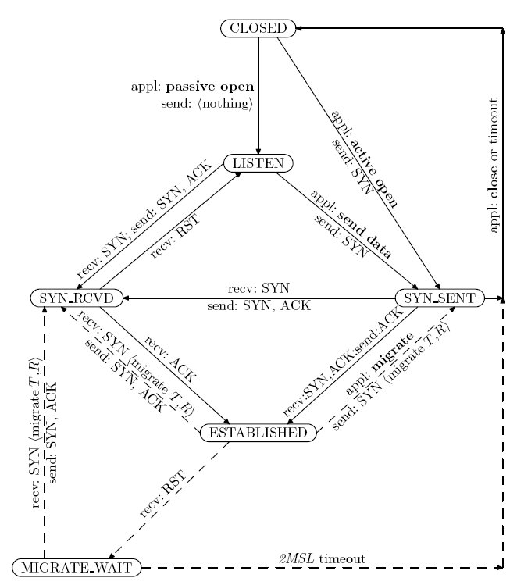
The New TCP State Machine

Slide 57
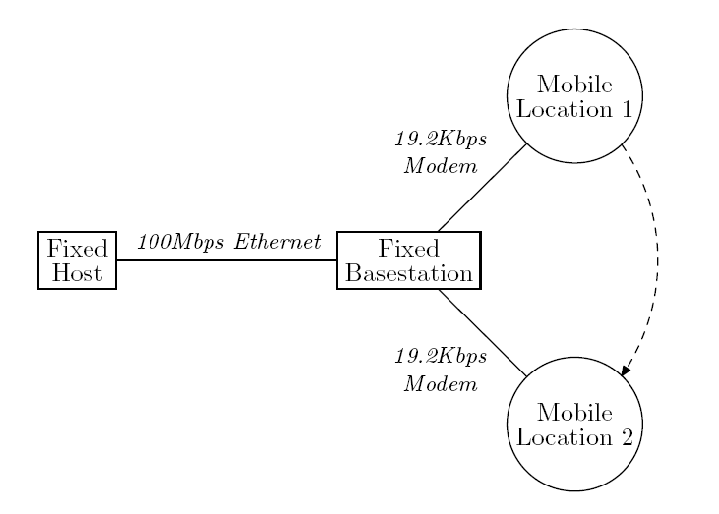
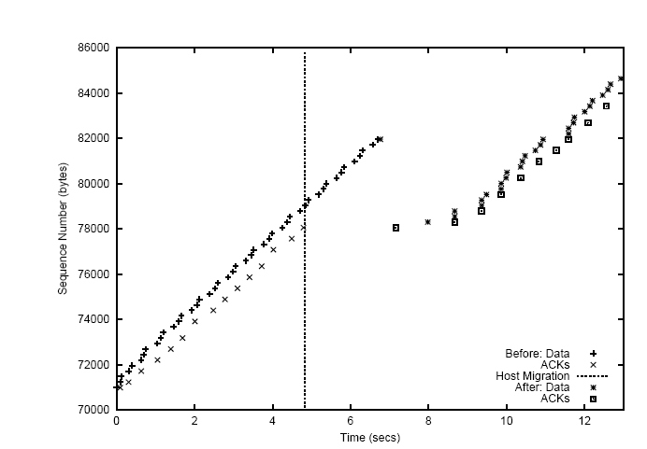
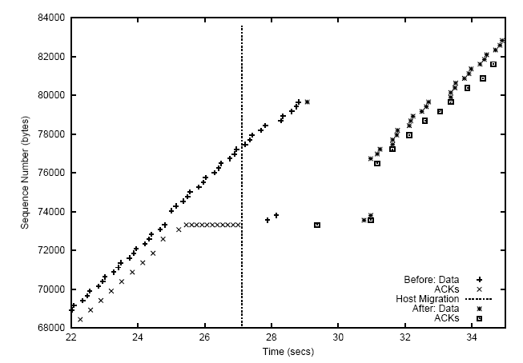

Slide 58
Issues
Three duplicate ACK or timeout
Deployment issues
Only one host can be mobile
Application IP address caching
NATs
SYN flooding

