Slide 1

The Data Link Layer
Unit-2

Slide 2
Data Link Layer Design Issues
Services Provided to the Network Layer
Framing
Error Control
Flow Control
Dept.of CSE, VFSTRU

Slide 3
Functions of the Data Link Layer
Provide service interface to the network layer
Dealing with transmission errors
Regulating data flow
  Slow receivers not swamped by fast senders
Dept.of CSE, VFSTRU

Slide 4
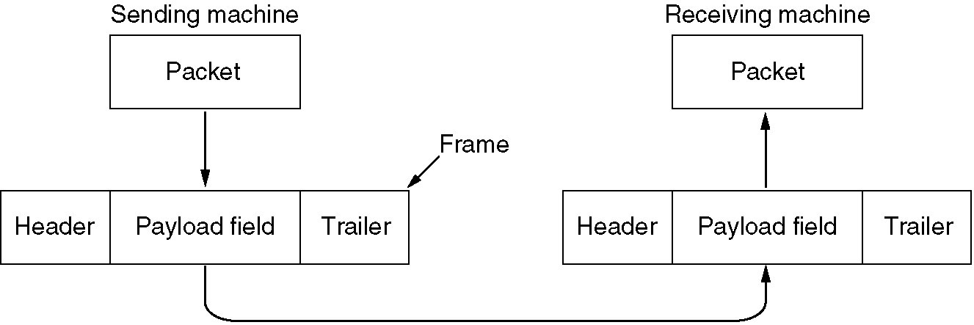
Functions of the Data Link Layer (2)
Relationship between packets and frames.
Dept.of CSE, VFSTRU

Slide 5
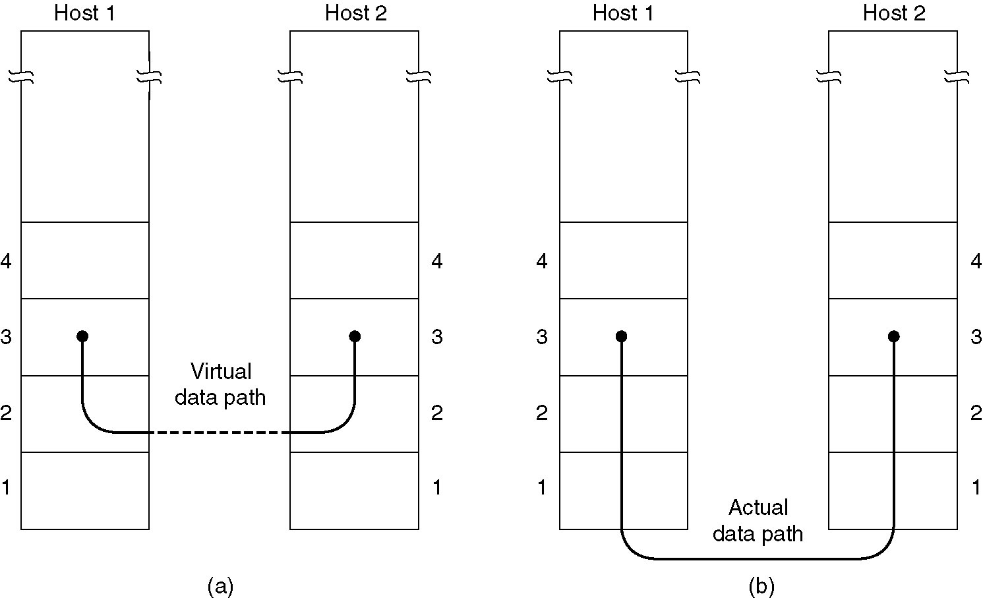
Services Provided to Network Layer
(a) Virtual communication.
(b) Actual communication.
Dept.of CSE, VFSTRU

Slide 6
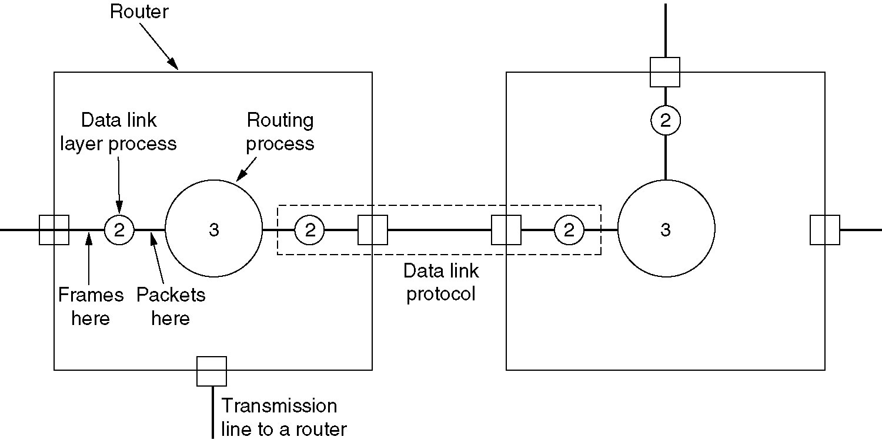
Services Provided to Network Layer (2)
Placement of the data link protocol.
Dept.of CSE, VFSTRU

Slide 7
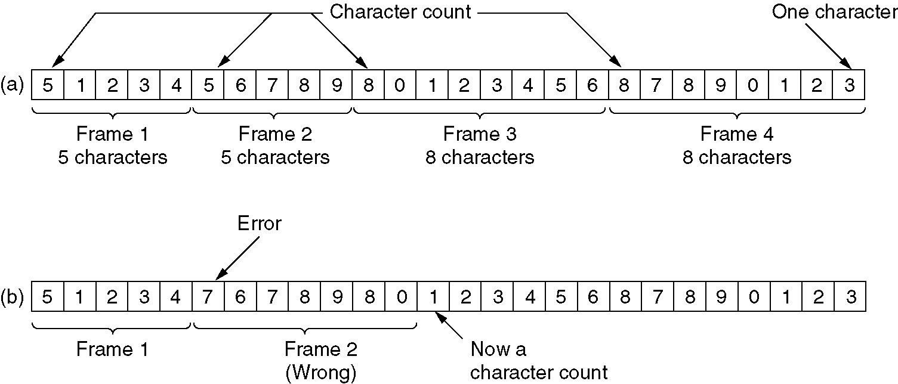
Framing
A character stream. (a) Without errors. (b) With one error.
Dept.of CSE, VFSTRU

Slide 8
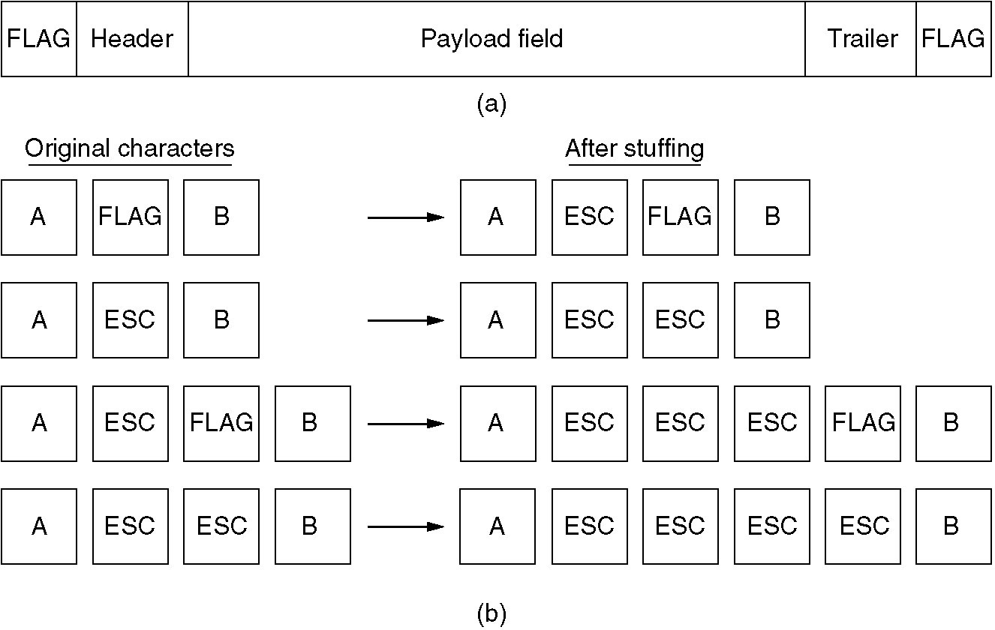
Framing (2)
(a) A frame delimited by flag bytes.
(b) Four examples of byte sequences before and after stuffing.
Dept.of CSE, VFSTRU

Slide 9
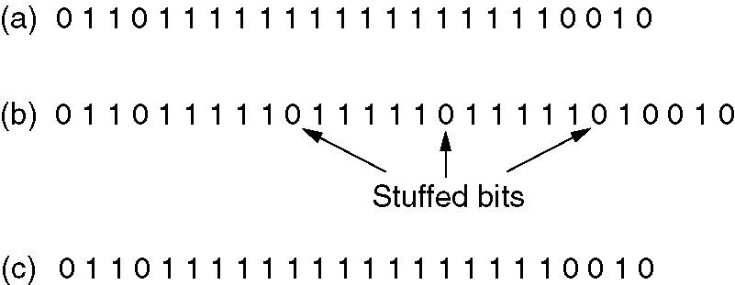
Framing (3)
Bit stuffing
(a) The original data.
(b) The data as they appear on the line.
(c) The data as they are stored in receiver’s memory after destuffing.
Dept.of CSE, VFSTRU

Slide 10
Error Detection and Correction
Error-Correcting Codes
Error-Detecting Codes
Dept.of CSE, VFSTRU

Slide 11
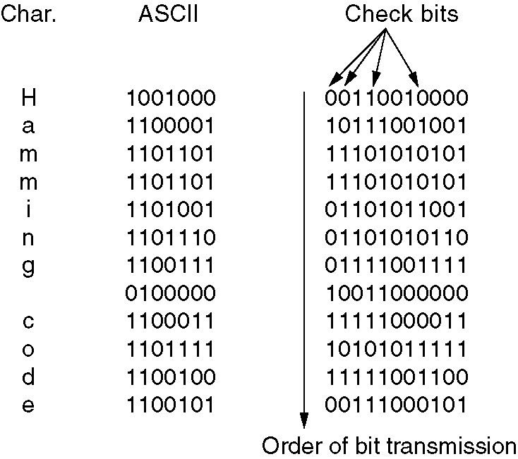
Error-Correcting Codes
Use of a Hamming code to correct burst errors.
Dept.of CSE, VFSTRU

Slide 12
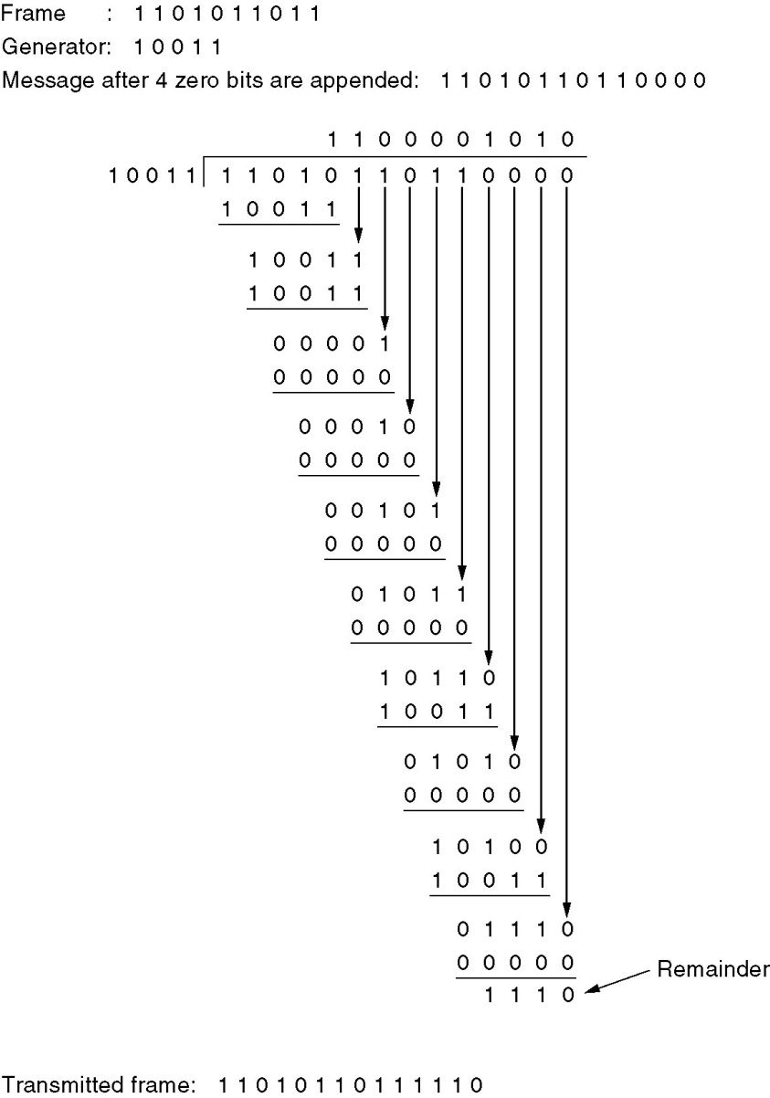
Error-Detecting Codes
Calculation of the polynomial code checksum.
Dept.of CSE, VFSTRU

Slide 13
Elementary Data Link Protocols
An Unrestricted Simplex Protocol
A Simplex Stop-and-Wait Protocol
A Simplex Protocol for a Noisy Channel
Dept.of CSE, VFSTRU

Slide 14
Sliding Window Protocols
A One-Bit Sliding Window Protocol
A Protocol Using Go –Back - N
A Protocol Using Selective Repeat
Dept.of CSE, VFSTRU

Slide 15
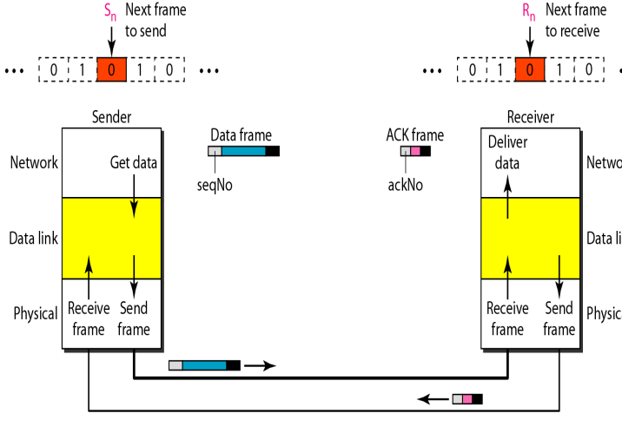
Stop-and- wait ARQ Protocol
Dept.of CSE, VFSTRU

Slide 16
Stop-and- wait ARQ Protocol
Cases of Operation:
Normal Operation
The Frame is lost
The Acknowledgment is lost
The ACK is delayed
Dept.of CSE, VFSTRU

Slide 17
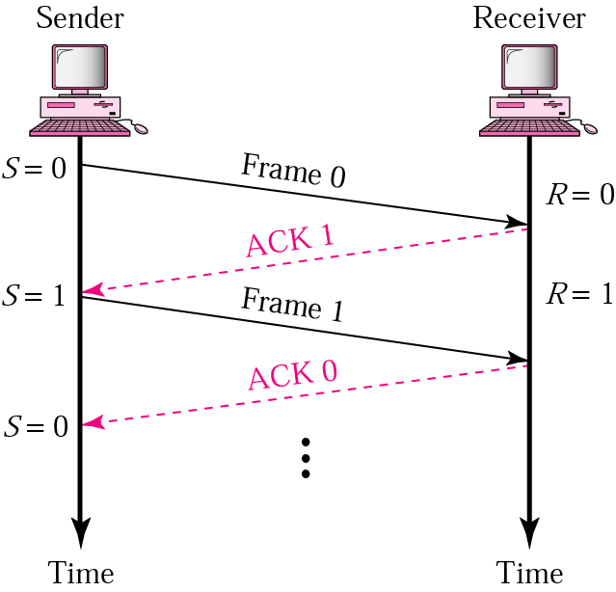
Normal Operation
The sender will not send the next frame until it is sure that the current one is correctly receive.
sequence number is necessary to check for duplicated frames
Dept.of CSE, VFSTRU

Slide 18
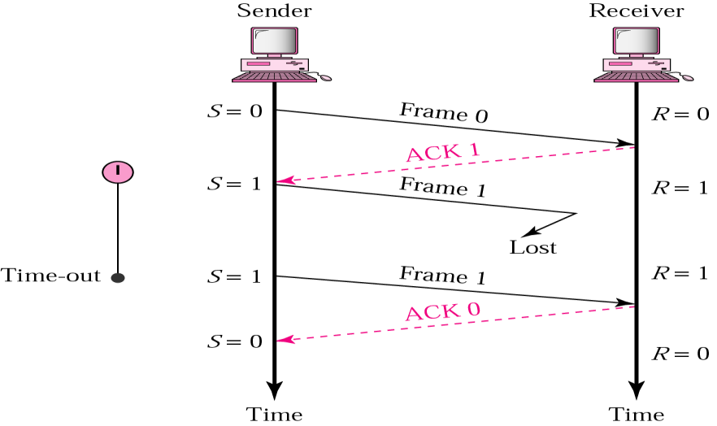
Lost or damaged frame
A damage or lost frame treated by the same manner by the receiver
No NACK when frame is corrupted / duplicate
Dept.of CSE, VFSTRU

Slide 19
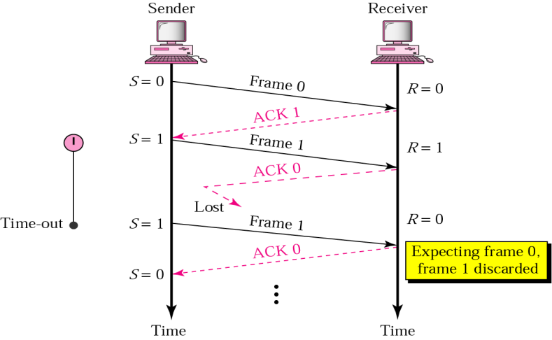
Lost ACK frame
Importance of frame numbering
Dept.of CSE, VFSTRU

Slide 20
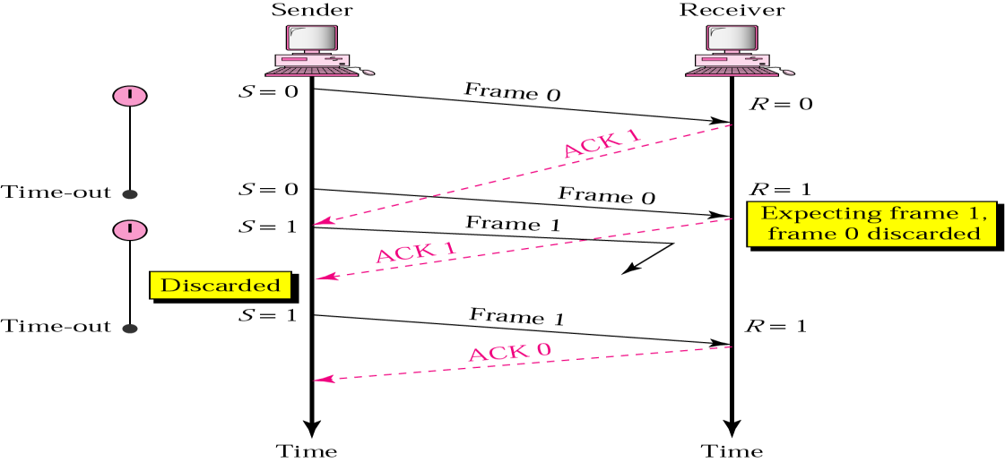
Delayed ACK and lost frame
Importance of ACK numbering
Dept.of CSE, VFSTRU

Slide 21
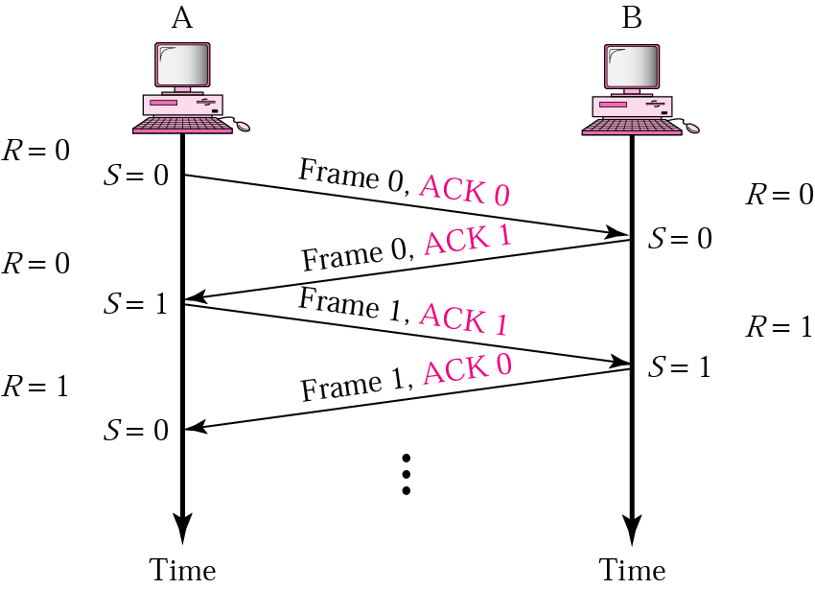
Piggybacking ( Bidirectional transmission)
Is a method to combine a data frame with an acknowledgment.
It can save bandwidth because data frame and an ACK frame can combined into just one frame
Dept.of CSE, VFSTRU

Slide 22
Stop-and- wait ARQ Protocol
After each frame sent the host must wait for an ACK
  inefficient use of bandwidth
To improve efficiency ACK should be sent after multiple frames
Alternatives: Sliding Window protocol
  Go-back-N ARQ
  Selective Repeat ARQ
Dept.of CSE, VFSTRU

Slide 23
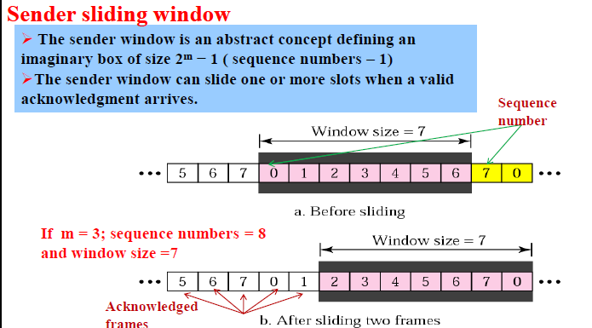
Go-Back-N ARQ
Dept.of CSE, VFSTRU

Slide 24
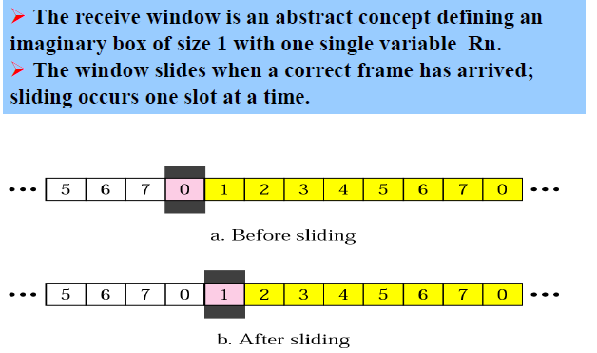
Receiver Sliding window
Dept.of CSE, VFSTRU

Slide 25
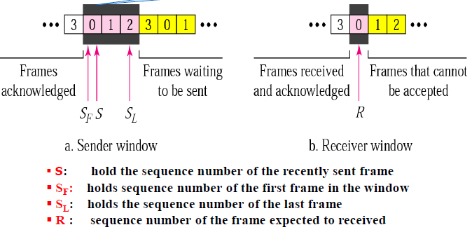
Control variables
Dept.of CSE, VFSTRU

Slide 26
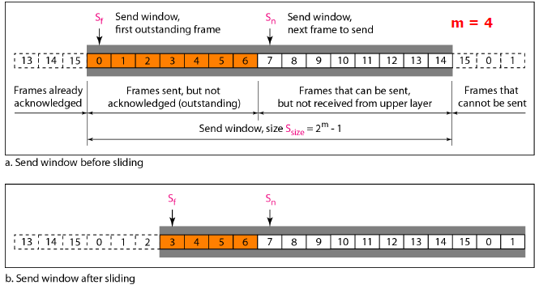
Go-Back-N ARQ
Dept.of CSE, VFSTRU

Slide 27
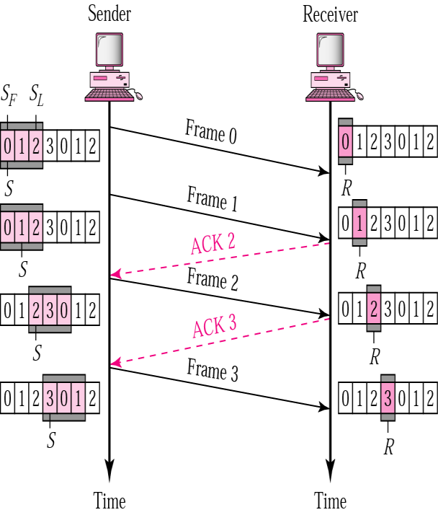
Go-Back-N ARQ
Normal Operation
How many framescan be transmittedWithout acknowledgment?
ACK1 is notnecessary if ACK2is sent: Cumulative ACK
Dept.of CSE, VFSTRU

