Slide 1

The Medium Access Control
Sublayer
Unit-2

Slide 2
The Channel Allocation Problem
Static Channel Allocation in LANs and MANs
Dynamic Channel Allocation in LANs and MANs
Dept.of CSE, VFSTRU

Slide 3
Dynamic Channel Allocation in LANs and MANs
Station Model.
Single Channel Assumption.
Collision Assumption.
(a) Continuous Time.
(b) Slotted Time.
(a) Carrier Sense.
(b) No Carrier Sense.
Dept.of CSE, VFSTRU

Slide 4
Multiple Access Protocols
ALOHA
Carrier Sense Multiple Access Protocols
Collision-Free Protocols
Limited-Contention Protocols
Wavelength Division Multiple Access Protocols
Wireless LAN Protocols
Dept.of CSE, VFSTRU

Slide 5
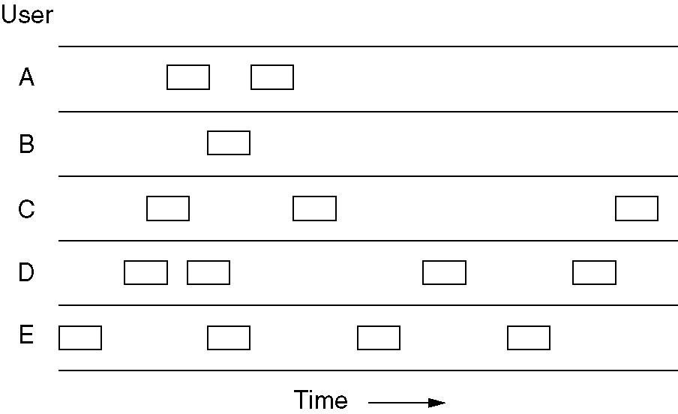
Pure ALOHA
In pure ALOHA, frames are transmitted at completely arbitrary times.
Dept.of CSE, VFSTRU

Slide 6
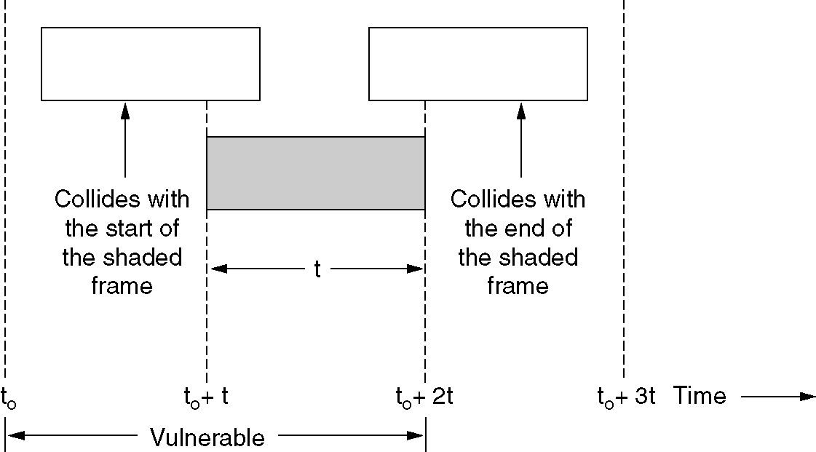
Pure ALOHA (2)
Vulnerable period for the shaded frame.
Dept.of CSE, VFSTRU

Slide 7
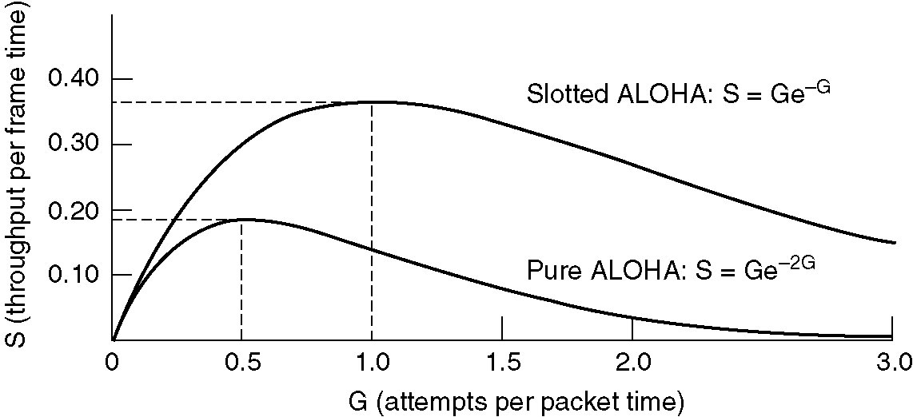
Pure ALOHA (3)
Throughput versus offered traffic for ALOHA systems.
Dept.of CSE, VFSTRU

Slide 8
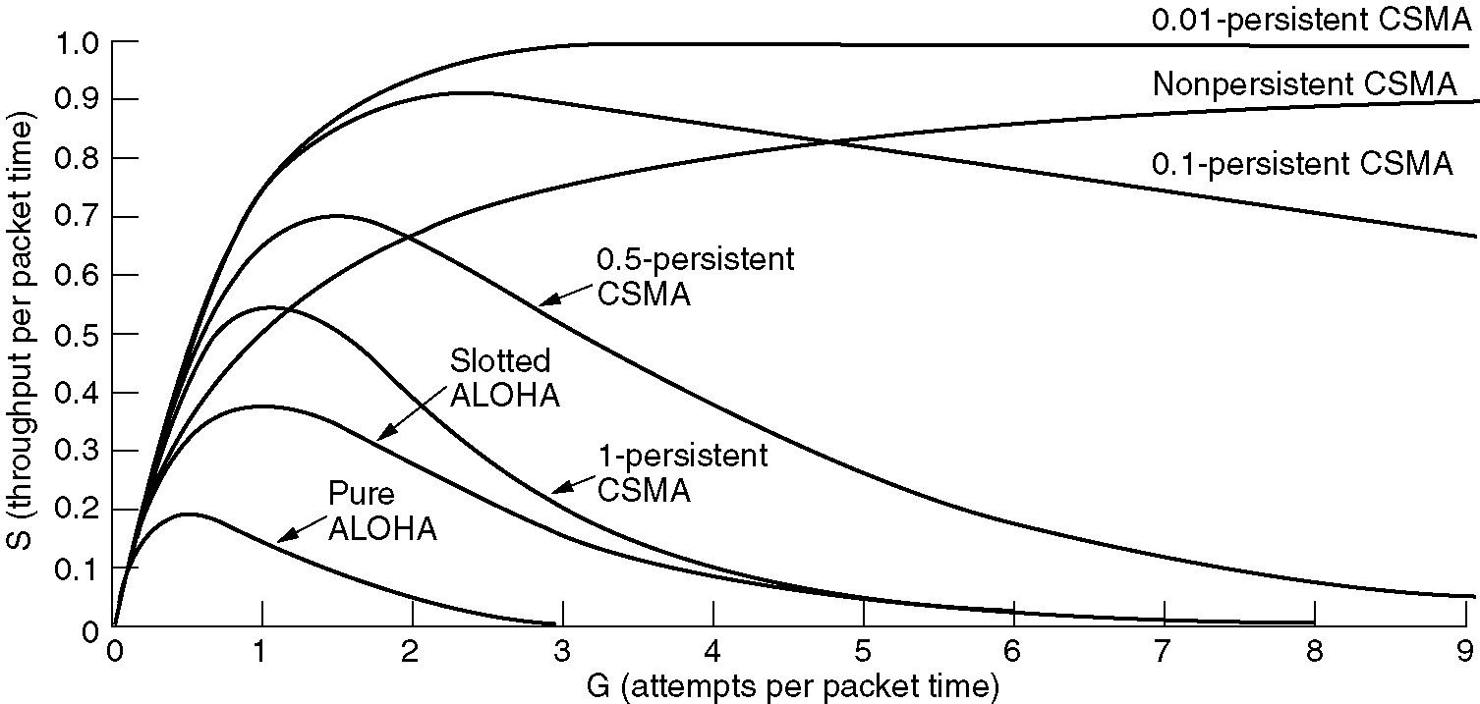
Persistent and Nonpersistent CSMA
Comparison of the channel utilization versus load for various random access protocols.
Dept.of CSE, VFSTRU

Slide 9
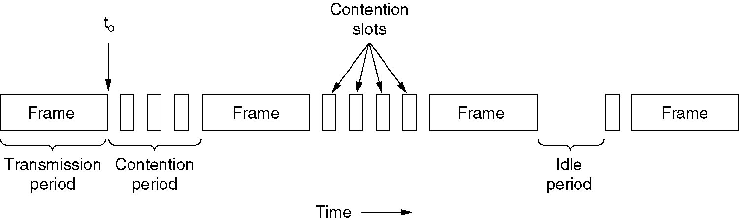
CSMA with Collision Detection
CSMA/CD can be in one of three states: contention, transmission, or idle.
Dept.of CSE, VFSTRU

Slide 10
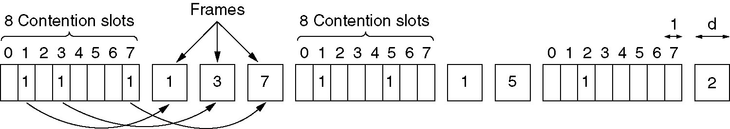
Collision-Free Protocols
The basic bit-map protocol.
Dept.of CSE, VFSTRU

Slide 11
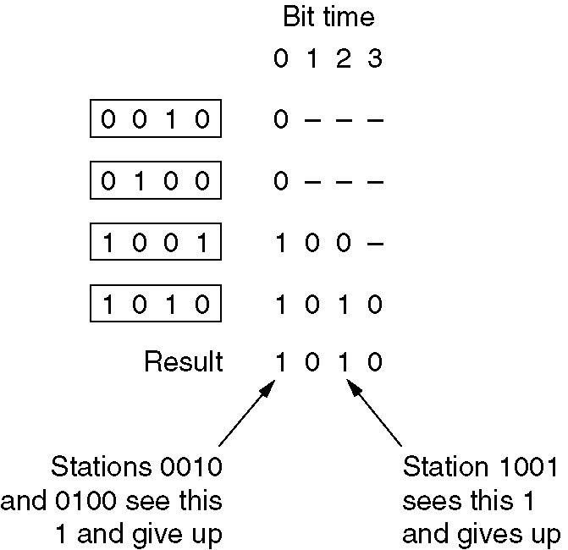
Collision-Free Protocols (2)
The binary countdown protocol. A dash indicates silence.
Dept.of CSE, VFSTRU

Slide 12
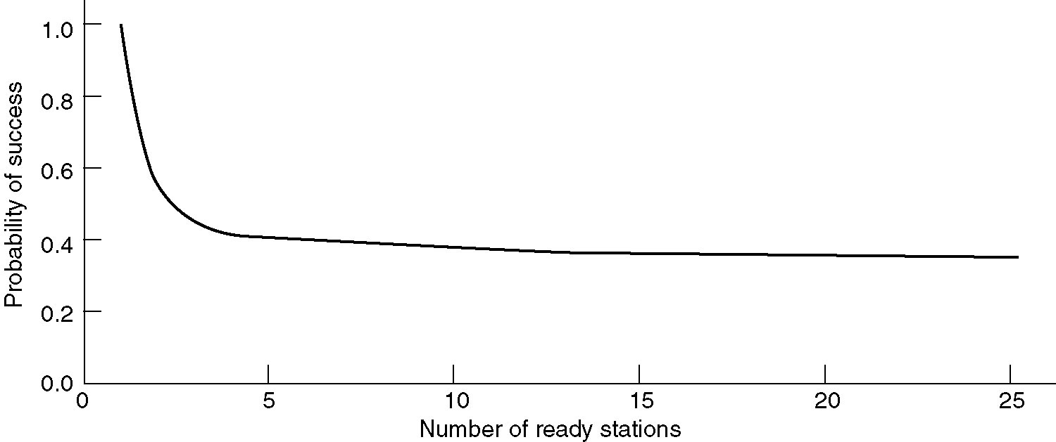
Limited-Contention Protocols
Acquisition probability for a symmetric contention channel.
Dept.of CSE, VFSTRU

Slide 13
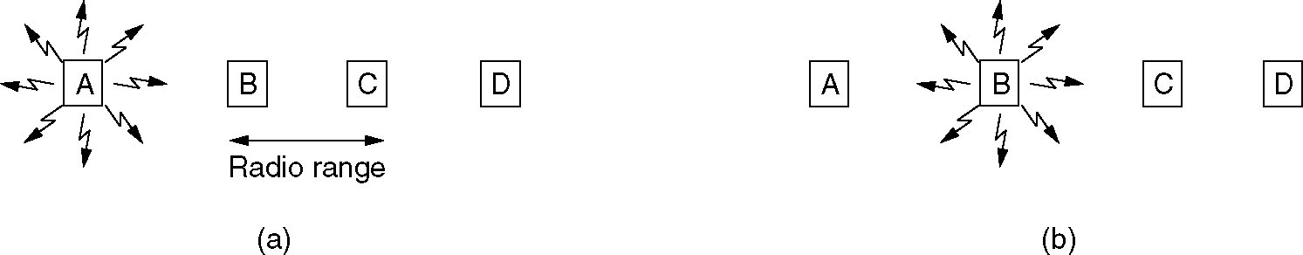
Wireless LAN Protocols
A wireless LAN. (a) A transmitting. (b) B transmitting.
Dept.of CSE, VFSTRU

Slide 14
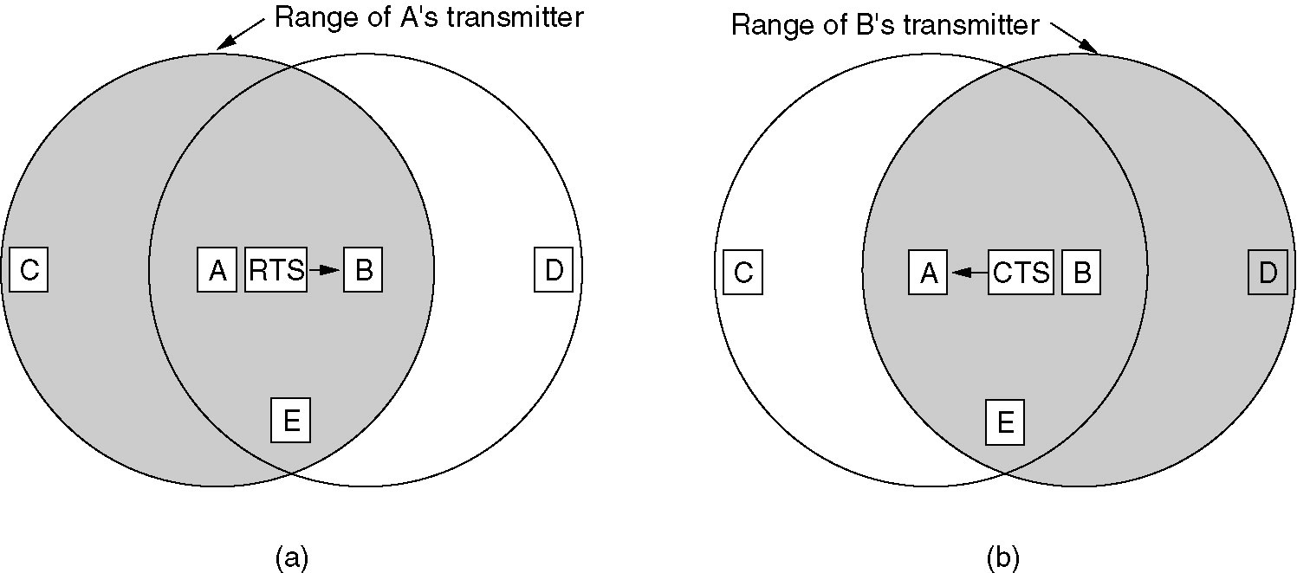
Wireless LAN Protocols (2)
The MACA protocol. (a) A sending an RTS to B.
(b) B responding with a CTS to A.
Dept.of CSE, VFSTRU

Slide 15
Ethernet
Ethernet Cabling
Manchester Encoding
The Ethernet MAC Sublayer Protocol
The Binary Exponential Backoff Algorithm
Ethernet Performance
Switched Ethernet
Fast Ethernet
Gigabit Ethernet
IEEE 802.2: Logical Link Control
Retrospective on Ethernet
Dept.of CSE, VFSTRU

Slide 16
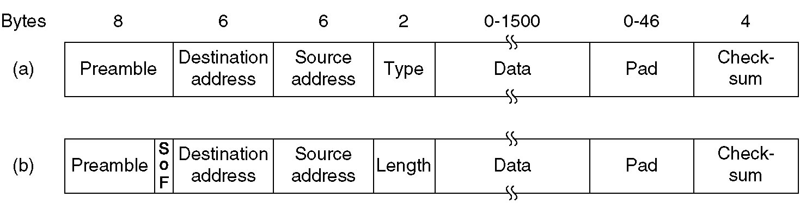
Ethernet MAC Sublayer Protocol
Frame formats. (a) DIX Ethernet, (b) IEEE 802.3.
Dept.of CSE, VFSTRU

Slide 17
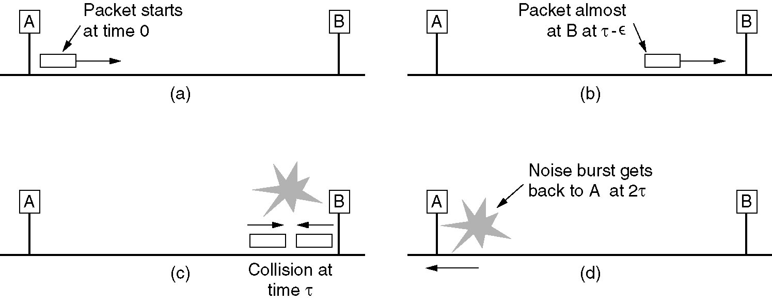
Ethernet MAC Sublayer Protocol (2)
Dept.of CSE, VFSTRU

Slide 18
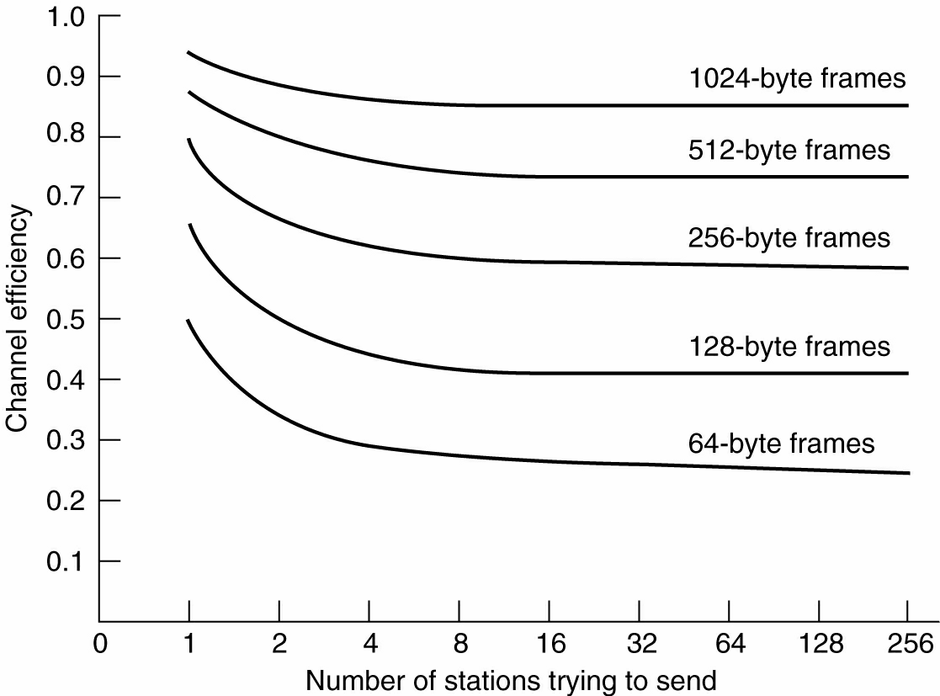
Ethernet Performance
Efficiency of Ethernet at 10 Mbps with 512-bit slot times.
Dept.of CSE, VFSTRU

Slide 19
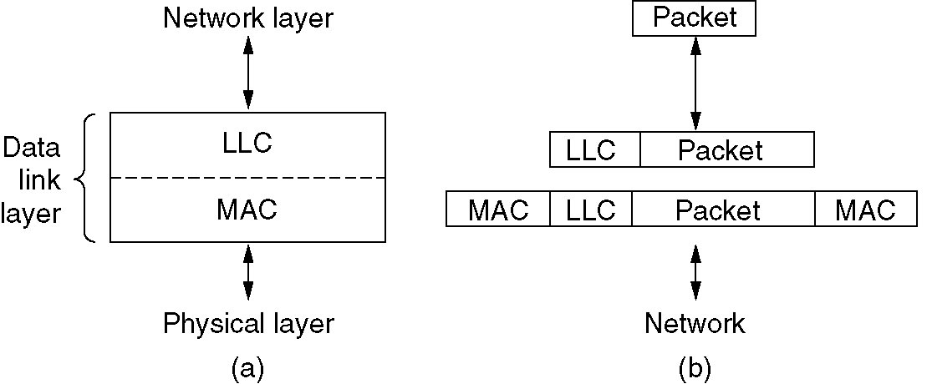
IEEE 802.2: Logical Link Control
(a) Position of LLC. (b) Protocol formats.
Dept.of CSE, VFSTRU

Slide 20
Wireless LANs
The 802.11 Protocol Stack
The 802.11 Physical Layer
The 802.11 MAC Sublayer Protocol
The 802.11 Frame Structure
Services
Dept.of CSE, VFSTRU

Slide 21
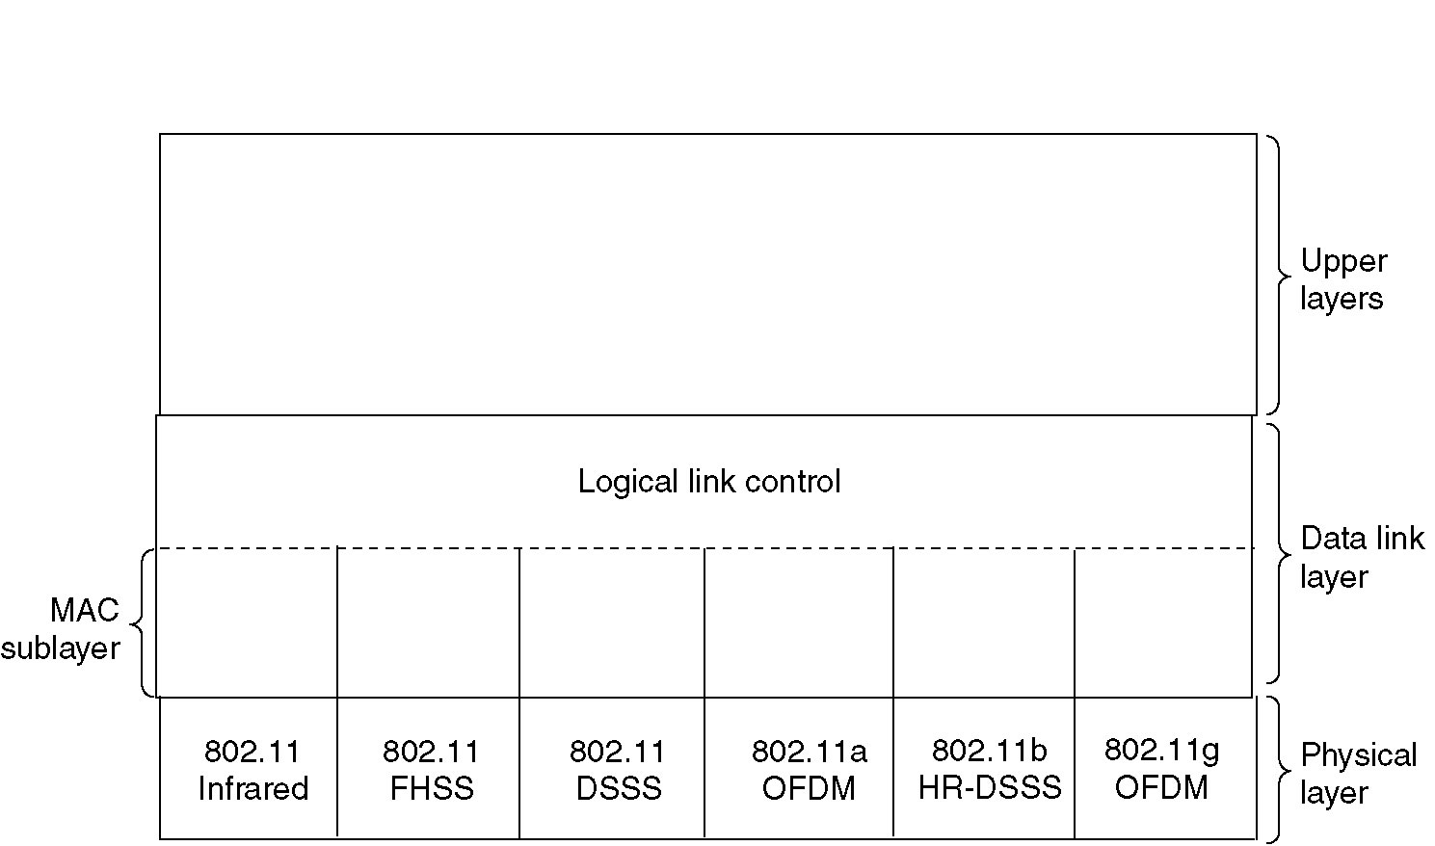
The 802.11 Protocol Stack
Part of the 802.11 protocol stack.
Dept.of CSE, VFSTRU

Slide 22
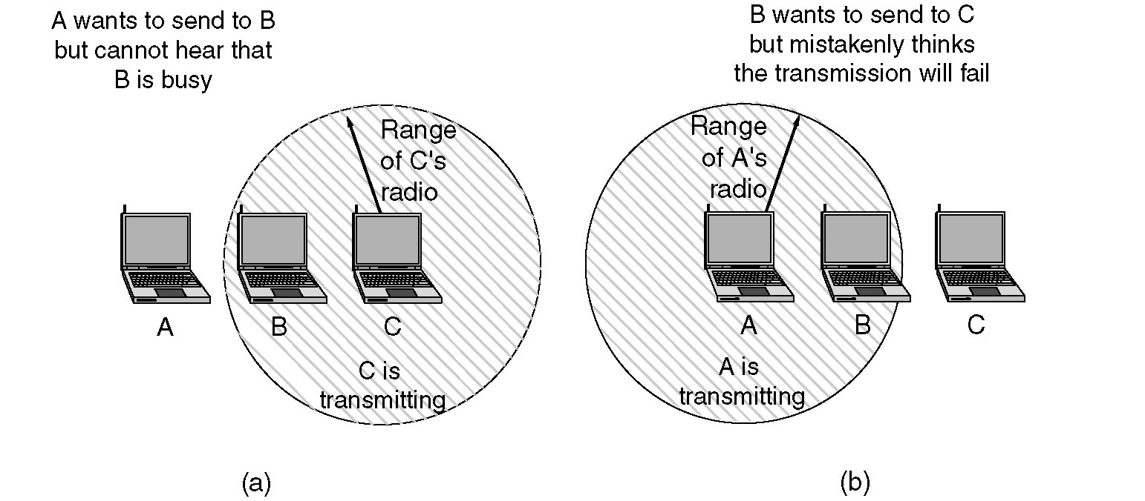
The 802.11 MAC Sublayer Protocol
(a) The hidden station problem.
(b) The exposed station problem.
Dept.of CSE, VFSTRU

Slide 23
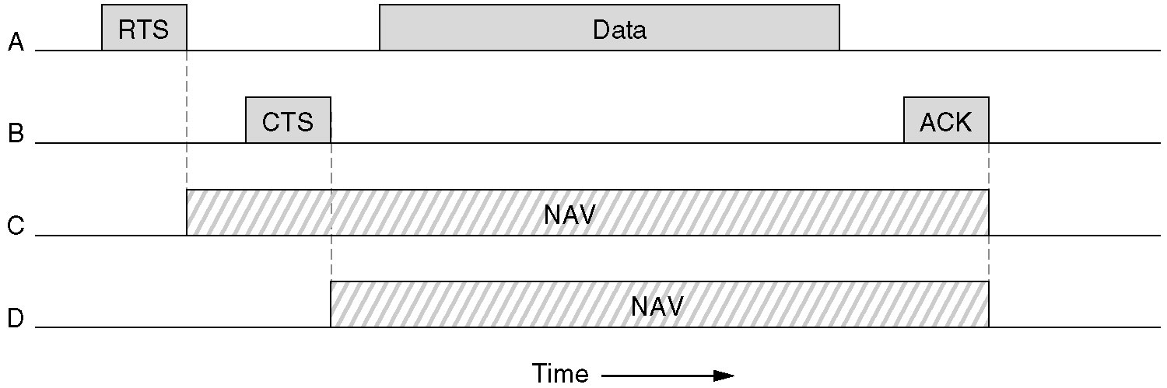
The 802.11 MAC Sublayer Protocol (2)
The use of virtual channel sensing using CSMA/CA.
Dept.of CSE, VFSTRU

Slide 24
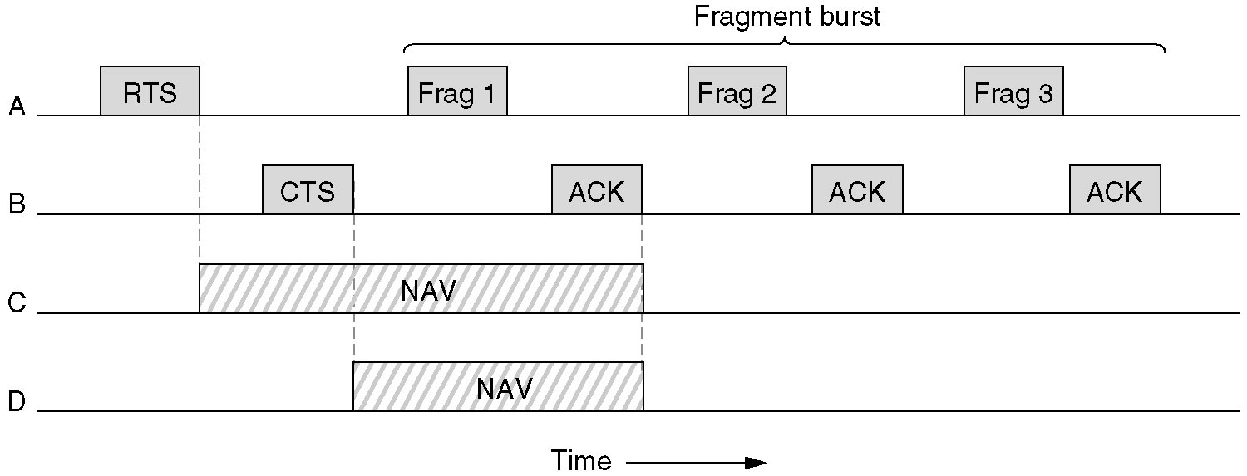
The 802.11 MAC Sublayer Protocol (3)
A fragment burst.
Dept.of CSE, VFSTRU

Slide 25
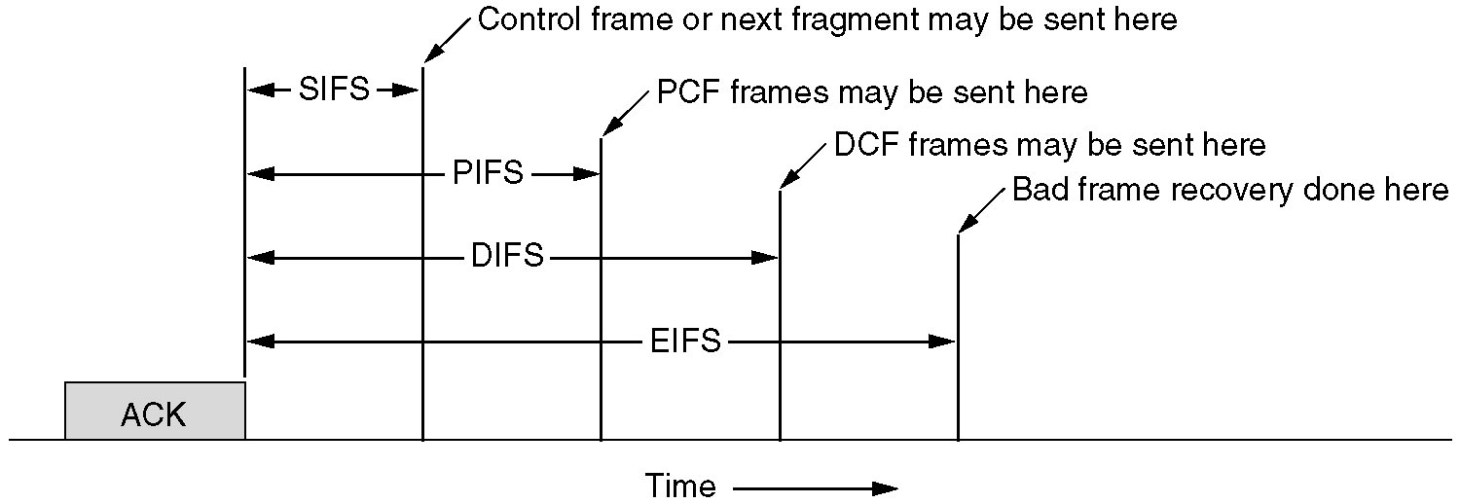
The 802.11 MAC Sublayer Protocol (4)
Interframe spacing in 802.11.
Dept.of CSE, VFSTRU

Slide 26
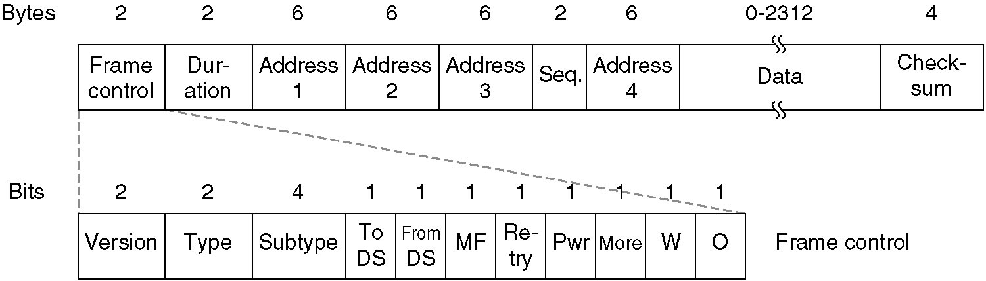
The 802.11 Frame Structure
The 802.11 data frame.
Dept.of CSE, VFSTRU

