Slide 1

The Physical Layer
Unit- 2

Slide 2
Guided Transmission Data
Magnetic Media
Twisted Pair
Coaxial Cable
Fiber Optics
Dept.of CSE, VFSTRU

Slide 3
Twisted Pair
(a) Category 3 UTP.
(b) Category 5 UTP.
Dept.of CSE, VFSTRU

Slide 4
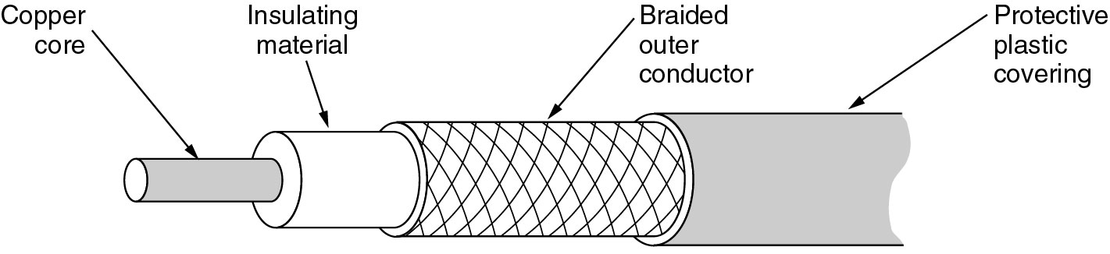
Coaxial Cable
A coaxial cable.
Dept.of CSE, VFSTRU

Slide 5
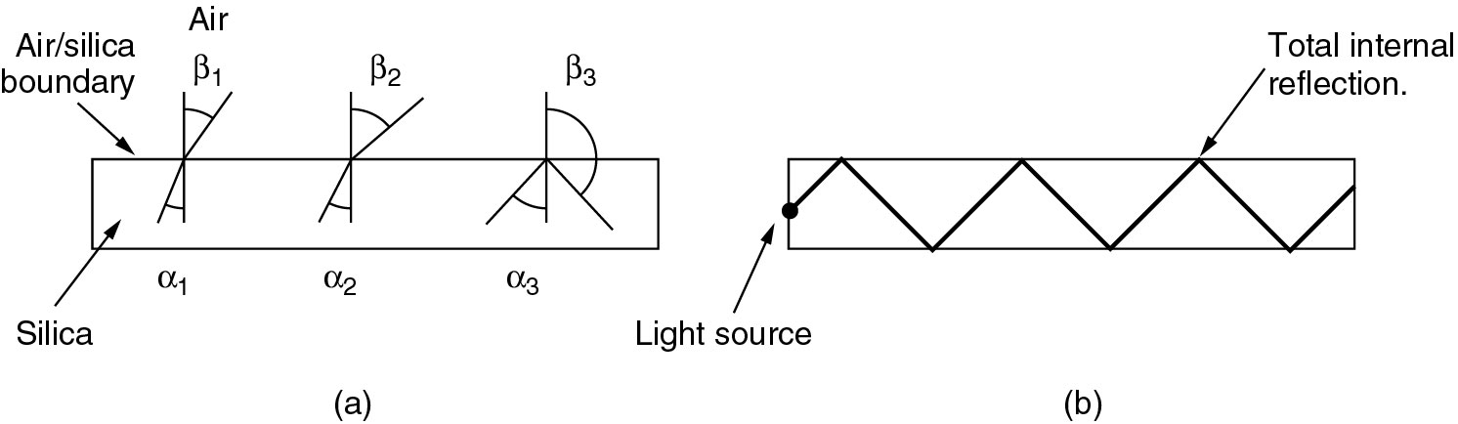
Fiber Optics
(a) Three examples of a light ray from inside a silica fiber impinging on the air/silica boundary at different angles.
(b) Light trapped by total internal reflection.
Dept.of CSE, VFSTRU

Slide 6
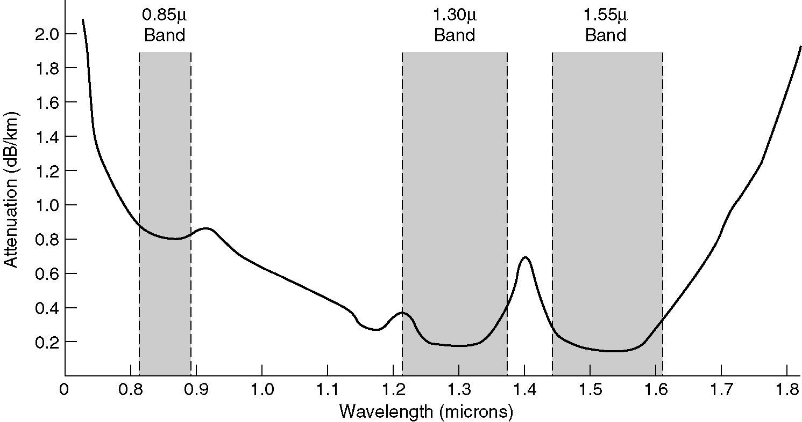
Transmission of Light through Fiber
Attenuation of light through fiber in the infrared region.
Dept.of CSE, VFSTRU

Slide 7
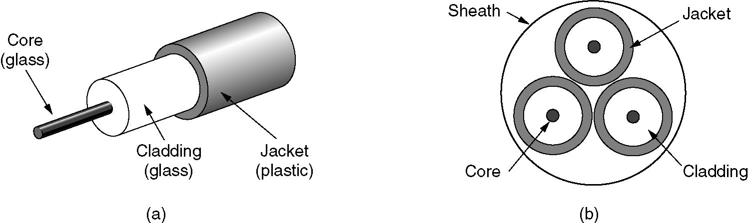
Fiber Cables
(a) Side view of a single fiber.
(b) End view of a sheath with three fibers.
Dept.of CSE, VFSTRU

Slide 8
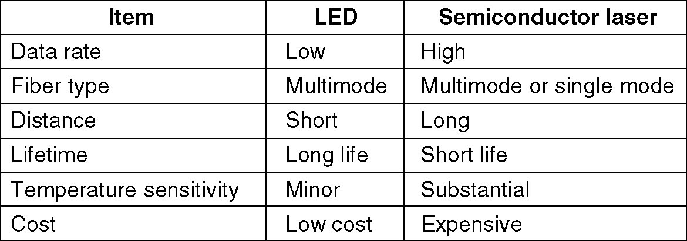
Fiber Cables (2)
A comparison of semiconductor diodes and LEDs as light sources.
Dept.of CSE, VFSTRU

Slide 9
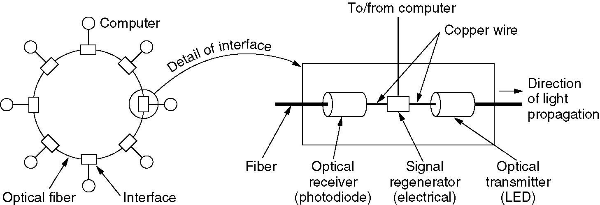
Fiber Optic Networks
A fiber optic ring with active repeaters.
Dept.of CSE, VFSTRU

