Slide 1
Unit-IV
Combining and Merging Data Sets
Data Transformation
String Manipulation

Slide 2
Combining and Merging Data Sets
Data contained in pandas objects can be combined together in a number of built-in ways: •
pandas.merge connects rows in DataFrames based on one or more keys. This will be familiar to users of SQL or other relational databases, as it implements database join operations.
pandas.concat glues or stacks together objects along an axis.
combine_first instance method enables splicing together overlapping data to fill in missing values in one object with values from another.

Slide 3
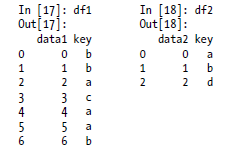
Database-style DataFrame Merges
Merge or join operations combine data sets by linking rows using one or more keys. These operations are central to relational databases. The merge function in pandas is the main entry point for using these algorithms on your data.
Let’s start with a simple example:
df1 = DataFrame({'key': ['b', 'b', 'a', 'c', 'a', 'a', 'b'], ....: 'data1': range(7)})
df2 = DataFrame({'key': ['a', 'b', 'd'],....: 'data2': range(3)})

Slide 4
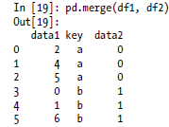
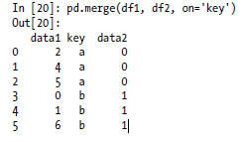
Database-style DataFrame Merges
Note that I didn’t specify which column to join on. If not specified, merge uses the overlapping column names as the keys. It’s a good practice to specify explicitly, though:

Slide 5
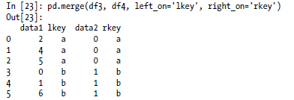
Database-style DataFrame Merges
If the column names are different in each object, you can specify them separately:
df3 = DataFrame({'lkey': ['b', 'b', 'a', 'c', 'a', 'a', 'b'], ....: 'data1': range(7)})
df4 = DataFrame({'rkey': ['a', 'b', 'd'],....: 'data2': range(3)})

Slide 6
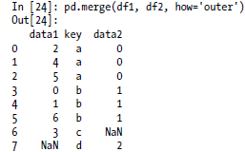
Database-style DataFrame Merges
You probably noticed that the 'c' and 'd' values and associated data are missing from the result.
By default merge does an 'inner' join; the keys in the result are the intersection.
Other possible options are 'left', 'right', and 'outer'.
The outer join takes the union of the keys, combining the effect of applying both left and right joins:

Slide 7
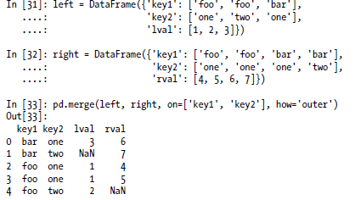
Database-style DataFrame Merges
To merge with multiple keys, pass a list of column names:

Slide 8
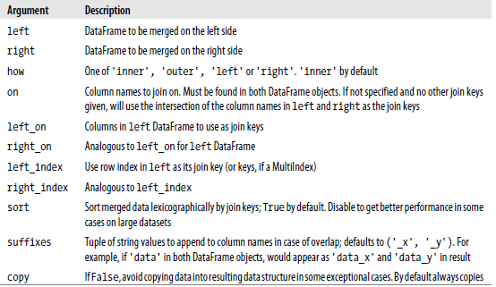
Database-style DataFrame Merges
merge function arguments:

Slide 9
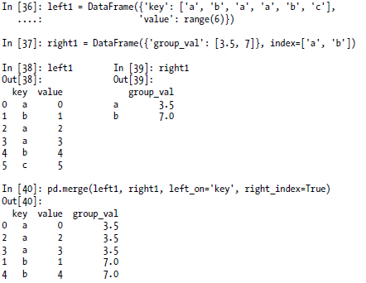
Database-style DataFrame Merges
Merging on Index
In some cases, the merge key or keys in a DataFrame will be found in its index. In this case, you can pass left_index=True or right_index=True (or both) to indicate that the index should be used as the merge key:

Slide 10

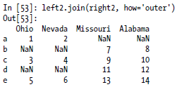
Database-style DataFrame Merges
pandas.join
DataFrame has a more convenient join instance for merging by index. It can also be used to combine together many DataFrame objects having the same or similar indexes but non-overlapping columns.

Slide 11
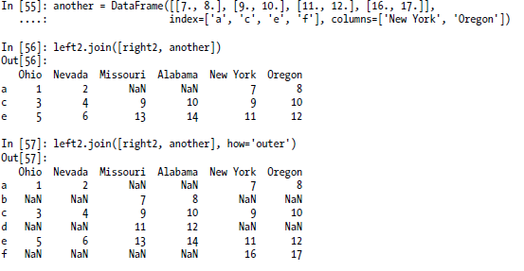
Database-style DataFrame Merges

Slide 12
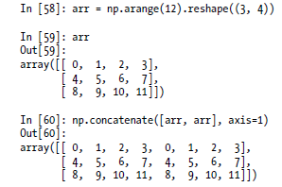
Concatenating Along an Axis
Another kind of data combination operation is alternatively referred to as concatenation, binding, or stacking.
NumPy has a concatenate function for doing this with raw NumPy arrays:

Slide 13
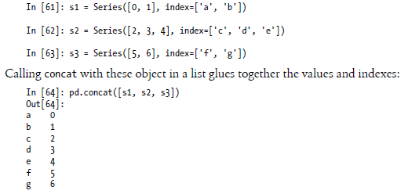
Concatenating Along an Axis
In the context of pandas objects such as Series and DataFrame, having labeled axes enable you to further generalize array concatenation.
The concat function in pandas provides a consistent way to address each of these concerns.
Suppose we have three Series with no index overlap:

Slide 14
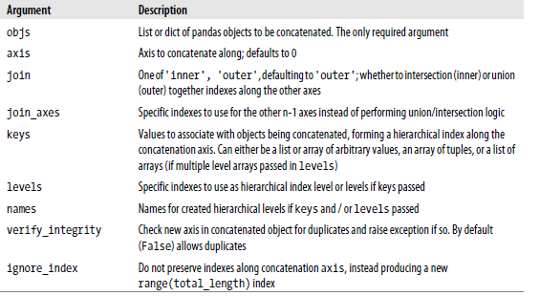
Concatenating Along an Axis
concat function arguments

Slide 15
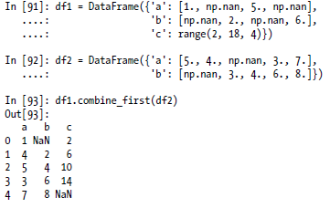
combine_first
With DataFrames, combine_first naturally does the same thing column by column, so you can think of it as “patching” missing data in the calling object with data from the object you pass:

Slide 16
Data Transformation

Slide 17
Data transformation
Data transformation is the process of converting data from one format or structure into another format or structure.
Data transformation can include a range of activities: you might convert data types, cleanse data by removing nulls or duplicate data, enrich the data, or perform aggregations, depending on the needs of your project.
Generally, businesses want to transform data to make it compatible with other data, move it to another system, join it with other data, or aggregate information in the data.

Slide 18
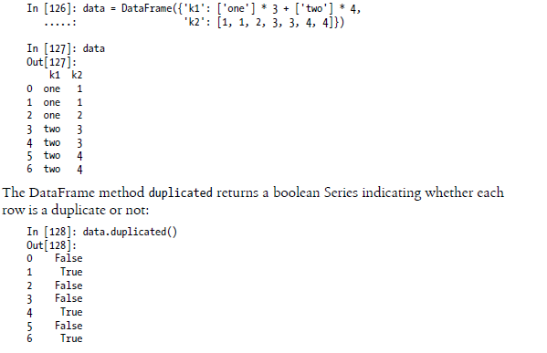
Removing Duplicates
Duplicate rows may be found in a DataFrame for any number of reasons.

Slide 19
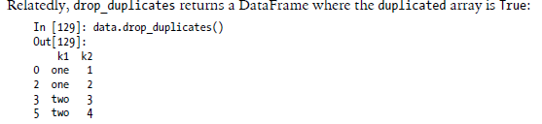
Removing Duplicates
drop_duplicates() method is used to remove duplicates from the data frame.

Slide 20
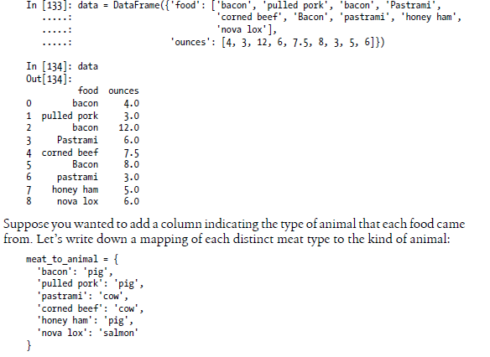
Transforming Data Using a Function or Mapping
The map() function applies a given function to each item of an iterable and returns a list of the results

Slide 21
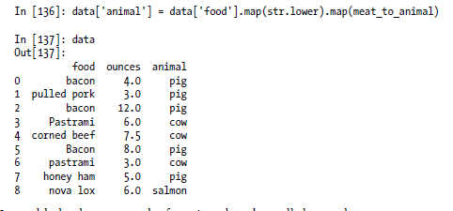
Transforming Data Using a Function or Mapping

Slide 22
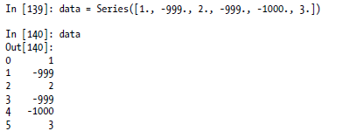
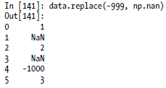
Replacing Values
Pandas dataframe.replace() function is used to replace a string, regex, list, dictionary, series, number etc. in a dataframe.

Slide 23
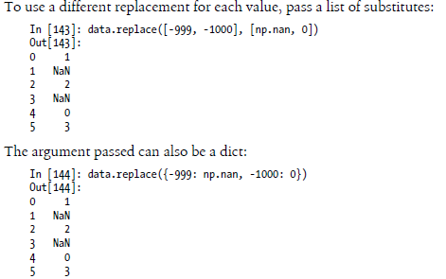
Replacing Values

Slide 24

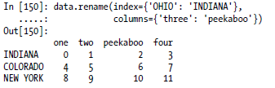
Renaming Axis Indexes
Pandas rename() method is used to rename any index, column or row.

Slide 25
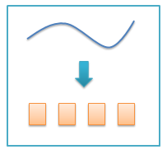
Discretization and Binning
Continuous data is often discretized or separated into “bins” for analysis.
Binning or discretization is the process of transforming numerical variables into categorical counterparts.
Binning may improve accuracy of the predictive models by reducing the noise or non-linearity.
Finally, binning allows easy identification of outliers, invalid and missing values of numerical variables.
Suppose you have data about a group of people in a study, and you want to group them into discrete age buckets:

Slide 26
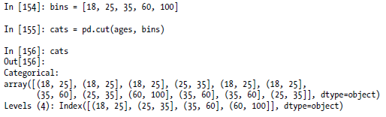
Discretization and Binning
ages = [20, 22, 25, 27, 21, 23, 37, 31, 61, 45, 41, 32]
Let’s divide these into bins of 18 to 25, 26 to 35, 35 to 60, and finally 60 and older. To do so, you have to use cut, a function in pandas:
Cut: It is used to create bins from continuous data.

Slide 27
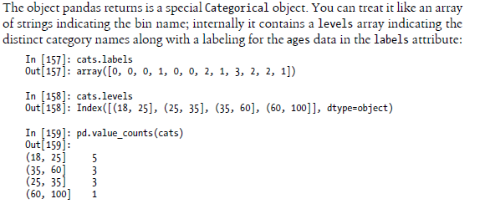
Discretization and Binning

Slide 28


Discretization and Binning

Slide 29
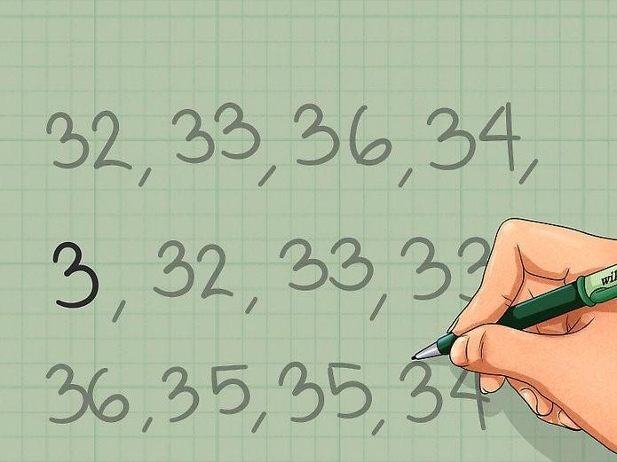
Detecting and Filtering Outliers
In statistics, an outlier is an observation point that is distant from other observations.
An outlier is a data point in a data set
that is distant from all other observations.
An outlier could exist in a dataset due to
Variability in the data or an experimental measurement error
How can we identify an outlier?
using scatter plots
using Z score

Slide 30
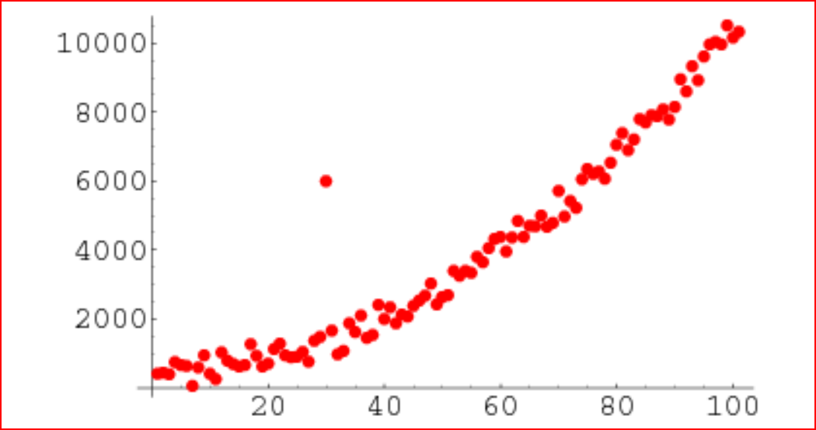
Detecting and Filtering Outliers
The scatter plot is the collection of points that shows values for two variables.
The data are displayed as a collection of points, each having the value of one variable determining the position on The horizontal axis and the value of the other variable determining the position on the vertical axis.
We can see the scatter plot and it shows us if a data point lies outside the overall distribution of the dataset

Slide 31
Detecting and Filtering Outliers
Using Z score
The Z-score is the signed number of standard deviations by which the value of data a point is above the mean value of what is being measured.
Z score = (Observation — Mean)/Standard Deviation
z = (X — μ) / σ
The data points which are too far from zero will be treated as the outliers.
In most of the cases a threshold of 3 or -3 is used i.e if the Z-score value is greater than or less than 3 or -3 respectively, that data point will be identified as outliers.
We will use Z-score function defined in scipy library to detect the outliers.
from scipy import stats import numpy as npz = np.abs(stats.zscore(boston_df)) print(z)

Slide 32
Detecting and Filtering Outliers
data= [10,12,12,13,12,11,14,13,15,10,10,10,100,12,14,13, 12,10, 10,11,12,15,12,13,12,11,14,13,15,10,15,12,10,14,13,15,10]
import numpy as np import pandas as pd outliers=[] threshold=3 m= np.mean(data) st=np.std(data) for y in data: z_score= (y - m)/st if np.abs(z_score) > threshold: outliers.append(y)
print(outliers)

Slide 33
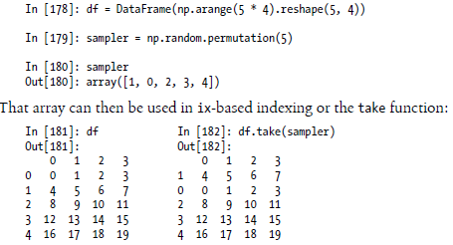
Permutation and Random Sampling
Permuting (randomly reordering) a Series or the rows in a DataFrame is easy to do using the numpy.random.permutation function.
Calling permutation with the length of the axis you want to permute produces an array of integers indicating the new ordering:

Slide 34

Permutation and Random Sampling
To select a random subset without replacement, one way is to slice off the first k elements of the array returned by permutation, where k is the desired subset size.
There are much more efficient sampling-without-replacement algorithms, but this is an easy strategy that uses readily available tools:

Slide 35
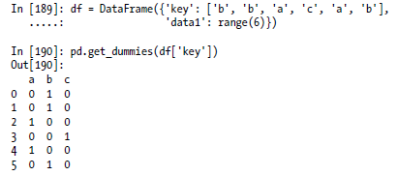
Computing Indicator/Dummy Variables
Another type of transformation for statistical modeling or machine learning applications is converting a categorical variable into a “dummy” or “indicator” matrix.
If a column in a DataFrame has k distinct values, you would derive a matrix or DataFrame containing k columns containing all 1’s and 0’s. pandas has a get_dummies function for doing this, though devising one yourself is not difficult.
Let’s return to an earlier example DataFrame:

Slide 36
String Manipulation

Slide 37
String Manipulation
Python has long been a popular data munging language in part due to its ease-of-use for string and text processing.
Most text operations are made simple with the string object’s built-in methods.
For more complex pattern matching and text manipulations,regular expressions may be needed.
pandas adds to the mix by enabling you to apply string and regular expressions concisely on whole arrays of data, additionally handling the annoyance of missing data

Slide 38
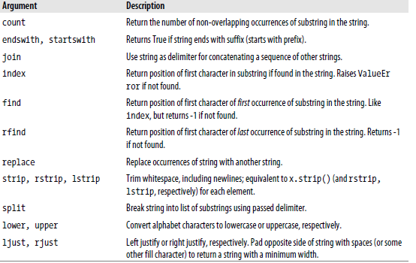
String Object Methods

Slide 39
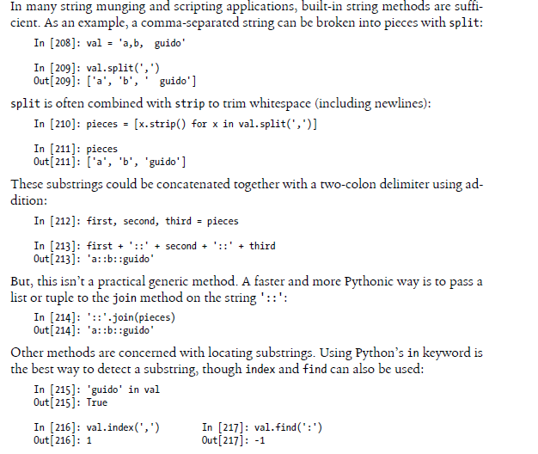
String Object Methods

Slide 40
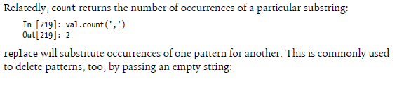

String Object Methods

Slide 41
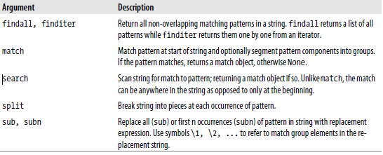
Regular expressions
Regular expressions provide a flexible way to search or match string patterns in text.
A single expression, commonly called a regex, is a string formed according to the regular expression language.
Python’s built-in re module is responsible for applying regular expressions to strings

Slide 42
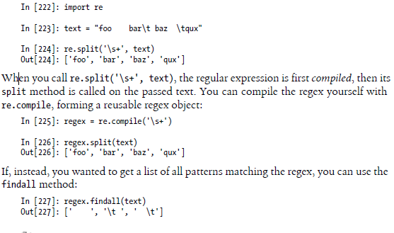
Regular expressions

Slide 43
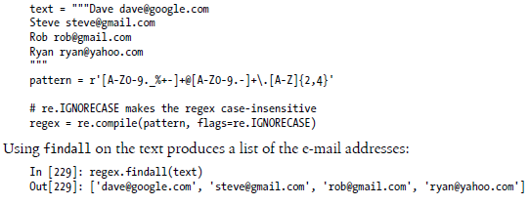
Regular expressions

Slide 44
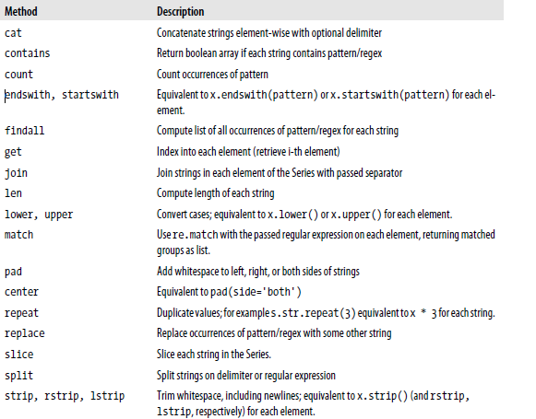
Vectorized string functions in pandas

Slide 45
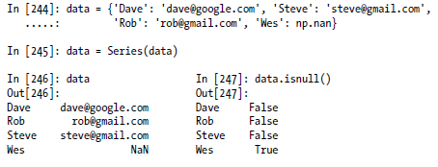
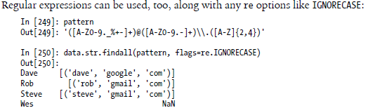
Vectorized string functions in pandas

Slide 46
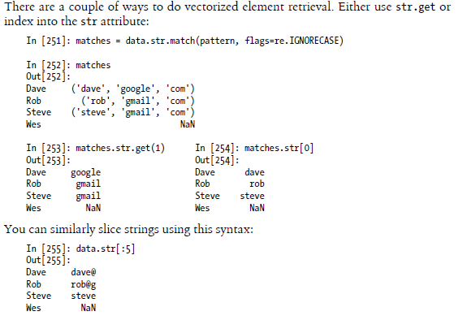
Vectorized string functions in pandas

