Slide 1
Introduction to Pandas
Pandas is Python package for data analysis.
It Provides built-in data structures which simplify the manipulation and analysis of data sets.
Pandas is easy to use and powerful.
pandas is a Python package providing fast, flexible, and expressive data structures designed to make working with “relational” or “labeled” data
http://pandas.pydata.org/pandas-docs/stable/

Slide 2
Introduction to Pandas
pandas is well suited for many different kinds of data:
Tabular data with heterogeneously-typed columns, as in an SQL table or Excel spreadsheet
Ordered and unordered time series data.
Arbitrary matrix data with row and column labels
Any other form of observational / statistical data sets.
The data actually need not be labeled at all to be placed into a pandas data structure

Slide 3
Introduction to Pandas
Here are just a few of the things that pandas does well:
Easy handling of missing data (represented as NaN)
Size mutability: columns can be inserted and deleted from DataFrame and higher dimensional objects
Powerful, flexible group by functionality to perform split-apply-combine operations on data sets, for both aggregating and transforming data
Make it easy to convert NumPy data structures into DataFrame objects
Intelligent label-based slicing, fancy indexing, and subsetting of large data sets
Intuitive merging, joining and reshaping data sets
Robust IO tools for loading data from flat files (CSV and delimited), Excel files and databases.

Slide 4
Data structures in Pandas
The two primary data structures of pandas are
Series (1-dimensional)
DataFrame (2-dimensional).
These data structures handle the vast majority of typical data in finance, statistics, social science, and many areas of engineering.

Slide 5
Series
Series is a one-dimensional labeled array capable of holding any data type (integers, strings, floating point numbers, Python objects, etc.).
The axis labels are collectively referred to as the index.
A Series is a one-dimensional array-like object containing an array of data and an associated array of data labels, called its index.
Syntax:
Obj=pd.Series(data)
Obj= =pd.Series(data, index=index) # index is a list of axis labels
Here, data can be many different things:
a scalar value
an ndarray
a Python dict

Slide 6
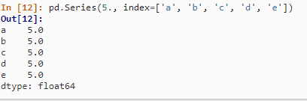
Series
From scalar value
If data is a scalar value, an index must be provided.
The value will be repeated to match the length of index.

Slide 7
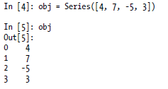
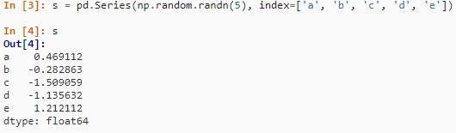
Series
From ndarray
If data is an ndarray, index must be the same length as data.
If no index is passed, it will be created having values [0, ..., len(data) - 1].

Slide 8
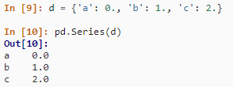
Series
From dict
Series can be instantiated from dicts:

Slide 9
Series
obj = Series([4, 7, -5, 3])
In [5]: obj
Out[5]:
0 4
1 7
2 -5
3 3
In [6]: obj.values
Out[6]: array([ 4, 7, -5, 3])
In [7]: obj.index
Out[7]: Int64Index([0, 1, 2, 3])

Slide 10
Series
you can use values in the index when selecting single values or a set of values:
In [11]: obj2['a']
Out[11]: -5
In [12]: obj2['d'] = 6
In [13]: obj2[['c', 'a', 'd']]
Out[13]:
c 3
a -5
d 6

Slide 11
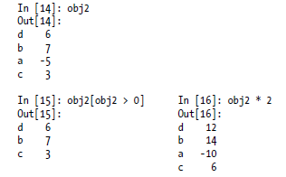

Series
You may apply NumPy array operations, such as filtering with a boolean array and scalar multiplication.

Slide 12
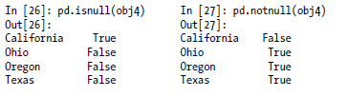
Series
The isnull() and notnull() functions in pandas should be used to detect missing data:
In [25]: obj4
Out[25]:
California NaN
Ohio 35000
Oregon 16000
Texas 71000

Slide 13
DataFrame
A DataFrame represents a tabular, spreadsheet-like data structure containing an ordered collection of columns, each of which can be a different value type (numeric,string, boolean, etc.).
The DataFrame has both a row and column index; it can be thought of as a dict of Series (one for all sharing the same index)
Like Series, DataFrame accepts many different kinds of input:
Dict of 1D ndarrays, lists, dicts, or Series

Slide 14
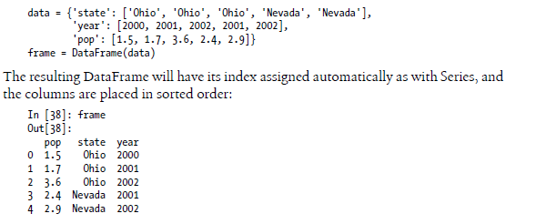
DataFrame
From dict of ndarrays / lists:
The ndarrays must all be the same length. If an index is passed, it must clearly also be the same length as the arrays.
If no index is passed, the result will be range(n), where n is the array length.

Slide 15
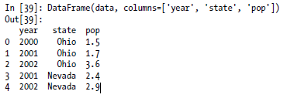
DataFrame
If you specify a sequence of columns, the DataFrame’s columns will be exactly what you pass:

Slide 16
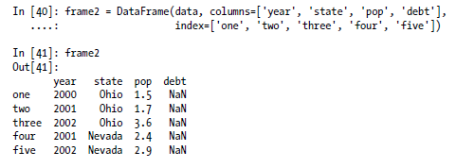

DataFrame
As with Series, if you pass a column that isn’t contained in data, it will appear with NA values in the result.

Slide 17
DataFrame
A column in a DataFrame can be retrieved as a Series either by dict-like notation or by attribute:
frame2['state'] In [44]: frame2.year
Out[43]: Out[44]:
One Ohio one 2000
Two Ohio two 2001
three Ohio three 2002
four Nevada four 2001
five Nevada five 2002
Name: state Name: year

Slide 18
DataFrame
Rows can also be retrieved by position or name by a couple of methods, such as the ix indexing field.
In [45]: frame2.ix['three']
Out[45]:
year 2002
state Ohio
pop 3.6
debt NaN
Name: three

Slide 19
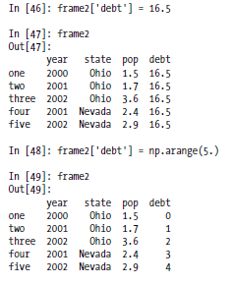
DataFrame
Columns can be modified by assignment.
For example, the empty 'debt' column could be assigned a scalar value or an array of values:

Slide 20
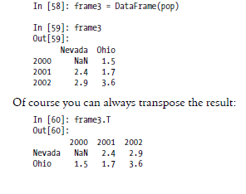
DataFrame
Another common form of data is a nested dict of dicts format:
pop = {'Nevada': {2001: 2.4, 2002: 2.9},
'Ohio': {2000: 1.5, 2001: 1.7, 2002: 3.6}}
If passed to DataFrame, it will interpret the outer dict keys as the columns and the inner keys as the row indices:

Slide 21
Essential Functionality
Reindexing
Dropping entries from an axis
Indexing, selection, and filtering

Slide 22
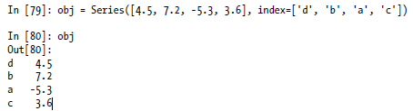


Reindexing:
A critical method on pandas objects is reindex , which rearranges the data according to the new index, introducing missing values if any index values were not already present.

Slide 23
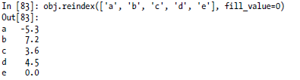
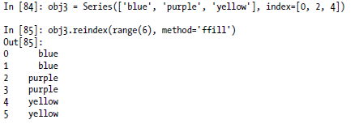
Reindexing:
ffill or pad: Fill (or carry) values forward

Slide 24
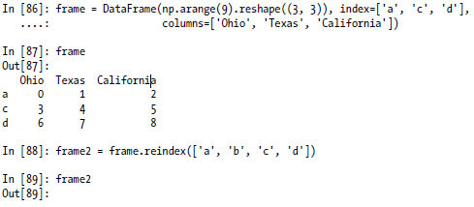

Reindexing
With DataFrame, reindex can alter either the (row) index, columns, or both.

Slide 25
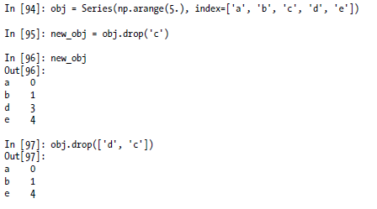
Dropping entries from an axis
Dropping one or more entries from an axis is easy if you have an index array or list
The drop method will return a new object with the indicated value or values deleted from an axis.

Slide 26
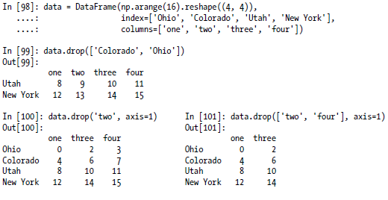
Dropping entries from an axis
With DataFrame, index values can be deleted from either axis:

Slide 27
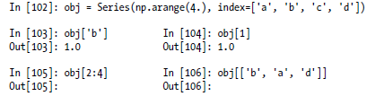
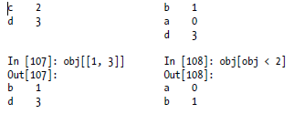
Indexing, selection, and filtering

Slide 28
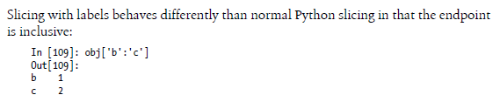
Indexing, selection, and filtering

Slide 29
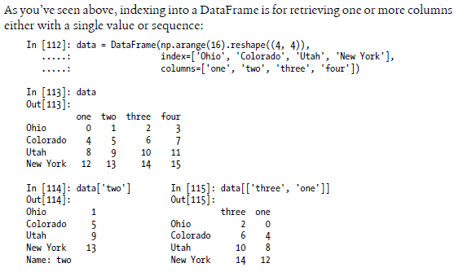
Indexing, selection, and filtering

Slide 30


Indexing, selection, and filtering

Slide 31
Handling Missing Data:
missing data, or missing values, occur when no data value is stored for the variable in an observation.
Missing data are a common occurrence and can have a significant effect on the conclusions that can be drawn from the data.
Missing data can occur because of non response:
no information is provided for one or more items or for a whole unit.
User forgot to fill in a field.
Data was lost while transferring manually from a legacy database.
Missing values make it difficult for analysts to perform data analysis.

Slide 32
Three types of problems are usually associated with missing values
loss of efficiency;
we will get complications in handling and analyzing the data;
bias resulting from differences between missing and complete data
In Pandas missing data is represented by two value:
NaN : NaN (Not a Number), is a special floating-point value recognized by all systems that use the standard IEEE floating-point representation.
None: None is a Python singleton object that is often used for missing data in Python code.

Slide 33
Handling Missing Values
NA handling methods
isnull:
notnull:
dropna.
fillna

Slide 34



Check for Missing Values using isnull() and notnull()
To detect missing values, Pandas provides two functions : isnull() and notnull() functions.
isnull(): Return object containing boolean values indicating which values are missing or NAN.
Notnull(): Negation of isnull.
data = Series(['aardvark', 'artichoke', np.nan, 'avocado'])
Print(data) print(data.isnull()) print(data.notnull())

Slide 35
Filtering Out Missing Data using dropna()
dropna():
The dropna() function is used to remove a row or a column from a dataframe which has a NaN or no values in it.
Syntax:
DataFrame.dropna(axis=0, how='any', thresh=None, subset=None,inplace=False)
Parameters:
axis: axis takes int or string value for rows/columns. Input can be 0 or 1 for Integer and ‘index’ or ‘columns’ for String. how: it takes either (‘any’ or ‘all’). ‘any’ drops the row/column if ANY value is Null and ‘all’ drops only if ALL values are null. thresh: thresh takes integer value which tells minimum amount of na values to drop. subset: It’s an array which limits the dropping process to passed rows/columns through list. inplace: It is a boolean which makes the changes in data frame itself if True.

Slide 36
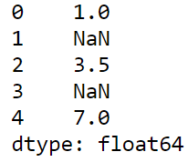
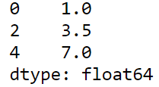
Example:
from numpy import nan as NA
import pandas as pd
data = pd.Series([1, NA, 3.5, NA, 7])
print(data)
print(data.dropna())

Slide 37
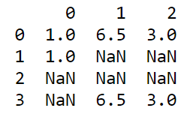
Naturally, you could have computed this yourself by boolean indexing:
print(data[data.notnull()])
With DataFrame objects, these are a bit more complex. You may want to drop rows or columns which are all NA or just those containing any NAs. dropna by default drops any row containing a missing value:
Example:
import pandas as pd
data = pd.DataFrame([[1., 6.5, 3.], [1., NA, NA],
[NA, NA, NA], [NA, 6.5, 3.]])
print(data)

Slide 38

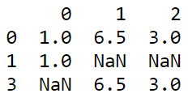
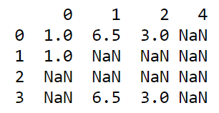
cleaned = data.dropna()
print(cleaned)
Passing how='all' will only drop rows that are all NA:
cleaned = data.dropna(how='all')
print(cleaned)
Dropping columns in the same way is only a matter of passing axis=1:
data[4] = NA
print(data)

Slide 39
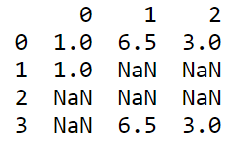
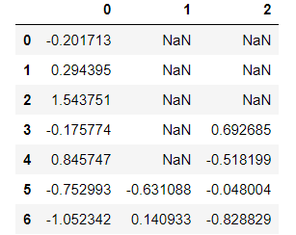
cleaned = data.dropna(axis=1, how='all')
print(cleaned)
Example:
import numpy as np
import pandas as pd
df = pd.DataFrame(np.random.randn(7, 3))
df.ix[:4, 1] = None
df.ix[:2, 2] = None
print(df.dropna(thresh=3))

Slide 40
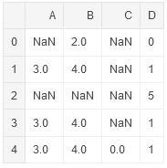
Example-2
import numpy as np
import pandas a
df = pd.DataFrame([[np.nan, 2, np.nan, 0],
[3, 4, np.nan, 1],
[np.nan, np.nan, np.nan, 5],
[3, 4, np.nan, 1],
[3, 4, 0, 1]],
columns=list('ABCD'))
Print(df)

Slide 41
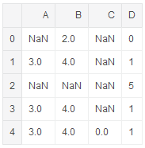


#remve all column where all value is 'NaN' exists
df.dropna(axis=1, how='all')
#remve all column where any value is 'NaN' exists
df.dropna(axis=1, how='any')
#remve all rows where any row value is 'NaN' exists
df.dropna(axis=0, how='any')

Slide 42
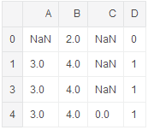
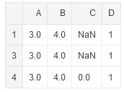
#remove all rows having more than 2 nan values
df.dropna(thresh=2)
#remove row where if there is any 'NaN' value in column 'A‘
df.dropna(axis=0, subset=['A'])

Slide 43
Filling in Missing Data
The fillna() function is used to fill the the missing or NaN values in the pandas dataframe with a suitable data as decided by the user.
Syntax:
DataFrame.fillna(value=None, method=None, axis=None, inplace=False, limit=None)
parameters:
value : Static, dictionary, array, series or dataframe to fill instead of NaN. method : Method is used if user doesn’t pass any value. Pandas has different methods like bfill, backfill or ffill which fills the place with value in the Forward index or Previous/Back respectively. axis: Axis to fill on, default axis=0 inplace: It is a boolean which makes the changes in data frame itself if True. limit : This is an integer value which specifies maximum number of consequetive forward/backward NaN value fills.

Slide 44
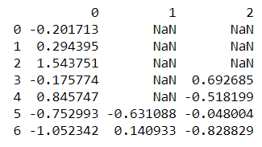
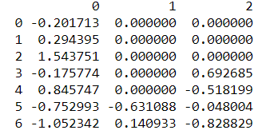
Example:
import numpy as np
import pandas as pd
df = pd.DataFrame(np.random.randn(7, 3))
df.ix[:4, 1] = None
df.ix[:2, 2] = None
print(df)
# fill all NAN values with 0
print(df.fillna(0))

Slide 45
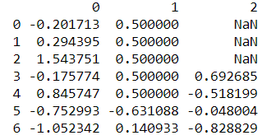
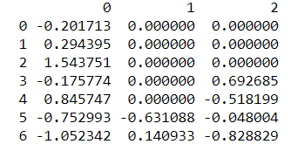
Calling fillna with a dict you can use a different fill value for each column:
print(df.fillna({1: 0.5}))
fillna returns a new object, but you can modify the existing object using inplace attribute:
df.fillna(0, inplace=True)
print(df)

Slide 46
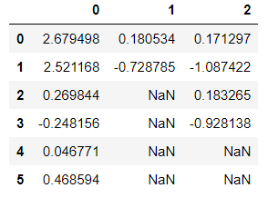
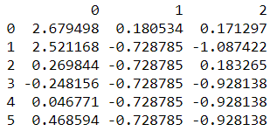
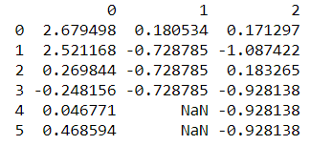
df = pd.DataFrame(np.random.randn(6, 3))
df.ix[2:, 1] = None
df.ix[4:, 2] = None
print(df)
print(df.fillna(method='ffill')) print(df.fillna(method='ffill', limit=2))

Slide 47

With fillna you can do lots of other things with a little creativity. For example, you might pass the mean or median value of a Series:
data = pd.Series([1., NA, 3.5, NA, 7])
data.fillna(data.mean())

Slide 48
Descriptive statistics
statistics can be thought of as a scientific framework for handling data.
This definition includes all the tasks involved with collecting, analyzing and interpretation of data.
Statistics can also refer to individual measures that represent summaries or aspects of the data itself.
When we have a set of observations, it is useful to summarize features of our data into a single statement called a descriptive statistic.
As their name suggests, descriptive statistics describe a particular quality of the data they summarize
These statistics fall into two general categories: the measures of central tendency and the measures of spread.

Slide 49
Measures of central tendency
Mean or mean():
The mean is a descriptive statistic that looks at the average value of a data set.
If mean() called on an empty container of data, it raises a StatisticsError.
Ex:
import statistics as st
nums=[1,2,3,5,7,9]
st.mean(nums) # 4.5
Median or median():
the median is the value that coincides with the middle of the data set.
If there are an even amount of items, then we take the average of the two values that would “surround” the middle.
Ex:
st.median(nums) #(3+5)/2

Slide 50
Measures of central tendency
Mode or mode():
The mode is defined as the value that appears the most frequently in our data.
Ex:
nums=[1,2,3,5,7,9,7,2,7,6]
st.mode(nums) # 7

Slide 51
Measures of spread
Range or range():
Range is the simplest to compute of the measures by subtract the smallest value of your data set from the largest value in the data.
Ex:
Prices=pd.series(5,7,22,55,60,8,9,15,20,)
min_price = min(prices)
max_price = max(prices)
Range=max_price-min_price # 55

Slide 52

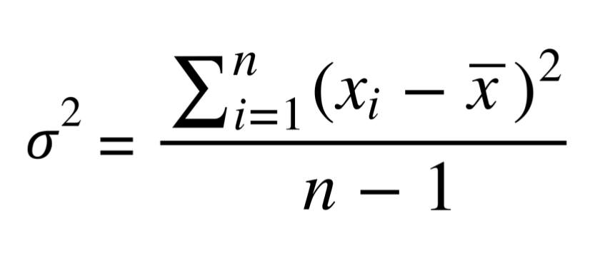
Measures of spread
Varianec or var() :
In statistics, variance is a measure of how far a value in a data set lies from the mean value.
Example: import statistics as st
a= pd.series(0, 1, 2, 3, 4, 5, 6, 7, 8)
print(st.var(a))
Ch .Venkata RamiReddy Department Of Computer Science and Engineering

Slide 53
Measures of spread
Standard deviation or st.std():
It shows how much variation in the data.
A low standard deviation indicates that the data points tend to be very close to the mean, whereas high standard deviation indicates that the data is spread out over a large range of values.
Example:
import statistics as st
nums=[1,2,3,5,7,9,7,2,7,6]
st.stdev(nums) # 2.72
Ch .Venkata RamiReddy Department Of Computer Science and Engineering

Slide 54

Covariance or cov()
In probability theory and statistics, covariance is a measure of how much two random variables change together.
Covariance provides a measure of the strength of the correlation between two or more sets of random variates.
Where x’ is mean of ‘x’ variable and y’ is mean of ‘y’ variable N is the sample size.
Ex:
x = [1,2,3,4,5,6,7,8,9 ,10]
y = [0.1, 0.2,0.3, 0.4, 0.5,0.6, 0.7,0.8,0.9,1.0]
print ('Covariance : ' + str(cov(x,y)) )
Ch .Venkata RamiReddy Department Of Computer Science and Engineering

Slide 55

Correlation
A correlation is a single number that describes the degree of relationship between two variables.
Ex:
x = [1,2,3,4,5,6,7,8,9 ,10]
y = [0.1, 0.2,0.3, 0.4, 0.5,0.6, 0.7,0.8,0.9,1.0]
print ('Correlation of X and Y is ' + str(corr(x,y)))
Ch .Venkata RamiReddy Department Of Computer Science and Engineering

Slide 56
Thank You

