Slide 1
Case Study
CORBA
Sai Pavan .S | G. Vishwanth | Sarath S.N |Sukash .G

Slide 2
Contents
History.
Goal.
Definitions.
CORBA RMI Features
CORBA RMI Structure
CORBA Services
Applications of CORBA
Significant Points

Slide 3
History
The CORBA (Common Object Request Broker Architecture) specification was developed in 1991 by the Object Management Group (OMG).
The OMG was founded by eleven corporations to develop CORBA.
CORBA 2.0 specification (introduced in 1996) permit communications between implementations made by different developers.
VFSTR

Slide 4
Goal
The OMG’s goal was to adopt distributed object systems that utilize object-oriented programming for distributed systems.
Systems to be built on heterogeneous hardware, networks, operating systems and programming languages.
The distributed objects would be implemented in various programming languages and still be able to communicate with each other.
VFSTR

Slide 5
Definitions
CDR – Common Data Representation: A external data representation of all data types that can be used as arguments or return values in remote invocations.
CORBA – Common Object Request Broker Architecture: An Object Request Broker (ORB) architecture specification for distributed object systems.
GIOP – General Inter-ORB Protocol: CORBA 2.0 standard that enables different developer implementations to communicate with each other.
IDL – Interface Definition Language: An interfacing programming language that that allow communication across a heterogeneous distributed system.
VFSTR

Slide 6
Definitions (cont.)
IIOP – Internet Inter-ORB Protocol: Internet version of GIOP that use the TCP/IP protocol.
Marshalling: The process of taking a collection of data items and assembling them into a form suitable for transmission in a message.
Middleware: A software layer that provides a programming abstraction as well as masking the heterogeneity of the underlying networks, hardware, operating systems, and programming languages.
OMG – Object Management Group: The organization that developed and maintains CORBA
POS – Persistent Object Service: A persistent object store for CORBA where objects that live between processes activations can be stored.
VFSTR

Slide 7
Features
CORBA consists of a language independent RMI
Consists of a set of generic services useful for distributed applications.
The CORBA RMI acts as a “universal translator” that permits client processes to invoke a method or process that may reside on a different operating system or hardware, or implemented via a different programming language.
VFSTR

Slide 8
CORBA RMI Features
The CORBA RMI consists of the following main components:
  An interface definition language (IDL)
  An architecture (discussed in Structure)
  The General Inter-ORB Protocol (GIOP)
  The Internet Inter-ORB Protocol (IIOP)
VFSTR

Slide 9
CORBA IDL Features
The CORBA Interface Definition Language, IDL, provides facilities for defining modules, interfaces, types, attributes and method signatures.
We give here only a brief overview of IDL.
Interfaces and other IDL type definitions can be grouped into logical units called modules.
VFSTR

Slide 10
GIOP and IIOP Features
GIOP: General Inter-ORB Protocol are the standards (included in CORBA 2.0), which enable implementations to communicate with each other regardless of who developed it.
IIOP: Internet Inter-ORB Protocol is an implementation of GIOP that uses the TCP/IP protocol for the Internet.
VFSTR

Slide 11
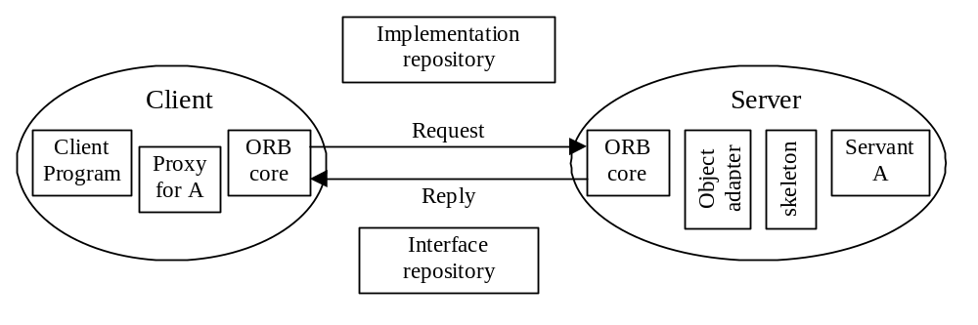
CORBA RMI Structure
VFSTR

Slide 12
Structure - ORB Core
ORB core
  Carries out the request-reply protocol between client and server.
  Provide operations that enable process to be started and stopped.
  Provide operations to convert between remote object references and strings.
VFSTR

Slide 13
Structure - Object Adapter
Object Adapter (server)
  Creates remoter object references for the CORBA objects
  Assigns a unique name to itself and each object..
VFSTR

Slide 14
Structure –
Skeletons and Proxies
Skeletons (server)
  An IDL compiler generates skeleton classes in the server’s language.
  Dispatch RMI’s to the appropriate servant class.
Client Proxies / Stubs
  Generated by an IDL compiler in the client language.
  A proxy class is created for object oriented languages
  Stub procedures are created for procedural languages.
Both are responsible for marshalling and unmarshalling arguments, results and exceptions.
VFSTR

Slide 15
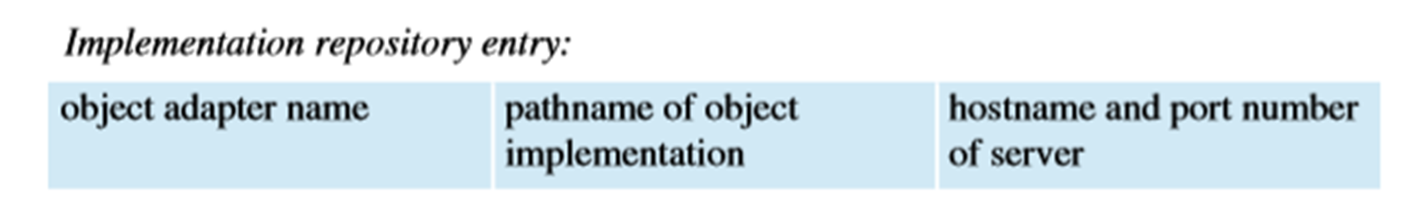
Structure - Repositories
Implementation Repository
  Activates registered servers on demand and locates servers that are currently running.
Interface Repository
  Provides information about registered IDL interfaces to the clients and servers that require it. Optional for static invocation; required for dynamic invocation.
VFSTR

Slide 16
CORBA Services
Set of generic service specifications useful for distributed applications. CORBA Naming Service - essential to any ORB.
  CORBA Event Service - define inferfaces
  CORBA Notification Service - extention of event service
  CORBA Security Service - controls access
  CORBA Trading Service - allows locatation by attribute
  CORBA Transaction and Concurrency Control Service
  CORBA Persistent Object Service
VFSTR

Slide 17
How to use CORBA
Server must include IDL interfaces in the form of servant classes.
An interface compiler generates:
  the program(Java or C++) interfaces
  server skeletons for each IDL interface
  proxy classes (or client stubs) for each IDL interface
  A Java / C++ class for IDL defined struct
  helper classes for each IDL defined type
VFSTR

Slide 18
How to use CORBA (cont.)
Server
  Creates and initializes the ORB
  Creates an instance of servant class, which is registered with the ORB. Servant class extends the corresponding skeleton class and implementation methods of an IDL interface.
  Makes a CORBA object
Client
  Creates and initializes the ORB
  Contacts Naming service to get reference to the server
  Invokes methods on the server
VFSTR

Slide 19
Applications of CORBA
Used primarily as a remote method invocation of a distributed client – server system.
Can communicate between clients and servers on different operating systems and implemented by different programming languages (Java cannot do this).
Has many standards and services useful in implementing distributed appliations.
Process can be both server and client to another server
Ideal for a heteregeneous distributed system like the Internet.
VFSTR

Slide 20
Significant Points
Harder to use than a single language RMI such as JAVA.
Compatible with various languages and operating systems.
CORBA’s IDL is the crucial part because it permits communication on a heterogeneous distributed system.
The OMG consists of several companies that maintain compatibility and standardization of the CORBA system.
VFSTR

Slide 21
References
Book Sellers <http://www.booksellersnow.com/bsnpopularcorba.htm>. Book Sellers, 2003
CORBA. <http://www.corba.org/>
Coulouris, Dollimore, Kindberg. Distributed Systems Concepts and Design. Harlow, England: Addison-Wesley, 2001.
Bolton. Pure CORBA. Sams, 2001
OMG. Home page. <http://www.omg.org>. OMG, 2003
OMG. ”About The Object Management Group™ (OMG™)”. <http://www.omg.org/gettingstarted/gettingstartedindex.htm>. OMG, 2003
Seetharamanan, K. “Special Issue: The CORBA Connection”. Comms. ACM, October, Vol. 41, No. 10.
VFSTR

Slide 22
Thank you…………!!!!!!!!
VFSTR

