Slide 1
Unit-2-2 Operating System Support
.
Chapter 6:
Introduction
The operating system layer
Protection
Processes and threads
Communication and invocation
operating system architecture

Slide 2
Learning objectives
Know what a modern operating system does to support distributed applications and middleware
–
–
Definition of network OS Definition of distributed OS
Understand the relevant abstractions and techniques, focussing on:
processes, threads, ports and support for invocation mechanisms.
Understand the options for operating system architecture
monolithic and micro-kernels
If time:
Lightweight RPC
2
*

Slide 3
Os support:Introduction
Important aspect of DS is resource sharing
Client applications invoke operations
Middleware provides remote invocations between processes at nodes of DS
OS is layer below middleware
OS supports middleware at nodes of a DS
–encapsulation
–protection
–invocation

Slide 4
Provide abstraction of physical resources
–Processors
–Memory
–Communications
–Storage media
System call interface
–Files rather than data blocks –Sockets rather than raw network access

Slide 5
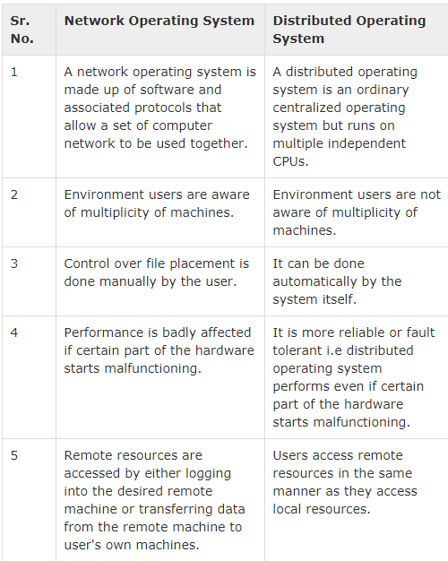

Slide 6
6.2 Operating system layers
Users only satisfy if their middleware –os combination had good performance
Middleware runs on avariety of os-hardware combinations at nodes of distributed system
In the fig shows how the os layer at each of two node support common middle ware layer in providing a distributed infrastructure for applications and services

Slide 7
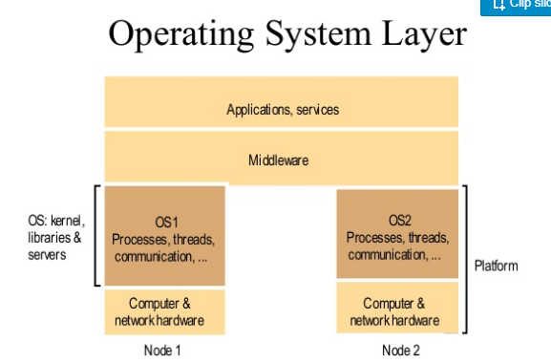

Slide 8
System layers
Figure 6.1
Applications, services
Middleware
OS: kernel, libraries & servers
Figure 2.1
Software and hardware service layers in distributed
systems
OS1
Processes, threads, communication, ...
OS2
Processes, threads, communication, ...
Platform
Computer & network hardware
Node 2
Applications, services
Computer & network hardware
Middleware
Operating system
Node 1
Platform
Computer and network hardware
3
*

Slide 9
Kernal and server processes are the components that manage resources and present clients with an interface to the resources,we require at least the following
Encapsulation:details such as management of memory and devices used to implement resources should be hidden
Protection:Resources require protection from illegitimate accesses
Concurrent processing:clients may share resources and access them concurrently .resource managers are responsible for achieving concurrency transparency
A combination of libraries ,kernals and servers may be called to perform invocation-related tasks
Communication:operation parameters and results have to be passed to and from resource managers,over n/w
Scheduling:when operation is invoked its processing must be scheduled with in kernal or server

Slide 10
Core OS functionality
Figure 6.2
Process manager
Communication manager
Thread manager
Memory manager
Supervisor
6
*

Slide 11
Core OS Components:
Process Manager:creation and operations on processors
Thread Manager:creation ,synchronization and scheduling
Communication Manager:comm b/w threads attached to diff processors
Memory Manager:Managent of physical and virtual memory
Supervisior:control of memory management

Slide 12
6.3 Protection
The resources require protection from illegitimate accesses
Code that contains a bug or which has unanticipated behaviour may cause rest of the system behaviour incorrectly
Illegitimate access means consider a file that have only two operations read and write .
The person who owns the file have read and write rights,others can only access read operations..if some how they managed to perform write operations on the file,the solution to this problem is cryptographic techniques

Slide 13
Kernal and protection:Kernal is a central part of os that manages the os mostly memory and cpu time
The kernal process executes with the processor in supervisior mode and the kernal arranges that other processes execute in user(unprivileged)mode
The Kernal also sets up address spaces to protect itself and other processes from accesses of an aberrant process

Slide 14
6.4 Processes and Threads
Now a days process consists of an execution environment together with one or more threads
A thread in os is abstraction of an activity
An execution environment is the unit of resource management
An execution environment primarly consists of:
An address space
Thread synchronization and communication resources such as semaphores and sockets
Higher level abstractions such as open files and windows
execution environment are normally expensive to create and manage but several threads can share
Threads can be created and destroyed dynamically as needed
The main aim of having multiple threads is to maximize the degree of concurrent execution between operations

Slide 15
6.4.1 Address space
It is a unit of management of aprocess virtual memeory
It is large typically upto 2^32 bytes and consistes of one or more regions sepated by inaccessible areas of virtual memory
Each region is specified by following properties
Its extent (lowest virtual address and size)
Read/write/execute permissions for process’s thread
Whether it can be grown upward or downward
Note this model is page-oriented rather than segment-oriented
This representation of address space has three regions:a fixed ,unmodifiable text region containing program code,a heap,partof which is initialized by values stored in the programs binary file,and a stack which is extensible towards lower virtual address

Slide 16
Process address space
Figure 6.3
N
Fixed: un-modifiable text region containing program code.
Heap: part of which is initialized by values.
- There are indefinite no. of regions because a separate stack is needed for each thread.
2
Auxiliary regions
Stack
Heap
Text
0
7
*

Slide 17
6.4.2 Creation of a new process
For a distributed system,the design of a process creation mechanism has divided in two two independent aspects:
a.The choice of target host
b.Creation of a new execution environment
Choice of a target host:
Node where process will reside, consists of some policy.
1. Transfer Policy: Whether to situate a new process locally or remotely depending on load of local node.
2. Location Policy : which node should host a new process. Location Policy can be
Static: optimize overall process throughput policy operate w/o regard to current state of the system. - Deterministic: ‘A’ should always transfer process to ‘B’ - Probabilistic: ‘A’ should transfer to any of nodes between ‘B’ to ‘E’ b. Adaptive: Apply methods to make allocation( Ex. Measure load at each node)

Slide 18
b. Creation of new execution environment:
Once the host computer has been selected ,a new process requires an execution environment consisting of an address space with initialised contents
• Two approaches to define address space of newly created process:
1. Statically defined- Address space regions are initialized from an executable file. (contains only textregion,heap region& stack region)
2. Defined w.r.t. existing execution envt. Ex. In UNIX the newly created child process can physically share parent’s address space. The region is not getting physically copied but the page frames that make up the inherited region are shared between 2 address spaces.(COW technique)

Slide 19
Copy-on-write – a convenient optimization
Figure 6.4
Process A’s address space
Process B’s address space
RB
RB copied from RA
RA
Kernel
Shared frame
A's page table
B's page table
a) Before write
b) After write
8
*

Slide 20
Copy-on-write is a general technique ,consider regions RA and RB whose memory is shared copy-on-write between two processes A and B,let us assume that process A set region RA andto be copy-inherited by its child process B and the region RB was thus created in process B

Slide 21
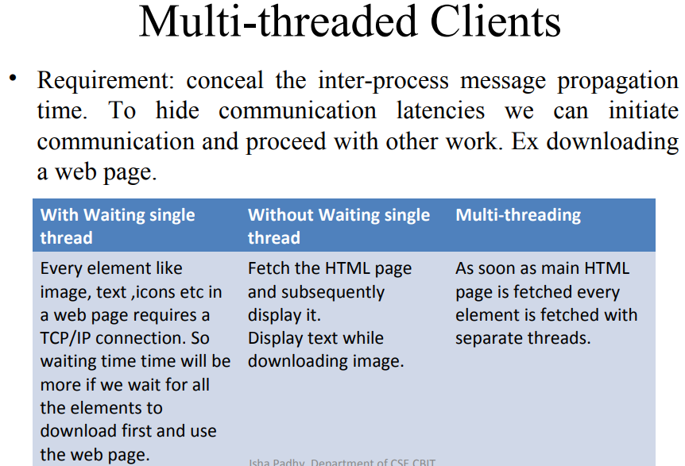
6.4.3 Threads

Slide 22
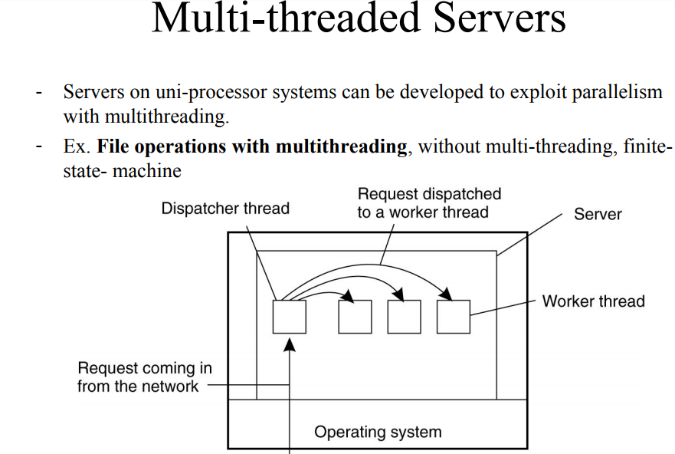

Slide 24
Threads concept and implementation
Process
Thread activations
Activation stacks (parameters, local variables)
Heap (dynamic storage, objects, global variables)
'text' (program code)
system-provided resources (sockets, windows, open files)
9
*

Slide 25



Client and server with threads
Figure 6.5
Thread 2 makes requests to server
Receipt & queuing
Input-output
Thread 1 generates results
Requests
N threads
Client
Server
The 'worker pool' architecture
See Figure 4.6 for an example of this architecture programmed in Java.
10
*

Slide 26
Alternative server threading architectures
Figure 6.6
server process
server
process per-connection threads
server process
workers
per-object threads
I/O
remote objects
remote objects
I/O
remote objects
a. Thread-per-request b. Thread-per-connection
c. Thread-per-object
– Implemented by the server-side ORB in CORBA
would be useful for UDP-based service, e.g. NTP
is the most commonly used - matches the TCP connection model
is used where the service is encapsulated as an object. E.g. could have multiple shared whiteboards with one thread each. Each object has only one
thread, a₁v₁oiding the need for thread synchronization within objects.
*

Slide 27
Java thread constructor and management methods
Figure 6.8
Methods of objects that inherit from class Thread
Thread(ThreadGroup group, Runnable target, String name) Creates a new thread in the SUSPENDED state, which will belong to group and be identified as name; the thread will execute the run() method of target.
setPriority(int newPriority), getPriority() Set and return the thread’s priority.
run() A thread executes the run() method of its target object, if it has one, and otherwise its own run() method (Thread implements Runnable).
start() Change the state of the thread from SUSPENDED to RUNNABLE.
sleep(int millisecs) Cause the thread to enter the SUSPENDED state for the specified time.
yield() Enter the READY state and invoke the scheduler.
destroy()
•
Destroy th₁e₃thread.
*

Slide 28
Java thread synchronization calls
Figure 6.9
See Fi
gure 12.17 for an example of the use of object.wait() and
.notifyall() in a transaction implementation with locks.
d for up to the specified time until thread ha terminated. es it to return from a blocking method call such as sleep().
nt nanosecs)
d until a call made to notify() or notifyAll() on object wakes is interrupted, or the specified time has elapsed.
All()
e or all of any threads that have called wait() on object.
object
thread.join(int millisecs)
Blocks the calling threa
thread.interrupt()
Interrupts thread: caus
object.wait(long millisecs, i
Blocks the calling threa the thread, or the thread
object.notify(), object.notify
Wakes, respectively, on
object.wait() and object.notify() are very similar to the semaphore operations. E.g. a worker thread in Figure 6.5 would use queue.wait() to wait for incoming requests.
synchronized methods (and code blocks) implement the monitor abstraction. The operations within a synchronized method are performed atomically with respect to other synchronized methods of the same object. synchronized should be used for any methods that update the
state of an object1in4a threaded environment.
*

Slide 29
Threads implementation
Threads can be implemented:
in the OS kernel (Win NT, Solaris, Mach)
at user level (e.g. by a thread library: C threads, pthreads), or in the language (Ada, Java).
+ lightweight - no system calls
+ modifiable scheduler
+ low cost enables more threads to be employed
-
-
-
not pre-emptive
can exploit multiple processors
- page fault blocks all threads
Java can be implemented either way
hybrid approaches can gain some advantages of both
user-level hints to kernel scheduler
heirarchic threads (Solaris)
event-based (SPIN, FastThreads)
15
*

Slide 30
Support for communication and invocation
The performance of RPC and RMI mechanisms is critical for effective distributed systems.
–
–
–
–
Typical times for 'null procedure call':
Local procedure call Remote procedure call
< 1 microseconds
~ 10 milliseconds
10,000 times slower!
'network time' (involving about 100 bytes transferred, at 100 megabits/sec.) accounts for only .01 millisecond; the remaining delays must be in OS and middleware - latency, not communication time.
Factors affecting RPC/RMI performance
– marshalling/unmarshalling + operation despatch at the server
– data copying:- application -> kernel space -> communication buffers
– thread scheduling and context switching:- including kernel entry
– protocol processing:- for each protocol layer
– network access delays:- connection setup, network latency
17
*

Slide 31
Implementation of invocation mechanisms
Most invocation middleware (Corba, Java RMI, HTTP) is implemented over TCP
For universal availability, unlimited message size and reliable transfer; see section 4.4 for further discussion of the reasons.
Sun RPC (used in NFS) is implemented over both UDP and TCP and generally works faster over UDP
Research-based systems have implemented much more efficient invocation protocols, E.g.
–
–
–
Firefly RPC (see www.cdk3.net/oss)
Amoeba's doOperation, getRequest, sendReply primitives (www.cdk3.net/oss) LRPC [Bershad et. al. 1990], described on pp. 237-9)..
Concurrent and asynchronous invocations
– middleware or application doesn't block waiting for reply to each invocation
18
*

Slide 32
Invocations between address spaces
Figure 6.11
(a) System call
Thread
Control transfer via trap instruction
Control transfer via privileged instructions
User
Kernel
Protection domain
(b) RPC/RMI (within one computer)
boundary
Thread 1
Thread 2
User 1
Kernel
User 2
(c) RPC/RMI (between computers)
Thread 1
Network
Thread 2
User 1
User 2
Kernel 2
19
Kernel 1
*

Slide 33
Bershad's LRPC
Uses shared memory for interprocess communication
while maintaining protection of the two processes
arguments copied only once (versus four times for convenitional RPC)
Client threads can execute server code
– via protected entry points only (uses capabilities)
Up to 3 x faster for local invocations
21

Slide 34


A lightweight remote procedure call
Figure 6.13
Client
Server
A stack
A
1. Copy args
4. Execute procedure and copy results
User
stub
stub
Kernel
2. Trap to Kernel
3. Upcall
5. Return (trap)
23
*

Slide 35
Monolithic kernel and microkernel
Figure 6.15
S4
.......
S1 S2 S3 S4
.......
S1 S2 S3
.......
Kernel
Kernel
Monolithic Kernel
Microkernel
Figure 6.16
Middleware
 | Language support subsystem | Language support subsystem | OS emulation subsystem | ....
Microkernel
Hardware
The₂m₅icrokernel supports middleware via subsystems
*

Slide 36
Advantages and disadvantages of microkernel
+ flexibility and extensibility
services can be added, modified and debugged
small kernel -> fewer bugs
protection of services and resources is still maintained
- service invocation expensive
-
-
unless LRPC is used
extra system calls by services for access to protected resources
26

Slide 37
Relevant topics not covered
Protection of OS resources (Section 6.3)
– Control of access to distributed resources is covered in Chapter 7 - Security
Mach OS case study (Chapter 18)
–
–
Halfway to a distributed OS
The communication model is of particular interest. It includes:
ports that can migrate betwen computers and processes
support for RPC
typed messages
access control to ports
open implementation of network communication (drivers outside the kernel)
Thread programming (Section 6.4, and many other sources)
– e.g. Doug Lea's book Concurrent Programming in Java, (Addison Wesley 1996)
27
*

Slide 38
Summary
The OS provides local support for the implementation of distributed applications and middleware:
–
–
Manages and protects system resources (memory, processing, communication) Provides relevant local abstractions:
files, processes
threads, communication ports
Middleware provides general-purpose distributed abstractions
RPC, DSM, event notification, streaming
Invocation performance is important
it can be optimized, E.g. Firefly RPC, LRPC
Microkernel architecture for flexibility
– The KISS principle ('Keep it simple – stupid!')
ω has res₂u₈lted in migration of many functions out of the OS
*

