Slide 1
Chapter 12 Coordination and Agreement
CSD511 – Distributed Systems

Slide 2
Chapter 12 Coordination and Agreement
Introduction
Distributed mutual exclusion
Elections
Multicast communication
Consensus and related problems (agreement)
Summary
2

Slide 3
12.1 Introduction
Fundamental issue: for a set of processes, how to coordinate their actions or to agree on one or more values?
even no fixed master-slave relationship between the components
Further issue: how to consider and deal with failures when designing algorithms
Topics covered
mutual exclusion
how to elect one of a collection of processes to perform a special role
multicast communication
agreement problem: consensus and byzantine agreement
3

Slide 4
Failure Assumptions and Failure Detectors
Failure assumptions of this chapter
Reliable communication channels
Processes only fail by crashing unless state otherwise
Failure detector: object/code in a process that detects failures of other processes
unreliable failure detector
One of two values: unsuspected or suspected
Evidence of possible failures
Example: most practical systems
Each process sends “alive/I’m here” message to everyone else
If not receiving “alive” message after timeout, it’s suspected
– maybe function correctly, but network partitioned
reliable failure detector
One of two accurate values: unsuspected or failure
few practical systems
4

Slide 5
12.2 Distributed Mutual Exclusion
Process coordination in a multitasking OS
Race condition: several processes access and manipulate the same data concurrently and the outcome of the execution depends on the particular order in which the access take place
critical section: when one process is executing in a critical section, no other process is to be allowed to execute in its critical section
Mutual exclusion: If a process is executing in its critical section, then no other processes can be executing in their critical sections
Distributed mutual exclusion
Provide critical region in a distributed environment
message passing
for example, locking files, lockd daemon in UNIX (NFS is stateless, no file-locking at the NFS level)
5

Slide 6
Algorithms for mutual exclusion
Problem: an asynchronous system of N processes
processes don't fail
message delivery is reliable; not share variables
only one critical region
application-level protocol: enter(), resourceAccesses(), exit()
Requirements for mutual exclusion
Essential
[ME1] safety: only one process at a time
[ME2] liveness: eventually enter or exit
Additional
[ME3] happened-before ordering: ordering of enter() is the same as HB ordering
Performance evaluation
overhead and bandwidth consumption: # of messages sent
client delay incurred by a process at entry and exit
throughput measured by synchronization delay: delay between one's exit and next's entry
6

Slide 7
A central server algorithm
server keeps track of a token---permission to enter critical region
a process requests the server for the token
the server grants the token if it has the token
a process can enter if it gets the token, otherwise waits
when done, a process sends release and exits
Server
Queue of requests
4
2
3. Grant token
1. Request
token
2. Release token
p
p₁
4
p₂
p₃
Figure 12.2 Server managing a mutual exclusion token for a set of processes
7

Slide 8
A central server algorithm: discussion
Properties
safety, why?
liveness, why?
HB ordering not guaranteed, why?
Performance
enter overhead: two messages (request and grant)
enter delay: time between request and grant
exit overhead: one message (release)
exit delay: none
synchronization delay: between release and grant
centralized server is the bottleneck

Slide 9
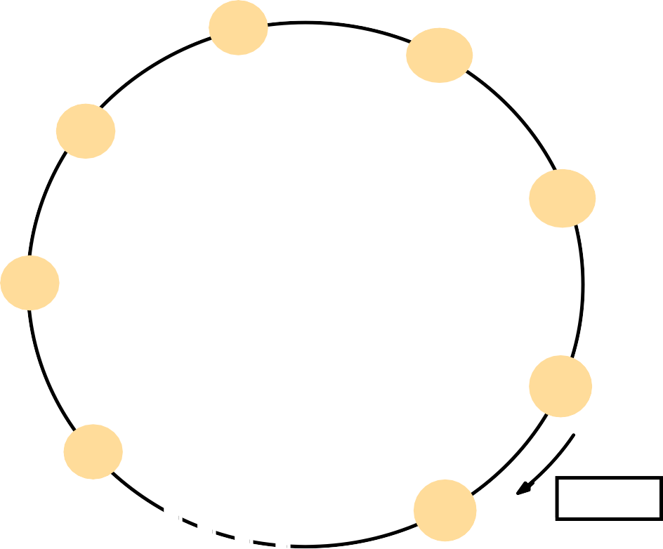
A ring-based algorithm
Arrange processes in a logical ring to rotate a token
Wait for the token if it requires to enter the critical section
The ring could be unrelated to the physical configuration
p_{i} sends messages to p_{(i+1) mod N}
when a process requires to enter the critical section, waits for the token
when a process holds the token
If it requires to enter the critical section, it can enter
– when a process releases a token (exit), it sends to its neighbor
If it doesn’t, just immediately forwards the token to its neighbor
p
1
p
2
p_{n}
p
3
p
4
Figure 12.3 A ring of processes transferring a mutual exclusion token
Token

Slide 10
A ring-based algorithm: discussion
Properties
safety, why?
liveness, why?
HB ordering not guaranteed, why?
Performance
bandwidth consumption: token keeps circulating
enter overhead: 0 to N messages
enter delay: delay for 0 to N messages
exit overhead: one message
exit delay: none
synchronization delay: delay for 1 to N messages

Slide 11





An algorithm using multicast and logical clocks
Multicast a request message for the token (Ricart and Agrawala [1981])
enter only if all the other processes reply
totally-ordered timestamps: <T, p_{i} >
Each process keeps a state: RELEASED, HELD, WANTED
if all have state = RELEASED, all reply, a process can hold the token and enter
if a process has state = HELD, doesn't reply until it exits
if more than one process has state = WANTED, process with the lowest timestamp will get all N-1 replies first
41
41
P₃
P₁
Reply
Reply
34
34
Reply
41
P₂
34
Figure 12.5 Multicast synchronization
11

Slide 12
Figure 12.4 Ricart and Agrawala’s algorithm
On initialization
state := RELEASED;
To enter the section state := WANTED;
Multicast request to all processes; request processing deferred here
T := request’s timestamp;
Wait until (number of replies received = (N – 1));
state := HELD;
On receipt of a request <T_{i}, p_{i}> at p_{j} (i ≠ j)
if (state = HELD or (state = WANTED and (T, p_{j}) < (T_{i}, p_{i}))) then
queue request from p_{i} without replying;
else
reply immediately to p_{i}; end if
To exit the critical section
state := RELEASED;
reply to any queued requests;

Slide 13
An algorithm using multicast: discussion
Properties
safety, why?
liveness, why?
HB ordering, why?
Performance
bandwidth consumption: no token keeps circulating
entry overhead: 2(N-1), why? [with multicast support: 1 + (N - 1) = N]
entry delay: delay between request and getting all replies
exit overhead: 0 to N-1 messages
exit delay: none
synchronization delay: delay for 1 message (one last reply from the previous holder)

Slide 14
Maekawa’s voting algorithm
•Observation: not all peers to grant it access
Only obtain permission from subsets, overlapped by any two processes
•Maekawa’s approach
subsets Vi,Vj for process Pi, Pj
Pi ∈Vi, Pj ∈ Vj
Vi ∩ Vj ≠ ∅, there is at least one common member
subset |Vi|=K, to be fair, each process should have the same size
Pi cannot enter the critical section until it has received all K reply messages
Choose a subset
Simple way (2√N): place processes in a √N by √N matrix and let Vi be the union of the row and column containing Pi
Optimal (√N): non-trivial to calculate (skim here)
Deadlock-prone
V1={P1, P2}, V2={P2, P3}, V3={P3, P1}
If P1, P2 and P3 concurrently request entry to the critical section, then its possible that each process has received one (itself) out of two replies, and none can proceed
adapted and solved by [Saunders 1987]
14

Slide 15
Figure 12.6 Maekawa’s algorithm
On initialization
state := RELEASED;
voted := FALSE;
For p_{i} to enter the critical section state := WANTED;
Multicast request to all processes in V_{i}; Wait until (number of replies received = K); state := HELD;
On receipt of a request from p_{i} at p_{j}
if (state = HELD or voted = TRUE)
then
queue request from p_{i} without replying;
else
send reply to p_{i}; voted := TRUE;
end if
For p_{i} to exit the critical section state := RELEASED;
Multicast release to all processes in V_{i};
On receipt of a release from p_{i} at p_{j} if (queue of requests is non-empty) then
remove head of queue – from p_{k}, say; send reply to p_{k};
voted := TRUE;
else
voted := FALSE;
end if
15

Slide 16
12.3 Elections
Election: choosing a unique process for a particular role
All the processes agree on the unique choice
For example, server in dist. mutex
Assumptions
Each process can call only one election at a time
multiple concurrent elections can be called by different processes
Participant: engages in an election
each process p_{i} has variable elected_{i} = ? (don't know) initially
process with the largest identifier wins
– The (unique) identifier could be any useful value
Properties
[E1] elected_{i} of a “participant” process must be P (elected process=largest id) or ⊥ (undefined)
[E2] liveness: all processes participate and eventually set elected_{i} != ⊥ (or crash)
Performance
overhead (bandwidth consumption): noof of messages sent
– turnaround time: # of messages to complete an election
16

Slide 17
A ring-based election algorithm
Arrange processes in a logical ring
p_{i} sends messages to p_{(i+1) mod N}
It could be unrelated to the physical configuration
Elect the coordinator with the largest id
Assume no failures
Initially, every process is a non-participant. Any process can call an election
Marks itself as participant
Places its id in an election message
Sends the message to its neighbor
17

Slide 18
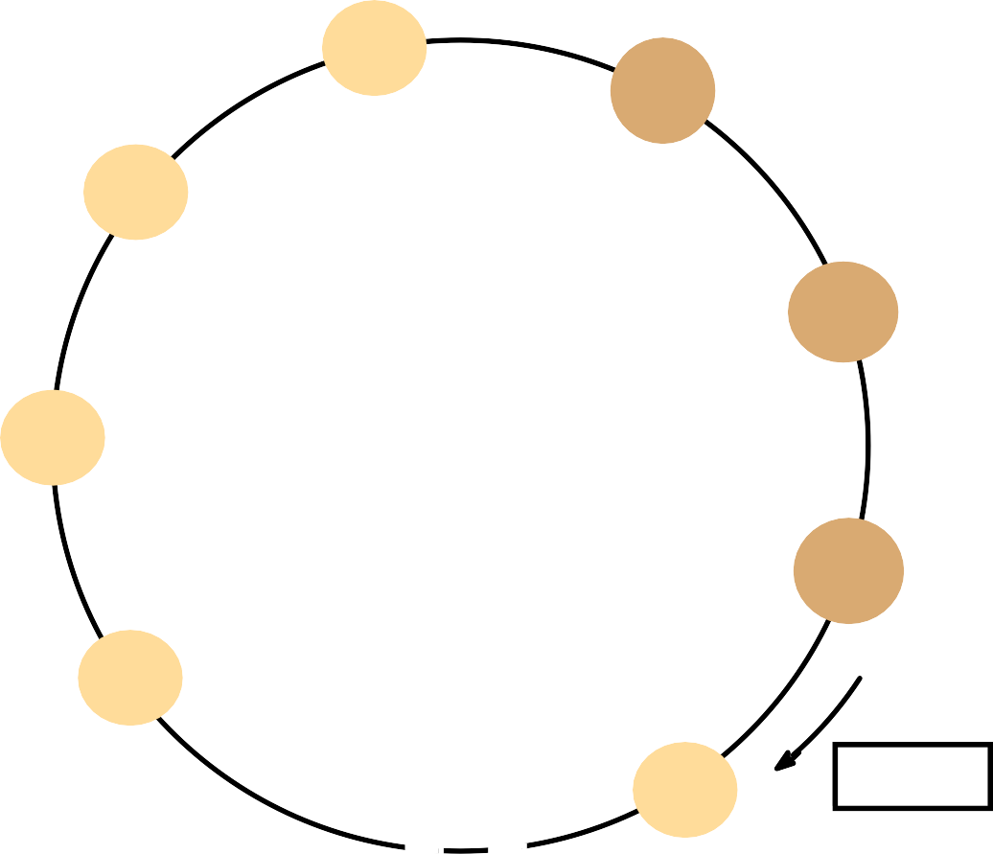
Figure 12.7 A ring-based election in progress
3
Receiving an election message:
if id > myid, forward the msg, mark participant
if id < myid
non-participant: replace id with myid: forward the msg, mark participant
17
4
24
participant: stop forwarding (why?
9
Later, multiple elections)
– if id = myid, coordinator found,
mark non-participant, elected_{i} := id,
1
send elected message with myid
Receiving an elected message:
15
– id != myid, mark non-participant,
28
24
elected_{i} := id forward the msg
– if id = myid, stop forwarding
Note: The election was started by process 17.
The highest process identifier encountered so far is 24. Participant processes are shown darkened

Slide 19
A ring-based election algorithm: discussion
Properties
safety: only the process with the largest id can send an
elected message
liveness: every process in the ring eventually participates in the election; extra elections are stopped
Performance
one election, best case, when?
N election messages
N elected messages
turnaround: 2N messages
one election, worst case, when?
2N - 1 election messages
N elected messages
turnaround: 3N - 1 messages
can't tolerate failures, not very practical

Slide 20
The bully election algorithm
Assumption
Each process knows which processes have higher identifiers, and that it can communicate with all such processes
Compare with ring-based election
Processes can crash and be detected by timeouts
synchronous
timeout T =
(max transmission delay) + (max
^{2T}transmitting ^{T}processing
processing delay).this is the total time for sending and receiving a response,no response with in T the local failure dectector report as request failed
Three types of messages
Election: announce an election
Answer: in response to Election
– Coordinator: announce the identity of the elected process

Slide 21
The bully election algorithm: howto
Start an election when detect the coordinator has failed or begin to replace the coordinator, which has lower identifier
Send an election message to all processes with higher id's and waits for answers (except the failed coordinator/process)
If no answers in time T
Considers it is the coordinator
sends coordinator message (with its id) to all processes with lower id's
else
waits for a coordinator message and starts an election if T’ timeout
To be a coordinator, it has to start an election
A higher id process can replace the current coordinator (hence “bully”)
The highest one directly sends a coordinator message to all process with lower identifiers
Receiving an election message
sends an answer message back
starts an election if it hasn't started one—send election messages to all higher-id processes (including the “failed” coordinator—the coordinator might be up by now)
Receiving a coordinator message
– set elected_{i} to the new coordinator

Slide 22

Figure 12.8 The bully algorithm
election
election
C
Stage 1
p
1
answer
p
2
answer
p
p
4
3
election
election
election
C
Stage 2
p₁
p
answer
p
p
4
2
3
timeout
Stage 3
p
1
p
2
p
p
4
3
Eventually.....
coordinator
C
Stage 4
p
1
p
2 3
p
p
4
The election of coordinator p₂, after the failure of p₄ and then p₃
22

Slide 23
The bully election algorithm: discussion
Properties
safety:
a lower-id process always yields to a higher-id process
However, it’s guaranteed
if processes that have crashed are replaced by processes with the same identifier since message delivery order might not be guaranteed and
failure detection might be unreliable
liveness: all processes participate and know the coordinator at the end
Performance
best case: when?
overhead: N-2 coordinator messages
turnaround delay: no election/answer messages
worst case: when?
overhead:
1+ 2 + ...+ (N-2) + (N-2)= (N-1)(N-2)/2 + (N-2) election messages,
1+...+ (N-2) answer messages,
N-2 coordinator messages,
total: (N-1)(N-2) + 2(N-2) = (N+1)(N-2) = O(N²)
turnaround delay: delay of election and answer messages

Slide 24
12.4 Multicast Communication
Group (multicast) communication: for each of a group of processes to receive copies of the messages sent to the group, often with delivery guarantees
The set of messages that every process of the group should receive
On the delivery ordering across the group members
Challenges
Efficiency concerns include minimizing overhead activities and increasing throughput and bandwidth utilization
Delivery guarantees ensure that operations are completed
Types of group
Static or dynamic: whether joining or leaving is considered
Closed or open
A group is said to be closed if only members of the group can multicast to it. A process in a closed group sends to itself any messages to the group
A group is open if processes outside the group can send to it

Slide 25
Reliable Multicast
Simple basic multicasting (B-multicast) is sending a message to every process that is a member of a defined group
B-multicast(g, m) for each process p ∈ group g, send(p, message m)
On receive(m) at p: B-deliver(m) at p
Reliable multicasting (R-multicast) requires these properties
Integrity: a correct process sends a message to only a member of the group and does it only once
Validity: if a correct process sends a message, it will eventually be delivered
Agreement: if a message is delivered to a correct process, all other correct processes in the group will deliver it

Slide 26
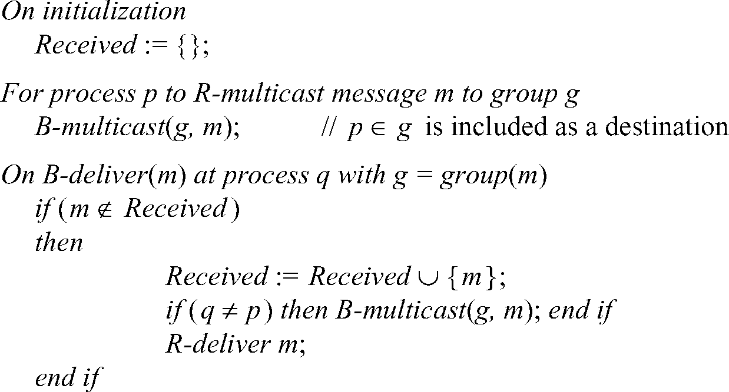
Figure 12.10 Reliable multicast algorithm
Implementing reliable R-multicast over B-multicast
When a message is delivered, the receiving process multicasts it
Duplicate messages are identified (possible by a sequence number) and not delivered
26

Slide 27
Types of message ordering
•Three types of message ordering
FIFO (First-in, first-out) ordering: if a correct process delivers a message before another, every correct process will deliver the first message before the other
Casual ordering: any correct process that delivers the second message will deliver the previous message first
Total ordering: if a correct process delivers a message before another, any other correct process that delivers the second message will deliver
the first message first
•Note that
FIFO ordering and casual ordering are only partial orders
Not all messages are sent by the same sending process
Some multicasts are concurrent, not able to be ordered by happened- before
Total order demands consistency, but not a particular order

Slide 28




Figure 12.12 Total, FIFO and causal ordering of multicast messages
T₁
Notice
the consistent ordering of totally ordered messages T₁ and T₂,
the FIFO-related
T₂
F₁
messages F₁ and F₂ and
the causally related messages C₁ and C₃
– and
the otherwise arbitrary delivery ordering of messages
F₂
F₃
Time
C₁
C₂
C
3
Note that T₁ and T₂ are delivered in opposite order to the physical time of message creation
P₁
P₂
P₃

Slide 29
Bulletin board example (FIFO ordering)
A bulletin board such as Web Board at NJIT illustrates the desirability of consistency and FIFO ordering. A user can best refer to preceding messages if they are delivered in order. Message 25 in Figure 12.13 refers to message 24, and message 27 refers to message 23.
Note the further advantage that Web Board allows by permitting messages to begin threads by replying to a particular message. Thus messages do not have to be displayed in the same order they are delivered
Bulletin board: os.interesting
 | Item | From | Subject
 | 23 | A.Hanlon | Mach
 | 24 | G.Joseph | Microkernels
 | 25 | A.Hanlon | Re: Microkernels
 | 26 | T.L’Heureux | RPC performance
 | 27 end | M.Walker | Re: Mach
Figure 12.13 Display from bulletin board program
29

Slide 30
Implementing total ordering
The normal approach to total ordering is to assign totally ordered identifiers to multicast messages, using the identifiers to make ordering decisions.
One possible implementation is to use a sequencer process to assign identifiers. See Figure 12.14. A drawback of this is that the sequencer can become a bottleneck.
An alternative is to have the processes collectively agree on identifiers. A simple algorithm is shown in Figure 12.15.

Slide 31
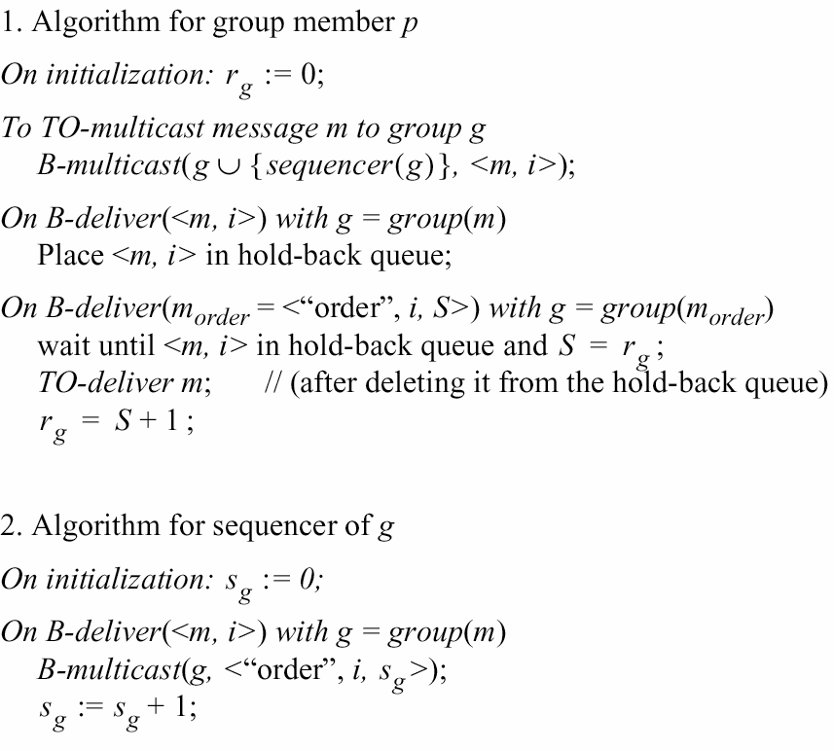
Figure 12.14 Total ordering using a sequencer

Slide 32
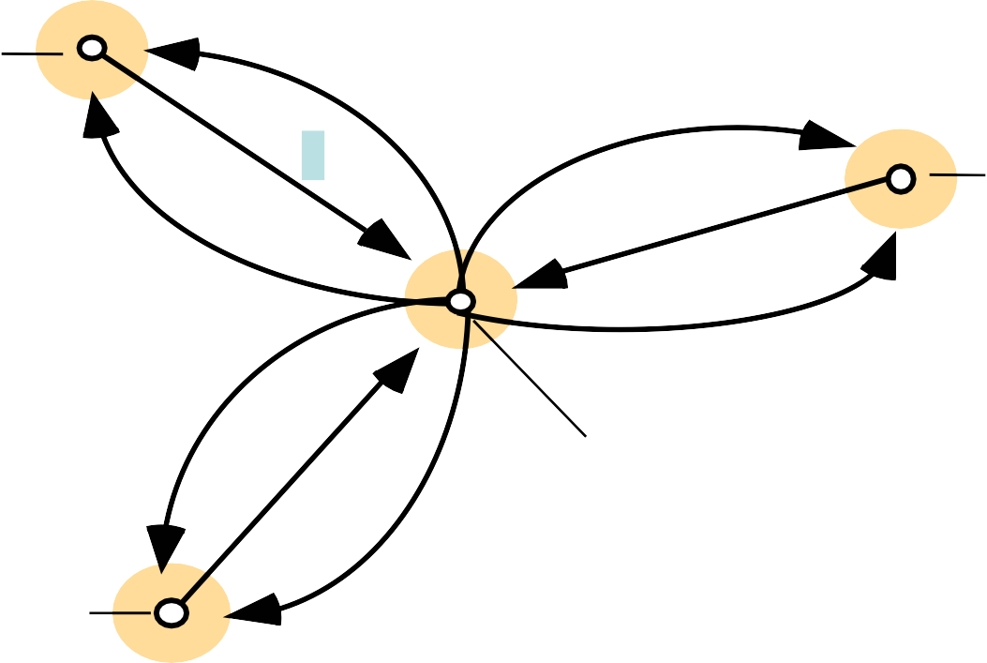
Figure 12.15 The ISIS algorithm for total ordering
P2
Each process q in group g keeps
1 Message
A^{q} : the largest agreed
3
g
sequence number it has
observed so far for the group g
2
P4
2
2 Proposed Sequence
1
3 Agreed Sequence
P^{q} : its own largest proposed
1
g
sequence number
2
P1
3
P3
Algorithm for process p to multicast a message m to group g
p B-multicasts <m, i> to g, where i is a unique identifier for m
Each process q replies to the sender p with a proposal for the message’s agreed sequence number of P^{q} :=Max(A^{q} , P^{q} )+1
g g g
p collects all the proposed sequence numbers and selects the largest one a as the
next agreed sequence number. It then B-multicasts <i, a> to g.
Each process q in g sets A^{q} := Max(A^{q} , a) and attaches a to the message
g g
identified by i
32

Slide 33
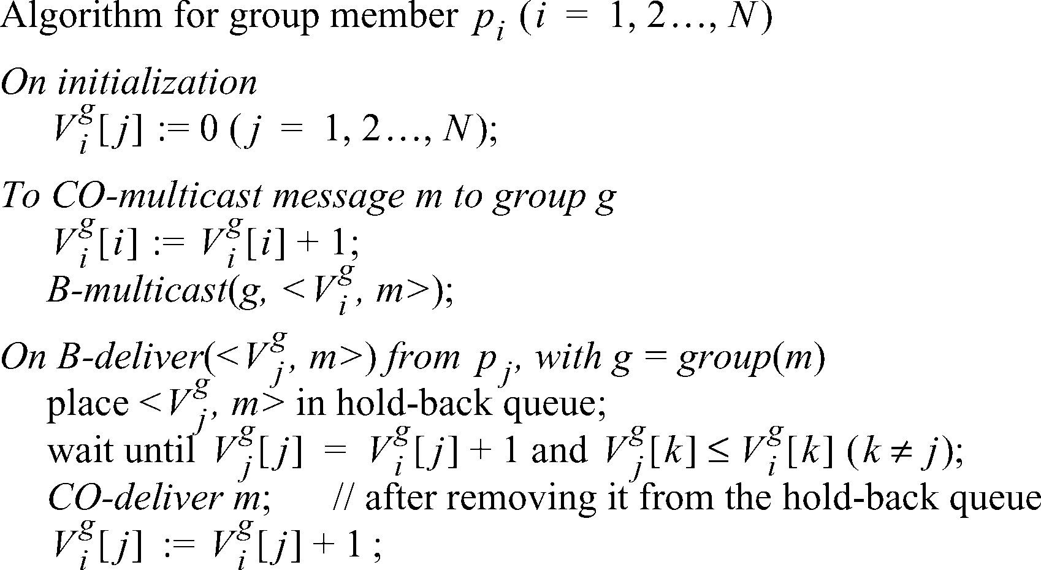
Implementing casual ordering
Causal ordering using vector timestamps (Figure 12.16)
– Only orders multicasts, and ignores one-to-one messages
between
processes
– Each process updates its vector timestamp before delivering a message to maintain the count of precedent messages
Figure 12.16 Causal ordering using vector timestamps

Slide 34
12.5 Consensus and related problems
Problems of agreement
For processes to agree on a value (consensus) after one or more of the processes has proposed what that value should be
Covered topics: byzantine generals, interactive consistency, totally ordered multicast
The byzantine generals problem: a decision whether multiple armies should
attack or retreat, assuming that united action will be more successful than some attacking and some retreating
Another example might be space ship controllers deciding whether to proceed or abort. Failure handling during consensus is a key concern
Assumptions
communication (by message passing) is reliable
processes may fail
Sometimes up to f of the N processes are faulty

Slide 35
Consensus Process
Each process p_{i} begins in an undecided state and proposes a single value v_{i}, drawn from a set D (i=1…N)
Processes communicate with each other, exchanging values
Each process then sets the value of a decision variable d_{i} and enters the decided state
d₁ :=proceed d₂ :=proceed
P₁ P₂
Two processes propose “proceed.” One proposes “abort,” but then crashes. The two remaining processes decide proceed.
v₁ =proceed
v₂=proceed
1
Consensus algorithm
v₃=abort
Figure 12.17 Consensus for three processes
P₃ (crashes)

Slide 36
Requirements for Consensus
Three requirements of a consensus algorithm
Termination: Eventually every correct process sets its decision variable
Agreement: The decision value of all correct processes is the same: if pi and pj are correct and have entered the decided state, then di=dj (i,j=1,2, …, N)
Integrity: If the correct processes all proposed the same value, then any correct process in the decided state has chosen that value

Slide 37
The byzantine generals problem
Problem description
Three or more generals must agree to attack or to retreat
One general, the commander, issues the order
Other generals, the lieutenants, must decide to attack or retreat
One or more generals may be treacherous
A treacherous general tells one general to attack and another to retreat
Difference from consensus is that a single process supplies the value to agree on
Requirements
Termination: eventually each correct process sets its decision variable
Agreement: the decision variable of all correct processes is the same
Integrity: if the commander is correct, then all correct processes agree on the value that the commander has proposed (but the commander need not be correct)

Slide 38
The interactive consistency problem
Interactive consistency: all correct processes agree on a vector of values, one for each process. This is called the decision vector
Another variant of consensus
Requirements
Termination: eventually each correct process sets its decision variable
Agreement: the decision vector of all correct processes is the same
Integrity: if any process is correct, then all correct processes decide the correct value for that process

Slide 39
Relating consensus to other problems
Consensus Consensus
(C), Byzantine Generals (BG), and Interactive (IC) are all problems concerned with making
decisions in the context of arbitrary or crash failures
We can sometimes generate solutions for one problem in terms of another. For example
We can derive IC from BG by running BG N times, once for each process with that process acting as commander
We can derive C from IC by running IC to produce a vector of values at each process, then applying a function to the vector’s values to derive a
single value.
We can derive BG from C by
Commander sends proposed value to itself and each remaining process
All processes run C with received values
They derive BG from the vector of C values

Slide 40
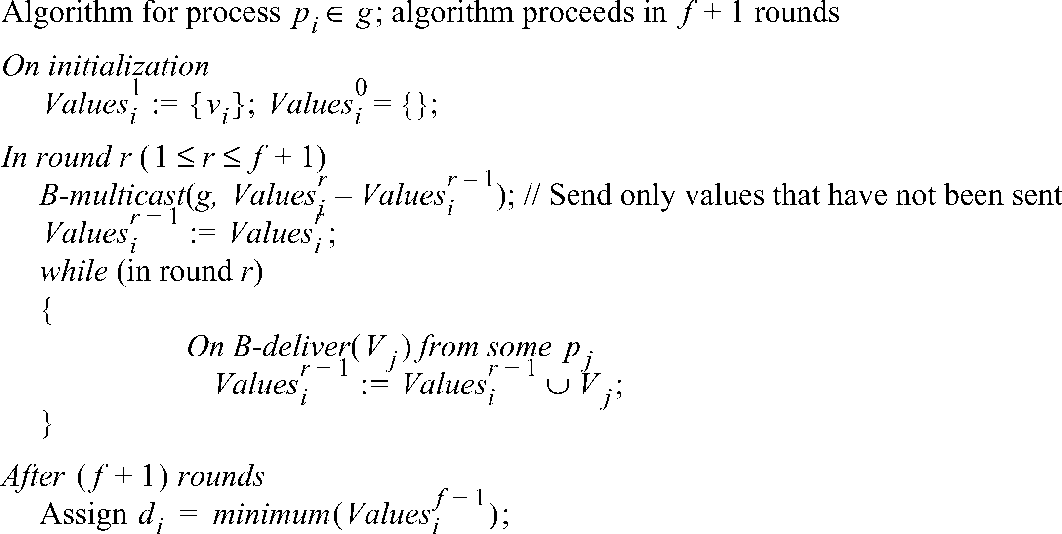
Consensus in a Synchronous System
Up to f processes may have crash failures, all failures occurring during f+1 rounds. During each round, each of the correct processes multicasts the values among themselves
The algorithm guarantees all surviving correct processes are in a position to agree
Note: any process with f failures will require at least f+1 rounds to agree
Figure 12.18 Consensus in a synchronous system

Slide 41
Limits for solutions to Byzantine Generals
Some cases of the Byzantine Generals problems have no solutions
Lamport et al found that if there are only 3 processes, there is no solution
Pease et al found that if the total number of processes is less than three times the number of failures plus one, there is no solution
Thus there is a solution with 4 processes and 1 failure, if there
are two rounds
In the first, the commander sends the values
while in the second, each lieutenant sends the values it received

Slide 42
Figure 12.19 Three Byzantine generals
p₁ (Commander)
p₁ (Commander)
1:v
1:v
1:w
1:x
2:1:v 2:1:w
p₂ p₃ p₂ p₃
3:1:u 3:1:x
Faulty processes are shown coloured

Slide 43

Figure 12.20 Four Byzantine generals
p₁ (Commander)
p₁ (Commander)
1:v
1:v
1:u
2:1:u
1:w
1:v
1:v
2:1:v
p₂
3:1:u
p₃
p₂
3:1:w
p₃
4:1:v 4:1:v
4:1:v 4:1:v
2:1:v
3:1:w
2:1:u
3:1:w
p₄
p₄
Faulty processes are shown coloured

Slide 44
Asynchronous Systems
All solutions to consistency and Byzantine generals problems are limited to synchronous systems
Fischer et
al found that there are no solutions in an
asynchronous system with even one failure
This impossibility is circumvented by masking faults or using
failure detection
There is
also a partial solution, assuming an adversary
process, based on introducing random values in the process to prevent an effective thwarting strategy. This does not always reach consensus

