Slide 1
Unit-IV
Combining and Merging Data Sets
Data Transformation
String Manipulation

Slide 2
Combining and Merging Data Sets
Data contained in pandas objects can be combined together in a number of built-in ways: •
pandas.merge connects rows in DataFrames based on one or more keys. This will be familiar to users of SQL or other relational databases, as it implements database join operations.
pandas.concat glues or stacks together objects along an axis.
combine_first instance method enables splicing together overlapping data to fill in missing values in one object with values from another.

Slide 3
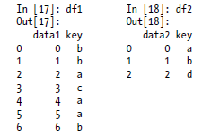
Database-style DataFrame Merges
Merge or join operations combine data sets by linking rows using one or more keys. These operations are central to relational databases. The merge function in pandas is the main entry point for using these algorithms on your data.
Let’s start with a simple example:
df1 = DataFrame({'key': ['b', 'b', 'a', 'c', 'a', 'a', 'b'], ....: 'data1': range(7)})
df2 = DataFrame({'key': ['a', 'b', 'd'],....: 'data2': range(3)})

Slide 4
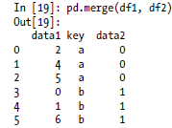
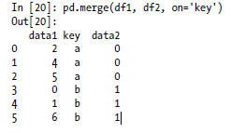
Database-style DataFrame Merges
Note that I didn’t specify which column to join on. If not specified, merge uses the overlapping column names as the keys. It’s a good practice to specify explicitly, though:

Slide 5
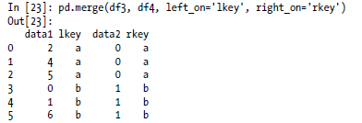
Database-style DataFrame Merges
If the column names are different in each object, you can specify them separately:
df3 = DataFrame({'lkey': ['b', 'b', 'a', 'c', 'a', 'a', 'b'], ....: 'data1': range(7)})
df4 = DataFrame({'rkey': ['a', 'b', 'd'],....: 'data2': range(3)})

Slide 6
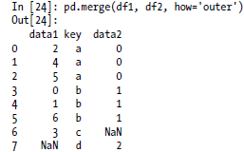
Database-style DataFrame Merges
You probably noticed that the 'c' and 'd' values and associated data are missing from the result.
By default merge does an 'inner' join; the keys in the result are the intersection.
Other possible options are 'left', 'right', and 'outer'.
The outer join takes the union of the keys, combining the effect of applying both left and right joins:

Slide 7
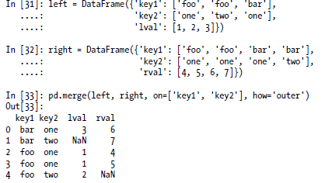
Database-style DataFrame Merges
To merge with multiple keys, pass a list of column names:

Slide 8
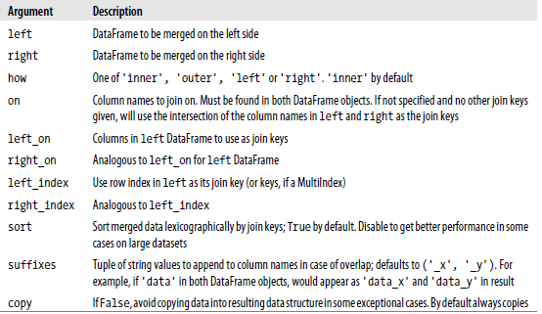
Database-style DataFrame Merges
merge function arguments:

Slide 9
Database-style DataFrame Merges
merge function arguments:

Slide 10
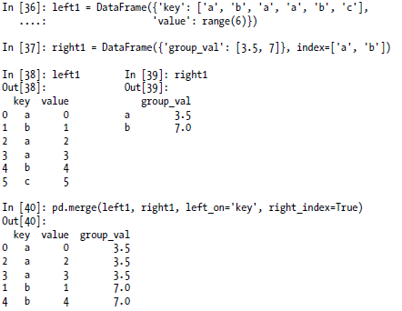
Database-style DataFrame Merges
Merging on Index
In some cases, the merge key or keys in a DataFrame will be found in its index. In this case, you can pass left_index=True or right_index=True (or both) to indicate that the index should be used as the merge key:

Slide 11

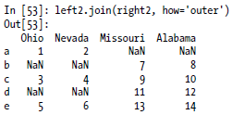
Database-style DataFrame Merges
pandas.join
DataFrame has a more convenient join instance for merging by index. It can also be used to combine together many DataFrame objects having the same or similar indexes but non-overlapping columns.

Slide 12
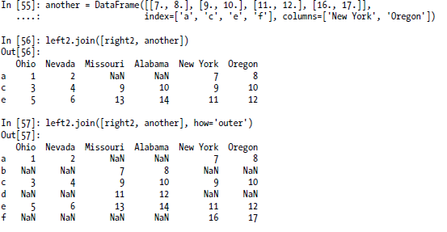
Database-style DataFrame Merges

Slide 13
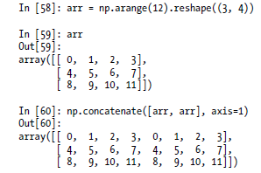
Concatenating Along an Axis
Another kind of data combination operation is alternatively referred to as concatenation, binding, or stacking.
NumPy has a concatenate function for doing this with raw NumPy arrays:

Slide 14
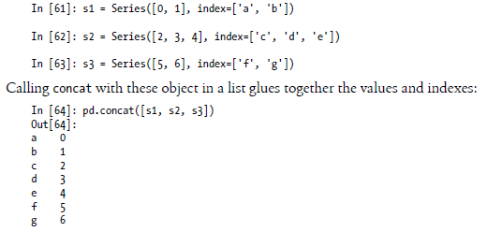
Concatenating Along an Axis
In the context of pandas objects such as Series and DataFrame, having labeled axes enable you to further generalize array concatenation.
The concat function in pandas provides a consistent way to address each of these concerns.
Suppose we have three Series with no index overlap:

Slide 15
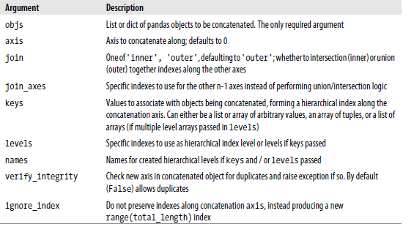
Concatenating Along an Axis
concat function arguments

Slide 16
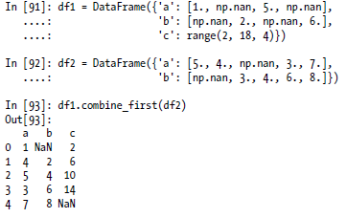
combine_first
With DataFrames, combine_first naturally does the same thing column by column, so you can think of it as “patching” missing data in the calling object with data from the object you pass:

Slide 17
Data Transformation

Slide 18
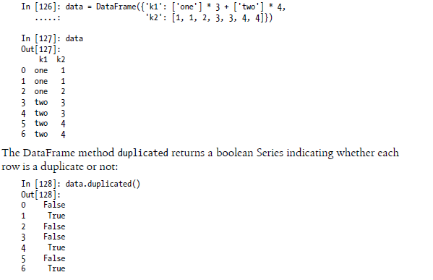
Removing Duplicates
Duplicate rows may be found in a DataFrame for any number of reasons.

Slide 19
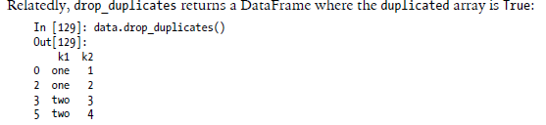
Removing Duplicates

Slide 20
Removing Duplicates

Slide 21
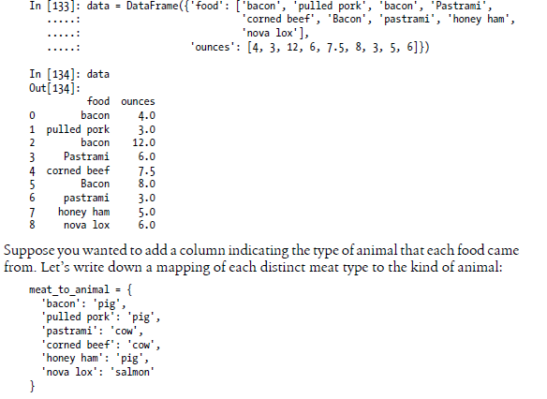
Transforming Data Using a Function or Mapping
For many data sets, you may wish to perform some transformation based on the values in an array, Series, or column in a DataFrame.

Slide 22
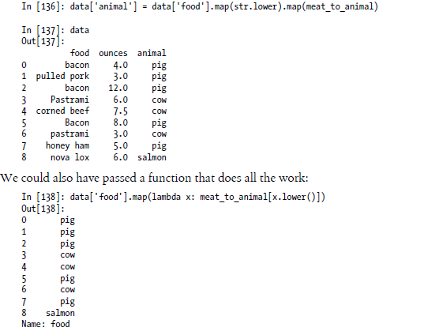
Transforming Data Using a Function or Mapping

Slide 23
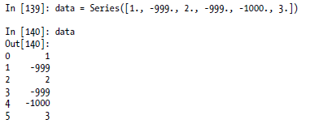
Replacing Values
Filling in missing data with the fillna method can be thought of as a special case of more general value replacement.
While map, as you’ve seen above, can be used to modify a subset of values in an object, replace provides a simpler and more flexible way to do so.

Slide 24
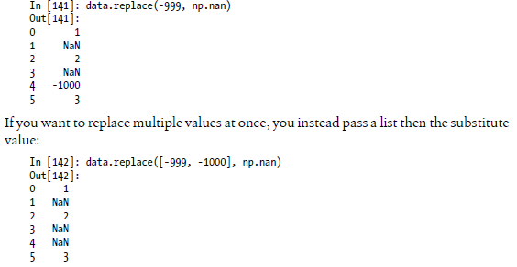
Replacing Values
The -999 values might be sentinel values for missing data. To replace these with NAvalues that pandas understands, we can use replace, producing a new Series:

Slide 25
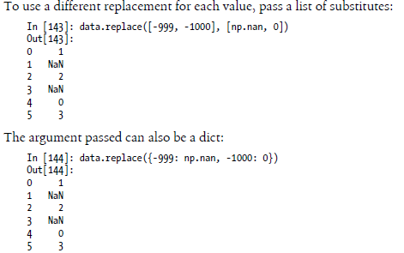
Replacing Values

Slide 26

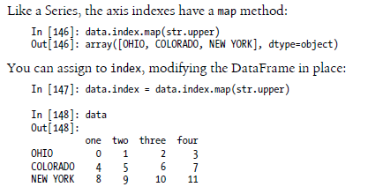
Renaming Axis Indexes
Like values in a Series, axis labels can be similarly transformed by a function or mapping of some form to produce new, differently labeled objects.
The axes can also be modified in place without creating a new data structure.

Slide 27
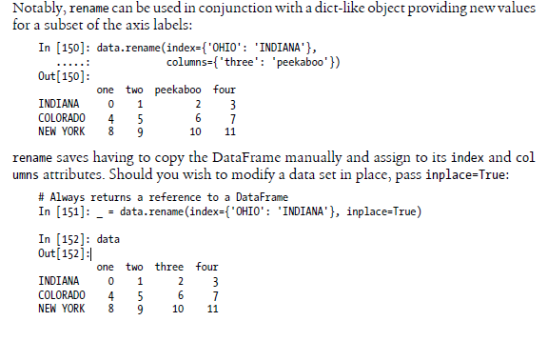
Renaming Axis Indexes

Slide 28
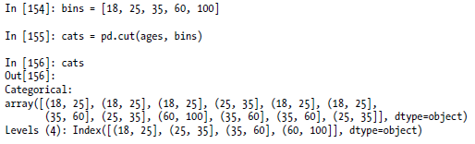
Discretization and Binning
Continuous data is often discretized or other wised separated into “bins” for analysis. Suppose you have data about a group of people in a study, and you want to group them into discrete age buckets:
In [153]: ages = [20, 22, 25, 27, 21, 23, 37, 31, 61, 45, 41, 32]
Let’s divide these into bins of 18 to 25, 26 to 35, 35 to 60, and finally 60 and older. To do so, you have to use cut, a function in pandas:

Slide 29
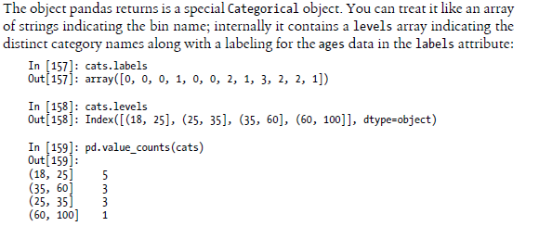
Discretization and Binning

Slide 30
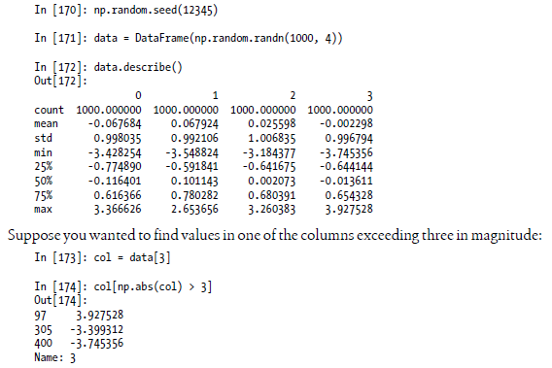
Detecting and Filtering Outliers
Filtering or transforming outliers is largely a matter of applying array operations. Consider a DataFrame with some normally distributed data:

Slide 31
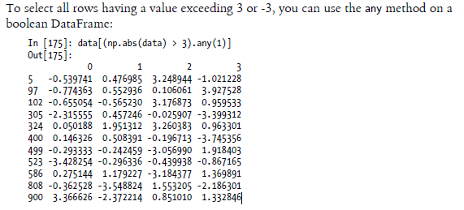
Detecting and Filtering Outliers

Slide 32
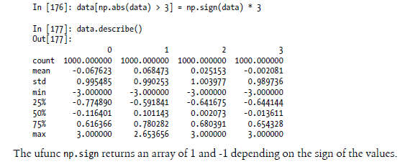
Detecting and Filtering Outliers
Here is code to cap values outside the interval -3 to 3: Data

Slide 33
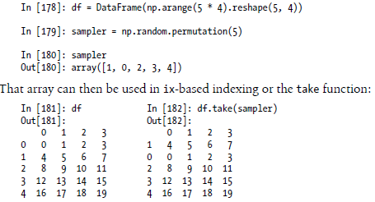
Permutation and Random Sampling
Permuting (randomly reordering) a Series or the rows in a DataFrame is easy to do using the numpy.random.permutation function.
Calling permutation with the length of the axis you want to permute produces an array of integers indicating the new ordering:

Slide 34

Permutation and Random Sampling
To select a random subset without replacement, one way is to slice off the first k elements of the array returned by permutation, where k is the desired subset size.
There are much more efficient sampling-without-replacement algorithms, but this is an easy strategy that uses readily available tools:

Slide 35
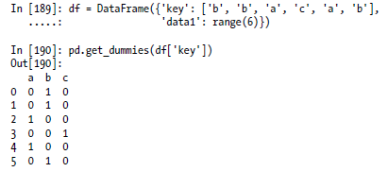
Computing Indicator/Dummy Variables
Another type of transformation for statistical modeling or machine learning applicationsis converting a categorical variable into a “dummy” or “indicator” matrix.
If a column in a DataFrame has k distinct values, you would derive a matrix or DataFrame containing k columns containing all 1’s and 0’s. pandas has a get_dummies function for doing this, though devising one yourself is not difficult.
Let’s return to an earlier example DataFrame:

Slide 36
String Manipulation

Slide 37
String Manipulation
Python has long been a popular data munging language in part due to its ease-of-use for string and text processing.
Most text operations are made simple with the string object’s built-in methods.
For more complex pattern matching and text manipulations,regular expressions may be needed.
pandas adds to the mix by enabling you to apply string and regular expressions concisely on whole arrays of data, additionally handling the annoyance of missing data

Slide 38
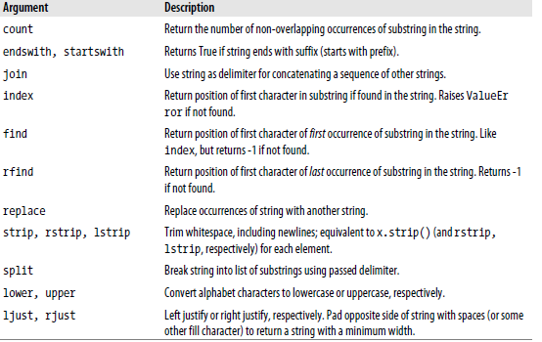
String Object Methods

Slide 39
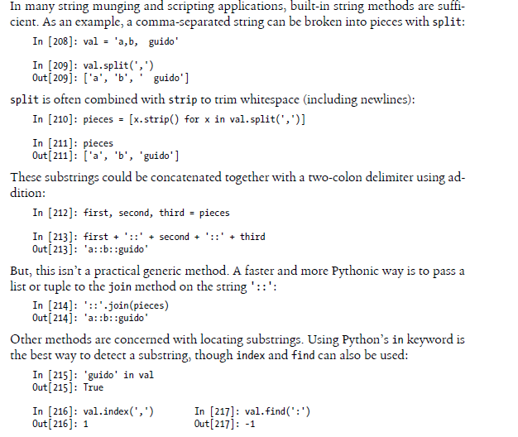
String Object Methods

Slide 40
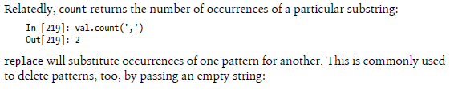

String Object Methods

Slide 41
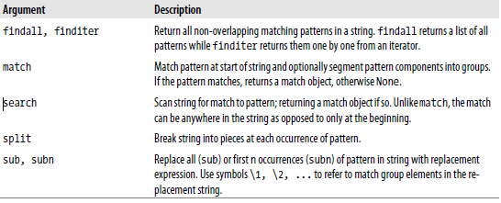
Regular expressions
Regular expressions provide a flexible way to search or match string patterns in text.
A single expression, commonly called a regex, is a string formed according to the regular expression language.
Python’s built-in re module is responsible for applying regular expressions to strings

Slide 42
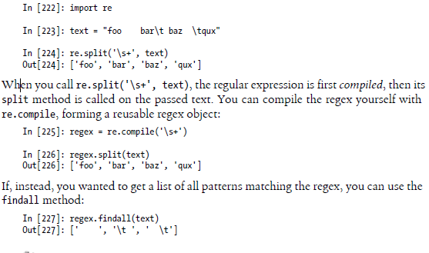
Regular expressions

Slide 43
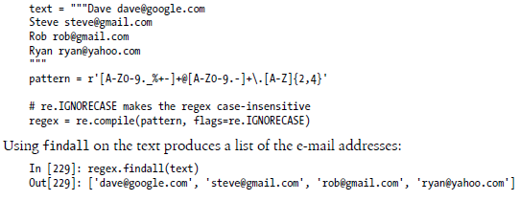
Regular expressions

Slide 44
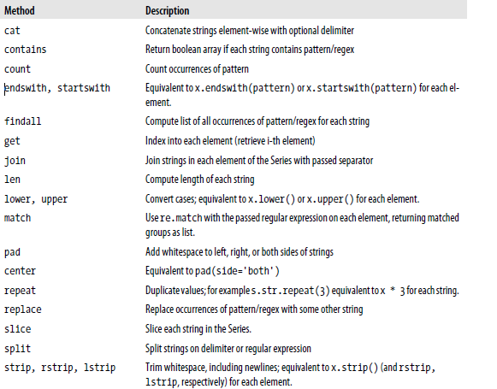
Vectorized string functions in pandas

Slide 45
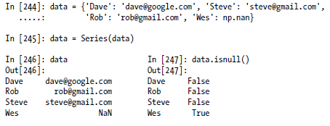
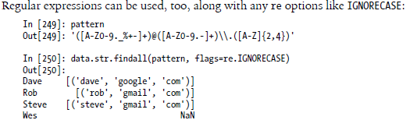
Vectorized string functions in pandas

Slide 46
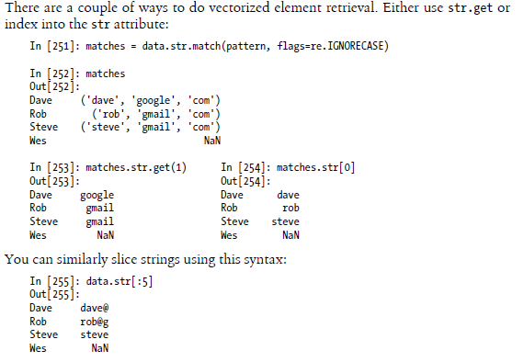
Vectorized string functions in pandas

