Slide 1
All the power is with in you, you can do any thing and every thing with what you have believe in that.
Swami Vivekananda

Slide 2
Data Science Using Python
By
Ch Venkata RamiReddy, M.Tech,(Ph.D.)

Slide 3
Data Science
Data science is the process of deriving knowledge and insights from a huge and diverse set of data through organizing, processing and analyzing the data.
Data Science is the science which uses computer science, statistics and machine learning, visualization and human-computer interactions to collect, clean, integrate, analyze, visualize the data to create data products.

Slide 4
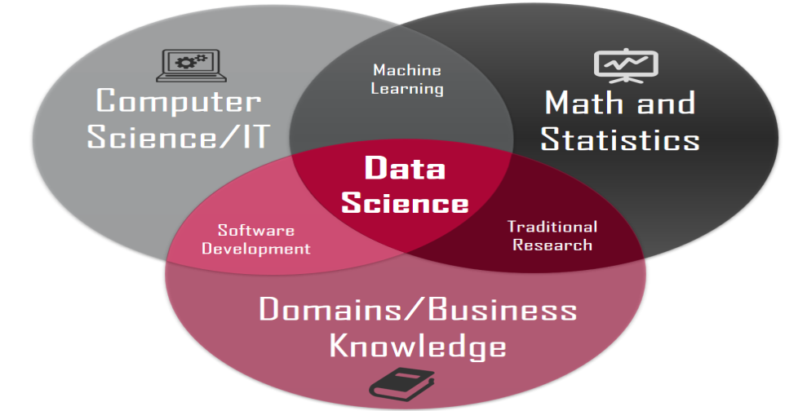
Data Science
It involves many different disciplines like mathematical and statistical modeling, extracting data from source and applying data visualization techniques.

Slide 5
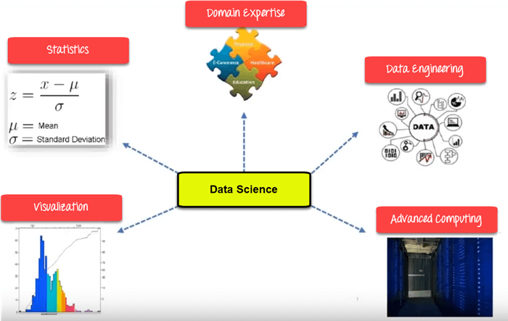
Data Science Components

Slide 6
Data Science Components
Statistics:
Statistics is the most critical unit in Data science.
It is the method or science of collecting and analyzing numerical data in large quantities to get useful insights.
Visualization:
Visualization technique helps you to access huge amounts of data in easy to understand and digestible visuals.
Machine Learning:
Machine Learning explores the building and study of algorithms which learn to make predictions about future data.

Slide 7
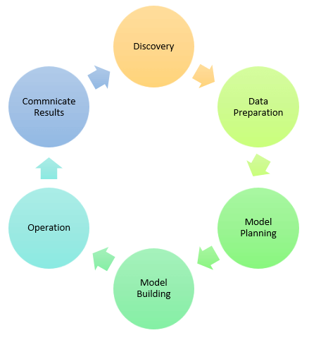
Data Science Process

Slide 8
Data Science Process
1.Discovery:
Discovery step involves acquiring data from all the identified internal & external sources which helps you to answer the business question.
The data can be:
Logs from webservers
Data gathered from social media
Census datasets
Data streamed from online sources using APIs
2.Data Preparation:
Data can have lots of inconsistencies like missing value, blank columns, incorrect data format which needs to be cleaned.
The cleaner your data, the better are your predictions.

Slide 9
Data Science Process
3.Model Planning:
In this stage, you need to determine the method and technique to draw the relation between input variables.
Planning for a model is performed by using different statistical formulas and visualization tools.
4. Model Building:
In this step, the actual model building process starts.
Here, Data scientist distributes datasets for training and testing.
Techniques like association, classification, and clustering are applied to the training data set.
The model once prepared is tested against the "testing" dataset.

Slide 10
Data Science Process
5. Operation:
In this stage, you deliver the final base lined model with reports, code, and technical documents.
Model is deployed into a real-time production environment after thorough testing.
6. Communicate Results
In this stage, the key findings are communicated to all stakeholders.
This helps you to decide if the results of the project are a success or a failure based on the inputs from the model.

Slide 11
Applications of Data science
Internet Search:
Google search use Data science technology to search a specific result within a fraction of a second
Recommendation Systems:
To create a recommendation system. Example, "suggested friends" on Facebook or suggested videos" on YouTube, everything is done with the help of Data Science.
Image & Speech Recognition:
Speech recognizes system like Siri, Google assistant, Alexa runs on the technique of Data science.
Moreover, Facebook recognizes your friend when you upload a photo with them, with the help of Data Science.

Slide 12
Applications of Data science
Gaming world:
EA Sports, Sony, Nintendo, are using Data science technology. This enhances your gaming experience.
Games are now developed using Machine Learning technique.
Online Price Comparison:
PriceRunner, Junglee, Shopzilla work on the Data science mechanism.
Here, data is fetched from the relevant websites using APIs.
Financial Risk management
The financial risk involving loans and credits are better analyzed by using the customers past spend habits, past defaults, other financial commitments and many socio-economic indicators.

Slide 13
Data Science Jobs Roles
Most prominent Data Scientist job titles are:
Data Scientist
Data Engineer
Data Analyst
Statistician
Data Architect
Data Admin
Business Analyst
Data/Analytics Manager

Slide 14
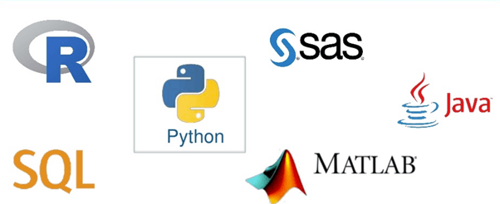
Tools for Data Science

Slide 15
Why Learn Python For Data Science?
Python is no-doubt the best-suited language for a Data Scientist.
Few points which will help you understand why people go with Python for Data Science:
Python is a free, flexible and powerful open source language
Python cuts development time in half with its simple and easy to read syntax
With Python, you can perform data manipulation, analysis, and visualization
Python provides powerful libraries for Machine learning applications and other scientific computations

Slide 16
Why Learn Python For Data Science?
Python was created by Guido Van Rossum in 1989.
It is an interpreted language with dynamic semantics.
It is free to access and run on all platforms.
Python is:
1) Object Oriented 2) High-Level Language 3) Easy to Learn 4) Procedure Oriented

Slide 17
Python Libraries for Data Science
Many popular Python toolboxes/libraries:
NumPy
SciPy
Pandas
SciKit-Learn
Visualization libraries
matplotlib
Seaborn
and many more …

Slide 18
Python Libraries for Data Science
NumPy:
introduces objects for multidimensional arrays and matrices, as well as functions that allow to easily perform advanced mathematical and statistical operations on those objects
provides vectorization of mathematical operations on arrays and matrices which significantly improves the performance
many other python libraries are built on NumPy
Link: http://www.numpy.org/

Slide 19
Python Libraries for Data Science
SciPy:
collection of algorithms for linear algebra, differential equations, numerical integration, optimization, statistics and more
part of SciPy Stack
built on NumPy
Link: https://www.scipy.org/scipylib/

Slide 20
Python Libraries for Data Science
Pandas:
adds data structures and tools designed to work with table-like data (similar to Series and Data Frames in R)
provides tools for data manipulation: reshaping, merging, sorting, slicing, aggregation etc.
allows handling missing data
Link: http://pandas.pydata.org/

Slide 21
Python Libraries for Data Science
SciKit-Learn:
provides machine learning algorithms: classification, regression, clustering, model validation etc.
built on NumPy, SciPy and matplotlib
Link: http://scikit-learn.org/

Slide 22
Python Libraries for Data Science
matplotlib:
python 2D plotting library which produces publication quality figures in a variety of hardcopy formats
a set of functionalities similar to those of MATLAB
line plots, scatter plots, barcharts, histograms, pie charts etc.
relatively low-level; some effort needed to create advanced visualization
Link: https://matplotlib.org/

Slide 23
Python Libraries for Data Science
Seaborn:
based on matplotlib
provides high level interface for drawing attractive statistical graphics
Similar (in style) to the popular ggplot2 library in R
Link: https://seaborn.pydata.org/

