Slide 1
Indexes
Indexes are data structures designed to make search faster
Text search has unique requirements, which leads to unique data structures
Most common data structure is inverted index
general name for a class of structures
“inverted” because documents are associated with words, rather than words with documents
similar to a concordance

Slide 2
Indexes and Ranking
Indexes are designed to support search
faster response time, supports updates
Text search engines use a particular form of search: ranking
documents are retrieved in sorted order according to a score computing using the document representation, the query, and a ranking algorithm
What is a reasonable abstract model for ranking?
enables discussion of indexes without details of retrieval model

Slide 3
Abstract Model of Ranking

Slide 4
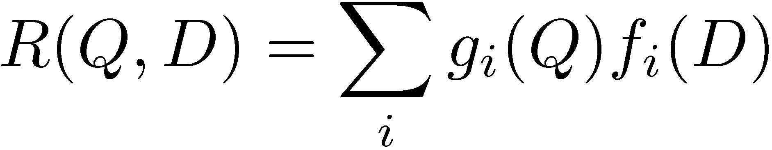
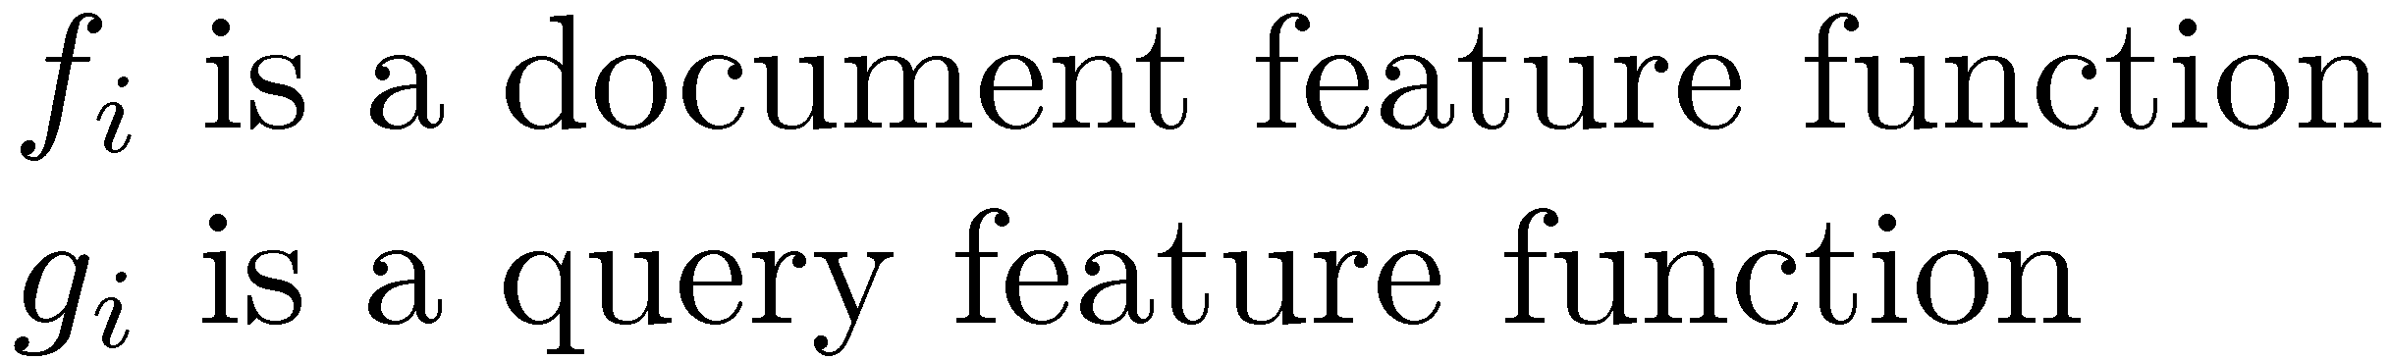
More Concrete Model

Slide 5
Inverted Index
Each index term is associated with an inverted list
Contains lists of documents, or lists of word occurrences in documents, and other information
Each entry is called a posting
The part of the posting that refers to a specific document or location is called a pointer
Each document in the collection is given a unique number
Lists are usually document-ordered (sorted by document number)

Slide 6
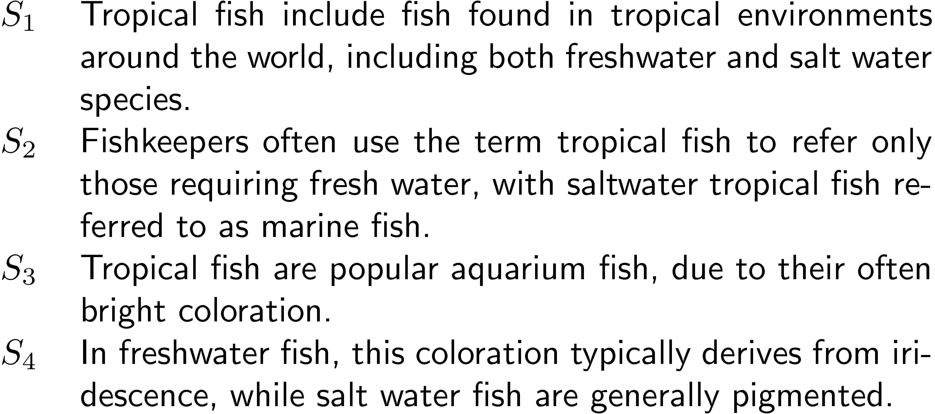
Example “Collection”

Slide 7
Simple Inverted Index

Slide 8
Inverted Index
with counts
supports better ranking algorithms

Slide 9
Inverted Index
with positions
supports
proximity matches

Slide 10
Proximity Matches
Matching phrases or words within a window
e.g., "tropical fish", or “find tropical within 5 words of fish”
Word positions in inverted lists make these types of query features efficient
e.g.,

Slide 11
Fields and Extents
Document structure is useful in search
field restrictions
e.g., date, from:, etc.
some fields more important
e.g., title
Options:
separate inverted lists for each field type
add information about fields to postings
use extent lists

Slide 12
Extent Lists
An extent is a contiguous region of a document
represent extents using word positions
inverted list records all extents for a given field type
e.g.,
extent list

Slide 13
Other Issues
Pre computed scores in inverted list
e.g., list for “fish” [(1:3.6), (3:2.2)], where 3.6 is total feature value for document 1
improves speed but reduces flexibility
Score-ordered lists
query processing engine can focus only on the top part of each inverted list, where the highest-scoring documents are recorded
very efficient for single-word queries

Slide 14
Compression
Inverted lists are very large
e.g., 25-50% of collection for TREC collections using Indri search engine
Much higher if n-grams are indexed
Compression of indexes saves disk and/or memory space
Typically have to decompress lists to use them
Best compression techniques have good compression ratios and are easy to decompress
Lossless compression – no information lost

Slide 15
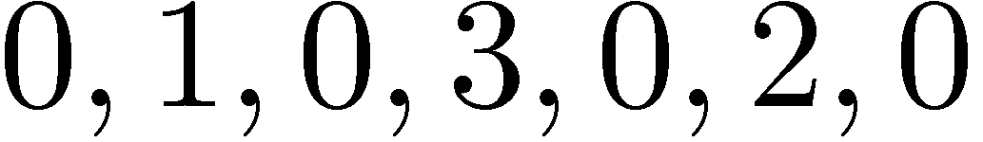

Compression
Basic idea: Common data elements use short codes while uncommon data elements use longer codes
Example: coding numbers
number sequence:
possible encoding:
encode 0 using a single 0:
only 10 bits, but...

Slide 16

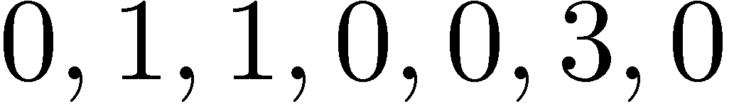
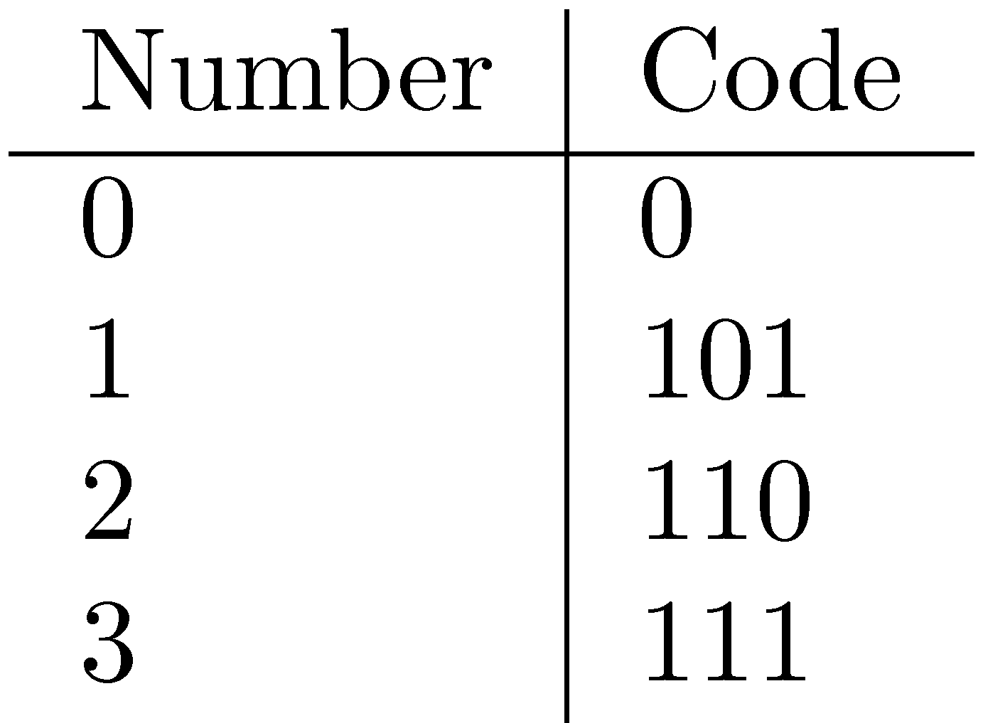
Compression Example
Ambiguous encoding – not clear how to decode
another decoding:
which represents:
use unambiguous code:
which gives:

Slide 17
Delta Encoding
Word count data is good candidate for compression
many small numbers and few larger numbers
encode small numbers with small codes
Document numbers are less predictable
but differences between numbers in an ordered list are smaller and more predictable
Delta encoding:
encoding differences between document numbers (d-gaps)

Slide 18
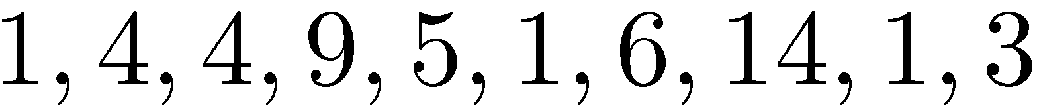
Delta Encoding
Inverted list (without counts)
Differences between adjacent numbers
Differences for a high-frequency word are easier to compress, e.g.,
Differences for a low-frequency word are large, e.g.,

Slide 19
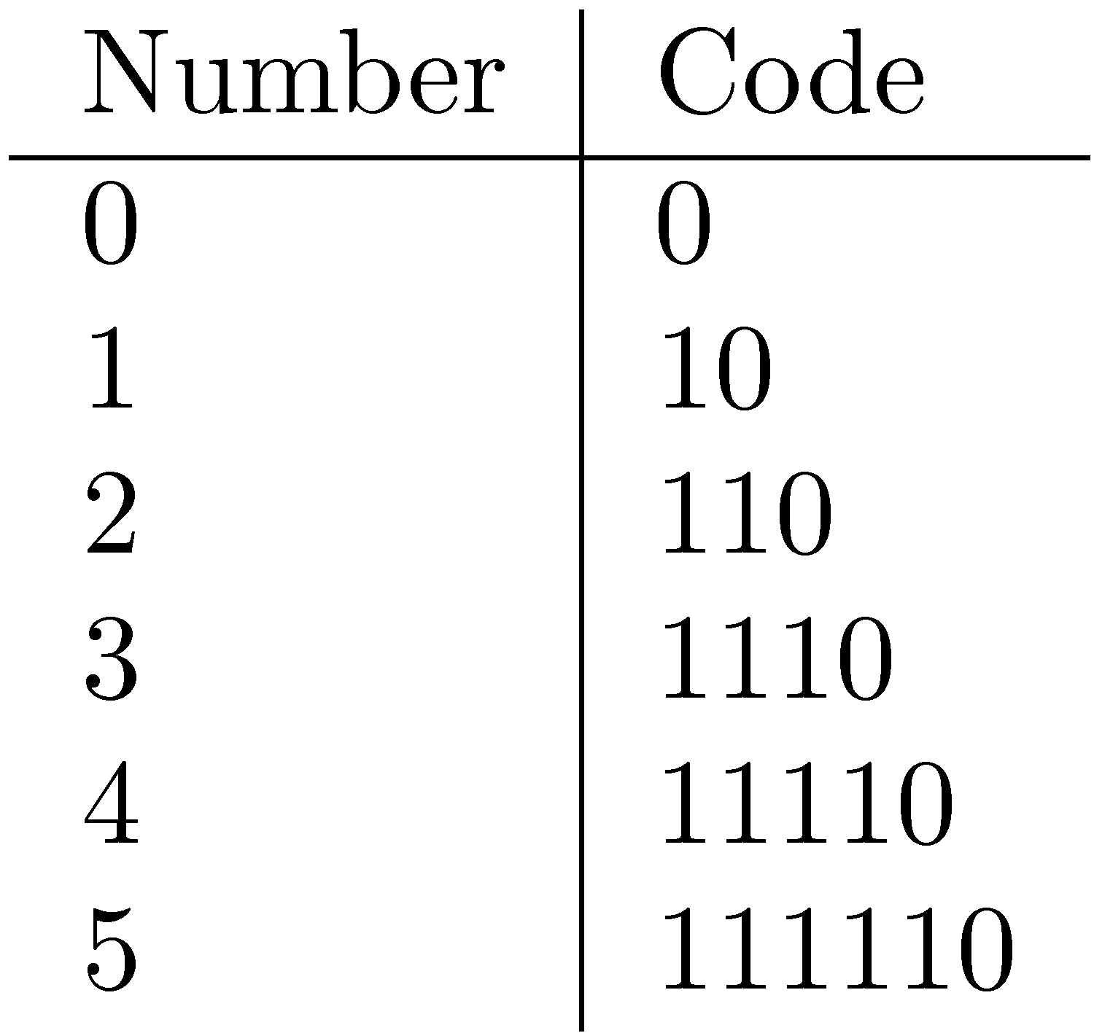
Bit-Aligned Codes
Breaks between encoded numbers can occur after any bit position
Unary code
Encode k by k 1s followed by 0
0 at end makes code unambiguous

Slide 20
Unary and Binary Codes
Unary is very efficient for small numbers such as 0 and 1, but quickly becomes very expensive
1023 can be represented in 10 binary bits, but requires 1024 bits in unary
Binary is more efficient for large numbers, but it may be ambiguous

Slide 21
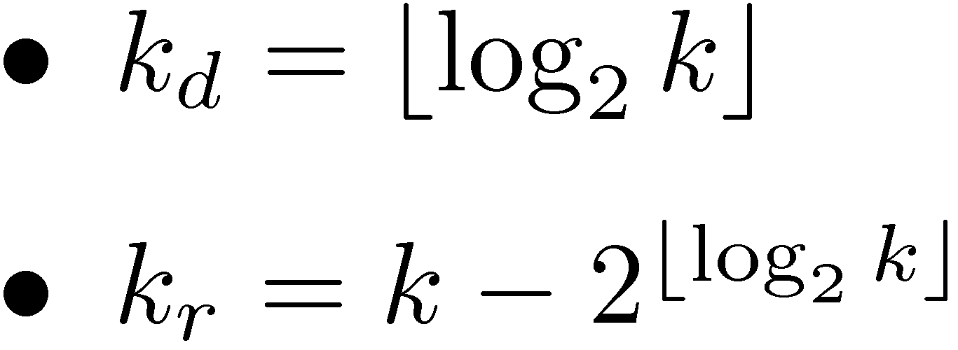
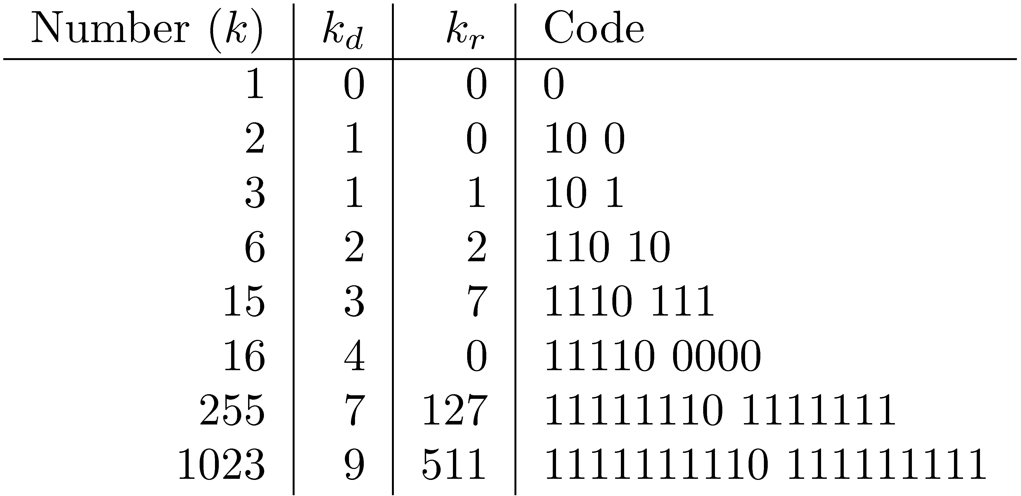
Elias-γ Code
To encode a number k, compute
k_{d} is number of binary digits, encoded in unary

Slide 22
Elias-δ Code
Elias-γ code uses no more bits than unary, many fewer for k > 2
1023 takes 19 bits instead of 1024 bits using unary
In general, takes 2⌊log₂k⌋+1 bits
To improve coding of large numbers, use Elias-δ code
Instead of encoding k_{d} in unary, we encode k_{d} + 1 using Elias-γ
Takes approximately 2 log₂ log₂ k + log₂ k bits

Slide 23
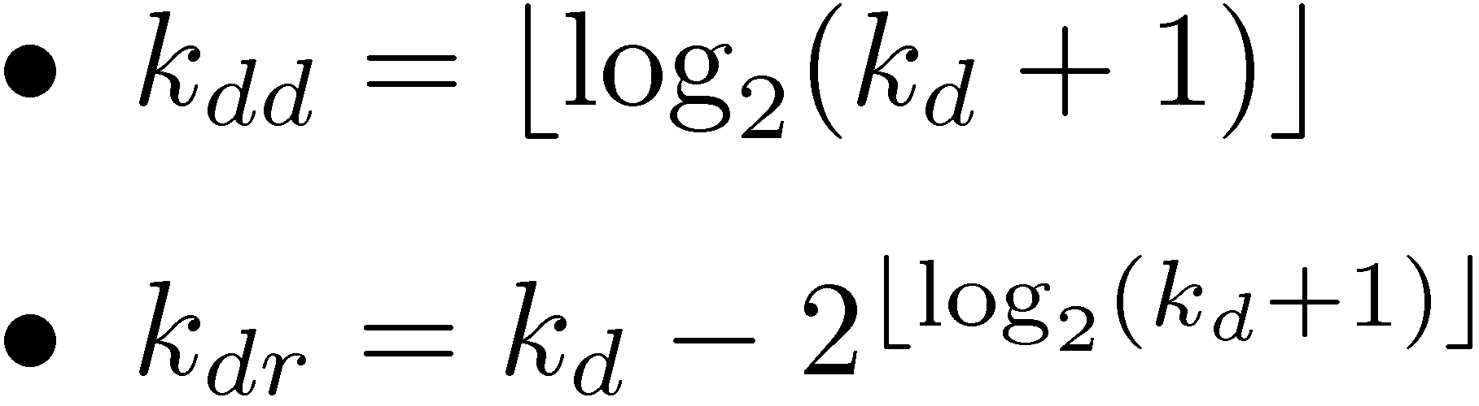
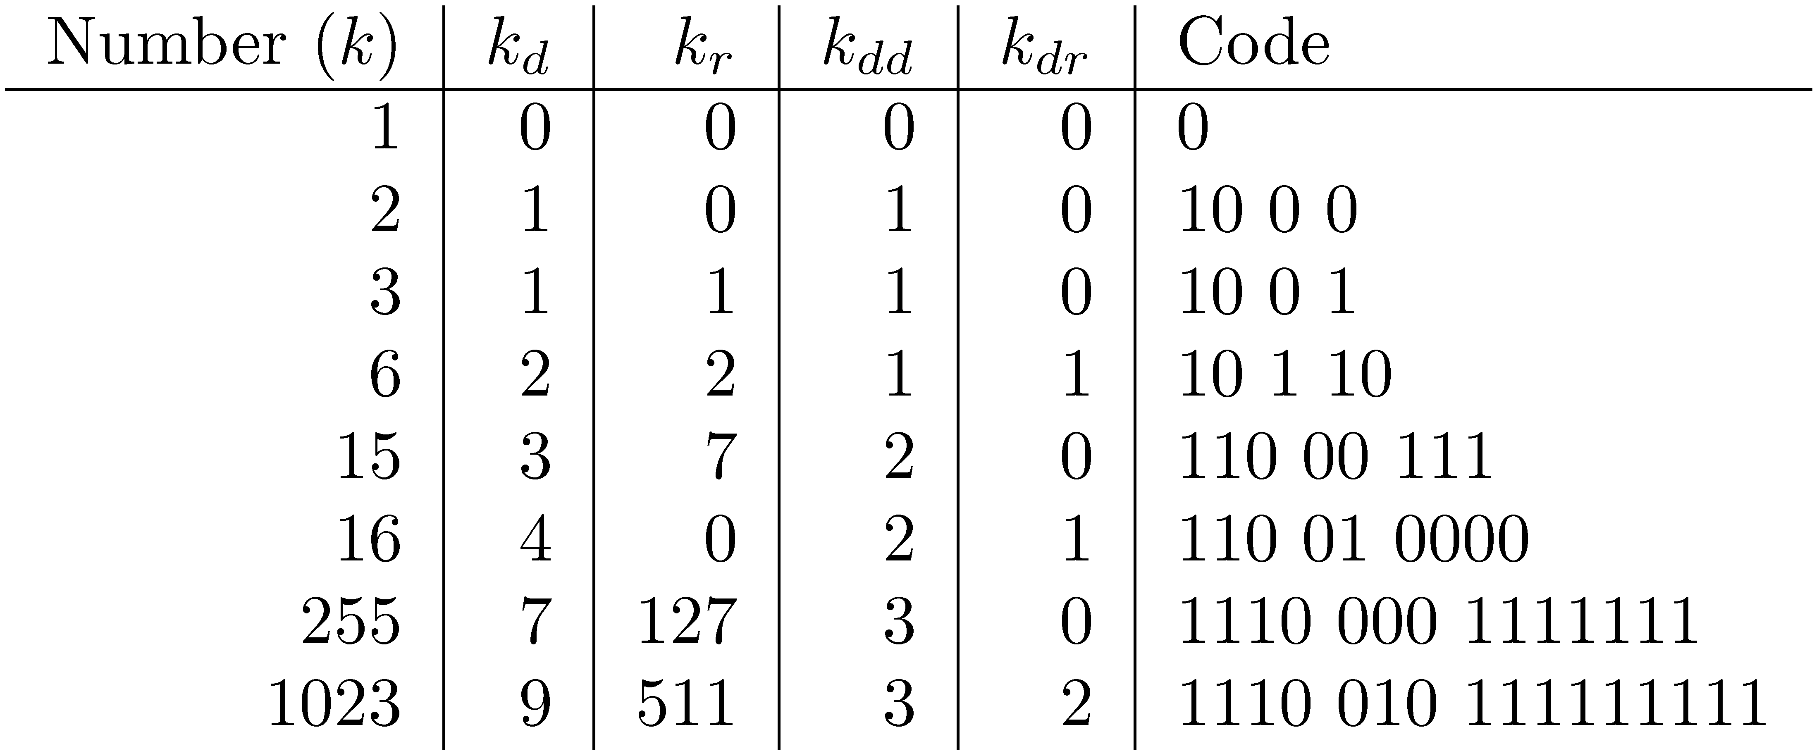
Elias-δ Code
Split k_{d} into:
encode k_{dd} in unary, k_{dr} in binary, and k_{r} in binary

Slide 24
Byte-Aligned Codes
Variable-length bit encodings can be a problem on processors that process bytes
v-byte is a popular byte-aligned code
Similar to Unicode UTF-8
Shortest v-byte code is 1 byte
Numbers are 1 to 4 bytes, with high bit 1 in the last byte, 0 otherwise

Slide 25
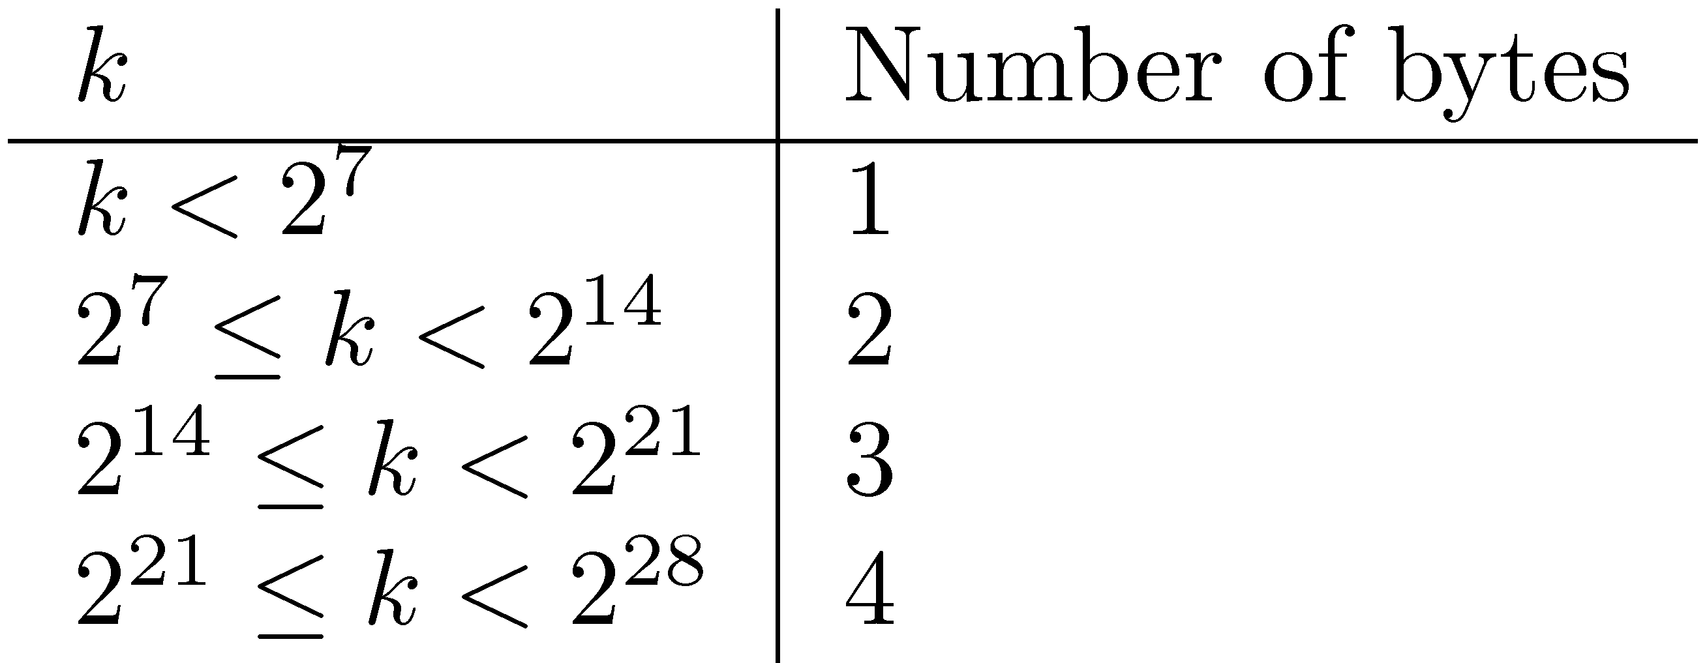
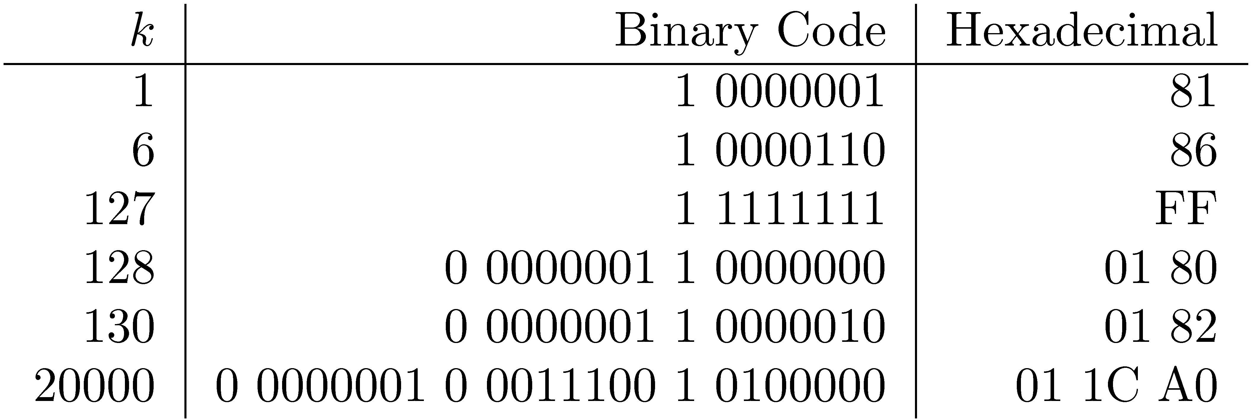
V-Byte Encoding

Slide 26
Compression Example
Consider invert list with positions:
Delta encode document numbers and positions:
Compress using v-byte:

Slide 27
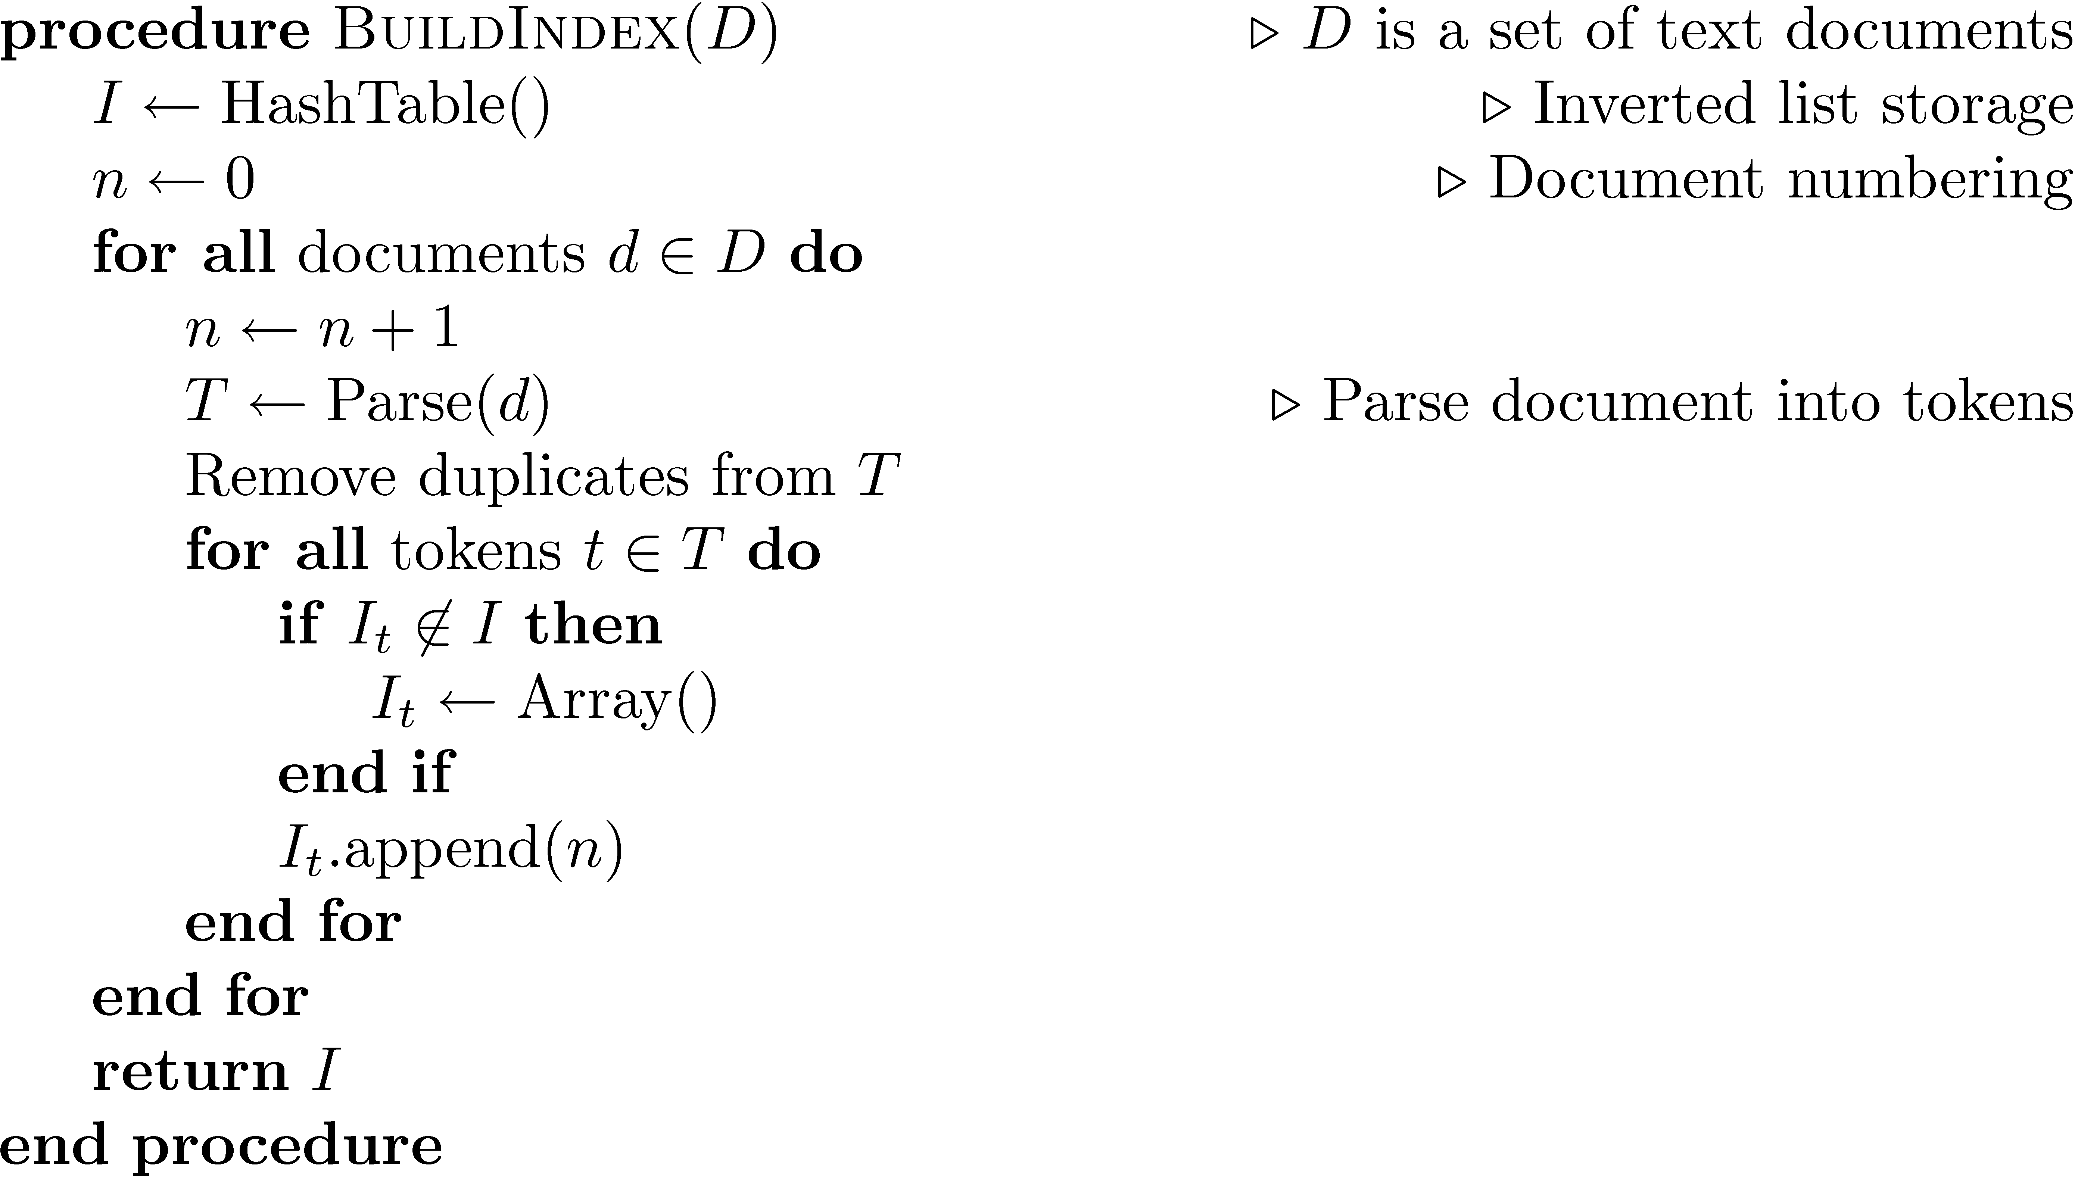
Index Construction
Simple in-memory indexer

Slide 28
Merging
Merging addresses limited memory problem
Build the inverted list structure until memory runs out
Then write the partial index to disk, start making a new one
At the end of this process, the disk is filled with many partial indexes, which are merged
Partial lists must be designed so they can be merged in small pieces
e.g., storing in alphabetical order

Slide 29
Merging

Slide 30
Distributed Indexing
Distributed processing driven by need to index and analyze huge amounts of data (i.e., the Web)
Large numbers of inexpensive servers used rather than larger, more expensive machines
MapReduce is a distributed programming tool designed for indexing and analysis tasks

Slide 31
Example
Given a large text file that contains data about credit card transactions
Each line of the file contains a credit card number and an amount of money
Determine the number of unique credit card numbers
Could use hash table – memory problems
counting is simple with sorted file
Similar with distributed approach
sorting and placement are crucial

Slide 32
MapReduce
Distributed programming framework that focuses on data placement and distribution
Mapper
Generally, transforms a list of items into another list of items of the same length
Reducer
Transforms a list of items into a single item
Definitions not so strict in terms of number of outputs
Many mapper and reducer tasks on a cluster of machines

Slide 33
MapReduce
Basic process
Map stage which transforms data records into pairs, each with a key and a value
Shuffle uses a hash function so that all pairs with the same key end up next to each other and on the same machine
Reduce stage processes records in batches, where all pairs with the same key are processed at the same time
Idempotence of Mapper and Reducer provides fault tolerance
multiple operations on same input gives same output

Slide 34
MapReduce

Slide 35
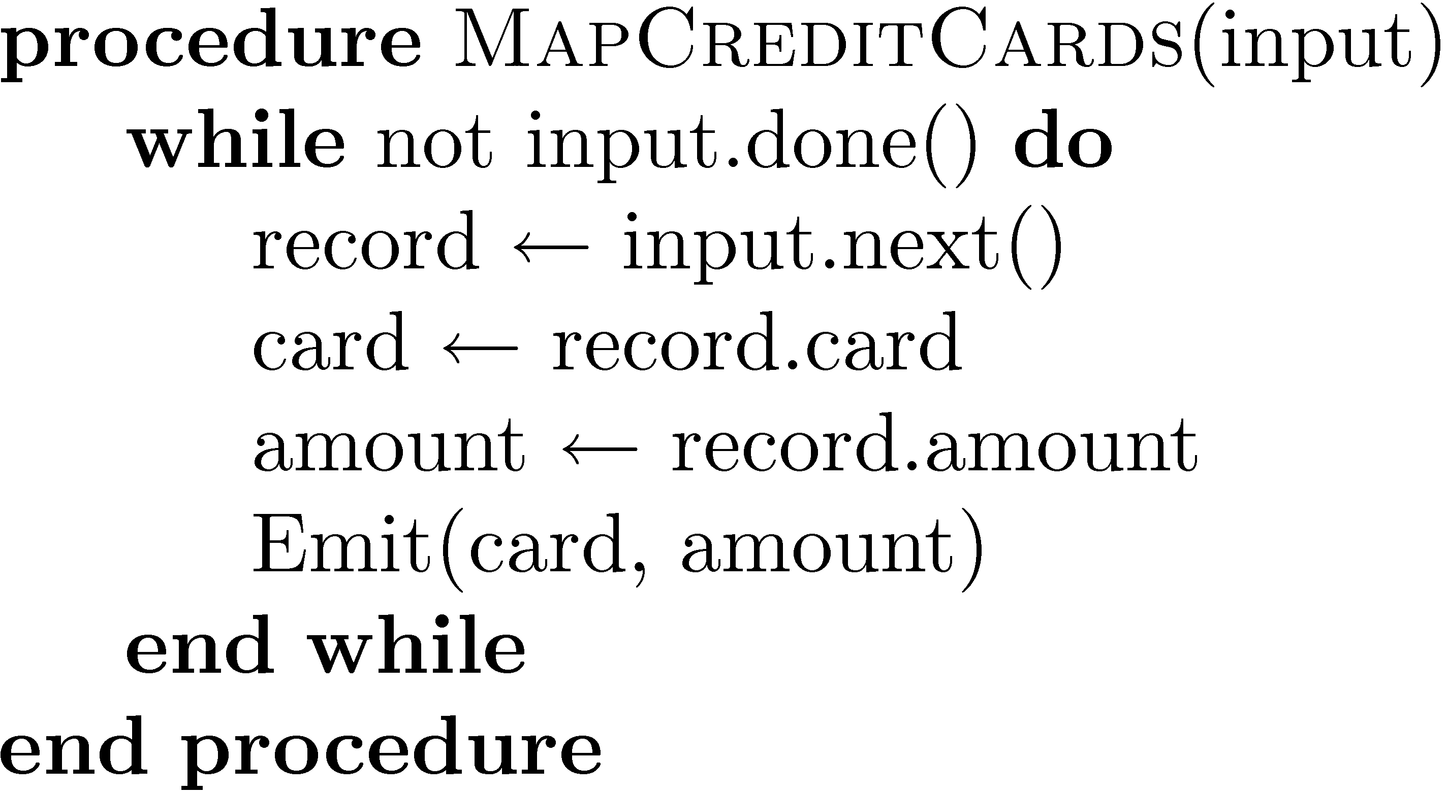
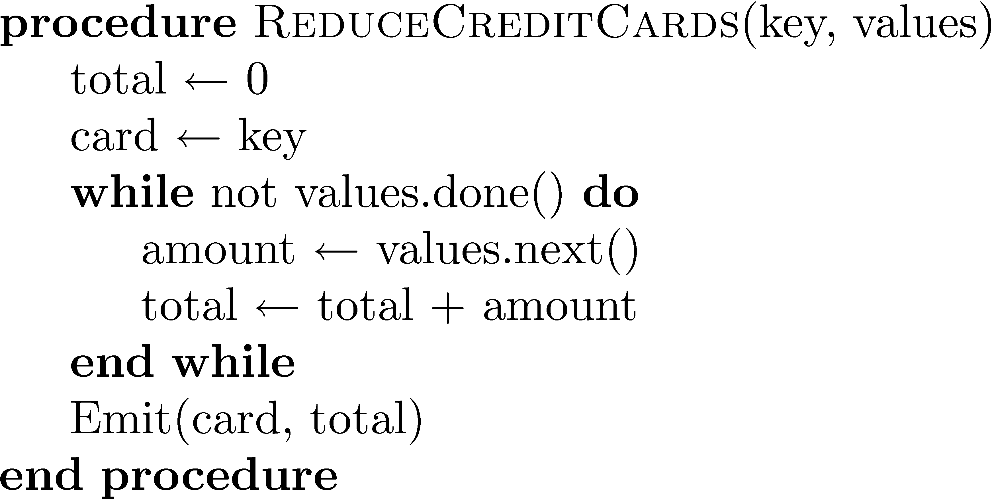
Example

Slide 36
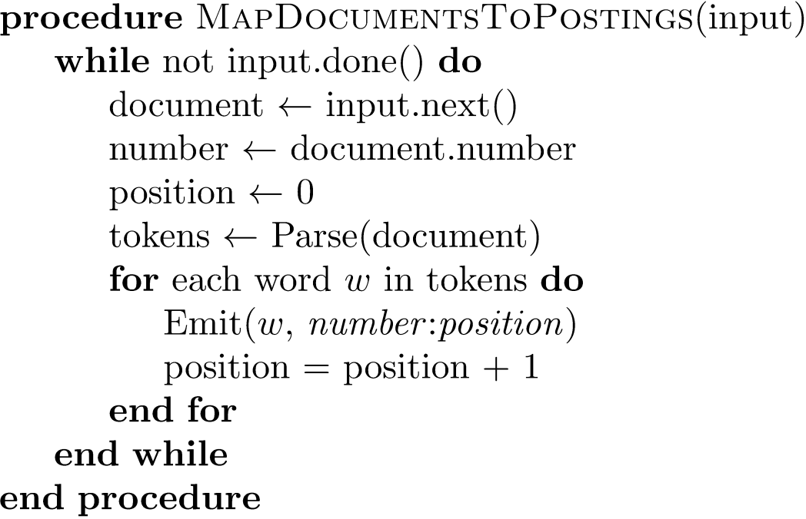
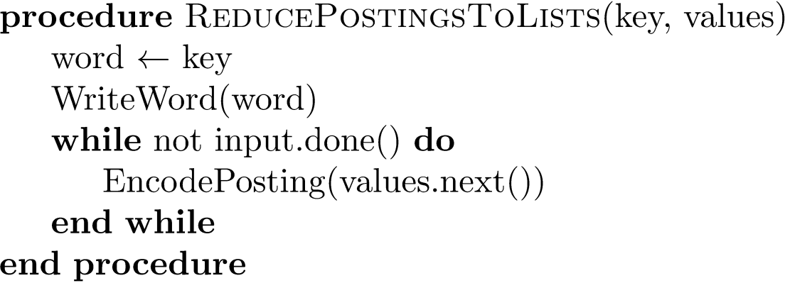
Indexing Example

Slide 37
Result Merging
Index merging is a good strategy for handling updates when they come in large batches
For small updates this is very inefficient
instead, create separate index for new documents, merge results from both searches
could be in-memory, fast to update and search
Deletions handled using delete list
Modifications done by putting old version on delete list, adding new version to new documents index

