Slide 1
UNIT-III Categories of Wireless Networks

Slide 2
Wireless LAN

Slide 3
Wireless LAN
Advantages
Flexibility
Planning
Design
Robustness
Cost
Disadvantages
Quality of service
Proprietary solutions
Restrictions
Safety and Security

Slide 4
Wireless LAN (Contd…)
Design Goals
Global Operation
Low Power
License free operation
Robust transmission technology
Simplified spontaneous cooperation
Easy to Use
Protection of Investment
Safety and Security
Transparency for Applications

Slide 5
Infrared Vs Radio LANs

Slide 6
Transmission Technologies for WLAN
Infrared Transmission
Radio Transmission

Slide 7
1. Infrared Transmission
Advantages
Simple
Cheap sender and receiver
Integrated into all mobile devices
No licenses are needed for infrared technology
Shielding is very simple
Electrical devices do not interfere with infrared transmission
Disadvantages
Low Bandwidth
Easily shielded
Cannot penetrate walls or other obstacles
For good transmission quality & high data rates, LOS is needed

Slide 8
2. Radio Transmission
Advantages
Cover larger area
Can penetrate walls, furniture, plants
More coverage can be gained by reflection
Does not need LOS if frequencies are too high
Offer higher transmission rates
Disadvantages
Shielding is not simple
Can interfere with other devices & destroy data transmitted
Radio transmission is permitted in certain frequency

Slide 9
Types of Wireless Networks
Infrastructure-based Wireless Networks
Ad-hoc Wireless Networks

Slide 10
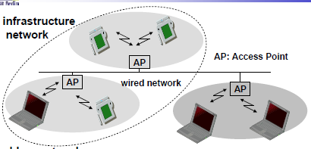
1. Infrastructure based Wireless Networks
Example: Cellular Phone Network

Slide 11
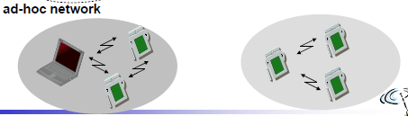
2. Ad-hoc Wireless Networks
Example: Bluetooth

Slide 12
IEEE 802.11

Slide 13
IEEE 802.11
Simple and robust WLAN which offers time bounded & asynchronous services
System architecture
Infrastructure based IEEE 802.11
IEEE 802.11 Ad-hoc WLAN

Slide 14
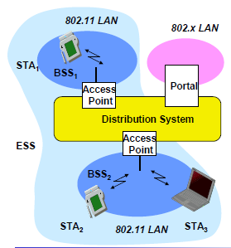
Infrastructure based IEEE 802.11

Slide 15
Infrastructure based IEEE 802.11 (Contd…)
Station (STA)
terminal with access mechanisms to the wireless medium and radio contact to the access point
Basic Service Set (BSS)
group of stations using the same radio frequency
Access Point
station integrated into the wireless LAN and the distribution system
Portal
bridge to other (wired) networks
Distribution System
interconnection network to form one logical network (EES: Extended Service Set) based on several BSS

Slide 16
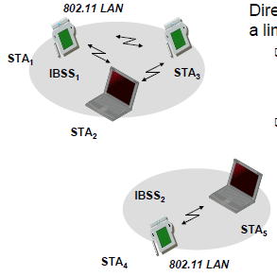
IEEE 802.11 Ad-hoc WLAN

Slide 17
IEEE 802.11 Ad-hoc WLAN (Contd…)
Direct communication within a limited range
Station (STA):
terminal with access mechanisms to the wireless medium
Independent Basic Service Set (IBSS):
group of stations using the same radio frequency

Slide 18
IEEE 802.11 Protocol Architecture

Slide 19
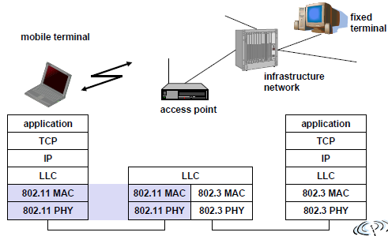
IEEE 802.11 Protocol Architecture and Bridging

Slide 20
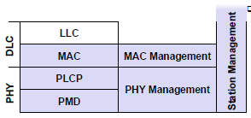
Detailed IEEE 802.11 Protocol Architecture and Management

Slide 21
Protocol Architecture (Contd…)
Physical layer subdivided into
Physical layer convergence protocol (PLCP)
Physical medium dependent sublayer (PMD)
PLCP provides
Common PHY service access point SAP
Carrier Sense Signal
Clear Channel Assessment
PMD handles
Modulation
Encoding/Decoding

Slide 22
Protocol Architecture (Contd…)
Tasks of MAC layer
Medium access
Fragmentation of user data
Encryption
MAC Management supports
Association & reassociation of station to an access point
Roaming between different APs
Authentication mechanisms
Encryption
Synchronization of station
Power management to save power
Maintains MAC Management Information Base (MIB)

Slide 23
Protocol Architecture (Contd…)
PHY Management include
Channel tuning
Maintains PHY Management Information Base (MIB)
Station Management
Interact with management layers
Responsible for addition layer functions

Slide 24
IEEE 802.11 PHY Layer

Slide 25
IEEE 802.11 Physical Layer
IEEE 802.11 supports 3 different physical layers
One layer based in infra red
Two layers based on radio transmission
Frequency hopping spread spectrum
Direct Sequence Spread Spectrum

Slide 26

Frequency Hopping Spread Spectrum
Format of IEEE 802.11 PHY frame using FHSS
Synchronization | 010101……….
Start Frame Delimiter (SFD) | 0000110010111101
PLCP_PDU length Word (PLW) | Length of payload in bytes
PLCP signaling Field (PSF) | Data rate of payload
Header Error Check (HEC) | 16 bit checksum

Slide 27
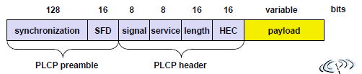
Direct Sequence Spread Spectrum
Format of IEEE 802.11 PHY frame using DSSS
Synchronization | 010101……….
Start Frame Delimiter (SFD) | 1111001110100000
Signal | Data rate of payload
Service | Reserve for future use
Length | Length of payload
Header Error Check (HEC) | Sig, ser, len are protected by checksum

Slide 28
IEEE 802.11 MAC Layer

Slide 29
MAC Layer
Tasks of MAC layer
Control medium access
Offer support for roaming, authentication and power conservation
Services provided by MAC layer
Mandatory asynchronous data service
Optional time bounded service
802.11 offer
Only asynchronous service in adhoc based network
2 services in infrastructure based network

Slide 30
MAC Layer (Contd…)
3 access mechanisms have been defined for IEEE 802.11
Mandatory basic method based on CSMA/CA
Optional method avoiding hidden terminal problem
Contention free polling method for time bounded service
First methods are summarized as Distributed Coordination Function (DCF)
DCF offers asynchronous Service
Third method is Point Coordination Function (PCF)
PCF offers both asynchronous & time-bounded service
MAC mechanisms are also called Distributed Foundation Wireless Medium Access Control (DFWMAC)

Slide 31
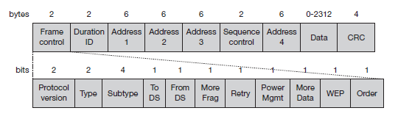
MAC frames
Basic structure of an IEEE 802.11 MAC data frame
Frame control: The first 2 bytes serve several purposes.
Duration/ID: period of time in which the medium is occupied (in μs).

Slide 32
MAC frames (Contd…)
Address 1 to 4: The four address fields contain standard IEEE 802 MAC addresses (48 bit each)
Sequence control: Due to the acknowledgement mechanism frames may be duplicated. So, sequence number is used to filter duplicates.
Data: The MAC frame may contain arbitrary data (max. 2,312 byte), which is transferred transparently from a sender to the receiver(s).
Checksum (CRC): 32 bit checksum is used to protect the frame

Slide 33
MAC frames (Contd…)
Protocol version: indicates the current protocol version
Type: function of a frame
00 -- management
01 -- control
10 -- data
11 -- reserved
Subtype: Example subtypes for management frames are:
0000 for association request,
1000 for beacon
1011for RTS
1100 for CTS

Slide 34
MAC frames (Contd…)
More fragments: This field is set to 1
Retry: If frame is a retransmitted, this bit is set to 1.
Easy to eliminate duplicate frames.
Power management: mode of a station after transmission
1 → power saving mode
0 → active
More data: indicate a receiver that a sender has more data to send than the current frame
Wired equivalent privacy (WEP): Indicates that the standard security mechanism of 802.11 is applied.
Order: set to 1 → received frames must be processed in strict order

Slide 35
IEEE 802.11 Versions

Slide 36
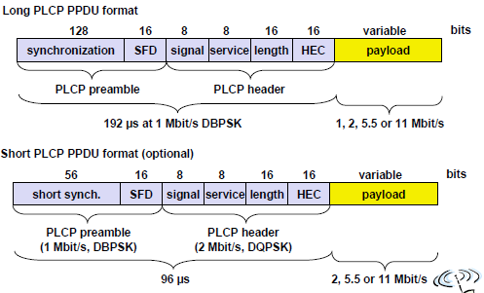
IEEE 802.11b
PHY packet formats

Slide 37
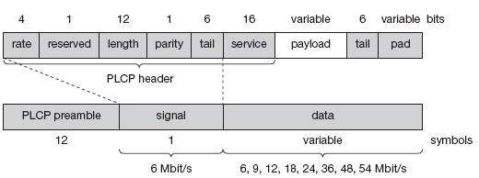
IEEE 802.11a
Physical layer PDU

Slide 38
Bluetooth

Slide 39
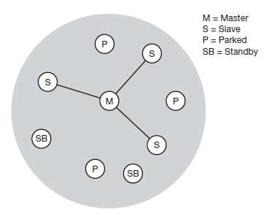
Bluetooth
Simple bluetooth piconet

Slide 40
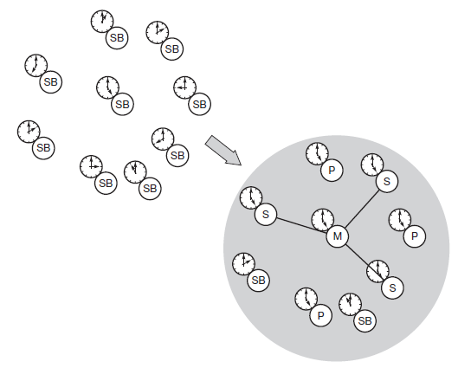
Bluetooth (Contd…)
Forming Bluetooth Piconet

Slide 41
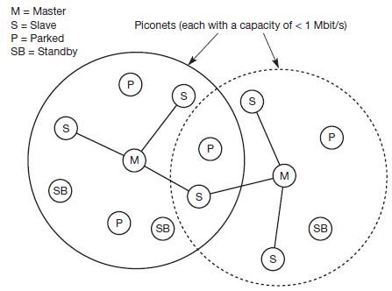
Bluetooth (Contd…)
Bluetooth Scatternet

Slide 42
Bluetooth Protocol Architecture

Slide 43
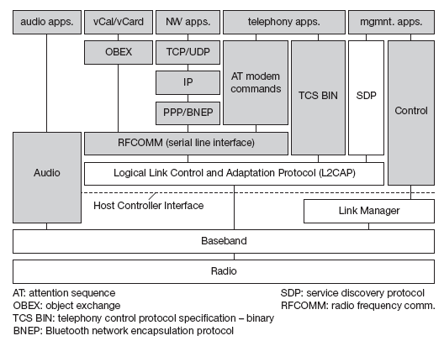
Bluetooth Protocol Stack

Slide 44
Bluetooth Protocol Stack (Contd…)
The Bluetooth protocol stack divided into
Core specification
describes the protocols from physical layer to the data link control together with management functions,
Profile specifications
describes many protocols and functions needed to adapt the wireless Bluetooth technology to legacy and new applications

Slide 45
Bluetooth Protocol Stack (Contd…)
Elements of core protocols of Bluetooth
Radio
Specification of the air interface, i.e.,
frequencies,
modulation,
transmit power
Baseband:
Basic connection establishment,
packet formats,
timing, and
basic QoS parameters

Slide 46
Bluetooth Protocol Stack (Contd…)
Link manager protocol:
Link set-up and management between
devices
security functions
parameter negotiation
Logical link control and adaptation protocol (L2CAP):
Adaptation of higher layers to the baseband
connectionless
connection-oriented services,
Service discovery protocol:
Device discovery in close proximity
querying of service characteristics

Slide 47
Bluetooth Protocol Stack (Contd…)
Cable replacement protocol RFCOMM
Emulates a serial line interface
supports multiple serial ports over a single physical channel.
Telephony control protocol specification – binary (TCS BIN)
A bit-oriented protocol
Defines call control signaling for the establishment of voice and data calls between Bluetooth devices.
Describes mobility and group management functions.
The host controller interface (HCI)
A command interface to the baseband controller and link manager
Access to the hardware status and control registers.

Slide 48
Bluetooth Protocol Stack (Contd…)
Many protocols have been adopted in the Bluetooth standard.
Classical Internet applications can still use the standard TCP/IP stack running over PPP or use the more efficient Bluetooth network encapsulation protocol (BNEP).
Telephony applications can use the AT modem commands
Calendar and business card objects (vCalendar/vCard) can be exchanged using the object exchange protocol (OBEX)
A real difference to other protocol stacks is the support of audio.
Audio applications may directly use the baseband layer after encoding the audio signals.

Slide 49
Bluetooth Protocol Stack (Contd…) Radio Layer
Bluetooth uses license free frequency band at 2.4GHz
Frequency hopping scheme is used for transmission
Bluetooth transceivers use Gaussian FSK for modulation
3 classes of modulation
Power class 1: Max power – 100 mW, Min power – 1 mW
Power class 2: Max power – 2.5 mW, nomial power – 1 mW, Min power – 0.25 mW
Power class 3: Max power – 1 mW

Slide 50
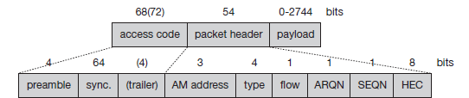
Bluetooth Protocol Stack (Contd…) Baseband layer
Baseband packet format

Slide 51
Bluetooth Protocol Stack (Contd…) Baseband layer
Bluetooth offers 2 different types of links
Synchronous connection-oriented Link - SCO
Asynchronous connection less Link - ACL

Slide 52
Bluetooth Protocol Stack (Contd…) Link Manager Protocol
Functions of Link Manager Protocol
Authentication, pairing, and encryption
Synchronization
Capability negotiation
Quality of service negotiation
Power control
Link supervision
State and transmission mode change

Slide 53
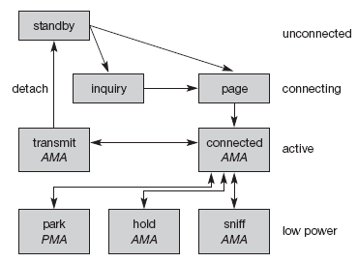
Bluetooth Protocol Stack (Contd…) Link Manager Protocol
Major baseband states of a Bluetooth device

Slide 54
Bluetooth Protocol Stack (Contd…) Link Manager Protocol
To save battery power, a Bluetooth device can go into one of three low power states:
Sniff state:
The sniff state has the highest power consumption
Here, the device listens to the piconet
Device keeps its AMA
Hold state:
No activity in the piconet,
Device does not release AMA but stops ACL transmission
Park state:
The device has lowest power consumption.
The device releases its AMA and receives a parked member address (PMA).
It is still member of piconet, gives room for other device to be active

Slide 55
Bluetooth Protocol Stack (Contd…) L2CAP
Logical Link Control and Adaptation Protocol
L2CAP provides three different types of logical channels
Connectionless:
Unidirectional channels are used for broadcasts from a master to its slave(s)
Connection-oriented:
Bi-directional and supports QoS flow specifications for each direction
Signaling:
used to exchanging signaling messages between L2CAP entities

Slide 56
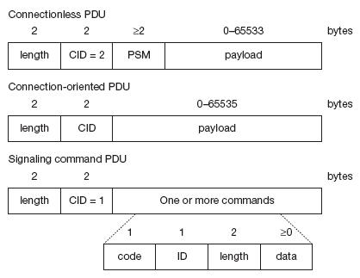
Bluetooth Protocol Stack (Contd…) L2CAP
L2CAP Packet formats

