Slide 1
Chapter 9:
File-System Interface

Slide 2
Chapter 9: File-System Interface
File Concept
Access Methods
Disk and Directory Structure
File-System Mounting
File Sharing
Protection

Slide 3
Objectives
To explain the function of file systems
To describe the interfaces to file systems
To discuss file-system design tradeoffs, including access methods, file sharing, file locking, and directory structures
To explore file-system protection

Slide 4
File Concept
Uniform logical view of information storage (no matter the medium)
OS abstracts from physical properties into a logical storage unit, the file
Files mapped onto physical devices, usually nonvolatile
File is a collection of related information
  Smallest allotment of nameable storage
Contiguous logical address space
Types:
  Data
    numeric
    character
    binary
  Program
  May be free form or rigidly formed (structured)

Slide 5
File Structure
None - sequence of words, bytes
Simple record structure
  Lines
  Fixed length
  Variable length
Complex Structures
  Formatted document
  Relocatable load file
Can simulate last two with first method by inserting appropriate control characters
Who decides:
  Operating system
  Program / programmer

Slide 6
File Attributes
Name – only information kept in human-readable form
Identifier – unique tag (number) identifies file within file system
Type – needed for systems that support different types
Location – pointer to file location on device
Size – current file size
Protection – controls who can do reading, writing, executing
Time, date, and user identification – data for protection, security, and usage monitoring
Information about files are kept in the directory structure, which is maintained on the disk
  Typically file’s name and identifier
    Identifier locates other file attributes
Attributes may be > 1KB
Directory structures may be > 1MB

Slide 7
File Operations
File is an abstract data type
Operations include the following (and usually more)
Create – find space, add entry to directory
Write – write data at current file position pointer location and update pointer
Read – read file contents at pointer location, update pointer
Reposition within file (seek) – change pointer location
Delete – free space and remove entry from directory
Truncate – delete data starting at pointer

Slide 8
Open Files
Open(F_{i}) – allow process to access a file
  Returns a file handle for system call reference to the file
  Search the directory structure on disk for entry F_{i}, and move the content or cache some of entry to memory
Close(file handle) – end processes’ access to the file
  Move the content of entry F_{i} in memory to directory structure on disk

Slide 9
Open File Data Structures
Usually a global table containing process-independent open file information
  Size
  Access dates
  Disk location of the file: cache of data access information
  File-open count: counter of number of times a file is open
    To allow removal of data from open-file table when last processes closes it
Per-process open file table contains pertinent info, plus pointer to entry in global open file table
  Current file position pointer: pointer to next read/write location
  Access rights: per-process access mode information
    read, write, append

Slide 10
Open File Locking
Provided by some operating systems and file systems
Mediates access to a file
  shared
  exclusive
Mandatory or advisory:
  Mandatory – access is denied depending on locks held and requested
  Advisory – processes can find status of locks and decide what to do

Slide 11
File Locking Example – Java API
import java.io.*;
import java.nio.channels.*;
public class LockingExample {
public static final boolean EXCLUSIVE = false;
public static final boolean SHARED = true;
public static void main(String arsg[]) throws IOException {
FileLock sharedLock = null;
FileLock exclusiveLock = null;
try {
RandomAccessFile raf = new RandomAccessFile("file.txt", "rw");
// get the channel for the file
FileChannel ch = raf.getChannel();
// this locks the first half of the file - exclusive
exclusiveLock = ch.lock(0, raf.length()/2, EXCLUSIVE);
/** Now modify the data . . . */
// release the lock
exclusiveLock.release();

Slide 12
File Locking Example –
Java API (Cont.)
// this locks the second half of the file - shared
sharedLock = ch.lock(raf.length()/2+1, raf.length(), SHARED);
/** Now read the data . . . */
// release the lock
sharedLock.release();
} catch (java.io.IOException ioe) {
System.err.println(ioe);
}finally {
if (exclusiveLock != null)
exclusiveLock.release();
if (sharedLock != null)
sharedLock.release();
}
}
}

Slide 13
File Types
Most operating systems recognize file types
  Filename extension
  I.e. resume.doc, server.java, readerthread.c
Most support them
  Automatically open a type of file via a specific application (.doc)
  Only execute files of a given extension (.exe, .com)
  Run files of a given type via a scripting language (.bat)
Can get more advanced
  If source code modified since executable compiled, if attempt made to execute, recompile and then execute (TOPS-20)
  Mac OS encodes creating program’s name in file attributes
    Double clicking on file passes the file name to appropriate application
  Unix has magic number stored in file at first byte indicating file type

Slide 14

File Types – Name, Extension

Slide 15
File Structure
Types can indicate internal file structure
  Some Oses enforce, some use as hints, some ignore
But some most conform to OS-required format
  I.e. executable file
  Some support more formats
    DEC VMS supported 3
  The more that are supported, the more kernel code, etc
  Some enforce access methods
  Others allow arbitrary access
    Unix supports directory files, executable files
    But all files are strings of bytes
      Can open a directory file via a text editor
Files stored in fixed-size disk blocks
  Can have internal fragmentation

Slide 16
Access Methods
Sequential Access – tape model of a file
read next
write next
reset
no read after last write
(rewrite)
Direct Access – random access, relative access
read n
write n
position to n
read next
write next
rewrite n
n = relative block number
Can accommodate structured data in file by mapping record number to block number
Oses usually support both kinds, sometimes require access method declaration during create()

Slide 17

Sequential-access File

Slide 18

Simulation of Sequential Access on
Direct-access File

Slide 19

Example of Index and Relative Files

Slide 20
Disk Structure
Disk can be subdivided into partitions
Disks or partitions can be RAID protected against failure
Disk or partition can be used raw – without a file system, or formatted with a file system
Partitions also known as minidisks, slices
Entity containing file system known as a volume
Each volume containing file system also tracks that file system’s info in device directory or volume table of contents or directory)
  Records information for all files on the volume
As well as general-purpose file systems there are many special-purpose file systems, frequently all within the same operating system or computer

Slide 21

A Typical File-system Organization

Slide 22
File System Types
Operating systems have multiple file system types
  One or more general-purpose (for storing user files)
  One or more special-purpose, i.e.
    tmpfs—“temporary” file system in volatile main memory, contents erased if the system reboots or crashes
    objfs—a “virtual” file system (essentially an interface to the kernel that looks like a file system) that gives debuggers access to kernel symbols
    ctfs— a virtual file system that maintains “contract” information to manage which processes start when the system boots and must continue to run during operation
    lofs—a “loop back” file system that allows one file system to be accessed in place of another one
    procfs—a virtual file system that presents information on all processes as a file system

Slide 23
Directory Overview
Directory similar to symbol table translating file names to their directory entries
  Can be organized in many ways
Organization needs to support operations including:
  Search for a file or multiple files
  Create a file
  Delete a file
  List a directory
  Rename a file
  Traverse the file system

Slide 24
Directory Organization
Should have the features
  Efficiency – locating a file quickly
  Naming – convenient to users
    Two users can have same name for different files
    The same file can have several different names
  Grouping – logical grouping of files by properties, (e.g., all Java programs, all games, …) or arbitrarily

Slide 25

Single-Level Directory
A single directory for all users
Naming problem
Grouping problem

Slide 26

Two-Level Directory
Separate directory for each user
Path name
Can have the same file name for different users
Efficient searching
No grouping capability

Slide 27
Added Directory Concepts
Many variations, but some components essential
Idea of current directory – default location for activities
Now need a path specification
  If file is in current directory, just name it
  If in another directory, must specify by more detailed name
  Also need way to specify different filesystems
  MS-DOS gives letter to each volume, “\” separates directory name from file name – C:\userb\test
  VMS uses letter for volume and “[]” for directory specification – u:[sst.jdeck]login.com;1
    Note the support for versions via the trailing number
  Unix treats volume name as part of directory name - /u/pbg/test
Many Oses search a set of paths for command names
  “ls” might search in current directory then in system directories

Slide 28

Tree-Structured Directories

Slide 29
Tree-Structured Directories (Cont.)
Most common
For example, allows users to can create directories within their directory
Directory can then contain files or other directories
Directory can be another file with defined formatting and attribute indicating its type
Separate system calls to manage directory actions
Absolute path is full specification of file local - /foo/bar/baz
Relative path is location relative to current directory - ../baz
Efficient searching
  Search path
Grouping Capability
Current directory (working directory)
  cd /spell/mail/prog
  type list

Slide 30
Tree-Structured Directories (Cont)
mail
Creating a new file is done in current directory
Delete a file
rm <file-name>
Creating a new subdirectory is done in current directory
  mkdir <dir-name>
Example: if in current directory /mail
mkdir count
prog
copy
prt
exp
count
Deleting “mail” ⇒ deleting the entire subtree rooted by “mail”?
Make users manually delete contents (and subcontents) first (MS-DOS)
Provide an option to delete all contents (Unix)

Slide 31

Acyclic-Graph Directories
Have shared subdirectories and files

Slide 32
Acyclic-Graph Directories (Cont.)
Adds ability to directly share directories between users
  But can now have multiple absolute paths to the same file
Two different names (aliasing)
If dict deletes list ⇒ dangling pointer
Solutions:
  Backpointers, so we can delete all pointers
  Variable size records a problem
  Entry-hold-count solution
New directory entry type
  Link – another name (pointer) to an existing file
    Indirect pointer
    Delete link separate from the files
    Hard and symbolic
  Resolve the link – follow pointer to locate the file

Slide 33

General Graph Directory

Slide 34
General Graph Directory (Cont.)
How do we guarantee no cycles?
  Allow only links to file not subdirectories
  Garbage collection
  Every time a new link is added use a cycle detection algorithm to determine whether it is OK
  Or just bypass links during directory traversal

Slide 35
File System Mounting
A file system must be mounted before it can be accessed
  Privileged operation
  First check for valid file system on volume
  Kernel data structure to track mount points
Some systems have separate designation for mount point (i.e. “c:”)
Others integrate mounted file systems into existing directory naming system
  In separate space (i.e. /volumes) or within current name space
A unmounted file system on /device/dsk (i.e., Fig. 11-11(b)) is mounted at a mount point
What if the mount point already has contents?
Configuration file or data structure to track default mounts
  Used at reboot or to reset mounts
What if files are open on a device that is being unmounted?

Slide 36
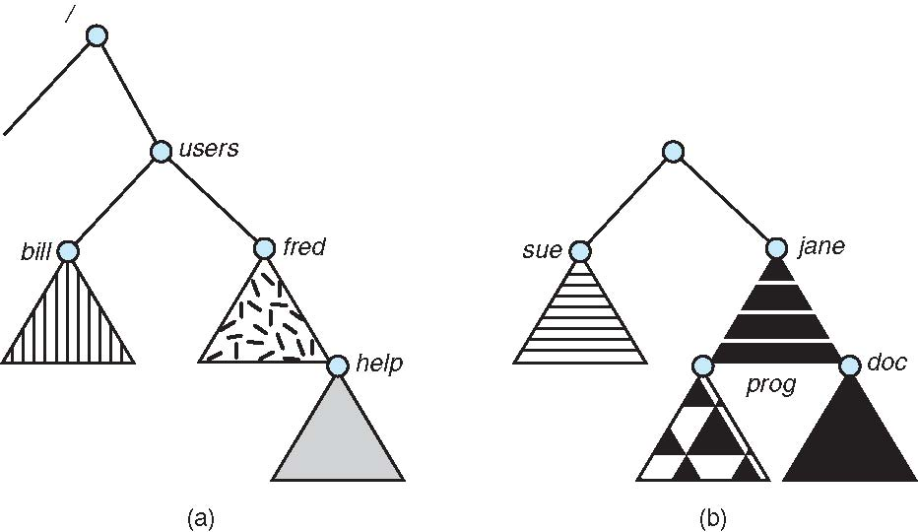
(a) Existing (b) Unmounted Partition

Slide 37

Mount Point

Slide 38
File Sharing
Sharing of files on multi-user systems is desirable
Sharing may be done through a protection scheme
On distributed systems, files may be shared across a network
Network File System (NFS) is a common distributed file-sharing method

Slide 39
File Sharing – Multiple Users
User IDs identify users, allowing permissions and protections to be per-user
Group IDs allow users to be in groups, permitting group access rights

Slide 40
File Sharing – Remote File Systems
Uses networking to allow file system access between systems
  Manually via programs like FTP
  Automatically, seamlessly using distributed file systems
  Semi automatically via the world wide web
    Using FTP under the covers
Client-server model allows clients to mount remote file systems from servers
  Server can serve multiple clients
  Client and user-on-client identification is insecure or complicated
  NFS is standard UNIX client-server file sharing protocol
  CIFS is standard Windows protocol
  Standard operating system file calls are translated into remote calls
Distributed Information Systems (distributed naming services) such as LDAP, DNS, NIS, Active Directory implement unified access to information needed for remote computing
  LDAP / Active Directory becoming industry standard -> Secure Single Sign-on
  IP addresses can be spoofed
  Protect remote access via firewalls
Open file request to remote server first checked for client-to-server permissions, then user-id checked for access permissions, then file handle returned
  Client process then uses file handle as it would for a local file

Slide 41
File Sharing – Failure Modes
Remote file systems add new failure modes, due to network failure, server failure
  Data or metadata loss or corruption
Recovery from failure can involve state information about status of each remote request
Stateless protocols such as NFS include all information in each request, allowing easy recovery but less security
  But stateless protocols can lack features, so NFS V4 and CIFS are both state-ful

Slide 42
File Sharing – Consistency Semantics
Consistency semantics specify how multiple users are to access a shared file simultaneously
  Similar to Ch 7 process synchronization algorithms
    Tend to be less complex due to disk I/O and network latency (for remote file systems)
  Andrew File System (AFS) implemented complex remote file sharing semantics
  Unix file system (UFS) implements:
    Writes to an open file visible immediately to other users of the same open file
    Sharing file pointer to allow multiple users to read and write concurrently
  AFS has session semantics
    Writes only visible to sessions starting after the file is closed
  Easier to implement is immutable shared files
    Once file is declared “shared”, can’t be renamed or modified

Slide 43
Protection
File owner/creator should be able to manage controlled access:
  What can be done
  By whom
  But never forget physical security
Types of access
  Read
  Write
  Execute
  Append
  Delete
  List
  Others can include renaming, copying, editing, etc
  System calls then check for valid rights before allowing operations
    Another reason for open()
  Many solutions proposed and implemented

Slide 44
Access Lists and Groups
Mode of access: read, write, execute
Three classes of users
RWX
a) owner access 7 ⇒ 1 1 1
RWX
b) group access 6 ⇒ 1 1 0
RWX
c) public access 1 ⇒ 0 0 1
Ask manager to create a group (unique name), say G, and add some users to the group.
For a particular file (say game) or subdirectory, define an appropriate access.
owner
group
public
chmod
761
game
Attach a group to a file
chgrp G game

Slide 45
Access Control
More generally solved via access control lists
  For a given entity, keep list of user-ids allowed to access and what access methods
  Constructing such as list can be tedious and unrewarding
  Data structure must be stored somewhere
    Variable size

Slide 46

Windows XP Access-Control
List Management

Slide 47

A Sample UNIX Directory Listing

Slide 48
End of Chapter 9

