Slide 1
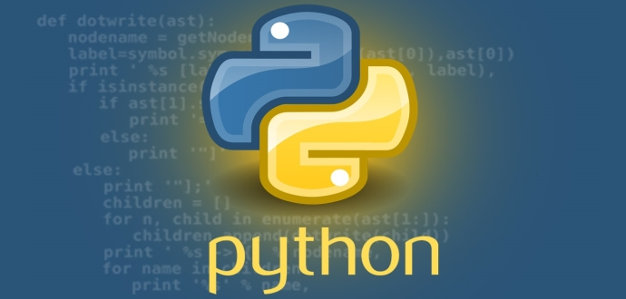
Python Programming Language

Slide 2

UNITV
Files and Object Oriented Programming in Python
Ch .Venkata RamiReddy Department Of Computer Science and Engineering

Slide 3
What is a file?
File is a named location on disk to store related information.
It is used to permanently store data in a non-volatile memory (e.g. hard disk).
Since, random access memory (RAM) is volatile which loses its data when computer is turned off, we use files for future use of the data.
Ch .Venkata RamiReddy Department Of Computer Science and Engineering

Slide 4
Types of files
In Python, a file is categorized as either text or binary.
Text files:
Text files are structured as a sequence of lines, where each line includes a sequence of characters.
Each line is terminated with a special character, called the EOL or End of Line character.
Common extensions that are text file formats:
Web standards: html, xml, css, ...
Source code: c, cpp, java, pl, php, , ...
Documents: txt, tex,rtf, ps, ...
Tabular data: csv, tsv, ...
Ch .Venkata RamiReddy Department Of Computer Science and Engineering

Slide 5
Types of files
Binary files:
Binary" files are any files where the format isn't made up of readable characters.
Binary files can range from image files like JPEGs or GIFs, audio files like MP3s or binary document formats like Word or PDF.
Binary files can only be processed by an application that know or understand the file’s format.
Common extensions that are binary file formats:
Images: jpg, png, gif, bmp, tiff, ...
Videos: mp4, avi, mov, mpg, ...
Audio: mp3, wav, wma, ...
Archive: zip, rar, 7z, tar, ...
Executable: exe, dll, so, class, ...
Ch .Venkata RamiReddy Department Of Computer Science and Engineering

Slide 6
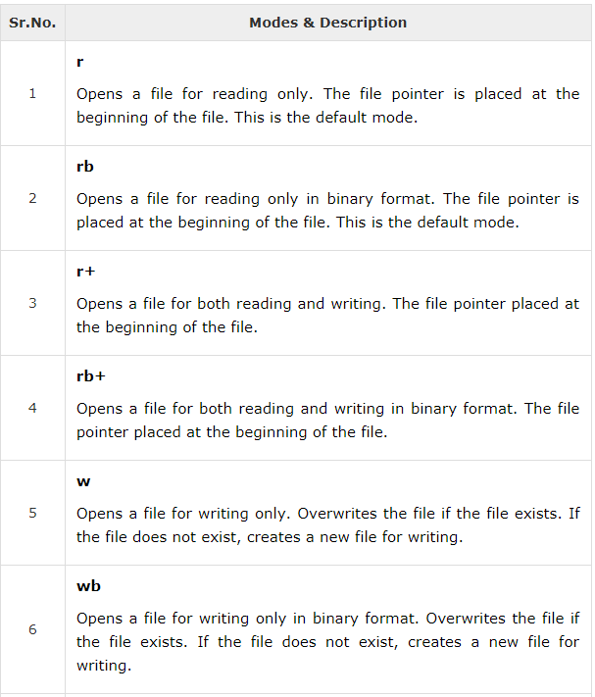
Python File Modes
Ch .Venkata RamiReddy Department Of Computer Science and Engineering

Slide 7
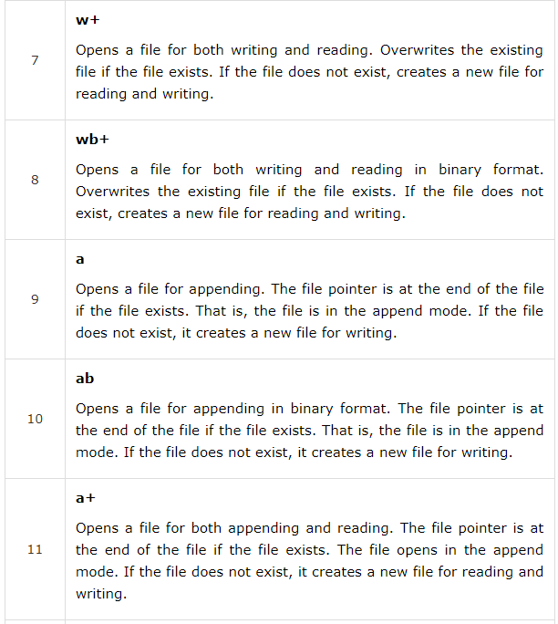
Python File Modes
Ch .Venkata RamiReddy Department Of Computer Science and Engineering

Slide 8
Python File Operations
open()
close()
write()
read()
readLine()
readLines()
tell()
seek()
rename()
Ch .Venkata RamiReddy Department Of Computer Science and Engineering

Slide 9
open()
open() function is used to open a file.
open() returns a file object, also called a “file handle” is a variable used to perform operations on the file.
Syntax: handle= open(filename, mode)
It returns a handle used to manipulate the file.
We can specify the mode while opening a file. In mode, we specify whether we want to read 'r', write 'w' or append 'a' to the file.
We also specify if we want to open the file in text mode or binary mode.
The default is reading in text mode. In this mode, we get strings when reading from the file.
On the other hand, binary mode returns bytes and this is the mode to be used when dealing with non-text files like image or exe files
Ch .Venkata RamiReddy Department Of Computer Science and Engineering

Slide 10
Example
Open.py
f= open('one.txt','r')
for l in f:
print(l)
Output:
hi this cse
vignan
One.txt
hi this cse
vignan
Ch .Venkata RamiReddy Department Of Computer Science and Engineering

Slide 11
close()
close() function is used to close the file.
it closes the file object, after which no more writing can be done.
Syntax: fileObject.close();
Ex:
fo = open("foo.txt", "wb")
print("Name of the file: ", fo.name)
fo.close()
with:
It automatically close the file when the cursor reached the end of the file.
Syntax: with open(“filename”) as f:
Ch .Venkata RamiReddy Department Of Computer Science and Engineering

Slide 12
write()
The write() function writes any string to an open file.
It is used to write the data in to a open file.
In order to write string into a file , we need to open it in write 'w', append 'a' or exclusive creation 'x' mode.
The write() method does not add a newline character ('\n') to the end of the string
Syntax : fileObject.write(string);
Here, passed parameter is the content to be written into the opened file.
This method returns the number of characters written to the file.
Ch .Venkata RamiReddy Department Of Computer Science and Engineering

Slide 13
write()
Ex1:
fo = open("foo.txt","w")
fo.write( "Python is a great language.\nYeah its great!!\n");
fo.close()
Ex2:
fo = open("one.txt","a")
c=fo.write( "\nyes");
print(c)
fo.close()
Ch .Venkata RamiReddy Department Of Computer Science and Engineering

Slide 14
read()
The read() method reads a string from an open file.
To read a file in Python, we must open the file in reading mode.
We can use the read(size) method to read in size number of data.
If size parameter is not specified, it reads and returns up to the end of the file.
Syntax: fileObject.read([count]);
Ex:
f= open('one.txt','r')
str=f.read(5)
print(str)
o/p: hi th
Ch .Venkata RamiReddy Department Of Computer Science and Engineering

Slide 15
readline() & readlines()
readline() method is used to read individual lines of a file.
This method reads a file till the newline.
readlines() method returns every line in the file with separator.
Syntax: fileobject.readline() & fileobject.readlines()
Ex:
f= open('one.txt','r')
print(f.readline()) # it display first line of file o/p : hi this is cse
Ex2:
f= open('one.txt','r')
print(f.readlines())
o/p: [‘ hi this is cse\n’,’vignan’]
Ch .Venkata RamiReddy Department Of Computer Science and Engineering

Slide 16
tell()
The method tell() returns the current position of the file read/write pointer within the file.
Syntax: fileObject.tell()
Ex:
f= open('one.txt','r')
print(f.readline())
print(f.tell())
o/p:
Hi this is cse
16
Ch .Venkata RamiReddy Department Of Computer Science and Engineering

Slide 17
seek()
It is used to change the file pointer position.
The method seek() sets the file's current position at the offset.
Syntax: fileObject.seek(offset, [whence])
offset − This is the position of the read/write pointer within the file.
whence − This is optional and defaults to 0 which means absolute file positioning, other values are 1 which means seek relative to the current position and 2 means seek relative to the file's end.
Ex:
f= open('one.txt','r')
print(f.readline()) #o/p: hi this is cse
f.seek(3,0)
print(f.readline()) #o/p: this is cse
Ch .Venkata RamiReddy Department Of Computer Science and Engineering

Slide 18
rename()
rename() method is used to rename a file or directory.
This method is a part of the os module
Syntax:
os.rename(oldname,newname)
Ex:
import os
os.rename("one2.txt","two.txt")
Ch .Venkata RamiReddy Department Of Computer Science and Engineering

Slide 19
Programs
Write a Python program to read first n lines of a file.
from itertools import islice
f=open("one.txt","r");
n=int(input("no of lines required"))
for line in islice(f,n):
print(line)
Write a Python program to read a file line by line and store it into a list.
f=open("one.txt","r");
l=[]
l=f.readlines();
print(l)
Ch .Venkata RamiReddy Department Of Computer Science and Engineering

Slide 20
Program to count the no of lines ,words and characters in a file
f=open("one.txt","r");
num_lines = 0
num_words = 0
num_chars = 0
for line in f:
num_lines += 1
words=line.split()
num_words +=len(words)
num_chars +=len(line)
print(num_lines)
print(num_words)
print(num_chars)
Ch .Venkata RamiReddy Department Of Computer Science and Engineering

Slide 21
Write a python program copy one file content into another file.
f=open("test.txt“,”r”):
f1=open("out.txt“,"w“):
for line in f:
f1.write(line)
Ch .Venkata RamiReddy Department Of Computer Science and Engineering

Slide 22
Object Oriented Programming in Python
Classes
Methods
Constructor Method
Inheritance
Overriding Methods.
Ch .Venkata RamiReddy Department Of Computer Science and Engineering

Slide 23
Python OOPs Concepts
Python is an object-oriented programming language.
It allows us to develop applications using Object Oriented approach.
In Python, we can easily create and use classes and objects.
Major principles of object-oriented programming system are given below
Class
Object
Method
Inheritance
Polymorphism
Data Abstraction
Encapsulation
Ch .Venkata RamiReddy Department Of Computer Science and Engineering

Slide 24
Class
A Class is a "blueprint" for creating objects.
Class can be defined as a collection of objects.
It is a logical entity that has some specific attributes and methods.
Variables that belong to an object or class are referred to as fields.
Objects can also have functions that belong to a class. Such functions are called methods of the class.
Collectively, the fields and methods can be referred to as the attributes of that class.
Fields belongs to each instance/object of the class are called instance variables and fields belongs to a class are called class variables
Ch .Venkata RamiReddy Department Of Computer Science and Engineering

Slide 25
class
In Python, a class is defined by using a keyword class like a function definition begins with the keyword def.
Syntax of a class definition:
class ClassName:
<statement-1>
<statement-N>
class Example:
def add(self):
c=self.a+self.b
print(c)
ob=Example()
ob.a=50
ob.b=20
ob.add()
Ch .Venkata RamiReddy Department Of Computer Science and Engineering

Slide 26
object
An object is an entity that has attributes and behavior.
Object is an instance of a class.
When class is defined, no memory or storage is allocated.
Syntax:
objetcname=classname()
Ex:
ob=Example()
Here ob is the object of class Example.
Ch .Venkata RamiReddy Department Of Computer Science and Engineering

Slide 27
Method
An object has attributes and behaviors. These behaviors are called methods in programming.
They are used to define the behaviors of an object.
Methods are functions defined inside the body of a class and associated with an object.
Syntax:
class classname:
def methodname(self):
statements
Ch .Venkata RamiReddy Department Of Computer Science and Engineering

Slide 28
The Self
self refers to the current object.
Class methods have only one specific difference from ordinary functions, they must have an extra first name that has to be added to the beginning of the parameter list, but you do not give a value for this parameter. when you call the method.
You can give any name for this parameter but it is recommended to use self.
Ch .Venkata RamiReddy Department Of Computer Science and Engineering

Slide 29
Example
class Box:
def readData(self):
self.height=20
self.width=30
self.depth=40
def volume(self):
return self.height* self.width* self.depth
ob=Box()
ob.readData()
print(ob.volume())
Ch .Venkata RamiReddy Department Of Computer Science and Engineering

Slide 30
Constructor Method
A constructor is a special kind of method which is used for initializing the instance variables during object creation.
Constructor is used for initializing the instance members when we create the object of a class.
Constructor can be parameterized and non-parameterized as well.
A constructor always has a name init and the name init is prefixed and suffixed with a double underscore(__).
We declare a constructor using def keyword, just like methods.
Syntax of constructor declaration
def __init__(self):
# body of the constructor
Ch .Venkata RamiReddy Department Of Computer Science and Engineering

Slide 31
Types of constructors in Python
We have two types of constructors in Python. 1. default constructor – constructor with out parameters .
def __init__(self):
# body of the constructor
2. parameterized constructor – constructor with parameters is known as parameterized constructor.
def __init__(self,a,b):
# body of the constructor
Ch .Venkata RamiReddy Department Of Computer Science and Engineering

Slide 32
default constructor example
class Box:
def __init__(self):
self.height=20
self.width=30
self.depth=40
def volume(self):
return self.height* self.width* self.depth
ob=Box()
print(ob.volume())
Ch .Venkata RamiReddy Department Of Computer Science and Engineering

Slide 33
parameterized constructor example
class Box:
def __init__(self,h,w,d):
self.height=h
self.width=w
self.depth=d
def volume(self):
return self.height* self.width* self.depth
ob=Box(20,30,40)
print(ob.volume())
Ch .Venkata RamiReddy Department Of Computer Science and Engineering

Slide 34
a student class which include name, 5 subject marks and define average() & display() methods in it.
class Student:
def __init__(self,name,m1,m2,m3,m4,m5):
self.name=name
self.m1=m1
self.m2=m2
self.m3=m3
self.m4=m4
self.m5=m5
def average(self):
self.avg=(self.m1+self.m2+self.m3+self.m4+self.m5)/5
def display(self):
print("Name is",self.name)
print("avg is",self.avg)
ob=Student("devansh",10,20,30,40,50)
ob.average()
ob.display()
Ch .Venkata RamiReddy Department Of Computer Science and Engineering

Slide 35
Destructors
a destructor is used to destroy the object and perform the final clean up.
__del__ method is considered as the destructor method.
Example:
class Des:
def __init__(self):
print("Object created")
# destructor
def __del__(self):
print("Object destroyed")
b= Des()
# to delete the object explicitly
del ob
Ch .Venkata RamiReddy Department Of Computer Science and Engineering

Slide 36
class variables and instance variables
Instance variables are owned by each individual object/instance of the class.
Each object has its own copy of the field i,e they are not shared.
Instance variables are variables used for data that is unique to a particular instance
self is used to access instatnce variable.
class variables are shared and accessible by all the instances of that class.
There is only one copy of the class variable and when any one object makes a change to a class variable, that change will be seen by all other instances.
classname is used to access class variables
Ch .Venkata RamiReddy Department Of Computer Science and Engineering

Slide 37
class variables and instance variables
class Ex:
count=0 //class variable
def __init__(self, s):
self.str=s //str is a instance variable
print("it is"+self.str+"object")
Ex.count=Ex.count+1
def show():
print(Ex.count)
ob1=Ex("first")
ob2=Ex("second")
Ex.show()
Ch .Venkata RamiReddy Department Of Computer Science and Engineering

Slide 38
Inheritance
It refers to defining a new class from an existing class such that the new class can get the properties of existing class.
The new class is called derived (or child or sub) class and the one from which it inherits is called the base (or parent or super) class.
Python Inheritance Syntax
class BaseClass:
Body of base class
class DerivedClass(BaseClass):
Body of derived class
Ch .Venkata RamiReddy Department Of Computer Science and Engineering

Slide 39
Inheritance
class parent:
fname="RamiReddy"
sname="Ch"
pm=60000
class son(parent):
def __init__(self,name,money):
self.name=name
self.sm=money
def display(self):
self.total=self.pm+self.sm
print("my name is "+self.name+" "+self.sname)
print("my Father name is "+self.fname)
print("my total amount is",self.total)
ob= son ("Devansh",30000)
ob.display()
Ch .Venkata RamiReddy Department Of Computer Science and Engineering

Slide 40
Types of Inheritance
Base or single Inheritance
Multiple Inheritance
Multilevel Inheritance
Base or single Inheritance:
A new class is derived from only one parent class
Example: refer previous example
Ch .Venkata RamiReddy Department Of Computer Science and Engineering

Slide 41
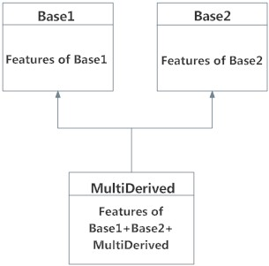
Multiple Inheritance
a class can be derived from more than one base classes is called multiple inheritance.
Syntax:
class Base1:
statements
class Base2:
statements
class MultiDerived(Base1, Base2):
statements
The class MultiDerived inherits from both Base1 and Base2.
Ch .Venkata RamiReddy Department Of Computer Science and Engineering

Slide 42
Multiple Inheritance
class Mother:
mname="Suneetha"
class Father:
fname="RamiReddy"
class son(Mother,Father):
def __init__(self,name):
print("My name is ",name)
print("I AM A SON OF "+self.fname+" AND "+self.mname)
ob=son("Devansh")
Ch .Venkata RamiReddy Department Of Computer Science and Engineering

Slide 43
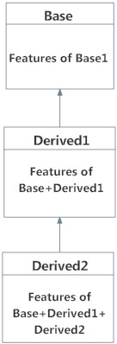
Multilevel Inheritance
a class can be derived from already derived class is called multilevel inheritance
class Base:
statements
class Derived1(Base):
statements
class Derived2(Derived1):
statements
Here, Derived2 is derived from Derived1 and is derived from Base.
Ch .Venkata RamiReddy Department Of Computer Science and Engineering

Slide 44
Multilevel Inheritance
class A:
a=10
class B(A):
b=20
class C(B):
def add(self,c):
self.d=self.a+self.b+c
print(self.d)
ob=C()
ob.add(20)
Ch .Venkata RamiReddy Department Of Computer Science and Engineering

Slide 45
Method Overriding in Python
Defining a method in subclass with same signature and return type as method in its super-class is known as method overriding.
Ex:
class A:
def show(self):
print("it is super class")
class B(A):
def show(self):
print("it overrides the super class method")
ob=B()
ob.show()
Ch .Venkata RamiReddy Department Of Computer Science and Engineering

Slide 46
Create the following inheritance and override sound() method in all the derived classes that is defined in base class.
class pet:
def __init__(self,name):
self.name=name
def sound(self):
print("sound")
class dog(pet):
def sound(self):
print(self.name+" sounds Bow Bow")
class cat(pet):
def sound(self):
print(self.name+" sounds Meow Meow")
class parrot(pet):
def sound(self):
print(self.name+" sounds coow coow")
ob1=dog("snoopy")
ob1.sound()
ob2=cat("chili")
ob2.sound()
ob3=parrot("chiluka")
ob3.sound()
pet
dog
cat
parrot
Ch .Venkata RamiReddy Department Of Computer Science and Engineering

Slide 47
Encapsulation
Encapsulation is a mechanism of wrapping the data (variables) and code acting on the data (methods) together as a single unit.
In encapsulation, the variables of a class will be hidden from other classes, and can be accessed only through the methods of their current class. Therefore, it is also known as data hiding.
Encapsulation can be achieved by: Declaring all the variables in the class as private and writing public methods in the class to set and get the values of variables.
In Python, we use double underscore (Or __) before the attributes name and those attributes will not be directly visible outside.
In Python, we denote private variables using double “ __“. underscore as prefix
Ch .Venkata RamiReddy Department Of Computer Science and Engineering

Slide 48
Encapsulation
class MyClass:
# Hidden member of MyClass
__hiddenVariable = 0
# A member method that changes _hiddenVariable
def add(self, increment):
self.__hiddenVariable += increment
print (self.__hiddenVariable)
# Driver code
Ob= MyClass()
Ob.add(2)
# This line causes error
print (Ob.__hiddenVariable)
Ch .Venkata RamiReddy Department Of Computer Science and Engineering

Slide 49
Polymorphism
Polymorphism means one name many forms.
Polymorphism is an ability (in OOP) to use common interface for multiple form (data types)
Applying same operation to different objects regardless of their class.
Ch .Venkata RamiReddy Department Of Computer Science and Engineering

Slide 50
Data abstraction
Data Abstraction is the property by virtue of which only the essential details are displayed to the user.
The trivial or the non-essentials units are not displayed to the user.
Ex: A car is viewed as a car rather than its individual components.
Data Abstraction may also be defined as the process of identifying only the required characteristics of an object ignoring the irrelevant details.
Ch .Venkata RamiReddy Department Of Computer Science and Engineering

