Slide 1
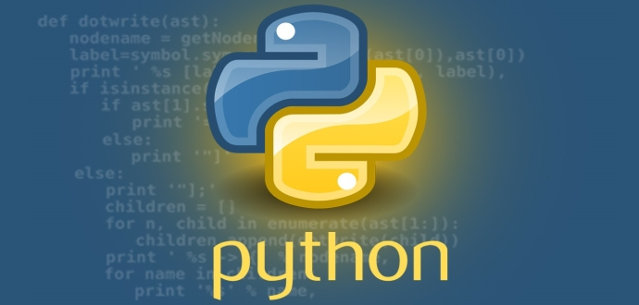
Python Programming Language

Slide 2
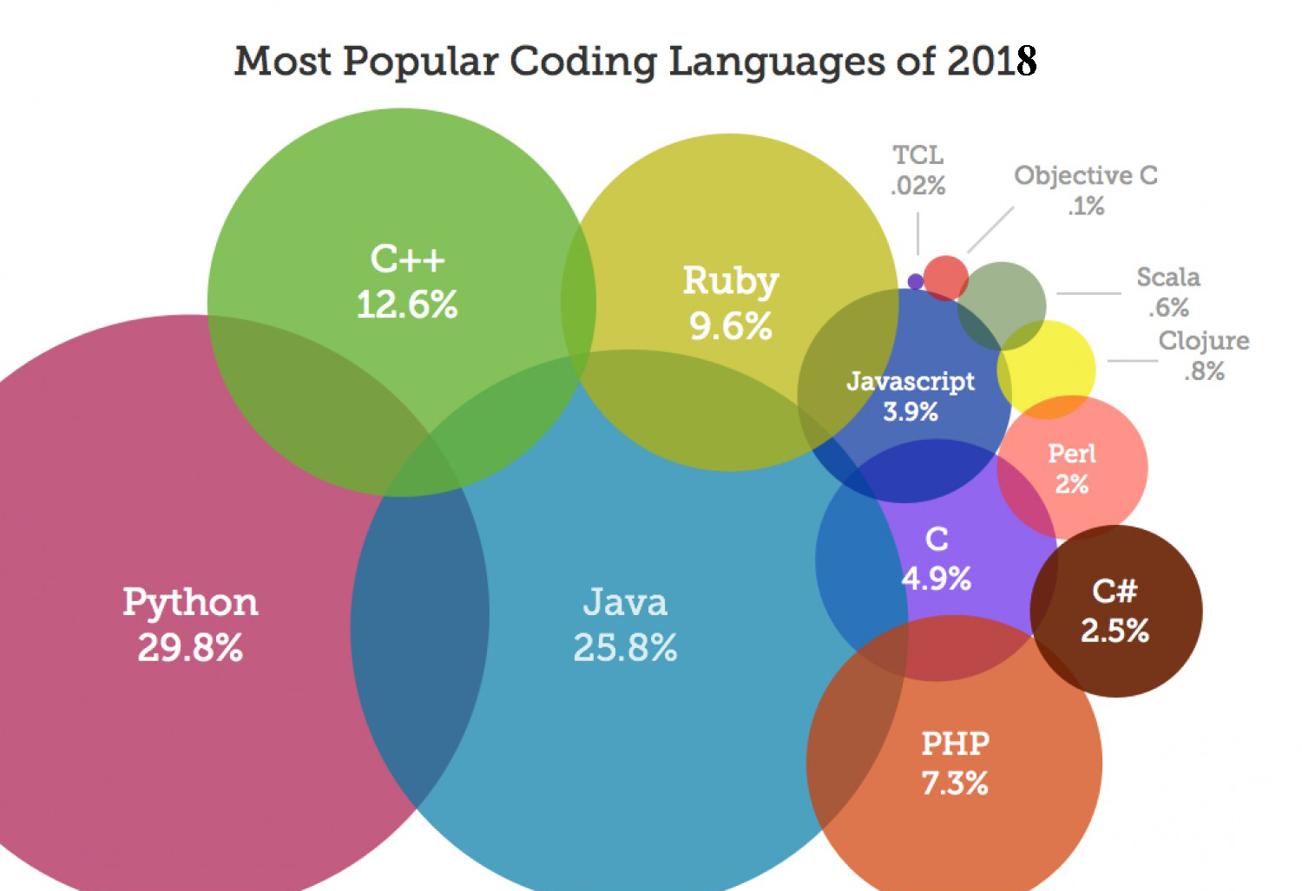
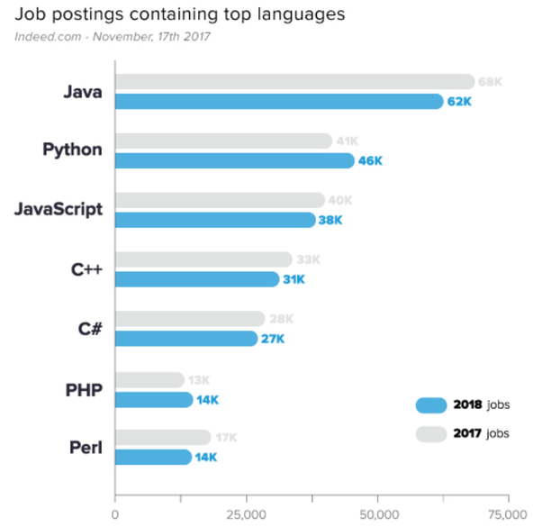

Slide 3
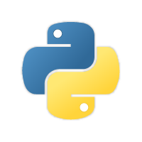
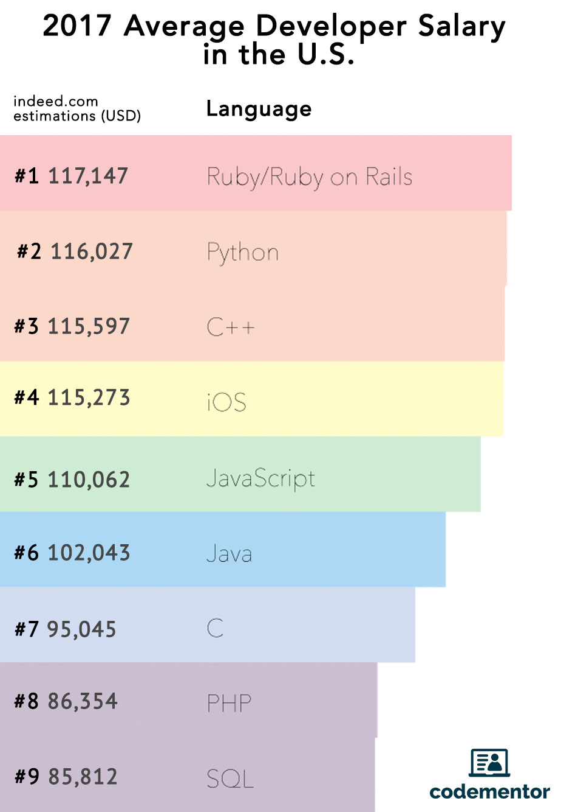
Why Learn Python
Python is Great for Beginners
Web Development with Python
Iterative, Agile Design
Python has High Salaries
Python Security
Python, Artificial Intelligence & Machine Learning
Python Diversity & Flexibility
Ch .Venkata RamiReddy Department Of Computer Science and Engineering

Slide 4

Python is the future of AI and Machine Learning.
Python numerical computation engines such as NumPy and SciPy, allowing complex calculations to be done by a single “import” statement followed by a function call.
Given the flexibility of the language, its speed, and the machine learning functionality delivered by libraries such as scikit-learn, Keras, and TensorFlow, we’ll continue to see Python dominate the machine learning landscape.
Ch .Venkata RamiReddy Department Of Computer Science and Engineering

Slide 5
Introduction
Python is a general-purpose, multi-paradigm ,interpreted and high-level programming language
It’s design philosophy emphasizes code readability.
Its syntax are said to be clear and expressive.
Python has a large and comprehensive standard library.
Python supports multiple programming paradigms, including object-oriented, imperative, procedural programming and functional programming styles.
Ch .Venkata RamiReddy Department Of Computer Science and Engineering

Slide 6
Introduction
Python interpreters are available for many operating systems.
Like Java, once written, programs can be run on any operating system.
Like other dynamic languages, Python is often used as a scripting language, but is also used in a wide range of non scripting contexts.
It has automatic memory management(Garbage collection)
Ch .Venkata RamiReddy Department Of Computer Science and Engineering

Slide 7
History
The history of Python starts with ABC.
Python was conceptualized by Guido Van Rossum in the late 1980s.
It was in late 1980’s, when Guido van Rossum came up with an idea to develop a programming language while working in CWI(Centrum Wiskunde and Informatica), Amsterdam, for a project named Amoeba which is a distributed operating system.
ABC is a general-purpose programming language and programming environment, which had been developed in the Netherlands, Amsterdam, at the CWI (Centrum Wiskunde & Informatica).
Ch .Venkata RamiReddy Department Of Computer Science and Engineering

Slide 8
History
He along with his team was using ABC language for their project which was not able to handle exceptions and interface with the Amoeba Operating System.
In December, 1989, he actually started implementing his ideas to develop a new programming language that is capable of exception handling with several other programming paradigms.
Rossum being a big fan of a British sketch comedy series, Monty Python’s Flying Circus, named the language as Python.
Python came into sight on 20 Feb, 1991 for the very first time with a version 0.9.0.
The greatest achievement of ABC was to influence the design of Python.
Ch .Venkata RamiReddy Department Of Computer Science and Engineering

Slide 9
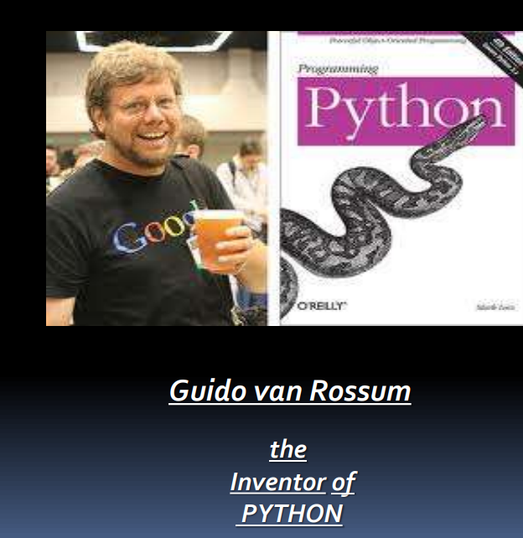
Ch .Venkata RamiReddy Department Of Computer Science and Engineering

Slide 10
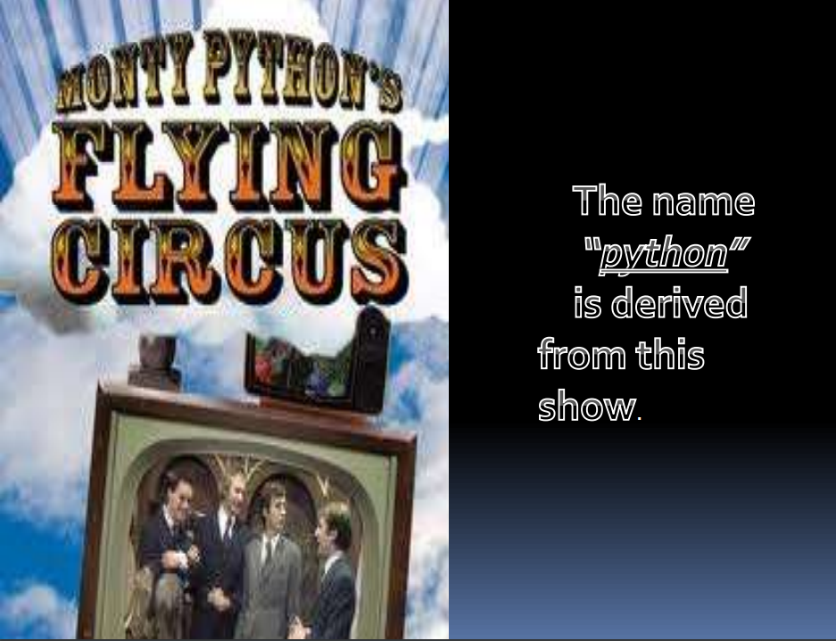
Ch .Venkata RamiReddy Department Of Computer Science and Engineering

Slide 11
History
Python 0.9.0 - February 20, 1991
Python 1.0 - January 1994
Python 2.0 - October 16, 2000
Python 3.0 - December 3, 2008
Python 3.7 - June 27, 2018
Ch .Venkata RamiReddy Department Of Computer Science and Engineering

Slide 12
Features of Python
Easy to Read, Learn and Use(Readability):
Python does not involve the use of complex syntaxes which makes it a highly readable language.
Python's syntax is clear and readable.
It is also very easy language to learn and use in web development and GUI-based applications.
Interpreted Language-
Python is an interpreted language.
It means you don’t need to compile your codes to execute the program.
Following is a list of Python Interpreters.
CPython
PyPy
Stackless Python
Ch .Venkata RamiReddy Department Of Computer Science and Engineering

Slide 13
Cont ..
Interactive Language-
Python is an interactive language, which means you can write your programs in Python prompt thus enabling you to interact with the interpreter.
Portable-
Since a python program has the ability to run on all platforms such as Windows, MacOS, Linux etc., thus making it a highly portable language.
It can run on various hardware platforms and has the same interface on all platforms.
Ch .Venkata RamiReddy Department Of Computer Science and Engineering

Slide 14
Cont ..
Free and Open Source-
Python is freely available on the internet and being an open source language it allows you to make changes to the source code.
Python is an example of a FLOSS (Free/Libre and Open Source Software).
Huge Library or Extensive Libraries-
Python has a huge standard library that includes support for MIME and HTTP and several modules for GUI development, performing unit testing, database connectivity etc.
Besides the standard library, there are various other high-quality libraries such as the Python Imaging Library which is an amazingly simple image manipulation library.
Ch .Venkata RamiReddy Department Of Computer Science and Engineering

Slide 15
Cont ..
Cross-Compilation-
You can actually use python codes in other languages by means of several compilers that are listed below.
Jython- compiles Python code to Java Bytecode
Pyjs- compiles Python code to JavaScript
Cython- compiles Python code to C and C++
Pythran- compiles Python code to C++
IronPython- it is used to run Python programs on .NET Framework.
Embeddable-
You can embed Python within your C/C++ program to give scripting capabilities for your program's users.
Ch .Venkata RamiReddy Department Of Computer Science and Engineering

Slide 16
Cont ..
Object Oriented-
Python supports procedure-oriented programming as well as object-oriented programming.
In procedure-oriented languages, the program is built around procedures or functions which are nothing but reusable pieces of programs.
In object-oriented languages, the program is built around objects which combine data and functionality.
Extensible-
If you need a critical piece of code to run very fast, you can achieve this by writing that piece of code in C, and then combine that with your Python program.
Ch .Venkata RamiReddy Department Of Computer Science and Engineering

Slide 17
Cont ..
Scalable-
Python provides a good structure and support for large programs.
Database Interfaces –
Python provides interfaces to all major commercial databases. These interfaces are pretty easy to use.
GUI programming –
Python supports GUI applications and has framework for Web. Interface to tkinter, WXPython, DJango in Python make it .
Automatic Memory Management-
Python supports automatic garbage collection.
Ch .Venkata RamiReddy Department Of Computer Science and Engineering

Slide 18
Cont ..
Scalable-
Python provides a good structure and support for large programs.
Database Interfaces –
Python provides interfaces to all major commercial databases. These interfaces are pretty easy to use.
GUI programming –
Python supports GUI applications and has framework for Web. Interface to tkinter, WXPython, DJango in Python make it .
Automatic Memory Management-
Python supports automatic garbage collection.
Ch .Venkata RamiReddy Department Of Computer Science and Engineering

Slide 19
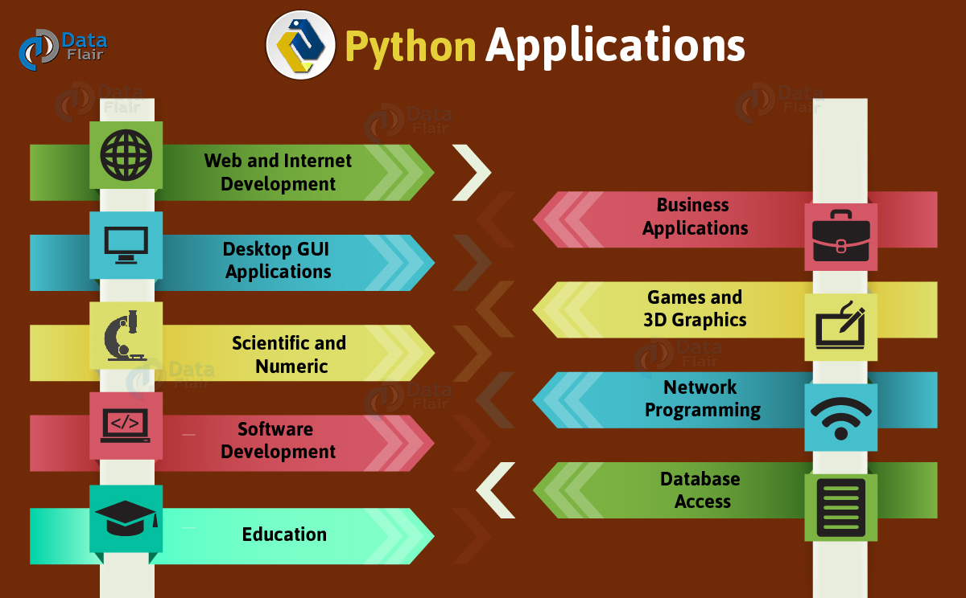
Ch .Venkata RamiReddy Department Of Computer Science and Engineering

Slide 20
Variables
A Python variable is a reserved memory location to store values.
A variable is a way of referring to a memory location used by a computer program.
A variable is a symbolic name for this physical location.
This memory location contains values, like numbers, text or more complicated types.
i = 42
S=“hi”
Ch .Venkata RamiReddy Department Of Computer Science and Engineering

Slide 21
Cont ..
One of the main differences between Python and strongly-typed languages like C, C++ or Java is the way it deals with types.
In strongly-typed languages every variable must have a unique data type.
E.g. if a variable is of type integer, solely integers can be saved in the variable.
In Java or C, every variable has to be declared before it can be used.
Declaration of variables is not required in Python.
Not only the value of a variable may change during program execution but the type as well.
You can assign an integer value to a variable, use it as an integer for a while and then assign a string to the variable.
Ch .Venkata RamiReddy Department Of Computer Science and Engineering

Slide 22
Cont ..
f=10
print(f)
f="valueafter"
print(f)
Ex2:
counter = 100 # An integer assignment
miles = 1000.0 # A floating point
name = "John" # A string
print (counter)
print (miles)
print (name)
Ch .Venkata RamiReddy Department Of Computer Science and Engineering

Slide 23
Assignment
An assignment statement is used to assign a value or expression to a variable.
Once a variable is assigned a value, the variable can be used in place of that value
The equal sign is symbol for assignment.
Width=10
Ex:
counter = 100
miles = 1000.0
sum=counter+miles
Ch .Venkata RamiReddy Department Of Computer Science and Engineering

Slide 24
Input and output
input() and print() are widely used for standard input and output operations respectively.
print() function is used to output data to the standard output device (screen).
Syntax:
Print(variable)
Ex:
a=5
Print(a) or print(‘value of c is’,c)
Ch .Venkata RamiReddy Department Of Computer Science and Engineering

Slide 25
Input and output
Input() function is used to read the input form the user.
variable=input(“prompt ”)
By default type of entered value is string.
int() or float() functions are used convert this string number in to integer or float.
a=input(“enter a value”)
a=int(a) or a=float(a)
Ch .Venkata RamiReddy Department Of Computer Science and Engineering

Slide 26
Input and output
The sep separator is used between the values.
It defaults into a space character.
After all values are printed, end is printed. It defaults into a new line.
Ex:
print(1,2,3,4) Output: 1 2 3 4
print(1,2,3,4,sep='*‘) Output: 1*2*3*4
print(1,2,3,4,sep='#',end='&') Output: 1#2#3#4&
Ch .Venkata RamiReddy Department Of Computer Science and Engineering

Slide 27
Input and output
Sometimes we would like to format our output to make it look attractive.
This can be done by using the str.format()
x = 5; y = 10
print('The value of x is {} and y is {}'.format(x,y))
o/p:The value of x is 5 and y is 10
print('I love {0} and {1}'.format('bread','butter'))
Output: I love bread and butter
print('I love {1} and {0}'.format('bread','butter'))
Output: I love butter and bread
Ch .Venkata RamiReddy Department Of Computer Science and Engineering

