Slide 1
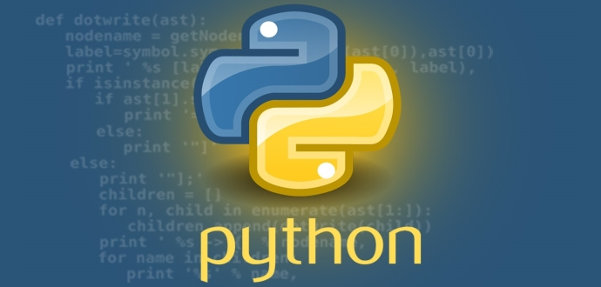
Python Programming Language

Slide 2

Basic Data types in Python
Every value in Python has a datatype.
Since everything is an object in Python programming, data types are actually classes and variables are instance (object) of these classes.
Numbers
Strings
Boolean
Ch .Venkata RamiReddy Department Of Computer Science and Engineering

Slide 3
Numbers
Integers, floating point numbers and complex numbers falls under Python numbers category.
They are defined as int, float and complex class in Python.
Integers can be of any length, it is only limited by the memory available.
A floating point number is accurate up to 15 decimal places.
Complex numbers are written in the form, x + yj, where x is the real part and y is the imaginary part.
Ch .Venkata RamiReddy Department Of Computer Science and Engineering

Slide 4
Numbers
We can use the type() function to know type a variable.
Ex:
a = 5
print(a, "is of type", type(a))
a = 2.0
print(a, "is of type", type(a))
a = 1+2j
print(a, "is of type ?", type(a))
Ch .Venkata RamiReddy Department Of Computer Science and Engineering

Slide 5
Strings
String is sequence of Unicode characters.
We can use single quotes or double quotes to represent strings.
Multi-line strings can be denoted using triple quotes, ''' or """.
Example:
firstName = 'john‘
lastName = "smith“
message = """This is a string that will span across multiple lines. Using newline characters and no spaces for the next lines. """
Ch .Venkata RamiReddy Department Of Computer Science and Engineering

Slide 6
Strings
Strings can be accessed as a whole string, or a substring of the complete variable using brackets ‘[]’.
Ex:
var1 = 'Hello World!‘
var2 = 'RhinoPython‘
print var1[0] # this will print the first character in the string an `H`
print var2[1:5] # this will print the substring 'hinoP`
Ch .Venkata RamiReddy Department Of Computer Science and Engineering

Slide 7
Boolean Type
Python 3 provides a Boolean data type.
Objects of Boolean type may have one of two values, True or False:
Ch .Venkata RamiReddy Department Of Computer Science and Engineering

Slide 8
Type Conversion
Function | Description
int() | Returns an integer object constructed from a number or string
float() | Returns a floating-point object constructed from a number or string
str() | Returns a string version of an object
Ch .Venkata RamiReddy Department Of Computer Science and Engineering

Slide 9
Python Operators
Operators are used to perform operations on variables and values.
Python provides the following operators:
Arithmetic operators
Assignment operators
Comparison operators
Logical operators
Identity operators
Membership operators
Bitwise operators
Ch .Venkata RamiReddy Department Of Computer Science and Engineering

Slide 10
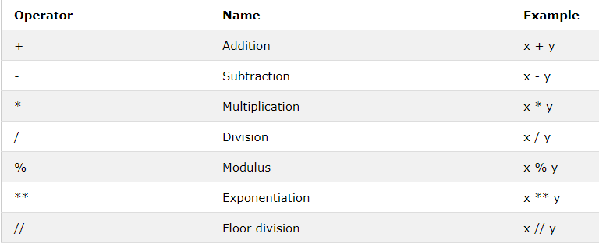
Arithmetic Operators
Arithmetic operators are used with numerc values to perform common mathematical operations:
Ch .Venkata RamiReddy Department Of Computer Science and Engineering

Slide 11
Arithmetic Operators
x = 15
y = 4
print('x + y =',x+y)
print('x - y =',x-y)
print('x * y =',x*y)
print('x / y =',x/y)
print('x // y =',x//y)
print('x ** y =',x**y)
Ch .Venkata RamiReddy Department Of Computer Science and Engineering

Slide 12
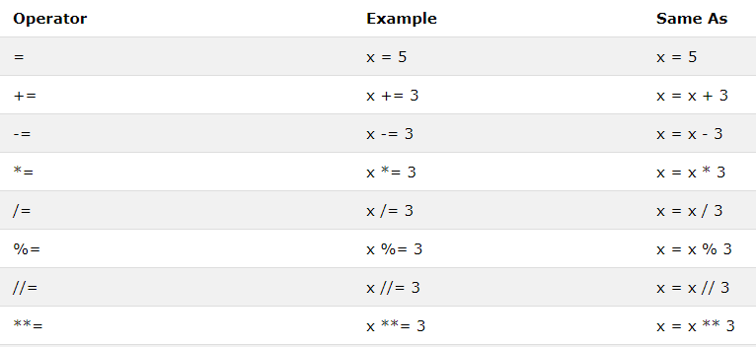
Assignment Operators
Assignment operators are used to assign values to variables:
Ch .Venkata RamiReddy Department Of Computer Science and Engineering

Slide 13
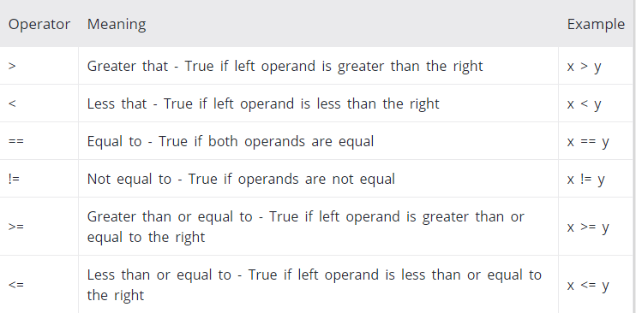
Comparison Operators
Comparison operators are used to compare two values: It either returns True or False according to the condition.
Ch .Venkata RamiReddy Department Of Computer Science and Engineering

Slide 14
Comparison Operators
x = 10
y = 12
print('x > y is',x>y)
print('x < y is',x<y)
print('x == y is',x==y)
print('x != y is',x!=y)
print('x >= y is',x>=y)
print('x <= y is',x<=y)
Ch .Venkata RamiReddy Department Of Computer Science and Engineering

Slide 15
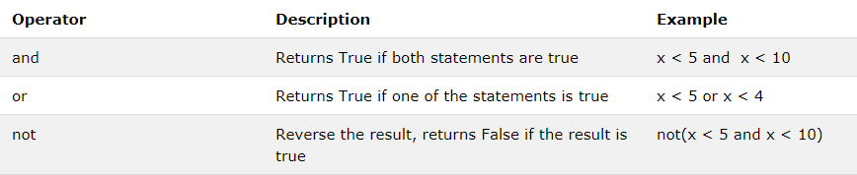
Logical Operators
Logical operators are used to combine conditional statements
Ex:
x = True
y = False
print('x and y is',x and y)
print('x or y is',x or y)
print('not x is',not x)
Ch .Venkata RamiReddy Department Of Computer Science and Engineering

Slide 16
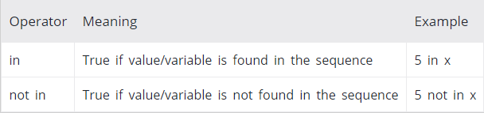
Membership operators
in and not in are the membership operators in Python.
They are used to test whether a value or variable is found in a sequence (string, list, tuple, set and dictionary).
In a dictionary we can only test for presence of key, not the value.
Ch .Venkata RamiReddy Department Of Computer Science and Engineering

Slide 17
Membership operators
x = 'Hello world'
y = {1:'a',2:'b'}
print('H' in x)
print(‘Hello' not in x)
print(1 in y)
print('a' in y)
Ch .Venkata RamiReddy Department Of Computer Science and Engineering

Slide 18
Bitwise operators
Bitwise operators act on operands as if they were string of binary digits.
It operates bit by bit, hence the name.
For example, 2 is 10 in binary and 7 is 111.
Ch .Venkata RamiReddy Department Of Computer Science and Engineering

Slide 19
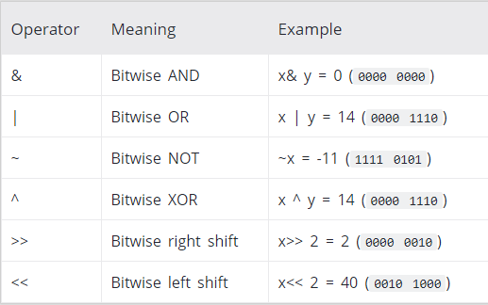
Bitwise operators
In the table below: Let x = 10 (0000 1010 in binary) and y = 4 (0000 0100 in binary)
Ch .Venkata RamiReddy Department Of Computer Science and Engineering

Slide 20
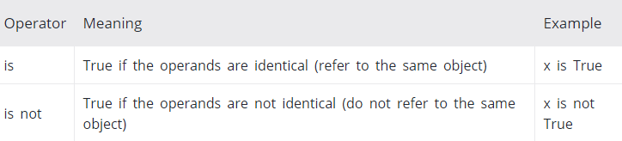
Identity operators
is and is not are the identity operators in Python.
They are used to check if two values (or variables) are located on the same part of the memory.
Ex:
a1 = 3
b1 = 3
a2 = 'CS2’
b2 = 'CSE’
'print(a1 is not b1)
print(a2 is b2)
Ch .Venkata RamiReddy Department Of Computer Science and Engineering

Slide 21
Decision making (or) conditional Statements
Decision making is required when we want to execute a code only if a certain condition is satisfied.
The if statement
The if else statement
if...elif...else Statement
Nested if statements
Ch .Venkata RamiReddy Department Of Computer Science and Engineering

Slide 22
Decision making
Syntax:
if test expression:
statement(s)
Here, the program evaluates the test expression and will execute statement(s) only if the text expression is True.
If the text expression is False, the statement(s) is not executed.
In Python, the body of the if statement is indicated by the indentation.
Body starts with an indentation and the first unindented line marks the end.
Ch .Venkata RamiReddy Department Of Computer Science and Engineering

Slide 23
Decision making
num = 3
if num>0:
print(num, "is a positive number.")
print("This is always printed.")
Ch .Venkata RamiReddy Department Of Computer Science and Engineering

Slide 24
if...else Statement
Syntax:
if test expression:
Body of if
else:
Body of else
The if..else statement evaluates test expression and will execute body of if only when test condition is True.
If the condition is False, body of else is executed.
Indentation is used to separate the blocks.
Ch .Venkata RamiReddy Department Of Computer Science and Engineering

Slide 25
if...else Statement
no=input("enter number")
no=int(no)
if(no%5==0 and no%11==0):
print("number is divisable by 5 and 11")
else:
print("number is notdivisable by 5 and 11")
Ch .Venkata RamiReddy Department Of Computer Science and Engineering

Slide 26
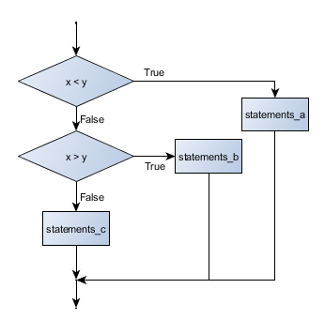
if...elif...else Statement
Syntax of if...elif...else
if test expression:
Body of if
elif test expression:
Body of elif
else:
Body of else
Ch .Venkata RamiReddy Department Of Computer Science and Engineering

Slide 27
if...elif...else Statement
If the condition for if is False, it checks the condition of the next elif block and so on.
If all the conditions are False, body of else is executed.
Only one block among the several if...elif...else blocks is executed according to the condition.
The if block can have only one else block. But it can have multiple elif blocks.
Ch .Venkata RamiReddy Department Of Computer Science and Engineering

Slide 28
if...elif...else Statement
a=int(input("enter numbers"))
b=int(input("enter numbers"))
c=int(input("enter numbers"))
if(a>b and a>c):
print(a,"is big")
elif b>c:
print(b,"is big")
else:
print(c,"is big")
Ch .Venkata RamiReddy Department Of Computer Science and Engineering

Slide 29
Nested if statement
We can have a if...elif...else statement inside another
if...elif...else statement. This is called nesting in computer programming.
Example:
num = int(input("Enter a number: "))
if num >= 0:
if num == 0:
print("Zero")
else:
print("Positive number")
else:
print("Negative number")
Ch .Venkata RamiReddy Department Of Computer Science and Engineering

Slide 30
Loops in Python
Python has two primitive loops
While
for
Ch .Venkata RamiReddy Department Of Computer Science and Engineering

Slide 31
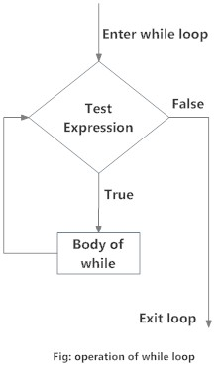
The while Loop
Syntax:
while test_expression:
Body of while
while loop executes a block of statements repeatedly till a given a condition is true. when the condition becomes false, it terminates the body of the loop.
The main characteristic of a while loop is that it will repeat a set of instructions based on a condition.
In Python, the body of the while loop is determined through indentation.
Ch .Venkata RamiReddy Department Of Computer Science and Engineering

Slide 32
The while Loop
# sum = 1+2+3+...+n
n= int(input("Enter a number: "))
sum=0
i=1
while i<=n:
sum=sum+i
i=i+1
print("sum of n natural num is",sum)
Ch .Venkata RamiReddy Department Of Computer Science and Engineering

Slide 33
Using else statement with while loops:
The else clause is only executed when your while condition becomes false.
If you break out of the loop, or if an exception is raised, it won’t be executed.
Syntax:
while condition:
# execute these statements
else:
# execute these statement
Ch .Venkata RamiReddy Department Of Computer Science and Engineering

Slide 34
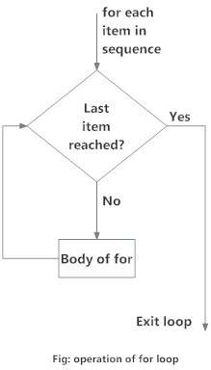
for loop:
A for loop is used for iterating over a sequence(list, tuple, string)
for loop can execute a set of statements, once for each item in a list
Syntax of for Loop
for val in sequence:
Body of for
Here, val is the variable that takes the value of the item inside the sequence on each iteration.
Loop continues until it reach the last item in the sequence.
Ch .Venkata RamiReddy Department Of Computer Science and Engineering

Slide 35
# Program to find the sum of all numbers stored in a list#
numbers = [6, 5, 3, 8, 4, 2, 5, 4, 11]
sum = 0
for val in numbers:
sum = sum+val
print("The sum is", sum)
Ex2:
Fruits=["apple“,"banana", "cherry"] for x in fruits: print(x)
Ch .Venkata RamiReddy Department Of Computer Science and Engineering

Slide 36
The range() function
it generates a sequence of numbers.
range(10) will generate numbers from 0 to 9 (10 numbers).
We can also define the start, stop and step size as range(start,stop,step size).
step size defaults to 1 if not provided.
list() function output all the items in the range.
print(list(range(10))) # Output: [0, 1, 2, 3, 4, 5, 6, 7, 8, 9]
print(list(range(2, 8))) # Output: [2, 3, 4, 5, 6, 7]
print(list(range(2, 20, 3))) # Output: [2, 5, 8, 11, 14, 17]
Ch .Venkata RamiReddy Department Of Computer Science and Engineering

Slide 37
Ex:
num= int(input("Enter a number: "))
factorial = 1
if num < 0:
print("Sorry, factorial does not exist for negative numbers")
elif num == 0:
print("The factorial of 0 is 1")
else:
for i in range(1,num + 1):
factorial=factorial*i
print("The factorial of",num,"is",factorial)
Ch .Venkata RamiReddy Department Of Computer Science and Engineering

Slide 38
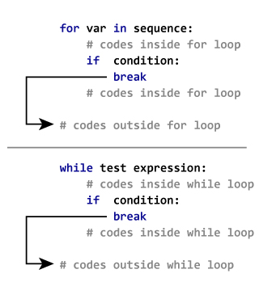
Python break and continue
In Python, break and continue statements can alter the flow of a normal loop.
Python break statement
The break statement terminates the loop containing it.
If break statement is inside a nested
loop, break will terminate the innermost
loop.
Ch .Venkata RamiReddy Department Of Computer Science and Engineering

Slide 39
Python break and continue
for val in "string":
if val == "i":
break
print(val)
print("The end")
Ch .Venkata RamiReddy Department Of Computer Science and Engineering

Slide 40
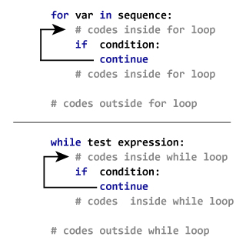
Python continue statement
The continue statement is used to skip the rest of the code inside a loop for the current iteration only.
Loop does not terminate but continues on with the next iteration.
Ex:
for val in "string":
if val == "i":
continue
print(val)
print("The end")
Ch .Venkata RamiReddy Department Of Computer Science and Engineering

Slide 41
Python pass statement
The pass statement is a null operation; nothing happens when it executes.
It indicates no operation (NOP).
Suppose we have a loop or a function that is not implemented yet, but we want to implement it in the future.
So, we use the pass statement to construct a body that does nothing.
Ex:
sequence = {'p', 'a', 's', 's'}
for val in sequence:
pass
print ("good bye")
Ch .Venkata RamiReddy Department Of Computer Science and Engineering

Slide 42
Expressions and order of Evalutions
A Python expression describes a computation or operation, performed on data.
The combination of values, variables, operators is termed as an expression
Ex:
10 - 4 * 2 o/p:
(10-4)*2 o/p:
Ch .Venkata RamiReddy Department Of Computer Science and Engineering

Slide 43
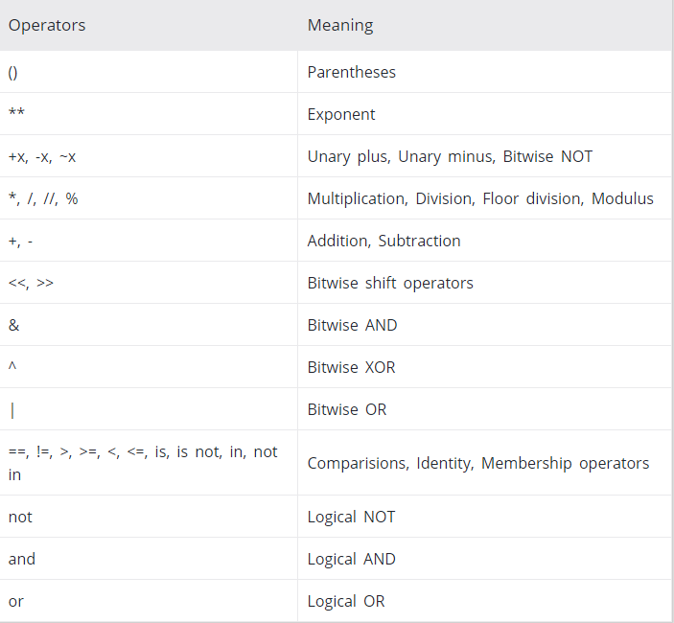
Operator precedence rule in Python
Ch .Venkata RamiReddy Department Of Computer Science and Engineering

Slide 44
Associativity of Python Operators
Associativity is the order in which an expression is evaluated When two operators have the same precedence
When two operators have the same precedence, associativity helps to determine which the order of operations.
Almost all the operators have left-to-right associativity.
This means that operators with the same precedence are evaluated in a left to right manner
Exponent operator ** has right-to-left associativity in Python.
Ch .Venkata RamiReddy Department Of Computer Science and Engineering

Slide 45
Associativity of Python Operators
2 * 5 + 1 ⇒
2 + 5 – 1 ⇒
4 * 6 / 8 ⇒
5 * 2 // 3 ⇒
5 * (2 // 3) ⇒
2 ** 3 ** 2 ⇒
(2 ** 3) ** 2 ⇒
Ch .Venkata RamiReddy Department Of Computer Science and Engineering

