Slide 1
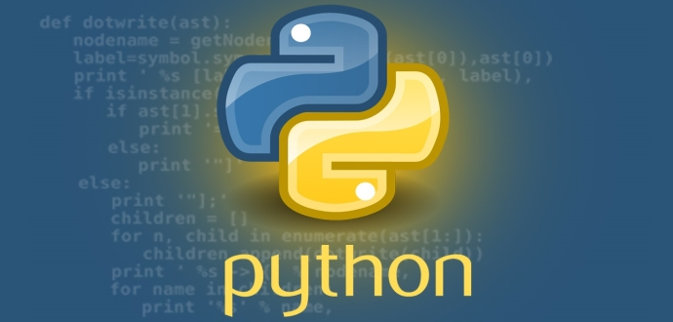
Python Programming Language

Slide 2

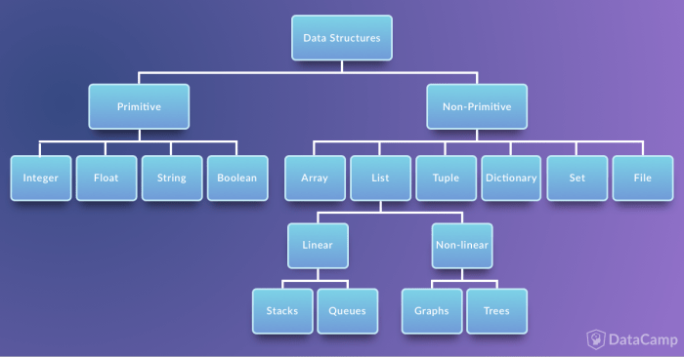
write a program to print the number of times one string is present in the other as a substring.
Data structures are a way of organizing and storing data so that they can be accessed and worked with efficiently.
Ch .Venkata RamiReddy Department Of Computer Science and Engineering

Slide 3
Data Types in PythonPython
Numbers
Booleans
Strings
List
Tuple
Set
Dictionary
Ch .Venkata RamiReddy Department Of Computer Science and Engineering

Slide 4
List
List is an ordered collection of items(elements)
Lists in Python are used to store collection of heterogeneous items.
These are mutable, which means that you can change their content without changing their identity.
It Allows duplicate members.
list indices start at 0
Ex:
list1 = ['physics', 'chemistry', 1997, 2000];
list2 = [1, 2, 3, 4, 5 ];
Ch .Venkata RamiReddy Department Of Computer Science and Engineering

Slide 5
How to create a list?
In Python programming, a list is created by placing all the items (elements) inside a square bracket [ ], separated by commas.
It can have any number of items and they may be of different types (integer, float, string etc.).
list my_list = []
my_list = [1, 2, 3]
my_list = [1, "Hello", 3.4]
Also, a list can even have another list as an item. This is called nested list.
my_list = ["mouse", [8, 4, 6], ['a']]
Ch .Venkata RamiReddy Department Of Computer Science and Engineering

Slide 6
slicing or How to access elements from a list?
Slicing : Extracting the particular part of a list.
List Index
We can use the index operator [] to access an item in a list.
Index starts from 0. So, a list having 5 elements will have index from 0 to 4.
Trying to access an element out of range index then it will raise an IndexError.
The index must be an integer. We can't use float or other types, this will result into TypeError.
Nested list are accessed using nested indexing.
Negative indexing
Python allows negative indexing for its sequences.
The index of -1 refers to the last item, -2 to the second last item and so on.
Ch .Venkata RamiReddy Department Of Computer Science and Engineering

Slide 7
Basic List Operations
s=[1,2,3,4,5]
print(s[2]) # 3
print(s[-3]) # 3
print(s[::]) # [1,2,3,4,5]
Print(s[:-2]) # 4
s2 = ["mouse", [8, 4, 6], ['a']]
print(s[1] # [8,4,6]
Print(s[0][2]) # u
Print(s[1][1] #4
print[(s[2][0] #1
print[(s[2][1] # Index error
Ch .Venkata RamiReddy Department Of Computer Science and Engineering

Slide 8
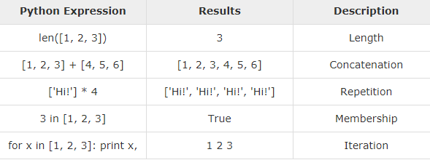
Basic List Operations
Write a python program to read and display items in the list?
Ch .Venkata RamiReddy Department Of Computer Science and Engineering

Slide 9
Write a python program to read and display items in the list?
L=[]
n=int(input("enter size of list"))
i=0
while(i<n):
a=int(input())
L.append(a)
i=i+1
for j in L:
print(j)
Ch .Venkata RamiReddy Department Of Computer Science and Engineering

Slide 10
Write a python program to find the sum of elements in a list
L=[]
n=int(input("enter size of list"))
i=0
sum=0
while(i<n):
a=int(input())
L.append(a)
i=i+1
#print(L)
for j in L:
print(j)
sum=sum+j
print(sum)
Ch .Venkata RamiReddy Department Of Computer Science and Engineering

Slide 11
Write a python program to find the largest element in a list
list=[1,2,4,7,3]
max=list[0]
for a in list:
if a > max:
max = a
print("largets is",max)
Ch .Venkata RamiReddy Department Of Computer Science and Engineering

Slide 12
Methods Of list
append(): method adds an item to the end of the list.
Syntax:
list.append(item)
The append() method takes a single item and adds it to the end of the list.
The item can be numbers, strings, another list, dictionary etc.
Ex:
animal = ['cat', 'dog', 'rabbit']
animal.append(‘pig')
len(): It returns the number of elements in the list.
Print(len(animal))
Ch .Venkata RamiReddy Department Of Computer Science and Engineering

Slide 13
Methods Of list
insert() : It inserts the element in to the list at the specified index.
syntax:
list.insert(index, element)
index - position where element needs to be inserted
element - this is the element to be inserted in the list
Ex:
vowel = ['a', 'e', 'i', 'u']
vowel.insert(3, 'o')
print('Updated List: ', vowel)
Ch .Venkata RamiReddy Department Of Computer Science and Engineering

Slide 14
Methods Of list
extend():it adds all items of a one list to the end of another list.
syntax:
list1.extend(list2)
Here, the elements of list2 are added to the end of list1.
language = ['French', 'English', 'German]
language1 = ['Spanish', 'Portuguese']
language.extend(language1)
print('Language List: ', language)
Ch .Venkata RamiReddy Department Of Computer Science and Engineering

Slide 15
Methods Of list
remove() : method searches for the given element in the list and removes the first matching element
syntax : list.remove(element)
Ex:
animal = ['cat', 'dog', 'rabbit', 'guinea pig','rabbit']
animal.remove('rabbit')
print('Updated animal list: ', animal)
pop(): method removes and returns the element at the given index
Sytax : list.pop(index)
language = ['Python', 'Java', 'C++', 'French', 'C']
r = language.pop(3)
print('Return Value: ', r) # French
print('Updated List: ', language)
Ch .Venkata RamiReddy Department Of Computer Science and Engineering

Slide 16
Methods Of list
clear(): It removes all items from the list.
syntax : list.clear()
index() : It searches an element in the list and returns its first index.
syntax : list.index(element)
vowels = ['a', 'e', 'i', 'o', 'i', 'u']
index = vowels.index('e') #1
Print(index)
count(): method returns the number of occurrences of an element in a list.
Syntax: list.count(element)
vowels = ['a', 'e', 'i', 'o', 'i', 'u']
count = vowels.count('i')
Print(count) #2
Ch .Venkata RamiReddy Department Of Computer Science and Engineering

Slide 17
Methods Of list
copy(): method returns a shallow copy of the list.
The copy() function returns a list. It doesn't modify the original list.
Syntax: new_list = list.copy()
Ex:
list = ['cat', 0, 6.7]
new_list = list.copy()
sum() : Calculates sum of all the elements of List. Syntax: sum(List)
List = [1, 2, 3, 4, 5]
print(sum(List))
Ch .Venkata RamiReddy Department Of Computer Science and Engineering

Slide 18
Methods Of list
min() : Calculates minimum of all the elements of List. Syntax: min(List)
List = [2, 4, 3, 5, 1, 2.5]
print(min(List)) #1
max(): Calculates maximum of all the elements of List. Syntax: max(List)
List = [2, 4, 3, 5, 1, 2.5]
print(max(List)) #5.
del() : it is used to delete element from the list Syntax: del list[index]
List = [2, 4, 3, 5, 1, 2.5]
del List[0]
print(List)
Ch .Venkata RamiReddy Department Of Computer Science and Engineering

Slide 19
List Comprehension:
List comprehension is an elegant and concise way to create new list from an existing list in Python.
List comprehension consists of an expression followed by for statement inside square brackets.
pow2 = [2 ** x for x in range(10)]
print(pow2)
# Output: [1, 2, 4, 8, 16, 32, 64, 128, 256, 512]
Ch .Venkata RamiReddy Department Of Computer Science and Engineering

Slide 20
List Comprehension:
import math as m
n=int(input())
sum=0
s=[m.sqrt(x) for x in range(n+1)]
for i in s:
sum=sum+i
avg=sum/n
print(s)
print(avg)
Ch .Venkata RamiReddy Department Of Computer Science and Engineering

Slide 21
Exmaples
Write a Python program to sum all the items in a list.
Write a Python program to get the largest number from a list.
Write a Python program to count the number of strings where the string length is 2 or more and the first and last character are same from a given list of strings. Sample List : ['abc', 'xyz', 'aba', '1221'] Expected Result : 2
Ch .Venkata RamiReddy Department Of Computer Science and Engineering

Slide 22
Tuple
A Tuple is a collection of Python objects(elements) separated by commas.
These are immutable, which means that you can not change their content.
Advantages of Tuple over List:
We generally use tuple for heterogeneous (different) datatypes and list for homogeneous (similar) datatypes.
Since tuple are immutable, iterating through tuple is faster than with list. So there is a slight performance boost.
Tuples that contain immutable elements can be used as key for a dictionary. With list, this is not possible.
If you have data that doesn't change, implementing it as tuple will guarantee that it remains write-protected
Ch .Venkata RamiReddy Department Of Computer Science and Engineering

Slide 23
Creating a Tuple
A tuple is created by placing all the items (elements) inside a parentheses (), separated by comma.
A tuple can have any number of items and they may be of different types (integer, float, list, string etc.).
my_tuple = ()
my_tuple = (1, 2, 3)
my_tuple = (1, "Hello", 3.4)
my_tuple = ("mouse", [8, 4, 6], (1, 2, 3))
my_tuple = 3, 4.6, "dog"
Ch .Venkata RamiReddy Department Of Computer Science and Engineering

Slide 24
Accessing Elements in a Tuple
Indexing:
We can use the index operator [] to access an item in a tuple where the index starts from 0.
So, a tuple having 6 elements will have index from 0 to 5.
Trying to access an element other that (6, 7,...) will raise an IndexError.
The index must be an integer, so we cannot use float or other types. This will result into TypeError
Negative Indexing
Python allows negative indexing for its sequences.
The index of -1 refers to the last item, -2 to the second last item and so on.
Slicing
We can access a range of items in a tuple by using the slicing operator - colon ":".
Ch .Venkata RamiReddy Department Of Computer Science and Engineering

Slide 25
Accessing Elements in a Tuple
my_tuple = ('p','e','r','m','i','t')
print(my_tuple[5])
n_tuple = ("mouse", [8, 4, 6], (1, 2, 3))
print(n_tuple[0][3])
print(my_tuple[-2])
print(my_tuple[1:4])
print(my_tuple[:])
n_tuple[0] = 9
n_tuple[2][0] = 10
print(n_tuple)
Ch .Venkata RamiReddy Department Of Computer Science and Engineering

Slide 26
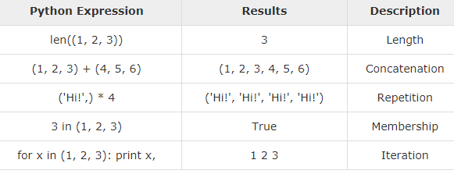
Basic Tuples Operations
Ch .Venkata RamiReddy Department Of Computer Science and Engineering

Slide 27
Methods
len(): returns the number of elements in the tuple.
t=(1,2,3)
Print(len(t))
max(): It returns the elements from the tuple with maximum value.
Syntax: max(tuple)
Print(max(t))
min() : It returns the elements from the tuple with minimum value.
Syntax :min(tuple)
Print(min(t))
tuple(): converts a list of items into tuples
Syntax: tuple( seq )
Ch .Venkata RamiReddy Department Of Computer Science and Engineering

Slide 28
Methods
count(): method searches the given element in a tuple and returns how many times the element has occurred in it.
syntax: tuple.count(element)
T=(1,5,3,2,5)
Print(T.count(5)) # 2
index(): index() method searches for the given element in a tuple and returns its position.
if the same element is present more than once, the first/smallest position is returned.
Syntax: tuple.index(element)
Print(T.index(5)) # 1
Ch .Venkata RamiReddy Department Of Computer Science and Engineering

Slide 29
Methods
sorted(): method sorts the elements of a given tuple in a specific order - Ascending or Descending.
Syntax: sorted(iterable,[reverse])
p = ('e', 'a', 'u', 'o', 'i')
print(sorted(p))
print(sorted(p,reverse=True))
reversed(): method reverse the contents of the tuple.
reversed(seq)
print(list(reversed(p)))
Ch .Venkata RamiReddy Department Of Computer Science and Engineering

Slide 30
Methods
sum() :function adds the items of an tuple and returns the sum.
Syntax: sum(tuple, start)
numbers = [2.5, 3, 4, -5]
sum = sum(numbers)
sum = sum(numbers, 1)
print(sum)
Ch .Venkata RamiReddy Department Of Computer Science and Engineering

Slide 31
boolean operators/methods on tuples
all(): method returns True when all elements in the given tuple are true. If not, it returns False.
Syntax: all(tuple)
Ex:
l = [1, 3, 4, 5]
print(all(l)) # True
l = [0, False]
print(all(l)) #False
l = [1, 3, 4, 0]
print(all(l)) # False
Ch .Venkata RamiReddy Department Of Computer Science and Engineering

Slide 32
boolean operators/methods on tuples
any() : method returns True if any element of tuple is true. If not, this method returns False.
Syntax: any(tuple)
l = [1, 3, 4, 0]
print(any(l)) # True
l = [0, False]
print(any(l)) # False
l = [1, 3, 4, 0]
print(all(l)) # True
Ch .Venkata RamiReddy Department Of Computer Science and Engineering

Slide 33
boolean operators/methods on tuples
bool(): method converts a value to Boolean (True or False) using the standard truth testing procedure.
Syntax : bool([value])
False values:
None, False ,Zero of any numeric type. For example, 0, 0.0, 0j
Empty sequence. For example, (), [], '‘, {}
test = 0.0
print(bool(test)) # False
test = 5
Print(bool(test)) # True
Ch .Venkata RamiReddy Department Of Computer Science and Engineering

Slide 34
Even and Odd sum in a tuple
t=(1,2,3,4,5)
sume=0
sumo=0
for i in t:
if(i%2==0):
sume=sume+i
else:
sumo=sumo+i
print(sume)
print(sumo)
Ch .Venkata RamiReddy Department Of Computer Science and Engineering

Slide 35
Prime sum in a tuple
t=(2,3,4,5,6,7)
sum=0
for i in t:
c=0
for j in range(1,i+1):
if(i%j==0):
c=c+1
if(c==2):
sum=sum+i
print(sum)
Ch .Venkata RamiReddy Department Of Computer Science and Engineering

Slide 36
python set
A set is an unordered collection of items.
All the elements in the set are unique (no duplicates) and must be immutable (which cannot be changed).
However, the set itself is mutable. We can add or remove items from it.
Sets can be used to perform mathematical set operations like union, intersection, symmetric difference etc.
S=set(“helloworld”)
Print(s)
Ch .Venkata RamiReddy Department Of Computer Science and Engineering

Slide 37
How to create a set?
A set is created by placing all the elements inside curly braces {}, separated by comma or by using the built-in function set().
It can have any number of items and they may be of different types (integer, float, tuple, string etc.).
But a set cannot have a mutable element, like list, or dictionary, as its element.
my_set = {1, 2, 3}
my_set = set([1,2,3]) #{1,2,3}
my_set = {1,2,3,4,3,2} # {1,2,3,4}
my_set = {1, 2, [3, 4]} # error
Ch .Venkata RamiReddy Department Of Computer Science and Engineering

Slide 38
Creating an empty set
Empty curly braces {} will make an empty dictionary in Python.
To make a set without any elements use the set() function without any argument.
We cannot access or change an element of set using indexing or slicing.
Set does not support it.
A={} # empty dictionary
A=set() # empty set
A=[] # empty list
Ch .Venkata RamiReddy Department Of Computer Science and Engineering

Slide 39
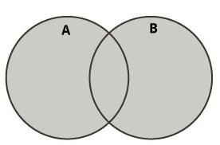
Python Set Operations
Sets can be used to carry out mathematical set operations like union, intersection, difference and symmetric difference.
Set Union
Union of A and B is a set of all elements from both sets
Union is performed using | operator.
Same can be performed using the method union().
Ex:
A = {1, 2, 3, 4, 5} B = {4, 5, 6, 7, 8}
print(A | B)
# Output: {1, 2, 3, 4, 5, 6, 7, 8} or
A.union(B)
Ch .Venkata RamiReddy Department Of Computer Science and Engineering

Slide 40
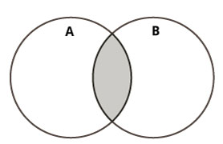
Python Set Operations
Set Intersection:
Intersection of A and B is a set of elements that are common in both sets.
Intersection is performed using & operator.
Same can be accomplished using the method intersection().
A = {1, 2, 3, 4, 5} B = {4, 5, 6, 7, 8}
print(A & B)
# Output: {4, 5}
Or
A.intersection(B)
Ch .Venkata RamiReddy Department Of Computer Science and Engineering

Slide 41
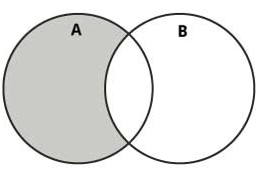
Python Set Operations
Set Difference
Difference of A and B (A - B) is a set of elements that are only in A but not in B. Similarly, B - A is a set of element in B but not in A.
Difference is performed using - operator.
Same can be accomplished using the method difference().
A = {1, 2, 3, 4, 5} B = {4, 5, 6, 7, 8}
print(A - B) # Output: {1, 2, 3}
print(B - A) # Output: {8,6,7}
Or
A.difference(B)
Ch .Venkata RamiReddy Department Of Computer Science and Engineering

Slide 42
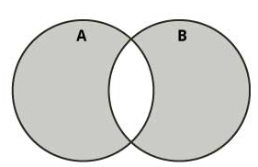
Python Set Operations
Set Symmetric Difference
Symmetric Difference of A and B is a set of elements in both A and B except those that are common in both.
Symmetric difference is performed using ^ operator.
Same can be accomplished using the method symmetric_difference().
A = {1, 2, 3, 4, 5} B = {4, 5, 6, 7, 8}
print(A ^ B) # Output: {1, 2, 3, 6, 7, 8}
A.symmetric_difference(B)
Ch .Venkata RamiReddy Department Of Computer Science and Engineering

Slide 43
Python program to perform all set operation
A = {1, 2, 3, 4, 5}
B = {4, 5, 6, 7, 8}
print(A | B)
print(A & B)
print(A-B)
print(A^B)
Ch .Venkata RamiReddy Department Of Computer Science and Engineering

Slide 44
Python Set Methods
add() : It adds a given element to a set. If the element is already present, it doesn't add any element.
Syntax: set.add(elem)
Ex:
v = {'a', 'e', 'i', 'u'}
v.add('o')
print('Vowels are:', v)
v.add('a')
print('Vowels are:', v)
Ch .Venkata RamiReddy Department Of Computer Science and Engineering

Slide 45
Python Set Methods
remove(): method searches for the given element in the set and removes it.
syntax: set.remove(element)
If the element passed to the remove() method doesn't exist, keyError exception is thrown.
Ex:
language = {'English', 'French', German'}
language.remove('German')
print(language)
Output: {'English', 'French'}
Ch .Venkata RamiReddy Department Of Computer Science and Engineering

Slide 46
Python Set Methods
discard(): method removes a specified element from the set (if present).
syntax : s.discard(x)
The discard() removes element x from the set if the element is present.
If element is not present it won’t raise an error.
numbers = {2, 3, 4, 5}
numbers.discard(3)
print(numbers) # {2, 4, 5}
numbers.discard(10)
Print(numbers) # {2, 4, 5}
Ch .Venkata RamiReddy Department Of Computer Science and Engineering

Slide 47
Python Set Methods
pop(): method removes an arbitrary element from the set and returns the element removed.
If the set is empty, TypeError exception is raised.
Syntax: set.pop()
Ex:
A ={'a', 'b', 'c', 'd'}
print( A.pop()) # a
print( A) #{b,c,d}
clear(): method removes all elements from the set.
Syntax: set.clear()
Ch .Venkata RamiReddy Department Of Computer Science and Engineering

Slide 48
Python Set Methods
update(): It adds elements of a set to the other set.
Syntax: A.update(B)
Here, A and B are two sets. The elements of set B are added to the set A.
A = {'a', 'b'} B = {1, 2, 3}
A.update(B)
print(A) # {'b', 1, 2, 3, 'a'}
copy(): method returns a shallow copy of the set.
Syntax : set.copy()
numbers = {1, 2, 3, 4}
new_numbers = numbers.copy()
new_numbers.add('5')
print(numbers) # {1, 2, 3, 4}
print(new_numbers) # {1, 2, 3, 4,5}
Ch .Venkata RamiReddy Department Of Computer Science and Engineering

Slide 49
Python Set Methods
len() function returns the number of items (length) of an object.
max() method returns the largest element in an iterable or largest of two or more parameters.
min() method returns the smallest element in an iterable or smallest of two or more parameters.
sum() function adds the items of an iterable and returns the sum.
Ex:
numbers = [2.5, 3, 4, -5]
print(sum(numbers)) # 4.5
print(max(numbers)) #4
print(min(numbers)) # -5
print(len(numbers)) #4
Ch .Venkata RamiReddy Department Of Computer Science and Engineering

Slide 50
Set Membership Operations
We can test if an item exists in a set or not, using the keyword in.
my_set = set("apple")
print('a' in my_set)
# Output: True
print('p' not in my_set)
# Output: False
Ch .Venkata RamiReddy Department Of Computer Science and Engineering

Slide 51
Python Dictionaries
Python dictionary is an unordered collection of items.
While other data structures have only value as an element, a dictionary has a key: value pair.
In Python dictionaries are written with curly brackets, and they have keys and values.
It consists of key value pairs.
The value can be accessed by unique key in the dictionary.
no duplicate key is allowed
The values in the dictionary can be of any type while the keys must be immutable.
Ex:
my_dict = {1: 'apple', 2: 'ball'}
Ch .Venkata RamiReddy Department Of Computer Science and Engineering

Slide 52
creating a dictionary
Creating a dictionary is as simple as placing items inside curly braces {} separated by comma.
An item expressed as a key: value pair,
empty dictionary : my_dict = {} or my_dict =dict()
dictionary with integer keys: my_dict = {1: 'apple', 2: 'ball'}
dictionary with mixed keys: my_dict = {'name': 'John', 1: [2, 4, 3]}
using dict():
my_dict = dict({1:'apple', 2:'ball'})
my_dict = dict([(1,'apple'), (2,'ball')])
Ch .Venkata RamiReddy Department Of Computer Science and Engineering

Slide 53
accessing elements from a dictionary
Key can be used either inside square brackets or with the get() method to access the elements of a dictionary.
The difference while using get() is that it returns None instead of KeyError, if the key is not found.
my_dict = {'name':'Jack', 'age': 26}
print(my_dict['name'] // Jack
print(my_dict.get('age')) //26
my_dict.get('address') //No error
my_dict['address'] // KeyError
Ch .Venkata RamiReddy Department Of Computer Science and Engineering

Slide 54
Adding or changing elements in a dictionary?
Dictionary are mutable. We can add new items or change the value of existing items using assignment operator.
If the key is already present, value gets updated, else a new key: value pair is added to the dictionary.
my_dict = {'name':'Jack', 'age': 26}
my_dict['age'] = 27 #updating
print(my_dict) # {'age': 27, 'name': 'Jack'}
my_dict['address'] = 'Downtown' # add item
print(my_dict) # Output: {'address': 'Downtown', 'age': 27, 'name': 'Jack'}
Ex:
d= dict()
d[1] =12
d[2]= 20
print(d)
Ch .Venkata RamiReddy Department Of Computer Science and Engineering

Slide 55
How to delete or remove elements from a dictionary?
Following methods are used to delete items from the dictionary
Pop()
Popitem()
del
Clear()
Ch .Venkata RamiReddy Department Of Computer Science and Engineering

Slide 56
pop()
The pop() method removes and returns an element from a dictionary having the given key.
Syntax: dictionary.pop(key[, default])
pop() Parameters:
key - key which is to be searched for removal
default - value which is to be returned when the key is not in the dictionary
Return value from pop()
If key is found - removed/popped element from the dictionary
If key is not found - value specified as the second argument (default)
If key is not found and default argument is not specified - KeyError exception is raised
Ch .Venkata RamiReddy Department Of Computer Science and Engineering

Slide 57
pop()
Ex:
sales = { 'apple': 2, 'orange': 3, 'grapes': 4 }
element = sales.pop('apple')
print('The popped element is:', element) # 2
print('The dictionary is:', sales)
Ch .Venkata RamiReddy Department Of Computer Science and Engineering

Slide 58
popitem()
The popitem() returns and removes an arbitrary element (key, value) pair from the dictionary.
Syntax:
dict.popitem()
Ex:
person = {'name': 'Phill', 'age': 22, 'salary': 3500.0}
result = person.popitem()
print('person = ',person)
print('Return Value = ',result) # ('name', 'Phill')
Ch .Venkata RamiReddy Department Of Computer Science and Engineering

Slide 59
del() and clear()
del:
del keyword is used to remove individual items or the entire dictionary itself.
Ex:
squares = {1:1, 2:4, 3:9, 4:16, 5:25}
del squares[5]
print(squares)
del squares
clear():
It is used to remove all the items at once.
squares.clear()
print(squares) # Output: {}
Ch .Venkata RamiReddy Department Of Computer Science and Engineering

Slide 60
Python Dictionary Methods
get()
pop()
popitem()
clear()
update()
items()
keys()
values()
copy()
Ch .Venkata RamiReddy Department Of Computer Science and Engineering

Slide 61
update()
It is used to update or add elements to dictionary.
The update() method adds element(s) to the dictionary if the key is not in the dictionary.
If the key is in the dictionary, it updates the key with the new value.
Syntax: dict.update(other)
Ex:
d = {1: "one", 2: "two"}
d1 = {3: "three"}
d.update(d1)
print(d)
Ch .Venkata RamiReddy Department Of Computer Science and Engineering

Slide 62
Python program to read and insert key and values in to a dictionary
d={}
for i in range(3):
k=input("enter key")
v=input("enter value")
d1={k:v}
d.update(d1)
print(d)
Ch .Venkata RamiReddy Department Of Computer Science and Engineering

Slide 63
items() method
The items() method returns a object that displays a items of a dictionary as tuple pairs.
Syntax: dictionary.items()
Ex:
sales = { 'apple': 2, 'orange': 3, 'grapes': 4 }
print(sales.items())
output:
dict_items([('apple', 2), ('orange', 3), ('grapes', 4)])
Ch .Venkata RamiReddy Department Of Computer Science and Engineering

Slide 64
keys() and values()
The keys() method returns a view object that displays a list of all the keys in the dictionary
Syntax: dict.keys()
The values() method returns a view object that displays a list of all the values in the dictionary.
Syntax: dict.values()
Example:
sales = { 'apple': 2, 'orange': 3, 'grapes': 4}
print(sales.keys()) # dict_keys(['grapes', 'orange', 'apple'])
print(sales.values()) # dict_values([4, 3, 2])
Ch .Venkata RamiReddy Department Of Computer Science and Engineering

Slide 65
copy()
copy() method returns a shallow copy of the dictionary.
It doesn't modify the original dictionary
syntax : dict.copy()
Ex:
original = {1:'one', 2:'two'}
new = original.copy()
Print(new)
Ch .Venkata RamiReddy Department Of Computer Science and Engineering

Slide 66
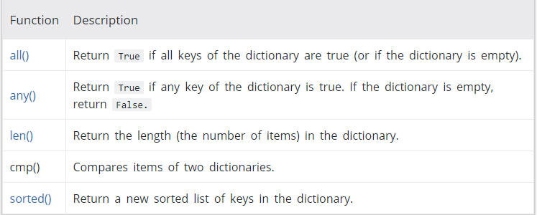
Built-in Functions with Dictionary
Ch .Venkata RamiReddy Department Of Computer Science and Engineering

Slide 67
Built-in Functions with Dictionary
squares = {0:0,1: 1, 3: 9, 5: 25, 7: 49, 9: 81}
print(all(squares)) # False
print(any(squares)) #true
print(len(squares)) # Output: 6
print(sorted(squares)) # Output: [0,1, 3, 5, 7, 9]
Ch .Venkata RamiReddy Department Of Computer Science and Engineering

Slide 68
Iterating Through a Dictionary
for loop can be used to iterate though each key in a dictionary.
Ex:
squares = {1: 1, 3: 9, 5: 25, 7: 49, 9: 81}
for i in squares:
print(squares[i])
Output:
1
9
81
25
49
Ch .Venkata RamiReddy Department Of Computer Science and Engineering

Slide 69
Dictionary Membership Test
We can test if a key is in a dictionary or not using the keyword in.
Membership test is for keys only, not for values.
Example:
squares = {1: 1, 3: 9, 5: 25, 7: 49, 9: 81}
print(1 in squares) # Output: True
print(2 in squares) # Output: False
Ch .Venkata RamiReddy Department Of Computer Science and Engineering

Slide 70
Python Dictionary Comprehension
Dictionary comprehension is an elegant and concise way to create new dictionary from an iterable in Python.
Dictionary comprehension consists of an expression pair (key: value) followed by for statement inside curly braces {}.
Example:
squares = {x: x*x for x in range(6)}
print(squares) # Output: {0: 0, 1: 1, 2: 4, 3: 9, 4: 16, 5: 25}
Ch .Venkata RamiReddy Department Of Computer Science and Engineering

Slide 71
Aliasing and Copying
Because the dictionaries are mutable, you need to be aware of aliasing.
Whenever two variables refer to the same object, the changes that occur affect the other.
If you want to modify a dictionary and keep a copy of the original, use the copy method.
Ex:
d= {1:’one’,2:’two’,3:’three’}
alias= d
copy= d.copy()
alias[‘2'] =‘TWO’
print(d[2]] # tWO
Copy[1]=‘ONE’
print(d[1]] # one
Ch .Venkata RamiReddy Department Of Computer Science and Engineering

Slide 72
Link For programs on Dictionaries in python
https://www.w3resource.com/python-exercises/dictionary/
Ch .Venkata RamiReddy Department Of Computer Science and Engineering

