Slide 1
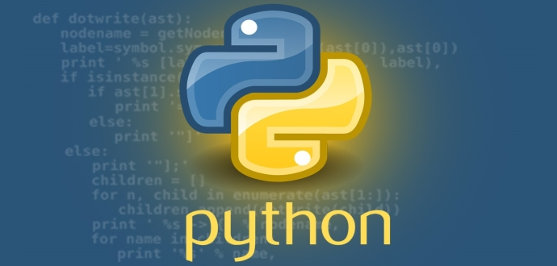
Python Programming Language

Slide 2

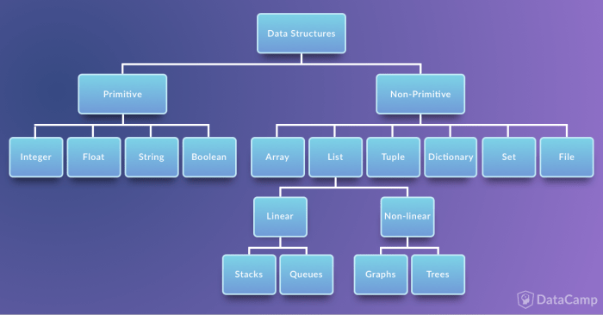
write a program to print the number of times one string is present in the other as a substring.
Data structures are a way of organizing and storing data so that they can be accessed and worked with efficiently.
Ch .Venkata RamiReddy Department Of Computer Science and Engineering

Slide 3
Data Types in PythonPython
Numbers
Booleans
Strings
List
Tuple
Set
Dictionary
Ch .Venkata RamiReddy Department Of Computer Science and Engineering

Slide 4
List
List is an ordered collection of items(elements)
Lists in Python are used to store collection of heterogeneous items.
These are mutable, which means that you can change their content without changing their identity.
It Allows duplicate members.
list indices start at 0
Ex:
list1 = ['physics', 'chemistry', 1997, 2000];
list2 = [1, 2, 3, 4, 5 ];
Ch .Venkata RamiReddy Department Of Computer Science and Engineering

Slide 5
How to create a list?
In Python programming, a list is created by placing all the items (elements) inside a square bracket [ ], separated by commas.
It can have any number of items and they may be of different types (integer, float, string etc.).
list my_list = []
my_list = [1, 2, 3]
my_list = [1, "Hello", 3.4]
Also, a list can even have another list as an item. This is called nested list.
my_list = ["mouse", [8, 4, 6], ['a']]
Ch .Venkata RamiReddy Department Of Computer Science and Engineering

Slide 6
slicing or How to access elements from a list?
Slicing : Extracting the particular part of a list.
List Index
We can use the index operator [] to access an item in a list.
Index starts from 0. So, a list having 5 elements will have index from 0 to 4.
Trying to access an element out of range index then it will raise an IndexError.
The index must be an integer. We can't use float or other types, this will result into TypeError.
Nested list are accessed using nested indexing.
Negative indexing
Python allows negative indexing for its sequences.
The index of -1 refers to the last item, -2 to the second last item and so on.
Ch .Venkata RamiReddy Department Of Computer Science and Engineering

Slide 7
Basic List Operations
s=[1,2,3,4,5]
print(s[2]) # 3
print(s[-3]) # 3
print(s[::]) # [1,2,3,4,5]
Print(s[:-2]) # 4
s2 = ["mouse", [8, 4, 6], ['a']]
print(s[1] # [8,4,6]
Print(s[0][2]) # u
Print(s[1][1] #4
print[(s[2][0] #1
print[(s[2][1] # Index error
Ch .Venkata RamiReddy Department Of Computer Science and Engineering

Slide 8
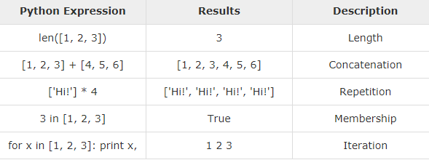
Basic List Operations
Write a python program to read and display items in the list?
Ch .Venkata RamiReddy Department Of Computer Science and Engineering

Slide 9
Write a python program to read and display items in the list?
L=[]
n=int(input("enter size of list"))
i=0
while(i<n):
a=int(input())
L.append(a)
i=i+1
for j in L:
print(j)
Ch .Venkata RamiReddy Department Of Computer Science and Engineering

Slide 10
Write a python program to find the sum of elements in a list
L=[]
n=int(input("enter size of list"))
i=0
sum=0
while(i<n):
a=int(input())
L.append(a)
i=i+1
#print(L)
for j in L:
print(j)
sum=sum+j
print(sum)
Ch .Venkata RamiReddy Department Of Computer Science and Engineering

Slide 11
Write a python program to find the largest element in a list
list=[1,2,4,7,3]
max=list[0]
for a in list:
if a > max:
max = a
print("largets is",max)
Ch .Venkata RamiReddy Department Of Computer Science and Engineering

Slide 12
Methods Of list
append(): method adds an item to the end of the list.
Syntax:
list.append(item)
The append() method takes a single item and adds it to the end of the list.
The item can be numbers, strings, another list, dictionary etc.
Ex:
animal = ['cat', 'dog', 'rabbit']
animal.append(‘pig')
len(): It returns the number of elements in the list.
Print(len(animal))
Ch .Venkata RamiReddy Department Of Computer Science and Engineering

Slide 13
Methods Of list
insert() : It inserts the element in to the list at the specified index.
syntax:
list.insert(index, element)
index - position where element needs to be inserted
element - this is the element to be inserted in the list
Ex:
vowel = ['a', 'e', 'i', 'u']
vowel.insert(3, 'o')
print('Updated List: ', vowel)
Ch .Venkata RamiReddy Department Of Computer Science and Engineering

Slide 14
Methods Of list
extend():it adds all items of a one list to the end of another list.
syntax:
list1.extend(list2)
Here, the elements of list2 are added to the end of list1.
language = ['French', 'English', 'German]
language1 = ['Spanish', 'Portuguese']
language.extend(language1)
print('Language List: ', language)
Ch .Venkata RamiReddy Department Of Computer Science and Engineering

Slide 15
Methods Of list
remove() : method searches for the given element in the list and removes the first matching element
syntax : list.remove(element)
Ex:
animal = ['cat', 'dog', 'rabbit', 'guinea pig','rabbit']
animal.remove('rabbit')
print('Updated animal list: ', animal)
pop(): method removes and returns the element at the given index
Sytax : list.pop(index)
language = ['Python', 'Java', 'C++', 'French', 'C']
r = language.pop(3)
print('Return Value: ', r) # French
print('Updated List: ', language)
Ch .Venkata RamiReddy Department Of Computer Science and Engineering

Slide 16
Methods Of list
clear(): It removes all items from the list.
syntax : list.clear()
index() : It searches an element in the list and returns its first index.
syntax : list.index(element)
vowels = ['a', 'e', 'i', 'o', 'i', 'u']
index = vowels.index('e') #1
Print(index)
count(): method returns the number of occurrences of an element in a list.
Syntax: list.count(element)
vowels = ['a', 'e', 'i', 'o', 'i', 'u']
count = vowels.count('i')
Print(count) #2
Ch .Venkata RamiReddy Department Of Computer Science and Engineering

Slide 17
Methods Of list
copy(): method returns a shallow copy of the list.
The copy() function returns a list. It doesn't modify the original list.
Syntax: new_list = list.copy()
Ex:
list = ['cat', 0, 6.7]
new_list = list.copy()
sum() : Calculates sum of all the elements of List. Syntax: sum(List)
List = [1, 2, 3, 4, 5]
print(sum(List))
Ch .Venkata RamiReddy Department Of Computer Science and Engineering

Slide 18
Methods Of list
min() : Calculates minimum of all the elements of List. Syntax: min(List)
List = [2, 4, 3, 5, 1, 2.5]
print(min(List)) #1
max(): Calculates maximum of all the elements of List. Syntax: max(List)
List = [2, 4, 3, 5, 1, 2.5]
print(max(List)) #5.
del() : it is used to delete element from the list Syntax: del list[index]
List = [2, 4, 3, 5, 1, 2.5]
del List[0]
print(List)
Ch .Venkata RamiReddy Department Of Computer Science and Engineering

Slide 19
List Comprehension:
List comprehension is an elegant and concise way to create new list from an existing list in Python.
List comprehension consists of an expression followed by for statement inside square brackets.
pow2 = [2 ** x for x in range(10)]
print(pow2)
# Output: [1, 2, 4, 8, 16, 32, 64, 128, 256, 512]
Ch .Venkata RamiReddy Department Of Computer Science and Engineering

Slide 20
Exmaples
Write a Python program to sum all the items in a list.
Write a Python program to get the largest number from a list.
Write a Python program to count the number of strings where the string length is 2 or more and the first and last character are same from a given list of strings. Sample List : ['abc', 'xyz', 'aba', '1221'] Expected Result : 2
Ch .Venkata RamiReddy Department Of Computer Science and Engineering

Slide 21
Tuple
A Tuple is a collection of Python objects(elements) separated by commas.
These are immutable, which means that you can not change their content.
Advantages of Tuple over List:
We generally use tuple for heterogeneous (different) datatypes and list for homogeneous (similar) datatypes.
Since tuple are immutable, iterating through tuple is faster than with list. So there is a slight performance boost.
Tuples that contain immutable elements can be used as key for a dictionary. With list, this is not possible.
If you have data that doesn't change, implementing it as tuple will guarantee that it remains write-protected
Ch .Venkata RamiReddy Department Of Computer Science and Engineering

Slide 22
Creating a Tuple
A tuple is created by placing all the items (elements) inside a parentheses (), separated by comma.
A tuple can have any number of items and they may be of different types (integer, float, list, string etc.).
my_tuple = ()
my_tuple = (1, 2, 3)
my_tuple = (1, "Hello", 3.4)
my_tuple = ("mouse", [8, 4, 6], (1, 2, 3))
my_tuple = 3, 4.6, "dog"
Ch .Venkata RamiReddy Department Of Computer Science and Engineering

Slide 23
Accessing Elements in a Tuple
Indexing:
We can use the index operator [] to access an item in a tuple where the index starts from 0.
So, a tuple having 6 elements will have index from 0 to 5.
Trying to access an element other that (6, 7,...) will raise an IndexError.
The index must be an integer, so we cannot use float or other types. This will result into TypeError
Negative Indexing
Python allows negative indexing for its sequences.
The index of -1 refers to the last item, -2 to the second last item and so on.
Slicing
We can access a range of items in a tuple by using the slicing operator - colon ":".
Ch .Venkata RamiReddy Department Of Computer Science and Engineering

Slide 24
Accessing Elements in a Tuple
my_tuple = ('p','e','r','m','i','t')
print(my_tuple[5])
n_tuple = ("mouse", [8, 4, 6], (1, 2, 3))
print(n_tuple[0][3])
print(my_tuple[-2])
print(my_tuple[1:4])
print(my_tuple[:])
n_tuple[0] = 9
n_tuple[2][0] = 10
print(n_tuple)
Ch .Venkata RamiReddy Department Of Computer Science and Engineering

Slide 25
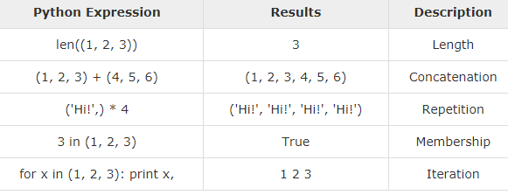
Basic Tuples Operations
Ch .Venkata RamiReddy Department Of Computer Science and Engineering

Slide 26
Methods
len(): returns the number of elements in the tuple.
t=(1,2,3)
Print(len(t))
max(): It returns the elements from the tuple with maximum value.
Syntax: max(tuple)
Print(max(t))
min() : It returns the elements from the tuple with minimum value.
Syntax :min(tuple)
Print(min(t))
tuple(): converts a list of items into tuples
Syntax: tuple( seq )
Ch .Venkata RamiReddy Department Of Computer Science and Engineering

Slide 27
Methods
count(): method searches the given element in a tuple and returns how many times the element has occurred in it.
syntax: tuple.count(element)
T=(1,5,3,2,5)
Print(T.count(5)) # 2
index(): index() method searches for the given element in a tuple and returns its position.
if the same element is present more than once, the first/smallest position is returned.
Syntax: tuple.index(element)
Print(T.index(5)) # 1
Ch .Venkata RamiReddy Department Of Computer Science and Engineering

Slide 28
Methods
sorted(): method sorts the elements of a given tuple in a specific order - Ascending or Descending.
Syntax: sorted(iterable,[reverse])
p = ('e', 'a', 'u', 'o', 'i')
print(sorted(p))
print(sorted(pe,reverse=True))
reversed(): method reverse the contents of the tuple.
reversed(seq)
print(list(reversed(p)))
Ch .Venkata RamiReddy Department Of Computer Science and Engineering

Slide 29
Methods
sum() :function adds the items of an tuple and returns the sum.
Syntax: sum(tuple, start)
numbers = [2.5, 3, 4, -5]
sum = sum(numbers)
sum = sum(numbers, 1)
print(sum)
Ch .Venkata RamiReddy Department Of Computer Science and Engineering

Slide 30
boolean operators/methods on tuples
all(): method returns True when all elements in the given tuple are true. If not, it returns False.
Syntax: all(tuple)
Ex:
l = [1, 3, 4, 5]
print(all(l))
l = [0, False]
print(all(l))
l = [1, 3, 4, 0]
print(all(l))
Ch .Venkata RamiReddy Department Of Computer Science and Engineering

Slide 31
boolean operators/methods on tuples
any() : method returns True if any element of tuple is true. If not, this method returns False.
Syntax: any(tuple)
l = [1, 3, 4, 0]
print(any(l))
l = [0, False]
print(any(l))
Ch .Venkata RamiReddy Department Of Computer Science and Engineering

Slide 32
boolean operators/methods on tuples
bool(): method converts a value to Boolean (True or False) using the standard truth testing procedure.
Syntax : bool([value])
False values:
None, False ,Zero of any numeric type. For example, 0, 0.0, 0j
Empty sequence. For example, (), [], '‘, {}
test = 0.0
print(test,'is',bool(test))
test = True
print(test,'is',bool(test))
Ch .Venkata RamiReddy Department Of Computer Science and Engineering

